Slide 1
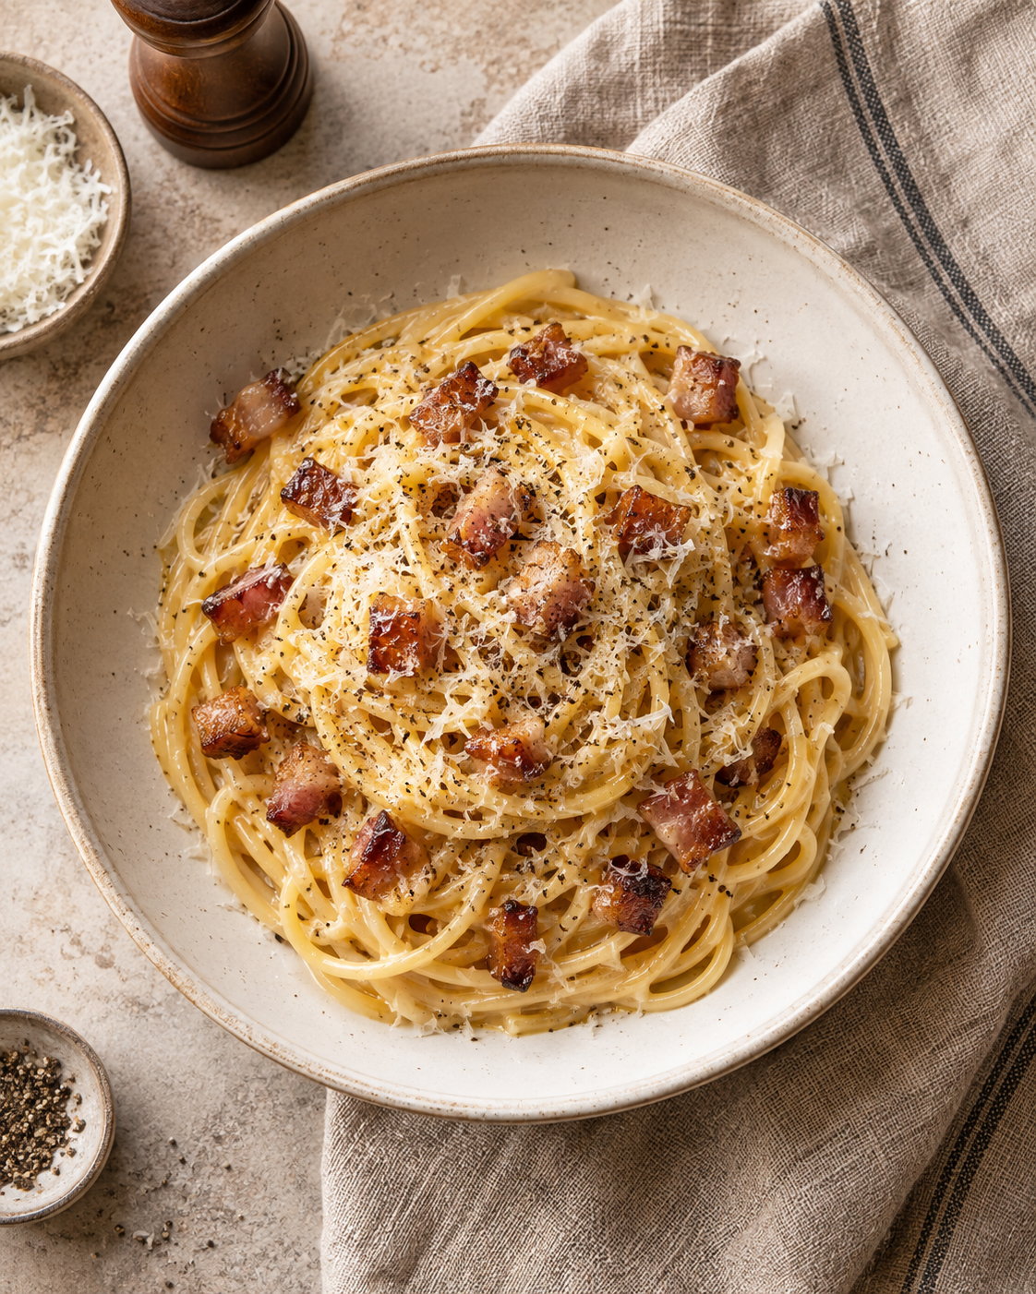
Carbonara
for two
A Roman pasta dish with crisp guanciale and a silky sauce made from egg yolks and Pecorino.
2 servings About 25 minutes
Notes:
This recipe uses egg yolks, Pecorino Romano, guanciale and spaghetti. Approximate timing is 15 minutes of preparation and 10 minutes of cooking, with some tasks overlapping. Image: AI-generated cookbook illustration, created with ImageGen.
Recipe and technique adapted from GialloZafferano, Spaghetti Carbonara: https://www.giallozafferano.com/recipes/Spaghetti-Carbonara-Bacon-and-egg-spaghetti.html . The spaghetti, guanciale, yolks and Pecorino quantities are half of its four-serving recipe.

Slide 2
Ingredients for two servings
Ingredient | Quantity | Preparation notes
Spaghetti | 160 g | Dry weight
Guanciale | 75 g | Remove rind. Cut into short strips.
Medium egg yolks | 3 | Separate from the whites.
Pecorino Romano | 25 g | Finely grate for a smooth sauce.
Black pepper | To taste | Freshly grind.
Salt | To taste | Use sparingly in the pasta water.
Reserved pasta water | About 200 mL | Reserve from the pot. Add as needed.
Guanciale and Pecorino are salty. Taste before adding extra salt.
02
Notes:
The first four ingredient quantities exactly halve the source recipe. About 200 mL is a practical amount of pasta water to keep available, not an amount to add in full. Black pepper and salt depend on taste.
Recipe and technique adapted from GialloZafferano, Spaghetti Carbonara: https://www.giallozafferano.com/recipes/Spaghetti-Carbonara-Bacon-and-egg-spaghetti.html . The spaghetti, guanciale, yolks and Pecorino quantities are half of its four-serving recipe.

Slide 3
The cooking sequence
1 Prep the mixture
Whisk yolks, cheese
and pepper.
2 Render guanciale
Crisp the pork.
Keep the fat.
3 Cook spaghetti
Boil in salted water
until al dente.
6 Loosen and serve
Add water gradually.
Return pork. Plate now.
5 Sauce off heat
Move pan off burner.
Add the yolk mixture.
4 Reserve and toss
Save pasta water.
Coat pasta in the fat.
Cook the pasta while the guanciale renders. Step 5 happens off the burner.
03
Notes:
Follow the numbered shapes across the top row, then down and back across the bottom row. Start boiling the pasta while the guanciale renders. Prepare the yolk mixture first so it is ready when the pasta is hot. Take the pan off the burner before adding eggs.
Recipe and technique adapted from GialloZafferano, Spaghetti Carbonara: https://www.giallozafferano.com/recipes/Spaghetti-Carbonara-Bacon-and-egg-spaghetti.html . The spaghetti, guanciale, yolks and Pecorino quantities are half of its four-serving recipe.

Slide 4
The egg mixture and guanciale
01
02
The egg mixture
The guanciale
Whisk 3 yolks with 25 g finely grated Pecorino and freshly ground black pepper.
Cook the strips in a dry pan over medium-low heat for about 10 minutes, until crisp.
Keep the thick mixture beside the stove, ready for the hot pasta.
Lift out the pork and keep the rendered fat in the pan.
04
Notes:
Remove the guanciale rind and cut the pork into short strips before cooking. The guanciale releases its own fat, so no oil is necessary. Watch the pork rather than relying only on the clock. If the pasta is not ready, turn off the pan to prevent burning.
Recipe and technique adapted from GialloZafferano, Spaghetti Carbonara: https://www.giallozafferano.com/recipes/Spaghetti-Carbonara-Bacon-and-egg-spaghetti.html . The spaghetti, guanciale, yolks and Pecorino quantities are half of its four-serving recipe.

Slide 5
The pasta and reserved water
03
04
Cook the spaghetti
Reserve and toss
Boil 160 g spaghetti in lightly salted water. Stir so the strands stay separate.
Before draining, reserve about 200 mL of the starchy pasta water.
Follow the packet timing and taste for a firm center.
Transfer the hot pasta to the pan and toss it in the guanciale fat.
05
Notes:
Al dente pasta has a slight bite. Pasta cooking time varies by brand and thickness, so use the packet as a guide and taste. Do not rinse the pasta. Its starch and the saved water help the sauce cling. Keep the reserved water in a mug beside the pan.
Recipe and technique adapted from GialloZafferano, Spaghetti Carbonara: https://www.giallozafferano.com/recipes/Spaghetti-Carbonara-Bacon-and-egg-spaghetti.html . The spaghetti, guanciale, yolks and Pecorino quantities are half of its four-serving recipe.

Slide 6
The sauce comes together off heat
05
06
Add the yolk mixture
Loosen and serve
Move the pan off the burner. Let fierce sizzling subside before adding the mixture.
Add warm pasta water a tablespoon at a time, tossing until the sauce looks glossy.
Pour it over the hot pasta and toss immediately.
Return the guanciale. Divide between two bowls and finish with pepper.
06
Notes:
Use the residual warmth of the pasta and pan to thicken the yolk mixture. Direct high heat can scramble eggs. The water amount depends on the cheese, pasta and heat. Add it gradually and stop when the sauce coats the strands. Serve immediately because the sauce thickens as it cools.
Recipe and technique adapted from GialloZafferano, Spaghetti Carbonara: https://www.giallozafferano.com/recipes/Spaghetti-Carbonara-Bacon-and-egg-spaghetti.html . The spaghetti, guanciale, yolks and Pecorino quantities are half of its four-serving recipe.

Slide 7
Small details that help
Finely grated cheese
Small particles blend into the yolks more easily.
A mug of pasta water
Keep it beside the pan before you drain the spaghetti.
Gentle heat for the pork
Let the fat melt slowly and stop when the strips turn crisp.
Everything ready to serve
Set out two bowls before you combine the sauce and pasta.
07
Notes:
Grate the Pecorino yourself if possible so it blends readily. Reserve water before draining. Render guanciale gently and remove it once crisp. Carbonara is best served straight away, so have bowls and serving utensils ready.
Recipe and technique adapted from GialloZafferano, Spaghetti Carbonara: https://www.giallozafferano.com/recipes/Spaghetti-Carbonara-Bacon-and-egg-spaghetti.html . The spaghetti, guanciale, yolks and Pecorino quantities are half of its four-serving recipe.

Slide 8
Common mistakes to avoid
Eggs scramble
The pan is too hot. Add the yolk mixture off the burner and keep tossing.
Sauce turns watery
Too much water went in at once. Add small spoonfuls and check the coating.
Pasta tastes too salty
Guanciale and Pecorino already add salt. Salt the cooking water lightly.
Pork tastes bitter
The guanciale burned. Use moderate heat and remove it as soon as it crisps.
The goal: glossy sauce that coats each strand. Serve straight away.
08
Notes:
A thick sauce can usually be loosened with warm pasta water. Add a small amount and toss, then reassess. Scrambled eggs cannot return to a smooth emulsion. The traditional ingredient list here contains no cream.
Recipe and technique adapted from GialloZafferano, Spaghetti Carbonara: https://www.giallozafferano.com/recipes/Spaghetti-Carbonara-Bacon-and-egg-spaghetti.html . The spaghetti, guanciale, yolks and Pecorino quantities are half of its four-serving recipe.

