Slide 1
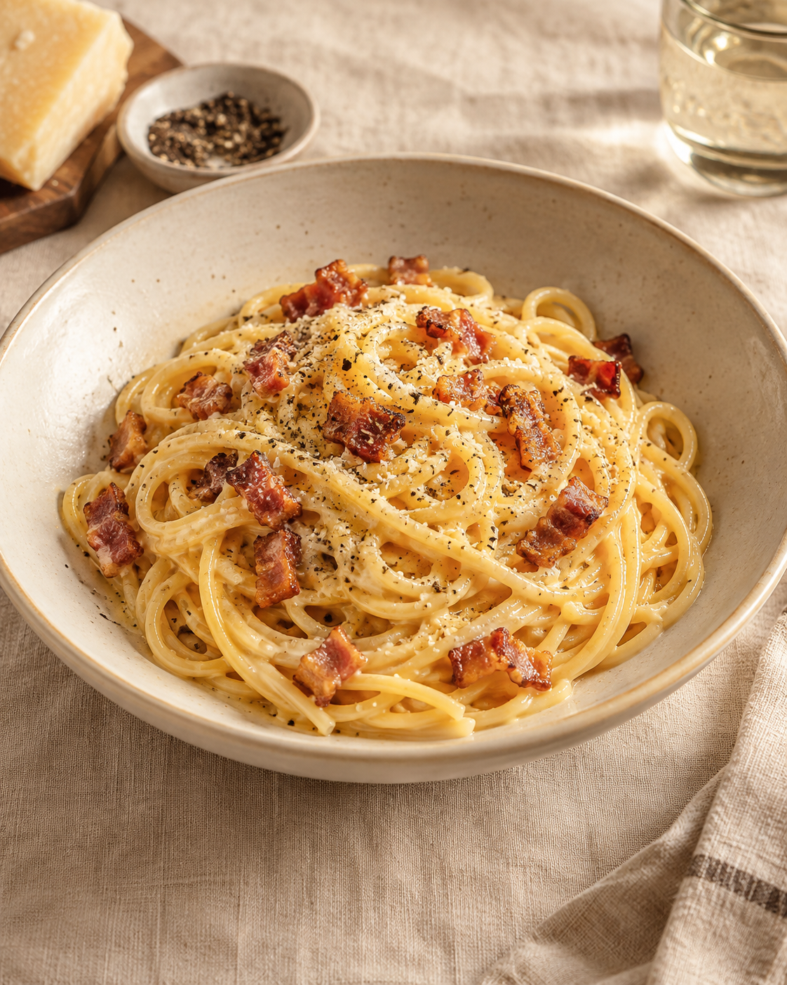
Carbonara
for two
A Roman pasta dish with guanciale,
Pecorino and egg yolks.
Hot pasta and careful mixing create
a glossy sauce.
Notes:
Recipe quantities scaled to two servings from GialloZafferano: https://www.giallozafferano.com/recipes/Spaghetti-Carbonara-Bacon-and-egg-spaghetti.html
Technique: https://www.giallozafferano.com/the-italian-guide-to-carbonara
https://www.lacucinaitaliana.it/ricetta/primi/carbonara-classica/
Cover food image generated with Imagegen. It is an illustrative scene.

Slide 2
Ingredients for two
Ingredient | Quantity | Preparation note
Spaghetti | 160 g | Cook until al dente.
Guanciale | 75 g | Remove rind. Cut into short strips.
Medium egg yolks | 3 | Separate before cooking.
Pecorino Romano | 25 g | Finely grate. Extra for serving is optional.
Black pepper | To taste | Freshly grind.
Salt | As needed | Salt pasta water lightly.
Pasta cooking water | Reserve 120 ml | Use only as needed to loosen the sauce.
No guanciale? Use 75 g pancetta. Its flavor will differ.
Notes:
Recipe quantities scaled to two servings from GialloZafferano: https://www.giallozafferano.com/recipes/Spaghetti-Carbonara-Bacon-and-egg-spaghetti.html
Pancetta substitution: https://italianchef.com/spaghetti-alla-carbonara/
Reserve 120 ml of pasta cooking water as a practical allowance. The sauce may need less.

Slide 3
The cooking sequence
1 Prepare
Cut pork. Mix yolks,
cheese and pepper.
2 Render guanciale
Cook until golden.
Keep the fat.
3 Boil spaghetti
Cook until al dente.
4 Reserve water
Save 120 ml before
draining pasta.
8 Loosen and serve
Add water gradually.
Plate immediately.
7 Add egg mixture
Toss promptly
until coated.
6 Leave the heat
Move the pan
off the burner.
5 Coat the pasta
Toss in pork fat
with a splash of water.
The guanciale and pasta can cook at the same time. Keep the egg mixture off direct heat.
Notes:
Recipe quantities scaled to two servings from GialloZafferano: https://www.giallozafferano.com/recipes/Spaghetti-Carbonara-Bacon-and-egg-spaghetti.html
Technique: https://www.giallozafferano.com/the-italian-guide-to-carbonara
https://www.lacucinaitaliana.it/ricetta/primi/carbonara-classica/
Numbering is a simplified teaching sequence. Render guanciale while the pasta cooks.

Slide 4
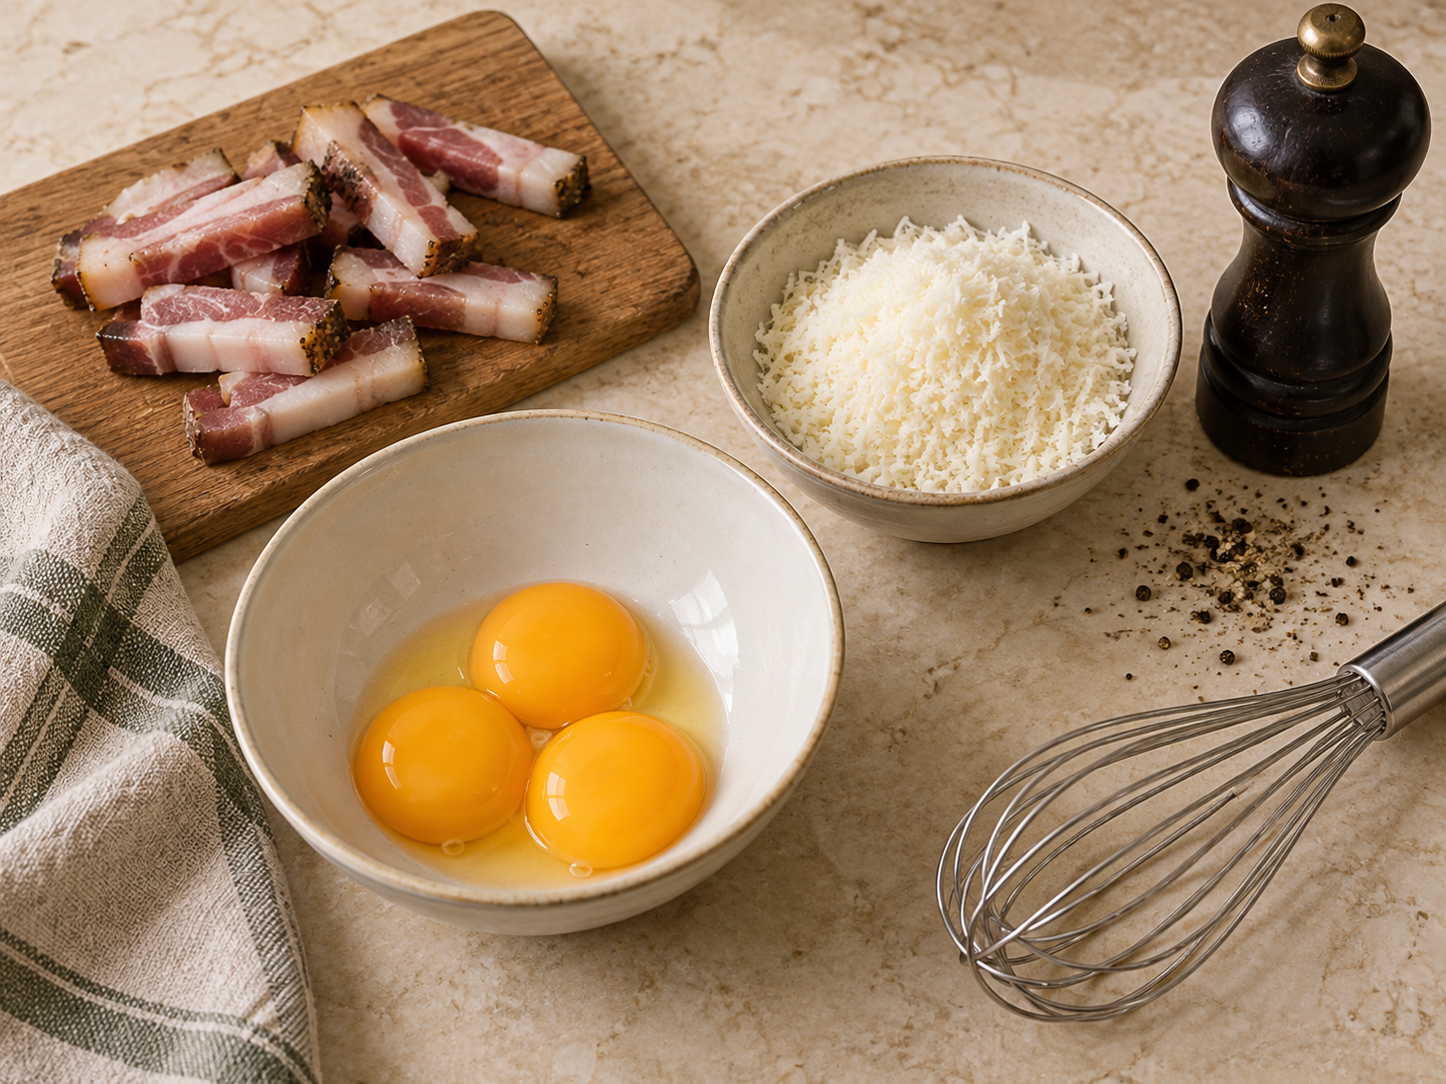
Preparation
The egg mixture
Whisk 3 yolks with 25 g finely grated Pecorino and black pepper. Aim for a thick, even paste.
The guanciale
Remove the rind, then cut 75 g into short, similar-sized strips.
Have tongs, a cup for pasta water and two plates ready.
Notes:
Recipe quantities scaled to two servings from GialloZafferano: https://www.giallozafferano.com/recipes/Spaghetti-Carbonara-Bacon-and-egg-spaghetti.html
Preparation image generated with Imagegen as an illustrative scene.

Slide 5
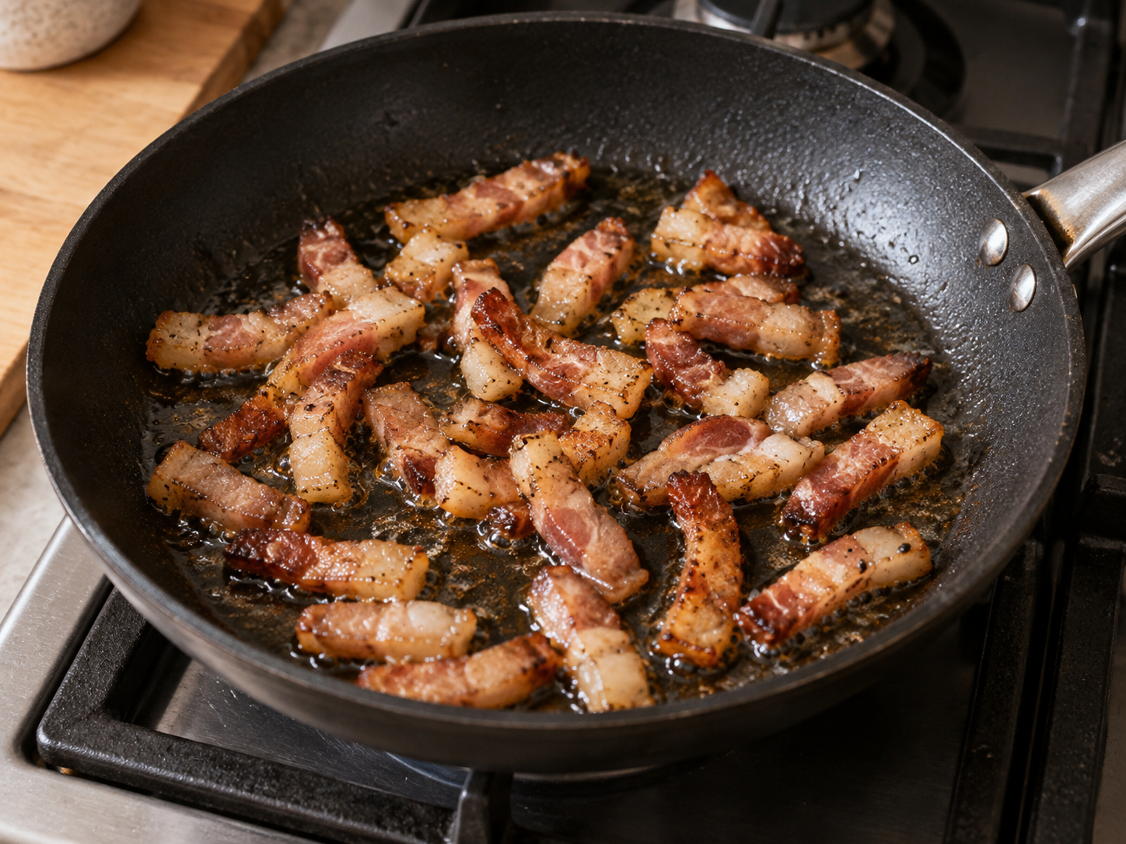
Guanciale and pasta
Golden guanciale
Cook over medium heat until the fat renders and the strips turn golden. Lift out the pork and keep the fat in the pan.
Al dente spaghetti
Boil 160 g spaghetti in lightly salted water. Follow the packet timing and taste for a slight bite.
Before draining, scoop out 120 ml of pasta water.
Stop at golden. Dark, burnt pieces taste bitter.
Notes:
Recipe quantities scaled to two servings from GialloZafferano: https://www.giallozafferano.com/recipes/Spaghetti-Carbonara-Bacon-and-egg-spaghetti.html
Technique: https://www.giallozafferano.com/the-italian-guide-to-carbonara
https://www.lacucinaitaliana.it/ricetta/primi/carbonara-classica/
The recipe source renders guanciale over medium heat until golden. Reserve water before draining. Image generated with Imagegen as an illustrative scene.

Slide 6
The sauce comes together off heat
1
Coat the pasta
Toss the hot spaghetti in the guanciale fat with a splash of reserved water.
2
Move the pan off the burner
Let the pan cool briefly if it is very hot. Add the egg mixture and toss promptly.
3
Loosen, then serve
Add pasta water a tablespoon at a time until glossy. Fold in the guanciale and plate.
Notes:
Recipe quantities scaled to two servings from GialloZafferano: https://www.giallozafferano.com/recipes/Spaghetti-Carbonara-Bacon-and-egg-spaghetti.html
Technique: https://www.giallozafferano.com/the-italian-guide-to-carbonara
https://www.lacucinaitaliana.it/ricetta/primi/carbonara-classica/
Direct heat can scramble the yolks. Residual heat from pasta helps the sauce form. Add water in small increments.

Slide 7
Practical cooking tips
Fine cheese
Finely grated Pecorino blends into the yolks more easily.
Light salting
Guanciale and Pecorino already bring salt. Taste before adding more.
Small additions
Keep tossing as you add water. Stop when the sauce coats the strands.
Ready plates
The sauce thickens as it stands. Serve immediately with pepper and extra cheese.
Notes:
Recipe quantities scaled to two servings from GialloZafferano: https://www.giallozafferano.com/recipes/Spaghetti-Carbonara-Bacon-and-egg-spaghetti.html
Technique: https://www.giallozafferano.com/the-italian-guide-to-carbonara
https://www.lacucinaitaliana.it/ricetta/primi/carbonara-classica/
These tips summarize the recipe method and practical ingredient handling.

Slide 8
Common mistakes and fixes
Problem
What helps
Scrambled eggs
Move the pan off the burner before adding the egg mixture.
Dry, clumpy sauce
Add reserved pasta water a tablespoon at a time while tossing.
Watery sauce
Add water gradually and check the texture after each spoonful.
Burnt guanciale
Use moderate heat and stop when the strips are golden.
Cream added
The yolks, cheese and pasta water already make a creamy sauce.
Notes:
Recipe quantities scaled to two servings from GialloZafferano: https://www.giallozafferano.com/recipes/Spaghetti-Carbonara-Bacon-and-egg-spaghetti.html
Technique: https://www.giallozafferano.com/the-italian-guide-to-carbonara
https://www.lacucinaitaliana.it/ricetta/primi/carbonara-classica/
The scrambled-egg row describes prevention. Once eggs set into curds, they cannot be made smooth again by adding water.

