Slide 1
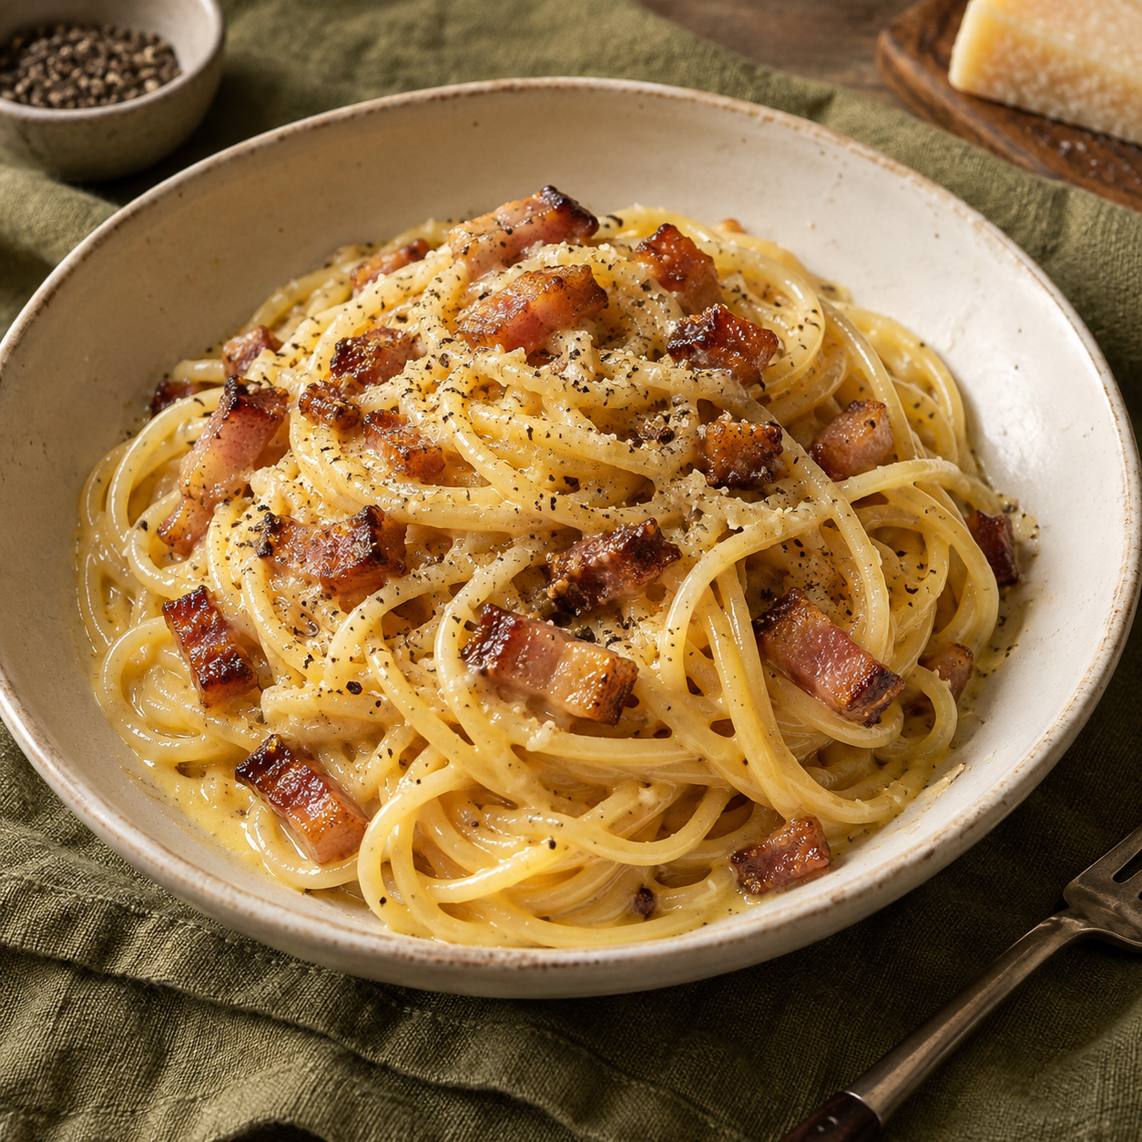
Carbonara
for two
A Roman pasta dish with a glossy sauce
of eggs, cheese and pasta water.
2 generous servings
About 25 minutes
01
Notes:
This is a practical home recipe for two generous servings. Time is an approximate planning estimate and depends on boiling water and the pasta packet. The sauce uses eggs, Pecorino Romano and starchy pasta water. No cream is needed.
Cover image: generated decorative food illustration using OpenAI ImageGen. It is not a photograph of a prepared recipe.
Prompt: Square photorealistic food editorial of spaghetti carbonara in an off-white bowl, glossy pale-golden egg-and-Pecorino sauce, browned guanciale, coarse black pepper, olive linen, warm natural light. No garnish, cream puddle, people, text, logo or watermark.
Sources:
GialloZafferano, Spaghetti Carbonara: https://www.giallozafferano.com/recipes/Spaghetti-Carbonara-Bacon-and-egg-spaghetti.html
La Cucina Italiana, Classic Carbonara: https://www.lacucinaitaliana.com/recipe/pasta/classic-carbonara

Slide 2
Ingredients for two
Ingredient | Quantity | Preparation notes
Spaghetti | 200 g | Use dried spaghetti.
Guanciale | 100 g | Cut into small strips. Pancetta is an option.
Large eggs | 1 whole + 2 yolks | Pasteurized eggs recommended.
Pecorino Romano | 50 g | Finely grate. Keep a pinch for serving.
Black pepper | About 1 tsp | Freshly grind. Adjust to taste.
Water | About 2 L | Reserve 250 mL from the pot before draining.
Salt | To taste | Salt water modestly. Pork and cheese add salt.
02
Notes:
Quantities are a practical two-person adaptation, not a claim that every Italian recipe uses one exact ratio. The reserved water is part of the cooking water, not an additional ingredient. Keep a pinch of the 50 g cheese for finishing. Guanciale is the classic ingredient; pancetta is an optional substitute. Pasteurized eggs are recommended because the gentle off-heat sauce method does not guarantee a food-safety temperature.
Sources:
GialloZafferano, Spaghetti Carbonara: https://www.giallozafferano.com/recipes/Spaghetti-Carbonara-Bacon-and-egg-spaghetti.html
La Cucina Italiana, Classic Carbonara: https://www.lacucinaitaliana.com/recipe/pasta/classic-carbonara
FDA, Egg Safety: https://www.fda.gov/food/buy-store-serve-safe-food/what-you-need-know-about-egg-safety

Slide 3
The cooking sequence
1 Prepare
Cut guanciale.
Grate cheese finely.
2 Whisk
Mix egg, yolks,
cheese and pepper.
3 Render
Cook guanciale
until golden.
4 Boil
Cook spaghetti
until al dente.
8 Finish
Add water gradually.
Serve immediately.
7 Off heat
Move pan off burner.
Add eggs and toss.
6 Coat
Toss pasta with
guanciale and fat.
5 Reserve
Save 250 mL water.
Drain without rinsing.
Guanciale and pasta can cook at the same time.
03
Notes:
Read the upper row left to right, follow the arrow downward, then read the lower row right to left. All eight steps are separate native PowerPoint shapes. Their text remains editable. Seven arrow connectors link adjacent steps. Heat the pasta water during preparation. Pork and pasta can cook concurrently. Move the pan physically away from the hot burner before adding the egg mixture.
Sources:
GialloZafferano, Spaghetti Carbonara: https://www.giallozafferano.com/recipes/Spaghetti-Carbonara-Bacon-and-egg-spaghetti.html
La Cucina Italiana, Classic Carbonara: https://www.lacucinaitaliana.com/recipe/pasta/classic-carbonara

Slide 4
Preparation before the heat
01
Guanciale
Equipment
Cut 100 g into small strips or cubes.
Similar sizes cook evenly.
Large pot
Wide frying pan
Mixing bowl
Tongs and ladle
Fine grater
02
Cheese
Finely grate 50 g Pecorino Romano.
Fine shreds melt into the sauce more easily.
03
Egg mixture
Whisk 1 whole egg + 2 yolks with the cheese
and pepper until well combined.
Heat the pasta water while you prepare the ingredients.
04
Notes:
Have the egg mixture ready before the pasta finishes so the hot pasta can go directly into the final mixing stage. Finely grated cheese distributes better than thick shavings. Warm serving bowls just before plating. Use pasteurized eggs for the gently heated sauce.
Sources:
GialloZafferano, Spaghetti Carbonara: https://www.giallozafferano.com/recipes/Spaghetti-Carbonara-Bacon-and-egg-spaghetti.html
La Cucina Italiana, Classic Carbonara: https://www.lacucinaitaliana.com/recipe/pasta/classic-carbonara
FDA, Egg Safety: https://www.fda.gov/food/buy-store-serve-safe-food/what-you-need-know-about-egg-safety

Slide 5
Guanciale and pasta
Guanciale
Spaghetti
Start in an unheated pan.
Cook over medium-low heat.
Boil about 2 L water and salt modestly.
Add the spaghetti and stir.
Golden edges, rendered fat
Al dente: tender with a little bite
Stir often and watch the color.
Keep the fat for coating the pasta.
Turn off the heat if the pork finishes first.
Follow the packet time, then taste.
Reserve 250 mL water before draining.
Skip rinsing to keep starch on the pasta.
The reserved starchy water helps the sauce coat the spaghetti.
05
Notes:
The cold-pan start and moderate heat allow guanciale fat to render without burning the pork. Keep the browned pork and rendered fat. Pasta cooking time varies by brand and thickness, so use the packet as a guide and taste. Reserve water before draining. The pork and pasta can cook concurrently.
Sources:
GialloZafferano, Spaghetti Carbonara: https://www.giallozafferano.com/recipes/Spaghetti-Carbonara-Bacon-and-egg-spaghetti.html
La Cucina Italiana, Classic Carbonara: https://www.lacucinaitaliana.com/recipe/pasta/classic-carbonara

Slide 6
The sauce comes together off heat
1
Coat and cool
Toss hot pasta with the guanciale and fat.
Move the pan off the burner and let it stop sizzling.
Glossy sauce,
no visible curds
2
Add the egg mixture
Pour in the egg mixture while tossing
continuously with tongs.
3
Loosen gradually
Add warm pasta water 1 tbsp at a time.
Toss until the sauce coats each strand.
Residual heat gently thickens the sauce as you toss.
06
Notes:
A hot pan can scramble eggs. Move it away from the burner and wait briefly for vigorous sizzling to subside before adding the egg mixture. Toss continuously and add reserved water gradually, using only as much as needed. The amount needed varies with the pasta and pan. Residual heat is a culinary technique and does not guarantee the eggs reach the FDA food-safety temperature. Use pasteurized eggs.
Sources:
GialloZafferano, Spaghetti Carbonara: https://www.giallozafferano.com/recipes/Spaghetti-Carbonara-Bacon-and-egg-spaghetti.html
La Cucina Italiana, Classic Carbonara: https://www.lacucinaitaliana.com/recipe/pasta/classic-carbonara
FDA, Egg Safety: https://www.fda.gov/food/buy-store-serve-safe-food/what-you-need-know-about-egg-safety

Slide 7
Common mistakes and fixes
Mistake | Why it happens | Better approach
Eggs turn grainy | The pan is still too hot. | Move the pan off heat before adding eggs. Keep tossing. Curds will not smooth out.
Dish tastes too salty | Pork and Pecorino both add salt. | Salt the pasta water modestly. Taste before adding more salt.
Sauce turns watery | Too much water goes in at once. | Add water by the tablespoon. Stop when sauce clings to the pasta.
Pork tastes bitter | The guanciale burns. | Use medium-low heat. Stop when the edges turn golden.
07
Notes:
The table distinguishes the cause from the useful correction or prevention. Scrambled eggs cannot be restored to a smooth sauce by tossing. If the sauce is simply too thick, a little warm pasta water can loosen it. For watery sauce, prevention is gradual water addition. The off-heat method reduces the chance of curdling.
Sources:
GialloZafferano, Spaghetti Carbonara: https://www.giallozafferano.com/recipes/Spaghetti-Carbonara-Bacon-and-egg-spaghetti.html
La Cucina Italiana, Classic Carbonara: https://www.lacucinaitaliana.com/recipe/pasta/classic-carbonara

Slide 8
Serving and final checks
Two warm bowls.
Serve right away.
Glossy strands
Sauce coats the pasta
without a pool at the bottom.
Balanced seasoning
Finish with pepper and a little cheese.
Taste before adding salt.
Carbonara thickens as it cools.
Plate while the sauce still looks loose.
A quick texture fix
If the pasta tightens up, toss in
1 tbsp warm pasta water.
08
Notes:
Warm bowls and immediate plating preserve the loose texture. Finish with the reserved pinch of Pecorino and a little fresh pepper. Taste before adding extra salt. Use small amounts of warm pasta water to loosen a sauce that has tightened. This recipe contains wheat, egg and dairy.
Sources:
GialloZafferano, Spaghetti Carbonara: https://www.giallozafferano.com/recipes/Spaghetti-Carbonara-Bacon-and-egg-spaghetti.html
La Cucina Italiana, Classic Carbonara: https://www.lacucinaitaliana.com/recipe/pasta/classic-carbonara

