Slide 1
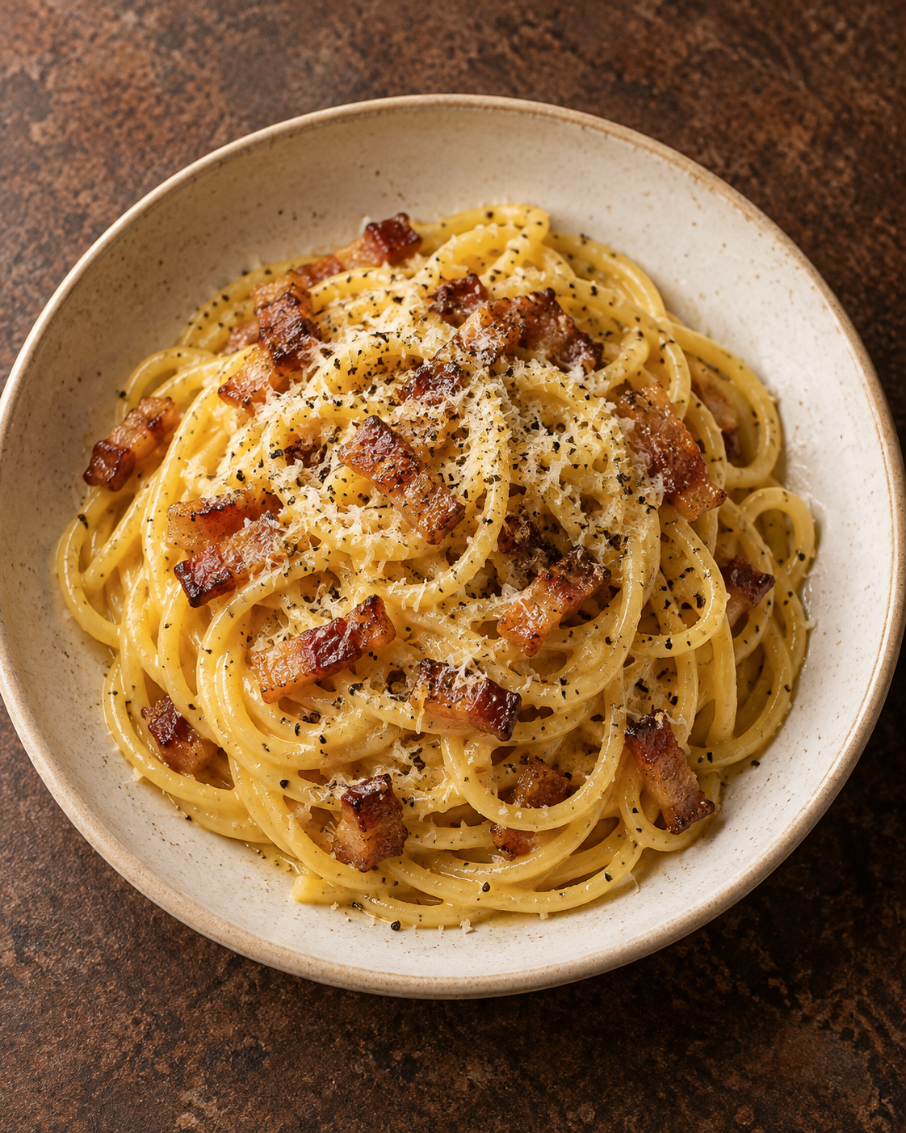
Carbonara
for two
A Roman pasta classic with guanciale,
Pecorino and a silky egg sauce.
2 servings / About 25 minutes
Notes:
Recipe adapted for two servings from GialloZafferano: https://www.giallozafferano.com/recipes/Spaghetti-Carbonara-Bacon-and-egg-spaghetti.html
Technique references: La Cucina Italiana, https://www.lacucinaitaliana.com/amp/recipe/pasta/classic-carbonara and Jamie Oliver, https://www.jamieoliver.com/inspiration/make-perfect-carbonara/
Quantities are a practical adaptation. Timing varies with pasta, pan and burner.
Introduction: Eggs, Pecorino and starchy pasta water create the creamy texture. This version uses guanciale, cured pork cheek.
Image: AI-generated food illustration, created with the built-in imagegen tool for this deck. It is an illustrative serving suggestion.

Slide 2
Ingredients for two servings
Ingredient | Quantity | Preparation notes
Spaghetti | 200 g | Cook until al dente.
Guanciale | 100 g | Remove rind. Cut into small strips.
Eggs | 1 whole egg + 2 yolks | Whisk with cheese and pepper.
Pecorino Romano | 50 g | Grate finely. Save a little for serving.
Black pepper | ½ tsp, plus more | Use freshly ground pepper.
Salt | As needed | Season the pasta water lightly.
Pasta water | Reserve 150 mL | Add gradually, only as needed.
Pancetta can replace guanciale. Taste before adding extra salt.
2
Notes:
Recipe adapted for two servings from GialloZafferano: https://www.giallozafferano.com/recipes/Spaghetti-Carbonara-Bacon-and-egg-spaghetti.html
Technique references: La Cucina Italiana, https://www.lacucinaitaliana.com/amp/recipe/pasta/classic-carbonara and Jamie Oliver, https://www.jamieoliver.com/inspiration/make-perfect-carbonara/
Quantities are a practical adaptation. Timing varies with pasta, pan and burner.
Use 50 g Pecorino in total, reserving a small amount for the final garnish. The 150 mL of cooking water is a reserve, not the amount to add to the sauce. Guanciale and Pecorino already provide considerable salt.

Slide 3
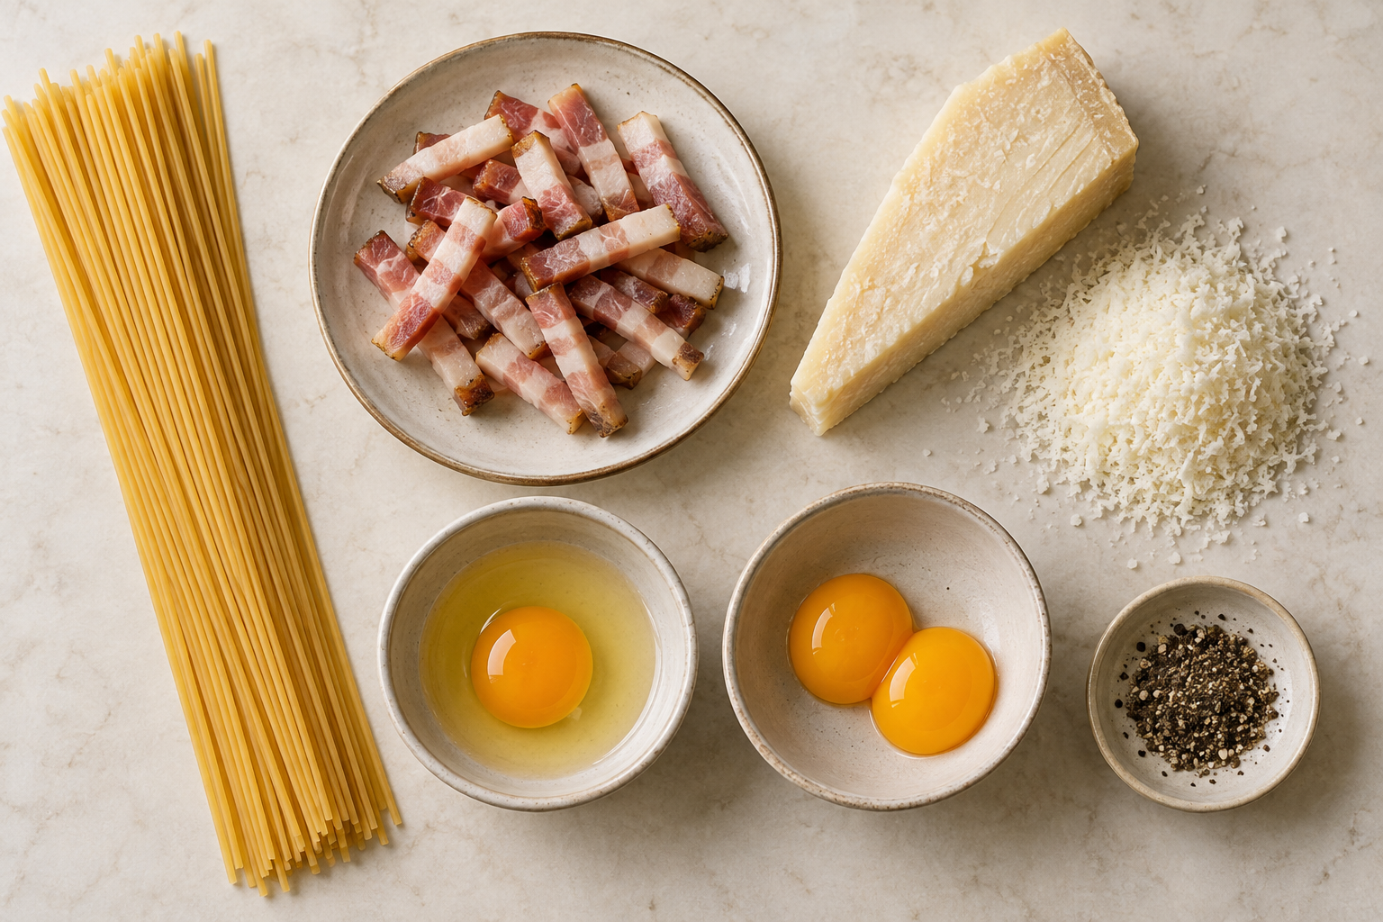
Preparation before the heat
01 Prepare the ingredients
Cut the guanciale into small strips.
Grate the Pecorino very finely.
Whisk the egg mixture
Mix 1 whole egg and 2 yolks with most
of the cheese and ½ tsp black pepper.
Equipment
Pot, wide skillet, bowl, whisk, tongs
and a cup for the pasta water.
3
Notes:
Recipe adapted for two servings from GialloZafferano: https://www.giallozafferano.com/recipes/Spaghetti-Carbonara-Bacon-and-egg-spaghetti.html
Technique references: La Cucina Italiana, https://www.lacucinaitaliana.com/amp/recipe/pasta/classic-carbonara and Jamie Oliver, https://www.jamieoliver.com/inspiration/make-perfect-carbonara/
Quantities are a practical adaptation. Timing varies with pasta, pan and burner.
Set the egg mixture beside the stove. Start heating the pasta water while preparing the ingredients. Image: AI-generated mise en place illustration made with built-in imagegen for this deck.

Slide 4
The cooking flow
Follow the arrows. Keep the egg mixture ready before the pasta finishes.
01
Prep & whisk
Cut pork. Mix egg sauce.
02
Render guanciale
Cook until golden.
03
Cook pasta
Stop at al dente.
04
Reserve water
Save 150 mL. Drain.
08
Serve immediately
Finish with cheese.
07
Add egg mix & toss
Loosen with pasta water.
06
Remove from heat
Wait for sizzling to stop.
05
Toss pasta in fat
Coat the hot strands.
4
Notes:
Recipe adapted for two servings from GialloZafferano: https://www.giallozafferano.com/recipes/Spaghetti-Carbonara-Bacon-and-egg-spaghetti.html
Technique references: La Cucina Italiana, https://www.lacucinaitaliana.com/amp/recipe/pasta/classic-carbonara and Jamie Oliver, https://www.jamieoliver.com/inspiration/make-perfect-carbonara/
Quantities are a practical adaptation. Timing varies with pasta, pan and burner.
Step 02 and Step 03 can overlap: cook the pasta while the guanciale finishes rendering. The sequence shows the checks to complete before adding the egg sauce. Step 06 is essential: move the skillet completely off the burner before Step 07. All process boxes, their text and their attached arrows are native editable PowerPoint objects.

Slide 5
Guanciale and pasta
02 Render the guanciale
03 Cook the pasta
Cook in a dry skillet over medium-low
heat for about 8–10 minutes. Stir until
the fat melts and the edges turn golden.
Set the skillet aside once golden.
Boil in lightly salted water. Stir and
follow the packet timing for al dente:
tender, with a slight bite.
04 Reserve the water
05 Toss in the rendered fat
Scoop out 150 mL before draining.
Keep it beside the skillet.
Transfer the hot pasta to the skillet.
Toss briefly to coat it with the fat
and distribute the guanciale.
5
Notes:
Recipe adapted for two servings from GialloZafferano: https://www.giallozafferano.com/recipes/Spaghetti-Carbonara-Bacon-and-egg-spaghetti.html
Technique references: La Cucina Italiana, https://www.lacucinaitaliana.com/amp/recipe/pasta/classic-carbonara and Jamie Oliver, https://www.jamieoliver.com/inspiration/make-perfect-carbonara/
Quantities are a practical adaptation. Timing varies with pasta, pan and burner.
Use appearance as the main guide for guanciale, because strip size and pans vary. Reduce the heat if the pork colors too quickly. No added oil is needed for this formulation. Use a ladle or cup to reserve water before transferring the pasta.

Slide 6
The off-heat finish
06 Move the pan off the burner
Target texture
Wait for active sizzling to stop. Keep the pasta hot.
Glossy sauce
that coats
every strand
07 Add the egg mixture and toss
Pour it over the pasta and toss rapidly. Add warm
pasta water 1 tablespoon at a time until glossy.
No visible egg curds
08 Serve immediately
Divide between warm bowls. Finish with reserved
cheese and freshly ground pepper.
6
Notes:
Recipe adapted for two servings from GialloZafferano: https://www.giallozafferano.com/recipes/Spaghetti-Carbonara-Bacon-and-egg-spaghetti.html
Technique references: La Cucina Italiana, https://www.lacucinaitaliana.com/amp/recipe/pasta/classic-carbonara and Jamie Oliver, https://www.jamieoliver.com/inspiration/make-perfect-carbonara/
Quantities are a practical adaptation. Timing varies with pasta, pan and burner.
The residual heat of the pasta and skillet thickens the egg mixture. Keep tossing to distribute that heat. Do not add the eggs while the pan sits over active heat. The sauce should cling to the pasta rather than pool at the bottom.

Slide 7
Small details that help
Fine cheese melts smoothly
Pasta water controls texture
Grate Pecorino very finely so it blends
quickly into the egg mixture.
Starchy water helps the sauce coat the
strands. Add only what it needs.
Gentle heat protects flavor
Warm bowls keep it creamy
Lower the heat if the guanciale browns
before its fat has rendered.
Set them out before adding the eggs.
Serve as soon as the sauce comes together.
7
Notes:
Recipe adapted for two servings from GialloZafferano: https://www.giallozafferano.com/recipes/Spaghetti-Carbonara-Bacon-and-egg-spaghetti.html
Technique references: La Cucina Italiana, https://www.lacucinaitaliana.com/amp/recipe/pasta/classic-carbonara and Jamie Oliver, https://www.jamieoliver.com/inspiration/make-perfect-carbonara/
Quantities are a practical adaptation. Timing varies with pasta, pan and burner.
Warm bowls gently with hot water and dry them before serving. Keep the starchy water in reach throughout the finish. Add a little water if the sauce becomes tight while tossing.

Slide 8
Common mistakes and simple fixes
Mistake | Better approach
Eggs added over active heat | Move the pan off the burner first. Wait for sizzling to stop, then toss rapidly.
Guanciale cooked too fast | Use medium-low heat and stir. Aim for golden edges, without blackening.
Too much pasta water at once | Add 1 tablespoon at a time. Stop when the sauce coats the strands.
Too much salt | Salt the cooking water lightly. Taste after adding the pork and cheese.
Finished pasta left waiting | Prepare warm bowls ahead of time. Serve immediately.
8
Notes:
Recipe adapted for two servings from GialloZafferano: https://www.giallozafferano.com/recipes/Spaghetti-Carbonara-Bacon-and-egg-spaghetti.html
Technique references: La Cucina Italiana, https://www.lacucinaitaliana.com/amp/recipe/pasta/classic-carbonara and Jamie Oliver, https://www.jamieoliver.com/inspiration/make-perfect-carbonara/
Quantities are a practical adaptation. Timing varies with pasta, pan and burner.
If the sauce becomes thick but still smooth, loosen it with a little reserved water while tossing. Heat-created egg curds cannot be fully reversed, so moving the pan off the burner is the key prevention.

