Slide 1
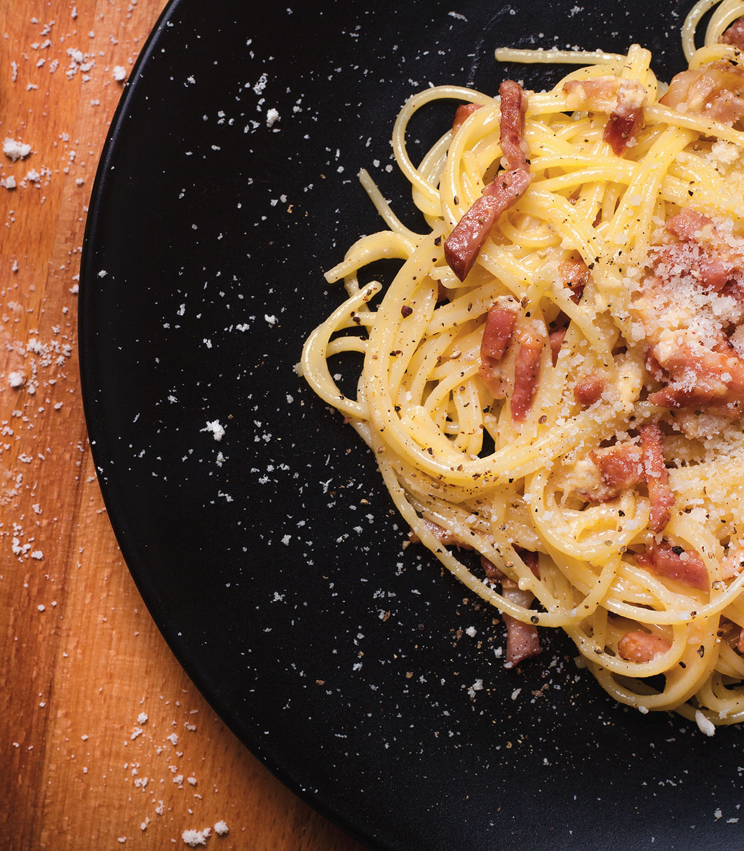
Carbonara
for two
A Roman pasta dish with a silky sauce of egg yolks, Pecorino and pasta water, finished with crisp guanciale and black pepper.
About 25 minutes
Notes:
Recipe quantities on slide 2 make two servings. Timing is approximate and depends on the pasta and stove.
Source: https://www.giallozafferano.com/recipes/Spaghetti-Carbonara-Bacon-and-egg-spaghetti.html
Photo: Javier Somoza, Espaguetis carbonara.jpg. https://commons.wikimedia.org/wiki/File:Espaguetis_carbonara.jpg
License: CC BY-SA 4.0, https://creativecommons.org/licenses/by-sa/4.0/ . Cropped for the slide. The photograph and this crop retain this license.

Slide 2
Ingredients for two servings
Ingredient | Quantity | Preparation notes
Spaghetti | 160 g | Cook until al dente.
Guanciale | 75 g | Remove rind. Cut into small strips.
Egg yolks | 3 medium | Separate before cooking.
Pecorino Romano | 25 g | Finely grate. Extra cheese is optional.
Black pepper | ½ tsp to start | Freshly grind. Adjust to taste.
Salt | As needed | Lightly salt the pasta water.
Pasta cooking water | Reserve 250 ml | Add gradually, only as needed.
Pancetta can replace guanciale. Parmesan can replace Pecorino, with a milder flavor.
2
Notes:
Core ingredient quantities are half of the four-serving GialloZafferano recipe. Black pepper is an adjustable starting quantity. Reserve more water than you expect to use.
Source: https://www.giallozafferano.com/recipes/Spaghetti-Carbonara-Bacon-and-egg-spaghetti.html
Source: https://www.bbcgoodfood.com/recipes/ultimate-spaghetti-carbonara-recipe

Slide 3
Cooking flowchart
Follow the numbered steps and arrows.
1. Prepare & whisk
Cut pork. Mix yolks,
cheese and pepper.
2. Crisp guanciale
Render the fat over
moderate heat.
3. Boil spaghetti
Cook al dente.
Reserve 250 ml water.
6. Plate & serve
Divide between two
warm bowls. Serve now.
5. Mix the sauce
Add egg mixture. Toss.
Add water as needed.
4. Coat & cool
Toss pasta in the fat.
Move pan off heat.
Guanciale can cook while the pasta boils. Keep the egg mixture ready before draining.
3
Notes:
Prepare the egg-cheese mixture first. Steps 2 and 3 can overlap. The critical transition is step 4: physically move the pan away from the hot burner before adding the egg mixture.
Source: https://www.bbcgoodfood.com/recipes/ultimate-spaghetti-carbonara-recipe
Source: https://www.seriouseats.com/pasta-carbonara-sauce-recipe

Slide 4
Preparation before the pasta cooks
Step 1
Guanciale and cheese
Egg mixture
Cut 75 g guanciale into small, even strips. Finely grate 25 g Pecorino so it mixes smoothly.
Whisk 3 medium yolks with the Pecorino and ½ tsp black pepper in a bowl. Set it beside the stove.
Equipment
Large pot, wide frying pan, mixing bowl, whisk,
tongs, fine grater and a heatproof measuring cup.
4
Notes:
Prepare everything before the pasta is ready, because the final mixing moves quickly. Fine cheese particles help the sauce become smooth.
Source: https://www.bbcgoodfood.com/recipes/ultimate-spaghetti-carbonara-recipe

Slide 5
Guanciale and spaghetti
Steps 2 and 3 can happen together.
2
Golden guanciale
3
Al dente spaghetti
Cook the strips in a dry frying pan over moderate heat for about 8–10 minutes. Stir until golden and the fat has melted out.
Boil 160 g spaghetti in lightly salted water. Follow the packet timing and taste for a firm bite. Stir to prevent sticking.
Keep the rendered fat in the pan.
Before draining, reserve 250 ml
of the hot cooking water.
5
Notes:
Watch the color rather than relying only on the timer. A little bite should remain in the pasta. Guanciale supplies its own cooking fat. Retain hot starchy water before transferring the pasta.
Source: https://www.giallozafferano.com/recipes/Spaghetti-Carbonara-Bacon-and-egg-spaghetti.html
Source: https://www.bbcgoodfood.com/recipes/ultimate-spaghetti-carbonara-recipe

Slide 6
A smooth carbonara sauce
Steps 4 and 5
Pan off the burner
before adding eggs
1
Toss the drained spaghetti in the guanciale fat.
2
Move the pan off the burner. Let strong sizzling stop.
Hot pasta and gentle residual heat help the sauce coat each strand. A sizzling pan can scramble the yolks.
3
Pour in the egg mixture and toss continuously.
4
Add hot pasta water 1 tbsp at a time until glossy.
6
Notes:
Mix the egg mixture into the pasta while the pan is away from direct heat. Keep stirring and add only enough water for a sauce that clings to the strands. The full reserved cup will usually not be necessary.
Source: https://www.bbcgoodfood.com/recipes/ultimate-spaghetti-carbonara-recipe
Source: https://www.seriouseats.com/pasta-carbonara-sauce-recipe

Slide 7
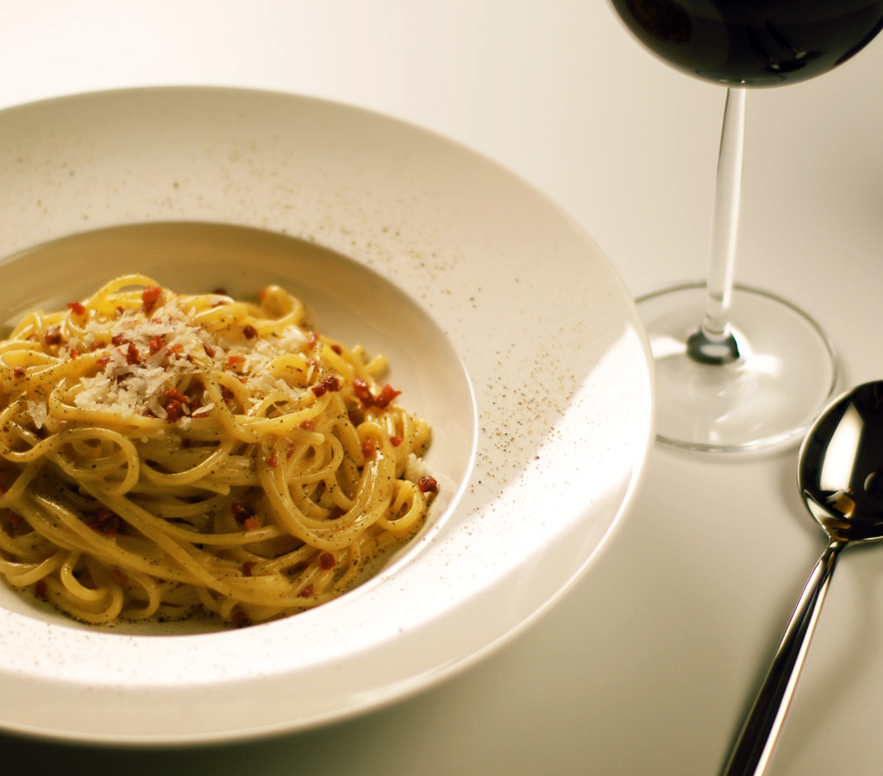
Tips at the stove
A cup of water nearby
Keep the reserved pasta water within reach. A small splash can loosen sauce that tightens.
Salt with restraint
Guanciale and Pecorino already bring salt. Taste the finished pasta before adding more.
Warm bowls, quick serving
Divide the pasta into two warm bowls. Finish with pepper and optional extra cheese.
7
Notes:
Serve immediately, because the sauce thickens as it stands. Use hot cooking water for adjustments.
Source: https://www.seriouseats.com/pasta-carbonara-sauce-recipe
Source: https://www.bbcgoodfood.com/recipes/ultimate-spaghetti-carbonara-recipe
Photo: Mattes Boch, Spaghetti alla Carbonara.jpg. https://commons.wikimedia.org/wiki/File:Spaghetti_alla_Carbonara.jpg . Released into the public domain. Cropped for the slide.

Slide 8
Common mistakes to avoid
Mistake
What helps
Eggs scramble
Move the pan off the hot burner before adding eggs. Toss continuously.
Sauce turns dry
Add a tablespoon of reserved hot water and toss again.
Sauce turns watery
Add water gradually. Stop when a glossy coating clings to the pasta.
Guanciale burns
Use moderate heat. Stop cooking once the strips turn golden.
Ready to eat: firm pasta, crisp guanciale and sauce that coats every strand.
8
Notes:
Scrambled egg curds cannot be restored to a smooth sauce, so heat control matters most. Gradual water additions prevent over-thinning. Watch the pork carefully and serve the finished pasta right away.
Source: https://www.bbcgoodfood.com/recipes/ultimate-spaghetti-carbonara-recipe
Source: https://www.seriouseats.com/pasta-carbonara-sauce-recipe
Source: https://www.giallozafferano.com/recipes/Spaghetti-Carbonara-Bacon-and-egg-spaghetti.html

