Slide 1
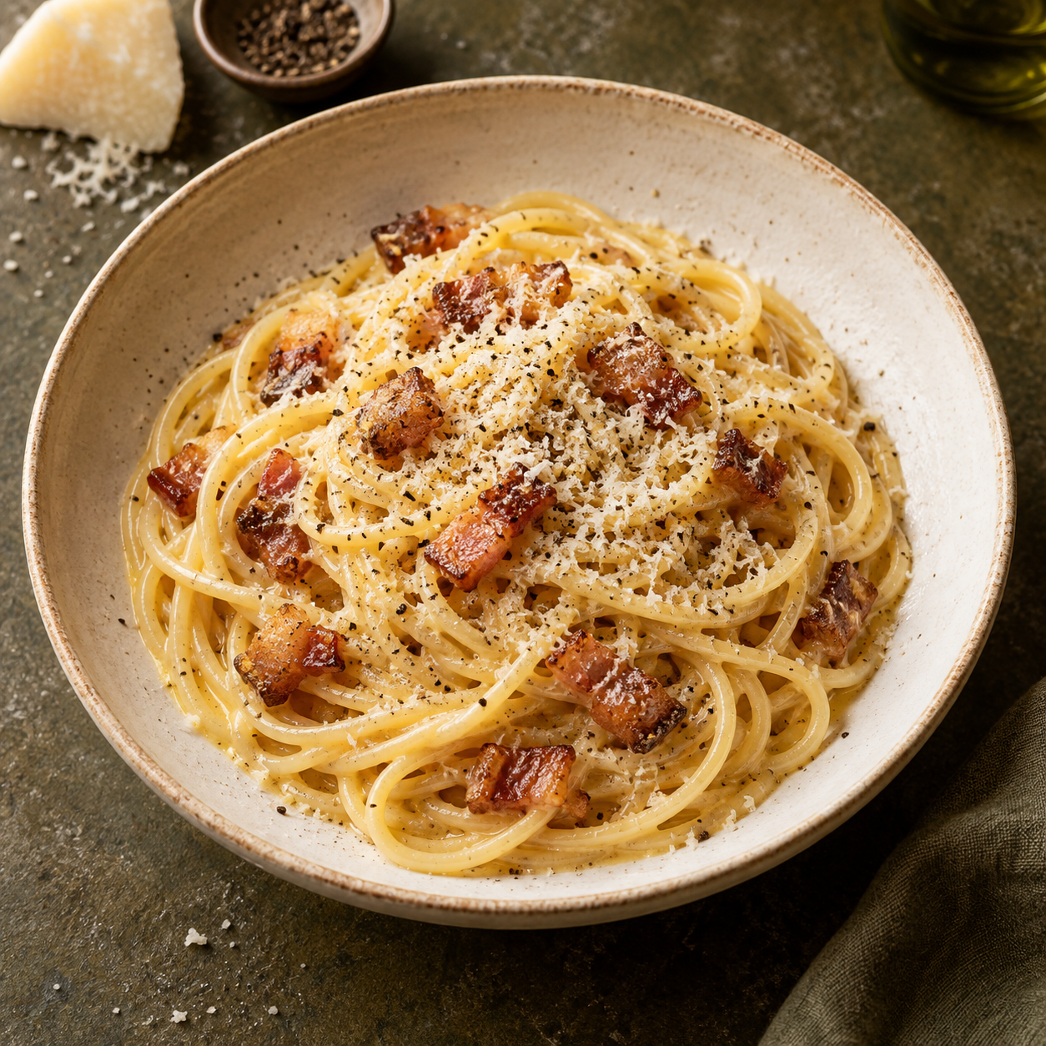
Carbonara
for two
A Roman pasta with guanciale, eggs,
Pecorino Romano and black pepper.
Silky sauce comes from gentle heat
and a little starchy pasta water.
2 generous servings
About 25 minutes
01
Notes:
A home-cooking recipe for two generous portions. The approximate time varies with the pasta and stove. The creamy texture comes from eggs, cheese, rendered pork fat and pasta water. This recipe uses no cream.
Recipe references:
https://www.giallozafferano.com/recipes/Spaghetti-Carbonara-Bacon-and-egg-spaghetti.html
https://www.seriouseats.com/pasta-carbonara-sauce-recipe
Image: illustrative food photograph generated with Imagegen.

Slide 2
Ingredients for two
Ingredient | Quantity | Preparation notes
Dry spaghetti | 200 g | Cook until al dente
Guanciale | 100 g | Remove rind, cut into small strips
Eggs | 1 whole egg + 2 yolks | Whisk together in a bowl
Pecorino Romano | 50 g | Grate finely, keep a pinch to finish
Black pepper | ½ tsp, or to taste | Grind fresh, plus more to finish
Water | About 2 L | Reserve 250 mL before draining
Salt | To taste | Salt water lightly, then taste later
Guanciale is cured pork cheek. Pancetta works as a substitute with a different flavor.
02
Notes:
Quantities are adapted for two generous servings rather than an exact scaled copy of one source recipe. Use one large whole egg and two large yolks. The 50 g of cheese includes a small pinch for finishing. Reserved pasta water is an adjustment ingredient: only add as much as the sauce needs. Guanciale and Pecorino are salty, so taste before adding more salt.
Recipe references:
https://www.seriouseats.com/pasta-carbonara-sauce-recipe
https://www.giallozafferano.com/recipes/Spaghetti-Carbonara-Bacon-and-egg-spaghetti.html

Slide 3
The cooking flow
1 Prepare & whisk
Cut guanciale, grate cheese, mix eggs with cheese and pepper.
2 Render guanciale
Cook gently until golden and the fat melts out.
3 Cook spaghetti
Boil in lightly salted water until al dente.
4 Reserve & toss
Save pasta water, then coat spaghetti in the pork fat.
5 Finish off heat
Add the egg mixture and loosen with water as needed.
6 Plate & serve
Return guanciale, add pepper and serve immediately.
03
Notes:
Follow the numbered steps from top to bottom. The guanciale can rest off the heat while the pasta cooks. Return the reserved guanciale at the end.
Recipe references:
https://www.giallozafferano.com/recipes/Spaghetti-Carbonara-Bacon-and-egg-spaghetti.html

Slide 4
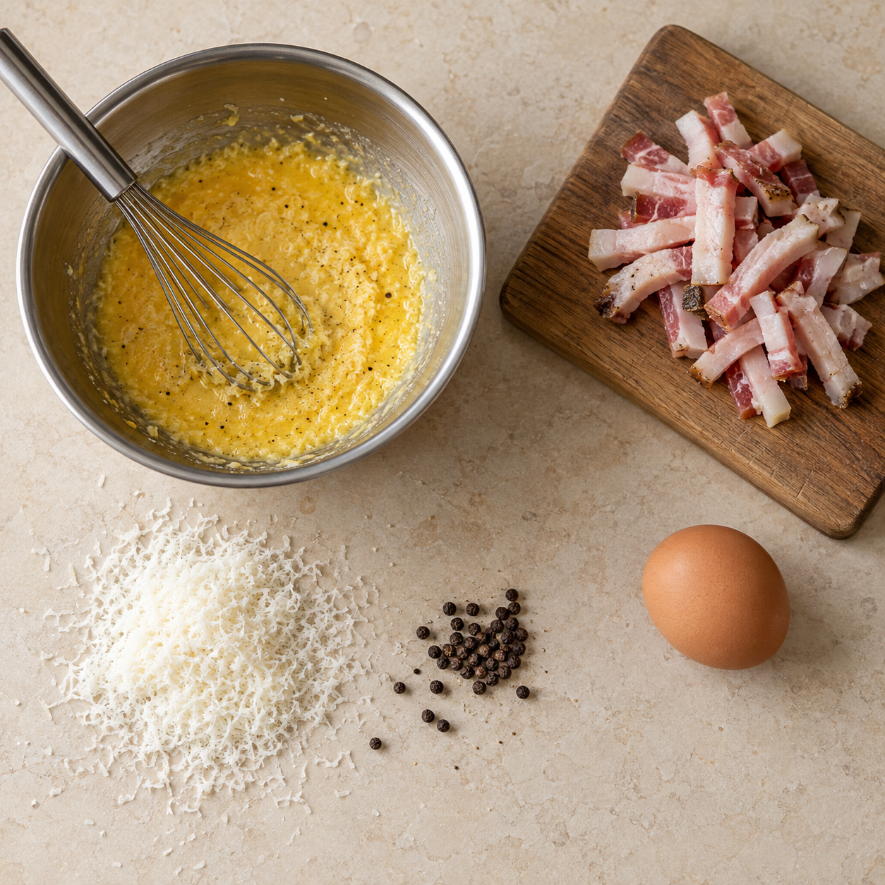
Preparation and egg mixture
Before the pasta cooks
Cut the guanciale into small strips.
Grate the Pecorino very finely.
A thick paste is normal
Whisk 1 whole egg and 2 yolks with
most of the cheese and the pepper.
Keep a bowl, tongs and a mug for
reserved water close to the stove.
04
Notes:
Use a fine grater so the cheese blends easily into the egg mixture. Save a pinch of cheese for the serving plates. Prepare the mixture before draining the pasta so the final toss can happen promptly.
Recipe references:
https://www.seriouseats.com/pasta-carbonara-sauce-recipe
Image: illustrative food photograph generated with Imagegen.

Slide 5
Guanciale and spaghetti
Guanciale
Spaghetti
Start in a cool, dry skillet. Use medium-low
heat and stir occasionally for about
7–10 minutes, until golden.
Boil in lightly salted water. Stir early
to prevent sticking and use the package
time as a guide.
Lift out the pork and keep the rendered
fat in the pan. Move the pan off the heat.
Taste for a firm center. Before draining,
scoop out 250 mL of the cooking water.
Cue: golden edges and clear melted fat.
Cue: tender pasta with a slight bite.
05
Notes:
Time is approximate. Reduce the heat if the pork colors before its fat has rendered. Guanciale should color without burning. Cook pasta al dente according to its thickness and package guidance. The 250 mL reserve gives enough water for small adjustments, but usually the sauce needs only a fraction of it.
Recipe references:
https://www.giallozafferano.com/recipes/Spaghetti-Carbonara-Bacon-and-egg-spaghetti.html

Slide 6
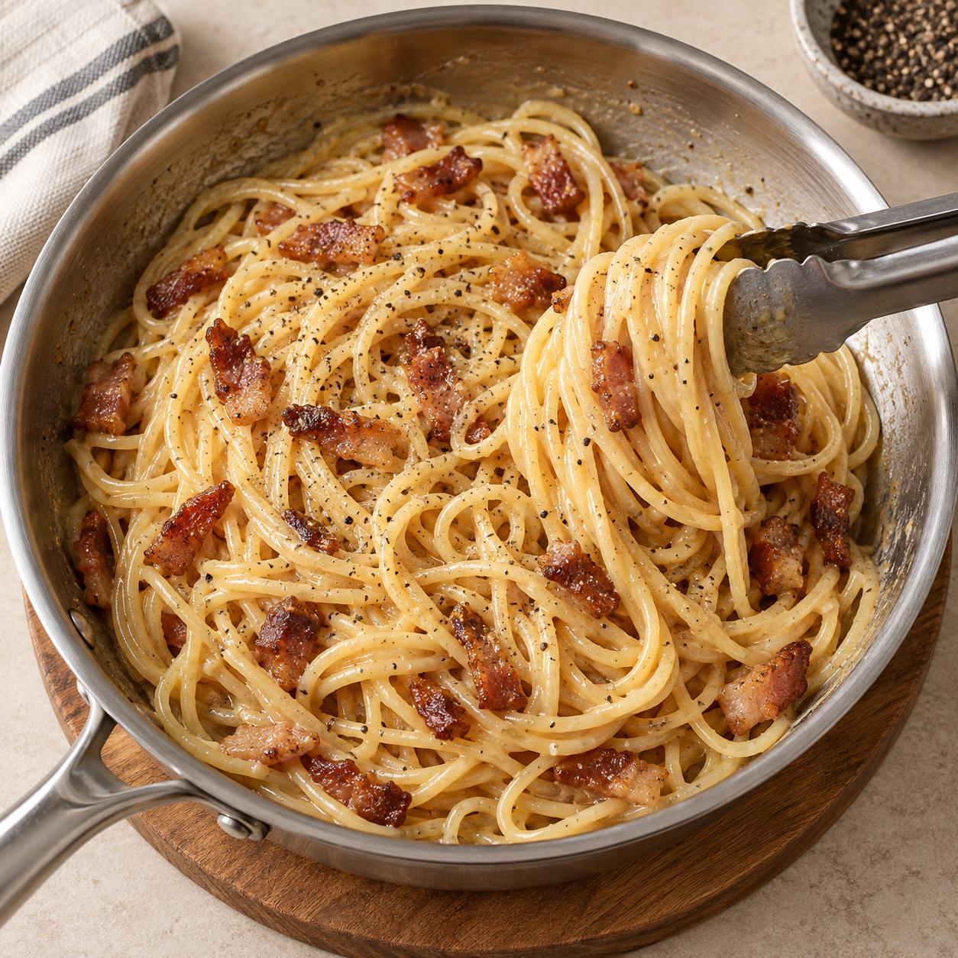
The silky finish
1 Coat the pasta
Toss hot spaghetti with the guanciale
fat and 1–2 tbsp of pasta water.
2 Move the pan off the burner
Let fierce sizzling settle. Add the egg
mixture while tossing continuously.
3 Adjust and finish
Add water 1 tbsp at a time until glossy.
Return the guanciale and taste.
The sauce should cling to each strand.
06
Notes:
The pasta and pan supply residual heat. Avoid pouring eggs into fiercely sizzling fat, because excessive heat can scramble them. Toss continuously to combine the mixture. Add water gradually, stopping once the sauce coats the pasta. Egg and cheese ratios vary among recipes. This deck uses a whole egg plus yolks for a rich, manageable sauce.
Recipe references:
https://www.giallozafferano.com/recipes/Spaghetti-Carbonara-Bacon-and-egg-spaghetti.html
https://www.seriouseats.com/pasta-carbonara-sauce-recipe
Image: illustrative food photograph generated with Imagegen.

Slide 7
Tips and common mistakes
Helpful habit
Mistake to avoid
Keep direct heat off when eggs go in.
A very hot pan turns eggs grainy.
Grate cheese finely and whisk well.
Coarse cheese can leave lumps.
Add reserved water a spoonful at a time.
Too much water makes the sauce thin.
Taste after adding pork and cheese.
Extra salt early can overpower the dish.
Toss promptly and serve straight away.
Waiting lets the sauce tighten.
07
Notes:
These tips focus on sauce texture and seasoning. Starchy water helps loosen the sauce, so reserve it before draining. Finely grated cheese blends more easily. If the sauce seems too thick, add a small amount of water and keep tossing. The sauce naturally thickens as the pasta cools.
Recipe references:
https://www.giallozafferano.com/recipes/Spaghetti-Carbonara-Bacon-and-egg-spaghetti.html
https://www.seriouseats.com/pasta-carbonara-sauce-recipe

Slide 8
Ready to serve
Two warm plates.
Dinner is ready.
Divide the pasta evenly. Finish with the reserved
Pecorino and a little freshly ground black pepper.
Look for a glossy coating, a slight bite in the pasta
and golden guanciale. Serve immediately.
08
Notes:
Warm the plates gently so the pasta stays pleasant to eat. Divide the finished carbonara into two servings and eat it immediately, while the sauce is glossy. The ingredients and method in this deck are an adaptation informed by the linked recipes.
Recipe references:
https://www.giallozafferano.com/recipes/Spaghetti-Carbonara-Bacon-and-egg-spaghetti.html
https://www.seriouseats.com/pasta-carbonara-sauce-recipe

