Slide 1
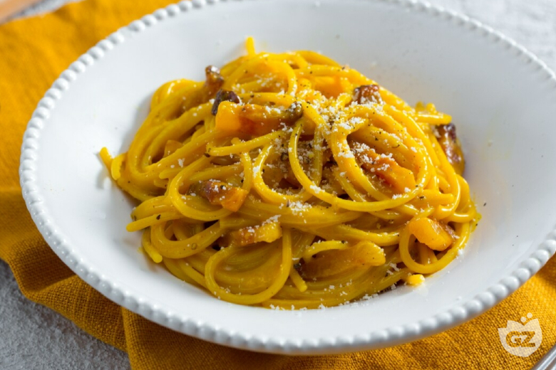
Carbonara for two
A Roman pasta classic
Egg yolks, cheese and starchy pasta water form a silky sauce around spaghetti and golden guanciale.
2 servings
About 25 minutes
01
Notes:
Recipe technique: https://www.giallozafferano.com/recipes/Spaghetti-Carbonara-Bacon-and-egg-spaghetti.html. Quantities adapted for two generous servings. Additional timing and troubleshooting are practical cooking guidance. Photo: GialloZafferano, https://www.giallozafferano.com/images/228-22819/Spaghetti-Carbonara-Bacon-and-egg-spaghetti_780x520_wm.jpg

Slide 2
Ingredients for two servings
Ingredient | Quantity | Preparation notes
Spaghetti | 200 g | Dry pasta
Guanciale | 100 g | Remove rind, cut into short strips
Egg yolks | 3 medium | Separate into a mixing bowl
Pecorino Romano | 40 g + extra | Grate finely, reserve extra for serving
Black pepper | ½ tsp, to taste | Freshly ground
Salt | As needed | Season the pasta water lightly
Pasta cooking water | Reserve 250 ml | Add only as needed for the sauce
Pancetta can substitute for guanciale. The flavor will differ.
02
Notes:
Recipe technique: https://www.giallozafferano.com/recipes/Spaghetti-Carbonara-Bacon-and-egg-spaghetti.html. Quantities adapted for two generous servings. Additional timing and troubleshooting are practical cooking guidance.

Slide 3
Cooking flowchart
1 Prepare ingredients
2 Render guanciale
3 Boil spaghetti
4 Mix yolks and cheese
8 Adjust sauce and serve
7 Add egg mixture and toss
6 Remove pan from heat
5 Reserve water and toss pasta
While the pasta cooks, whisk the yolks and cheese. Finish the sauce off the heat.
03
Notes:
Recipe technique: https://www.giallozafferano.com/recipes/Spaghetti-Carbonara-Bacon-and-egg-spaghetti.html. Quantities adapted for two generous servings. Additional timing and troubleshooting are practical cooking guidance.

Slide 4
Preparation before cooking
01
Ingredients ready
Cut the guanciale into even strips. Finely grate the cheese and separate the yolks.
02
Equipment ready
Use a pasta pot, wide frying pan, bowl, whisk, tongs and a measuring cup for pasta water.
Have two plates ready. The finished sauce thickens as it sits.
04
Notes:
Recipe technique: https://www.giallozafferano.com/recipes/Spaghetti-Carbonara-Bacon-and-egg-spaghetti.html. Quantities adapted for two generous servings. Additional timing and troubleshooting are practical cooking guidance.

Slide 5
Guanciale and spaghetti
03
Gentle rendering
Start guanciale in a dry pan over medium-low heat. Cook about 8–10 minutes until golden and the fat melts.
04
Pasta with a little bite
Boil spaghetti in lightly salted water. Follow the packet timing and taste before draining.
Set the guanciale aside and keep its fat in the pan. Reserve 250 ml pasta water.
05
Notes:
Recipe technique: https://www.giallozafferano.com/recipes/Spaghetti-Carbonara-Bacon-and-egg-spaghetti.html. Quantities adapted for two generous servings. Additional timing and troubleshooting are practical cooking guidance.

Slide 6
The egg and cheese mixture
3 yolks + 40 g Pecorino
Whisk the yolks with finely grated cheese and black pepper until evenly combined.
A thick paste is normal. Pasta water will loosen it when you finish the dish.
Fine grating helps the cheese blend smoothly.
06
Notes:
Recipe technique: https://www.giallozafferano.com/recipes/Spaghetti-Carbonara-Bacon-and-egg-spaghetti.html. Quantities adapted for two generous servings. Additional timing and troubleshooting are practical cooking guidance.

Slide 7
Finishing the sauce
05
Pasta into the pan
Toss the drained spaghetti in the guanciale fat with a splash of reserved pasta water.
06
Egg mixture off the heat
Move the pan away from the burner. Let fierce sizzling stop, add the egg mixture and toss continuously.
07
Glossy sauce, ready to serve
Add pasta water a tablespoon at a time until the sauce coats the strands. Return guanciale and serve with extra cheese.
07
Notes:
Recipe technique: https://www.giallozafferano.com/recipes/Spaghetti-Carbonara-Bacon-and-egg-spaghetti.html. Quantities adapted for two generous servings. Additional timing and troubleshooting are practical cooking guidance.

Slide 8
Tips and common mistakes
Scrambled eggs
A hot burner sets the eggs too quickly. Remove the pan from heat before adding them.
Thick or sticky sauce
Toss in small splashes of reserved pasta water until the strands move freely.
Watery sauce
Add water gradually and keep tossing. Stop when the sauce clings to the pasta.
Too much salt
Guanciale and Pecorino already add salt. Season the water lightly and taste at the end.
Serve immediately for the best texture. Cream is unnecessary for this recipe.
08
Notes:
Recipe technique: https://www.giallozafferano.com/recipes/Spaghetti-Carbonara-Bacon-and-egg-spaghetti.html. Quantities adapted for two generous servings. Additional timing and troubleshooting are practical cooking guidance.

