Slide 1
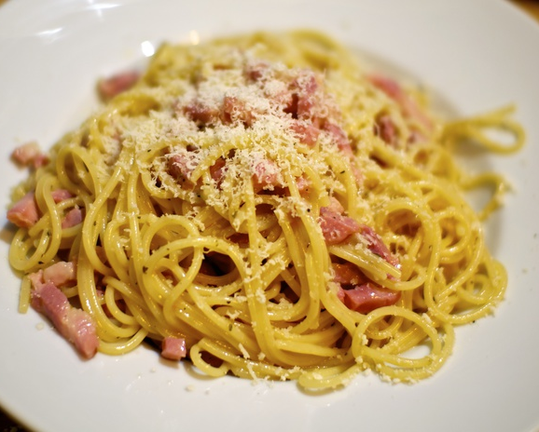
Carbonara for two
A creamy Roman pasta made with eggs,
cheese, cured pork and black pepper.
2 servings
About 25 minutes
01
Notes:
Technique reference: https://www.bbcgoodfoodme.com/recipes/next-level-spaghetti-carbonara/ . Quantities and method adapted for a simple two-serving version. Photo: ANSA, https://www.ansa.it/canale_terraegusto/notizie/prodotti_tipici/2016/04/09/carbonara-alla-francese-la-risposta-di-roma_a1849cad-5d3a-414a-9937-7b43fa4badc0.html

Slide 2
Ingredients for two servings
Ingredient | Quantity | Preparation notes
Spaghetti | 200 g | Use dry pasta
Guanciale | 100 g | Cut into small strips. Pancetta also works
Eggs | 1 whole + 2 yolks | Whisk together in a bowl
Pecorino Romano | 50 g | Finely grate. Reserve a little for serving
Black pepper | ½ tsp, or to taste | Freshly grind
Salt | To taste | Salt the pasta water lightly
Pasta water | Reserve 250 ml | Add only as much as the sauce needs
No cream needed. Eggs, cheese and pasta water form the sauce.
02
Notes:
Technique reference: https://www.bbcgoodfoodme.com/recipes/next-level-spaghetti-carbonara/ . Quantities and method adapted for a simple two-serving version.

Slide 3
Preparation before cooking
01
Ingredients ready
Cut the pork and finely grate the cheese before the pasta cooks.
02
Egg mixture
Whisk the whole egg, yolks, most of the cheese and pepper into a paste.
03
Equipment ready
Set out a large pot, frying pan, bowl, tongs and a mug for pasta water.
03
Notes:
Technique reference: https://www.bbcgoodfoodme.com/recipes/next-level-spaghetti-carbonara/ . Quantities and method adapted for a simple two-serving version.

Slide 4
Cooking sequence
1 Prepare
Cut pork, whisk eggs
and cheese
2 Render pork
Cook gently until
golden and crisp
3 Cook pasta
Boil until al dente
Reserve pasta water
6 Serve
Finish with cheese
and black pepper
5 Make sauce
Add egg mixture
Toss with pasta water
4 Toss pasta
Coat in the pork fat
Then remove heat
Follow the top row left to right, then the bottom row right to left.
04
Notes:
Technique reference: https://www.bbcgoodfoodme.com/recipes/next-level-spaghetti-carbonara/ . Quantities and method adapted for a simple two-serving version.

Slide 5
Pork and pasta
01
Golden pork, rendered fat
Cook the pork over medium-low heat for about 7–10 minutes.
Keep the fat in the pan. Turn off the heat when the pork is crisp.
02
Pasta with a firm bite
Boil the spaghetti in lightly salted water. Follow the pack timing
and taste near the end. Reserve a mug of water before draining.
Timing tip: cook the pasta while the pork renders.
05
Notes:
Technique reference: https://www.bbcgoodfoodme.com/recipes/next-level-spaghetti-carbonara/ . Quantities and method adapted for a simple two-serving version.

Slide 6
The creamy sauce
01
Pasta coated in the pork fat
Toss the hot pasta with the pork and its fat. Move the pan off the hob
and let fierce sizzling settle before adding the egg mixture.
02
Egg mixture added off the heat
Pour in the egg mixture while tossing continuously. Add pasta water
a tablespoon at a time until the sauce clings smoothly to the strands.
The goal: glossy pasta with a flowing sauce and no egg curds.
06
Notes:
Technique reference: https://www.bbcgoodfoodme.com/recipes/next-level-spaghetti-carbonara/ . Quantities and method adapted for a simple two-serving version.

Slide 7
Serving and practical tips
01
Warm bowls and immediate serving
Divide between two warm bowls. Add the reserved cheese and pepper.
02
Small additions of pasta water
Keep the mug close. The sauce thickens as it stands, so loosen it
with a little water just before serving.
03
Seasoning at the end
Taste first. Guanciale and Pecorino already bring plenty of salt.
07
Notes:
Technique reference: https://www.bbcgoodfoodme.com/recipes/next-level-spaghetti-carbonara/ . Quantities and method adapted for a simple two-serving version.

Slide 8
Common mistakes and quick fixes
Scrambled eggs
A hot pan sets the eggs too fast. Remove it from the heat
and keep tossing as you add the egg mixture.
Dry or sticky sauce
Add warm pasta water a spoonful at a time, tossing between additions.
Watery sauce
Pause the water additions and keep tossing. Add a little grated cheese.
Salty or gritty sauce
Salt the cooking water lightly and grate cheese finely.
Taste before adding more salt.
08
Notes:
Technique reference: https://www.bbcgoodfoodme.com/recipes/next-level-spaghetti-carbonara/ . Quantities and method adapted for a simple two-serving version.

