Slide 1
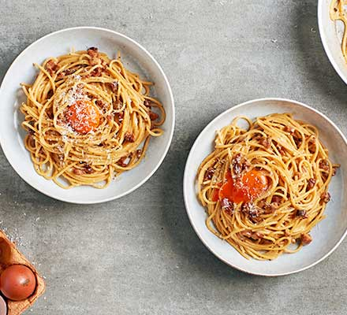
Carbonara for two
A small ingredient list.
A silky sauce made with eggs,
cheese and pasta water.
2 servings
About 25 minutes
01
Notes:
Technique reference: https://www.bbcgoodfoodme.com/recipes/next-level-spaghetti-carbonara/ . Quantities and method adapted for this two-serving version. Photo: Good Food Middle East, https://www.bbcgoodfoodme.com/assets/legacy/recipe/recipe-image/2018/01/spaghetti-carbonara.jpg . Photo illustrates a serving variation with an extra yolk.

Slide 2
Ingredients for two servings
Ingredient | Quantity | Preparation notes
Spaghetti | 200 g | Keep dry until cooking.
Guanciale | 100 g | Remove rind. Cut into small strips.
Eggs | 1 whole + 2 yolks | Whisk together in a bowl.
Pecorino Romano | 50 g | Grate finely. Save a little to finish.
Black pepper | ½ tsp, to taste | Grind freshly.
Salt | To taste | Use lightly in the pasta water.
Pasta cooking water | Reserve 250 ml | Add only as needed for the sauce.
Pancetta can replace guanciale. Parmesan gives a milder alternative to Pecorino.
02
Notes:
Technique reference: https://www.bbcgoodfoodme.com/recipes/next-level-spaghetti-carbonara/ . Quantities and method adapted for this two-serving version.

Slide 3
Cooking flow
1 Prepare ingredients
2 Crisp the guanciale
3 Cook pasta and save water
6 Adjust and serve
5 Mix sauce off the heat
4 Coat pasta in the fat
Follow the arrows across the top row, then back along the bottom row.
03
Notes:
Technique reference: https://www.bbcgoodfoodme.com/recipes/next-level-spaghetti-carbonara/ . Quantities and method adapted for this two-serving version.

Slide 4
Preparation and guanciale
01
Everything ready before the pasta finishes
Grate the cheese finely. Whisk the egg and yolks with most of the cheese and black pepper.
02
Gentle heat for crisp pork
Start the guanciale in a dry pan over medium-low heat. Cook for about 7–10 minutes until golden, with clear fat in the pan.
Turn off the pan once the pork is crisp. Keep the rendered fat for the pasta.
04
Notes:
Technique reference: https://www.bbcgoodfoodme.com/recipes/next-level-spaghetti-carbonara/ . Quantities and method adapted for this two-serving version.

Slide 5
Pasta and cooking water
03
Pasta with a little bite
Bring a pot of lightly salted water to a boil. Cook the spaghetti until al dente, following the packet as a guide.
04
Pasta coated in the rendered fat
Reserve 250 ml of cooking water before draining. Transfer the hot pasta to the guanciale pan and toss well.
Keep the water nearby. Its starch helps the sauce cling to the spaghetti.
05
Notes:
Technique reference: https://www.bbcgoodfoodme.com/recipes/next-level-spaghetti-carbonara/ . Quantities and method adapted for this two-serving version.

Slide 6
The silky sauce
05
Pan off the heat
Let the pan cool briefly until the strong sizzling stops.
Add the egg mixture and toss continuously.
Add warm pasta water a tablespoon at a time.
Keep tossing until the sauce looks glossy and coats the pasta.
The hot pasta thickens the eggs. A very hot pan can scramble them.
06
Notes:
Technique reference: https://www.bbcgoodfoodme.com/recipes/next-level-spaghetti-carbonara/ . Quantities and method adapted for this two-serving version.

Slide 7
Finishing and serving
06
A glossy coating on every strand
If the sauce feels thick or sticky, toss in a little more warm pasta water. Stop when it flows smoothly around the pasta.
Season and serve immediately
Taste before adding salt. Divide between two warm bowls, then finish with the reserved cheese and more black pepper.
07
Notes:
Technique reference: https://www.bbcgoodfoodme.com/recipes/next-level-spaghetti-carbonara/ . Quantities and method adapted for this two-serving version.

Slide 8
Tips and common mistakes
Scrambled eggs
Remove the pan from the heat before adding eggs. Toss constantly.
Dry or sticky sauce
Save cooking water. Add it in small splashes as the sauce thickens.
Watery sauce
Add water gradually. Toss well before deciding to add more.
Too salty
Salt the pasta water lightly. Taste after adding the cured pork and cheese.
Clumps of cheese
Grate finely and mix with the eggs before combining with pasta.
08
Notes:
Technique reference: https://www.bbcgoodfoodme.com/recipes/next-level-spaghetti-carbonara/ . Quantities and method adapted for this two-serving version.

