Slide 1
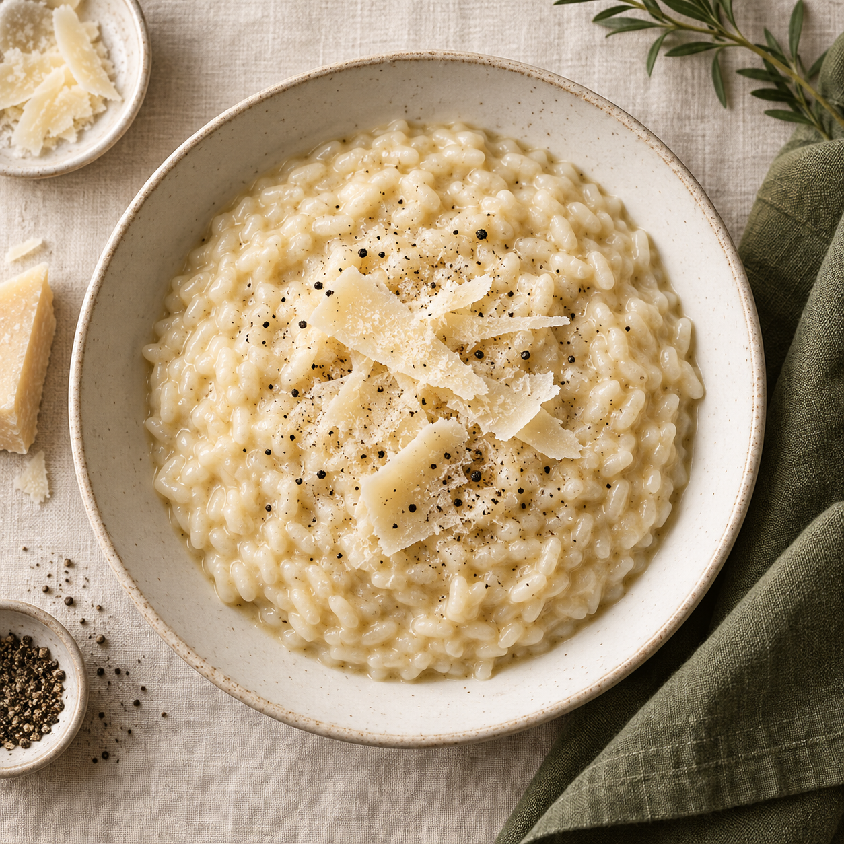
Parmesan
Risotto
Creamy rice with butter and Parmesan
Serves 4 as a main
Prep 10 min / Cook 30 min
Notes:
Original recipe. Cover image is an AI-generated food illustration.

Slide 2
Ingredients for four
320 g Arborio or Carnaroli rice
120 ml dry white wine (optional)
1.2–1.5 L low-sodium vegetable stock
80 g Parmesan, finely grated
1 small onion, finely diced
Salt and freshly ground black pepper
1 tbsp olive oil
Extra Parmesan, to serve (optional)
60 g unsalted butter, divided
No wine? Use 120 ml extra stock instead.
Equipment: wide heavy pan, small saucepan, ladle and wooden spoon

Slide 3
The first 10 minutes
1 Warm the stock
Bring the stock to a gentle simmer in a small saucepan.
Keep it hot over low heat.
2 Soften the onion
Heat the olive oil and 20 g butter in a wide pan over medium-low heat.
Add the onion and cook for 5–6 minutes until soft, without browning.
3 Toast the rice
Stir in the unwashed rice for 2 minutes. Add the wine and stir
for 1–2 minutes until almost absorbed. Use extra stock if omitting wine.

Slide 4
Stock, one ladle at a time
4 Simmer gently for about 18–22 minutes
Add a ladle of hot stock (about 150 ml). Stir often, scraping the
bottom of the pan, and keep the rice at a gentle simmer.
When most of the liquid has absorbed, add another ladle.
Repeat, tasting the rice from about 16 minutes onward.
The rice should be tender with a slight bite. You may not need all
the stock. If it runs out before the rice is ready, add hot water.

Slide 5
Finishing and serving
5 Finish off the heat
Stir in the remaining 40 g butter and 80 g Parmesan. Add a little
hot stock until the risotto flows loosely when you tilt the pan.
Rest for 1 minute. Taste, then season with salt and black pepper.
Spoon into warm bowls and serve immediately.
Texture check
Risotto should spread gently on the plate. If it holds a stiff mound,
stir in another splash of hot stock before serving.

