Slide 1
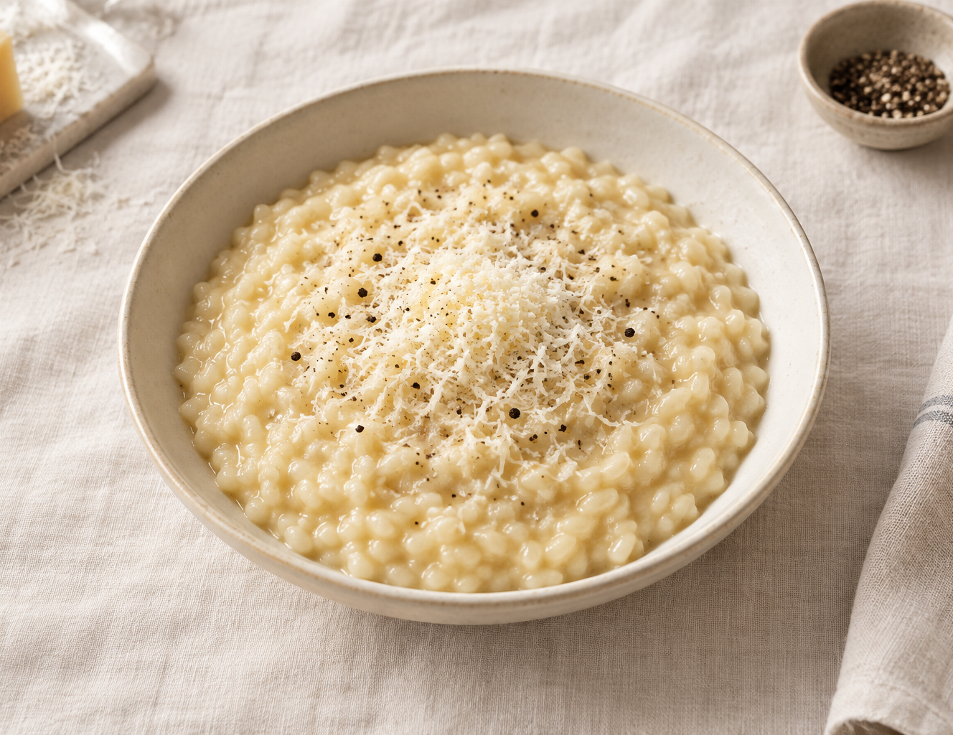
Parmesan risotto
A classic, creamy Italian rice dish
SERVES 4
Prep 10 minutes
Cook about 30 minutes
Arborio rice, warm stock,
butter and Parmesan
01
Notes:
Original recipe. Cover image is AI-generated food artwork. Timing and stock needs vary with rice, pan and heat.

Slide 2
Ingredients
RICE & STOCK
TO COOK & FINISH
320 g Arborio or Carnaroli rice
1.2–1.5 L low-sodium vegetable stock
120 mL dry white wine (optional)
1 small onion, finely chopped
1 tbsp olive oil
50 g unsalted butter, divided
80 g Parmesan, finely grated
Salt and black pepper, to taste
No wine? Use 120 mL extra stock. For a vegetarian dish, choose cheese made with vegetarian rennet.
02

Slide 3
Prepare the base
01
Keep the stock hot
Bring stock to a gentle simmer in a saucepan. Keep it hot over low heat.
02
Soften the onion
In a wide, heavy pan, heat the oil and 25 g butter over medium-low heat. Add onion and cook for 5–7 minutes until soft, without browning.
Have a ladle and wooden spoon ready. Do not rinse the rice.
03

Slide 4
Toast, then add stock gradually
03 Toast & deglaze
Add the rice and stir for 2 minutes. Pour in the wine and cook for 1–2 minutes, until nearly absorbed.
04 Simmer & stir
Add hot stock one ladle at a time, about 150 mL. Stir frequently and add more when most of the liquid is absorbed. Keep a gentle simmer.
Cook for about 18–22 minutes from the first ladle. Start tasting at 18 minutes. The grains should be tender with a slight bite.
04

Slide 5
Finish and serve immediately
05 Stir off the heat
Remove the pan from the heat. Stir in the remaining 25 g butter and the Parmesan. Add a splash of hot stock to loosen, then rest for 1 minute.
06 Check the texture
The risotto should flow gently when the pan is tilted and spread slowly on a warm plate. Taste, season with salt and black pepper, and serve.
Too thick? Add hot stock. Still chalky inside? Continue cooking with stock before adding butter and cheese.
05

