Slide 1
Technical Analysis of Stock Data
Team Members:
Siddharth Paraag Nilakhe
Mehul Sudhakar Ingale
Course: FE 520 B

Slide 2
Introduction:
In this stock analysis project, we delve into a comprehensive examination of a selected stock's historical performance.
Utilizing a variety of analytical tools and methods, the project aims to uncover insights into the stock's past behavior, providing a nuanced understanding of its market performance.
This analysis includes a range of techniques, from basic financial metrics like Return on Investment (ROI) to more complex technical indicators such as Moving Averages (SMA and EMA), Trading Volume, Candlestick Patterns, MACD (Moving Average Convergence Divergence), and RSI (Relative Strength Index).
The data for this analysis is meticulously fetched from reliable financial data sources, ensuring accuracy and relevance.
Each aspect of the stock's historical data is scrutinized, offering a multi-faceted view of its performance.
This comprehensive approach allows for a more informed evaluation, catering not only to seasoned investors but also to those new to stock market analysis.

Slide 3
Overview of the Tools and Methods:
Tools:
Financial Data APIs/Libraries: Utilization of libraries such as yfinance for fetching historical stock data.
Python and Data Analysis Libraries: Heavy reliance on Python for scripting, with libraries like pandas for data manipulation and matplotlib for visualization.
Jupyter Notebook: The entire analysis is conducted and presented in a Jupyter Notebook, facilitating code execution, visualization, and documentation in one place
Methods:
Data Retrieval: Automated fetching of historical stock data, including daily prices and volumes.
ROI Calculation: Calculation of Return on Investment to gauge the profitability of the stock over a specific period.
Moving Averages (SMA and EMA): Use of Simple and Exponential Moving Averages for trend analysis and to smooth out price volatility.

Slide 4
Methods:
Data Retrieval: Automated fetching of historical stock data, including daily prices and volumes.
ROI Calculation: Calculation of Return on Investment to gauge the profitability of the stock over a specific period.
Moving Averages (SMA and EMA): Use of Simple and Exponential Moving Averages for trend analysis and to smooth out price volatility.
Volume Analysis: Assessment of trading volumes to interpret market activity and investor interest.
Candlestick Charting: Application of candlestick charts for detailed price movement analysis, offering insights into market sentiment and potential reversals.
MACD Analysis: Implementation of Moving Average Convergence Divergence for identifying trends and momentum shifts.
RSI Analysis: Use of Relative Strength Index to detect overbought or oversold conditions in the stock market.

Slide 5
Fetching Stock Data
We have fetched the stock data from yfinance in our Python Project:
The library yfinance is imported into the Python script. This library is specifically designed to download historical market data from Yahoo Finance.
A stock ticker symbol is defined, which uniquely identifies the stock of interest. For example, 'AAPL' for Apple Inc.
The start and end dates for the period over which the stock data is to be fetched are specified. This defines the historical data range you're interested in.
Using yfinance, the data for the specified ticker and date range is downloaded. The download method of yfinance is typically used for this purpose. It retrieves data including Open, High, Low, Close prices, and Volume.
After fetching, the data is now ready to be used for various analyses like calculating ROI, analyzing trends, or applying technical indicators like SMA, EMA, MACD, RSI, etc.

Slide 6
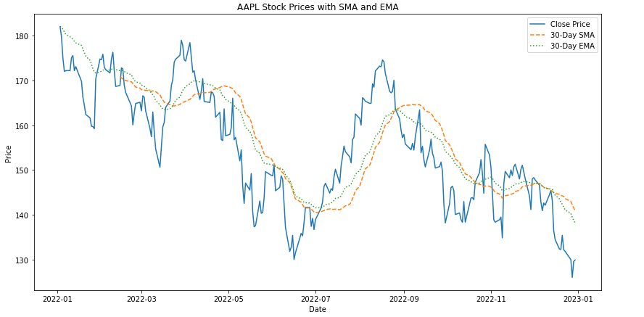
SMA and EMA Analysis
The SMA (Simple Moving Average) and EMA (Exponential Moving Average) analysis are important techniques in technical stock analysis.
They are used to smooth out price data over a specified period and help in identifying trends and potential reversal points in stock prices
In stock charts, both SMA and EMA are plotted as lines that move with the stock price. Traders often look for crossovers between short and long-term moving averages as potential trade signals.

Slide 7
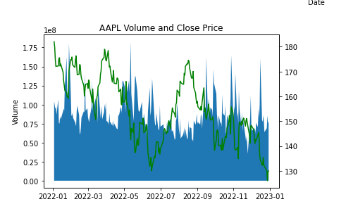
Volume and Close Price
In the context of stock market analysis, "Volume" and "Close Price" are two fundamental concepts that provide critical information about a stock's activity and performance.
volume and close price are essential metrics in stock market analysis. While close price gives an idea of the stock's value at the end of a trading session, volume provides context and helps assess the strength and significance of price movements.
Together, they offer valuable insights into the behavior and potential future movements of a stock.

Slide 8
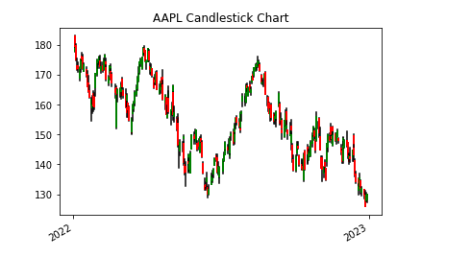
Candlestick Chart
Candlestick charts are a popular tool in technical analysis, used to understand the price movements of securities, derivatives, or currencies over a specific time period.
Traders use candlestick charts to look for patterns that may indicate potential future movements in the market.
These charts are often combined with other forms of technical analysis (like moving averages) to validate trading signals.
candlestick charts are a highly visual and effective method for analyzing market psychology and price movements. They can provide deep insights into market sentiment and help traders make informed decisions based on historical price patterns.

Slide 9
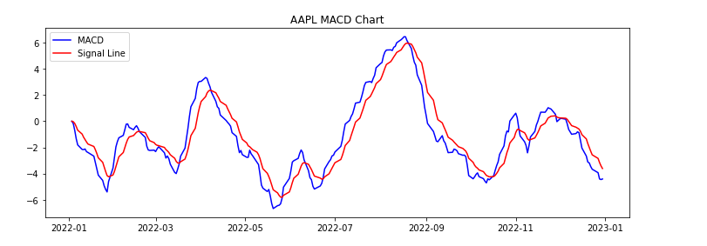
MACD Chart
The MACD (Moving Average Convergence Divergence) chart is a powerful tool in technical analysis, used to identify trends and momentum in stock prices
MACD chart is a valuable tool for traders looking to understand market momentum and trend direction.
By analyzing the relationships between the MACD Line, Signal Line, and Histogram, traders can make more informed decisions about entering or exiting positions in the market.

Slide 10
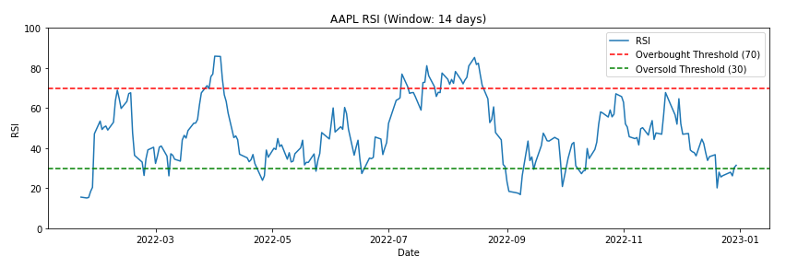
RSI
The Relative Strength Index (RSI) is a momentum oscillator commonly used in stock market analysis to measure the speed and change of price movements. It helps identify overbought or oversold conditions in the trading of an asset.
RSI is a valuable tool in technical analysis, offering insights into the momentum and potential price reversals of stocks.
However, it's most effective when used in combination with other analysis techniques and market knowledge.

Slide 11
Conclusion:
Key Findings
Trend Analysis: Through the use of SMA and EMA, we identified key trends in the stock's price movements, highlighting potential points of market entry and exit.
Momentum Insights: The MACD and RSI analyses provided valuable insights into the stock's momentum and possible reversal points, with specific attention to overbought and oversold conditions.
Volume Dynamics: The analysis of trading volume alongside price movements offered insights into market sentiment and potential confirmation of trends.
Price Action: Candlestick patterns revealed important market psychology aspects and potential short-term price movement indications.

Slide 12
Thank you

