Slide 1



RSOC-2026
GROUP 28
Domain :– Data Science
Problem Statement Title:- AI-Powered Urban Insights Platform
Team Leader Name: - Prakash Gond
Group No:- 28
Team Name:- Threads
Members:-
Abhinay Nachankar
Vaishnavi Nandurkar
Nagpur | Pune | Jalgaon | Amravati | Pandhura | Bhandara

Slide 2
NagarMitra
AI-powered platform that integrates traffic, pollution, energy, transport, water, and waste data into one smart city analytics system.
Uses data pipelines, machine learning, and interactive dashboards to monitor and manage urban systems.
Provides real-time insights, predictive analytics, and decision-support tools for city authorities.
How It Addresses the Problem
Unified Data Platform: Aggregates fragmented urban datasets into a single system.
Predictive Analytics: ML models forecast traffic congestion, pollution levels, and transport demand.
Anomaly Detection: Automatically detects pollution spikes, traffic surges, and energy overconsumption.
Policy Simulation: Allows planners to test interventions (e.g., reduce traffic by 20%) and evaluate their impact.
Interactive Dashboard: Real-time maps, alerts, and analytics for faster decision-making.
Innovation & Uniqueness
Integrated Smart City Digital Twin combining multiple urban domains.
AI-driven decision support (predictions + alerts + simulations).
Ai-chatbot using vector-less RAG.
Modular architecture enabling scalable and rapid development.
GROUP-28
Nagpur | Pune | Jalgaon | Amravati | Pandhura | Bhandara

Slide 3
FEASIBILITY AND VIABILITY
Feasibility of the Idea
Uses widely available technologies (Python, FastAPI, ML models, Streamlit, Firebase).
Can operate with synthetic or open urban datasets for prototyping.
Modular architecture allows parallel development and easy integration.
Scalable design suitable for future real-world smart city deployments.
Potential Challenges & Risks
Limited availability of real-time city data from sensors and authorities.
Data quality issues (missing, noisy, or inconsistent datasets).
Model accuracy limitations due to synthetic or limited training data.
System integration complexity across data pipeline, ML models, and dashboard.
Strategies to Overcome Challenges
Use public datasets and simulated IoT streams during development.
Implement data cleaning, validation, and normalization pipelines.
Continuously retrain models with real datasets as they become available.
Follow clear API contracts and modular architecture for smooth integration.
GROUP-28
Nagpur | Pune | Jalgaon | Amravati | Pandhura | Bhandara

Slide 4
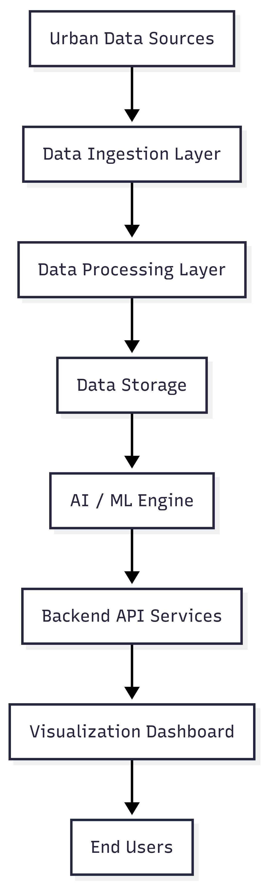
Impacts and Benefits & System Architecture
Potential Impact on Target Audience
Enables city authorities and planners to make faster, data-driven decisions.
Helps transport and infrastructure departments monitor congestion and resource usage.
Improves public awareness and transparency through accessible city analytics.
Supports policy makers in evaluating urban interventions before implementation.
Benefits of the Solution
Social: Improved urban mobility, better air quality, and enhanced quality of life.
Economic: Optimized resource usage and reduced costs from traffic congestion and energy waste.
Environmental: Lower pollution levels through smarter traffic and energy management.
Operational: Real-time alerts and predictive insights enable proactive city management.
GROUP-28
Nagpur | Pune | Jalgaon | Amravati | Pandhura | Bhandara

Slide 5
RESEARCH AND REFERENCES
Dataset :
dataset
Research Paper :
Smart City Traffic Patterns Prediction Using Machine Learning
Machine Learning-Based Air Pollution Monitoring and Forecasting
Traffic Pattern Classification in Smart Cities Using Deep Recurrent Neural Networks
News Articles :
Rising Vehicles Causing Severe Traffic Congestion
Bengaluru Among the Most Congested Cities in the World
Weather and Urban Conditions Increasing Air Pollution
Large Vehicles Increasing Urban Congestion and Safety Risks
GROUP-28
Nagpur | Pune | Jalgaon | Amravati | Pandhura | Bhandara

Slide 6
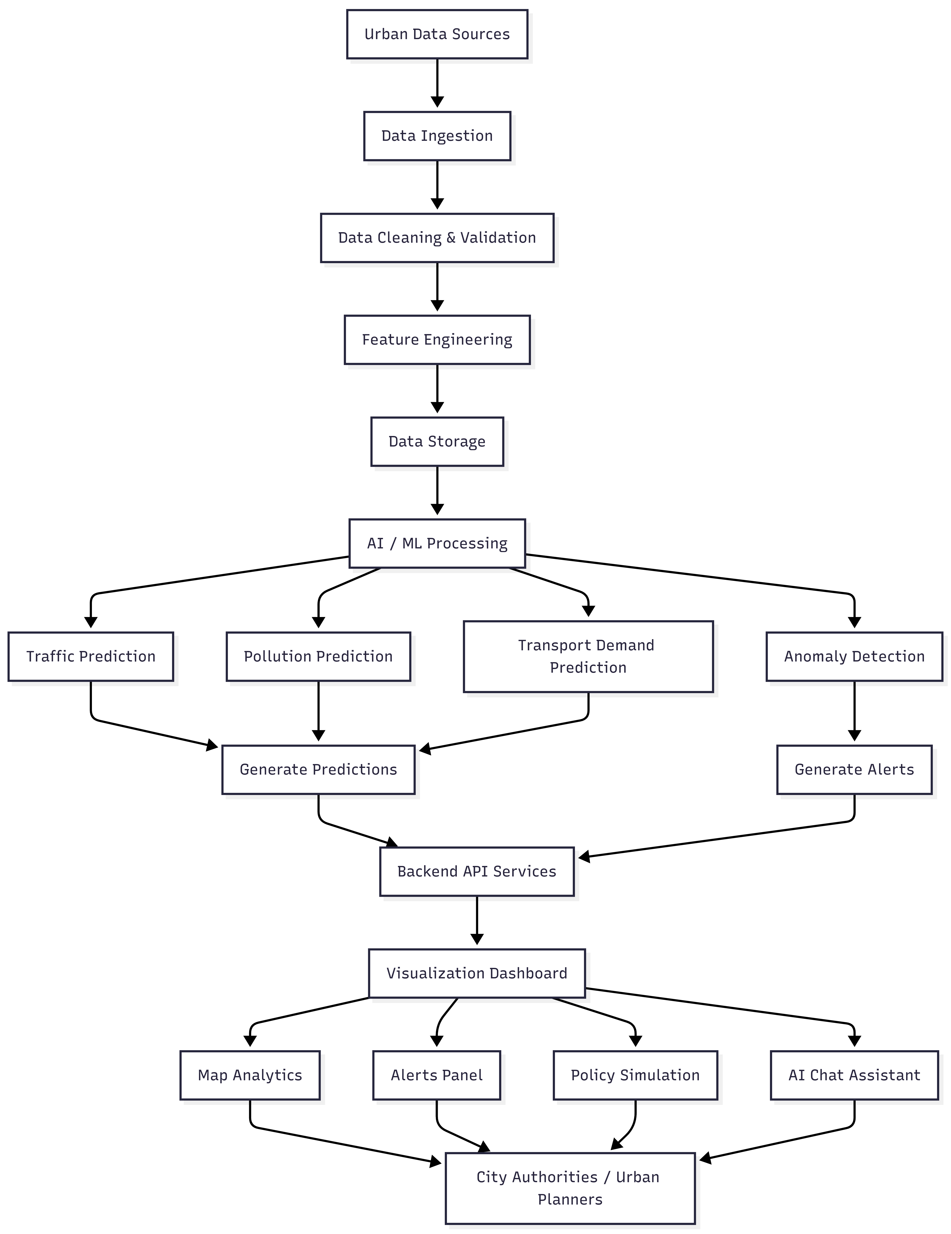
Use Case :
GROUP-28
Nagpur | Pune | Jalgaon | Amravati | Pandhura | Bhandara

