Slide 1

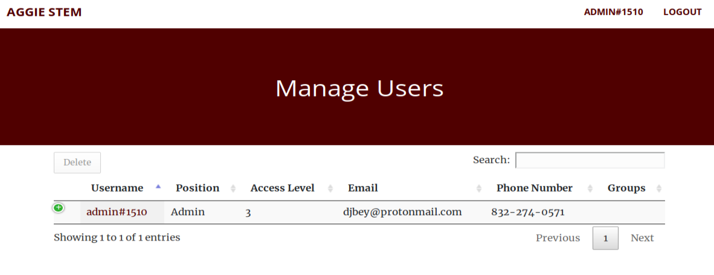
User Management
Usage
Admin tool used to view and manage users
Features
Dynamic table
Responsive interface
Delete users
Edit any property of the user

