Slide 1
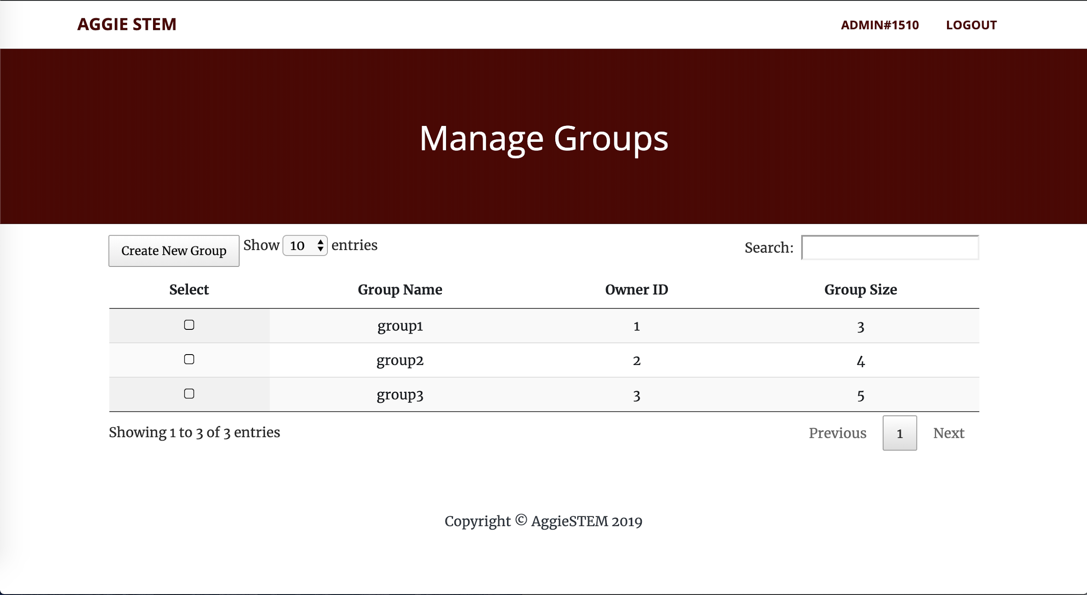
Group Management
Usage
Organize users into groups
Give group members access level permissions
Manage and edit groups
Features
Responsive interface
Create new group
Search group
Group information

