Slide 1
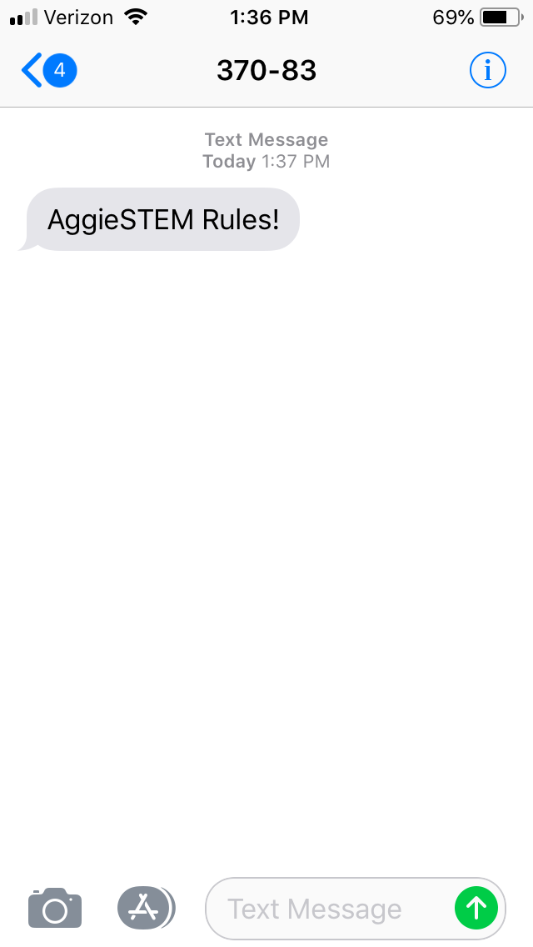
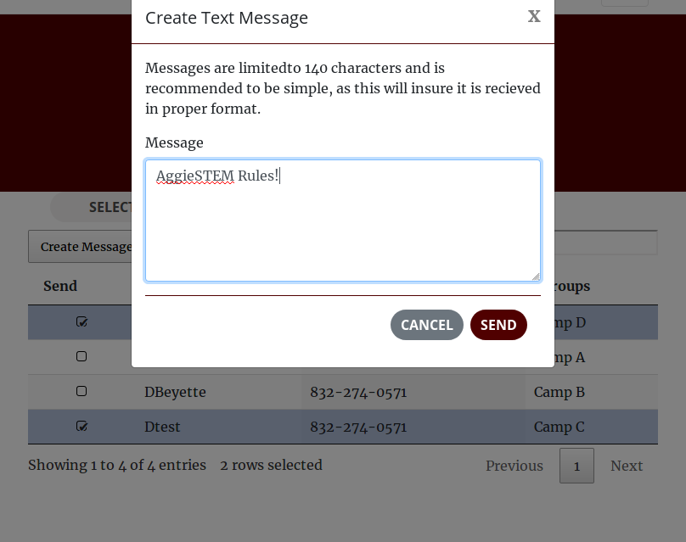
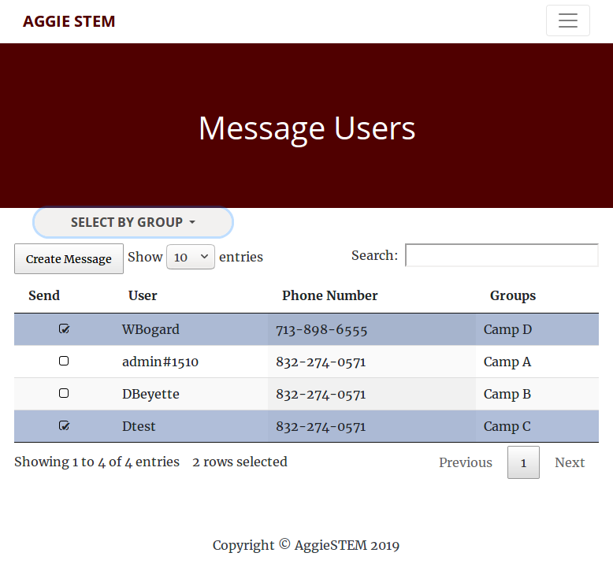
Message Users
Usage
Admin tool used to send SMS messages to users
Features
Responsive interface
Select numbers individually
Select numbers by group
Search by User, Phone Number, or Group
Send SMS messages to 1 or more users

