Slide 1

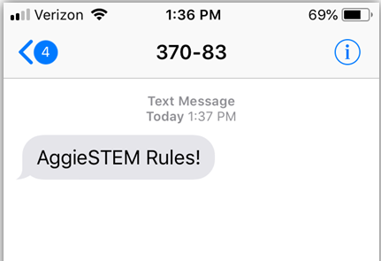
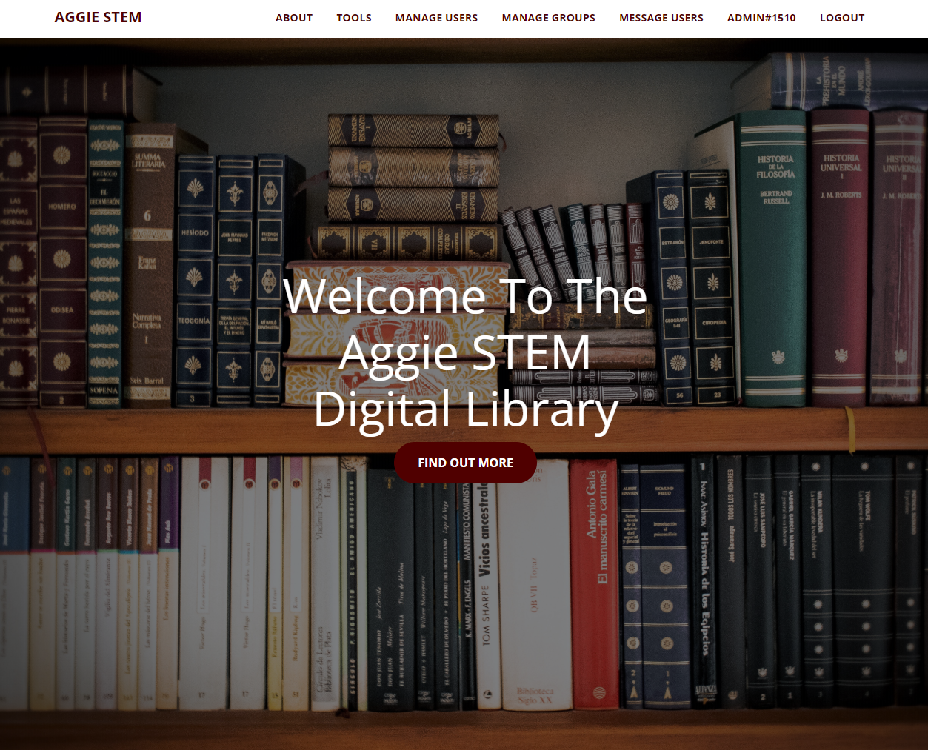
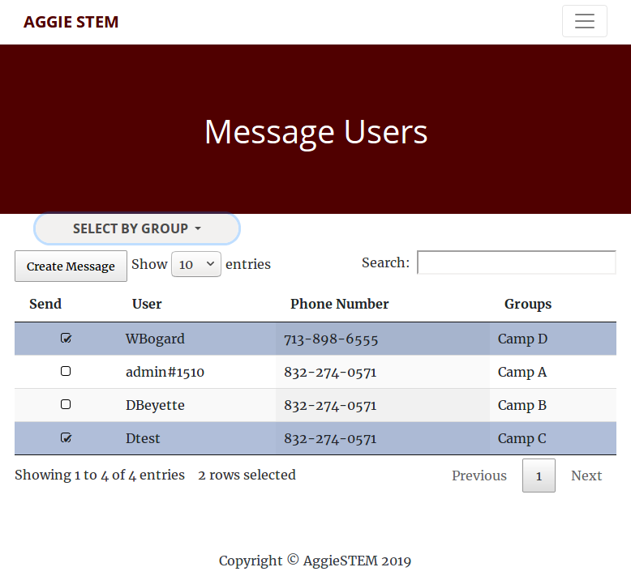
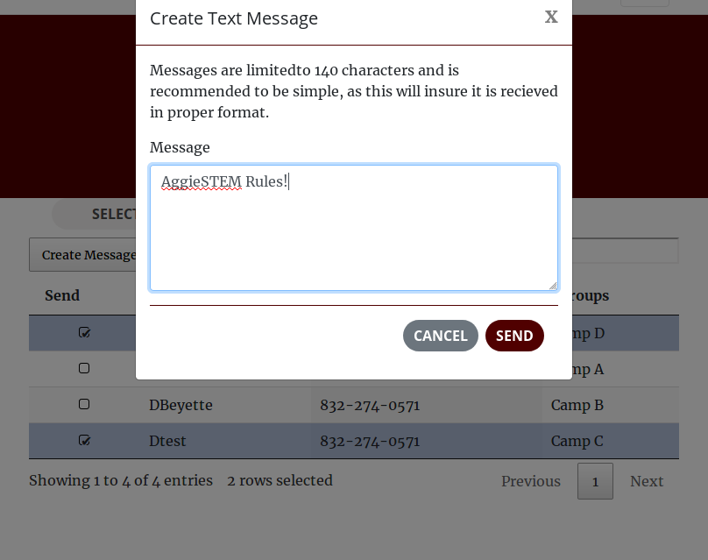
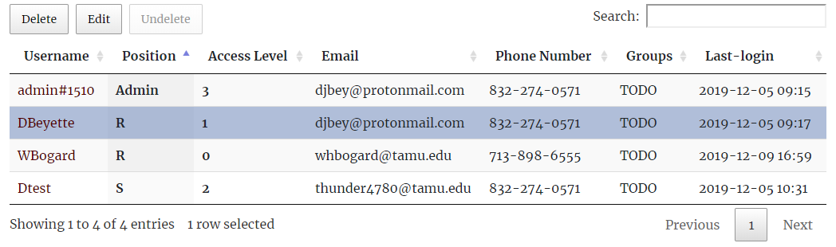
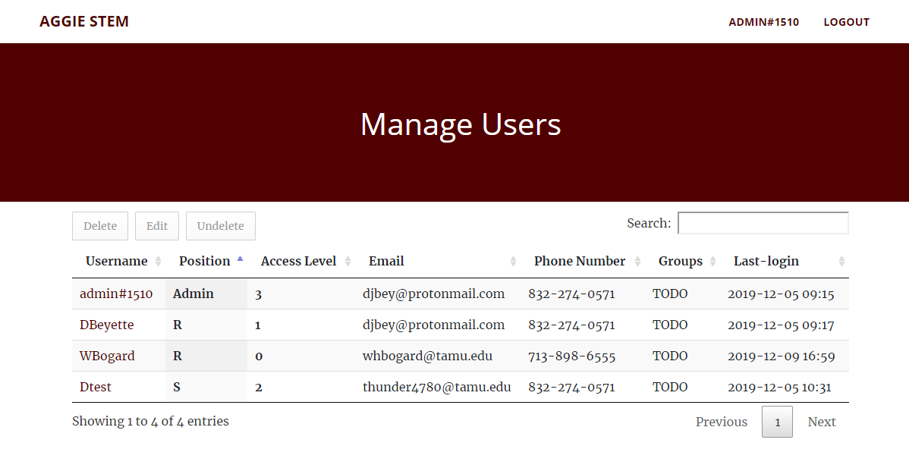
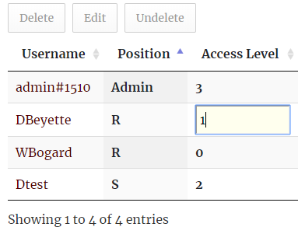
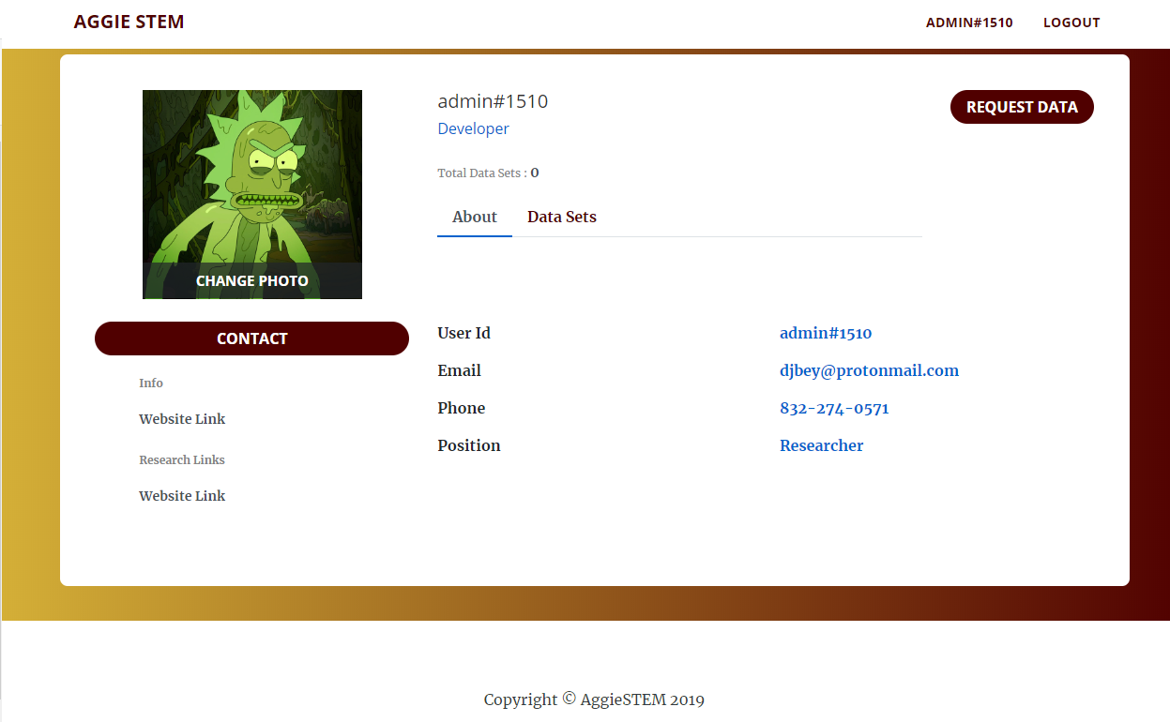
Aggie STEM Digital Library
Team Unknown
Donald (DJ) Beyette, William Bogardus, Garret Persyn, Carson Hanel, Xucheng Guo, Travis Stewart, and Zheng Fang
MOTIVATION
Message Users View
z
Digital libraries are used to provide: efficient and accessible storage and retrieve of information:
Reliable Storage
Easily Accessible Information
Efficient Retrieval of Information
through databases and software as a
service (SaaS)
Usage
Admin tool used to send SMS messages to users
Features
Responsive interface
Select numbers individually
Select numbers by group
Search by User, Phone Number, or Group
Send SMS messages to 1 or more users
As a result, customers and users of digital libraries do not have to worry about maintaining a physical infrastructure or logistics for storing and retrieving media items.
Accessibility:
The modern digital age often requires vast amounts of information that need to be readily made available instantaneously on request.
Why Aggie STEM?
Existing data sets were requested and reviewed manually, no centralized location to see who has access to what data, and a modern system to communicate and organize data for users.
CHALLENGES
Manage Users View
Data sets and user information require FERPA Law and
Encrypt user data and data sets
Send out end-to-end encrypted text messages
Manage access levels and user requested or current data
Efficient loading of content on phones and labtop computers
Reliable database for retrieving stored information
Usage
Admin tool used to view and manage users
Features
Dynamic table
Responsive interface
Delete users
Edit any property of the user
Objectives
Create a login system, user profiles, landing page, and database
Restrict views and data privileges based on user access level
Create a manage users view for directors and senior Docs
Send text messages and emails directly to users
Request data access registration
Allow the director to manage approved data for all users an upload or delete new data sets
Database
Our proposed system utilizes MongoDB scalable connection limit, non-relational schema, ad hoc queries, and high availability and scalability.
User Profile
Tables and Structure
Usage
Manage user information
Request and View Active Data Sets
Features
Upload Profile Image
View Active Data Sets
Request Data Access Form
Contact Users (Director & Senior Doc)
User
ID
Username
Access Level
Email
Phone
Position
Security Question
Login Timestamp
Delete Flag
Group
ID
Name
Owner ID
Access Level
User Ids
Delete Flag
User Library Access
ID
User ID
Library ID
Library Access
Security
User ID
Password
Security Answers
Library
ID
Name
Data
Delete Flag
Content Ids
Content
ID
Name
Data
Deleted
Server Host and Specs
Host
Digital Ocean
Specs
Memory 1GB
1vCPU
1TB Transfer
Amazon SMS Price
$0.000645 per message
First 100 messages free per month
25 GB SSD DISK
$5/month ($0..07/hr)
250 GB storage ($5/month)

