Slide 1
Bridge Collapse Risk in Omaha, Nebraska
Max Buettenback

Slide 2
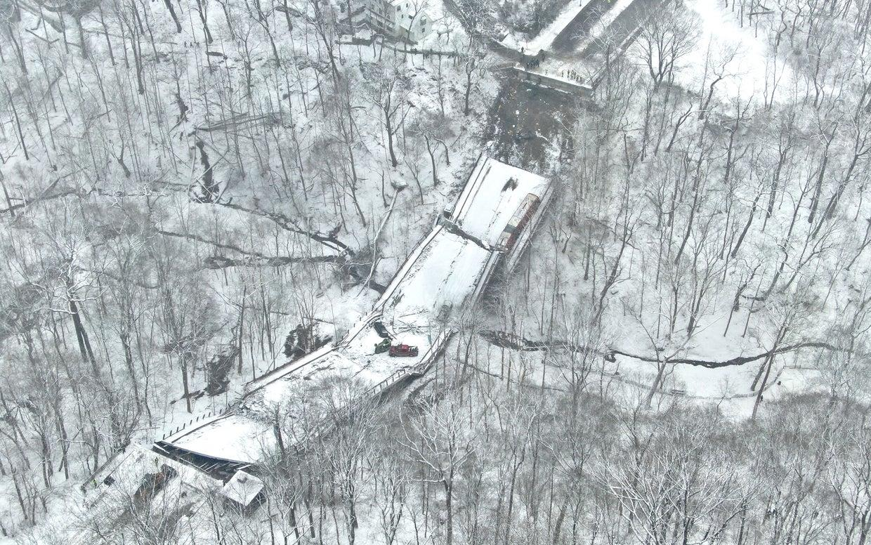
Why This Matters
Bridge failures have happened in the U.S.
Can cause serious safety issues
Can disrupt major traffic routes

Slide 3
What I’ll Cover
Data used
How risk was calculated
Key findings
Recommendations

Slide 4
Data Used
National Bridge Inventory (main data set)
Includes bridge condition and age
Traffic data used to measure impact
Nebraska Department of Transportation(NDOT) was used for additional context
511 bridges analyzed in Omaha

Slide 5
Key Variables
Bridge age (calculated from year built)
Condition ratings (scale from 0–9)
Lowest condition rating used for analysis
Traffic (vehicles per day)
Poor condition defined as rating ≤ 4

Slide 6
Methods
Filtered data to Omaha (Douglas County)
Removed bridges with missing data
Calculated bridge age
Identified bridges in poor condition
Risk = Probability × Consequence
Condition ratings → probability of failure
Traffic → impact if failure occurs

Slide 7
Example of Cleaned Data
structure_number | county | facility_carried | location | year_built | bridge_age | deck_rating | superstructure_rating | substructure_rating | lowest_rating | bridge_condition | daily_traffic | percent_truck_traffic | poor_condition
C002800205P | 55 | ‘COUNTRY ROAD’ | ‘.3M W OF 276TH STREET’ | 1927 | 99 | 5 | 6 | 6 | 5 | F | 81 | 10 | FALSE
C002800403 | 55 | ‘PAWNEE ROAD’ | ‘1S 2.5W N133/WASHGTON CL’ | 1992 | 34 | N | N | N | 5 | F | 116 | 0 | FALSE
C002800405 | 55 | ‘PAWNEE ROAD’ | ‘JCT N36/N133 1N .8E’ | 2010 | 16 | 7 | 8 | 7 | 7 | G | 85 | 0 | FALSE
C002800410 | 55 | ‘PAWNEE ROAD’ | ‘JCT N36/N133 1N 1E’ | 2020 | 6 | 7 | 7 | 8 | 7 | G | 57 | 0 | FALSE
C002800420P | 55 | ‘PONCA RD/COLL 7949’ | ‘42ND & PONCA ROAD’ | 1985 | 41 | 5 | 5 | 7 | 5 | F | 350 | 0 | FALSE

Slide 8
Data Characteristics
511 bridges total
Average age ~45 years
Only 16 bridges in poor condition (~3%)
Most bridges are still in fair to good condition

Slide 9
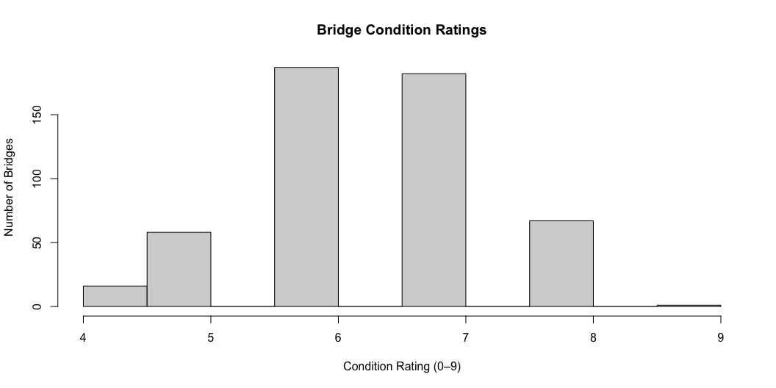
Bridge Condition Distribution
Distribution of bridge condition ratings in Omaha.

Slide 10
Probability of Failure
Lower condition rating = higher risk
Older bridges tend to have lower ratings
Shows deterioration over time
Most bridges are still in acceptable condition

Slide 11
Consequences of Failure
Traffic varies across bridges
Some carry over 100,000 vehicles/day
High traffic = bigger impact

Slide 12
Highest Risk Bridges
Low condition rating (≤ 4)
High traffic volume
→ Typically major routes (I-80, etc.)

Slide 13
Key Findings
Most bridges are in good condition
Only 16 / 511 (~3%) are poor
Older bridges show more wear
High traffic = biggest impact

Slide 14
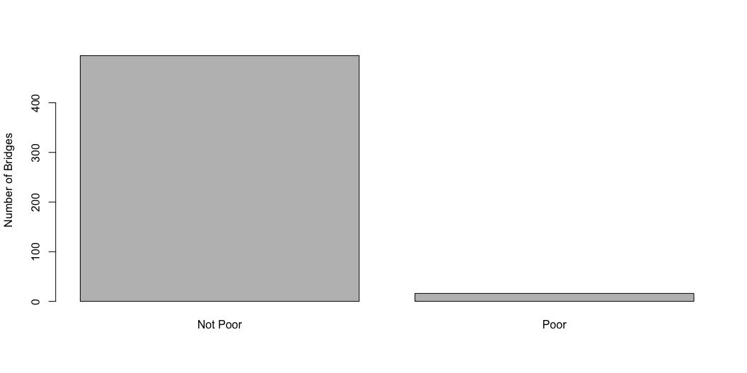
Bridge Condition Summary
Number of bridges in poor vs acceptable condition

Slide 15
Recommendations
Monitor lower rated bridges more closely
Prioritize repairs
Continue inspections
Focus on high traffic bridges

Slide 16
Final Takeaway
Bridge collapse risk is low
BUT
Targeted maintenance is needed

Slide 17
Thank You
Questions?

