Slide 1
Welcome to PSYC 350 Laboratory
Course Welcome
PSYC 350 Laboratory

Slide 2
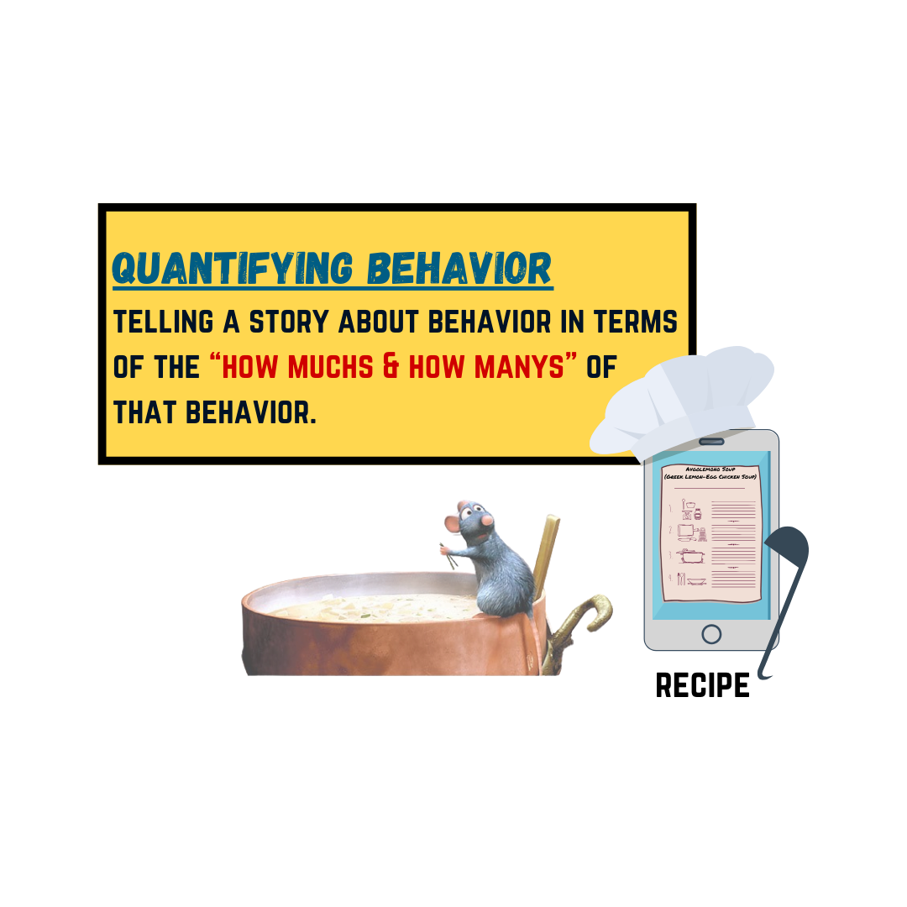
1 Today’s path
Find current course contacts.
Preview what you will learn.
See why research skills matter.
Learn how lab will work.
Notes:
Welcome students and frame this as a short orientation to the people, purpose, and structure of the laboratory. Current section contacts appear on the course homepage and in Canvas.

Slide 3
2 Find current course contacts
Use the current section details
Check the Course Contact tab on the homepage.
Consult Canvas for section-specific announcements.
Use the contact method listed for your current section.
Notes:
Show students where the current section contact details appear on the homepage and in Canvas.

Slide 4
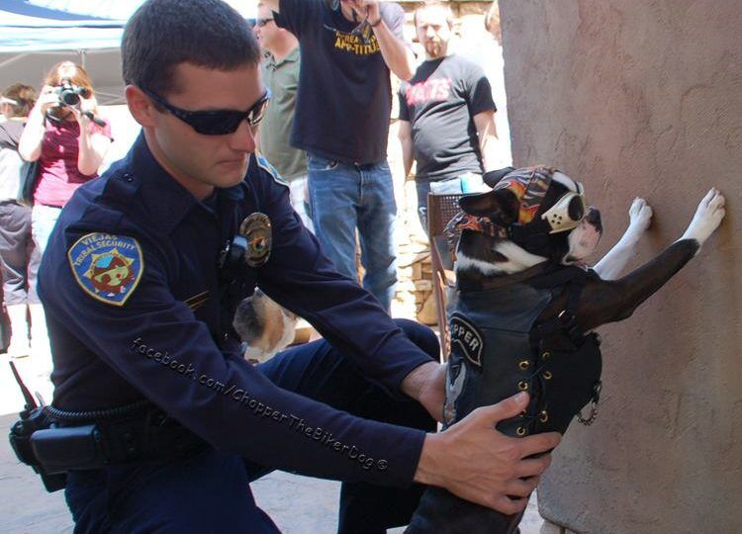
3 Research skills travel across topics
Research methods can answer questions about:
police searches
health and well-being
learning and development
how people understand evidence
Notes:
Use one or two examples to make the research process concrete. The point is that the same core skills apply across research topics.

Slide 5

4 Two truths and a lie
Share three statements about yourself.
Make two true and one false.
Let the group identify the lie.
Also share your name and year in school.
Notes:
Give students time to prepare, then move around the room. The activity should help everyone learn names and begin speaking in a low-stakes setting.

Slide 6
5 What you will learn
Locate and integrate primary research and reviews.
Propose original, evidence-based hypotheses.
Plan data collection and analysis.
Report the work in APA style.
Notes:
Emphasize that each lab activity contributes to one or more of these four course-level objectives.

Slide 7

6 Bring the right tools
Canvas: materials, links, and assignments
Zotero: sources and APA citations
SPSS or Jamovi: data management and analysis
Install software before the lab that uses it.
Notes:
Show students where the installation links live in Canvas. Zotero is used for citations; SPSS or Jamovi is used for data work.

Slide 8

7 SPSS is available in the lab
installed in the lab
institutionally licensed
widely used in psychology
UNL SPSS software access
Notes:
SPSS is the software used in many demonstrations and is installed on laboratory computers. Show students where the UNL download information lives.

Slide 9

8 Jamovi is a free alternative
free on personal devices
built on R
approachable interface
jamovi.org
Notes:
Students may use either program unless a particular assignment says otherwise. The analysis concepts transfer even when the interfaces differ.

Slide 10
9 Lab is 40% of the course grade
Lab assignments · 20%
• in-class practice
• take-home work
Research project · 20%
• literature review
• APA-style report
Notes:
Connect these categories to the syllabus and Canvas gradebook. Clarify due-date or late-work policies using the current syllabus.

Slide 11
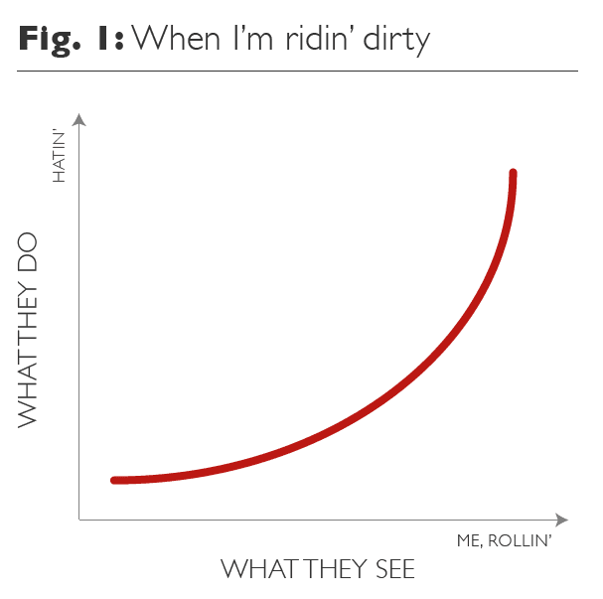
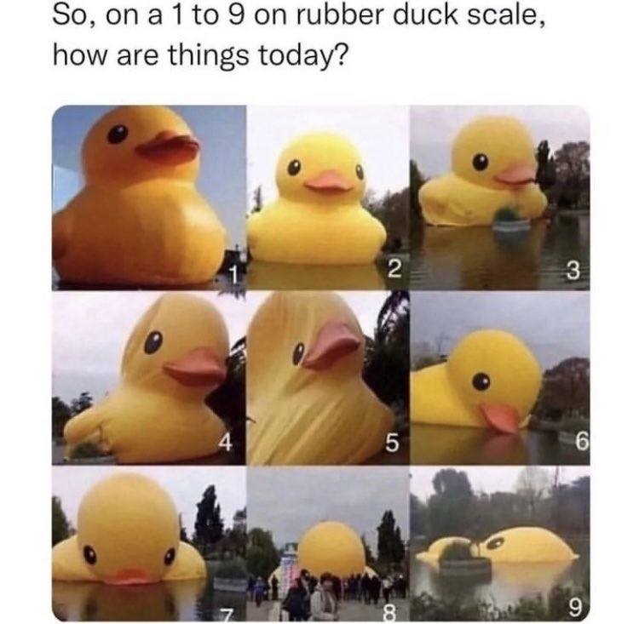
10 Why is lab required?
Evaluate knowledge
Create knowledge
Notes:
Professional research literacy means being able to evaluate evidence and, when needed, create it.

Slide 12
11 Empirical research guides decisions
Empirical research helps professionals decide:
who does what
what is already known
which action evidence supports
Peer review and replication add credibility; research is not limited to academic psychology.
Notes:
Give examples from clinical practice, education, human resources, criminal justice, or business. Each field relies on defensible evidence.

Slide 13
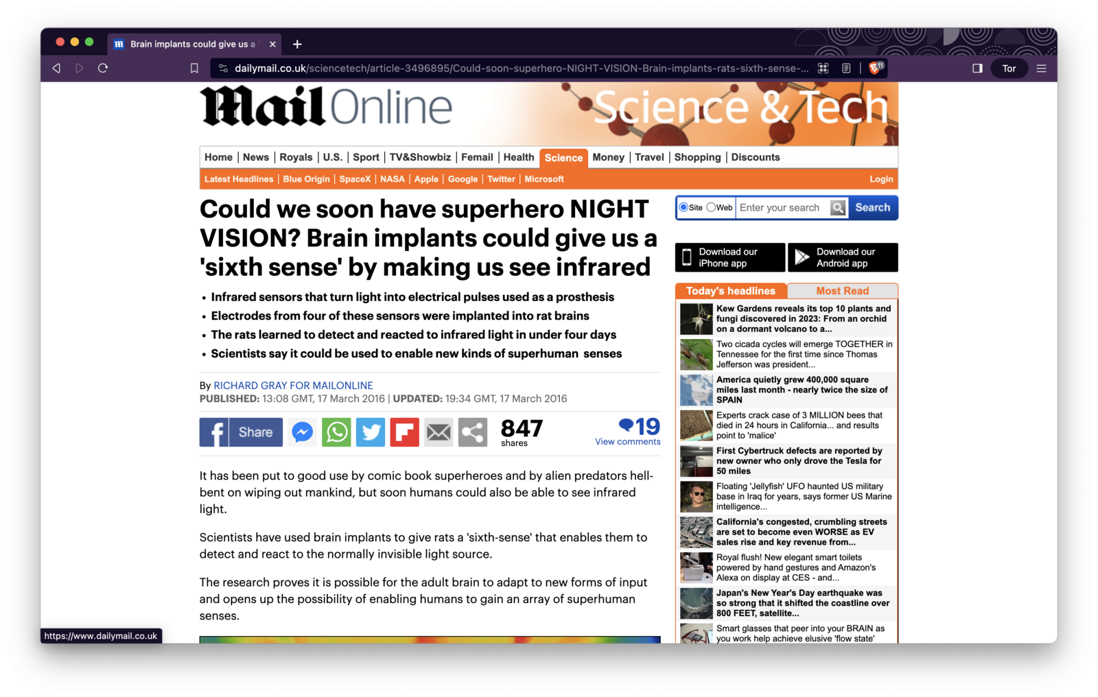
12 Become a competent consumer
A competent consumer can:
find relevant research
evaluate its theory, methods, and statistics
integrate trustworthy findings
apply them within appropriate limits
Notes:
Ask what information is missing from the headline and what pandemic-related confounds might matter. Distinguish a headline from the underlying study.

Slide 14
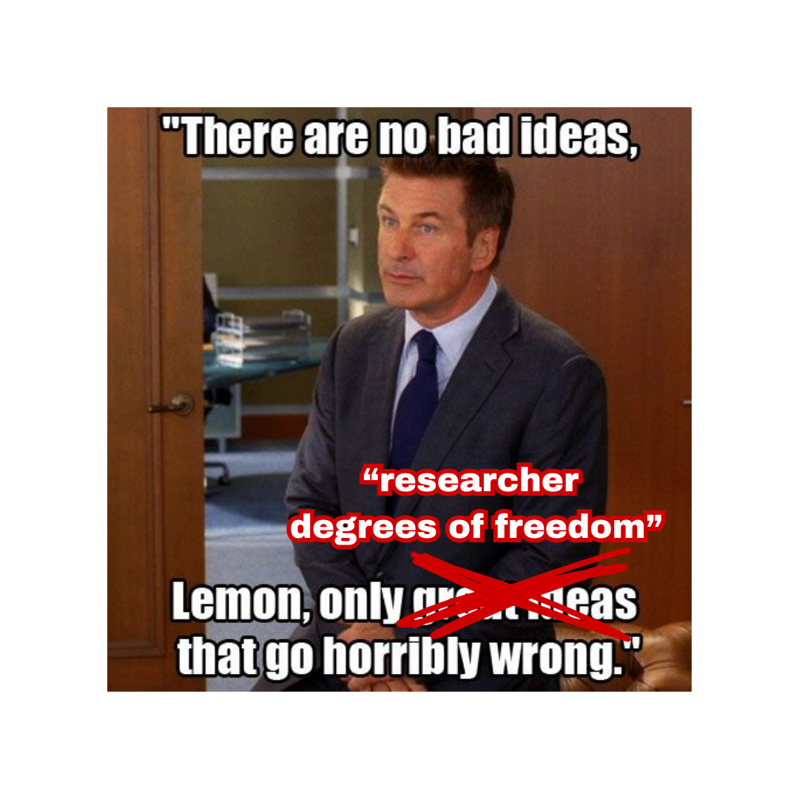
13 Many jobs require research skills
Employers, clients, and funders look for:
evidence that a program works
attention to time and cost
comparison with credible alternatives
decisions that can be defended
Notes:
Research production is not confined to university faculty. Many professionals collect, analyze, and explain data from their own organizations or clients.

Slide 15
14 Research literacy expands your options
People who can evaluate, integrate, and apply evidence gain:
better job prospects
stronger job performance
more flexibility across industries
better preparation for graduate study
Notes:
Invite students to connect one skill on this slide with a job or graduate program they may want later.

Slide 16
15 Lecture explains; lab practices
Lecture
explains vocabulary and concepts
shows why methods work
Lab
applies those concepts
rehearses research workflows
builds skill through repeated practice
Notes:
Lecture and lab are complementary. The lab gives students guided repetitions with the processes introduced in lecture.

Slide 17
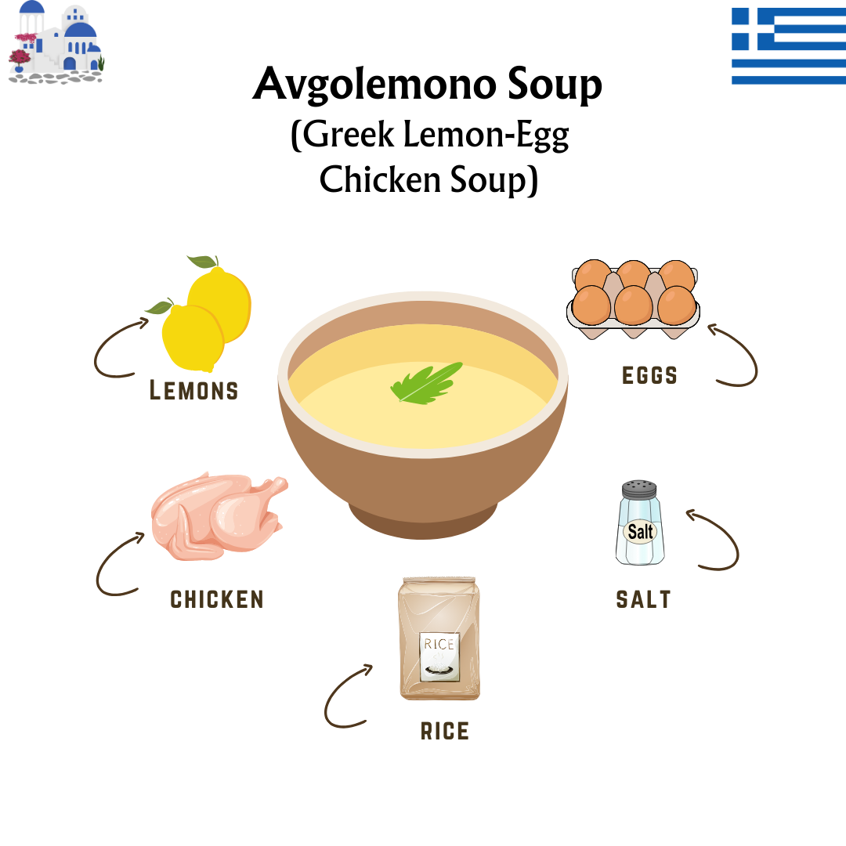
16 Research is like learning a recipe
Start with ingredients
a focused question
defined variables
a usable sample
relevant evidence
Then follow the process deliberately.
Notes:
Use the cooking metaphor to explain that knowing terms is different from executing a process. Research requires both a recipe and practice following it.

Slide 18
17 The process is iterative
Define the idea.
Measure behavior.
Analyze and inspect.
Revise when needed.
Report a result others can evaluate.
Notes:
The process loops. Unexpected output may require checking definitions, coding, assumptions, or the original question before reporting a result.

Slide 19
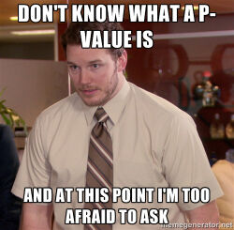
18 Build a foundation that works for you
Build the skills in sequence.
Develop a workflow you can repeat.
Ask questions when a step is unclear.
Take time to understand both the recipe and the result.
Notes:
Normalize early uncertainty without suggesting the course can be completed by memorizing isolated rules. Encourage deliberate practice and questions.

Slide 20
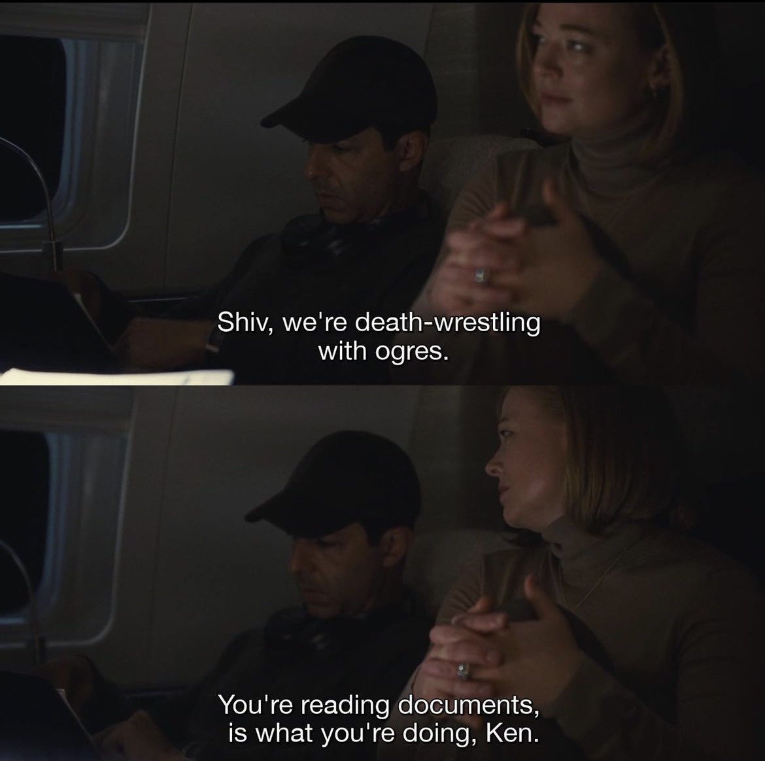
19 The short version
Take this course seriously if you want to:
earn a strong grade
prepare for graduate school
work in any evidence-driven industry
understand the claims you encounter every day
Notes:
Summarize the value proposition: the course supports immediate academic goals and broader evidence literacy.

Slide 21
20 Requirements to keep in mind
Earn at least a C, not a C−, for the course to count toward the psychology major.
Complete all required exams.
Complete all take-home laboratory assignments.
Attend laboratory sessions as required by the syllabus.
Notes:
Read these requirements exactly as they appear in the current syllabus. If policy language differs, update the slide before presenting.

Slide 22
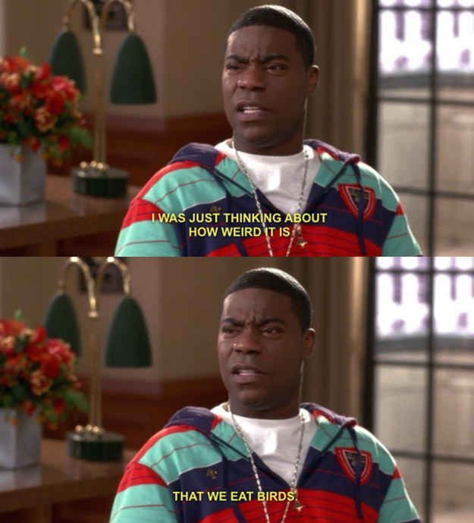
21 How to succeed
Do the work before the deadline.
Come to lab ready to practice.
Be professional with peers and instructors.
Embrace revision as part of the process.
Ask for help early.
Notes:
Translate each point into one observable behavior. Emphasize that asking questions early is a professional research skill.

Slide 23
22 Do not freak out
You are not expected to know everything now.
You are expected to:
practice
ask questions
revise your work
keep moving one step at a time
Notes:
Pause here and reassure students that the course is designed to teach the process. Mastery develops across the semester.

Slide 24
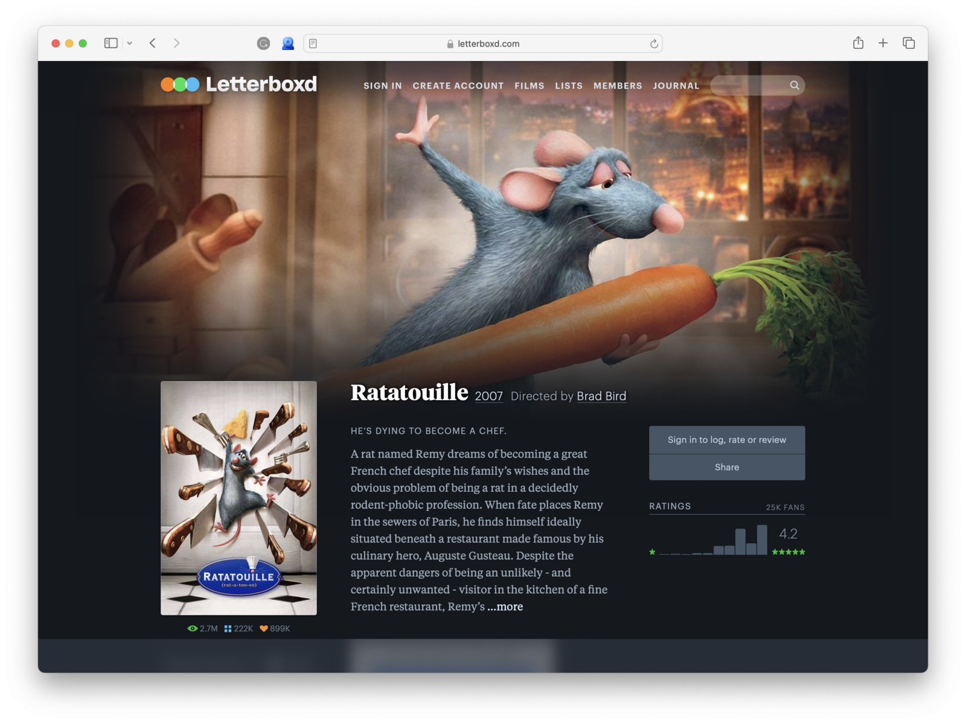

23 Anyone can learn the process
Notes:
Use the cooking analogy one final time: research is a craft, not an innate talent. Students improve through repeated, supported practice.

Slide 25
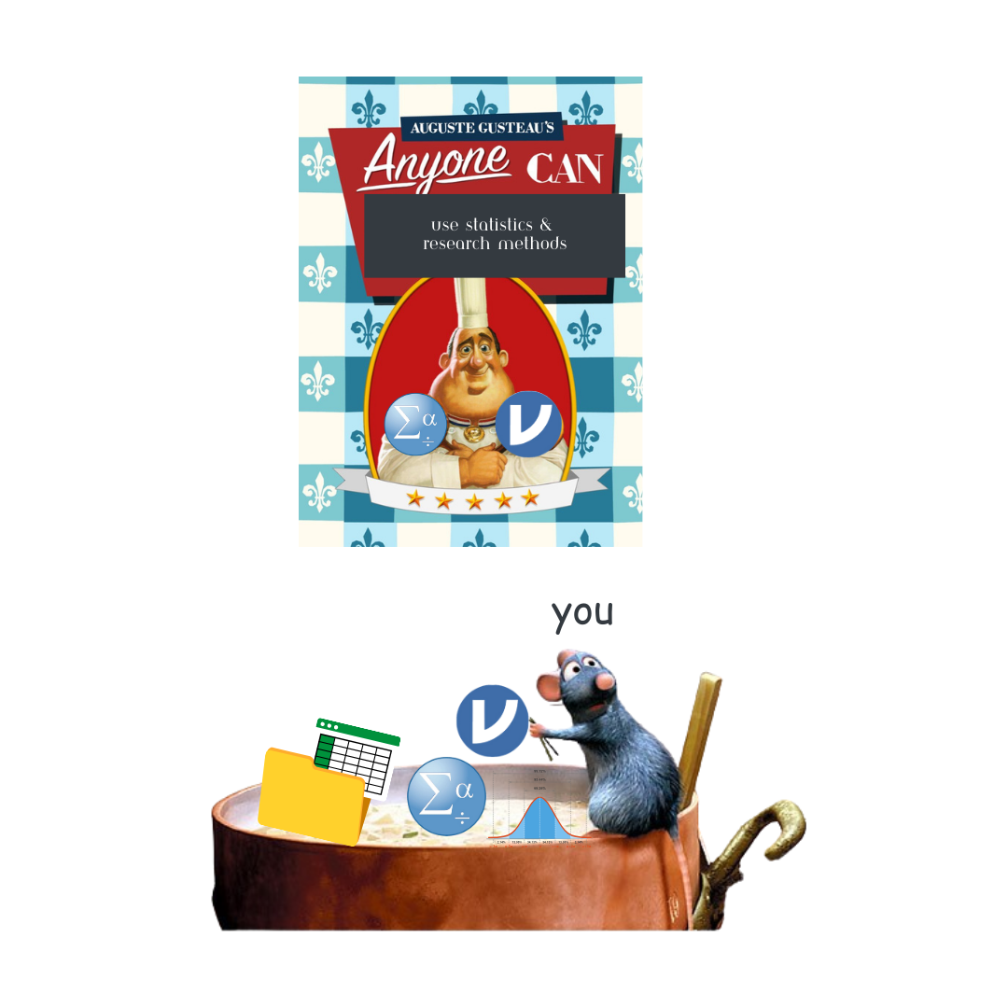
24 You will have support
Notes:
Point students to the current Course Contact tab, Canvas, and the listed method for asking questions between laboratory meetings.

Slide 26
25 Questions?
What would help you feel ready for the first lab?
software or materials
assignments and grading
research project
course expectations
Notes:
Invite questions and note anything that needs a follow-up in Canvas. End by previewing the next concrete task students should complete.

