Slide 1
Between-Groups and Within-Groups ANOVA
Lab 08 · Choosing the Design That Matches the Cases
PSYC 350 Laboratory

Slide 2
1 Download the Lab 8 files
Worksheet
Download worksheet
Datasets
Superman SMEs
Hot Ones
Between-groups guides
ANOVA
Bar graph
Within-groups guides
ANOVA
Bar graph
Paired test
Notes:
The two walkthroughs use the Superman SMEs file. RH3 through RH6 use the Hot Ones file.

Slide 3
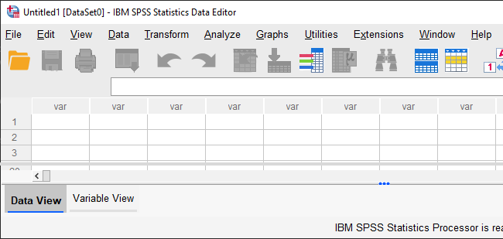
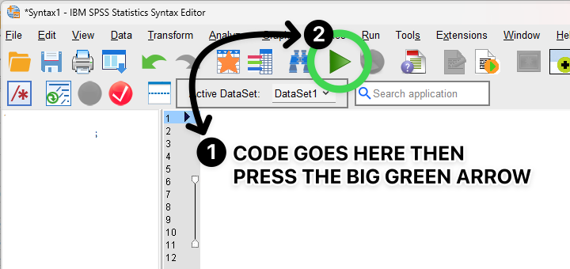
2 Keep Data and Syntax Editors open
Data Editor
Syntax Editor
Inspect groups and outcomes
Save and rerun commands
Notes:
Keep the dataset and saved syntax open together. Inspect variables and cases in the Data Editor; reproduce every command in the Syntax Editor.

Slide 4
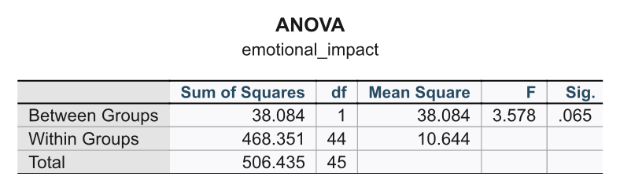
3 Read results in Output Viewer
Notes:
The Output Viewer accumulates tables, charts, warnings, and processing notes. Keep it open beside the data and syntax windows, and export only the results needed for the worksheet or report.

Slide 5
4 Choose between or within
Design question | Analysis
Different cases in each condition? | Between-groups ANOVA
Same cases in every condition? | Within-groups ANOVA
Notes:
Identify the unit of observation rather than deciding from how the columns happen to appear in SPSS.

Slide 6
5 Read means before the F test
State the predicted ordering of means.
Compare the observed means.
Read F, both df, p, and MSe.
Add effect size and decide.
Notes:
With two levels, the omnibus test answers the only mean comparison. With three or more levels, a significant omnibus test can justify follow-up comparisons.

Slide 7
6 Prepare the RH1 groups
RECODE height_gap
(1, 2 = 1) (3 = 2)
INTO height_gap_2cat.
VARIABLE LABELS height_gap_2cat
'Height gap: small versus big'.
VALUE LABELS height_gap_2cat
1 'Minimal or average' 2 'Big'.
EXECUTE.
Notes:
RH1 combines minimal and average height gaps into one category and compares them with big gaps. Verify the recode with frequencies before running the ANOVA.

Slide 8
7 Run the RH1 ANOVA
ONEWAY emotional_impact
BY height_gap_2cat
/STATISTICS DESCRIPTIVES
/MISSING LISTWISE.
Notes:
Compare the two descriptive means before interpreting F. Record MSe and effect size for the write-up, even when the result is not significant.

Slide 9
8 Read F, both df, MSe, and p
Notes:
The result is not statistically significant at the .05 level. Students should still report the descriptive pattern and effect size accurately.

Slide 10
9 Run the RH2 repeated test
GLM emotional_impact aesthetic_appeal
/WSFACTOR=RatingType 2
/PRINT=DESCRIPTIVE ETASQ
/EMMEANS=TABLES(RatingType) COMPARE.
RH2: Compare emotional impact with aesthetic appeal for the same films.
Notes:
No transformation or selection is required. With two repeated levels, sphericity is automatic. Define the repeated factor and assign the two outcomes in worksheet order.

Slide 11
10 Repeat the steps for Hot Ones
Identify between- or within-groups.
Run the worksheet transformation.
Apply the required selection.
Compare means, then interpret F.
Reset the filter before the next RH.
Notes:
RH3 through RH6 deliberately mix the two designs. Students should use the workflow, not copy variable names from a walkthrough.

Slide 12
11 Complete RH3 through RH6
RH3: first versus tenth sauce heat
RH4: actor status predicting views
RH5: comments versus likes
RH6: age group predicting likes
Save the transformation, filter, and analysis syntax for each.
Notes:
The worksheet supplies the exact transformed variables and the completed-challenge filter where required. Check that every analysis uses the intended active cases.

Slide 13
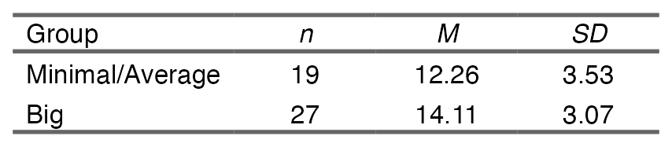
12 Make the APA descriptives table
Notes:
This output is generated with create_apa_anova_descriptives_table(), matching the reporting workflow in the SPSS handouts. A graph with labeled means and uncertainty is also acceptable when the worksheet requests a figure.

Slide 14
13 Write the ANOVA result
Describe the group or condition means.
Report F(df1, df2), MSe, and p.
Report effect size.
State whether the RH is supported.
Refer to the table or figure and add checker proof.
Notes:
The final reporting sequence works for both between- and within-groups analyses. The statistical sentence and the substantive interpretation must agree.

