Slide 1
Build the Preproposal
Lab 09 · Variables, Hypotheses, and Sources
PSYC 350 Laboratory

Slide 2

1 Prepare the project materials
Worksheet: Lab 09 Project RH Proposal
Project data: selected course dataset
Sources: three or more empirical articles
Earlier work: search collection and variable notes
Today’s path: select → prepare → predict → justify → document
Notes:
This lab turns earlier search and data work into a coherent project plan. Ask students to keep the worksheet, codebook, dataset, and Zotero collection open.

Slide 3
2 The preproposal is a blueprint
Name the core construct.
Define each measure.
State four predictions.
Connect the evidence.
Notes:
The worksheet is not a list of interesting variables. The variables, hypotheses, and references should form one connected argument.

Slide 4
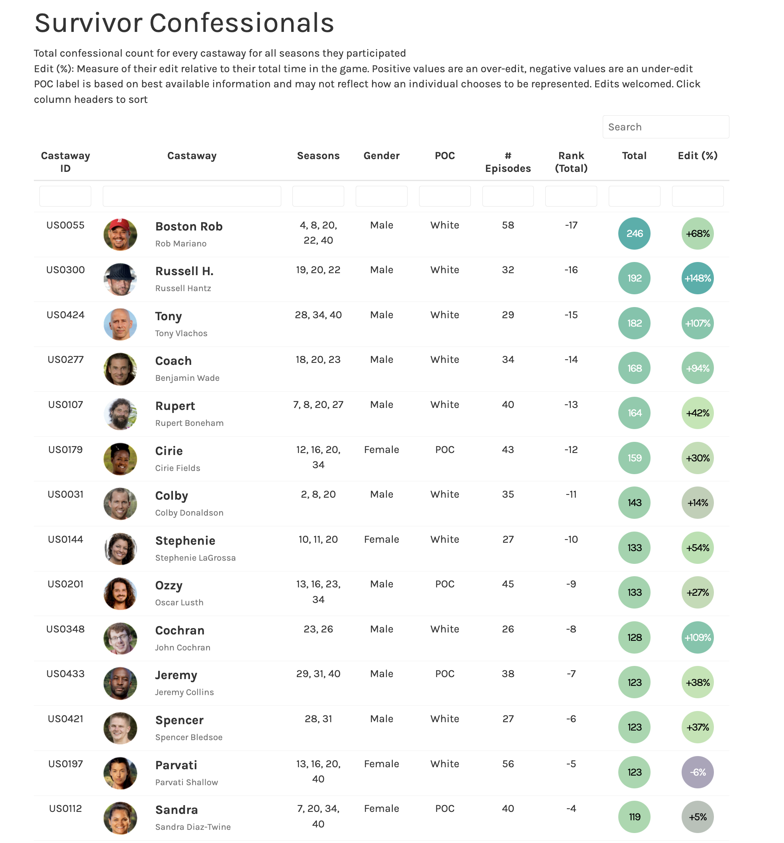
3 Anchor the project in one variable
Choose one core variable.
Name the psychological construct.
Explain how the dataset measures it.
Keep the construct distinct from its scale name.
Construct ≠ column name
Notes:
The image is an example of moving from a recognizable behavior or context to a measurable construct. Students’ own projects may use a different dataset.

Slide 5
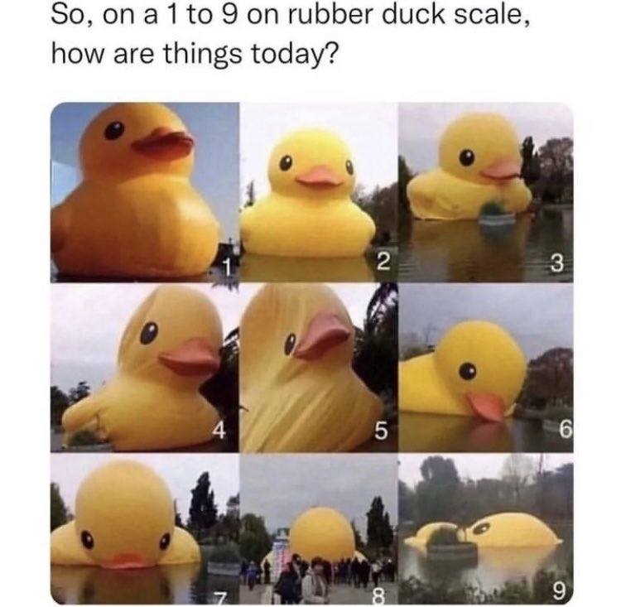
4 Audit every selected variable
For the core variable and every partner variable, verify:
readable label
correct type
category value labels
declared missing values
interpretable range
Notes:
Do this before recoding or writing hypotheses. A project built on mislabeled categories or undeclared missing codes will produce misleading results later.

Slide 6
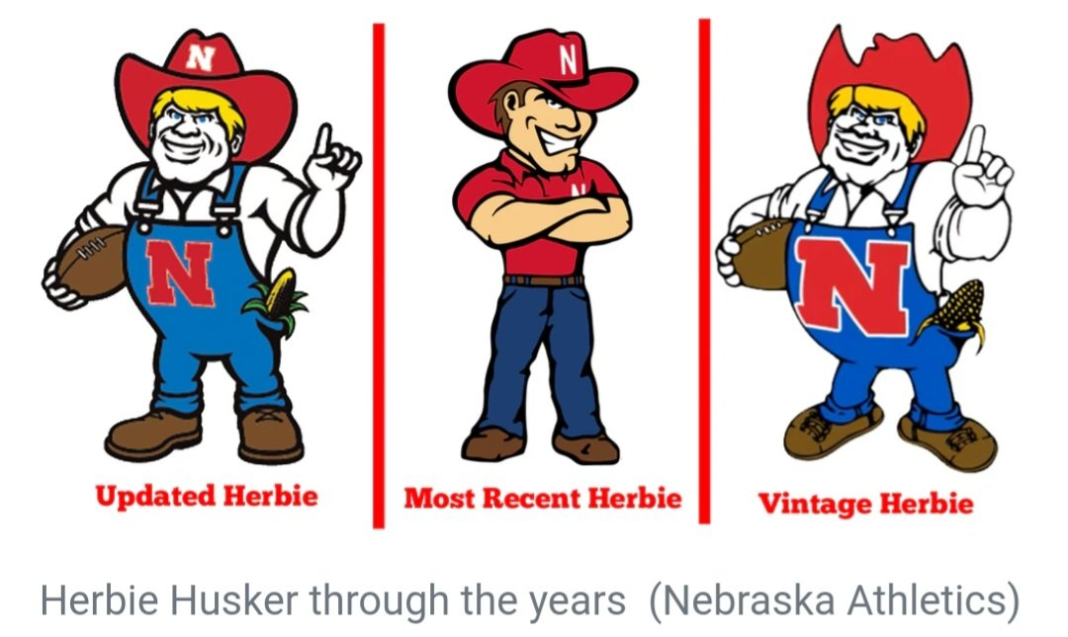
5 Transform only with a reason
Define what the new variable represents.
Compute or recode into a new variable.
Add labels.
Run frequencies.
Confirm the result.
Notes:
Students should preserve the source variable and save syntax. Each transformation must serve a stated project decision, not merely simplify the output.

Slide 7
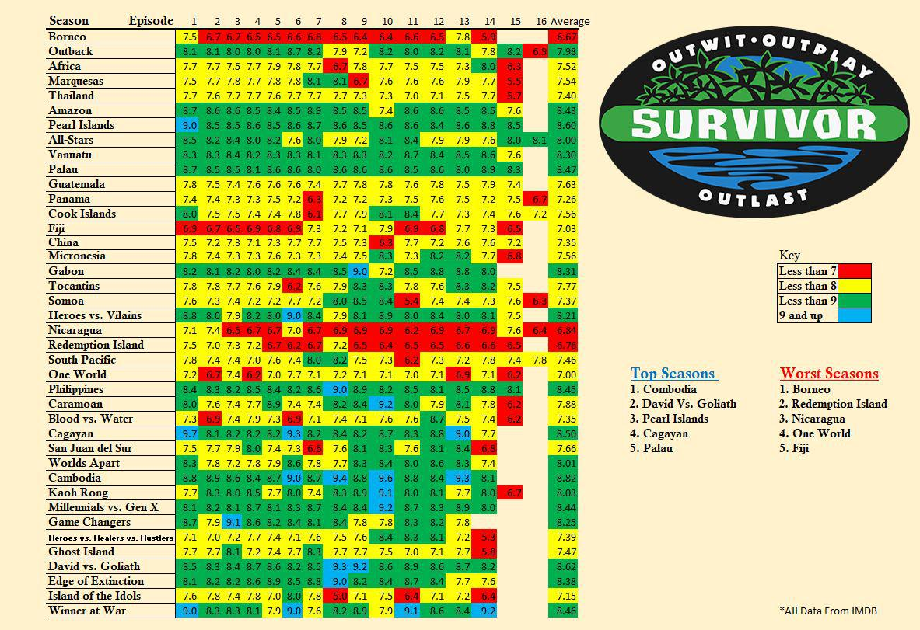
6 Write four testable hypotheses
Each hypothesis needs:
the core variable
one comparison or predictor
an expected direction
relevant population or context
One variable. Four relationships.
Notes:
The worksheet requires four core-variable relationships, with optional bonus hypotheses. Avoid vague wording such as “will be related.”

Slide 8
7 Match language to variables
Variable pattern | Say what should happen
Two quantitative | Higher values relate to higher or lower values.
Quantitative + binary | One group has a higher or lower mean.
Two categorical | One category is more or less likely.
Qualitative variable with 3+ groups | Select or recode it into two defensible groups before writing the RH.
Notes:
The wording should reveal the planned analysis. Students should be able to infer variable types from the hypothesis sentence. Any qualitative variable with three or more groups must be selected or recoded into two groups.

Slide 9

8 Predict before checking the data
The RH should come from:
theory
prior research
a defensible conceptual rationale
Write the prediction before looking for a favorable p value.
Notes:
Students may inspect distributions to verify data quality, but the substantive direction should be justified independently of the observed inferential result.

Slide 10
9 Link each RH to evidence
For every hypothesis, ask:
Which article supports the direction?
Does it study the same construct?
What differs in sample, setting, or measure?
What inference can it actually support?
Evidence chain
Article finding ↓ Conceptual rationale ↓ Directional RH
Notes:
One source may support more than one hypothesis, but each citation must have a clear role. Encourage precise claims rather than broad “research shows” statements.

Slide 11
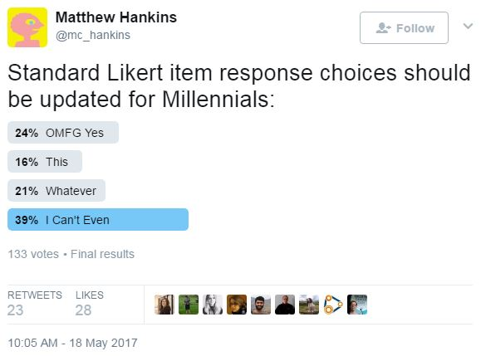
10 Use three empirical sources well
For each reference, record:
full APA citation
research question or hypothesis
sample and design
key finding
connection to the project
Notes:
The worksheet’s source sections are meant to support the rationale, not merely prove that three PDFs were located.

Slide 12
11 Keep claims within the design
Cause requires adequate assignment and control.
Association matches observational evidence.
Generalization must match the sample and setting.
Notes:
Carry forward the validity distinctions from Labs 3 and 4. Students should not turn an association in a cited article into a causal project prediction.

Slide 13
12 Check the four-RH set
Together, the hypotheses should be:
distinct, not repetitive
feasible with available variables
interpretable with the planned coding
supported by the selected literature
Notes:
If several hypotheses are minor variations of the same analysis, revise the set. The project should test a coherent but informative set of relationships.

Slide 14
13 Make the worksheet self-contained
Use exact variable names where requested, but explain them in ordinary language.
Dataset field: var_name Meaning: What does one value represent?
Notes:
The TA should not need to open the codebook to understand a hypothesis. At the same time, exact field names prevent ambiguity when the analysis begins.

Slide 15
14 Check before submitting
Name the dataset and core variable.
Confirm each qualitative variable has exactly two groups.
Verify every transformation in saved syntax.
Complete four directional RHs and support their rationales with three sources.
Notes:
Use the worksheet point values as the final checklist. Ask whether another researcher could understand the plan without opening the dataset. This completed preproposal becomes the plan for later analysis and writing labs.

