Slide 1
Compare Multiple Groups
Lab 11 · k-Group ANOVA and Chi-Square
PSYC 350 Laboratory

Slide 2
1 Download the Lab 11 data
Worksheet
Download worksheet
Walkthrough data
Download jury data
ANOVA practice
Download football data
Chi-square practice
Download tips data
Notes:
The jury file supports both walkthroughs. Football and tips are used in the independent sections.

Slide 3
2 Open the Lab 11 guides
Analysis guides
k-group ANOVA
k-group chi-square
Post-hoc calculator
Download Computator
APA table help
Open templates
Notes:
The computator supports the worksheet’s LSD minimum-mean-difference steps. The APA template is used in the reporting section.

Slide 4
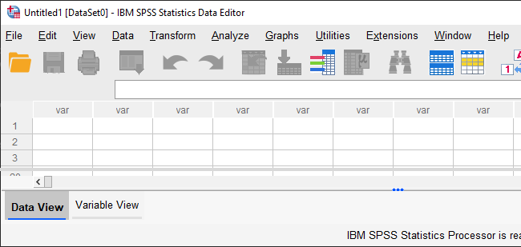
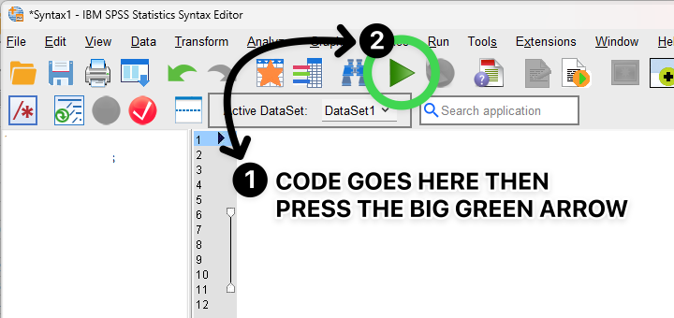
3 Keep Data and Syntax Editors open
Data Editor
Syntax Editor
Inspect groups and outcomes
Save and rerun commands
Notes:
Keep the dataset and saved syntax open together. Inspect variables and cases in the Data Editor; reproduce every command in the Syntax Editor.

Slide 5
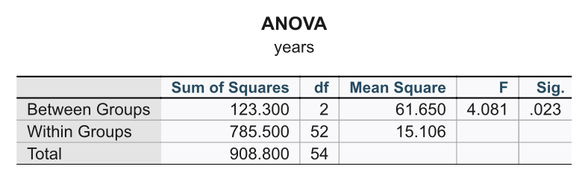
4 Read results in Output Viewer
Notes:
The Output Viewer accumulates tables, charts, warnings, and processing notes. Keep it open beside the data and syntax windows, and export only the results needed for the worksheet or report.

Slide 6
5 Omnibus comes before pairwise
Omnibus: Is there any group difference or association?
Pairwise: Which planned pairs differ?
Follow up only when the omnibus result justifies it.
Notes:
This is the central concept in both halves of the lab. Starting with multiple pairwise tests inflates the Type I error rate.

Slide 7
6 Match variables to the test
Predictor and outcome | Use
3+ groups and a quantitative outcome | k-group ANOVA
Two categorical variables, one with 3+ levels | k-group chi-square
Notes:
The same omnibus-then-follow-up logic applies to both test families, but the evidence is means for ANOVA and cell counts or percentages for chi-square.

Slide 8
7 Select the jury walkthrough
USE ALL.
COMPUTE filter_$ = (crime = 2).
FILTER BY filter_$.
EXECUTE.
FREQUENCIES VARIABLES=attr years.
Notes:
The walkthrough output uses the specified crime subset. Verify the active cases and the attractiveness value labels before running either analysis.

Slide 9
8 Run the jury ANOVA
UNIANOVA years BY attr
/METHOD=SSTYPE(3)
/POSTHOC=attr(LSD)
/PRINT=DESCRIPTIVE ETASQ
/CRITERIA=ALPHA(.05).
Notes:
Record group means, F, both degrees of freedom, MSe, p, and effect size before interpreting any pairwise row.

Slide 10
9 Let the omnibus result determine follow-up
Notes:
Read the model row first. The significant omnibus result justifies moving to the worksheet’s planned comparisons.

Slide 11
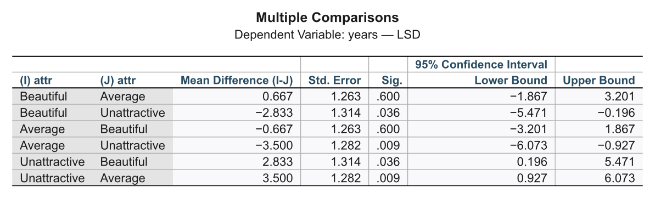
10 Read one direction for each planned pair
Notes:
SPSS prints each pair twice. Connect each planned pair to RH1, RH2, or RH3 and keep the stated direction visible.

Slide 12
11 Recode seriousness before the crosstab
* 1–4 = Serious Crime; 6–10 = Not Serious Crime; 5 = missing.
RECODE serious
(1 THRU 4 = 1)
(5 = SYSMIS)
(6 THRU 10 = 2)
INTO serious_cat.
EXECUTE.
Notes:
The worksheet requires this recode before the crosstab. Create a new variable rather than changing serious, then confirm its values before continuing.

Slide 13
12 Run the jury chi-square
CROSSTABS
/TABLES=attr BY serious_cat
/STATISTICS=CHISQ PHI
/CELLS=COUNT EXPECTED ROW COLUMN.
Read the full table and omnibus χ² before filtering to any 2 × 2 pair.
Notes:
Use the same jury subset. Describe row or column percentages before statistical significance, then follow up with the worksheet’s corrected threshold only when justified.

Slide 14
13 Follow up with 2-by-2 tables
Restore the full selected jury sample.
Keep only one planned pair of attractiveness levels.
Rerun the same crosstab syntax.
Compare the result with the corrected criterion.
Restore cases before the next pair.
Notes:
Save every filter in syntax. A leftover pairwise filter will silently invalidate the next comparison.

Slide 15
14 Repeat with new datasets
Football: k-group ANOVA on hippocampal volume
Tips: k-group chi-square on card condition and tipping
For each: prepare → omnibus → pairwise → effect size → RH decision.
Notes:
The independent analyses use different variables, but their order should match the walkthrough exactly.

Slide 16
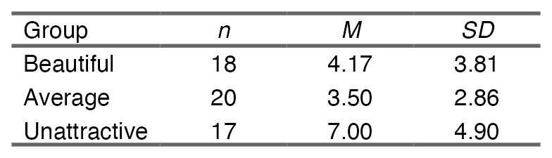
15 Make the APA descriptives table
Notes:
This output is generated with create_apa_anova_descriptives_table(), consistent with the course reporting functions and APA table template.

Slide 17
16 Write the full result package
Refer to the descriptive table or figure.
Report the omnibus test and effect size.
Name the follow-up method and corrected criterion.
Describe each planned pair and RH decision.
Add the all-green checker screenshot.
Notes:
For chi-square, replace means with the contingency-table pattern and report χ², df, p, sample size, and effect size before the pairwise results.

