Slide 1
References & APA style
Lab 1

Slide 2
Today’s Tasks
Lab 1:Overview of APA formatIntro to Zotero

Slide 3
What You Need Today
Everything for this week is linked on the next slides – and always on the lab page under Handouts & References.
Open these before we start so you can follow along.

Slide 4
Introduction to Psyc350 & why we do it this way!!
[arrow icon]
Introduction to Psyc 350 Lab
[Web page]

Slide 5
Bibliographic Research & Zotero (1/2)
[arrow icon]
Library Resources Link (start here)
[External link]
[book icon]
Powerpoint to guide you through library resources
[arrow icon]
Boolean Searching (link to how-to guide online)
[External link]
[book icon]
APA Format and Style + Using Zotero
[note icon]
Using Zotero
[PDF]
[note icon]
Journal Reference Checklist
[PDF]

Slide 6
Bibliographic Research & Zotero (2/2)
[note icon]
Student Paper Format
[PDF]
[note icon]
Research Report Format
[PDF]
[note icon]
Other Sources Reference Format

Slide 7
Weekly Lab Assignment
[book icon]
Lab 01: APA References Zotero Worksheet
[Word document]
[arrow icon]
Click for Zotero & APA Workbook
[Web page]

Slide 8
APA References

Slide 9
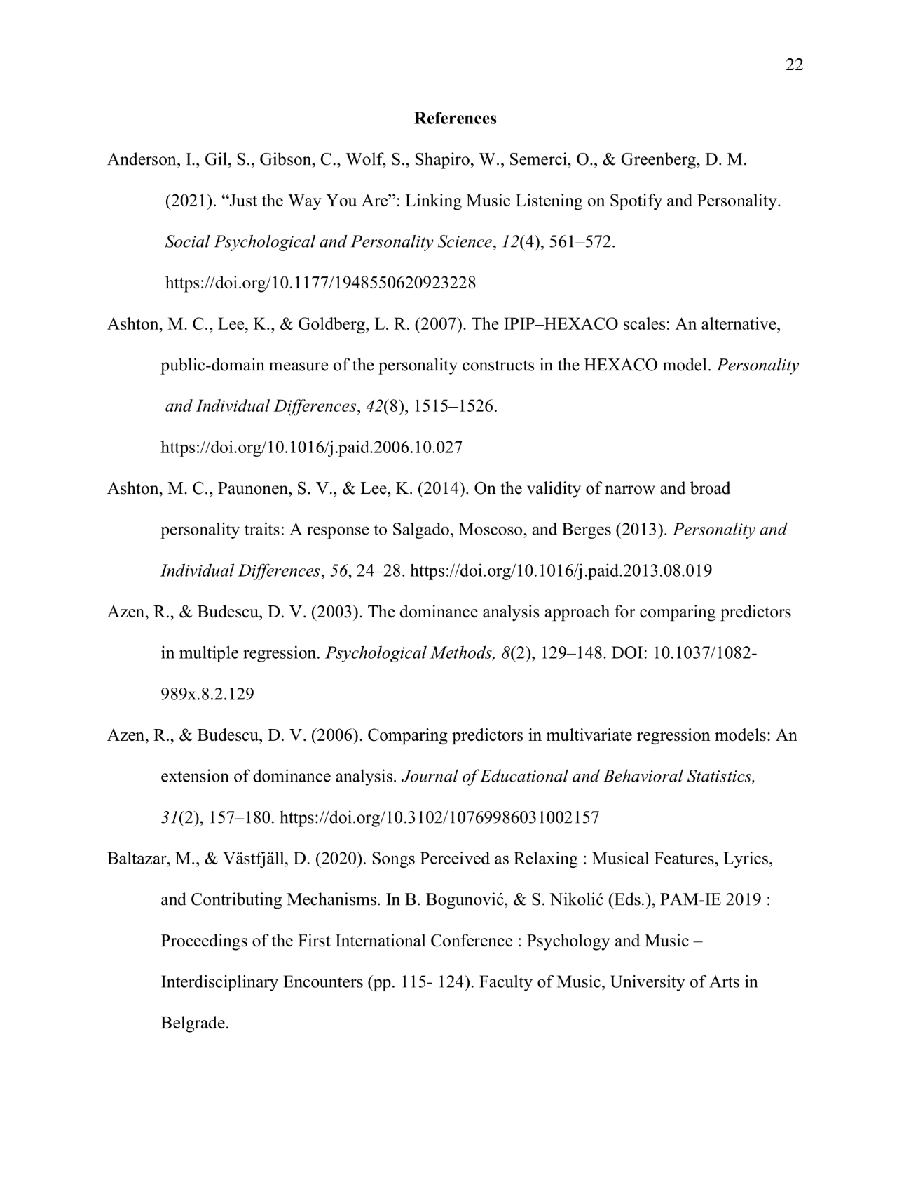
APA Style & References
Example of an APA-style References page

Slide 10
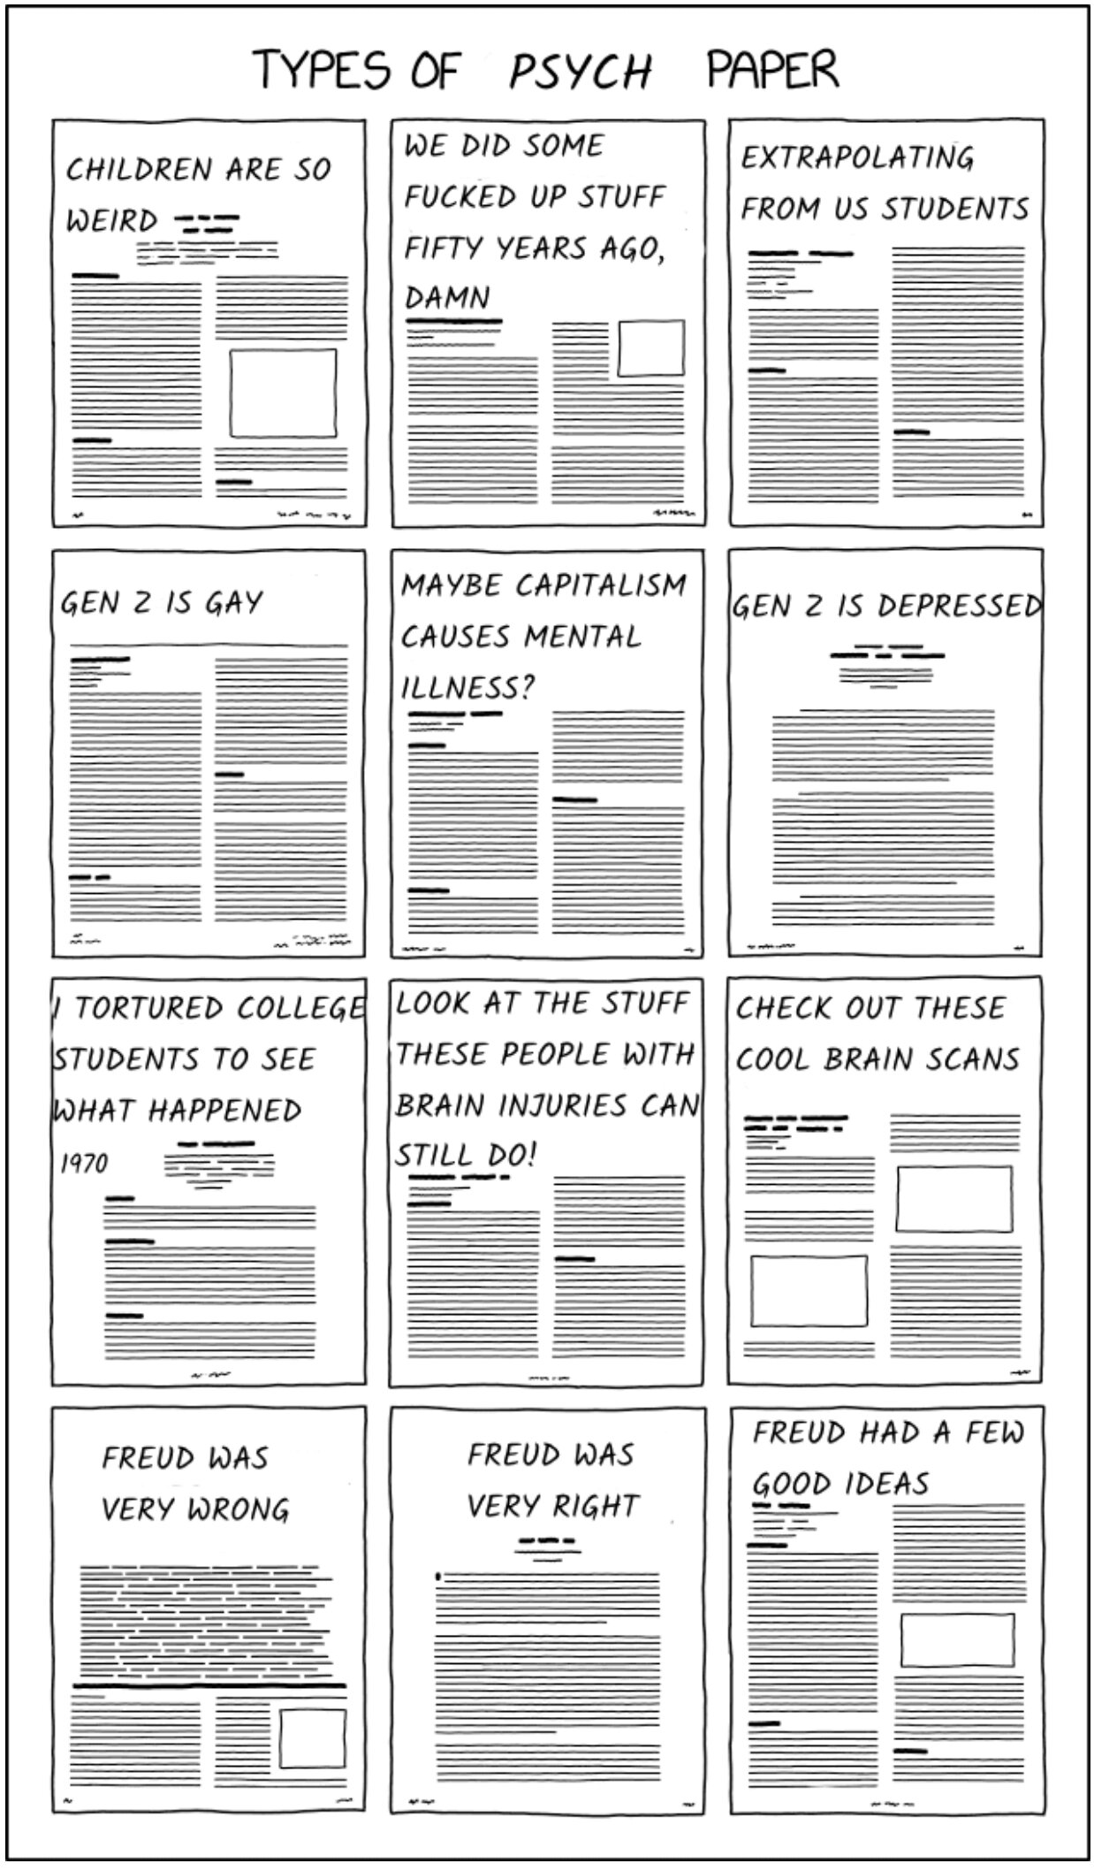
APA Style & References (continued)
Function of References is to:
  🎉 give credit to others work
  💡 add credibility to your work
  🚧 provide context for your work
  🎤 direct audience to other work

Slide 11

Why use Zotero?
Zotero logo

Slide 12
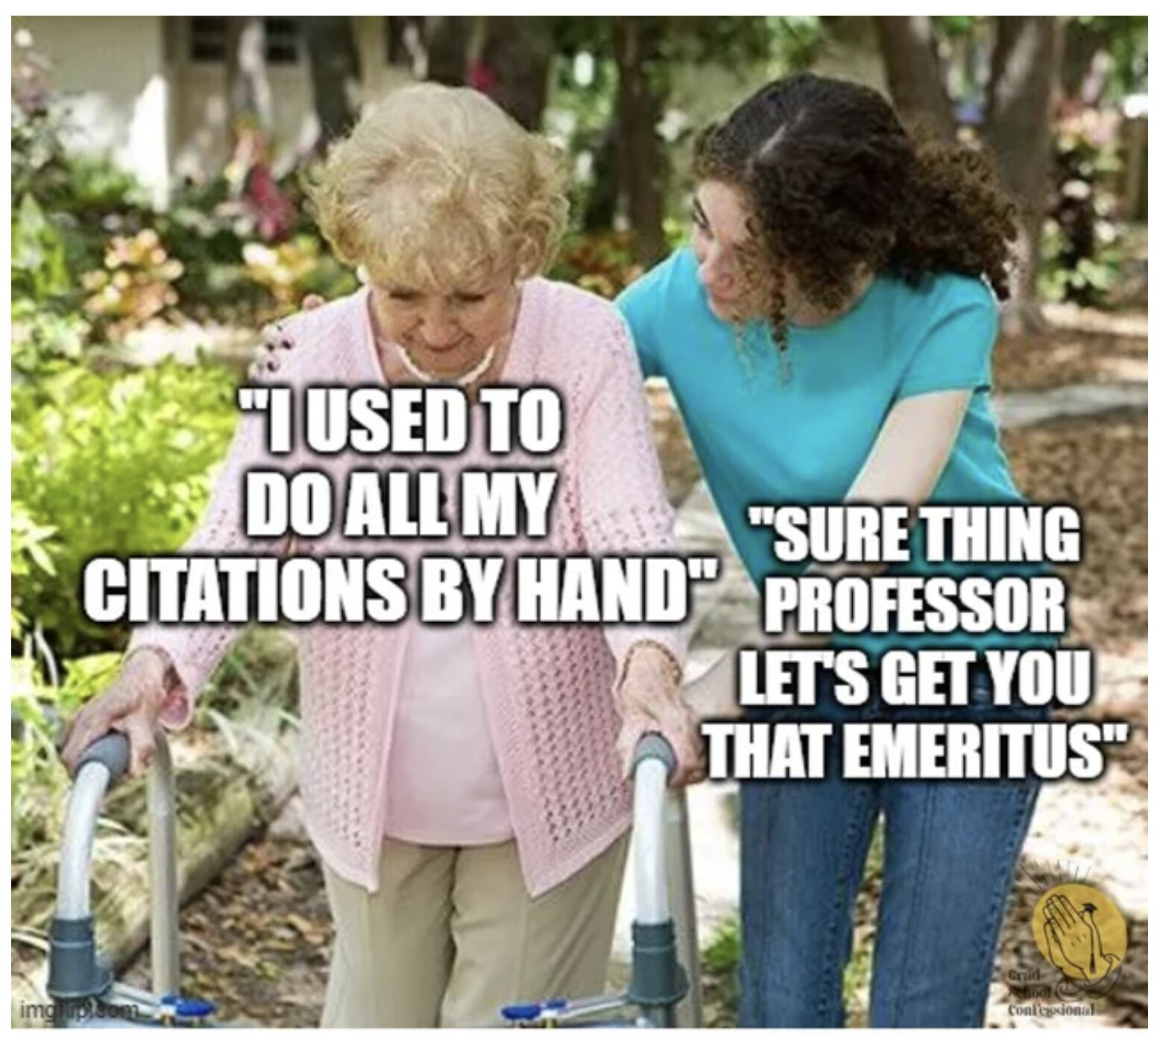
Why use Zotero? (continued)

Slide 13
Downloading Zotero
Zotero logo

Slide 14
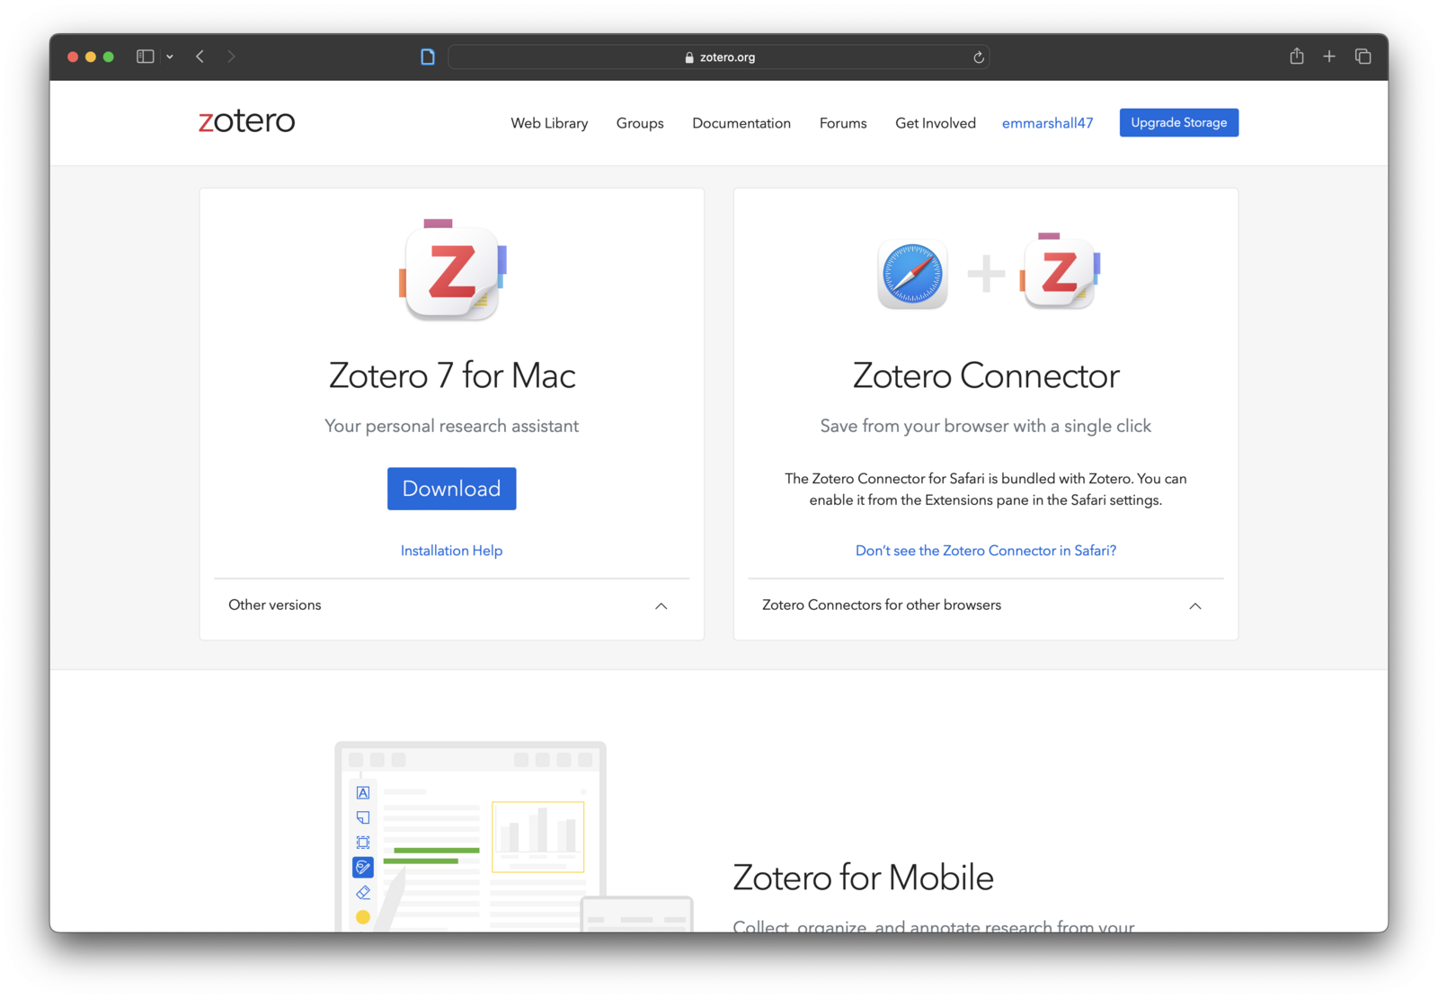
Downloading Zotero (continued)
Screenshot of the Zotero download page showing Zotero 7 for Mac and the Zotero Connector browser extension

Slide 15
Zotero Basics
Zotero logo

Slide 16
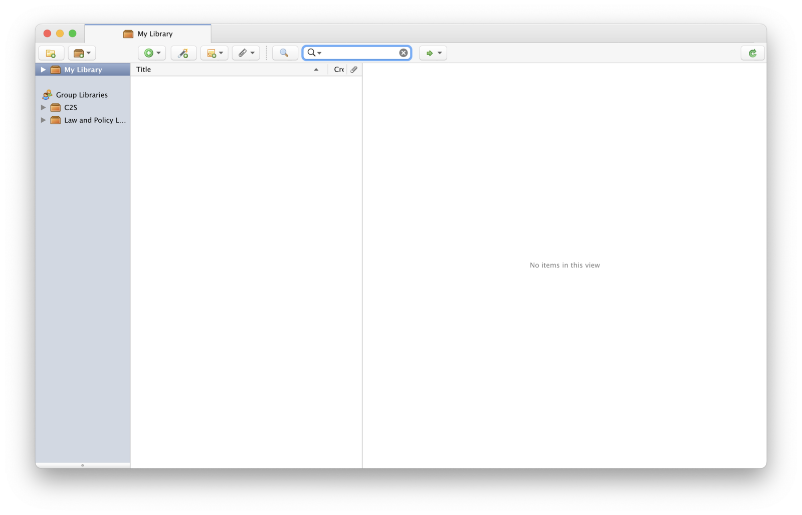
Zotero Basics (continued)
Screenshot of an empty Zotero library window showing My Library with no items

Slide 17
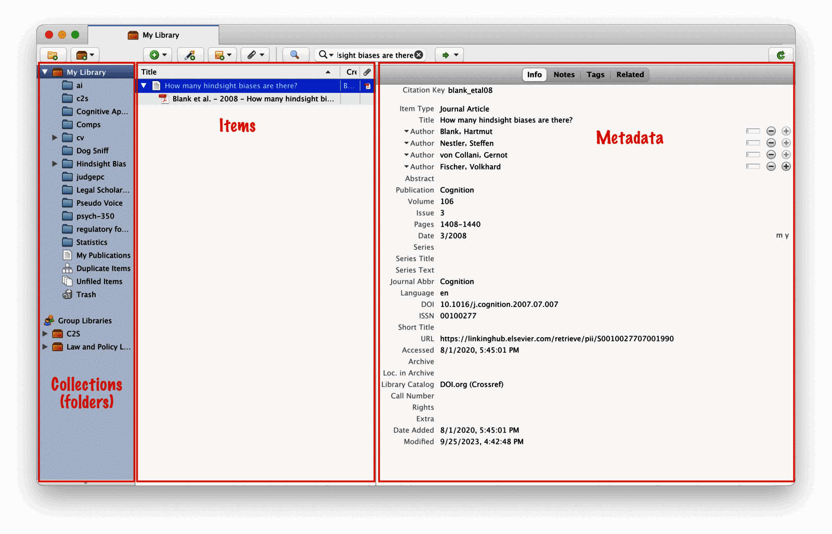
Zotero Basics (continued)
Annotated screenshot of the Zotero window divided into three panes: Collections folders on the left, Items in the center, and Metadata on the right

Slide 18
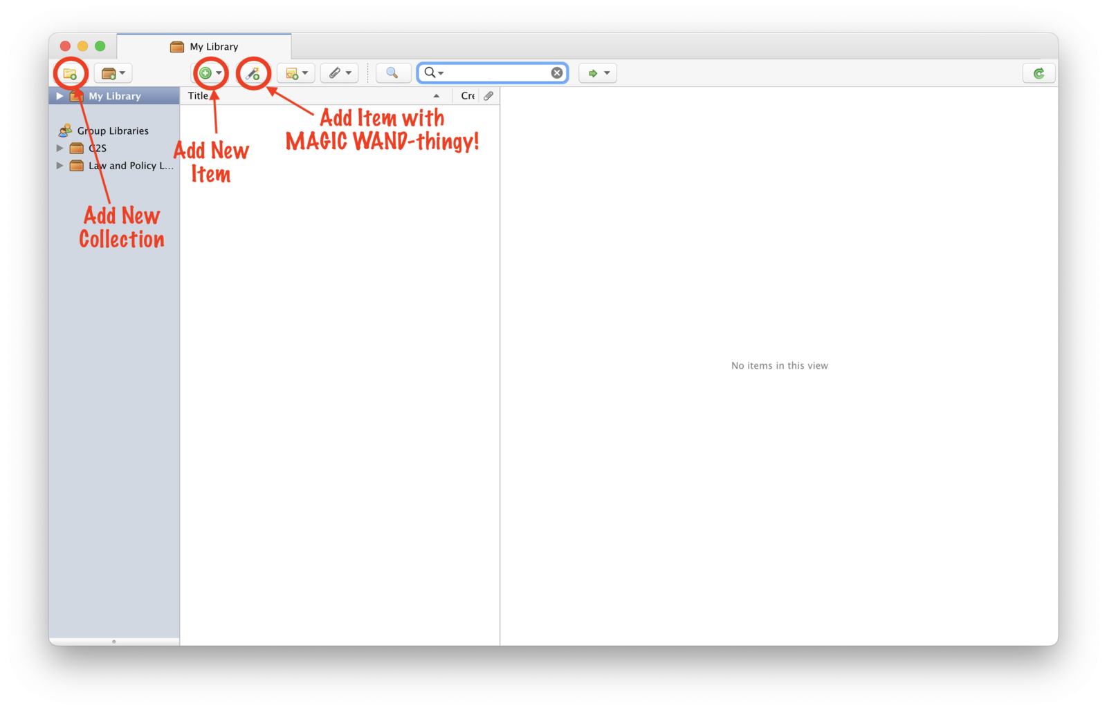
Zotero Basics (continued)
Annotated screenshot of the Zotero toolbar highlighting the Add New Collection, Add New Item, and Add Item by Identifier magic wand buttons

Slide 19
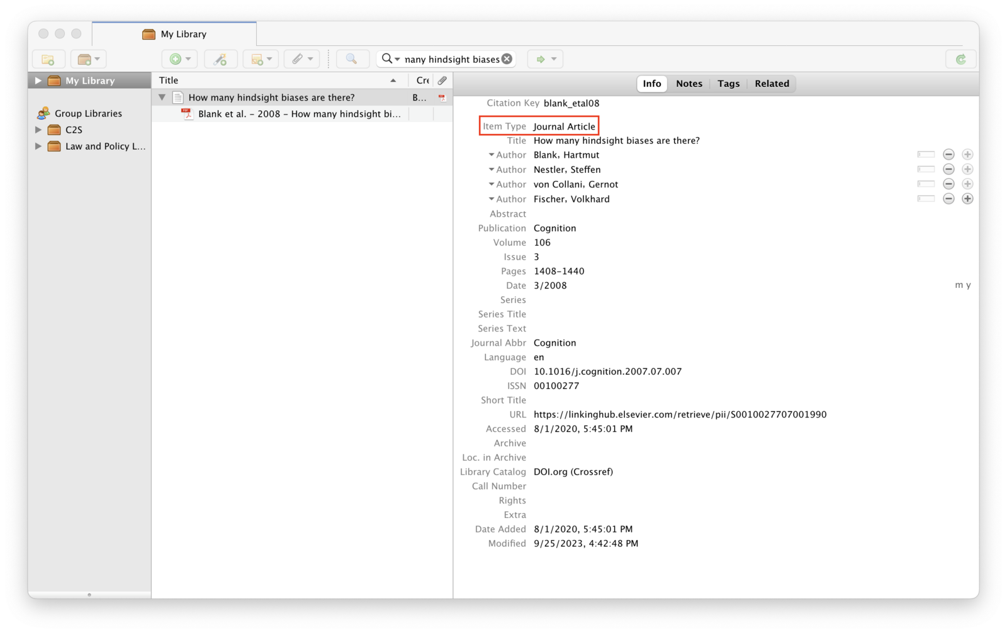
Zotero Basics (continued)
Screenshot of a Zotero metadata pane with the Item Type field highlighted as Journal Article

Slide 20
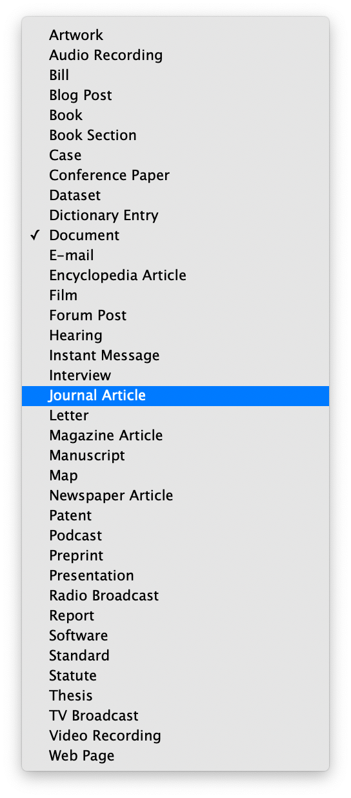
Zotero Basics (continued)
Screenshot of the Zotero item type dropdown menu listing source types with Journal Article highlighted

Slide 21
Zotero Basics (continued)
Screenshot of the Zotero item type dropdown menu listing source types with Journal Article highlighted

Slide 22
APA 7: Journal Articles
The general format is:

Slide 23
APA 7: Journal Articles (continued)
Author, A. A., Author, B. B., & Author, C. C. (Year of publication). Title of article. Title of Journal, volume number (issue number), pages. https://doi-org.libproxy.unl.edu/10.1111/j.1740-1461.2011.01230.x
EXAMPLE
Rachlinski, J. J., Guthrie, C., & Wistrich, A. J. (2011). Probable Cause, Probability, and Hindsight. Journal of Empirical Legal Studies, 72(51), 157–180. https://doi-org.libproxy.unl.edu/10.1111/j.1740-1461.2011.01230.x

Slide 24
Search & Use Key Terms

Slide 25
Assignments & Reminders
Given this week:
Finish and submit your Lab 01 to your lab section’s Canvas link before week 2
Submit to your lab section in Canvas by 11:59pm the day before your lab meets.

