Slide 1
Operationalization & Variables
Lab 02
PSYCH 350-Lab

Slide 2
Today’s Tasks
Lab 02: Operationalization & MeasurementUnderstanding Conceptual & Operational DefinitionsIdentifying & defining variablesDescribing measurement types & scalesPractice!!

Slide 3
What You Need Today
Everything for this week is linked on the next slides – and always on the lab page under Handouts & References.
Open these before we start so you can follow along.

Slide 4
Getting started with Variables
[arrow icon]
Identifying & understanding variables
[Web page]
[book icon]
Identifying & understanding variables

Slide 5
Weekly Lab Assignment
[book icon]
Lab 02: Operationalization & Measurement Worksheet
[Word document]

Slide 6
The Research Process
Research ideas can come from a variety of sources, including informal observations, practical problems, and previous research
Once you have a general research idea, you need to use it to generate empirically testable research questions, which requires conceptual clarity and operationally defining one or more variables

Slide 7
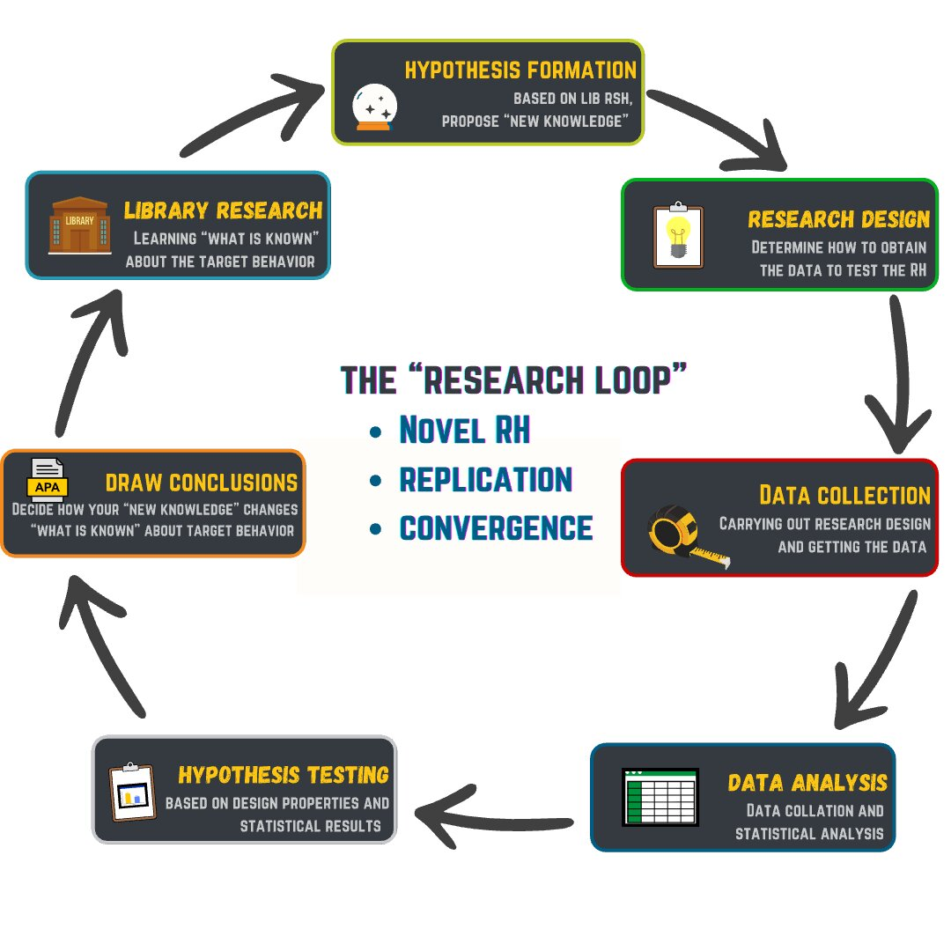
The Research Process (continued)
Circular diagram showing research process cycle with five stages: Idea, Question, Study, Analysis, and Interpretation connected by arrows forming a continuous loop

Slide 8
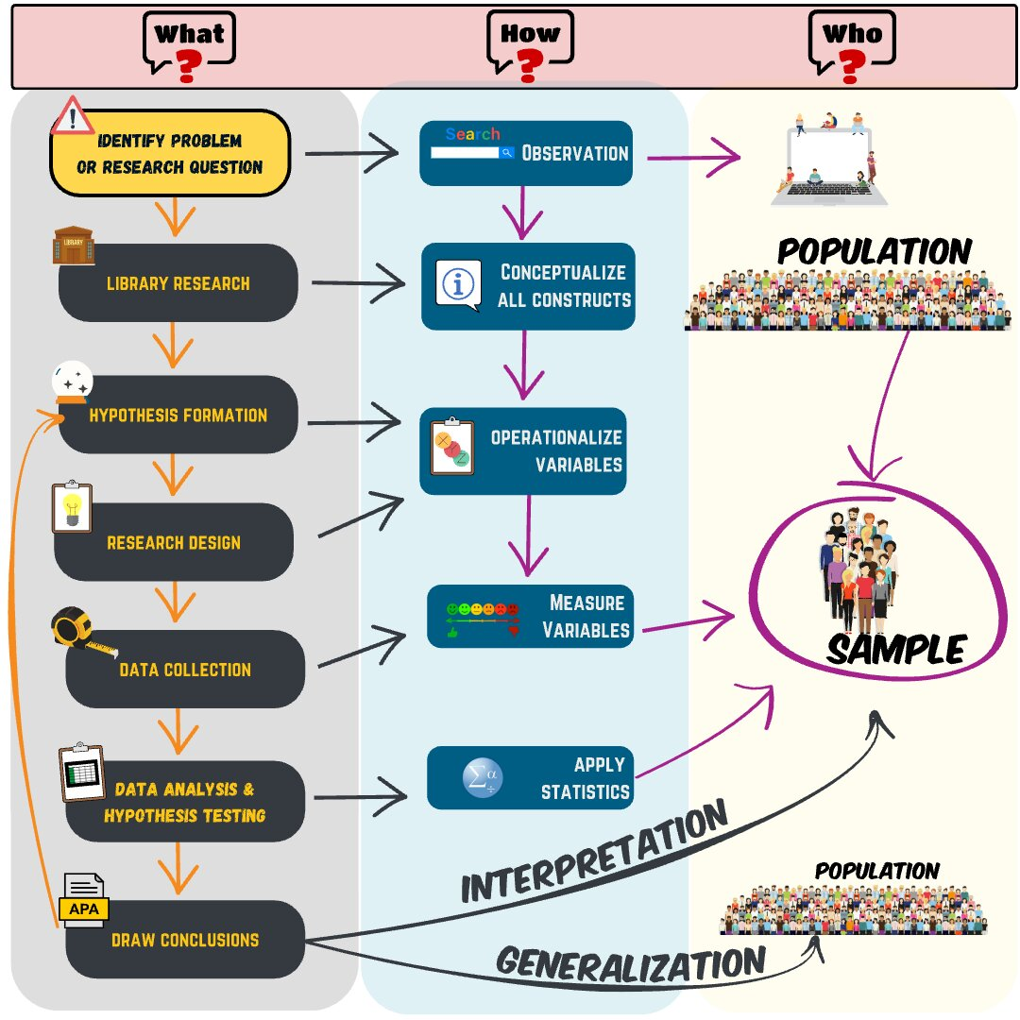
The Research Process (continued)
Research process diagram with idea stage highlighted showing sources of research ideas from observations, problems, and previous research

Slide 9
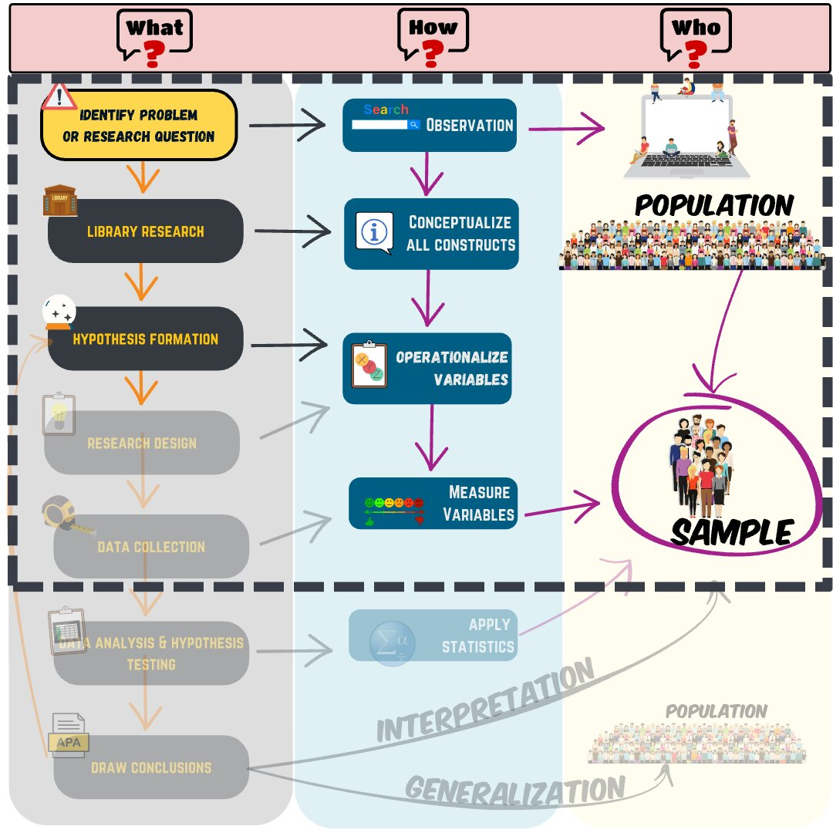
The Research Process (continued)
Research process diagram with Question stage highlighted showing formation of empirically testable research questions with conceptual clarity

Slide 10
The Research Process (continued)
Notes:
Research ideas can come from a variety of sources, including informal observations, practical problems, and previous research.
Once you have a research idea, you need to use it to generate one or more empirically testable research questions, that is, questions expressed in terms of a single variable or relationship between variables.
But this part of the process is more complicated and difficult than it might initially seem, especially with multidimensional or abstract psychological concepts.
But to get a better sense of what this process looks like, lets start with a very simple and unscientific question we might want to answer:
How big is Superman? [next slide]

Slide 11
What is the answer to this simple question?
Well…it depends!!
Answering requires agreement on clear and complete conceptual definition of all constructs

Slide 12
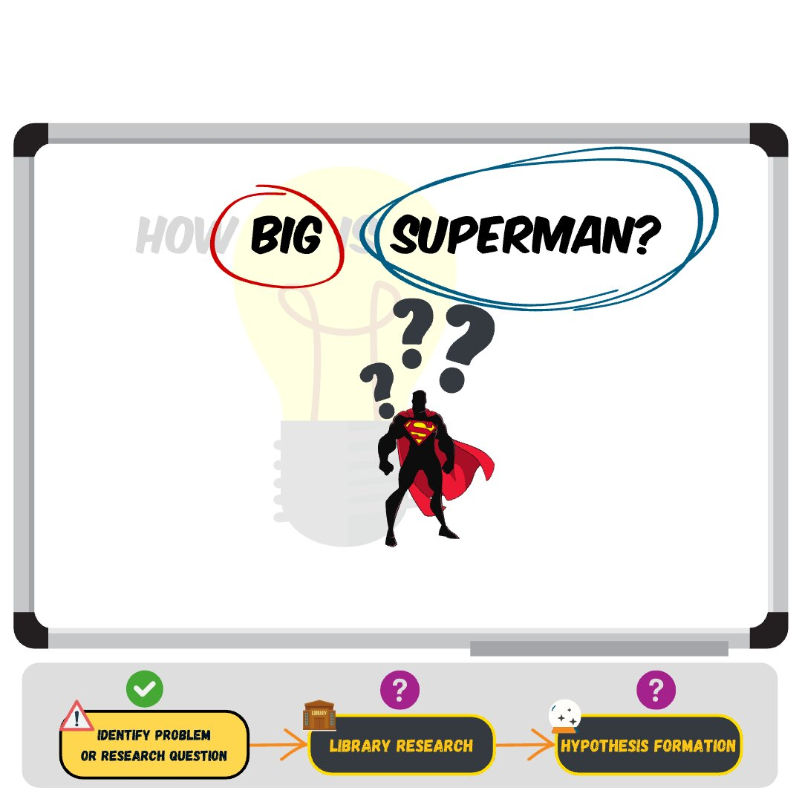
What is the answer to this simple question? (continued)
Diagram showing research question How big is Superman with question marks indicating conceptual ambiguity about both terms

Slide 13
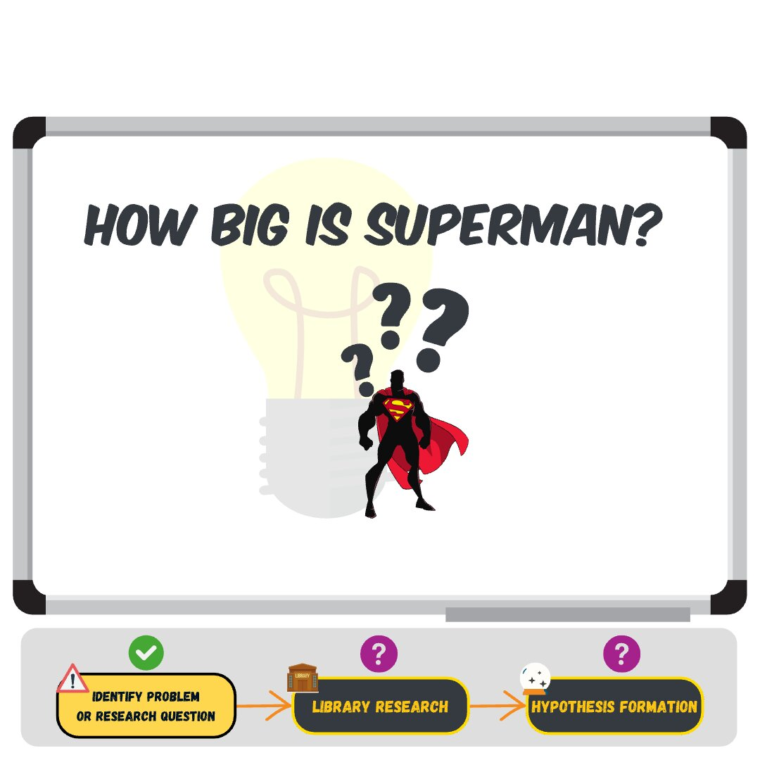
What is the answer to this simple question? (continued)
Research question diagram with Superman highlighted in yellow showing the need to define this concept clearly

Slide 14
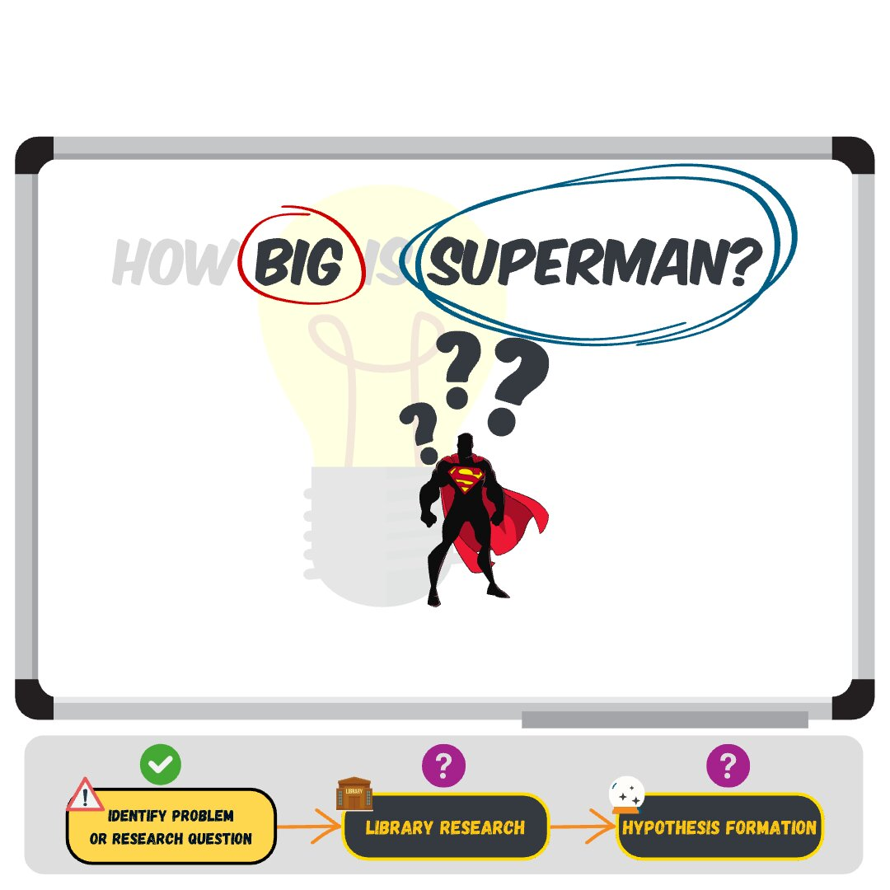
What is the answer to this simple question? (continued)
Research question diagram with both big and Superman highlighted showing both concepts need clear definitions

Slide 15
What is the answer to this simple question? (continued)
Notes:
Does anyone know the answer? (some might try to answer)
There are lots of potential answers to this question! But the accuracy of any of those answers will necessarily depend on what exactly we mean by both “big” and “superman”

Slide 16
Conceptually Defining “Superman”
Most have a general idea, but need to be more specific…

Slide 17
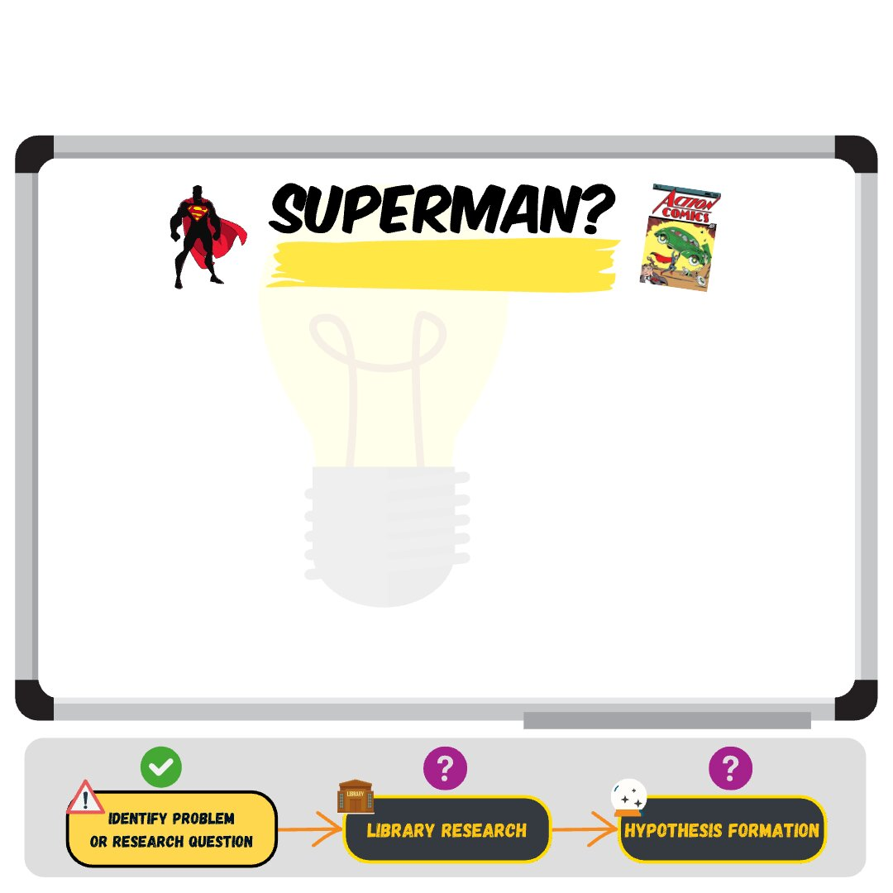
Conceptually Defining “Superman” (continued)
Question mark icon representing the abstract concept of Superman that needs a clear definition

Slide 18

Conceptually Defining “Superman” (continued)
Google search bar with Superman query showing the first step in finding a clear definition

Slide 19
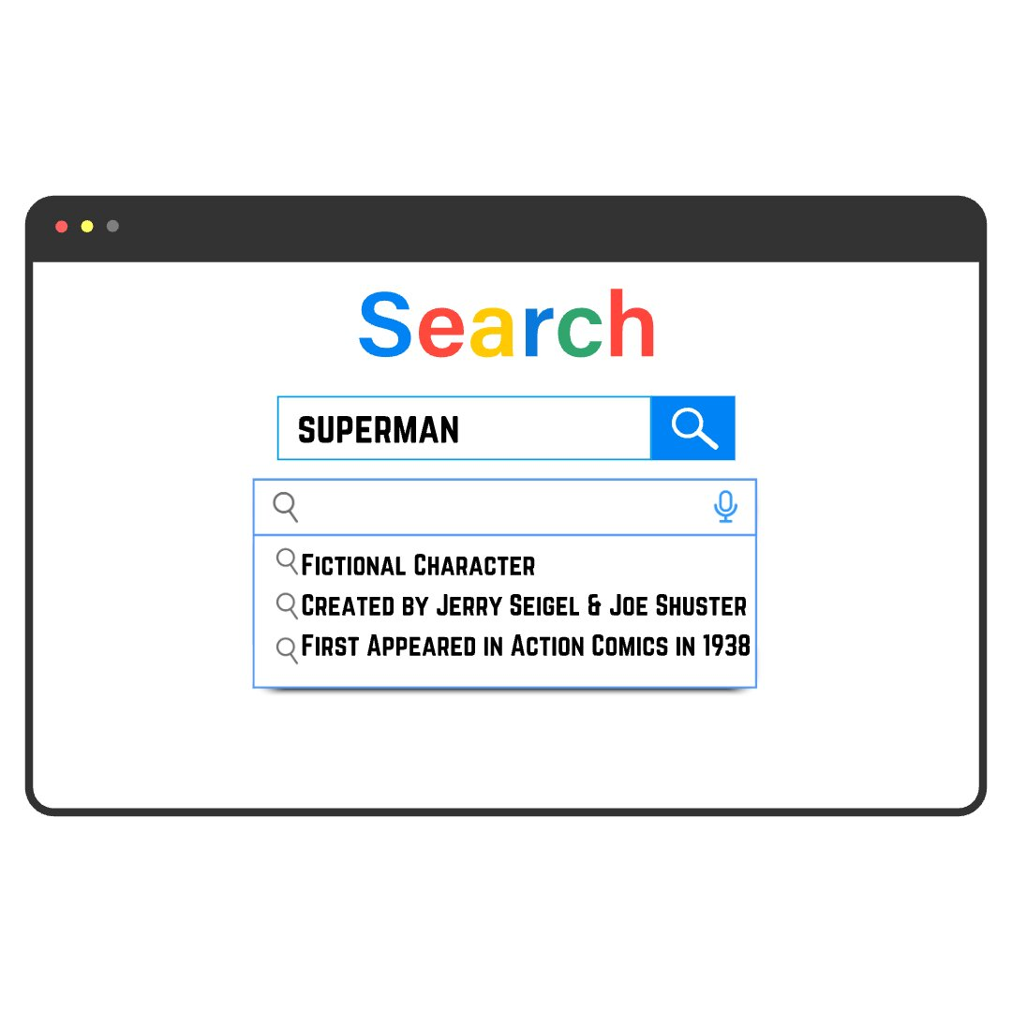
Conceptually Defining “Superman” (continued)
Google search results showing multiple Superman entries including comics, movies, TV shows, and different interpretations

Slide 20
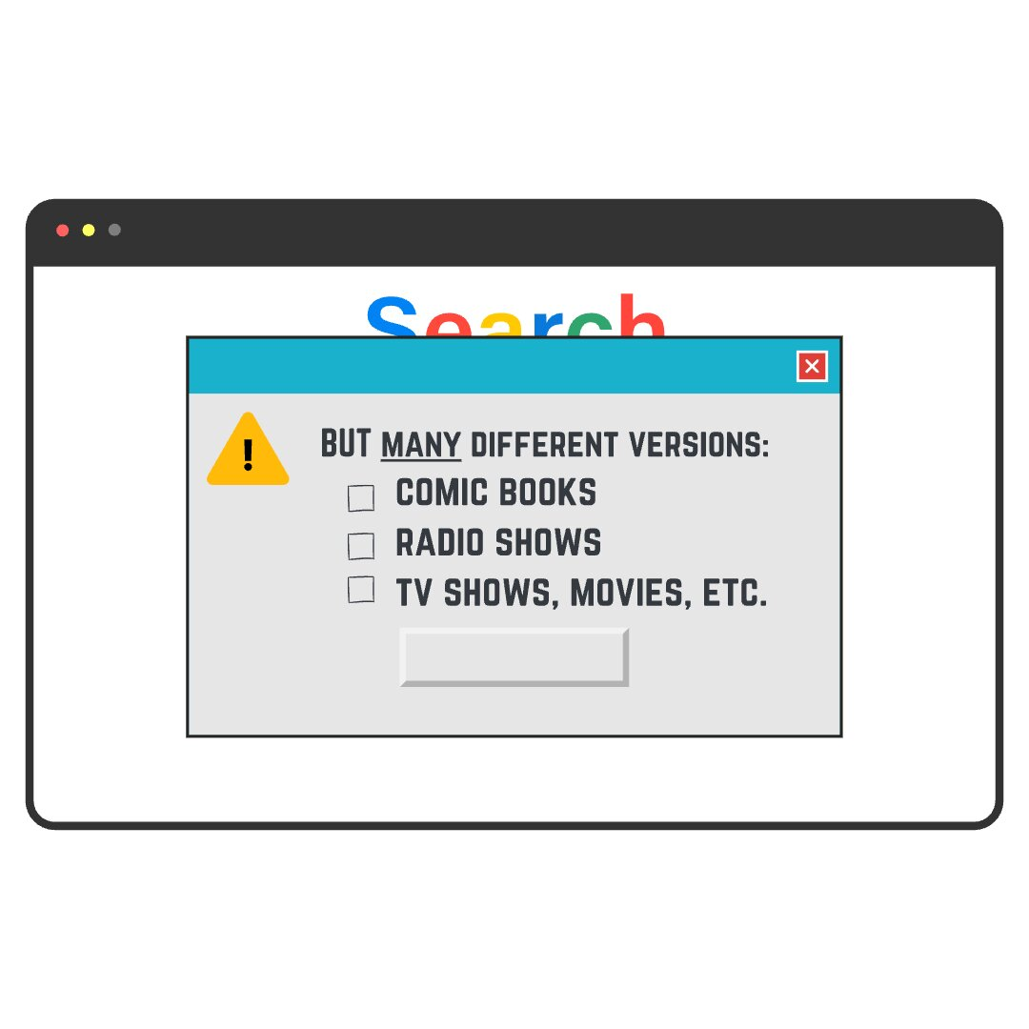
Conceptually Defining “Superman” (continued)
Narrowed search results focusing on specific Superman media adaptations and their details

Slide 21

Conceptually Defining “Superman” (continued)
Grid of photos showing different actors who portrayed Superman over the years demonstrating variation in the concept

Slide 22

Conceptually Defining “Superman” (continued)
Expanded grid of Superman actors from movies, TV series, and serials across decades from 1948 to present

Slide 23
Research questions must be specific!!!
Research question diagram showing partial progress with Superman now defined as actors who portrayed the character

Slide 24
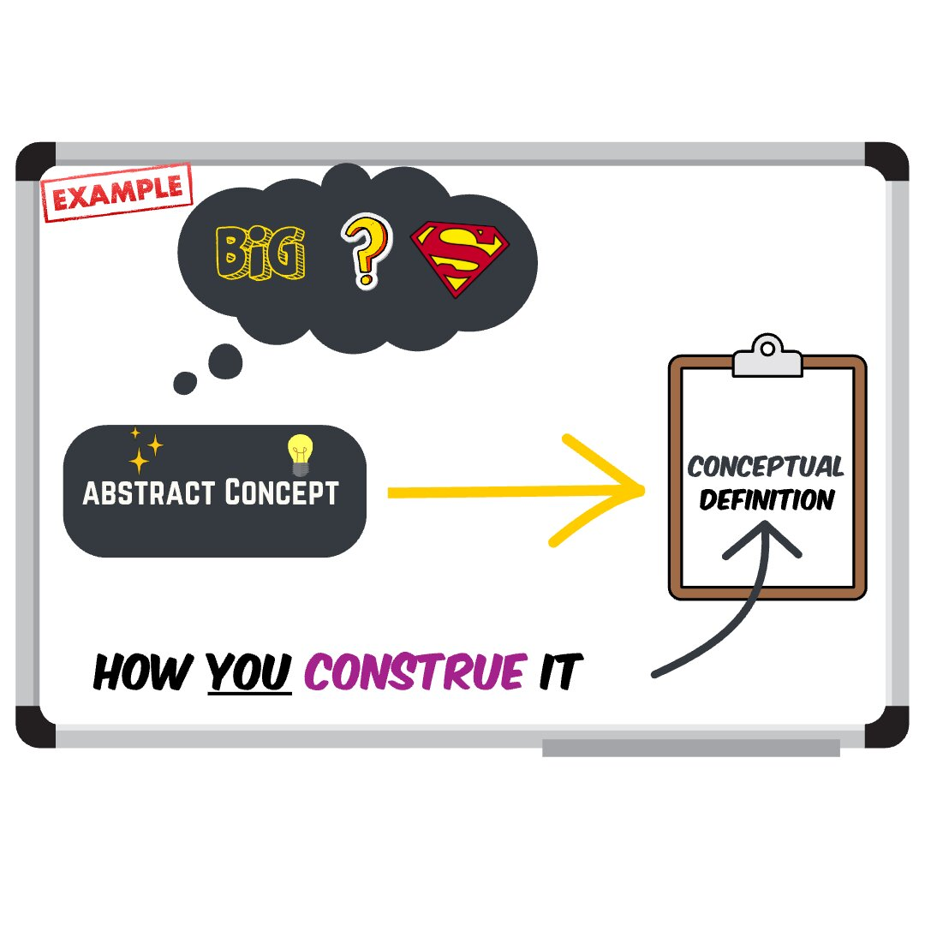
Research questions must be specific!!! (continued)
Complete conceptual definition stating Superman equals the actors who portrayed Clark Kent Superman in movies, TV series, and serial films from 1948 to present

Slide 25
Conceptually Defining “Big”
“Big” is a more abstract concept and can refer to many different ideas
Keep in mind: there is not an inherently right or wrong way to define a concept, but should look to what others have done

Slide 26
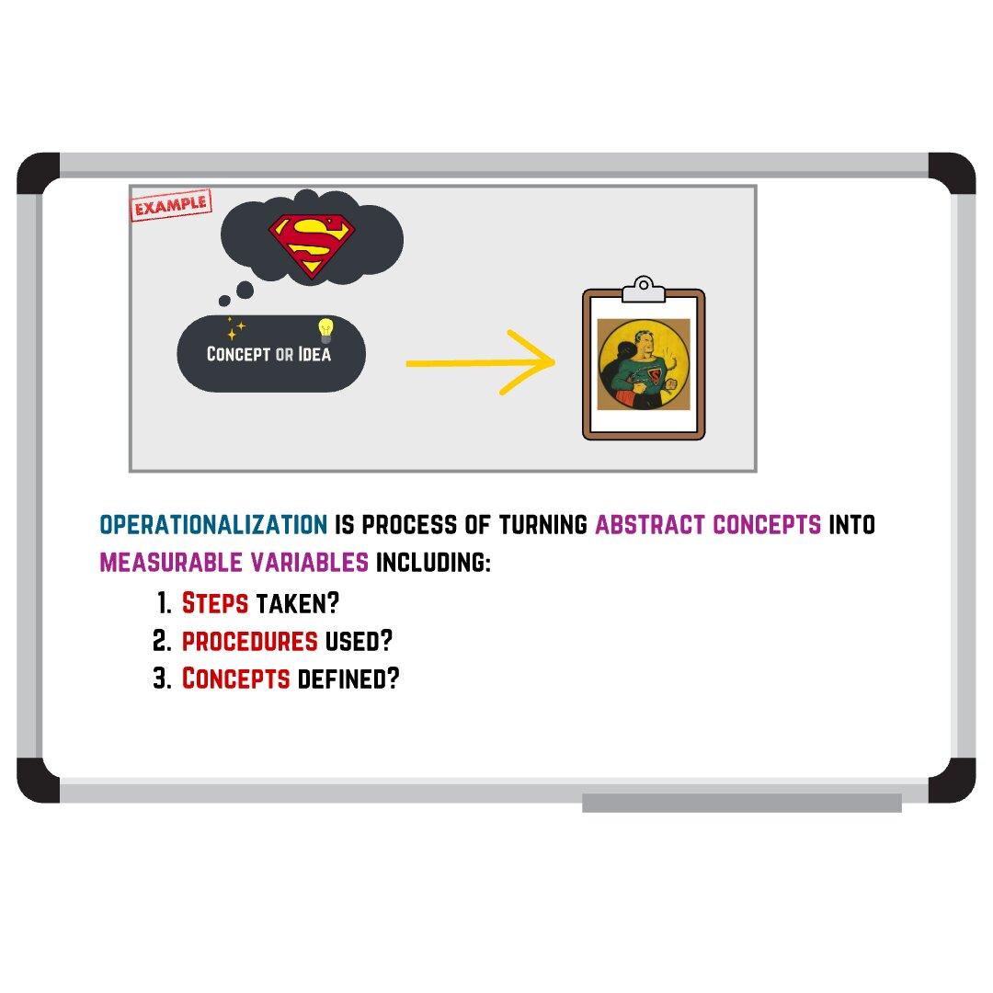
Conceptually Defining “Big” (continued)
Thought bubble showing multiple interpretations of big including height, weight, physical strength, cultural impact, and popularity

Slide 27
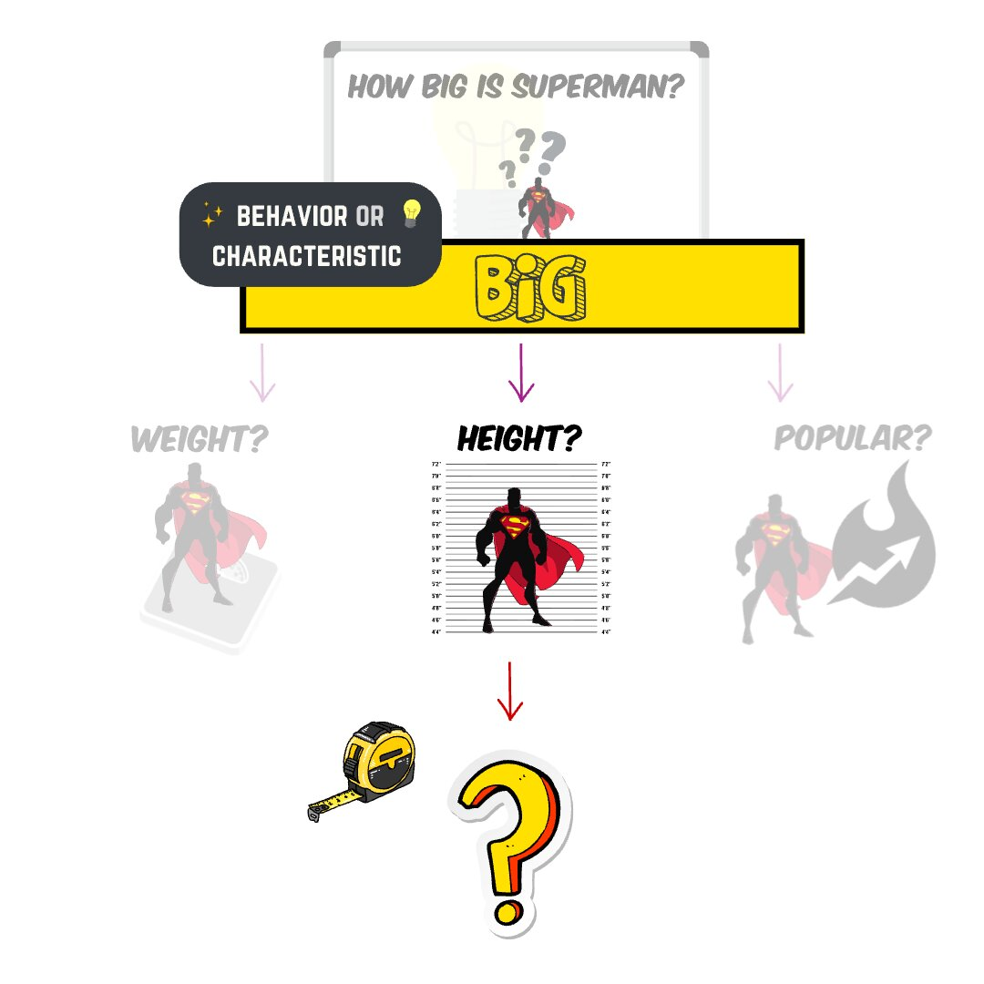
Conceptually Defining “Big” (continued)
Thought bubble highlighting height as one specific operational definition of big

Slide 28
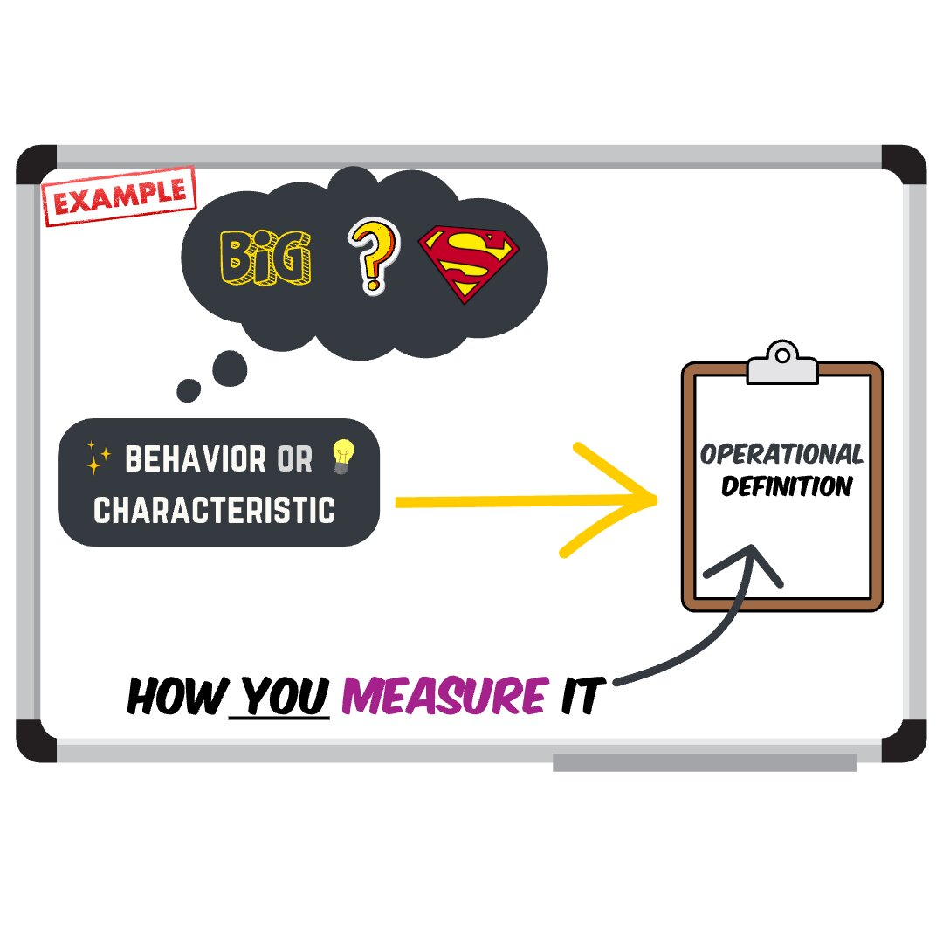
Conceptually Defining “Big” (continued)
Thought bubble showing height further specified as height of the actor in meters as a precise operational definition

Slide 29

Conceptually Defining “Big” (continued)
Meme with a businessman showing a researcher making choices, representing degrees of freedom in operationalization decisions

Slide 30
Conceptually Defining “Big” (continued)
List showing researcher decisions: height versus other measures, meters versus other units, multiple operational definitions possible

Slide 31
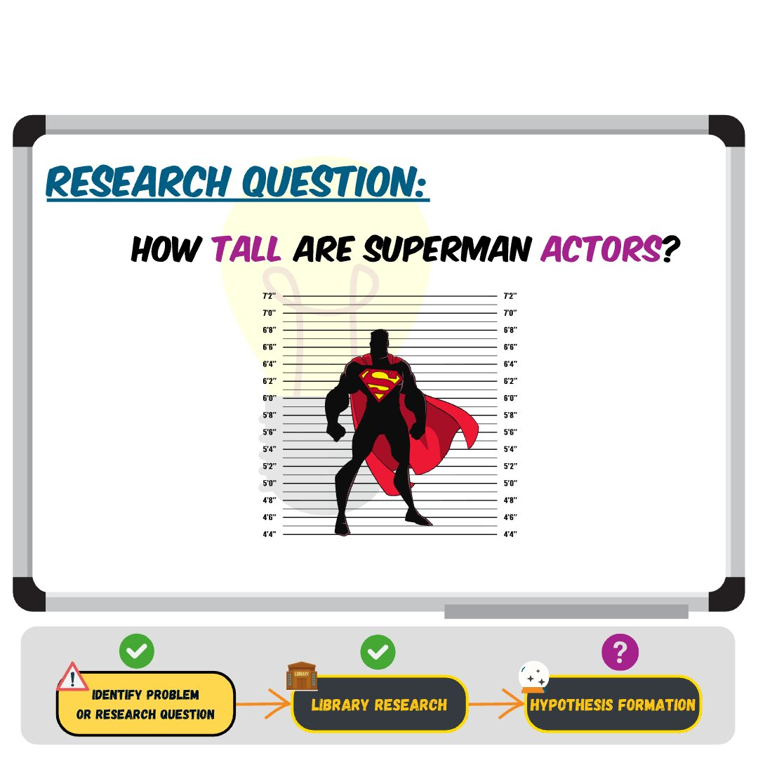
From concepts to research hypotheses
Complete research question: How big are the actors who portrayed Superman with both concepts now clearly defined

Slide 32
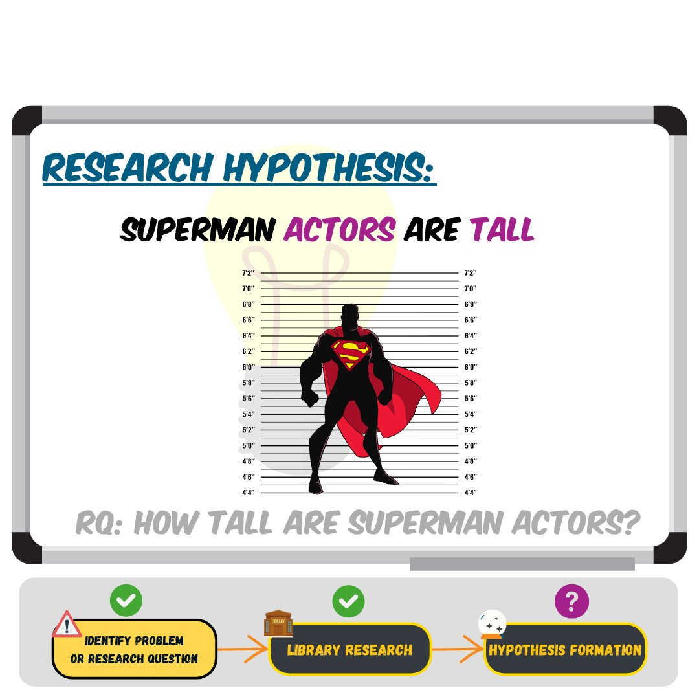
From concepts to research hypotheses (continued)
Research hypothesis formation step 1: Converting conceptual question into testable hypothesis about actor heights

Slide 33
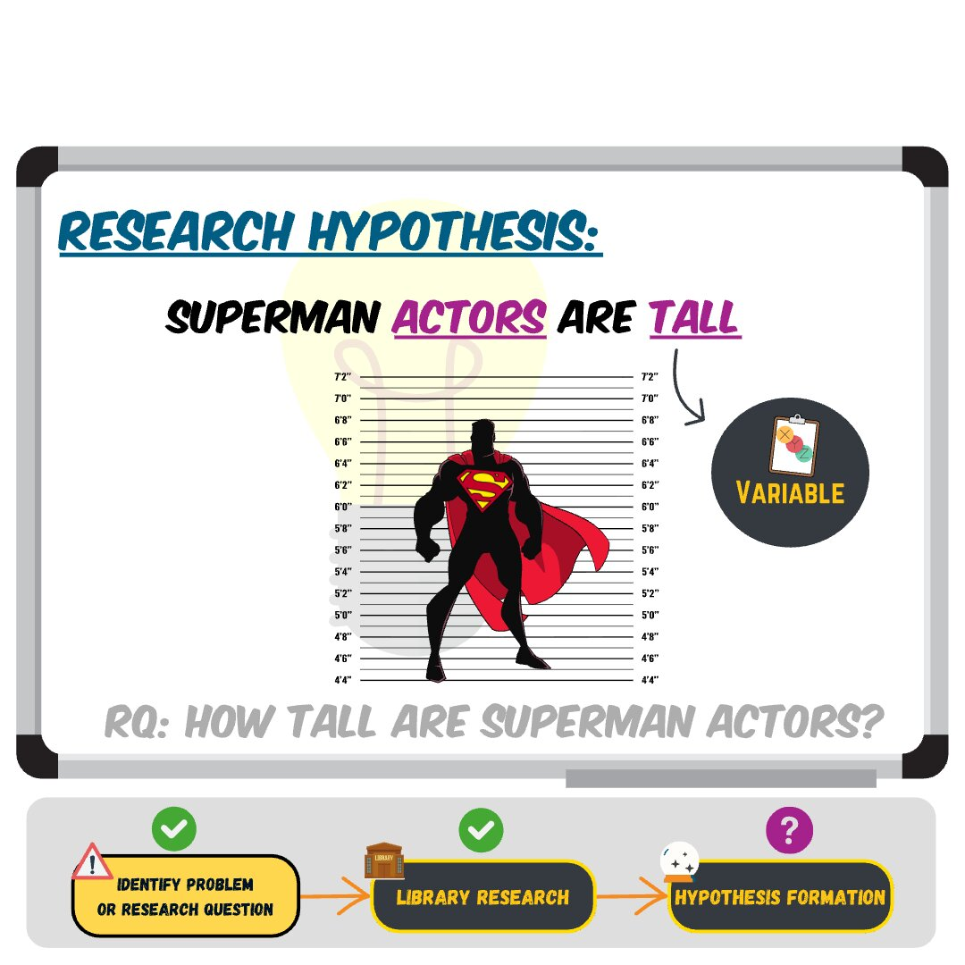
From concepts to research hypotheses (continued)
Research hypothesis formation step 2: Specifying the operational definition and measurement approach for testing

Slide 34
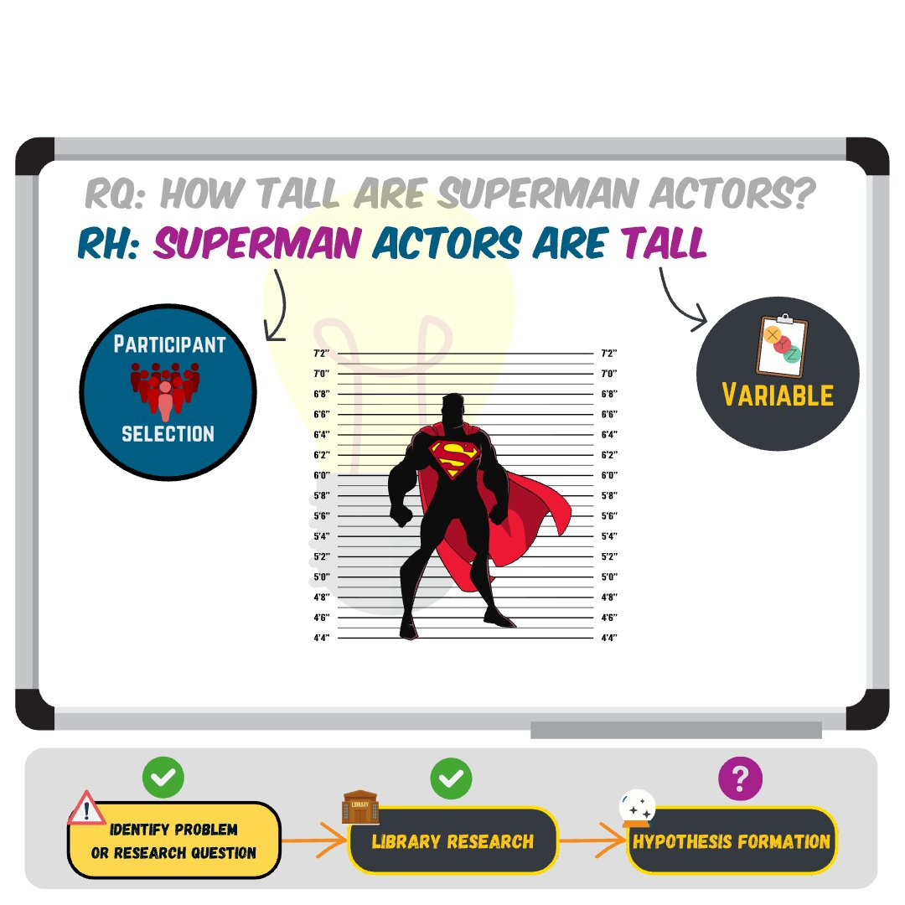
From concepts to research hypotheses (continued)
Research hypothesis formation step 3: Creating specific predictions based on the operationalized variables

Slide 35
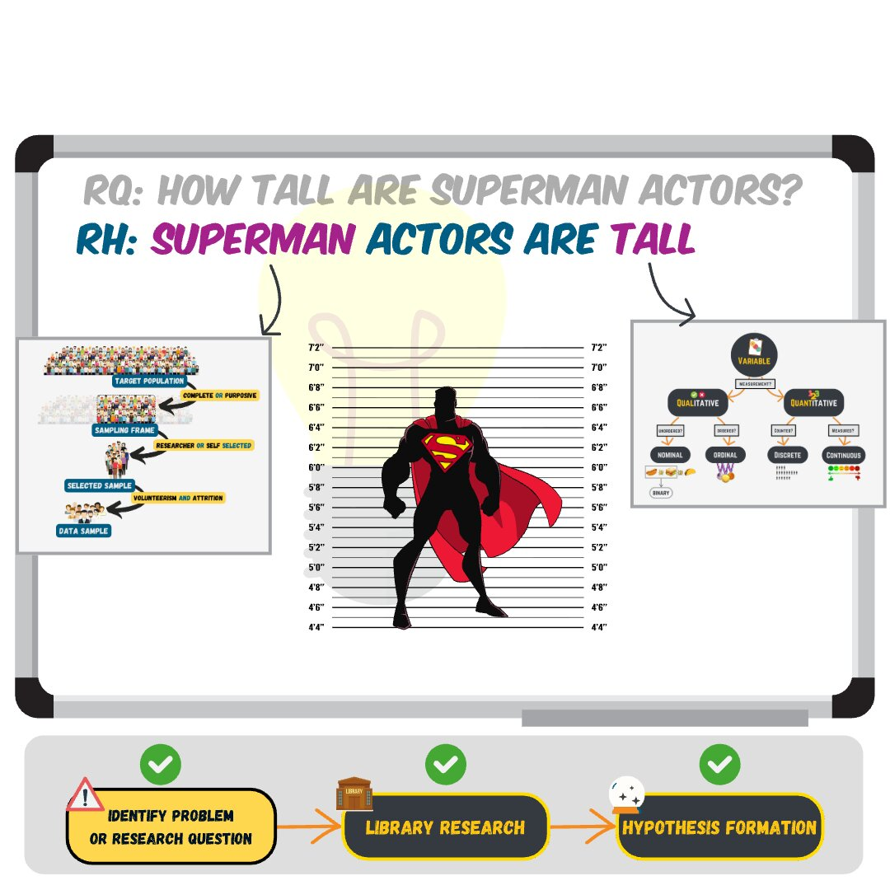
From concepts to research hypotheses (continued)
Final research hypothesis: The average height of actors who portrayed Superman from 1948 to present is 1.88 meters

Slide 36
From concepts to variables & other useful terminology

Slide 37
What is a Conceptual Definition?
Conceptual definition
A definition that describes the behaviors or internal processes that might make up a psychological construct, along with how it relates to other concepts

Slide 38
What is Operationalization?
Operationalization
The process of turning abstract concepts into measurable variables
Operational definition
A definition of a variable in terms of precisely how it is to be measured in a particular context
For any given construct, there will always be multiple possible operational definitions

Slide 39
What is a Variable?
Variable
A quantity or quality that varies across people or situations
For example, the height of the actors who have played Superman is a variable because it varies from actor to actor.

Slide 40
What is Measurement?
Measurement
The assignment of scores to individuals so that the scores represent some characteristic of the individuals
Requires some systemic procedure (operationalization) for assigning scores to individuals or objects so that scores represent a characteristic or concept of interest (variable)

Slide 41
Measuring variables

Slide 42
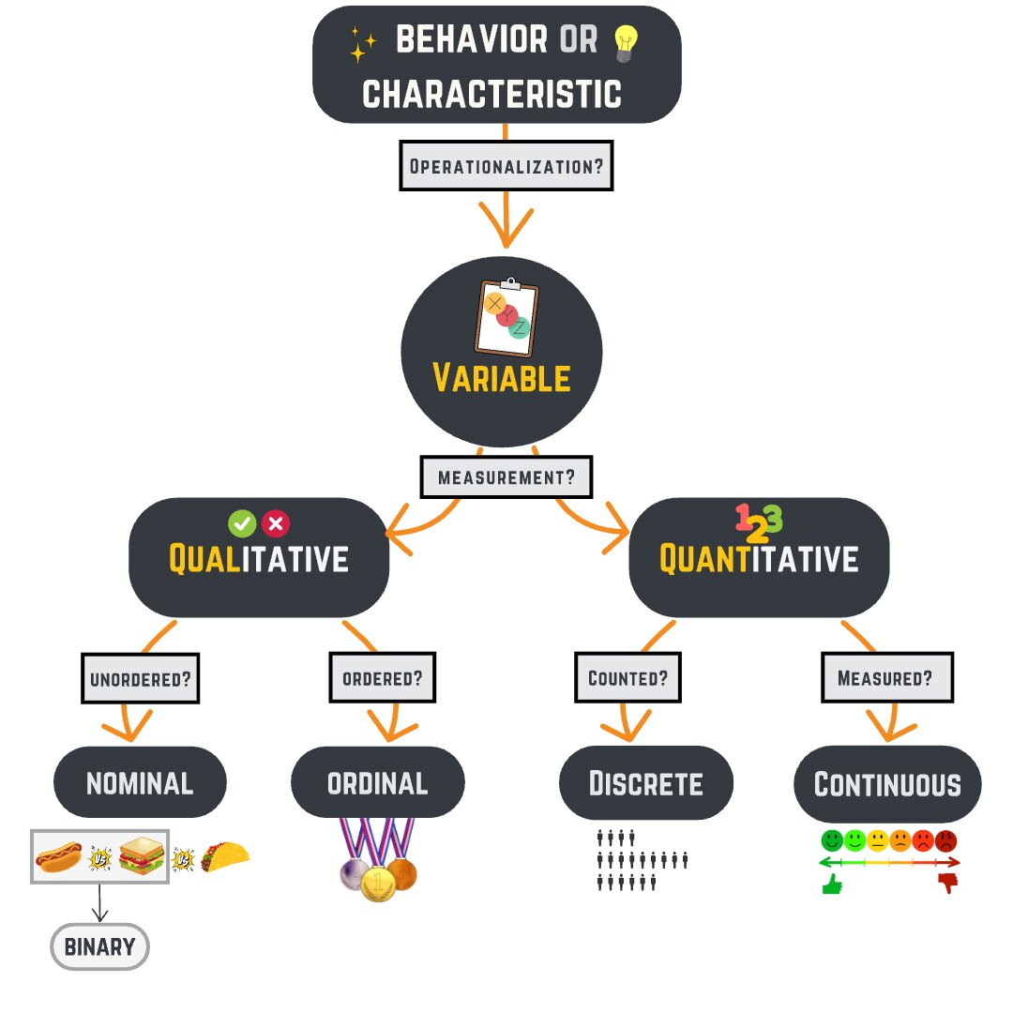
Types of Variables
Hierarchical flow chart showing how to categorize different variable types: top displays process of operationalizing a behavior or characteristic to a variable; then next level splits a variable through the measurement process into Qualitative and Quantitative; then Qualitative divides into Nominal and Ordinal; whereas Quantitative further divides into Discrete and Continuous

Slide 43
Qualitative vs Quantitative
All observations start as QUALITATIVEBoth are useful and legitimateCan choose based on topicOR Combine aspects of both
Qualitative Data Example

Slide 44
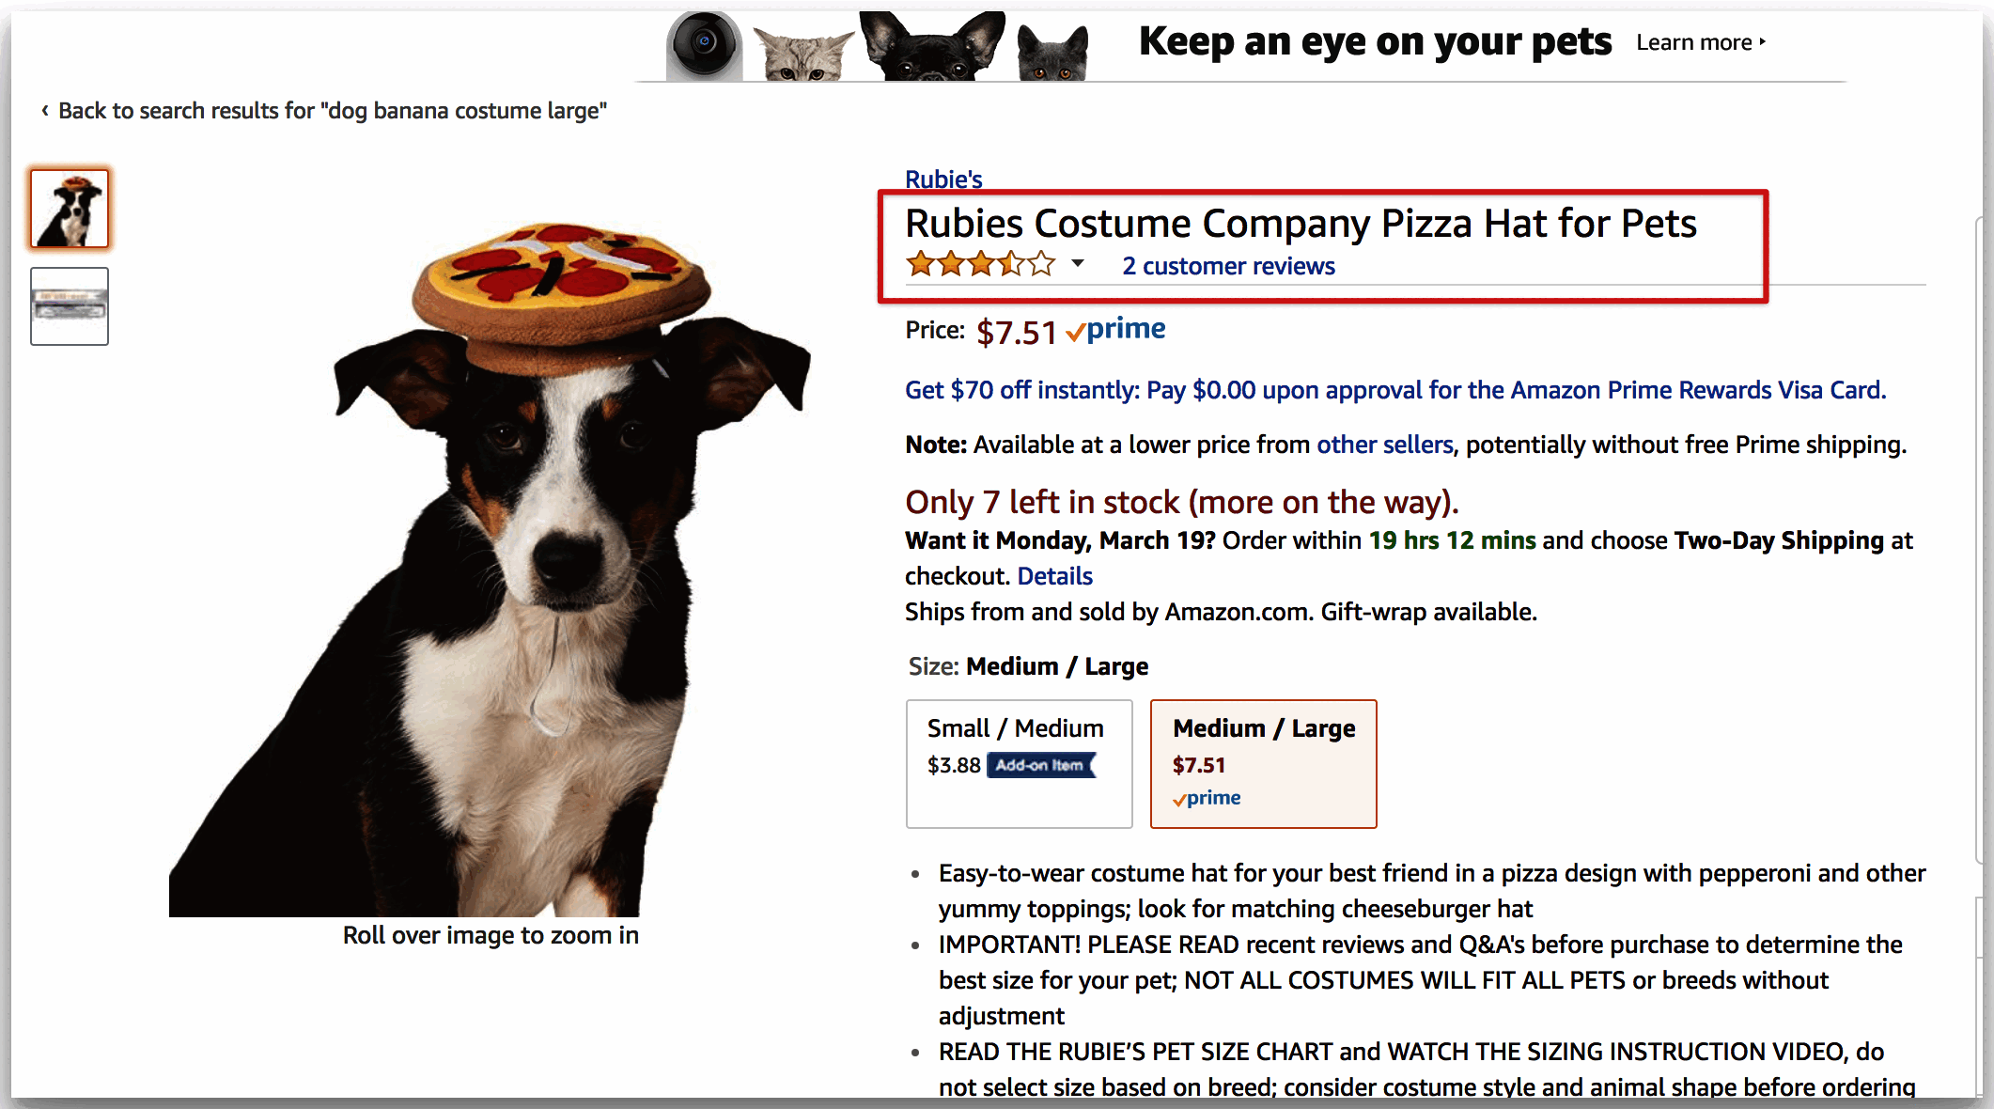
Qualitative vs Quantitative (continued)
Quantitative Data Example

Slide 45

Qualitative vs Quantitative (continued)
Bar chart showing frequency distribution of different colored hats worn by dogs - example of quantitative data

Slide 46
Quantitative Variables
You count discrete dataYou measure continuous data
Discrete Data Example

Slide 47
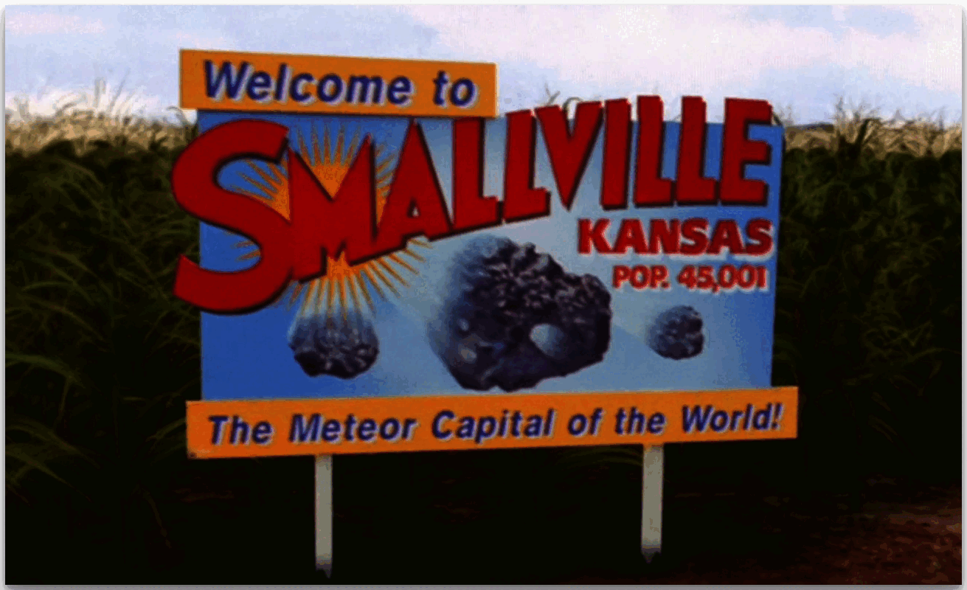
Quantitative Variables (continued)
Continuous Data Example

Slide 48
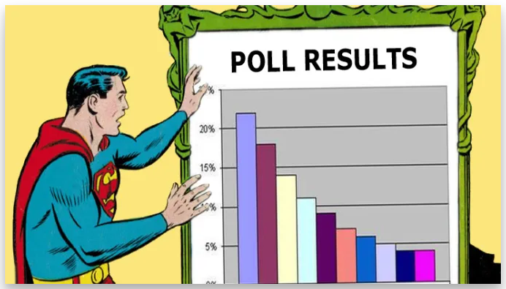
Quantitative Variables (continued)
Cartoon of a Superman figure pointing as a blank bar chart

Slide 49
Quantitative Variables (continued)
Notes:
What is Discrete Data? Discrete variables can only assume specific values that you cannot subdivide. Typically, you count them, and the results are integers. For example, if you work at an animal shelter, you’ll count the number of cats.
Discrete data can only take on specific values. For example, you might count 20 cats at the animal shelter. These variables cannot have fractional or decimal values. You can have 20 or 21 cats, but not 20.5! Natural numbers have discrete values.
Examples of discrete data include The number of books you check out from the library. The number of heads in a sequence of coin tosses. The result of rolling a die. The number of patients in a hospital. The population of a country.
What is Continuous Data? Continuous variables can assume any numeric value and can be meaningfully split into smaller parts. Consequently, they have valid fractional and decimal values. In fact, continuous data have an infinite number of potential values between any two points. Generally, you measure them using a scale.
When you see decimal places for individual values, you’re looking at a continuous variable.

Slide 50
Let’s Practice!!

Slide 51
Lab 02: Walk-through Section
Identify Types of Variables
For each of the variables, highlight (use yellow) whether it is quantitative (values reflect a count or measurement) or qualitative (values correspond to category membership).
For each quantitative, highlight (use yellow) whether it is continuous (can take on any value; e.g., decimal values) or discrete (integer or whole number values only).

Slide 52
Lab 02: Walk-through Section (continued)
Hierarchical flow chart showing how to categorize different variable types: top displays process of operationalizing a behavior or characteristic to a variable; then next level splits a variable through the measurement process into Qualitative and Quantitative; then Qualitative divides into Nominal and Ordinal; whereas Quantitative further divides into Discrete and Continuous

Slide 53
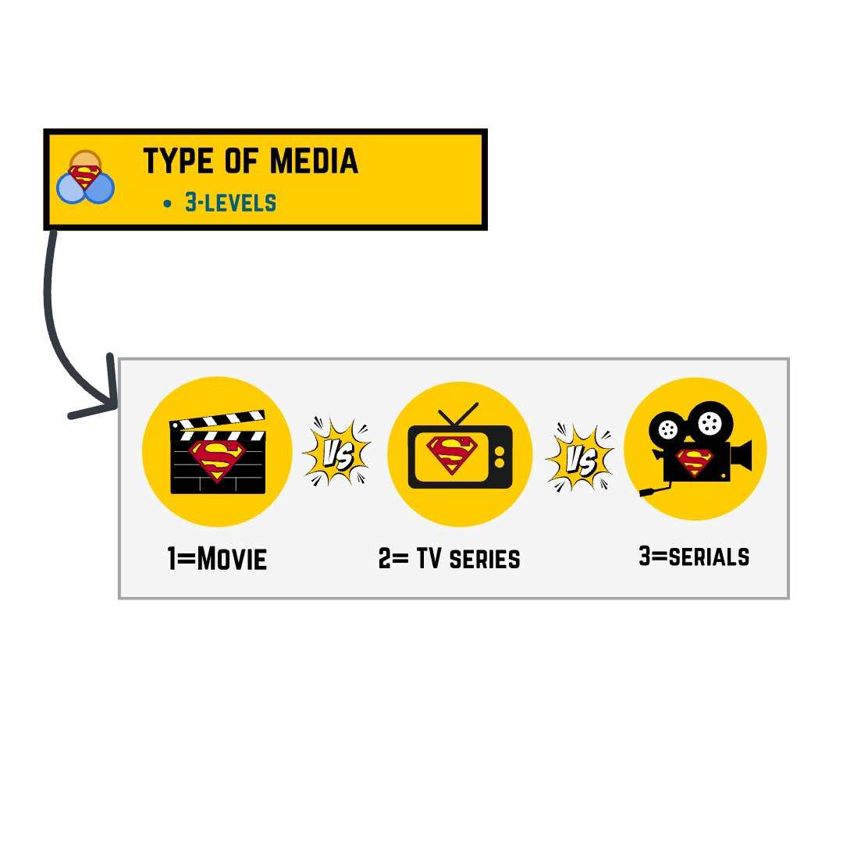
Variable Name: type
Movie clapperboard icon representing feature film productions and cinema media type

Slide 54
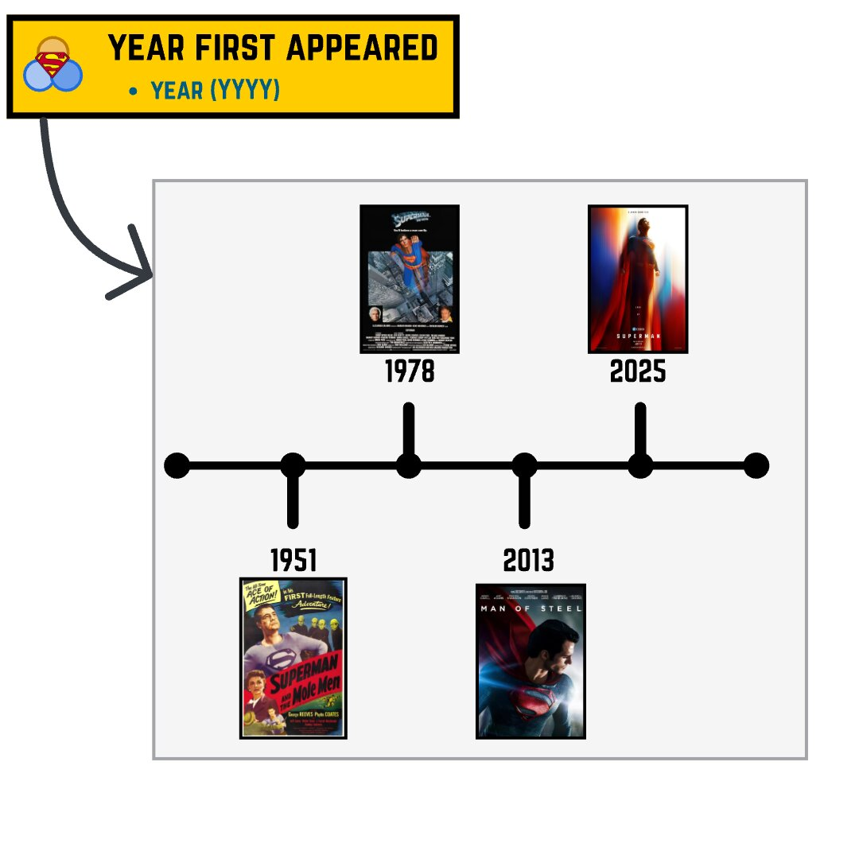
Variable Name: first_appear
Timeline showing years from 1940s to 2020s with markers indicating when different Superman adaptations first appeared

Slide 55
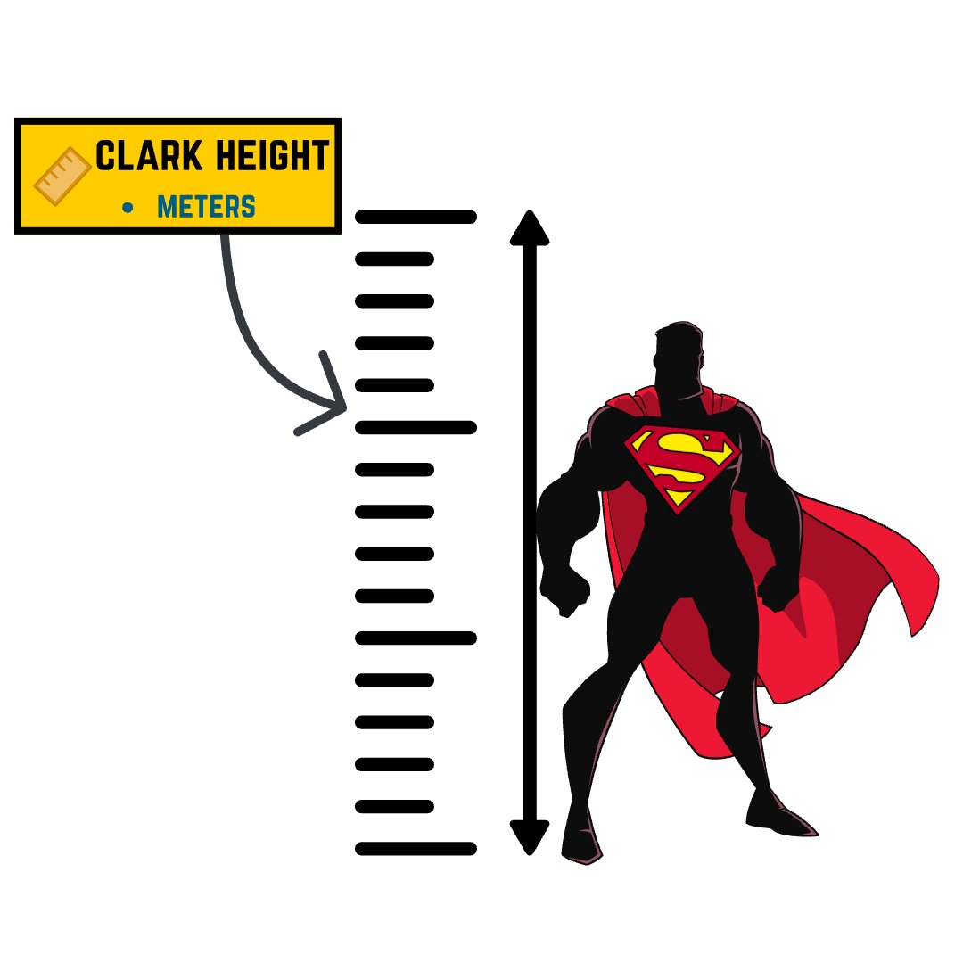
Variable Name: clark_height
Diagram showing metric height measurements stacked vertically illustrating continuous measurement in meters with decimal precision

Slide 56
Variable Name: height_grp
Whether or not Superman actor is over 6ft tall: 1=Yes (≥1.83m/6’0”), 2=No (<1.83m/6’0”)

Slide 57
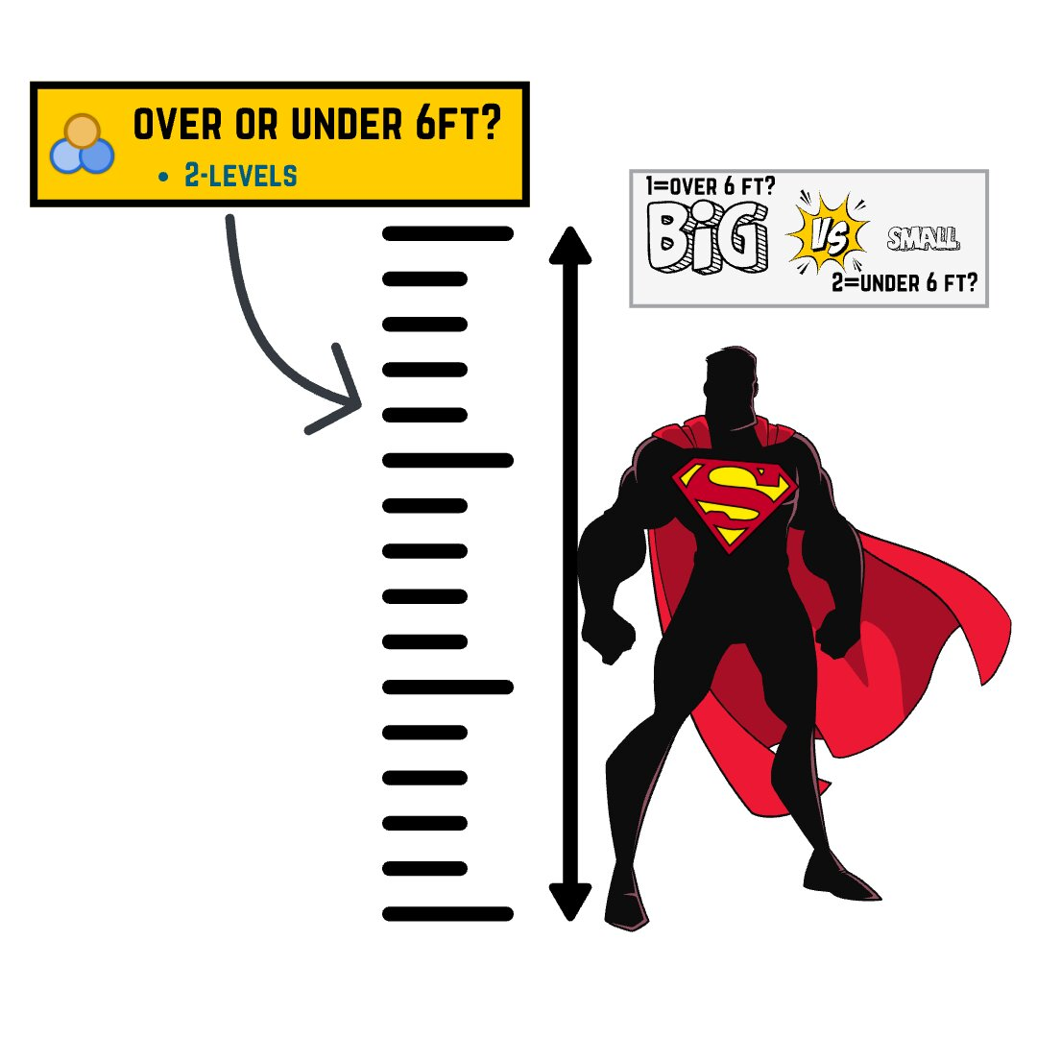
Variable Name: height_grp (continued)
Diagram showing binary categorization of height with actors classified as either over 6 feet tall or under 6 feet tall

Slide 58
Variable Name: lois_height
Height of Lois Lane actor in inches (rounded up)

Slide 59
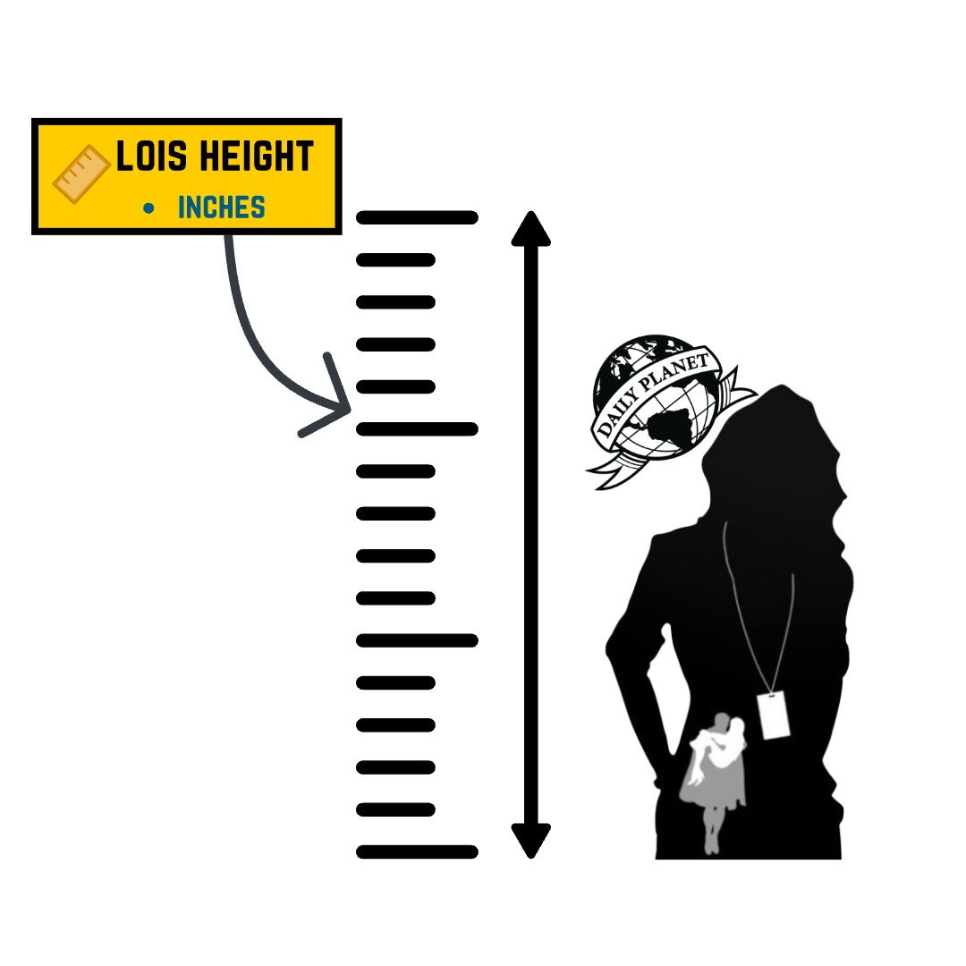
Variable Name: lois_height (continued)
Chart showing Lois Lane actor heights measured in centimeters with values rounded up to nearest whole number

Slide 60
Variable Name: height_diff
Clark’s height - Lois’s height in meters (to 2 decimal places)

Slide 61
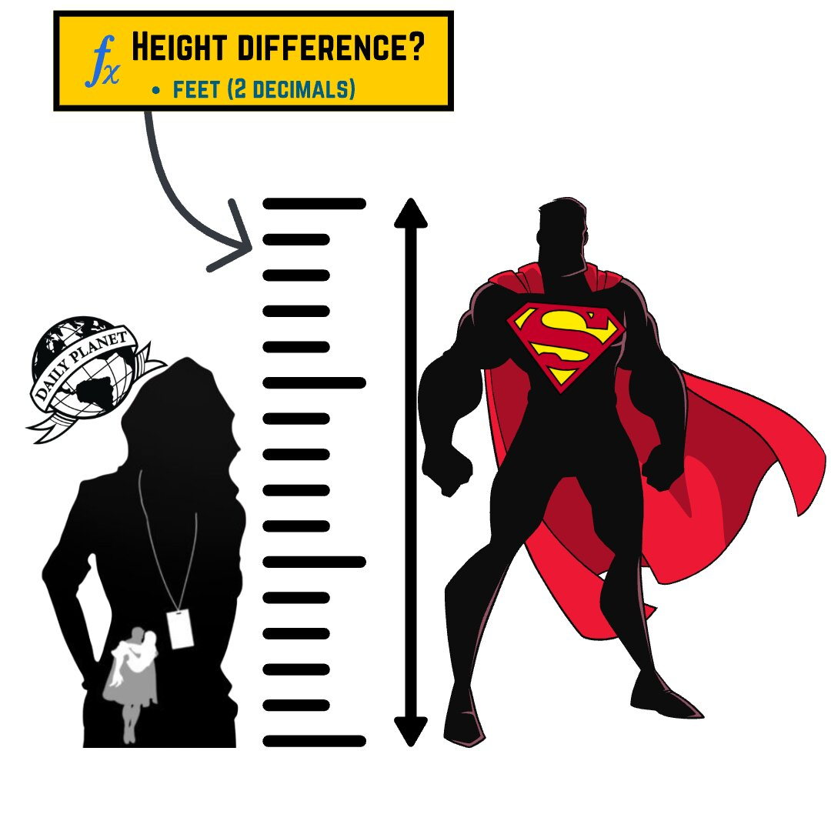
Variable Name: height_diff (continued)
Visual representation of height difference calculation between Clark Kent and Lois Lane actors showing the gap in meters

Slide 62
Developing More Research Questions
For any conceptual definition of a construct, there will be many different operational definitions or ways of measuring it.
The use of multiple operational definitions, or converging operations, is a common strategy in psychological research.

Slide 63
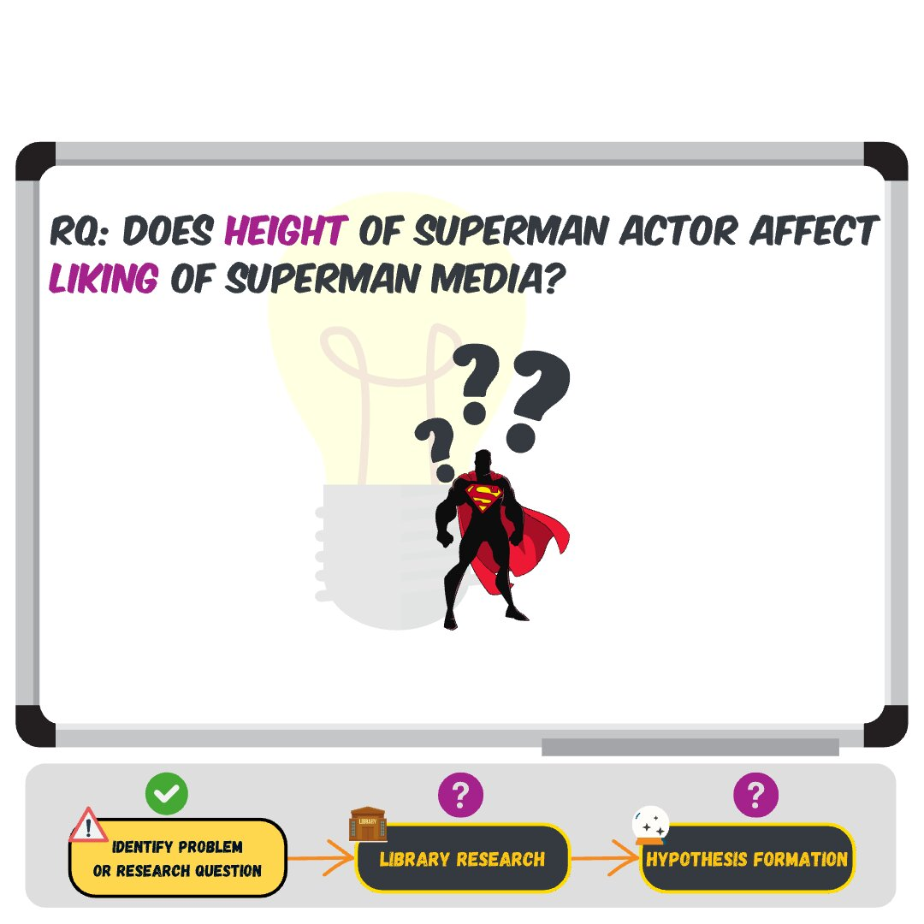
Bivariate Research Question?
Diagram showing research question about relationship between Superman and Lois Lane heights introducing bivariate analysis

Slide 64
More Practice: Measuring “enjoy”

Slide 65
Variable: rt_critics_score
Rotten Tomatoes critics score (0-100%)

Slide 66
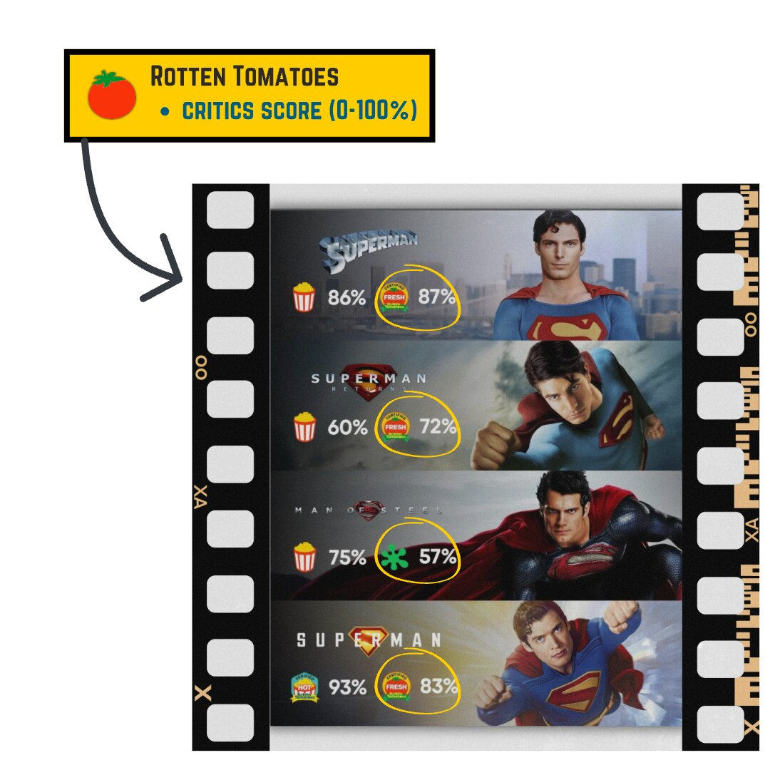
Variable: rt_critics_score (continued)
For more details, visit Rotten Tomatoes

Slide 67
Variable: rt_status
Rotten Tomatoes status (1=Fresh, 2=Certified Fresh, 3=Rotten)
For more details, visit Rotten Tomatoes

Slide 68
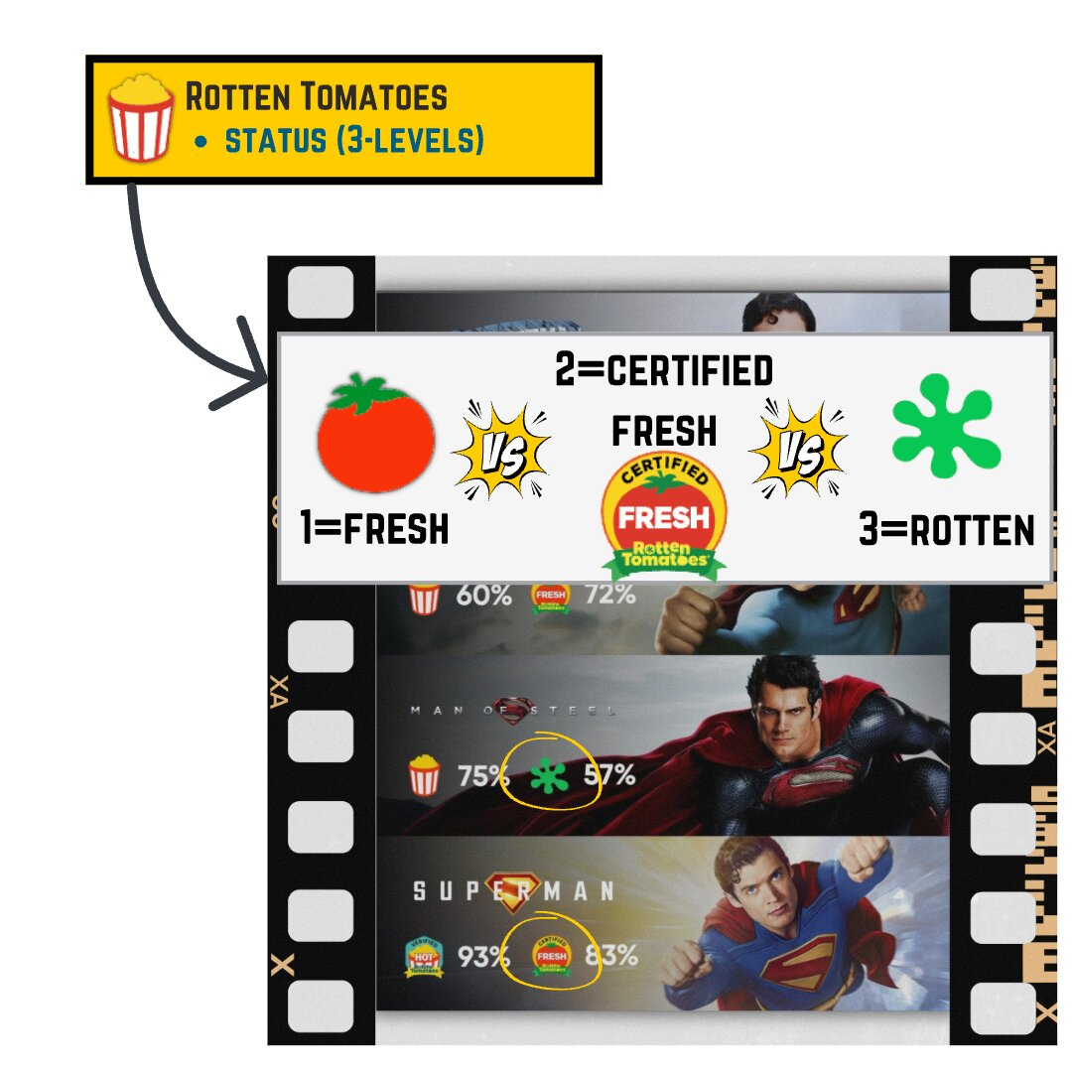
Variable: rt_status (continued)
Rotten Tomatoes logo featuring red tomato icon and brand name

Slide 69
Variable: rt_audience_score
Rotten Tomatoes audience score (0-100%)
For more details, visit Rotten Tomatoes

Slide 70
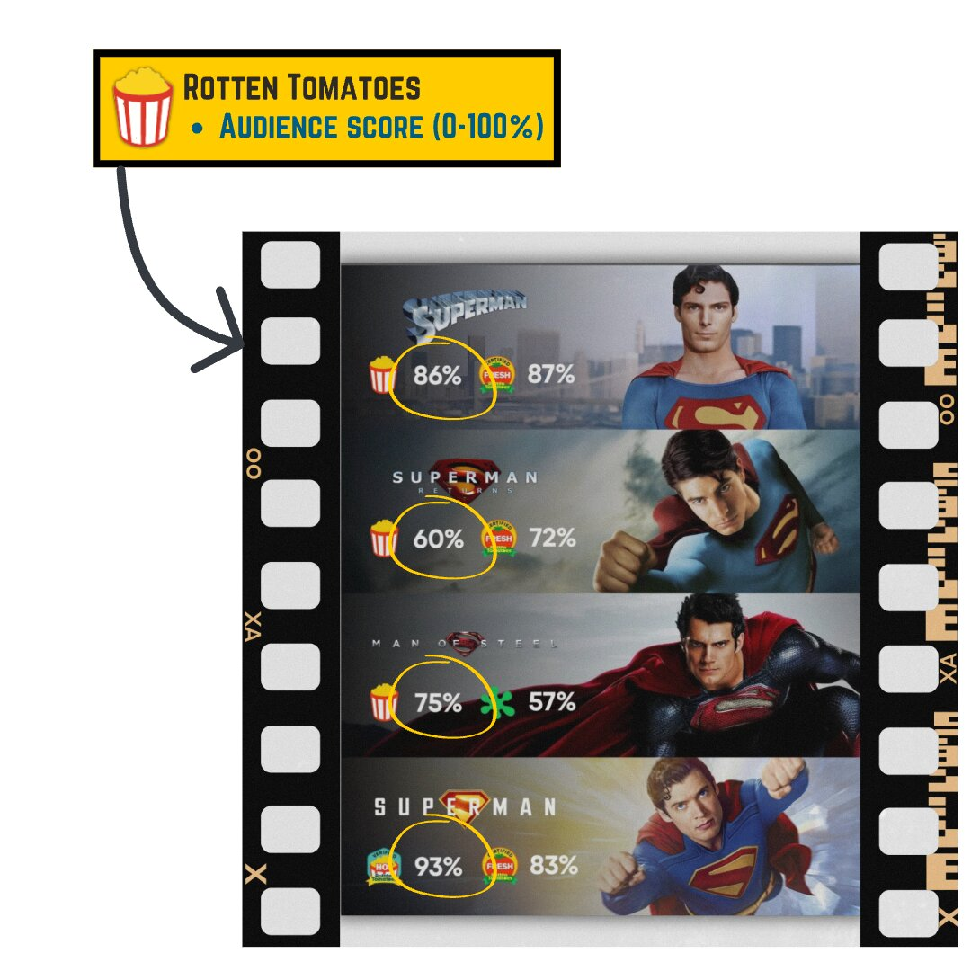
Variable: rt_audience_score (continued)
Rotten Tomatoes Audience Score showing general viewer ratings with popcorn bucket icons full for positive and spilled for negative scored 0 to 100 percent

Slide 71
Variable Name: lb_avg_stars
Letterboxd average rating (1-5 stars)
For more details, visit Letterboxd

Slide 72
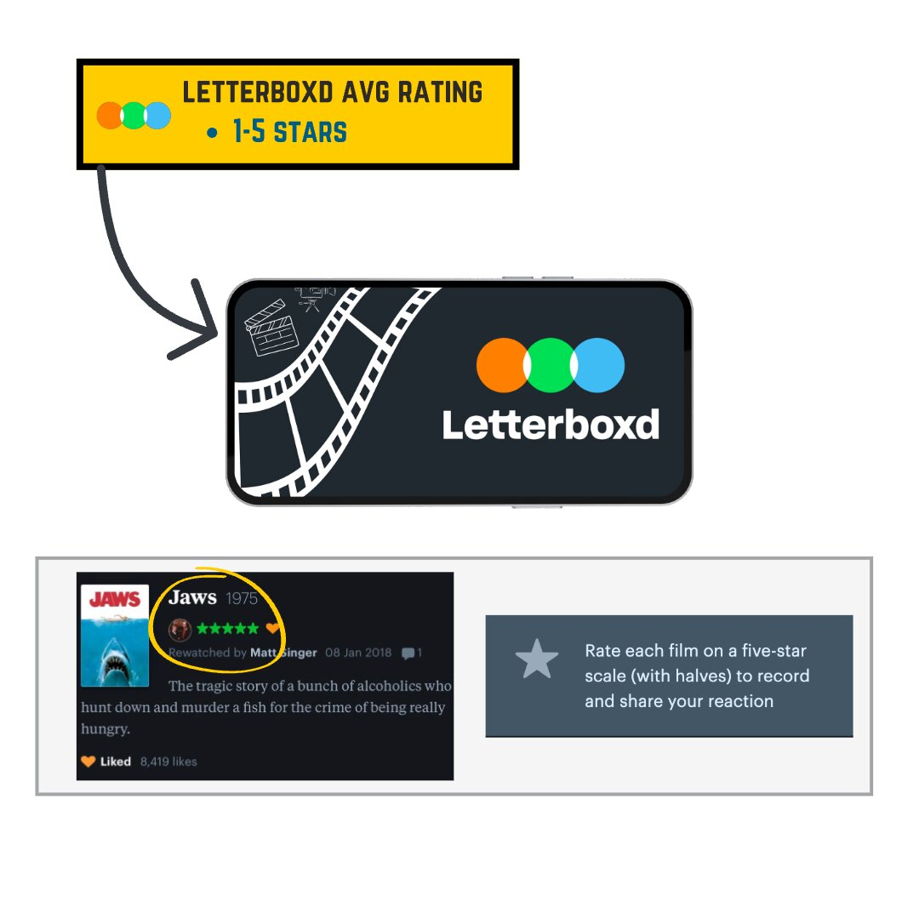
Variable Name: lb_avg_stars (continued)
Screenshot of Letterboxd review interface showing star rating system from 1 to 5 stars with average rating display

Slide 73
Variable Name: lb_reviews
Letterboxd number of reviews
For more details, visit Letterboxd

Slide 74
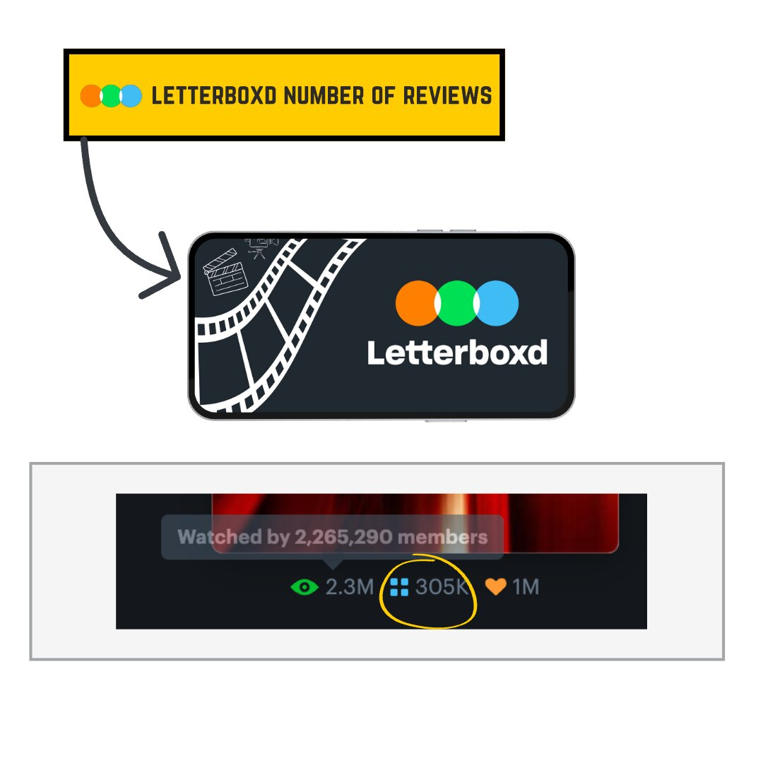
Variable Name: lb_reviews (continued)
Screenshot showing Letterboxd review count display with total number of user reviews for a film

Slide 75
Variable Name: metacritic_score
Metacritic score (0-100)
For more details, visit Metacritic

Slide 76
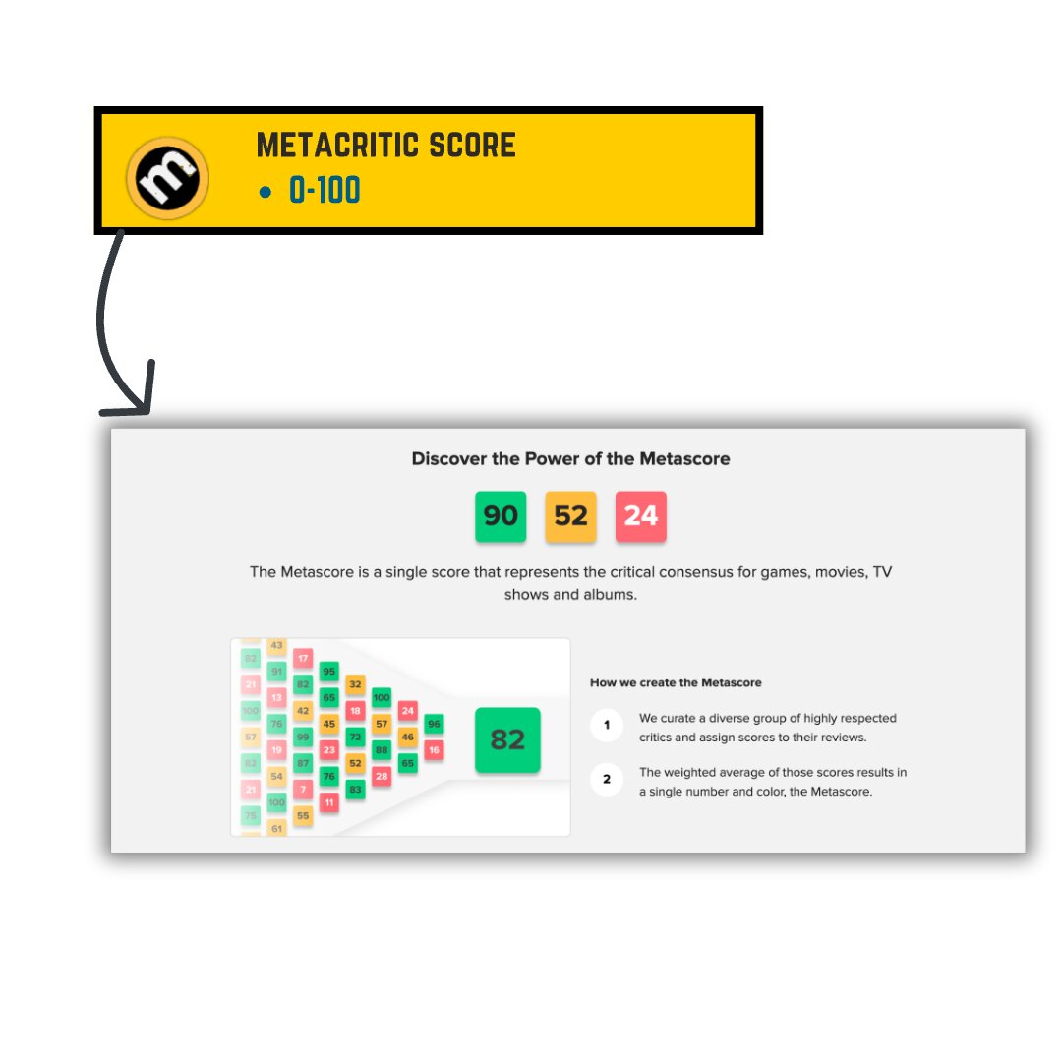
Variable Name: metacritic_score (continued)
Diagram of Metacritic score calculation. First, describes a Metascore as a single score that represents the critical consensus for games, movies, TV shows, and albums; Then it describes how that score is computed by first identifying a group of highly respected critics, and then second creating a weighted average of those scores to produce a single number

Slide 77
Variable Name: emotion
Primary emotion while watching (1=fear, 2=joy, 3=sadness, 4=anger, 5=disgust, 6=anxiety)

Slide 78
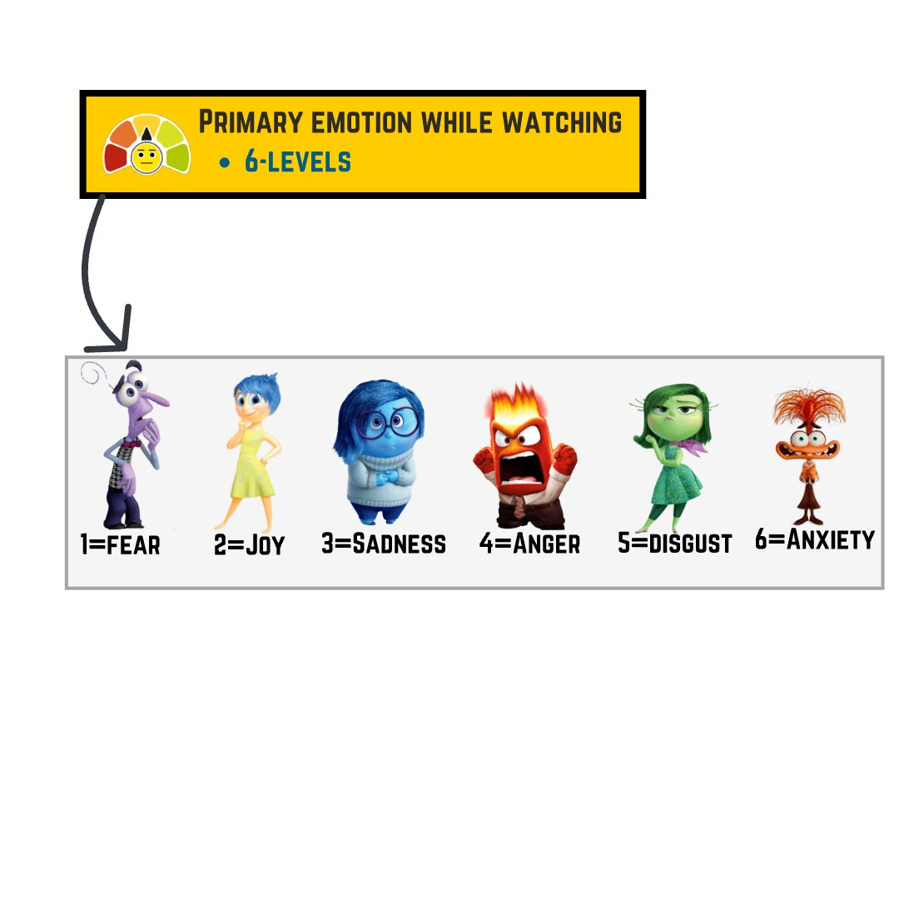
Variable Name: emotion (continued)
List of emotions from inside-out

Slide 79
Understanding Scales & Sub-scales!!
Overview of Subjective Movie Enjoyment Scale showing complete multi-item survey instrument with various subscales

Slide 80
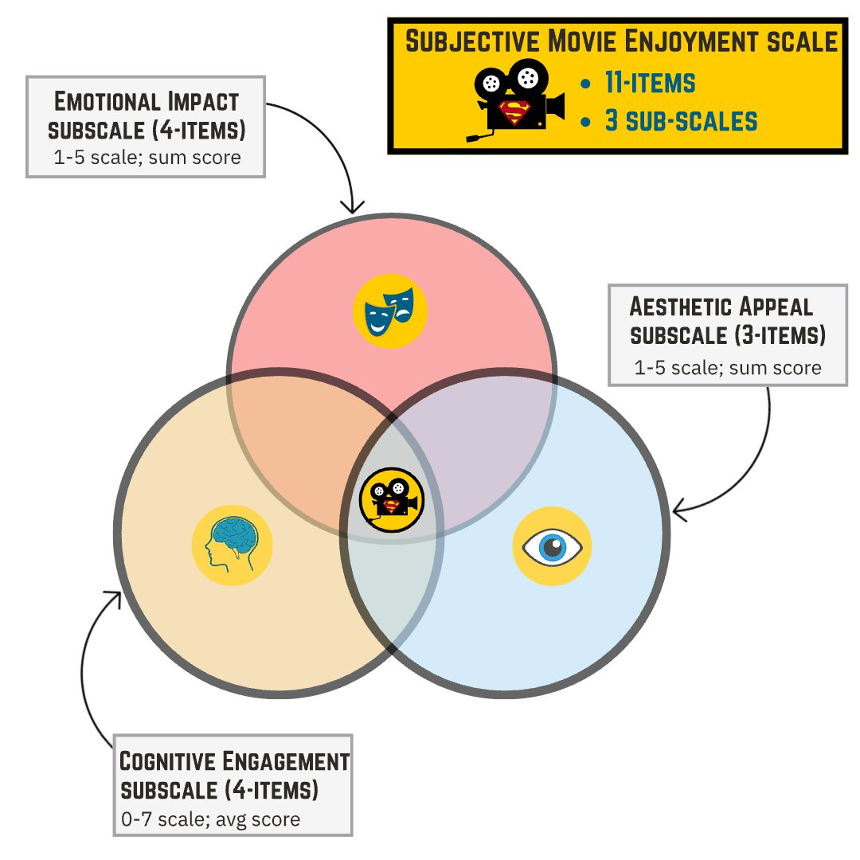
Understanding Scales & Sub-scales!! (continued)
Detailed view of SMES subscales: Emotional Impact 4 items on 1 to 5 scale, Aesthetic Appeal 3 items on 1 to 5 scale, and Cognitive Engagement 4 items on 0 to 7 scale

Slide 81
Variable Name: emo (SMES Subscale)
Detailed view of SMES subscales: Emotional Impact 4 items on 1 to 5 scale

Slide 82
Variable Name: aes (SMES Subscale)
Detailed view of SMES subscale: Aesthetic Appeal 3 items on 1 to 5 scale

Slide 83
Variable Name: cog (SMES Subscale)
Detailed view of SMES subscales: Cognitive Engagement 4 items on 0 to 7 scale

Slide 84
Questions?

Slide 85
Partner Activity: Find a partner and work on the Part 2: In-class section!!

Slide 86
✍️

Slide 87
45-minute practice activity

Slide 88
Discussion Time
Share answers and discuss Part 2: In-class section!!

Slide 89
Take-Home Assignment
Complete the Take-Home section and submit to canvas before Lab 03!

Slide 90
Assignments & Reminders
Given this week:
Submit to your lab section before week 3: Lab 2: Operationalization & Measurement Worksheet
Due this week:
Lab 01: APA References Zotero Worksheet
Submit to your lab section in Canvas by 11:59pm the day before your lab meets.

