Slide 1
Reading & Writing Research Reports
Lab 3
PSYCH 350-Lab

Slide 2
Today’s Tasks
Today’s lab:Reading & writing research reportsReview Lecture MaterialContents of a research report, Validity Net, All the words
Today is about learning to dig into a paper and read it critically. This means extracting information – especially extracting information that isn’t directly given to you in a paper and must be inferred. But, we will also learn when not to make assumptions that cover up potential flaws

Slide 3
What You Need Today
Everything for this week is linked on the next slides – and always on the lab page under Handouts & References.
Open these before we start so you can follow along.

Slide 4
Critically Reading Research Reports
[arrow icon]
Reading and Writing Research Reports
[Web page]
[book icon]
Reading and Writing Research Reports (pdf version)
[PowerPoint]

Slide 5
Contents of an APA Report: What Info is Where?
[book icon]
Validity Net (copied from lecture unit 1)
[PDF]
[book icon]
All The Words (copied from lecture unit 1)
[PDF]

Slide 6
Weekly Lab Assignment
[book icon]
Research Critique #1
[Word document]
[book icon]
Research Critique #2
[Word document]

Slide 7
Reading & Writing: Research Reports
Everything we do revolves around these six basic things!!
What has the author(s) read that prompted the research?
What is the purpose of the research being reported ?
What is the specific research question or research hypothesis?
How was the research conducted ?
What are the results of the statistical analysis of the data as they relate to the research question or research hypothesis?
How do the current findings integrate with what the author(s) read that prompted the research?

Slide 8
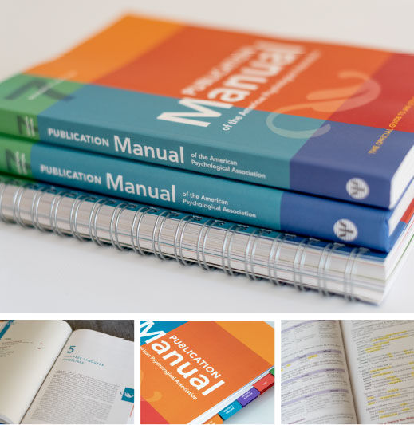
Standardizing Research with APA
APA standardized style & formatting for journals (1928-present) — currently on APA 7th Ed.
Three main components to style-guide:
  Content — order of concepts & material; rules for sections & labels
  Format — margins, citations, tables, etc.
  Style — language & terminology

Slide 9
Standardizing Research with APA (continued)
Notes:
Since there is a nearly universal set of 6 things used to describe one’s research and its outcomes, it makes sense to “standardize” those reports – making it easier to write them clearly and easier to read them.
Such “standardization” was the intent of a group of editors and business managers of anthropological and psychological journals in 1928. They wrote 7-page set of guidelines for authors. The most recent version of these guidelines, the Publication Manual of the American Psychological Association, 4th Ed., is a bit larger (368 pages), but has the same basic intent.
APA format, as we will apply it, has three components:
1) the content of the report and how it is organized and labeled 2) the format of the report (e.g., margins, citations, tables, etc.) 3) the style of the report (e.g., non-sexist language)

Slide 10
Elements of APA Style
Basic Rules:
Double-space everythingHave uniform margins of at least 1 in. at the top, bottom, right, and left of every pageWrite “formally” – without slang, contractions, etc.Use sentences and paragraphs (not “lists” unless hypotheses)Give credit to others for their ideas

Slide 11
Structure of an APA-style paper
APA uses six main sections that correspond with six basic components of research reports
Abstract
50-150 word summary of the key information of the study.
Introduction
Review of the literature that prompted the research.
Method
Participants: Who (what) and how they were selected
Materials: Equipment, measures, and materials used to collect data
Procedure: Treatment and data collection process

Slide 12
Structure of an APA-style paper (cont.)
Results
Description of the data analysis process and results.
Discussion
Relating the findings to the previous literature, limitations & future directions.
References
Citations of previous literature used to inform the study.

Slide 13

Introduction
General ➭ Specifics
Background: define the topic/context, what prior research says, and how it has been operationalized
Gaps: what information is missing? what questions remain unanswered?
The current study: the gap you plan to study and how you plan to study it

Slide 14
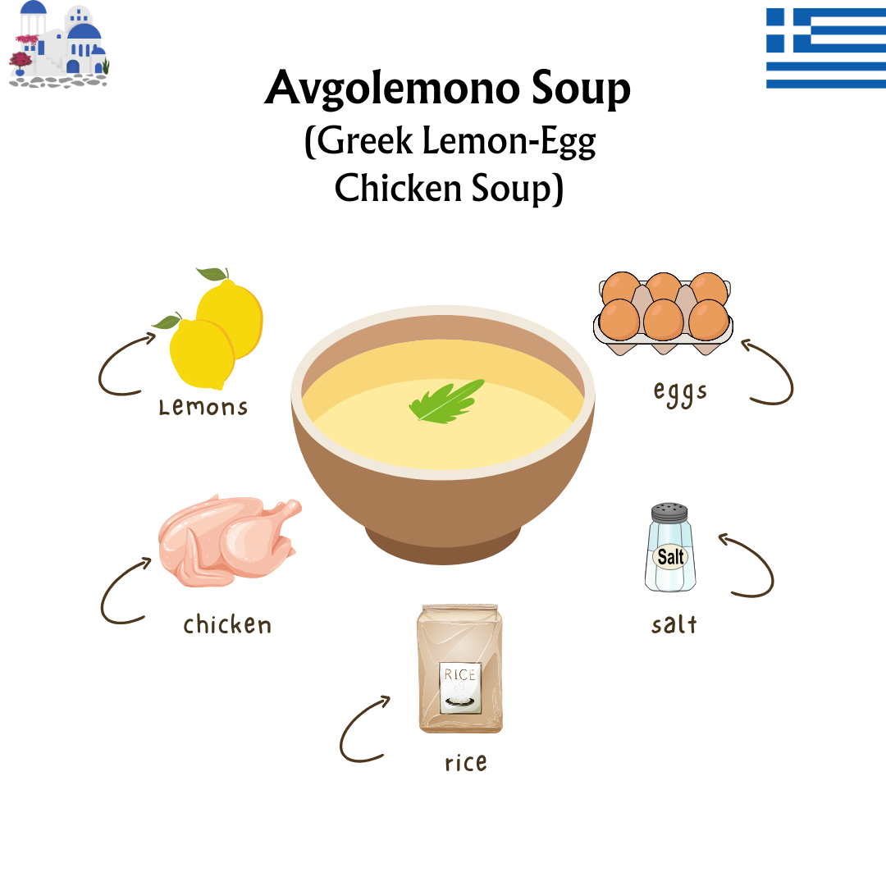
Method
Research recipe ➭ Ingredients + Steps
Participants: who is your sample, sample size, and demographics relevant to the population of interest
Materials: how the variables were measured, how the IV was manipulated (if experiment), and the range of values for each variable
Procedure: the design, and where & how the experiment took place

Slide 15
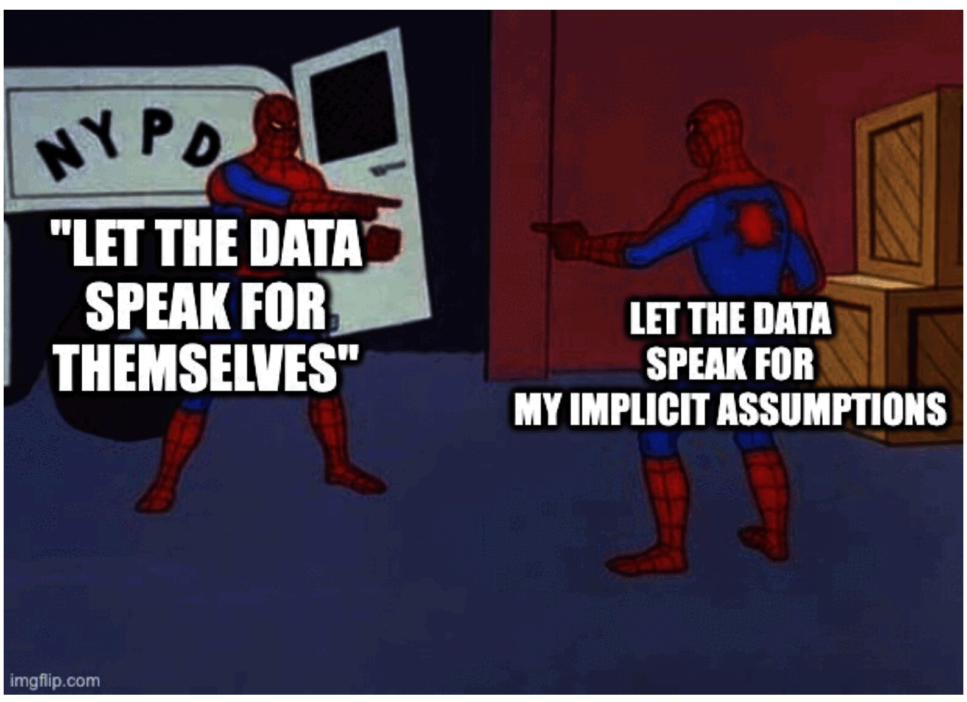
Results
Record of all data analysis
Univariate statistics: distribution & central tendency of each variable, any outliers or transformations, and reliability of scales
Bivariate or Multivariate analyses: what relationships exist between variables and how you tested them
Include all components of APA formatting for each analysis!!!!

Slide 16
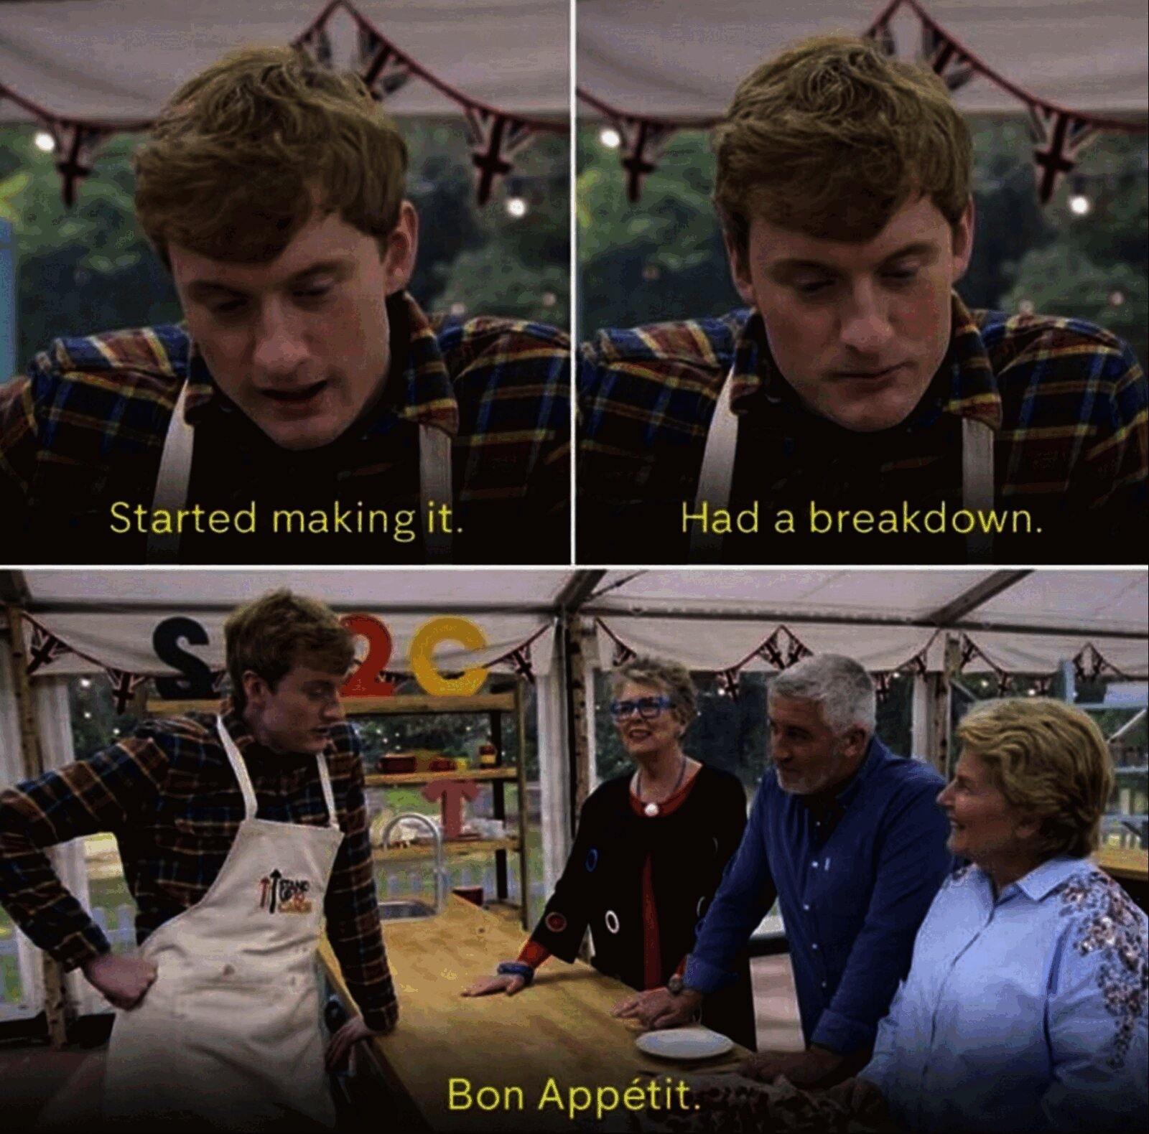
Discussion
Summarize & contextualize findings
Results (summarized): Brief recap of main findings without numbers
Interpretation and Implications:
  Were the main hypotheses supported?
  How do your findings fit within the existing literature?
Limitations:
  Explain limits of interpretability/generalizability
Future directions:
  What are the next steps?

Slide 17
Where to look for information
scroll down
What has the author(s) read that prompted the research ?
Introduction, Discussion, References
What is the purpose of the research being reported ?
Abstract, Introduction, Discussion
What is the specific research question or research hypothesis ?
Abstract, Introduction, Results, Discussion
Who were the participants ?
Abstract, Method - Participants
What equipment and/or materials were used ?
Abstract, Method - Materials/Apparatus
What treatment & data collection procedures were used ?
Abstract, Method - Procedures
What are the results of the statistical analysis of the data as they relate to the research question or research hypothesis?
Abstract, Results, Discussion, Tables/Figures
How do the current findings integrate with what the author(s) read that prompted the research?
Abstract, Discussion

Slide 18
Beware of Abstracts
Caution

Slide 19
Questions?

Slide 20

How to critique Research Articles
Step 1: Read (quickly-ish) the article
Step 2: Identify basics and big take-aways (main purpose, key design, etc.)
Step 3: Read (CAREFULLY) and take notes

Slide 21
Research Critiques: What to look for
1Hypotheses?
Look for all statements about the research hypothesis
  Remember can be explicit or implied
2External validity components
What looks good? What raises red flags? What is unclear?
  Relate generalizability back to stated goals of study (pop of interest)
3Internal validity components
What looks good? What raises red flags? What is unclear?
  Relate confounds or causal interpretation back to stated goals of study (design/hypotheses).
4Anything else of interest you find!
5Review your annotations and brainstorm alternatives
6Make suggestions or identify gaps in knowledge
But do not change the purpose, hypothesis, or overall design! Critique what they actually did, not the ideal study in your head!

Slide 22
Assignments & Reminders
Given this week:
Submit to your lab section before week 4: Research Critique #1 and Research Critique #2
Due this week:
Lab 02: Operationalization & Measurement Worksheet
Submit to your lab section in Canvas by 11:59pm the day before your lab meets.

