Slide 1
Project Planning & Bibliographic Research
Lab 5
PSYCH 350-Lab

Slide 2
Today’s Tasks
Introduction to Research Project MaterialsLiterature ReviewsBibliographic Research Assignment

Slide 3
What You Need Today
Everything for this week is linked on the next slides – and always on the lab page under Handouts & References.
Open these before we start so you can follow along.

Slide 4
Introduction to Research Project Data Sets and Project Planning (1/2)
[book icon]
Project Materials
[book icon]
Research Project Suggestions
[PDF]
[book icon]
Self-Descriptive Survey Materials (select one)
[book icon]
Self-Descriptive Content & Methods
[PDF]
[chart icon]
Self-Descriptive Dataset (.sav)
[SPSS data file]
[book icon]
Interpersonal Survey Materials

Slide 5
Introduction to Research Project Data Sets and Project Planning (2/2)
[book icon]
Interpersonal Content & Methods
[PDF]
[chart icon]
Interpersonal Dataset (.sav)
[SPSS data file]

Slide 6
Final Project Pre-proposal (select one)
[book icon]
Self-Descriptive Pre-proposal
[Word document]
[book icon]
Interpersonal Pre-proposal
[Word document]

Slide 7
Finding references for your project
[book icon]
Research Project References & Literature Review Worksheet
[Word document]

Slide 8
Research Project Pre-Proposal
Step 0: Select Data Source for project
Step 1: Select CORE variable
Step 2: Find (3) references related to the CONCEPT measured by core variable
Step 3: Select other variables for RHs in project
  Var 1 (Quant)
  Var 2 (Quant)
  Var 3 (Cat)
  Var 4 (Cat)
  BONUS: Var 5 (Quant) & Var 6 (Cat)

Slide 9
Questions?
Important
Reminder!! You will only complete and turn in ONE Project Pre-Proposal worksheet!

Slide 10
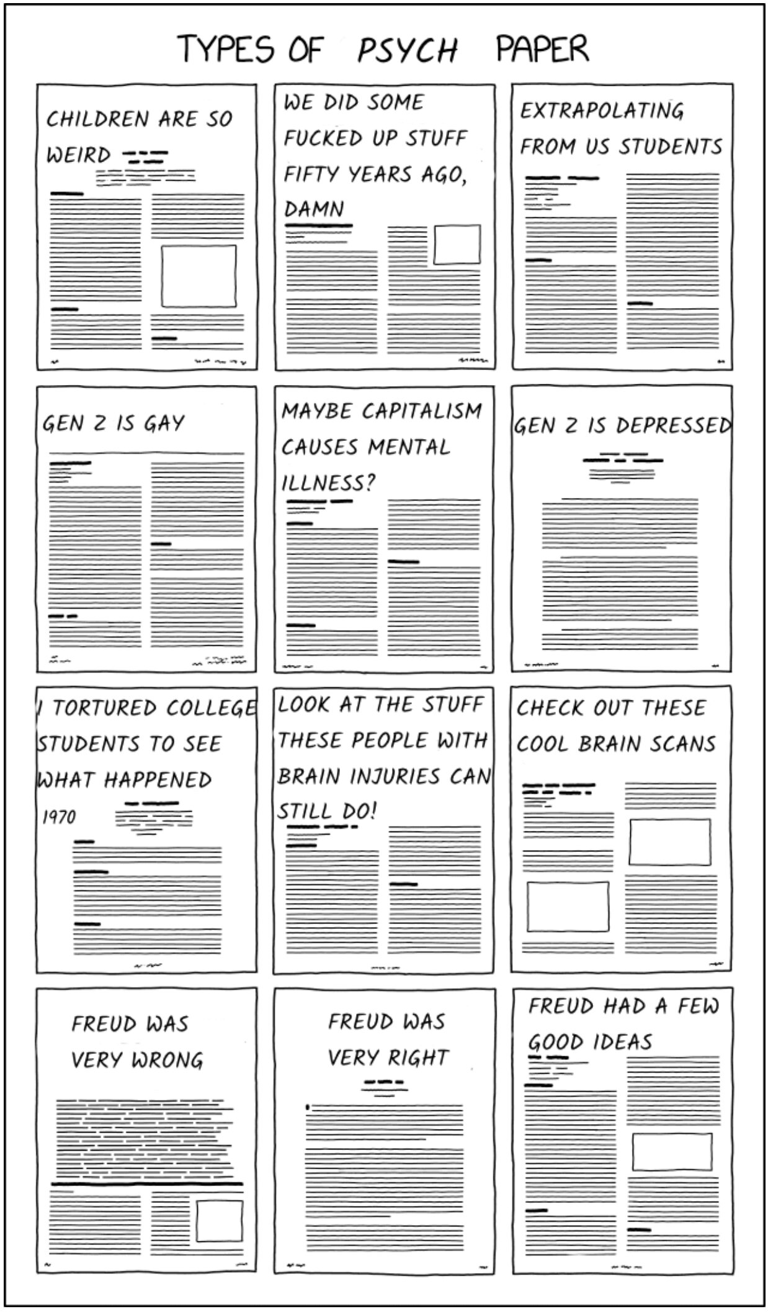
Reviewing the Literature
Function of literature review is to:
  🎉 define relevant constructs
  💡 build on prior work
  🚧 design program of research
  🎤 demonstrate credibility

Slide 11
Internet-ing as an academic
Tip
If you need help or have questions, ask a Librarian!

Slide 12
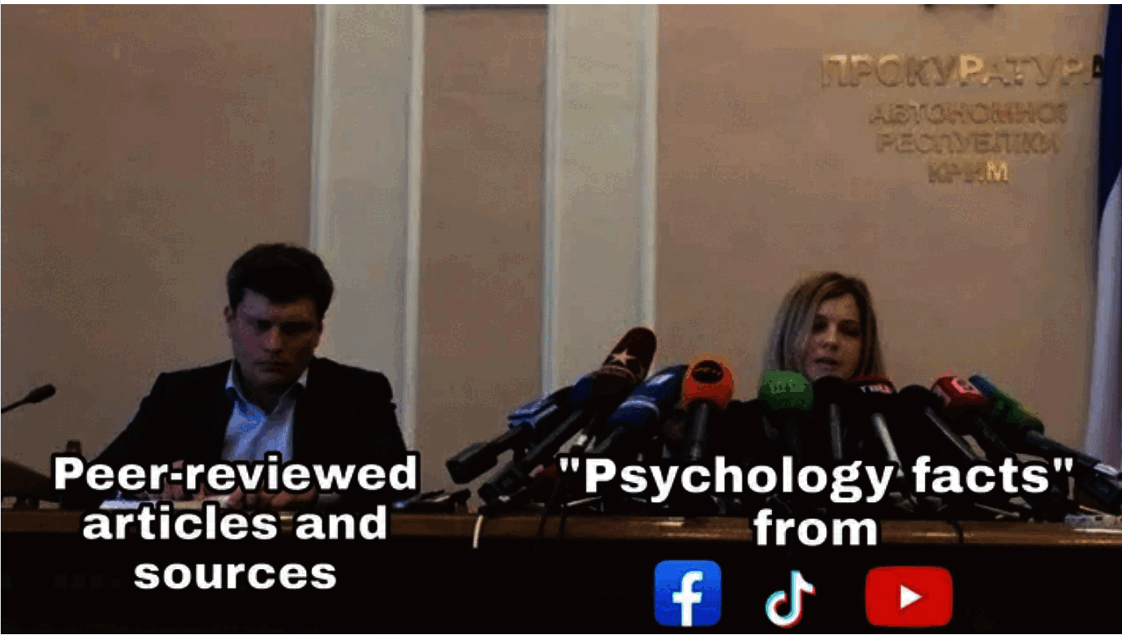
Internet-ing as an academic (continued)
UNL Library Resources
  PSYC-350 Guide
  Interlibrary loan service
Google Scholar
Boolean Searching
  Be creative!

Slide 13
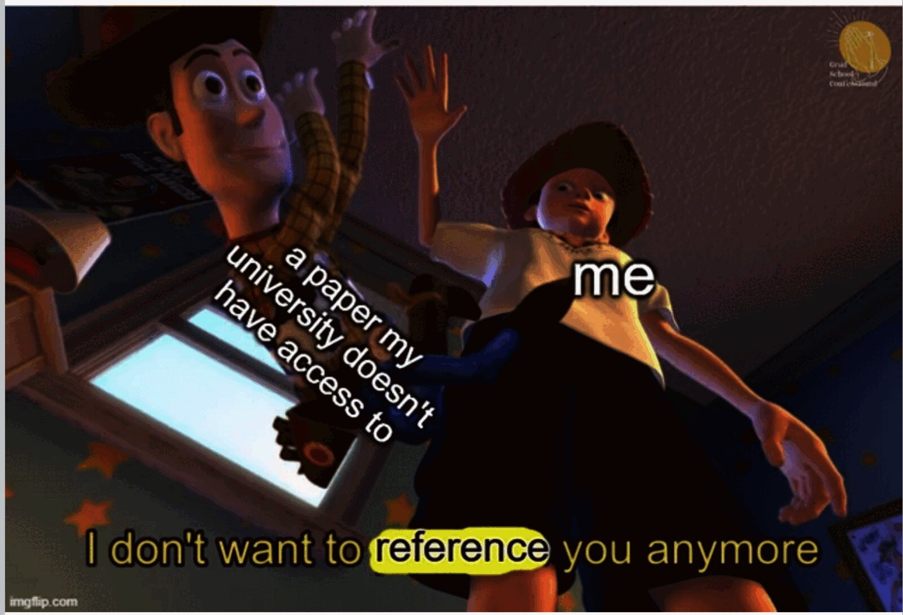
IYKYK
Toy Story meme where a paper my university does not have access to is dropped with the caption I do not want to reference you anymore

Slide 14
IYKYK (continued)
Tip
I am definitely not telling you to use an alternative open-source site like Sci-hub because I would never tell you to do that because IP & copyright law is super-duper moral and uncomplicated.

Slide 15
Questions?

Slide 16
Practice: Lit Review
Step 1: Find a starting point (identify topic/concept of interest)
Step 2: Expand the search: Find more recent articles
Step 3: Expand the search: Find more older articles
Step 4: Defining the “Scope” and “Structure” of your topic
Step 5: Search key terms in PsycINFO
Step 6: Expand with key author search
Step 7: Organize, track & take notes for each article
  Zotero → APA references

Slide 17
Step 1: Getting started
Hindsight bias
The tendency for individuals to rely on new knowledge when recalling their initial predictions of an event.

Slide 18
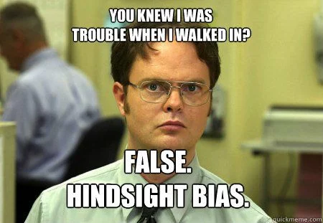
Step 1: Getting started (continued)
Dwight Schrute meme captioned You knew I was trouble when I walked in? False. Hindsight bias.

Slide 19
Reference types: classic vs hot new
“Classic” reference
An older reference on the subject – the building blocks of the field, cited in recent literature.
“Hot new” reference
A recent reference (within ~5 years) – identifies the current state of the field.

Slide 20
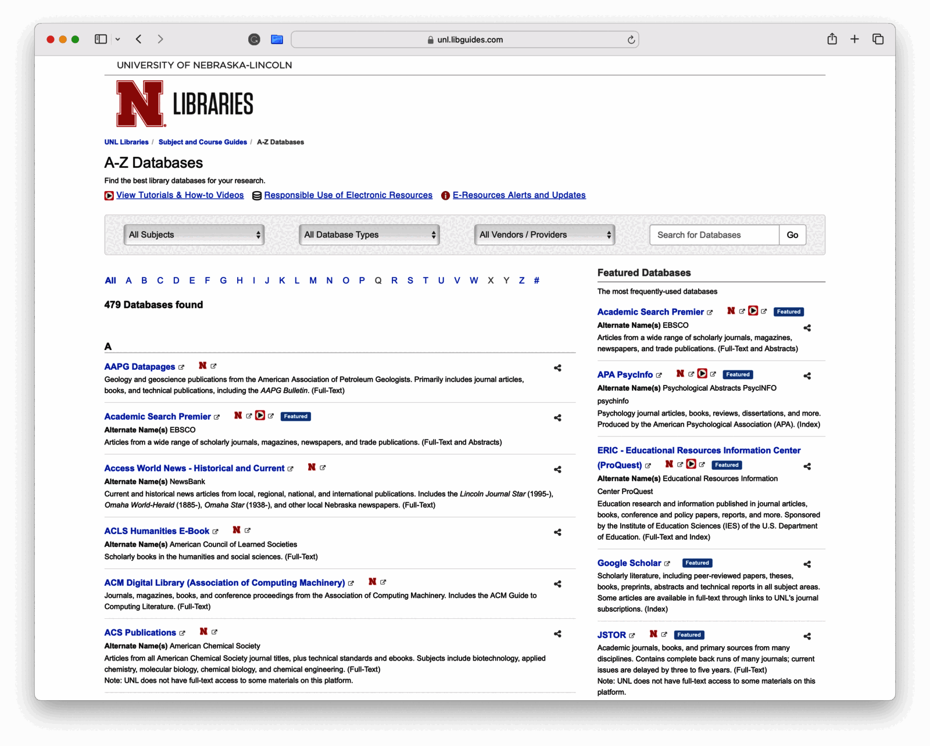
Finding a classic reference
Screenshot of the UNL Libraries A-Z Databases page listing research databases with APA PsycInfo featured

Slide 21
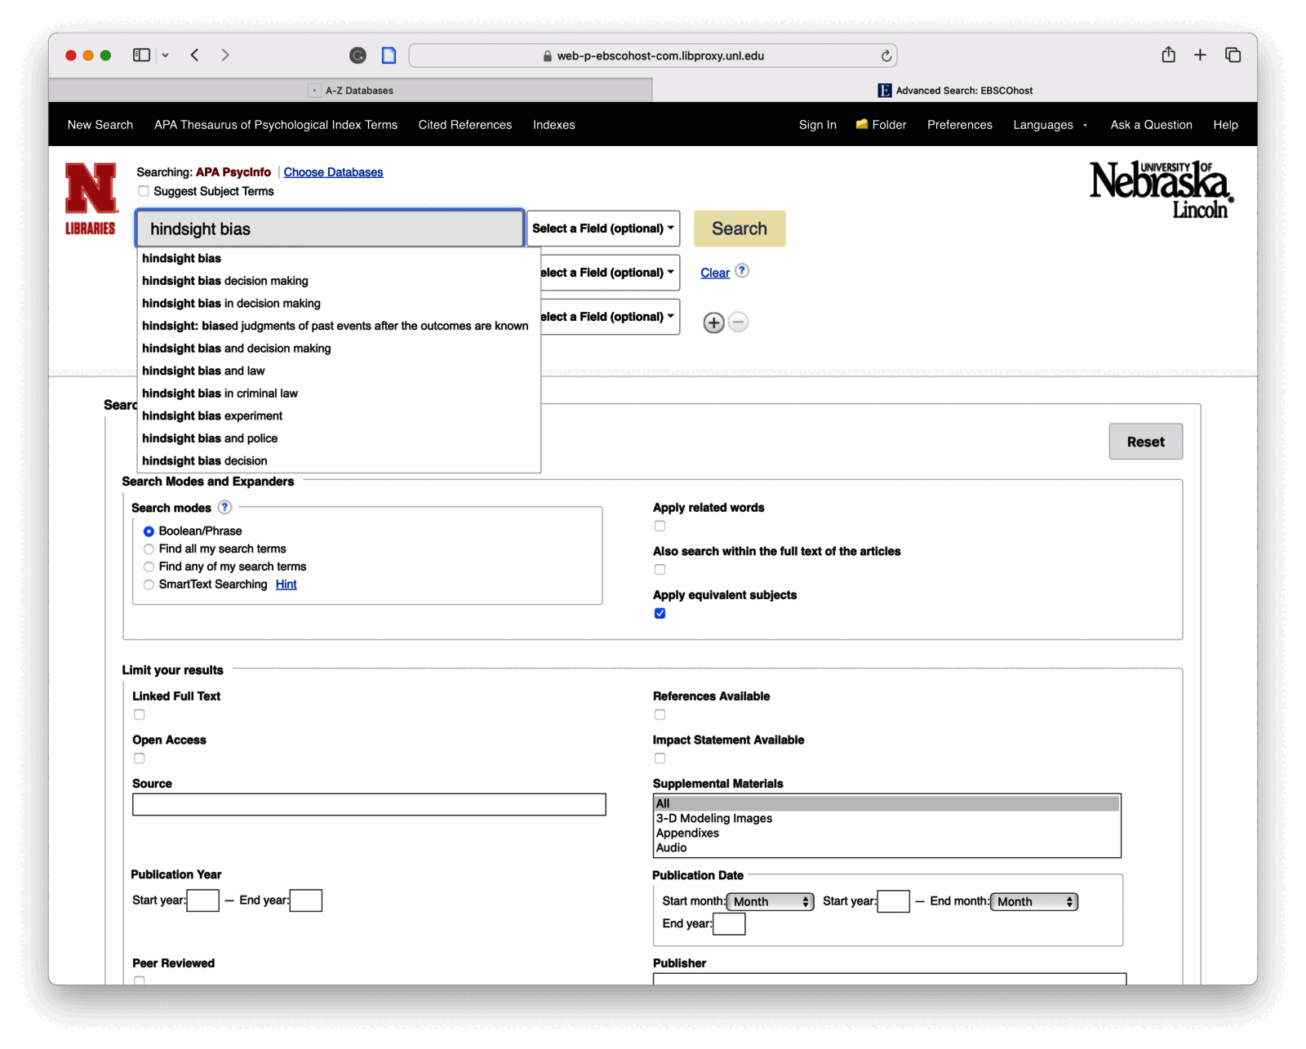
Finding a classic reference (continued)
Screenshot of the APA PsycInfo advanced search page with hindsight bias typed into the search box and autocomplete suggestions displayed

Slide 22
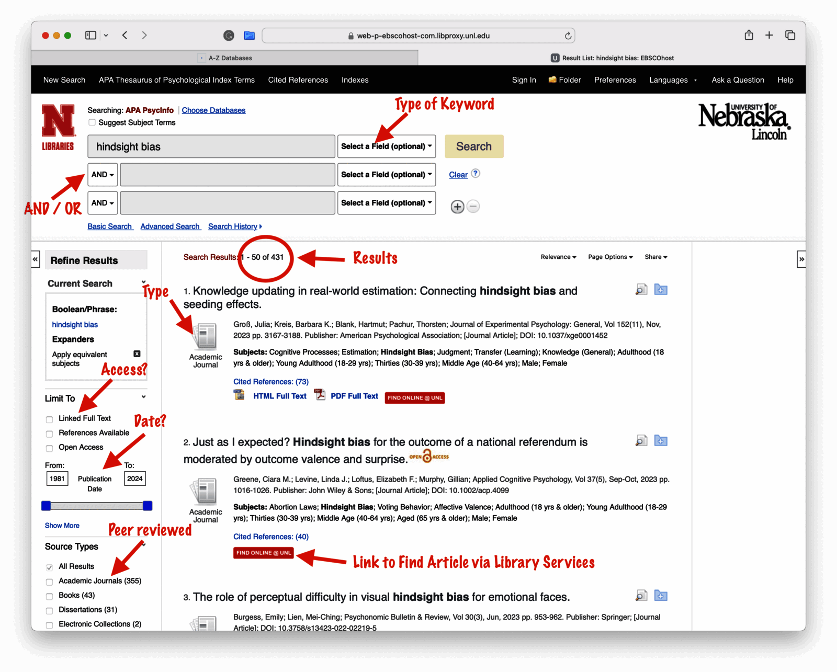
Finding a classic reference (continued)
Annotated screenshot of PsycInfo search results for hindsight bias, highlighting keyword fields, AND and OR connectors, the result count, and filters for access, date, and peer review

Slide 23
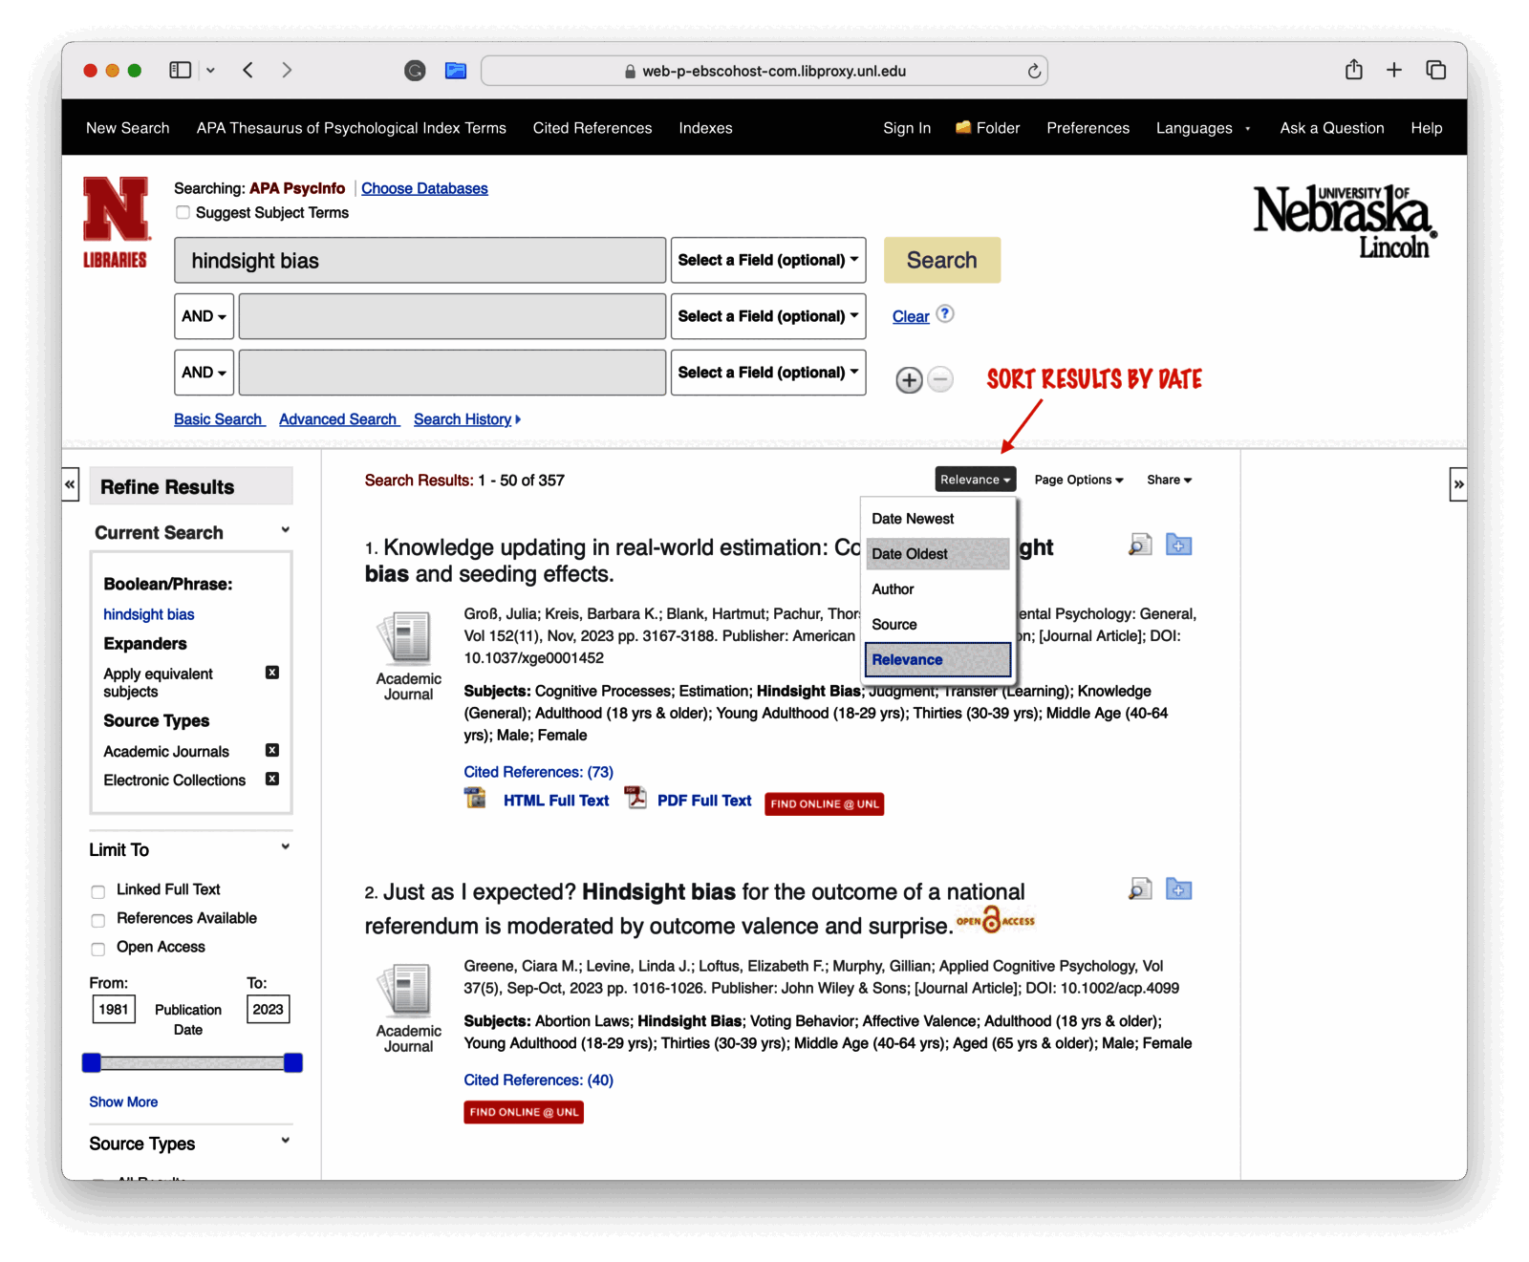
Finding a classic reference (continued)
Screenshot of PsycInfo search results with the sort menu open, highlighting the option to sort results by date

Slide 24
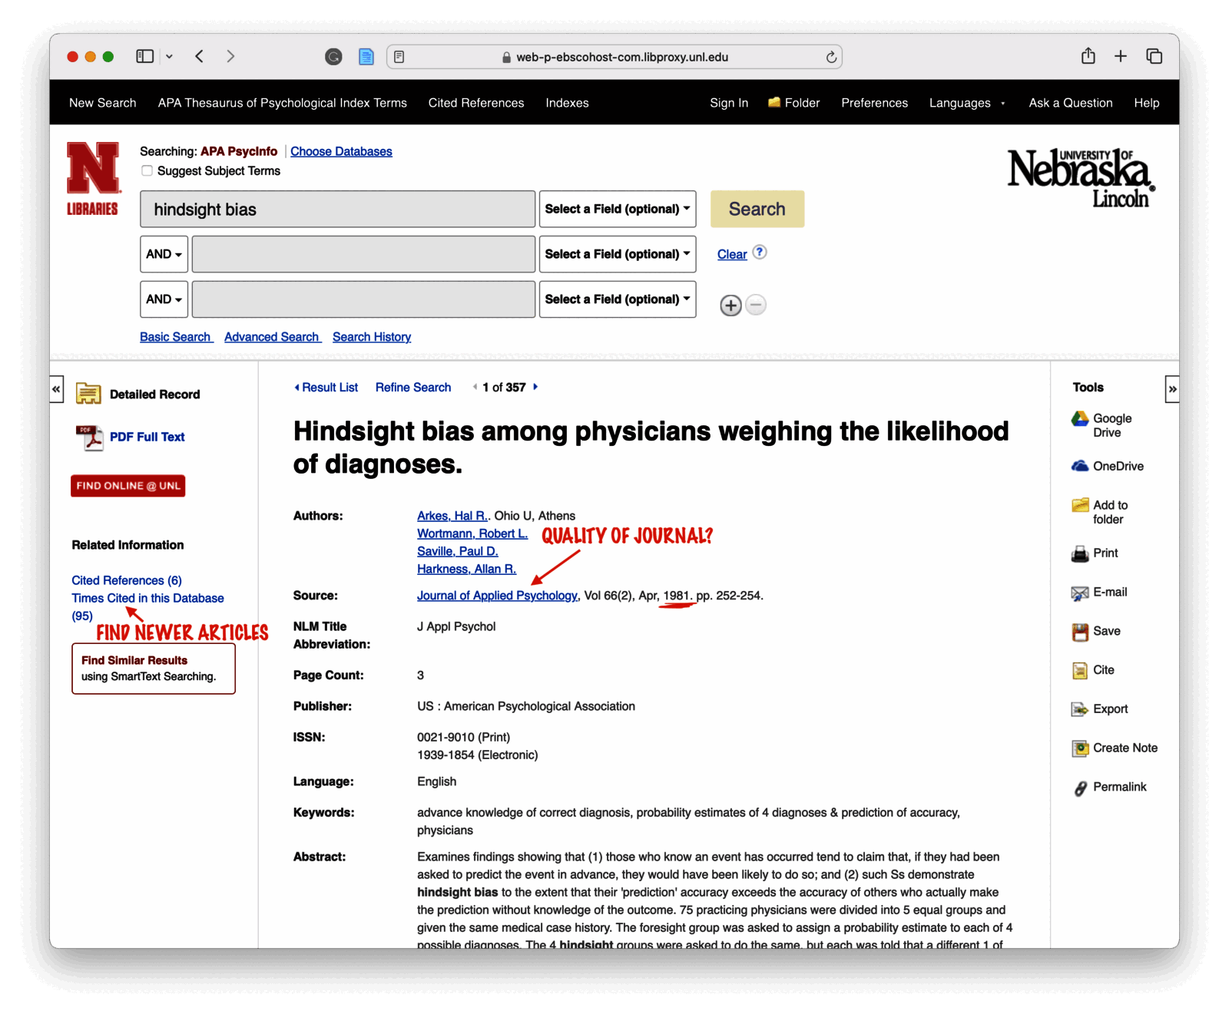
Finding a classic reference (continued)
Annotated screenshot of a 1981 PsycInfo article record on hindsight bias, highlighting the Times Cited link for finding newer articles and the journal name for checking quality

Slide 25
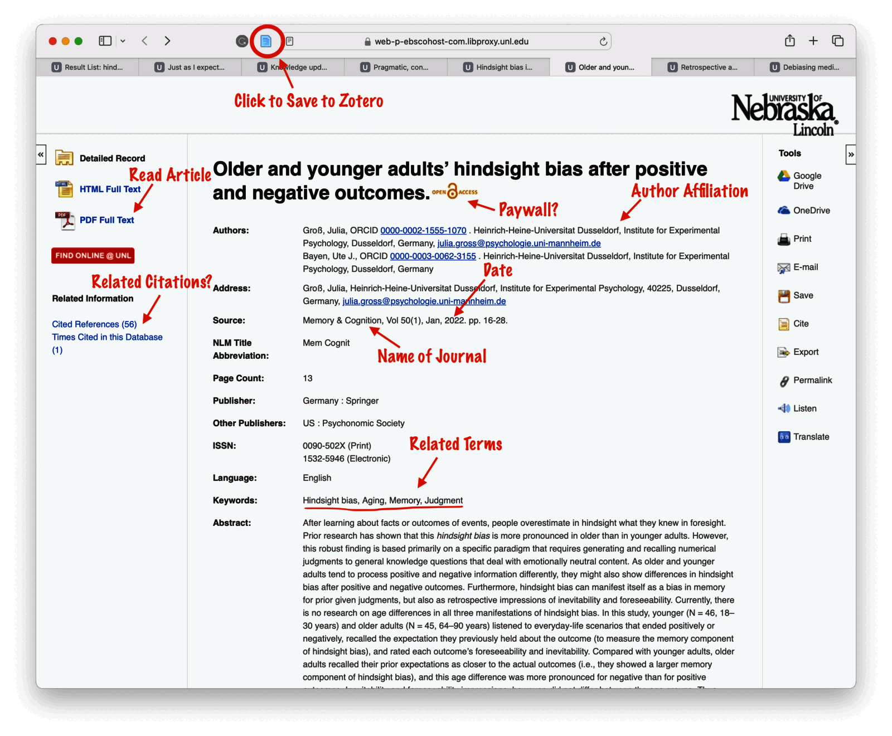
Finding a Hot New reference
Annotated screenshot of a PsycInfo article record highlighting where to read the article, save it to Zotero, and find the journal name, date, author affiliation, related terms, and related citations

Slide 26
Practice: Lit Review
Step 1: Find a stating point (identify topic/concept of interest)
  Find a “classic” (older) reference on subject
  Find a “hot new” reference
Step 2: Expand the search: Find more recent articles
Step 3: Expand the search: Find more older articles
Step 4: Define the “Scope” and “Structure” of your topic
Step 5: Search key terms in PsycINFO
Step 6: Expand with key author search
Step 7: Organize, track & take notes for each article
  Zotero → APA references

Slide 27
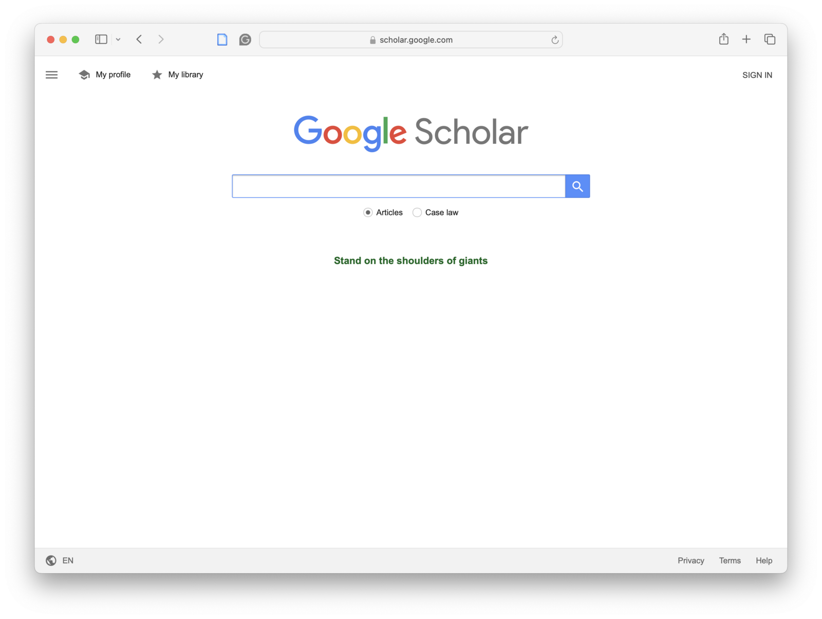
Step 2-3: Expand the search
Screenshot of the Google Scholar homepage with an empty search bar

Slide 28
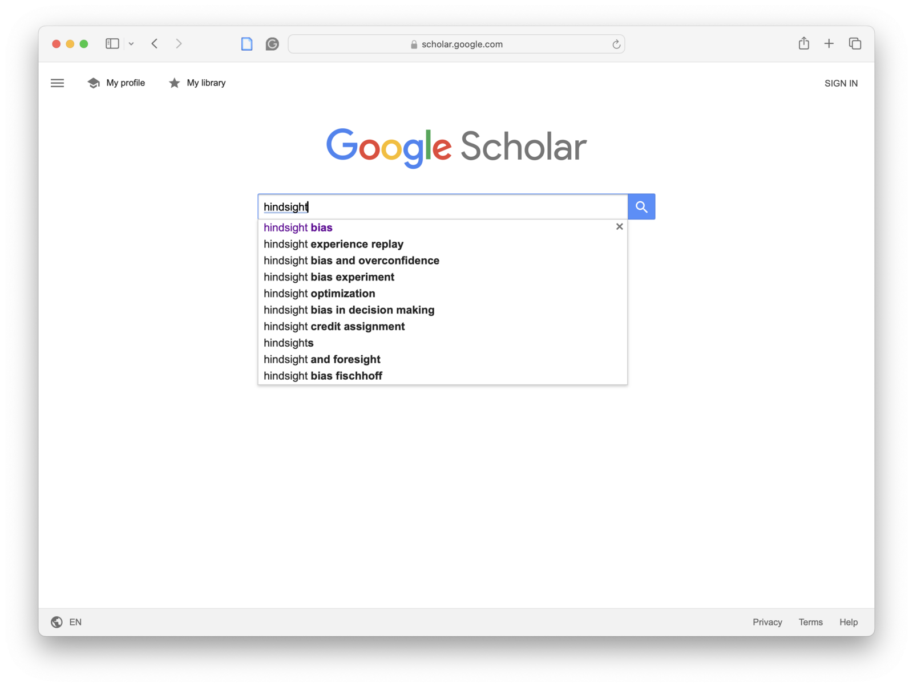
Step 2-3: Expand the search (continued)
Screenshot of Google Scholar with hindsight typed into the search bar and autocomplete suggestions including hindsight bias

Slide 29
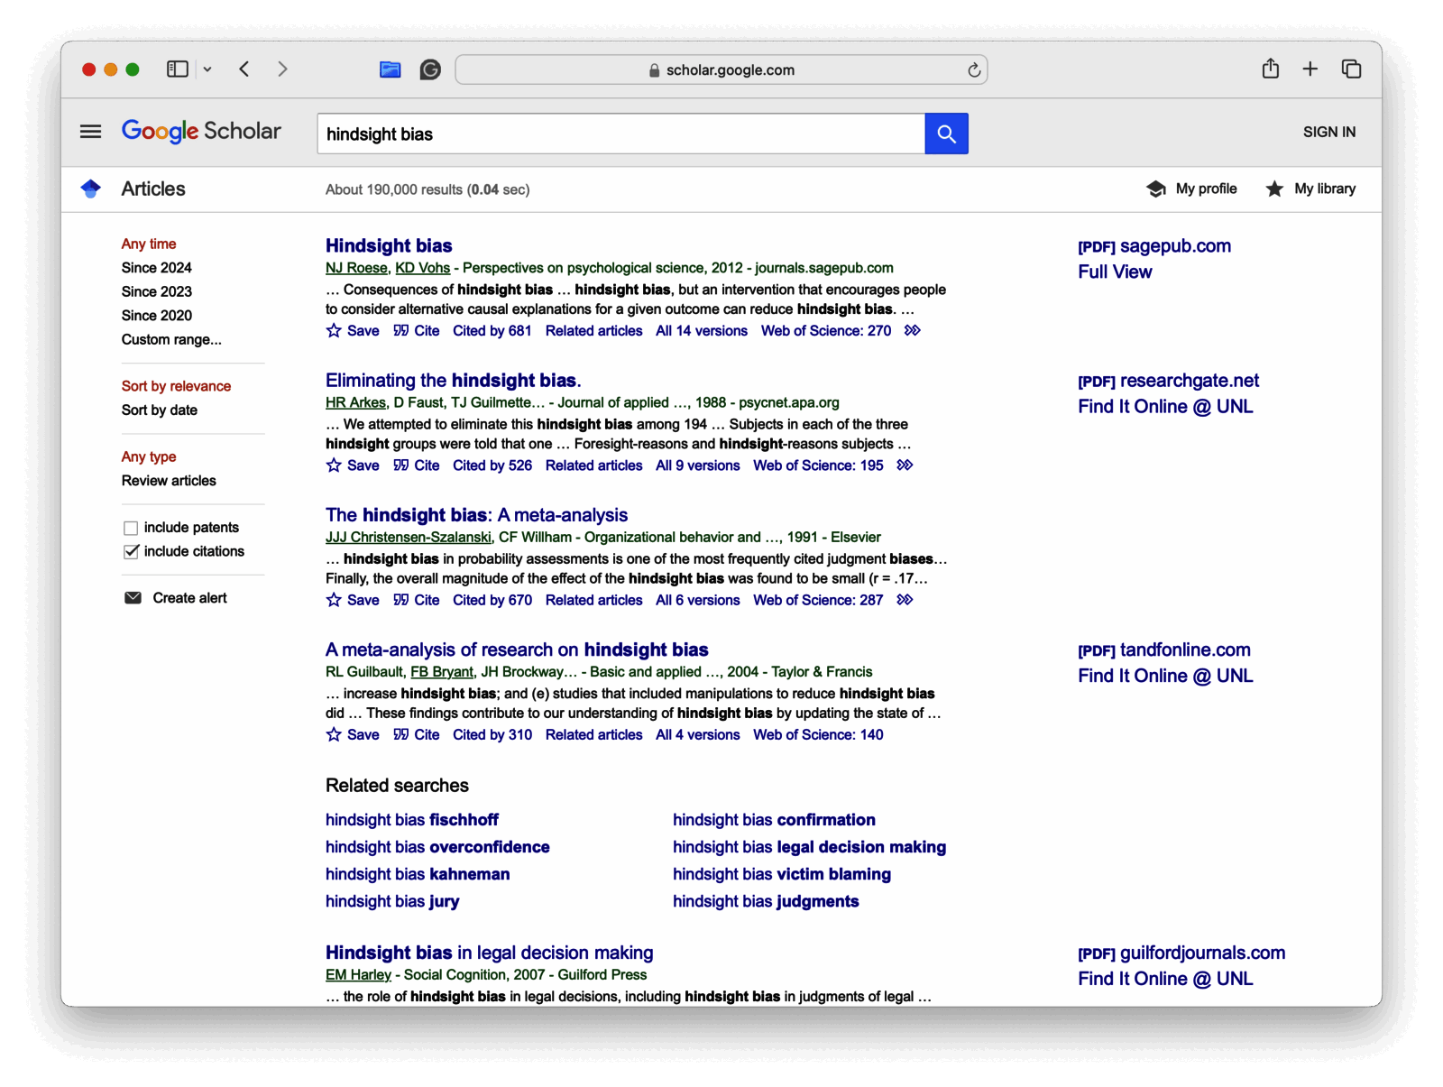
Step 2-3: Expand the search (continued)
Screenshot of Google Scholar search results for hindsight bias showing article titles, citation counts, and PDF links

Slide 30
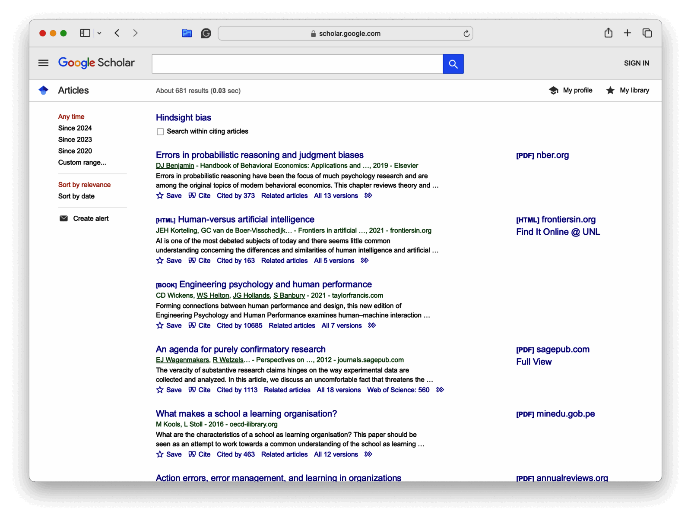
Step 2-3: Expand the search (continued)
Screenshot of Google Scholar results within citing articles for the paper Hindsight bias, showing newer related studies

Slide 31
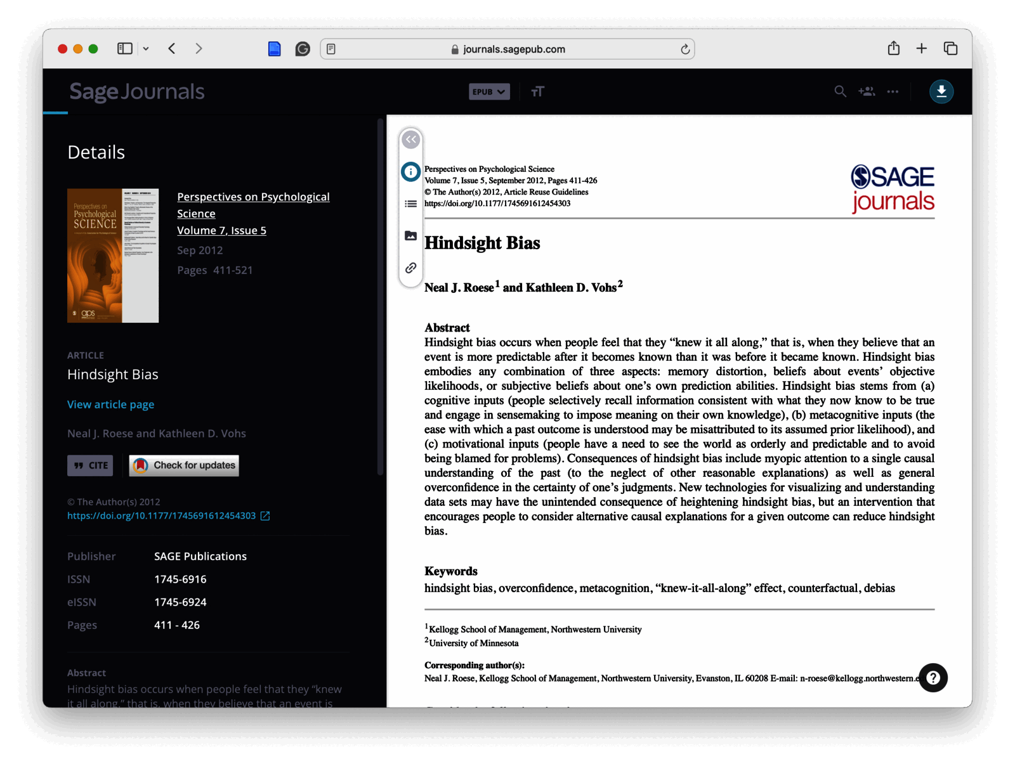
Step 2-3: Expand the search (continued)
Screenshot of the Sage Journals page for the 2012 article Hindsight Bias by Roese and Vohs, showing the abstract and article details

Slide 32
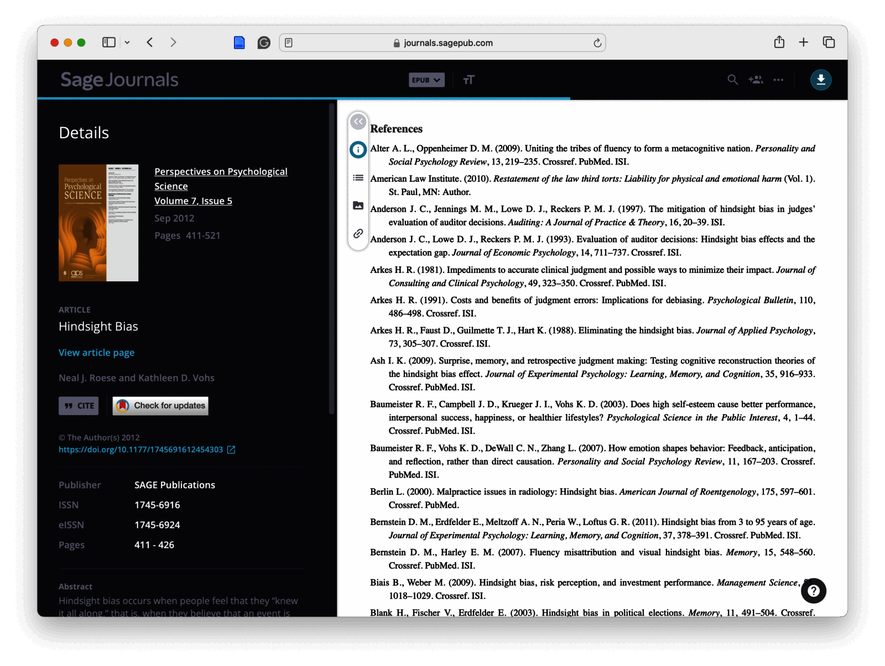
Step 2-3: Expand the search (continued)
Screenshot of the references section of the Hindsight Bias article on Sage Journals, listing related citations

Slide 33
Practice: Lit Review
Step 1: Find a stating point (identify topic/concept of interest)
  Find a “classic” (older) reference on subject
  Find a “hot new” reference
Step 2: Expand the search: Find more recent articles
  Identify current state of field (within ~5 years)
Step 3: Expand the search: Find more older articles
  Identify articles cited in recent literature (building blocks of field)
Step 4: Defining the “Scope” and “Structure” of your topic
Step 5: Search key terms in PsycINFO
Step 6: Expand with key author search
Step 7: Organize, track & take notes for each article
  Zotero → APA references

Slide 34
Step 4-6: Find & Use Key Terms

Slide 35
How to select good articles
Caution
Always check the Journal impact factor if you do not recognize the publication!!

Slide 36
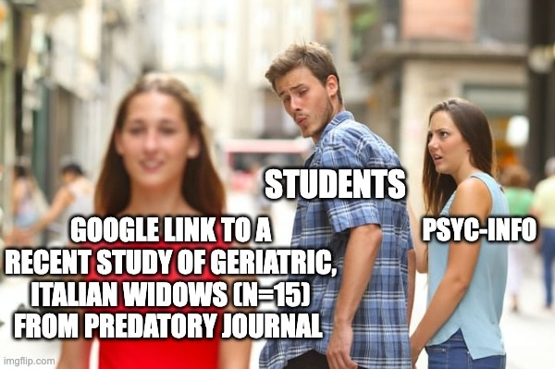
How to select good articles (continued)
Distracted boyfriend meme where students look away from PsycINFO toward a Google link to a recent small study from a predatory journal

Slide 37
How to select good articles (continued)
Learn more

Slide 38
Summary: Steps of Bibliographic Research
Step 1: Find a stating point (identify topic/concept of interest)
  Find a “classic” (older) reference on subject
  Find a “hot new” reference
Step 2: Expand the search: Find more recent articles
  Identify current state of field (within ~5 years)
Step 3: Expand the search: Find more older articles
  Identify articles cited in recent literature (building blocks of field)
Step 4: Defining the “Scope” and “Structure” of your topic
  Locate any review articles or encyclopedia entries
Step 5: Search key terms in PsycINFO
Step 6: Expand with key author search
Step 7: Organize, track & take notes for each article (use Zotero for APA references)

Slide 39
Assignments & Reminders
Given this week:
Submit to your lab section before week 6: Research Project Pre-proposal (only the one corresponding to your dataset) and Research Project References & Literature Review Worksheet
Due this week:
Lab 04: Literature Review worksheet
Submit to your lab section in Canvas by 11:59pm the day before your lab meets.

