Slide 1
Bivariate Analyses: Pearson’s Correlation & Chi-Square
Lab 07
PSYCH 350-Lab

Slide 2
Today’s Tasks
Intro to SPSSBasicsHandoutsLab 06: Data Entry, Data Transformations & Univariate StatsEntering DataRecoding & Transforming into New VariablesUnivariate Statistics Review

Slide 3
What You Need Today
Everything for this week is linked on the next slides – and always on the lab page under Handouts & References.
Open these before we start so you can follow along.

Slide 4
Bivariate Data Analysis
[book icon]
SPSS Handouts
[note icon]
Pearson’s Correlation
[PDF]
[note icon]
Scatterplots
[PDF]
[note icon]
2x2 Pearson’s Chi-square
[PDF]

Slide 5
Weekly Lab Assignment
[chart icon]
superman_data.sav
[SPSS data file]
[chart icon]
hotones_data.sav
[SPSS data file]

Slide 6
Additional Materials
[book icon]
Correlations & Chi-square worksheet
[Word document]
[arrow icon]
Correlations & Chi-square hw checker
[Web page]

Slide 7
SPSS Frequencies
styles.scss

Slide 8
Univariate Analysis: The Basics
In general, an experiment is a procedure that researchers use to assess the effect of one variable (IV) on another variable (DV).
Independent variable (IV): In experiments, this is the variable that the researchers manipulate (e.g., randomly assigning participants to 2 different groups).
synonyms:
Predictor variable Explanatory variable
Dependent variable (DV): In experiments, this is the variable of interest. This variable is expected to change according to the IV.
synonyms:
Outcome variable Response variable
Things

Slide 9
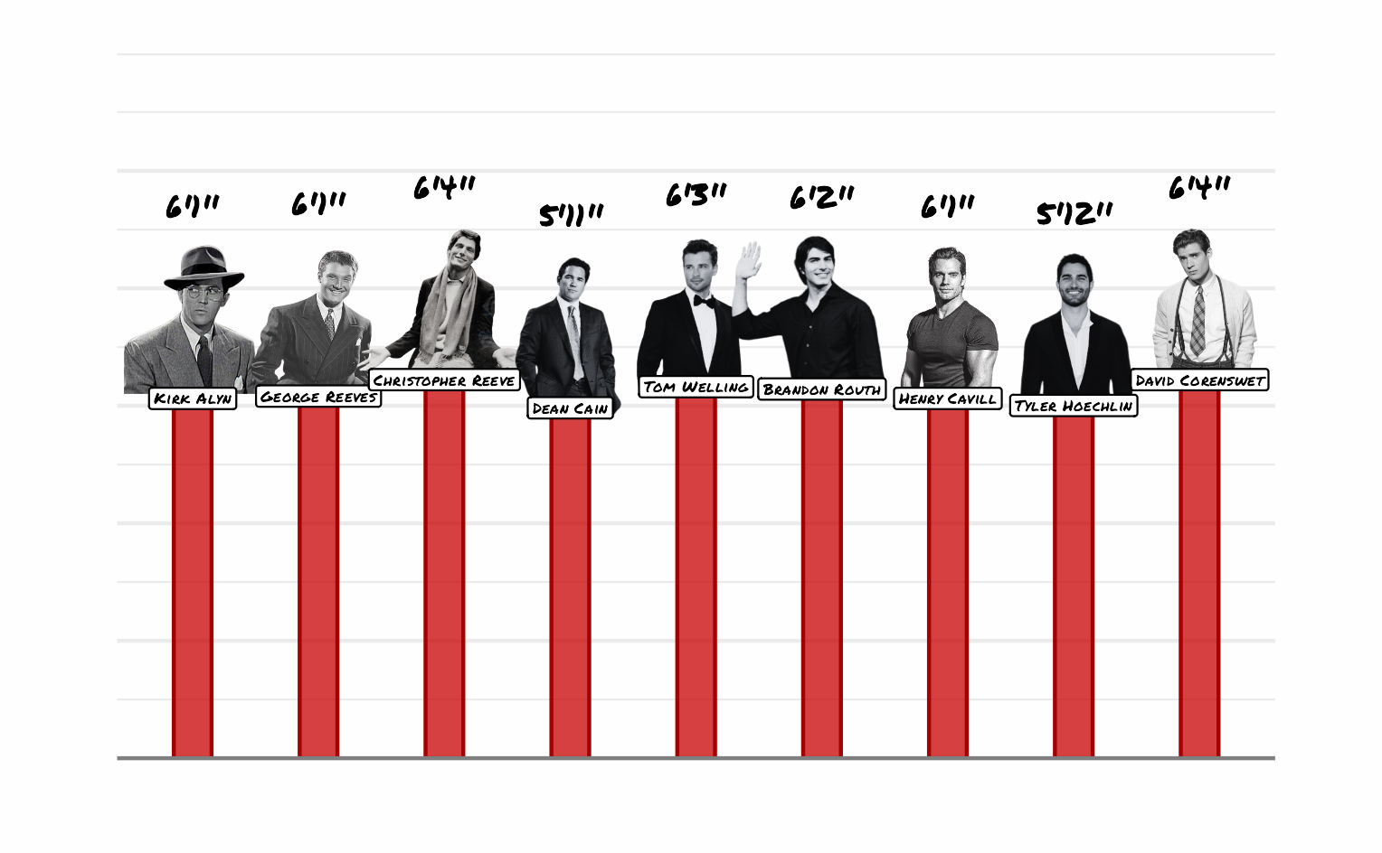
Measuring Variables
Bar chart of the height data used throughout the lab

Slide 10
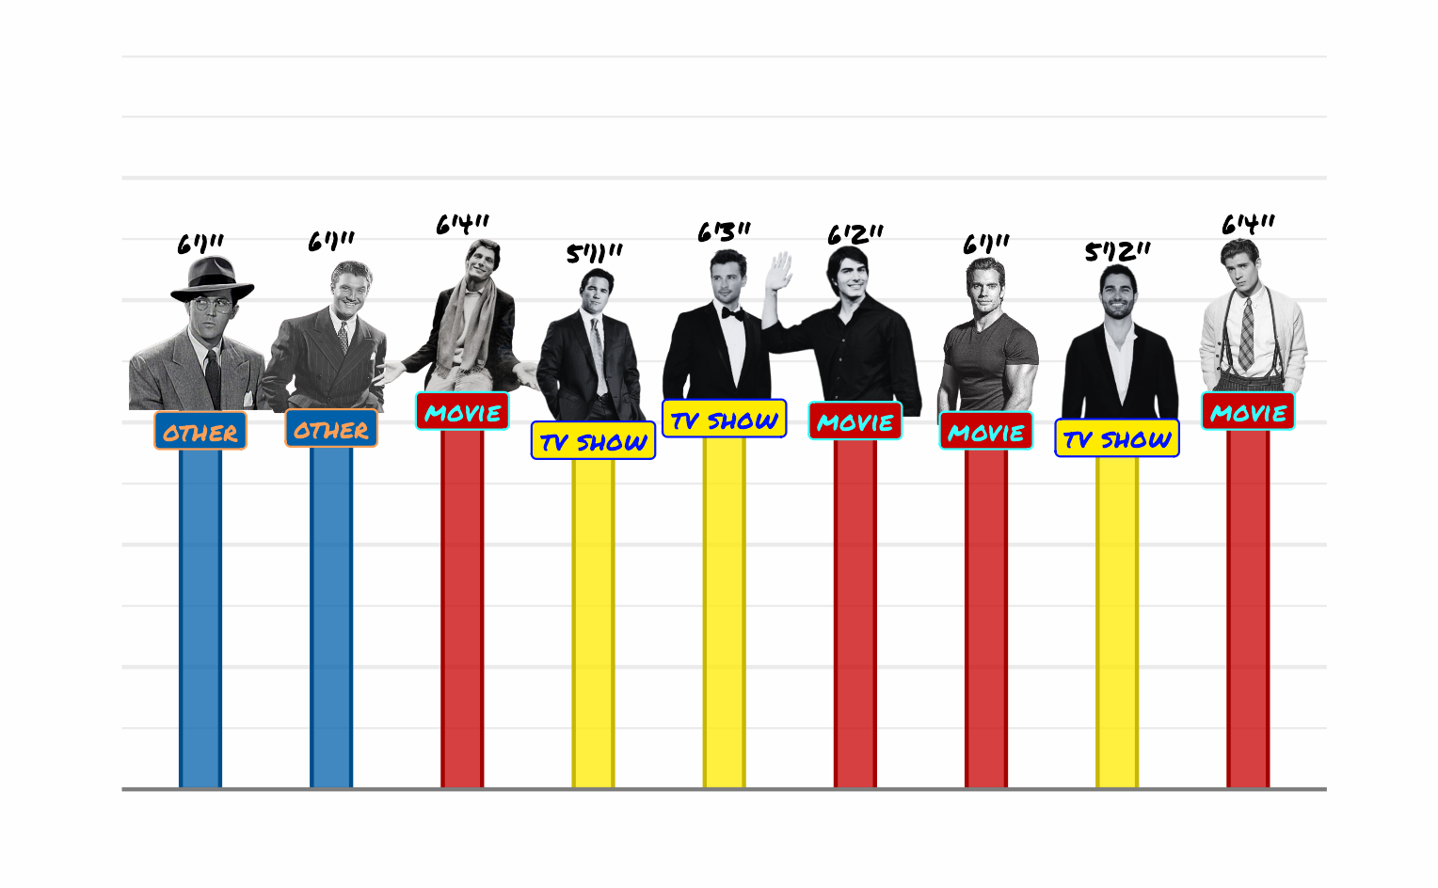
Measuring Variables (continued)
Chart showing how the same height measurements can be treated as different variable types

Slide 11
Univariate Statistics

Slide 12
Univariate Statistics (continued)
CONTINUOUS VARIABLES: Describe and understand our sample data with the Mean (M) and Standard Deviation (SD)

Slide 13
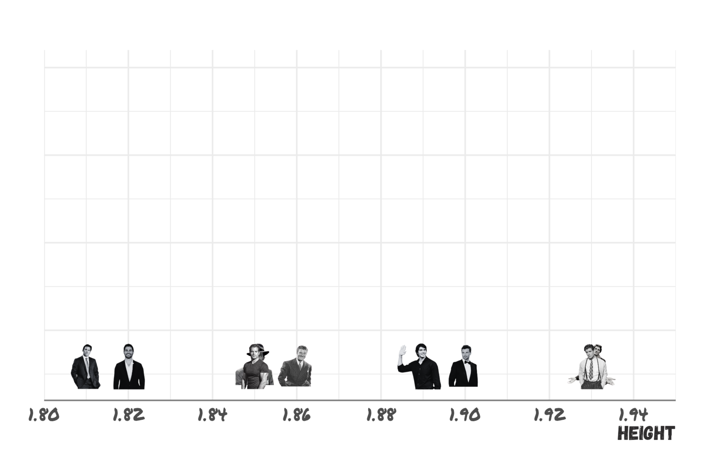
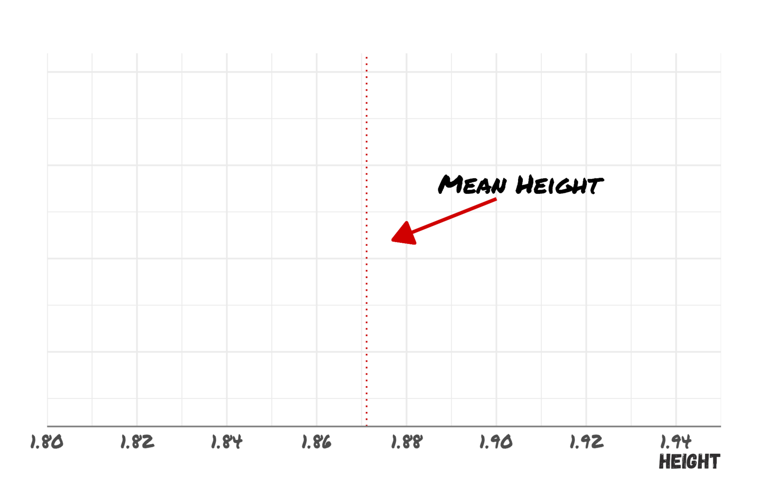
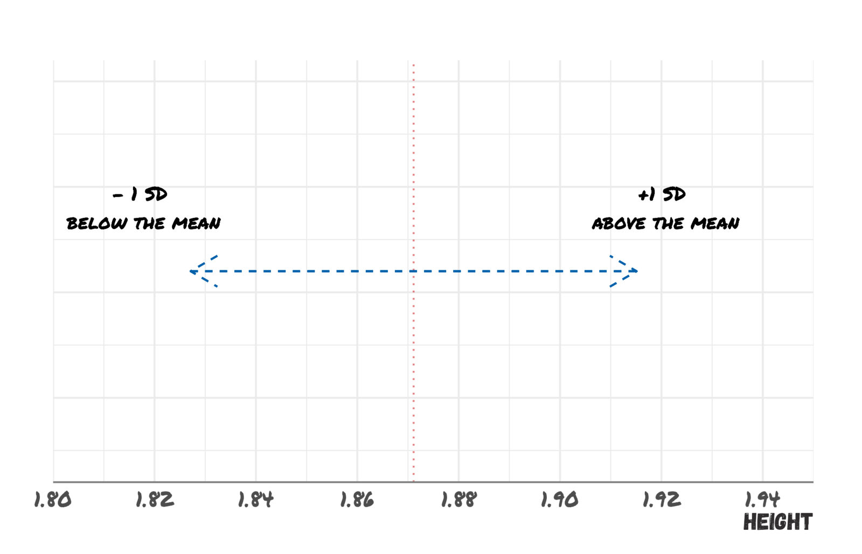
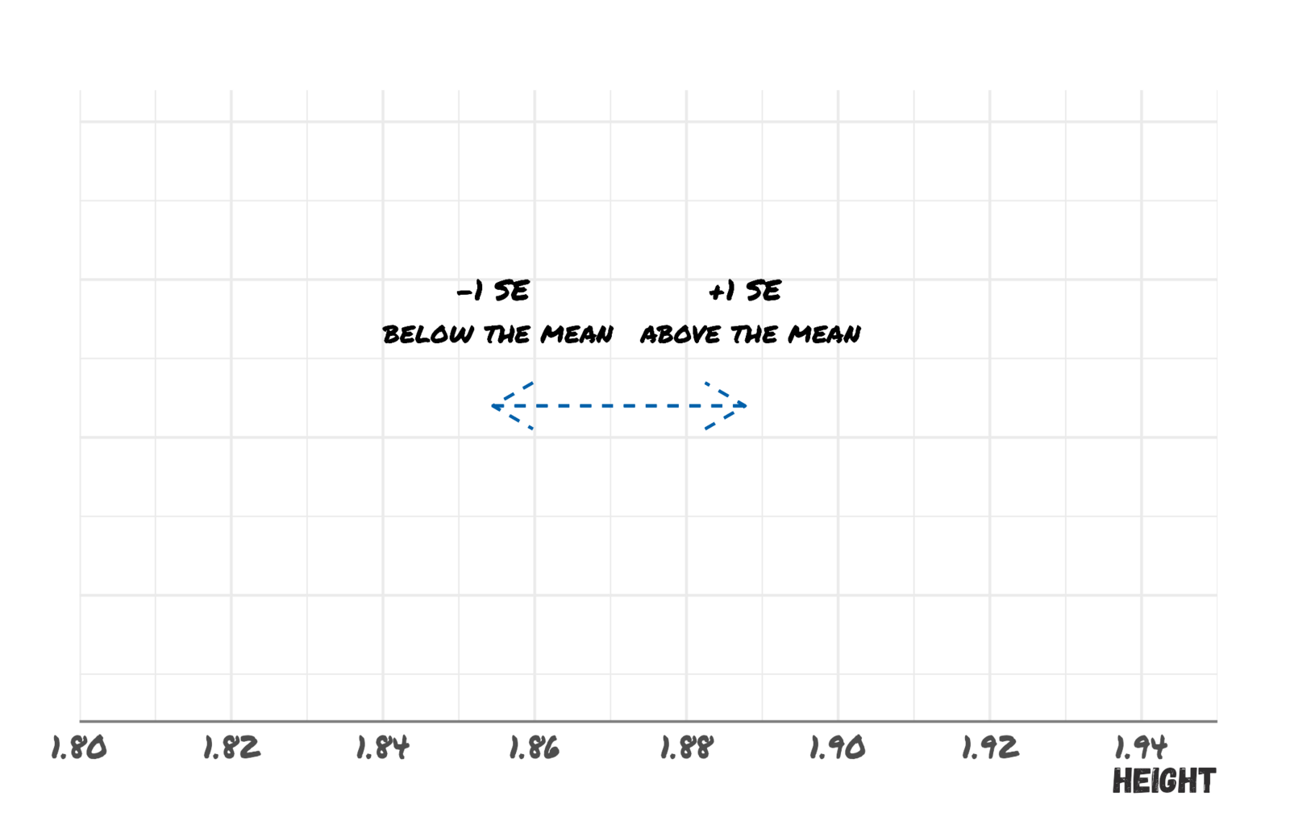
Univariate Statistics (continued)
1 $Mean_{Height}=\frac{∑Height_{i}}{N_{Height}}$
2 $SD_{Height}=\frac{\sqrt{∑(Mean_{Height}−Height_{i})^{2}}}{N_{Height}−1}$
3 $SE_{Height}=\frac{SD_{Height}}{\sqrt{N_{Height}}}$
The mean is a measure of central tendency
The standard deviation (SD) measures how spread out the data is.
The standard error (SE) can be interpreted as the degree of confidence one can have that the sample mean is close to the true population mean (lower SE implies higher confidence).
Height (meters)
1.93, 1.93, 1.90, 1.89, 1.86, 1.85, 1.85, 1.82, 1.81

Slide 14
Univariate Statistics

Slide 15
Univariate Statistics (continued)
CATEGORICAL VARIABLES: Describe and understand our sample data with Frequencies (N or %) and Categories (#)

Slide 16
Univariate Statistics (continued)
1 $Mean_{Height}=\frac{∑Height_{i}}{N_{Height}}$
2 $SD_{Height}=\frac{\sqrt{∑(Mean_{Height}−Height_{i})^{2}}}{N_{Height}−1}$
3 $SE_{Height}=\frac{SD_{Height}}{\sqrt{N_{Height}}}$
The mean is a measure of central tendency
The standard deviation (SD) measures how spread out the data is.
The standard error (SE) can be interpreted as the degree of confidence one can have that the sample mean is close to the true population mean (lower SE implies higher confidence).
Size (3-levels)
1.93, 1.93, 1.90, 1.89, 1.86, 1.85, 1.85, 1.82, 1.81

Slide 17
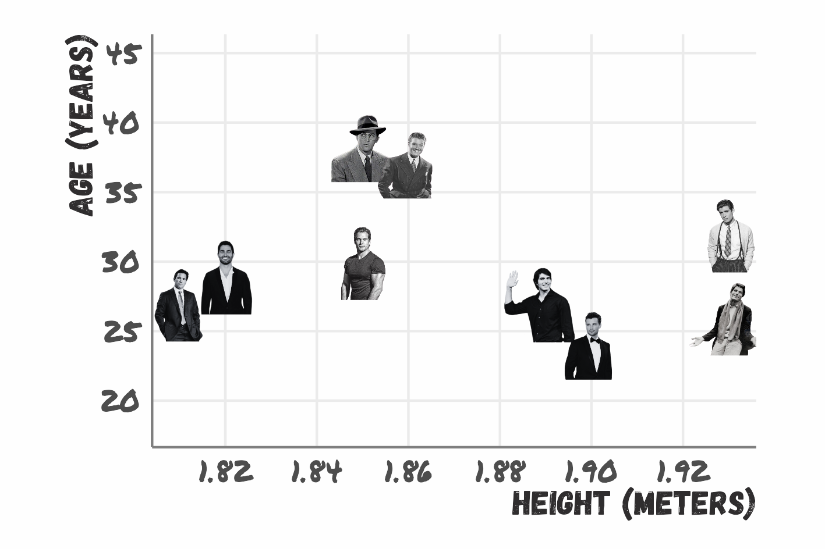
Bivariate Analysis
Scatterplot of age versus height for the sample

Slide 18
Correlation and Regression
It turns out that one cannot calculate many statistics with just one variable 🤷 Let’s also assume that, aside from people’s age, we also measured their height:
Height: 1.93, 1.93, 1.90, 1.89, 1.86, 1.85, 1.85, 1.82 1.81
Age: age = c(37, 38, 32, 26, 24, 27, 30, 29, 27
Astute observers 🧐 will probably notice a “tiny” upward trend. The Age and Height variables are indeed highly positively correlated, meaning that as age increases, so does height.
Regression simply plots the line that is closest to all the points. In our case, the line can be defined as $Height_{i}=a+b×Age_{i}$, were $a$ represents where the line hits the Y-axis (y intercept) and $b$ is the line slope.

Slide 19
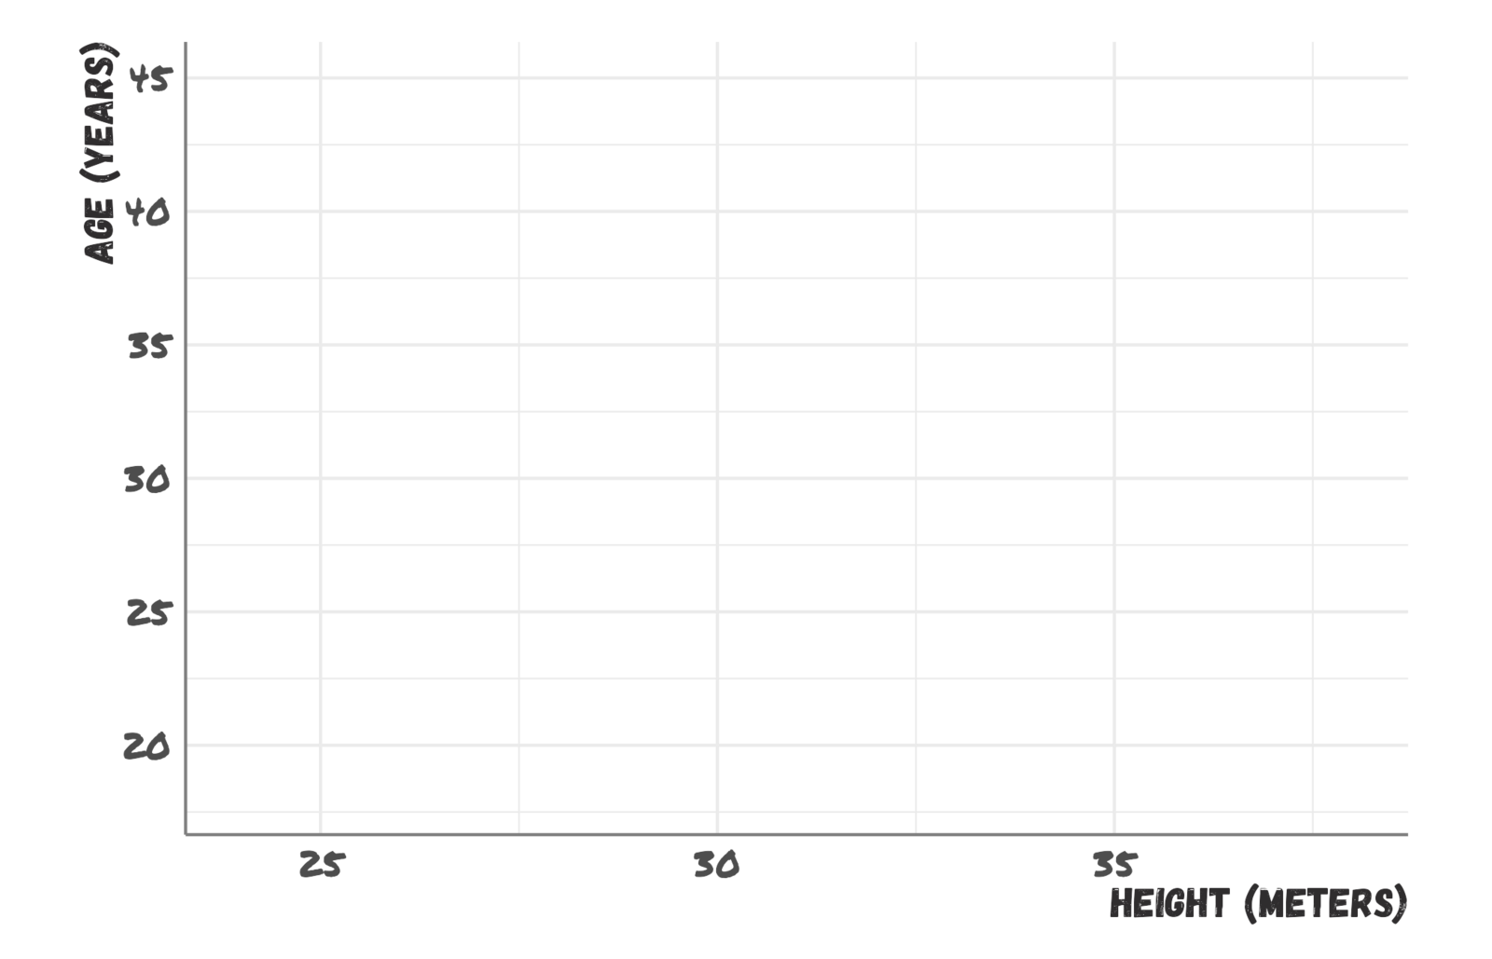
Correlation and Regression (continued)
Empty scatterplot template with axes for the two variables

Slide 20
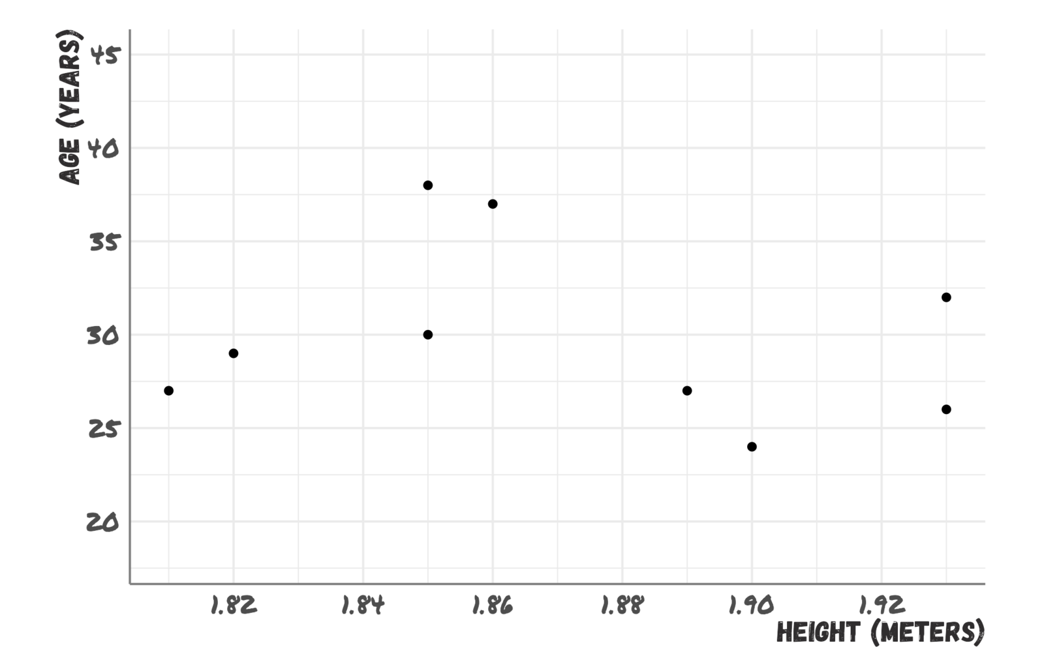
Correlation and Regression (continued)
Scatterplot showing the relationship between two quantitative variables

Slide 21
Correlation and Regression (continued)
Scatterplot showing the relationship between two quantitative variables

Slide 22
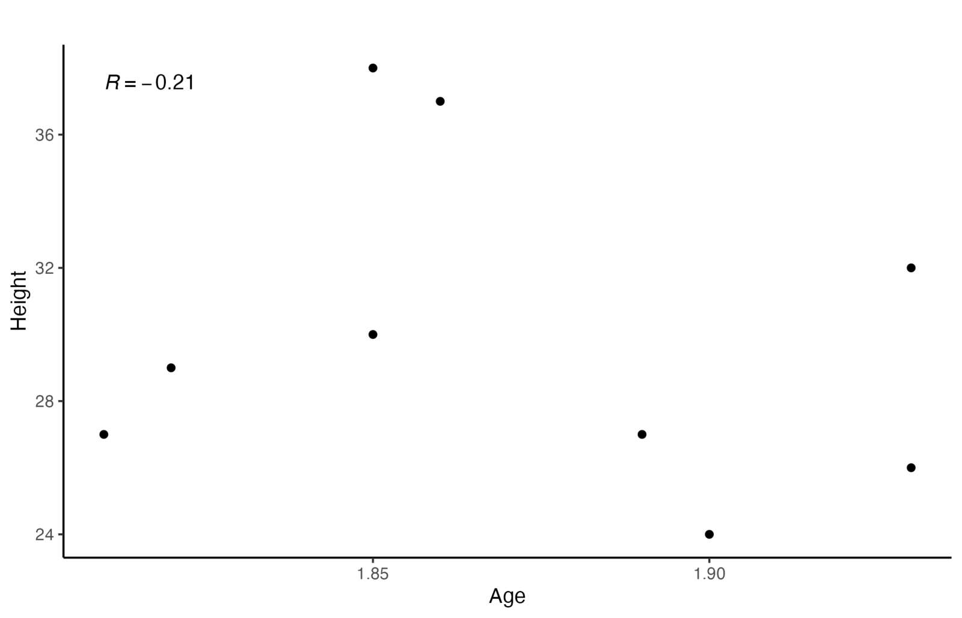
Correlation and Regression (continued)
Scatterplot illustrating a correlation between two quantitative variables

Slide 23
Correlation and Regression (continued)
Scatterplot illustrating a correlation between two quantitative variables

Slide 24
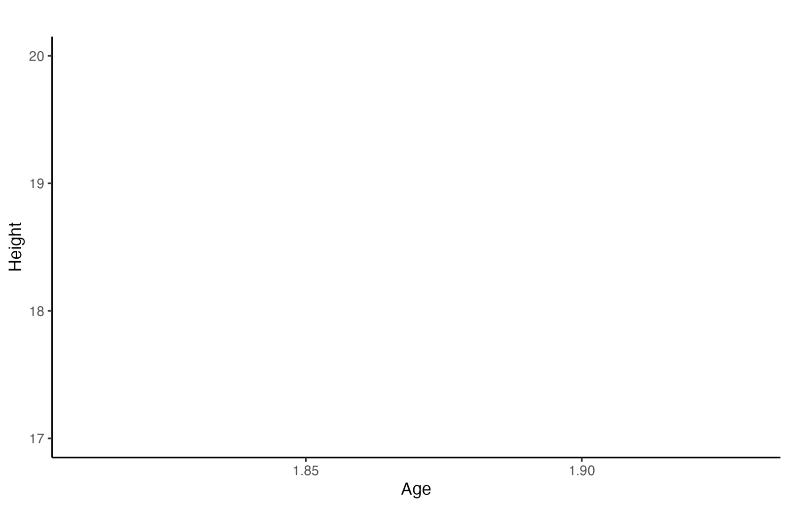
Correlation and Regression (continued)
Scatterplot with a fitted regression line predicting the outcome from the predictor

Slide 25
Correlation and Regression (continued)
NOTE: Correlation and regression carry very similar information. For instance, the correlation coefficient and the line slope are equivalent, $R=b×\frac{SD_{Age}}{SD_{Height}}=0.8×\frac{1.4}{1.17}≈.97$

Slide 26
One-Way ANOVAs
Although scary sounding, a one-way ANOVA is simply a direct extension of t-test! The only difference is that it deals with the case in which there are more than 2 groups.
AGE
14, 15, 15, 16, 30, 31, 31, 32, 32, 33, 33, 34
Once again, one-way ANOVA is also a glorified regression, and the visualization is very similar to that of a t-test. The equivalence to regression takes a bit longer to show, so I will omit it for the sake of time.
The main difference with t-tests is that one-way ANOVAs produces an F statistics instead of a t statistic. If we input the data in a one-way ANOVA calculator, the result is F(2,9) = 583.99, p <.001.
The interpretation of a significant one-way ANOVA is that we are confident that the mean of the DV (Age here) changes depending on the IV (Group here). If one so wishes, it is also possible to run multiple t-tests to see which two group means are significantly different from each other (known as post hoc, or pairwise comparison).

Slide 27
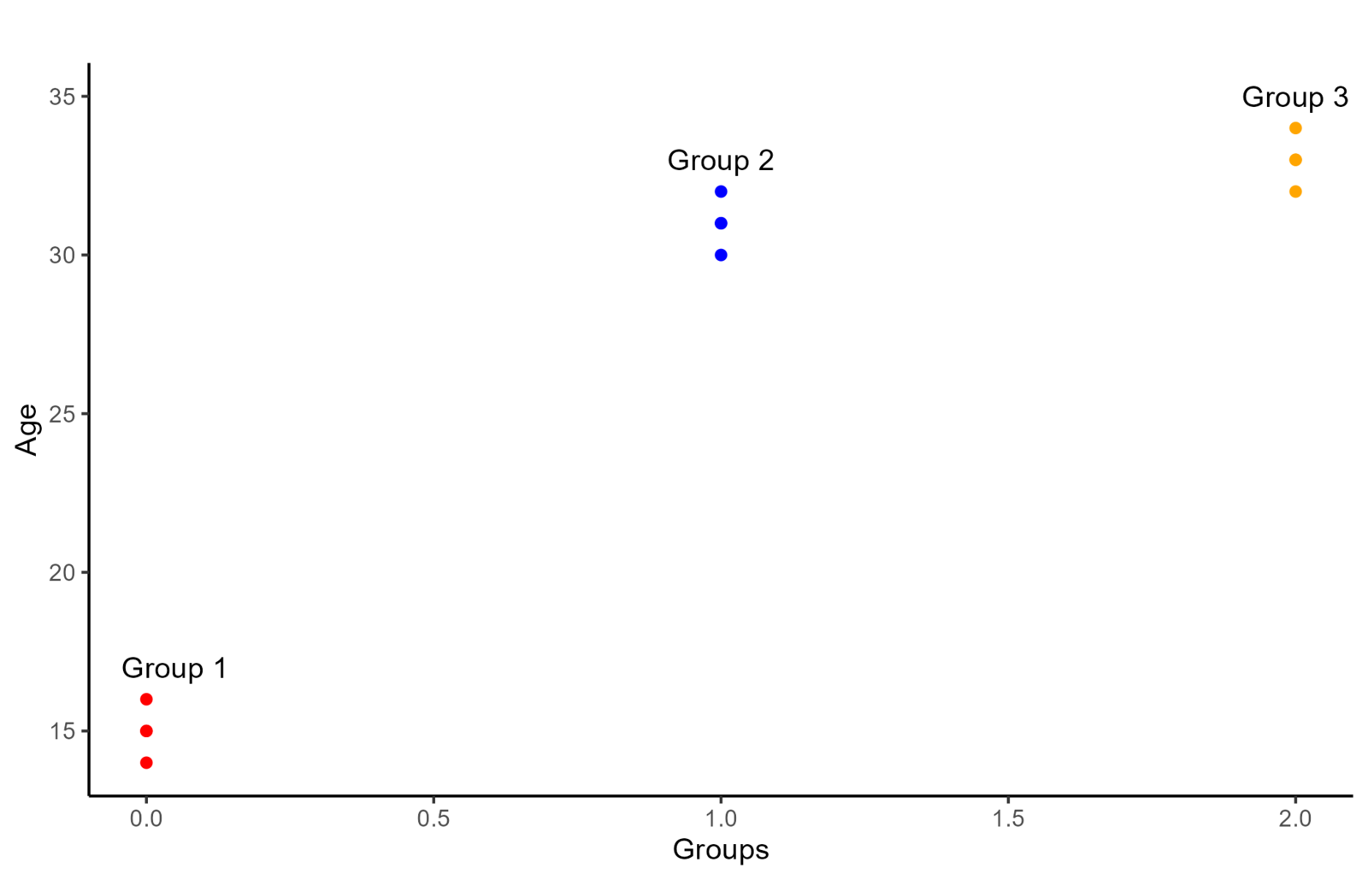
One-Way ANOVAs (continued)
Scatterplot illustrating a one-way ANOVA comparing several group means

Slide 28
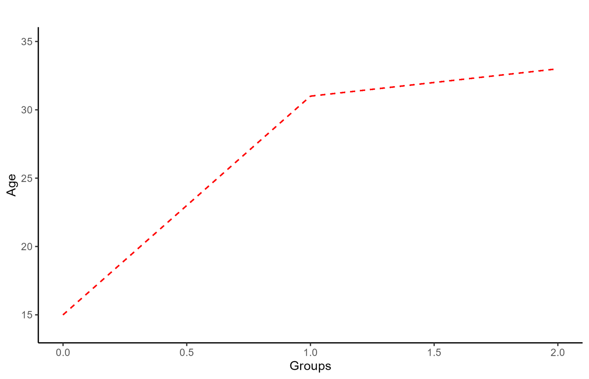
One-Way ANOVAs (continued)
Scatterplot showing how a one-way ANOVA maps onto a regression with group indicators

Slide 29
Two-Way ANOVAs
Finally, a two-way ANOVA (yes, also a regression) is generally used when there are 2 categorical IVs (usually two grouping variables).
Let’s say that we randomly sample 4 males and 4 females all weighting 80 kilos. Further, we assign diet A to 2 random male/females and diet B to the remaining people. After 3 months we measure the weight of all the participants:

Slide 30
Two-Way ANOVAs (continued)
 | Diet A | Diet B
**Female** | 60, 62 | 75, 76
**Male** | 74, 75 | 74, 77

Slide 31
Two-Way ANOVAs (continued)
the two-way ANOVA calculator gives the 3 following results:
Main effect of Diet: Weight after 3 months changes significantly depending on the type of diet that participants are assigned to, F(1, 4) = 64.07, p=.001.
Main effect of Gender: Weight after 3 months changes significantly depending on gender, F(1, 4) = 48.6, p = .002.
Interaction effect of Gender$×$Diet: The effect of the type of diet on weight after 3 months, changes significantly depending on what gender participants are, F(1, 4) = 48.6, p = .002.
The results that Two-way ANOVA provides are the two main effects of the IVs, which are the same as running two separate one-way ANOVAs, and an interaction effect.

Slide 32
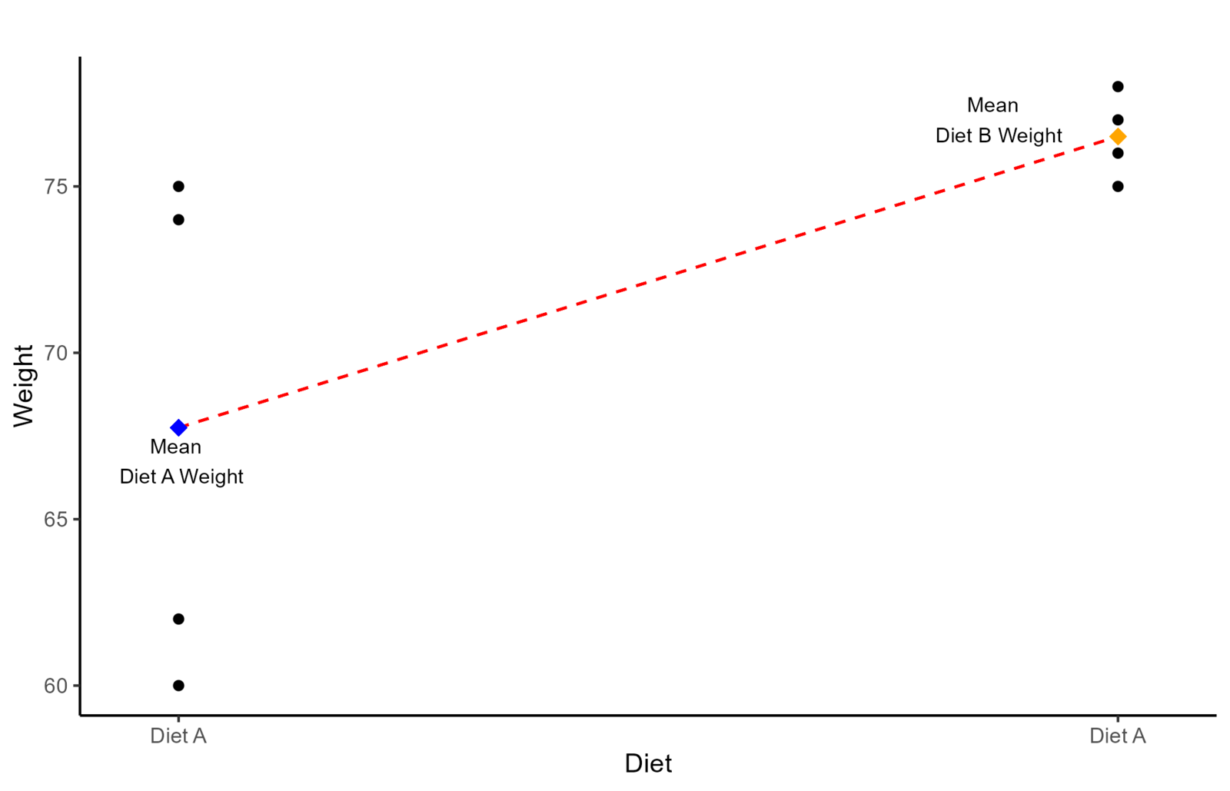
Two-Way ANOVAs (continued)
First scatterplot in a sequence building up a two-way ANOVA design

Slide 33
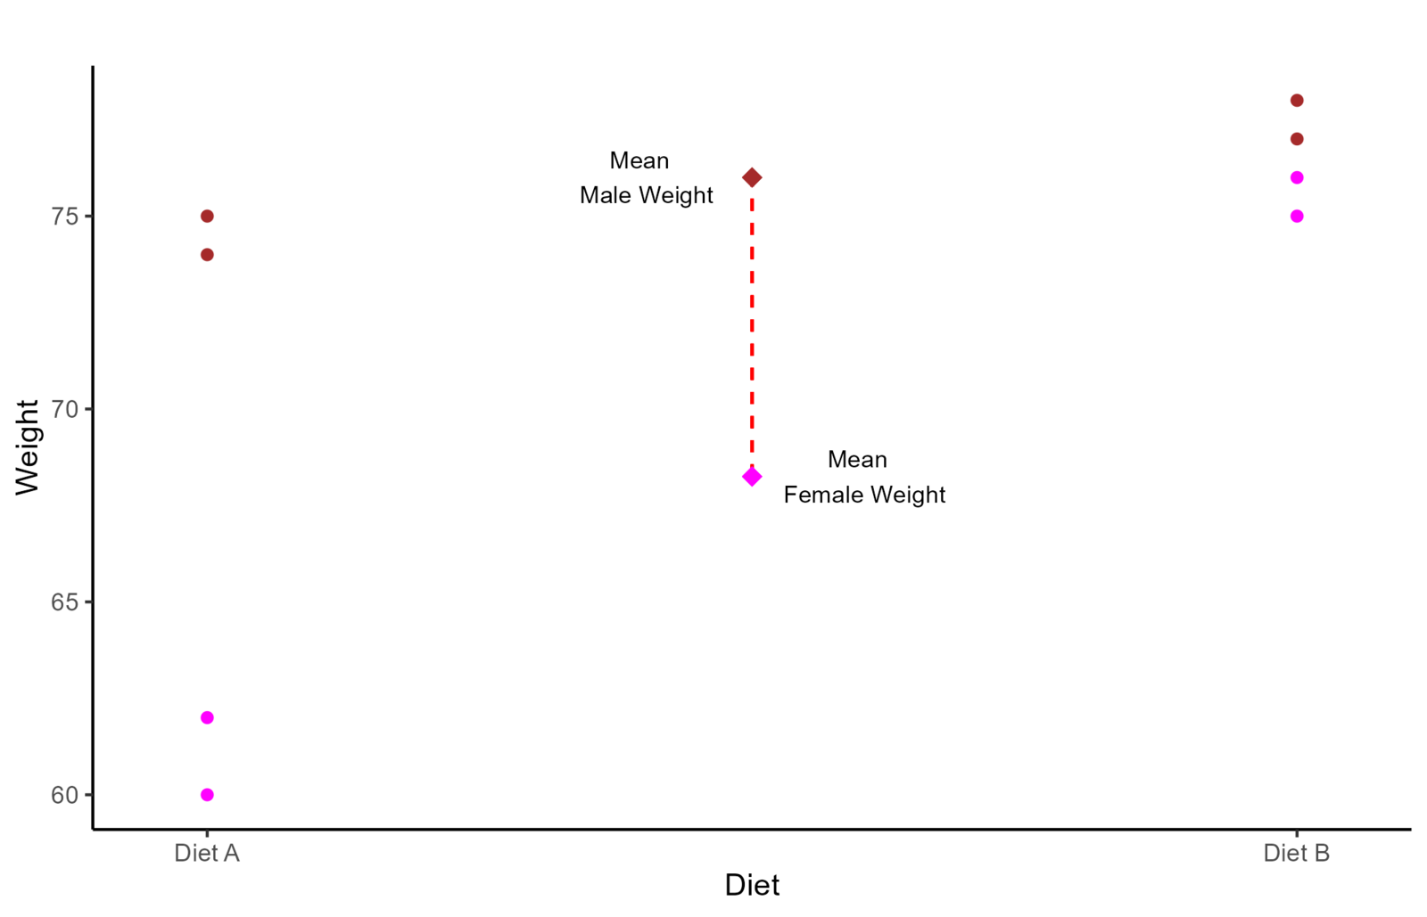
Two-Way ANOVAs (continued)
Second scatterplot in a sequence building up a two-way ANOVA design

Slide 34
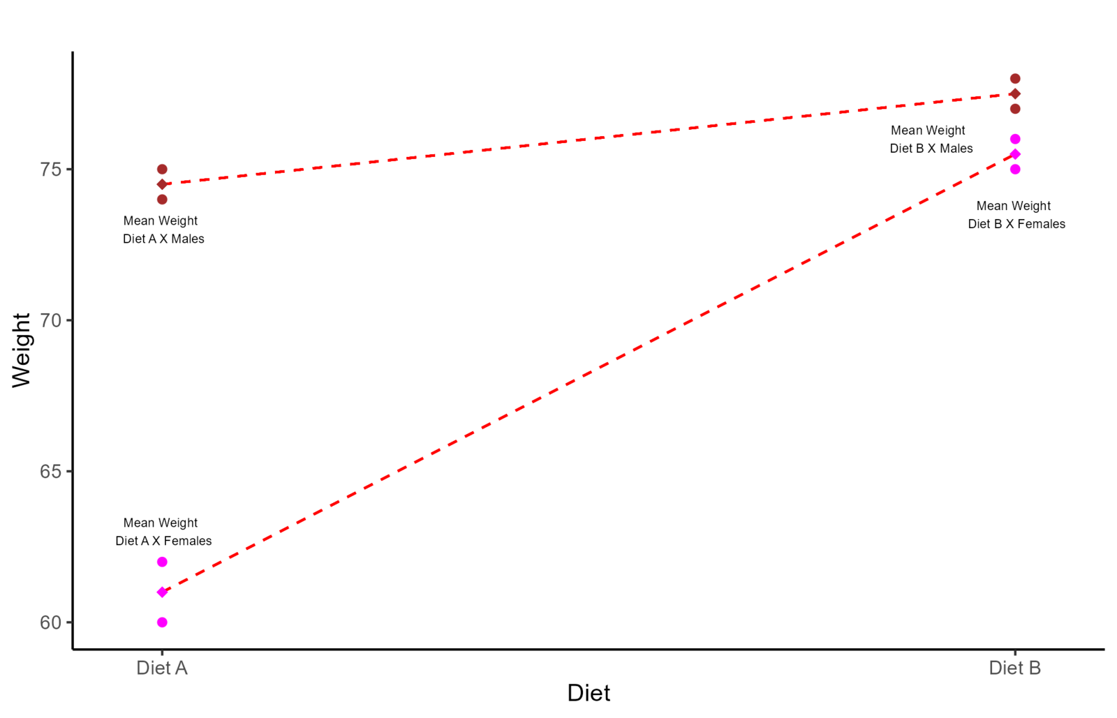
Two-Way ANOVAs (continued)
Third scatterplot completing the two-way ANOVA design sequence

Slide 35
p-values? 😕
P-values are another often misunderstood, and frankly overemphasized, concept. We are taught that a p-value smaller than .05 (5% probability) is significant. The appropriate interpretation of p-values is as follows:
Assuming that my hypothesis is wrong (Null hypothesis), if I were to sample the same number of observations from the population an infinite number of times , what is the probability that I will observe the same results. (note that you can calculate a p-value for just about every statistic)
The main problem of p-values by themselves is that they carry no information about how different or how big the effect of the IV on the DV is. They main thing that influences p-values is sample size!
Let’s assume that we know that the average depression score in the population is 5 (SD = 3). Now, let’s say that we tried 3 different depression treatments for 3 different groups and found that, after treatment, these groups scores in depression respectively were: 4.9, 4.8, 4.7.
In this case, even with a difference as small as .3, the p-value will turn out significant with a sample size of around 270 people. Given the standard deviation of 3, a mean difference of .3 is laughable in practice!

Slide 36
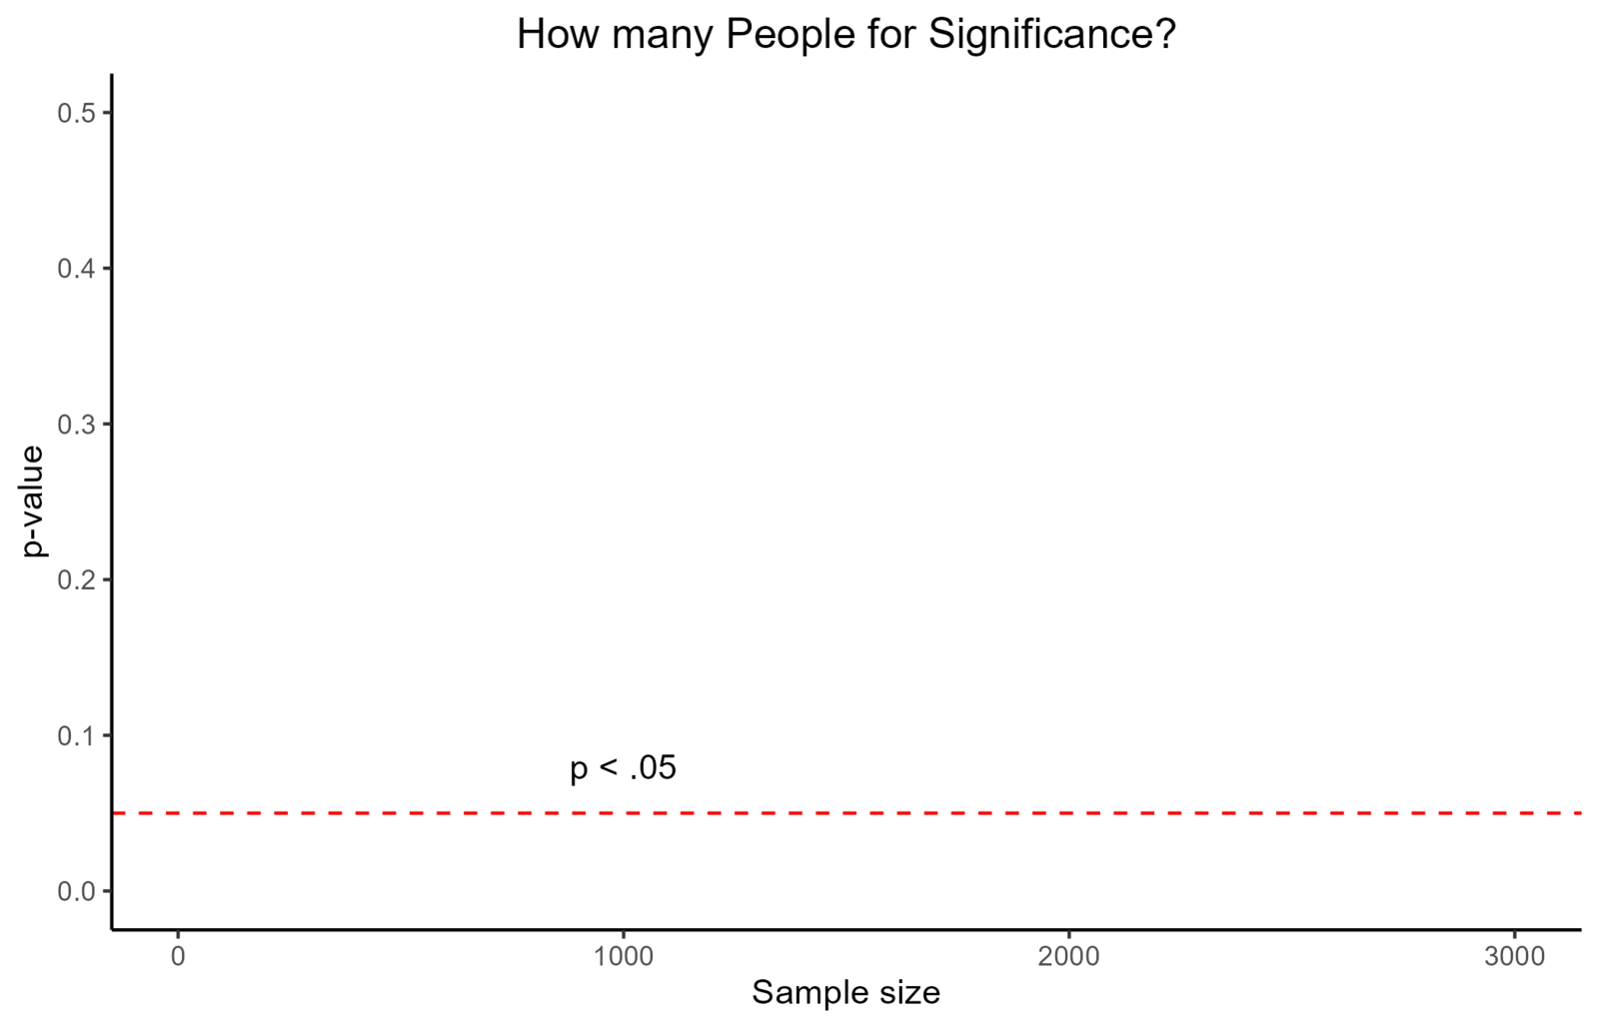
p-values? 😕 (continued)
Empty sampling distribution curve, before the p-value region is shown

Slide 37
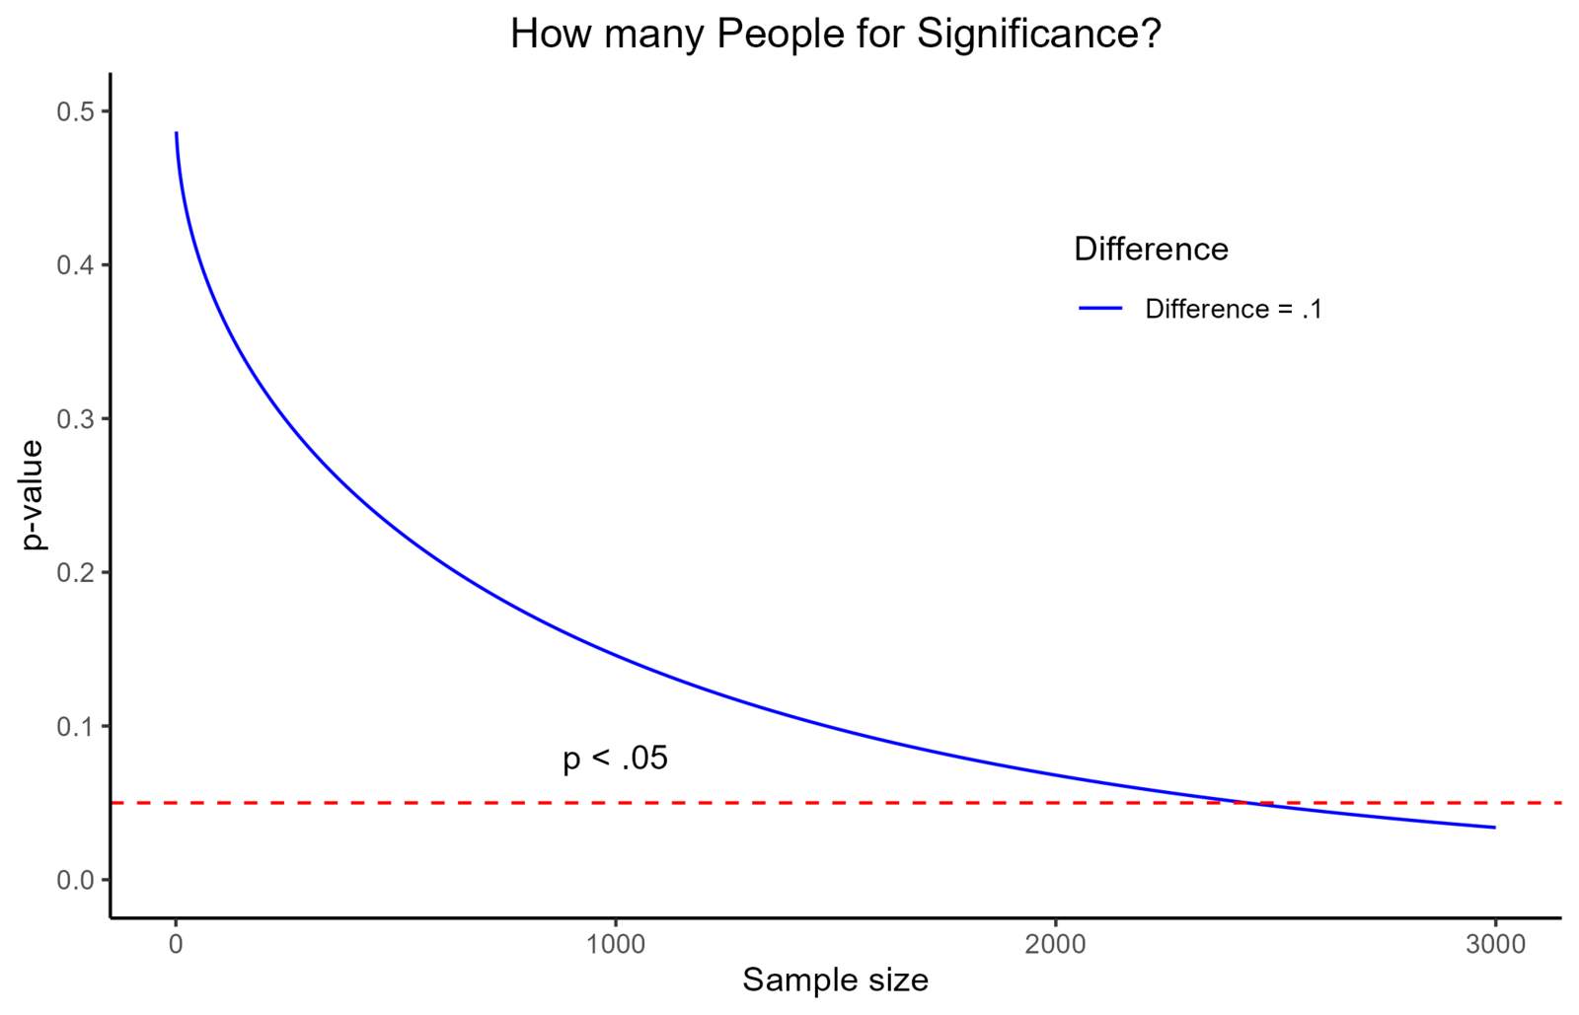
p-values? 😕 (continued)
Sampling distribution curve showing a one-tailed p-value region

Slide 38
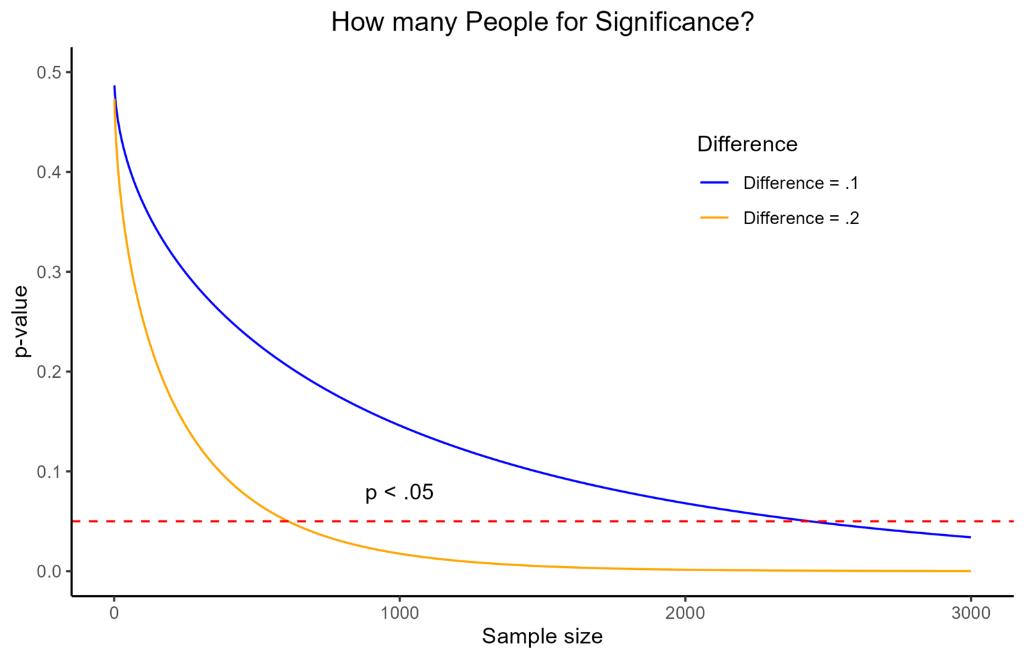
p-values? 😕 (continued)
Sampling distribution curve showing the two-tailed p-value regions

Slide 39
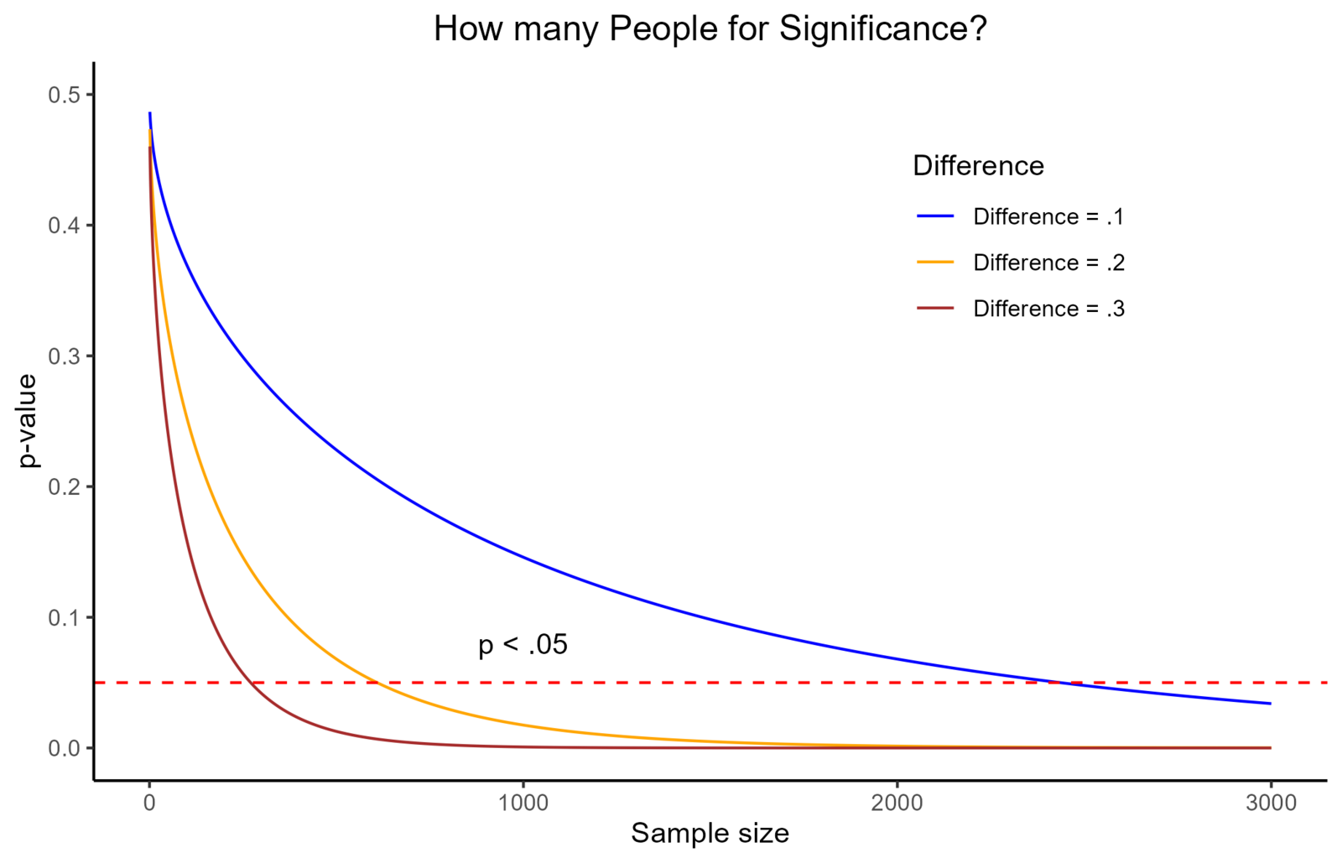
p-values? 😕 (continued)
Sampling distribution curve with the p-value region shaded

Slide 40
Assignments & Reminders
Given this week:
Submit to your lab section before week 7: Correlations & Chi-square Worksheet
Due this week:
Lab 06: Data entry & Univariate Stats worksheet
Submit to your lab section in Canvas by 11:59pm the day before your lab meets.

