Slide 1
Factorial Designs & Analyses
Lab 12
PSYCH 350-Lab

Slide 2
Today’s Tasks
From one IV to two: the logic of factorial designsThree effects in every factorial ANOVA:
Main effect A Main effect B A × B interaction
Reading cell means & profile plotsFactorial ANOVA in SPSS + APA write-upLab 12 worksheet walk-through
The interaction is the whole point today. Students reliably under-grasp “it depends,” so budget the most time on the three pattern plots.

Slide 3
What You Need Today
Everything for this week is linked on the next slides – and always on the lab page under Handouts & References.
Open these before we start so you can follow along.

Slide 4
Factorial Design & Analysis
[book icon]
SPSS Handouts
[note icon]
2x2 BG ANOVA on SPSS
[PDF]
[note icon]
2x2 MG ANOVA on SPSS
[PDF]
[arrow icon]
xls computator
[External link]
[note icon]
Factorial ‘effect map’

Slide 5
Weekly Lab Assignment
[chart icon]
parent_child_data.sav
[SPSS data file]
[book icon]
Factorial Analyses Worksheet
[Word document]
[arrow icon]
Factorial Analyses hw checker
[Web page]

Slide 6
From One-Way to Factorial

Slide 7
Review: The One-Way ANOVA
Lab 08: one qualitative factor → one quantitative outcomee.g., does treatment (yes/no) affect parental praise?One F-test answers one question: do the group means differ?
Caution
But real research questions rarely involve one variable at a time. Does treatment affect praise… the same way for every kind of family?

Slide 8
The Factorial Idea
A factorial design crosses two (or more) factors so every combination of levels appears:

Slide 9
The Factorial Idea (continued)
 | No Treatment | Treatment
2-Parent Family | cell | cell
Mother-Only Family | cell | cell

Slide 10
The Factorial Idea (continued)
2 factors × 2 levels each = a 2 × 2 design = 4 cellsEach cell holds a subgroup mean
Tip
One study, three questions: Does treatment matter? Does family type matter? And does treatment matter differently depending on family type?

Slide 11
Factorial Vocabulary
Factor: an independent variable (Family Type, Treatment)
Level: a category within a factor (2-Parent / Mother-Only)
Cell: one combination of levels (2-Parent + Treatment)
“Two-by-two” (2 × 2): levels of A × levels of B — a 3 × 2 design has 6 cells
BG factorial: different people in every cell (that’s today’s design)

Slide 12
Three Effects in Every Factorial

Slide 13
Effect 1 & 2: Main Effects
Effect 1 & 2: Main Effects
A main effect is the effect of one factor averaged across the levels of the other factor (the “margin” means):

Slide 14
Effect 1 & 2: Main Effects (continued)
 | No Tx | Tx | Row mean
2-Parent | 6 | 8 | 7
Mother-Only | 4 | 6 | 5
Column mean | 5 | 7

Slide 15
Effect 1 & 2: Main Effects (continued)
Main effect of Treatment? 5 → 7 (averaging over family types)Main effect of Family Type? 7 vs 5 (averaging over treatments)
Tip
Each main effect gets its own F-test — same logic as a one-way ANOVA on the marginal means.

Slide 16
Effect 3: The Interaction (A × B)
An interaction means the effect of one factor depends on the level of the other factor.
“Treatment increased praise more for mother-only families than for two-parent families.”The magic words: “it depends.”
Warning
If the interaction is significant, the main effects can be misleading on their own — the honest answer to “does treatment work?” becomes “it depends on the family.”

Slide 17
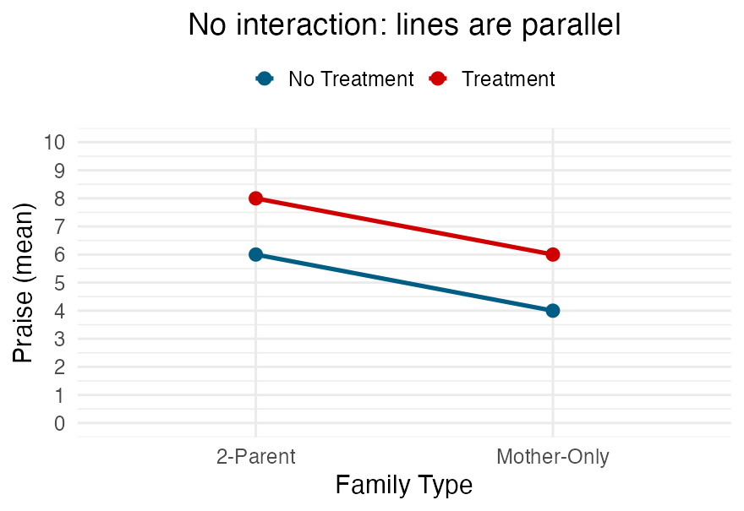
Seeing It: No Interaction
Lines are parallel
Treatment adds the same boost (+2) in both family types
Effects are additive — no interaction

Slide 18
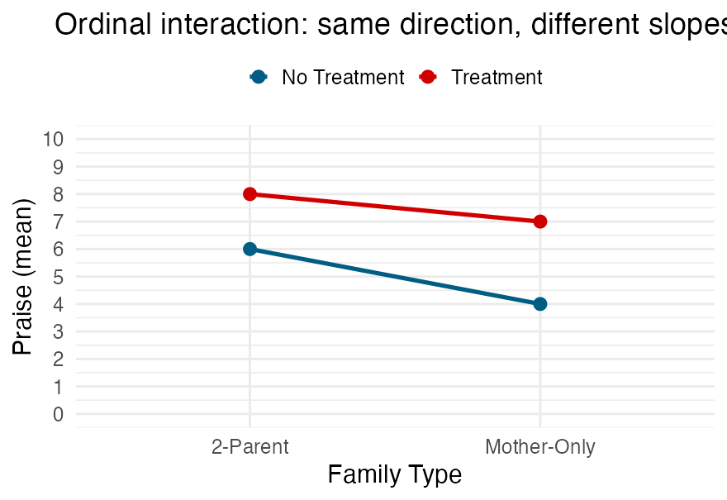
Seeing It: Ordinal Interaction
Lines are not parallel, but don’t cross
Treatment helps both groups — but helps mother-only families more (+3 vs. +2)
Same direction, different magnitude

Slide 19
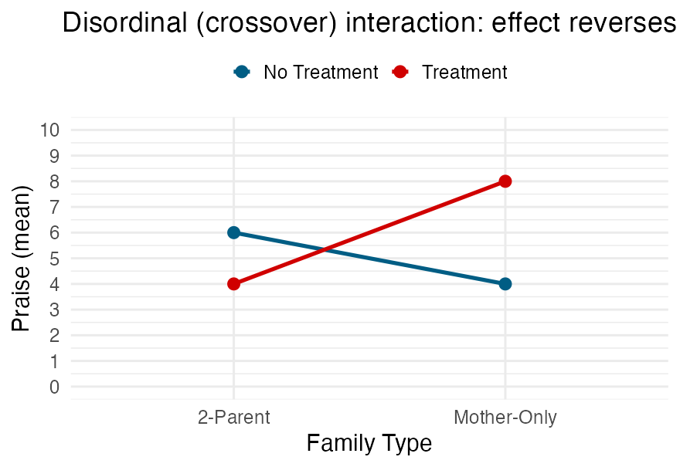
Seeing It: Crossover Interaction
Lines cross
Treatment helps mother-only families but hurts two-parent families
The effect reverses — the main effect of treatment could even average out to zero!

Slide 20
Your Turn: Describe the Pattern
For each result, say: main effect(s)? interaction? what kind?
No Tx/Tx means — 2-Parent: 5, 8; Mother-Only: 5, 82-Parent: 4, 8; Mother-Only: 8, 42-Parent: 5, 7; Mother-Only: 6, 9
Tip
Treatment main effect only (parallel, no family-type difference)Crossover interaction — no main effects at all (means wash out)Main effects of both factors, no interaction (parallel: +2 everywhere)

Slide 21
Running the Factorial ANOVA

Slide 22
SPSS: Two-Way Between-Groups
Analyze → General Linear Model → UnivariateDV → Dependent; both factors → Fixed FactorsPlots… → put one factor on Horizontal Axis, the other in Separate Lines → Add (this is your profile plot!)EM Means… → get estimated marginal means for each factor and the A × B cellsOptions… → Descriptive statistics, estimates of effect size
Tip
Always make the profile plot — it’s how you see the interaction before you read a single F.

Slide 23
Reading the Output
The Tests of Between-Subjects Effects table gives you three F-tests:

Slide 24
Reading the Output (continued)
Source | Question
Factor A | Main effect of A?
Factor B | Main effect of B?
A × B | Interaction?
Error | (within-cells variability)

Slide 25
Reading the Output (continued)
Caution
Read the interaction FIRST. If A × B is significant, interpret the pattern cell by cell — significant main effects may not mean what they appear to mean.

Slide 26
APA Write-Up: Factorial Style
One sentence per effect, then the story:
Main effect: F(1, 96) = 5.42, p = .022Interaction: F(1, 96) = 4.87, p = .030Then describe it: “Treatment increased praise among mother-only families (M = 8.0) more than among two-parent families (M = 7.0).”
Tip
df1 = levels − 1 for each effect (all 1’s in a 2 × 2); df2 = the error df from the same row of the table.

Slide 27
Worksheet Walk-Through

Slide 28
Today’s Analyses
All three use the parent–child dataset (2 × 2 BG factorials):
RH1 (walkthrough together): Family Type × Treatment → praiseRH2 (your turn): Mother’s Age Group × Child’s Age Group → directivenessRH3 (your turn): Treatment × Child’s Age Group → negative affect
Tip
For each RH: run the ANOVA → make the profile plot → decide which of the three effects are significant → write the APA sentences → check your numbers in the Homework Checker.

Slide 29
Common Traps
❌ Reporting only the main effects and ignoring the interaction
❌ Interpreting a main effect without checking whether the interaction qualifies it
❌ Post-hoc hunting in a 2 × 2 — with 2 levels per factor, a significant effect tells you which means differ already
❌ Mixing up dfs across the three effects (same df₂, but check df₁ per row)

Slide 30
Questions?

Slide 31
Looking Ahead
Lab 13: multiple regression — from comparing group means to modeling a quantitative outcome with several predictors at once
The mindset is the same: effects can depend on other variables. You’re ready for it.

Slide 32
Assignments & Reminders
Given this week:
Factorial Worksheet
Due this week:
Lab 11: Multi-Group Coding & Analysis Worksheet
Submit to your lab section in Canvas by 11:59pm the day before your lab meets.

