Slide 1
Multiple Regression
Lab 13
PSYCH 350-Lab

Slide 2
Today’s Tasks
From one predictor to many: the multiple regression modelTwo kinds of predictors: quantitative & binary (0/1)Reading the output: model fit (R², F) + individual predictors (b, β, t)Multiple regression in SPSS + APA write-upLab 13 worksheet walk-through (Huskers data!)
Last new analysis of the semester. Frame it as the culmination: correlation (Lab 07) grew up — several predictors at once, each controlled for the others.

Slide 3
What You Need Today
Everything for this week is linked on the next slides – and always on the lab page under Handouts & References.
Open these before we start so you can follow along.

Slide 4
Multiple Linear Regression
[book icon]
SPSS Handouts
[note icon]
Multiple Regression Example
[PDF]
[note icon]
Another Multiple Regression Example
[PDF]

Slide 5
Weekly Lab Assignment
[chart icon]
huskers_data.sav
[SPSS data file]
[book icon]
Multiple Linear Regression Worksheet
[Word document]
[arrow icon]
Multiple Regression hw checker
[Web page]

Slide 6
From One Predictor to Many

Slide 7
Review: One Predictor
Lab 07: Pearson’s r — how strongly are two quantitative variables related?
Regression with one predictor turns that into a prediction line:
$$\hat{Y}=b_{0}+b_{1}X_{1}$$
b₁ = slope: how much Y changes per unit of X
r² = proportion of variance in Y the line explains

Slide 8
Why More Than One Predictor?
Two reasons:
Better predictions — rushing yards alone won’t predict a football score; rushing + passing + home field mightControl — estimate each predictor’s unique contribution, holding the others constant
Tip
“Holding constant” is the superpower: it’s how we ask whether passing yards matter beyond what rushing yards already explain.

Slide 9
The Multiple Regression Model
\hat{Y} = b_0 + b_1 X_1 + b_2 X_2 + \dots + b_k X_k
Criterion (Y): the quantitative outcome you’re predictingPredictors (X’s): the variables doing the predictingb-weights: each predictor’s slope controlling for all the othersResidual: the gap between each real Y and its prediction
Warning
Same game as ANOVA’s “it depends”: predictors share variance, so a predictor’s b is usually smaller than its simple correlation.

Slide 10
Meet the Predictors

Slide 11
Two Kinds of Predictors
Quantitative
Rushing yards, passing yards, temperatureb = change in Y per 1 unit of X, holding the others constant
Binary (0 / 1)
Home game? Conference game? Win? (no = 0, yes = 1)b = the mean shift when the answer is “yes”

Slide 12
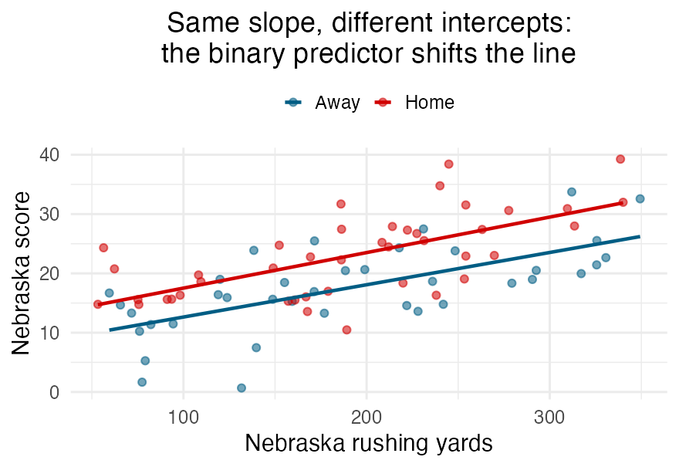
Seeing a Binary Predictor
Same slope for rushing yards, home or away
The home line sits higher by exactly the b for “home game”
A binary predictor shifts the intercept, it doesn’t tilt the line

Slide 13
Reading the Output

Slide 14
Level 1: Does the Model Work?
The Model Summary + ANOVA tables:
R² — proportion of criterion variance the whole model explainsAdjusted R² — R² with a penalty for extra predictors (use this one when comparing models)Model F — is R² significantly greater than zero? F(k, n − k − 1), with k predictors
Tip
Start here. If the model F isn’t significant, the individual predictor tests below it are a house built on sand.

Slide 15
Level 2: Which Predictors Matter?
The Coefficients table — one row per predictor:

Slide 16
Level 2: Which Predictors Matter? (continued)
Column | Meaning
b (unstandardized) | slope in original units (yards → points)
β (standardized) | slope in SD units — compare across predictors
t, p | is this contribution ≠ 0, holding others constant?

Slide 17
Level 2: Which Predictors Matter? (continued)
Caution
Comparing importance across predictors? Use β, not b — “yards” and “degrees Fahrenheit” aren’t on the same scale.

Slide 18
Saying It In English
Template for each significant predictor:
“Each additional rushing yard was associated with a b-point increase in score, holding passing yards, temperature, conference, and home-field constant, t(df) = X.XX, p = .XXX.”
Warning
Not “rushing caused points.” These are game-level associations — no random assignment here.

Slide 19
Running the Analysis

Slide 20
SPSS: Linear Regression
Analyze → Regression → LinearCriterion → Dependent; all predictors → Independent(s)Method: Enter (all predictors at once — that’s today)Statistics… → Estimates, Model fit, (optionally) Collinearity
Tip
You get three tables back: Model Summary (R²), ANOVA (model F), Coefficients (b, β, t). Read them in that order.

Slide 21
Sanity Checks
Signs make sense? Rushing yards negative would raise an eyebrow
β sizes — which predictor dominates? Is that plausible?
Adjusted vs. raw R² — a big gap means some predictors are dead weight
n per predictor — models get shaky when predictors pile up relative to sample size

Slide 22
APA Write-Up

Slide 23
The Model Sentence + Predictor Sentences
Model first: “The model predicted Nebraska’s score, F(5, 171) = XX.XX, p < .001, explaining XX% of the variance (adjusted R² = .XX).”Then each significant predictor: “b = X.XX, β = .XX, t(171) = X.XX, p = .XXX,” in plain EnglishName the non-significant ones too — an expected predictor that fell short is still a finding
Tip
df1 = k (number of predictors); df2 = n − k − 1. Both are in the ANOVA table.

Slide 24
Worksheet Walk-Through

Slide 25
Today’s Analyses: Husker Football
All games after 1997 (post-championship era):
RH1 (walkthrough together): Nebraska’s score ← rushing, passing, temperature + conference game? + home game?RH2 (your turn): Opponent’s score ← opponent rushing & passing, Nebraska penalty yards, temperature + Nebraska won? + home game?
Tip
For each RH: run the regression → record the Model Summary → record each predictor row → interpret → check your numbers in the Homework Checker.

Slide 26
Common Traps
❌ Reading b as “importance” across predictors — use β
❌ Forgetting “holding constant” when interpreting a coefficient
❌ Treating a binary predictor’s b as a slope (it’s a shift)
❌ Cherry-picking significant predictors without reporting the model first
❌ “Predicts” ≠ “causes” — no random assignment in game data

Slide 27
The Semester in Review

Slide 28
You Now Own the Whole Toolkit
Lab 06 · univariates Lab 07 · r & X² Lab 08 · one-way ANOVA Lab 11 · k-groups Lab 12 · factorial ANOVA Lab 13 · multiple regression
Tip
Every one of these answers the same core question differently: does the effect survive when you account for the other variables? That question is empirical psychology.

Slide 29
Questions?

Slide 30
Assignments & Reminders
Given this week:
Graded Research Project Reports will be returned
Due this week:
Lab 12: Factorial Worksheet
Lab 13: Multiple Regression Worksheet
Rewrites of Research Project Reports due
Submit to your lab section in Canvas by 11:59pm the day before your lab meets.

