Slide 1



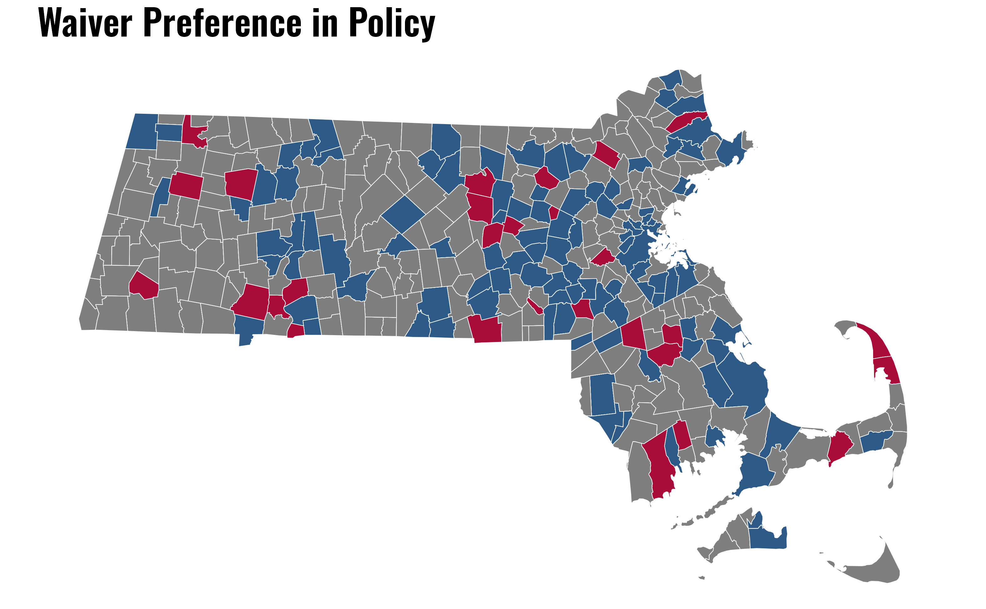
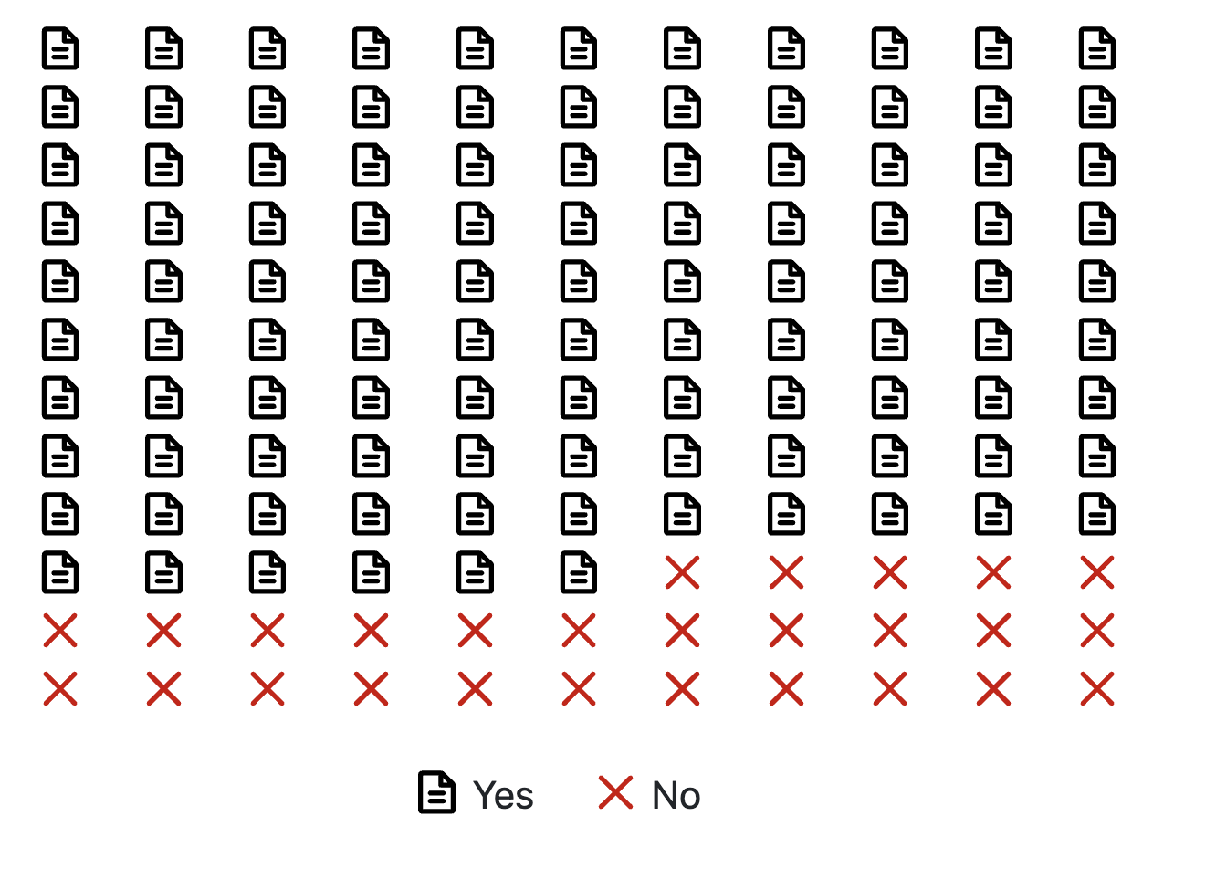
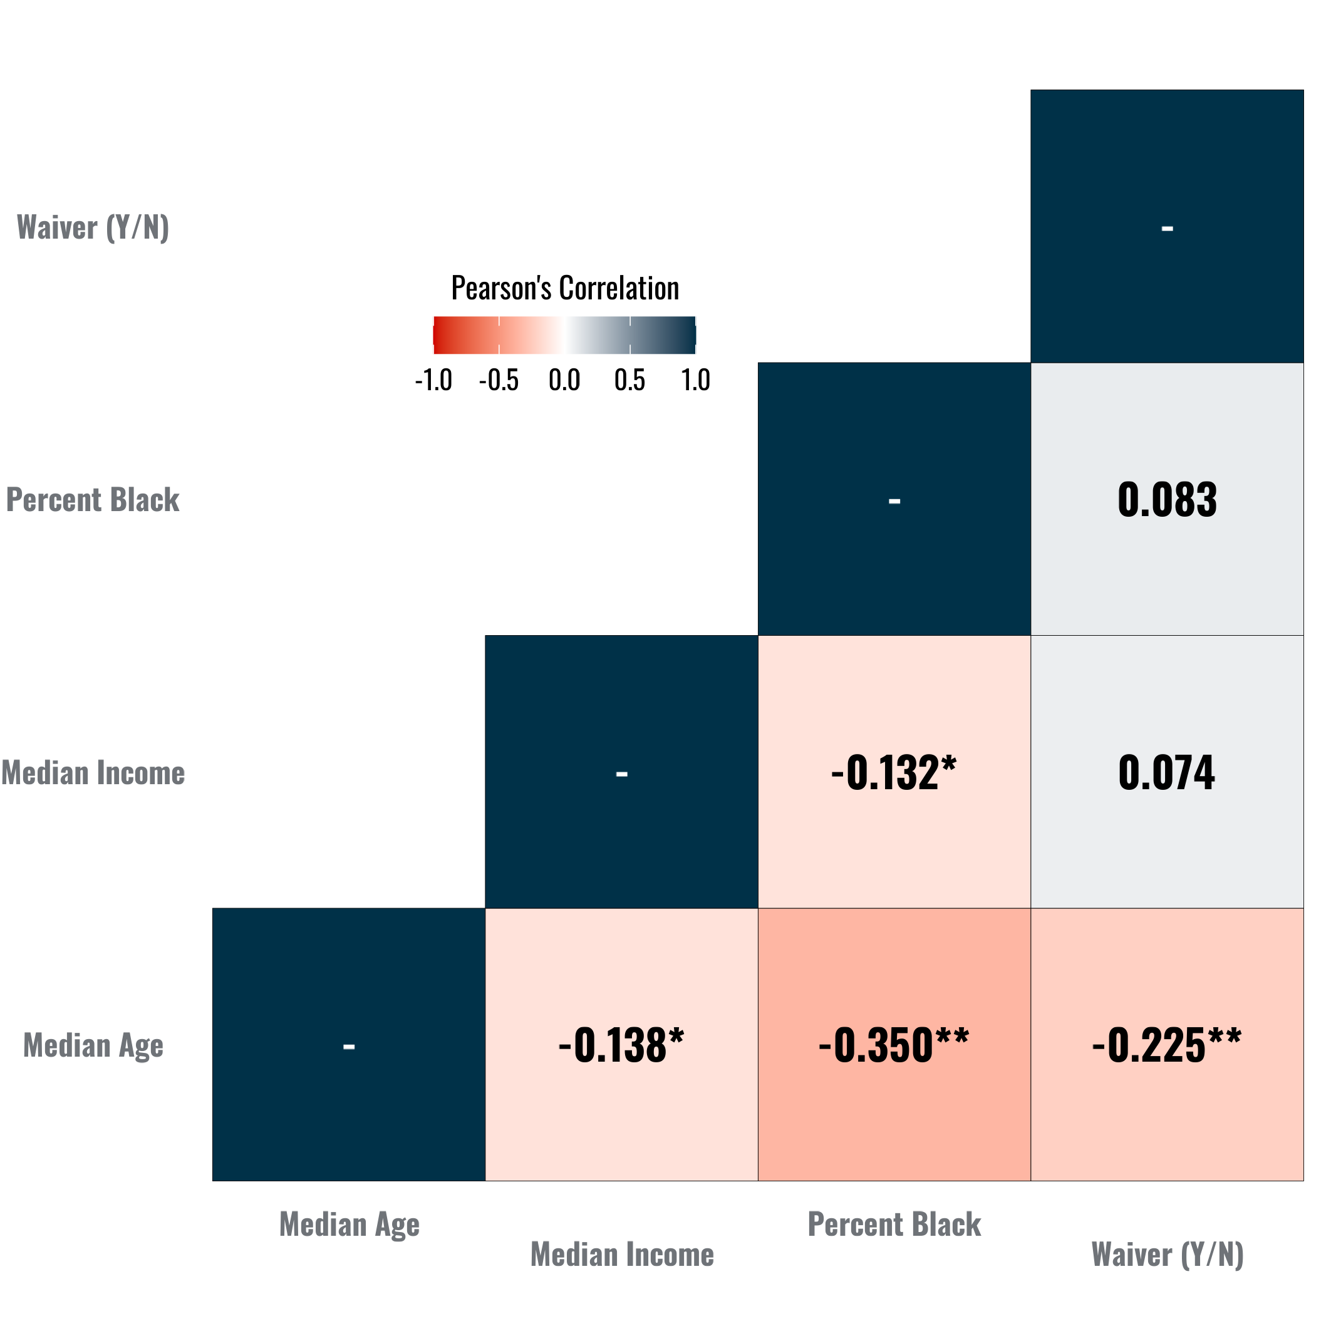
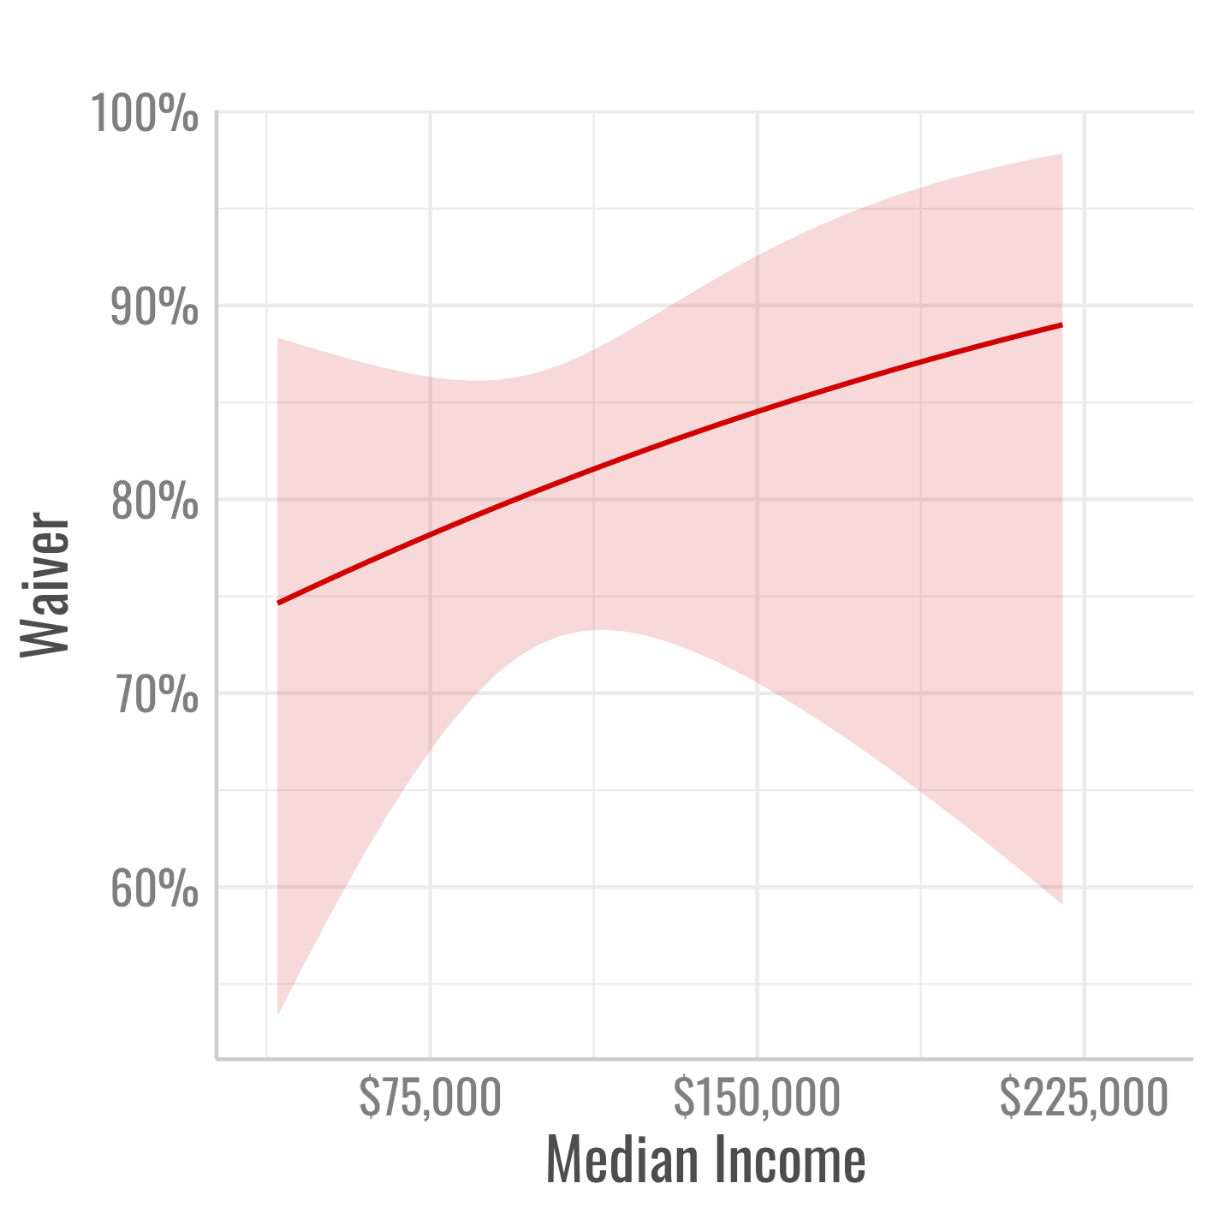
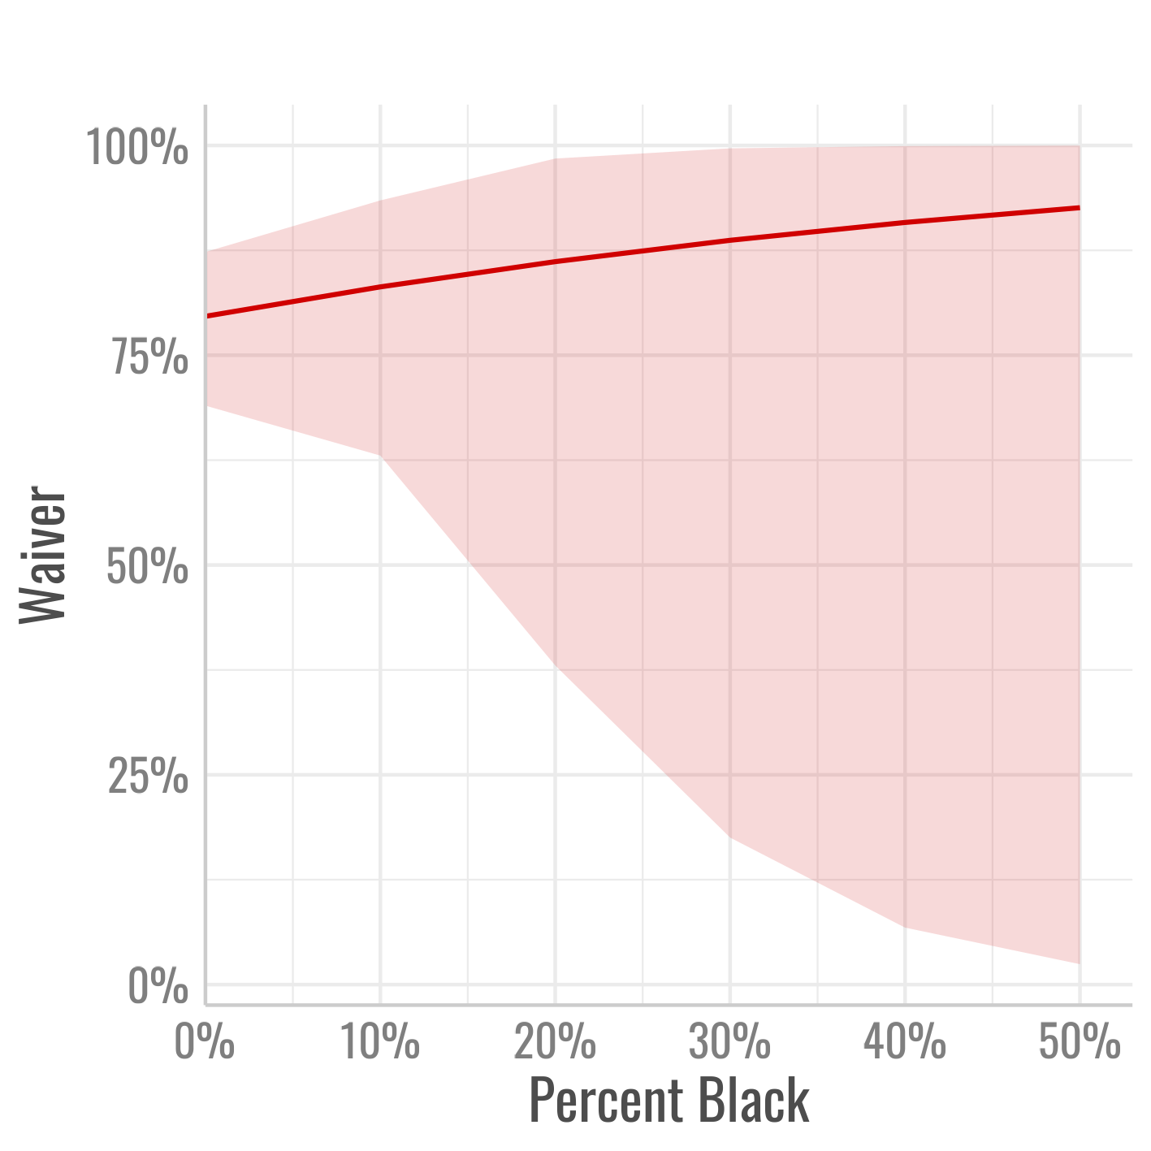
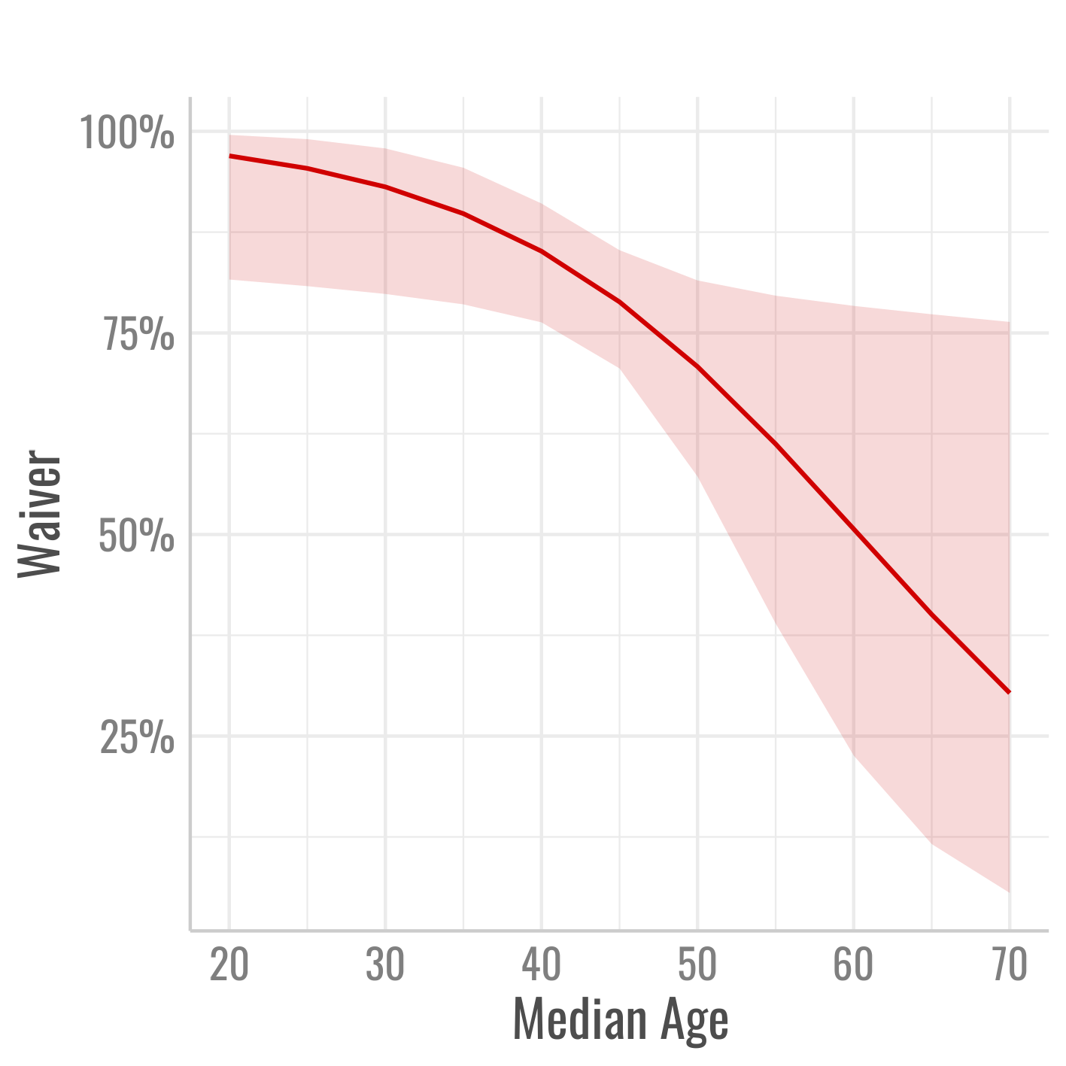
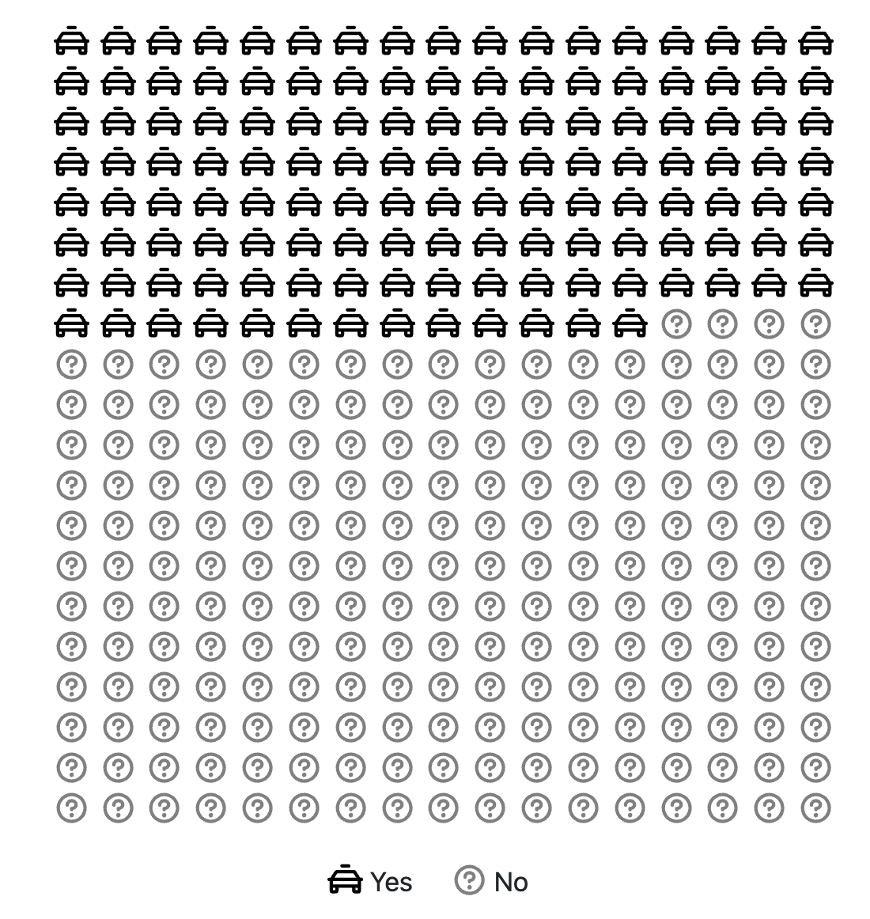
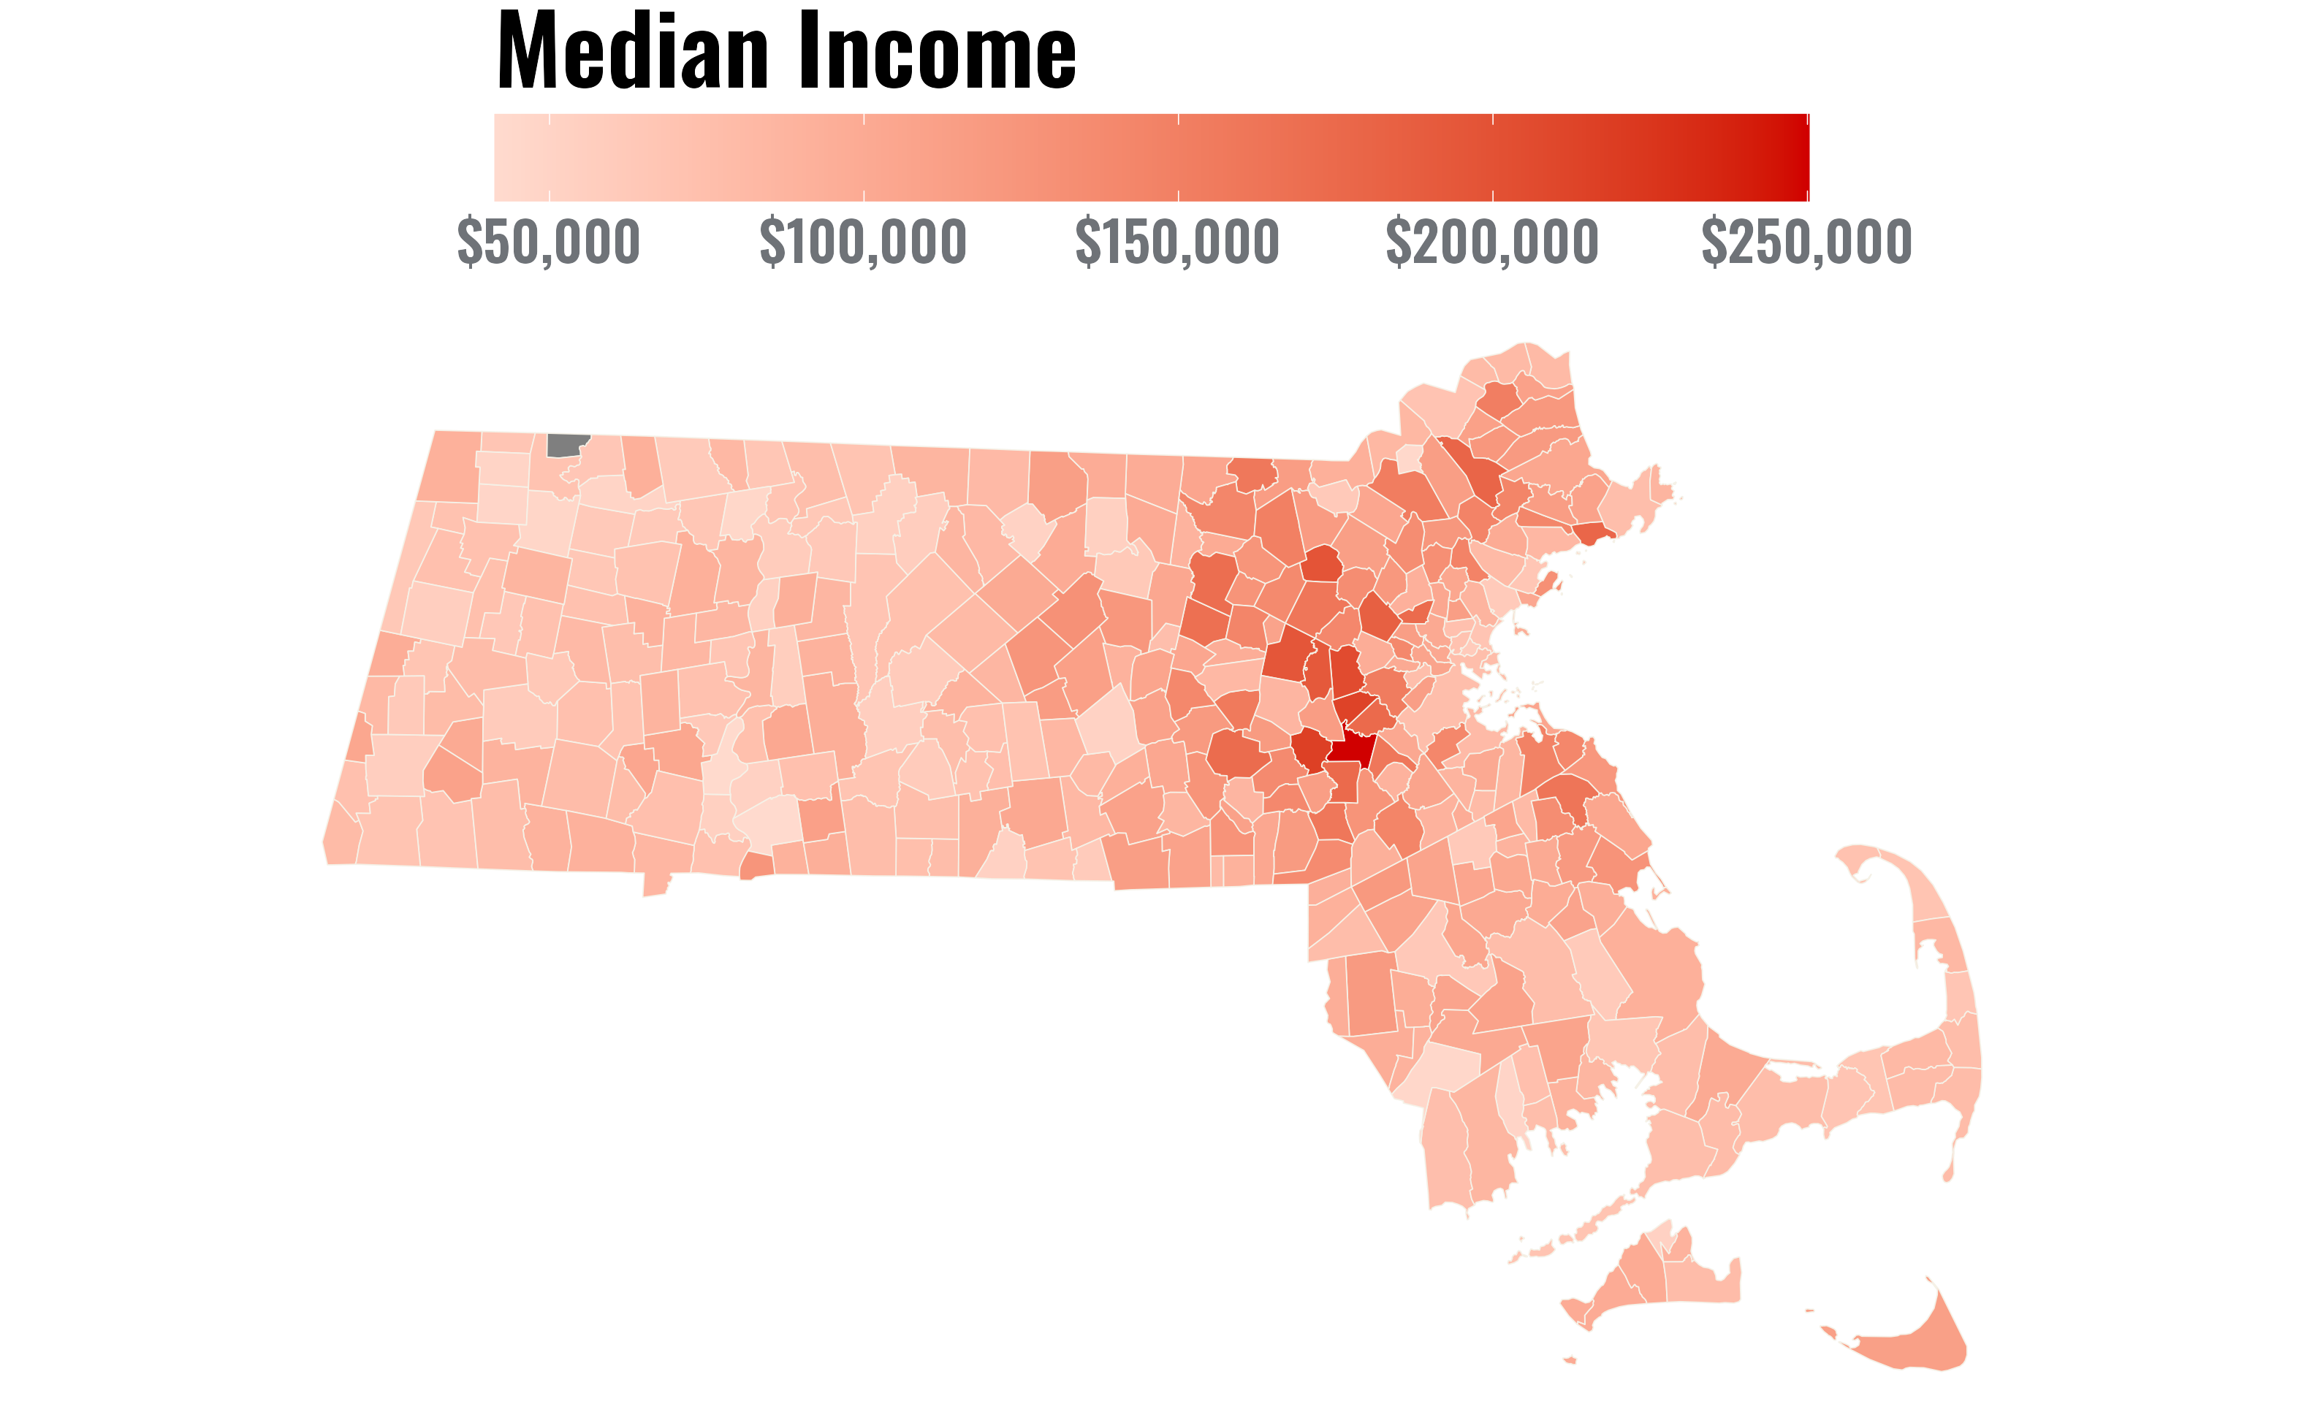
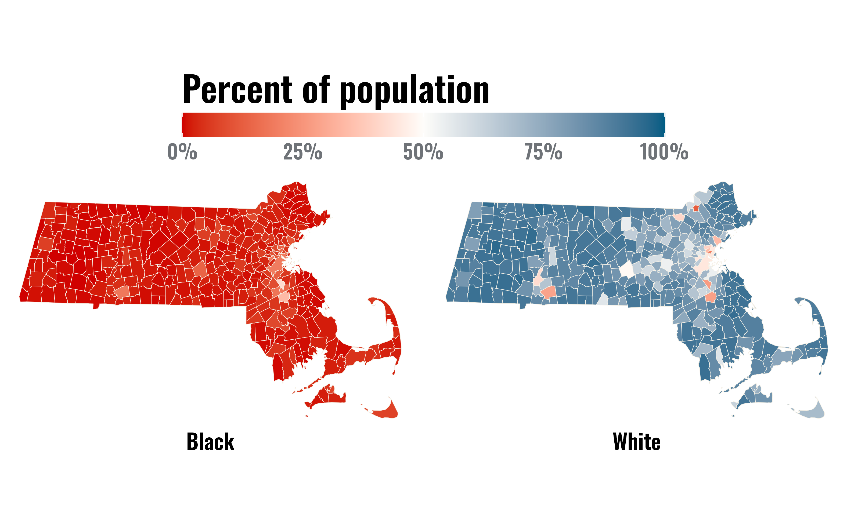
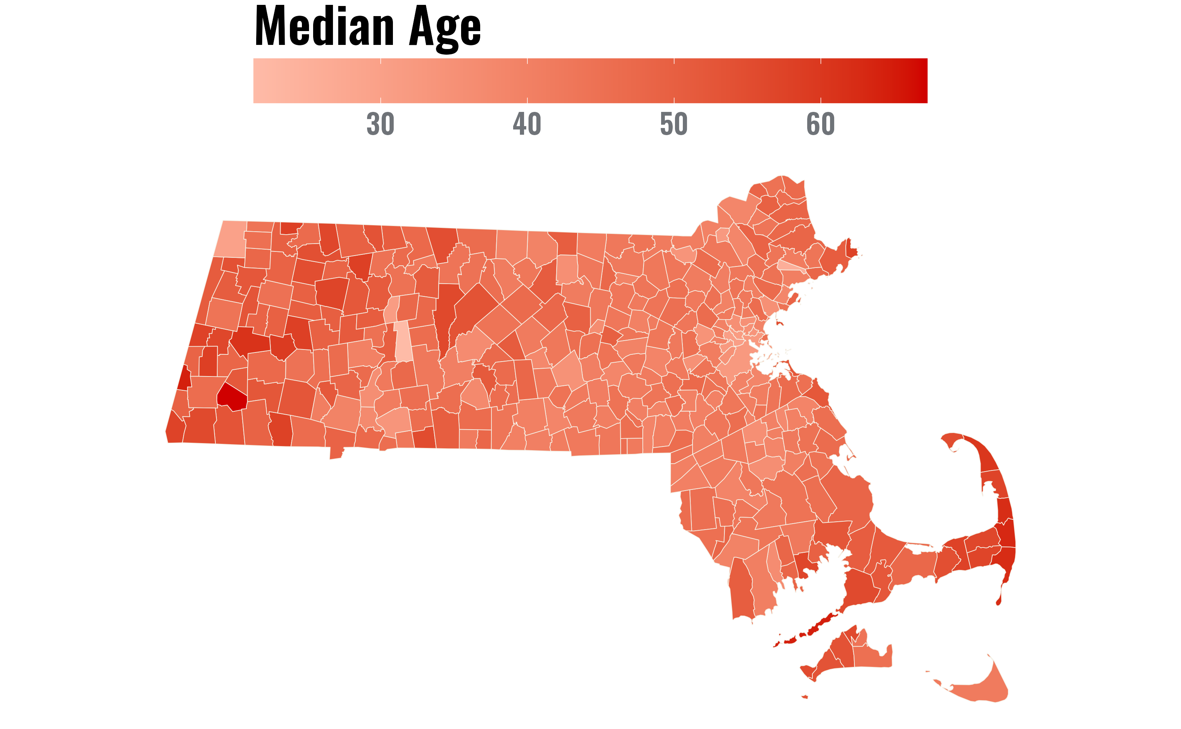

An Archival Analysis of Massachusetts’ Census Data and Police Department Search & Seizure Policies
Introduction
Results
Police Searches & Consent
The 4th Amendment protects individuals against unreasonable government searches and seizures
Police can request consent to search at any time, and consent searches do not violate the 4th Amendment so long as consent is voluntary and not “unduly coercive” (Schneckloth v. Bustamonte, 1973).
Written & Verbal Waivers of Rights
Many states including Massachusetts (MA) seek to provide additional safeguards for searches when based on a subject’s verbal or written consent
Recently, policy makers and police training committees in MA have encouraged municipal police departments to enact written consent-to-search waiver procedures
  But lack of formal mandate has resulted in patchwork of local protections and policies across the state
79.8% of department policies (107 out of 134) included a preference for written consent waivers…
Waiver Preference in Policy: Coded each departmental policy for inclusion of Written Consent Preference
YES, written preference
N0, not included
Policy Not Found
Waiver preference is negatively associated with median age but not median income or the percentage of
Black residents…
Binary Logistic Regression: Predicted inclusion of waiver preference (YES = 1; NO = 0) in policy based on median age, household income, & the percentage of Black residents
Research Questions
How many Massachusetts (MA) departments prefer written consent over verbal consent?
Do local demographics predict whether a municipal police department in MA has adopted a written waiver preference?
Methods
Archival Analysis: Reviewed (N = 344) Massachusetts’ municipal police departments websites for Search & Seizure Policies
Discussion
Located policies for 38.95% (n = 134) of departments
Towns younger residents prefer written consent to search waivers indication that there may be more political awareness around policing.
Looking at Cambridge, MA, a university town home to Harvard and MIT, may be more likely to adopt the written waiver policy as they may be more responsive to political needs of younger residents.
Increase of political and racial movements may allow for younger residents to be more aware of their rights.
Limitations: Did not locate policies from every municipal police department & analyses limited to MA
Future Directions: Examine the implications of adopting formal waiver procedures for both departments and individual consent search decisions
Police Departments serving younger populations may respond differently to calls for consent search reforms…
  If policy not available online, we contacted and requested the policy directly
US Census Data: Obtained local demographics by city/town from US Census (2020) & American Community Survey (2021) data via the Census Bureau API & tidycensus R packages (Recht, 2024; Walker & Herman, 2024)
Acknowledgements
We would like to thank the Law and Policy Lab at the University of Nebraska-Lincoln for their support, guidance, and work on this project. We would also like to thank the municipal Massachusetts police departments for their cooperation.
Notes:
Notes:
In Powerpoint, click View > Guides
Keep text within gutter guides.
Author list: Don’t split names onto two lines (e.g., “Jimmy [break] Smith”). If that happens, use a new line, unless you need the space. Bold the first names of anybody who’s presenting in person.
Intro/methods/result: Do not drop below font size 28, but if you have extra space, jack up the font size until the space is full.
Do not use color in the sidebars except in graphs/figures. It’ll pull attention from the center and slow interpretation for passersby.

