Slide 1
Reviewing the Literature
Lab 04 · Literature Review & Proposal
PSYC 350 Laboratory

Slide 2
1 Open the Lab 04 files
Worksheet
Write each section here before composing the paper
Worksheet: lab schedule
Assignment description
Read what the review and proposal should include
Description (Word)
Hints sheet
Check the guidance for each worksheet section
Hints (Word)
APA writing help
Check paper format, citations, and paraphrasing
APA guidelines
Notes:
Open the worksheet, description, and hints. The hints sheet is a reference, not a submission. The two assigned articles are linked on the reading slides.

Slide 3
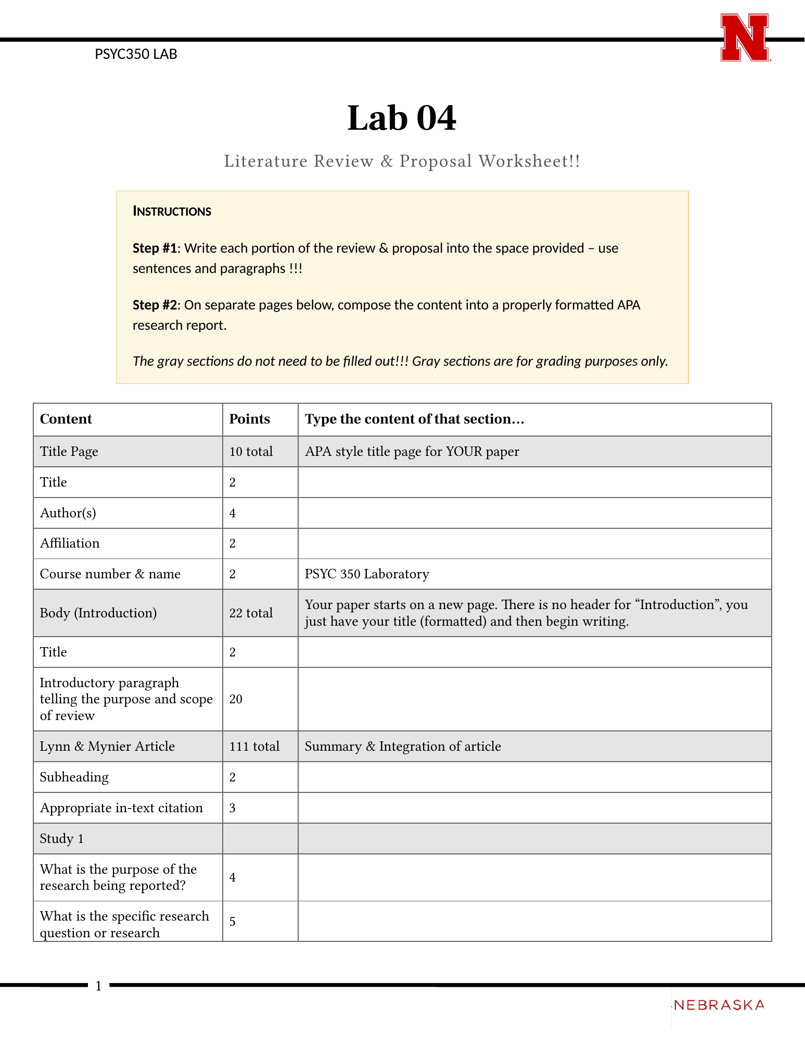
2 Start with the worksheet
Write each section in sentences and paragraphs
Use the hints to check that you included the required details
Compose the APA paper on new pages after the worksheet
Leave the gray grading rows blank
Notes:
Identify the article summaries, the two integration sections, and the proposal. The Word worksheet’s gray rows contain grading information. Students write in the response spaces, then compose the paper below.

Slide 4

3 Literature leads to the next study
Notes:
Connect the literature review to the proposal: students use what the articles found and left unanswered to decide what to study next.

Slide 5
4 Ask five questions as you read
Why was the study needed?
What did the authors predict?
How did they test it?
What did they find?
How do the findings relate to earlier research?
Report every result in words, as the hints require
Notes:
Use Study 1 to model this reading sequence. The worksheet also asks for participants, formal design terms, materials, and procedures. Students need all reported findings, including nonsignificant results and interactions, without copying the statistical values.

Slide 6
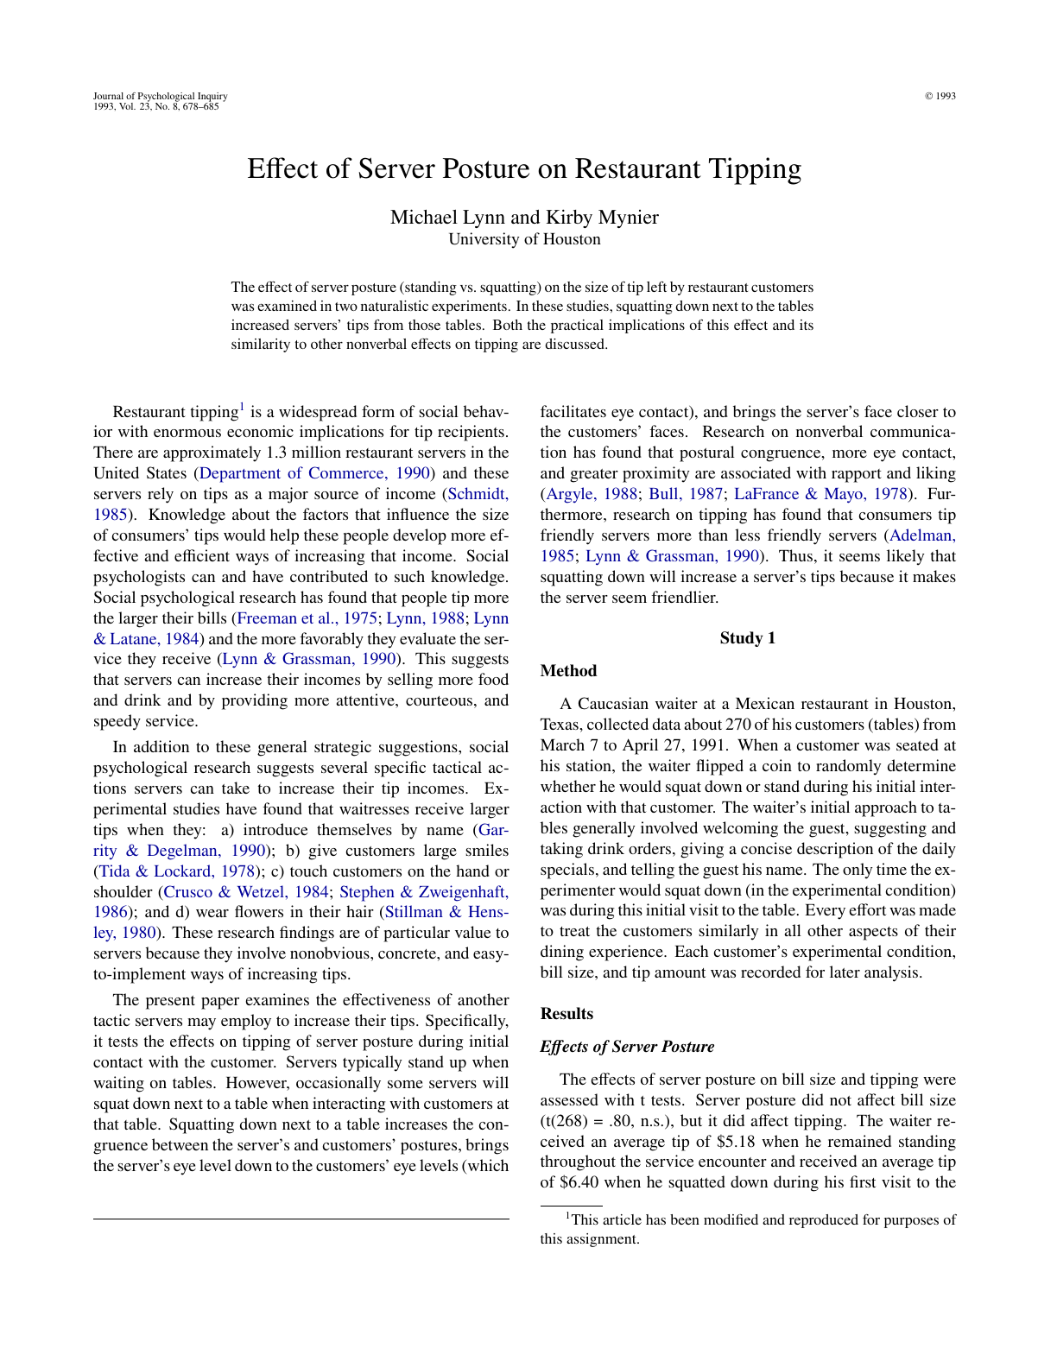
5 Read Lynn and Mynier first
Two studies in restaurants
Comparison: standing or squatting
Outcome: customer tips
Lynn and Mynier (1993) · PDF
Notes:
Start with the title and abstract. Have students identify the IV, DV, and predicted direction, then check the Method. Use the assigned course version of the article.

Slide 7
6 Study 1 assigns posture
A waiter recorded data for 270 tables
A coin toss determined standing or squatting
The waiter used that posture during the first visit
He recorded the condition, bill size, and tip
Notes:
Use the coin toss to explain why this is a between-groups experiment. The hints treat each table’s tip as one DV score; the waiter collects the data. Have students identify the other sampling and procedure details in the article.

Slide 8
7 Describe the result in words
Example paraphrase · Study 1
Customers left larger tips when the waiter squatted during his first visit to the table.
What other findings does the Results section report?
How does assignment affect the conclusion you can draw?
What limitation do the authors discuss?
Notes:
This sentence models one result, not the complete worksheet answer. Have students read both Results subsections and the Discussion. They need to explain the other findings and why a limitation matters.

Slide 9
8 Use Study 2 for practice
Why did the authors conduct a second study?
What stayed the same, and what changed in the method?
Which findings repeated, and which differed?
How did the authors connect these findings to earlier research?
Notes:
Students should complete each Study 2 box using the article. Check both Results subsections, including the weekday/weekend comparison, other interactions, and nonsignificant findings. Do not stop at the average-tip comparison.

Slide 10
9 Compare the two studies
Similarities: Which procedures and findings were alike?
Differences: What changed, and could it explain a difference in results?
Together: What do you learn from both studies that either one alone would not show?
Notes:
Follow the worksheet’s three integration questions. Ask students to connect specific similarities and differences to replication and generalizability.

Slide 11
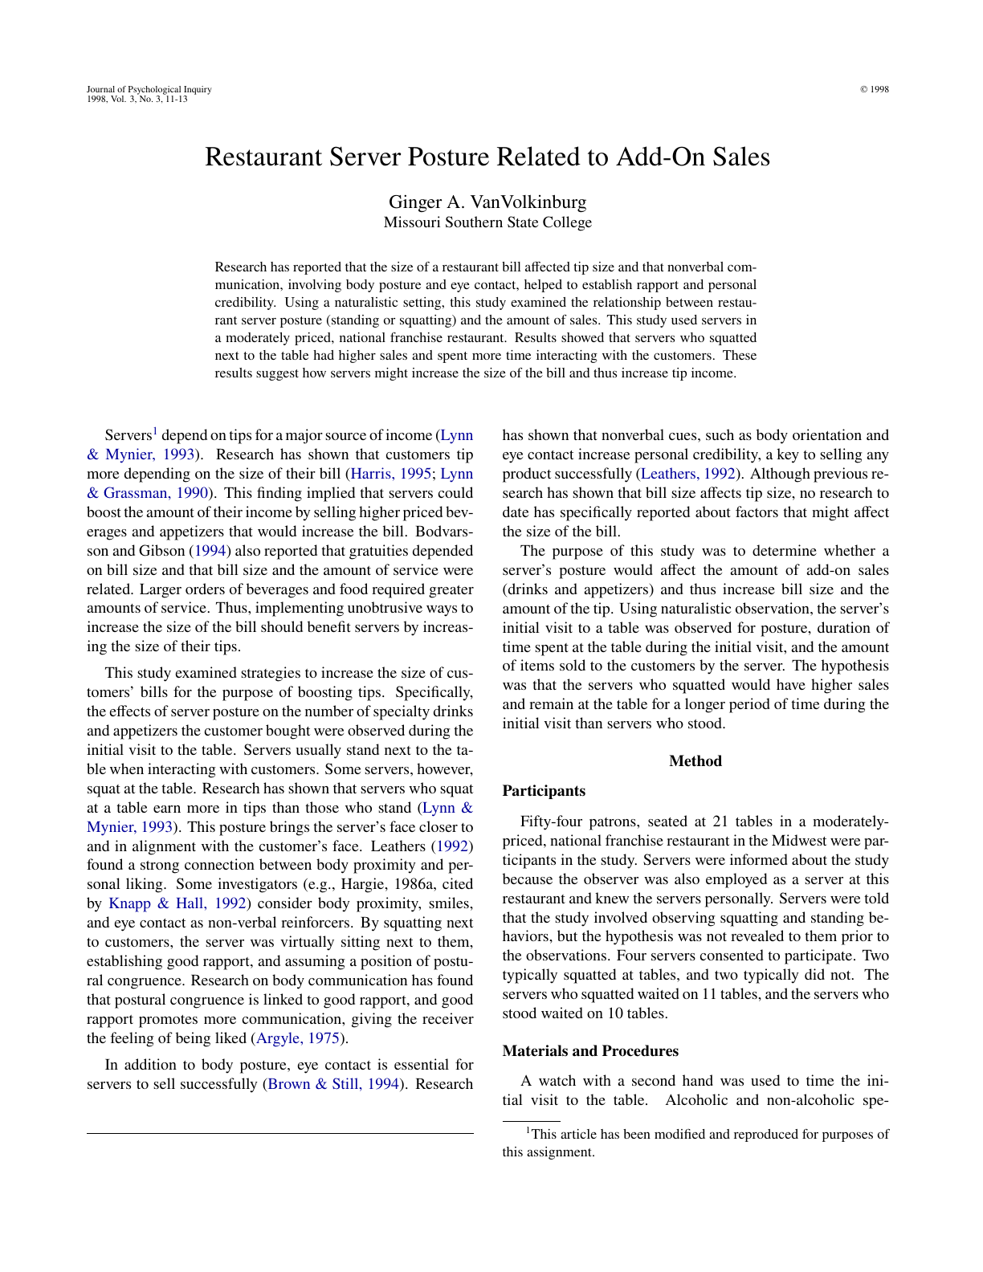
10 Read VanVolkinburg next
One observational study
Participants: 54 patrons at 21 tables
Outcomes: visit time and add-on sales
VanVolkinburg (1998) · PDF
Notes:
Ask students to identify how the research question and outcomes differ from Lynn and Mynier’s. Keep the patrons and tables separate from the servers whose behavior was observed.

Slide 12
11 Here, researchers observed habits
Two servers usually squatted, and two usually stood
The observer recorded their usual posture
She also recorded visit time and add-on sales
What else might differ between these servers?
Notes:
Ask students to use the Method to distinguish observation from assigned posture. Have them identify a possible confound and explain how it could affect the outcomes.

Slide 13
12 Match the claim to the design
How did the sales comparison change when the outliers were removed?
What did the authors find about time spent at the table?
How did the time–sales relationship differ by posture?
Does this design support a causal claim? Explain why
Notes:
Keep the sales comparison, visit duration, and correlations separate. Students need the results before and after the outlier exclusion, then the assignment details to judge the claim. Have them explain each finding in words.

Slide 14
13 Compare the two designs
Article | Posture | Outcomes | Claim to justify
Lynn & Mynier | Assigned | Tips | Causal or associative?
VanVolkinburg | Observed | Time and sales | Causal or associative?

Slide 15
13 Compare the two designs (continued)
What design evidence supports each choice?
Notes:
Have students justify the claims before writing the cross-article integration. They should explain how the design affects what they can conclude.

Slide 16
14 Connect the articles in your writing
Similarities: Connect findings and procedures from both articles
Differences: Explain how design differences might account for different findings
Together: State what considering both articles adds
Notes:
Use the completed comparison to build a paragraph that moves between articles. Students should explain the relationships among findings, rather than repeat the two summaries.

Slide 17
15 Choose a question for your proposal
One possible question
Does posture change customer outcomes because it increases interaction time?
Your proposal can use different variables or a different setting. Explain how the question follows from both articles.
Notes:
The question is an example, not an assigned topic. The rubric gives less credit for changing only the population or setting and more for an idea that adds to what the studies tell us. Ask students what their proposed study would establish that the reviewed studies did not.

Slide 18
16 State one testable prediction
Name the IV and DV in your proposed study
State the relationship or difference you expect
Use wording that matches your design
Notes:
Have students state a formal hypothesis using their own study’s variables and expected direction. They should be able to explain how it follows from the review. Use causal wording only when the proposed design supports it.

Slide 19
17 Plan the method for your question
Sample
Who will participate, how many, and how will you obtain the sample?
Materials
What equipment, stimuli, or measures will you need?
Procedure
How will conditions be formed, and what will each participant do?
Measures and controls
What will you record, and what will you keep consistent?
Notes:
Follow the proposal boxes for sample, materials, and procedures. Explain the sequence clearly enough that someone else could carry out the study. Include anyone needed to conduct it and what they would do.

Slide 20
18 Check both kinds of validity
Internal validity
• How will conditions be formed?
• What else could differ between them?
• Which procedures will stay consistent?
External validity
• Who does your sample represent?
• To which settings, tasks, and times could the findings apply?
Notes:
Ask students to identify a possible confound and how they would address it. Then check that their conclusions stay within the people and situations their study represents.

Slide 21
19 Build paragraphs around one point
State the paragraph’s main point
Add evidence and explain why it matters
Connect that point to what comes next
Notes:
Read a completed worksheet section without its prompt. It should make sense on its own and connect to the surrounding sections. Move or revise sentences that do not support the paragraph’s point.

Slide 22
20 Combine related facts
Separate facts
Study 1 included 270 tables. A waiter served them. He flipped a coin. The coin determined his posture.
Combined sentence
In Study 1, a waiter used a coin toss to assign 270 tables to a standing or squatting condition.
Notes:
This example combines related facts into one sentence. Integration also explains how evidence from different studies fits together.

Slide 23
21 Finish with the APA checklist
Create an APA student title page
Use descriptive headings; do not add an Introduction heading
Paraphrase and cite both articles; do not use direct quotations
Add a References page
Double-space and proofread
Notes:
Repeat the paper title at the top of the first body page. Check citations and both reference entries rather than assuming the reference manager has formatted them correctly. Use the linked APA guidance and assignment materials.

Slide 24
22 Finish the worksheet, then the paper
Introduce the topic and scope of your review
Summarize and integrate Lynn and Mynier’s two studies
Summarize VanVolkinburg’s study
Integrate the two articles
Explain your proposed study
Before Week 5: Submit the completed worksheet with the APA paper on new pages, then check that you uploaded the correct file
Notes:
Leave this sequence visible during work time. Students finish the worksheet sections before composing the paper, including its title and reference pages. The course schedule places submission before Week 5. The hints sheet is not submitted.

