Slide 1
Enter, Transform, Summarize
Lab 06 · SPSS Data and Univariate Statistics
PSYC 350 Laboratory

Slide 2
1 Open the Lab 06 files
Worksheet
Worksheet: lab schedule
Homework checker
Enter and transform
Data entry guide
Transform guide
Select and summarize
Select cases guide
Univariate guide
Notes:
Have students open the worksheet and SPSS. They will enter the walkthrough data themselves. The four guides cover the operations used in this lab.

Slide 3
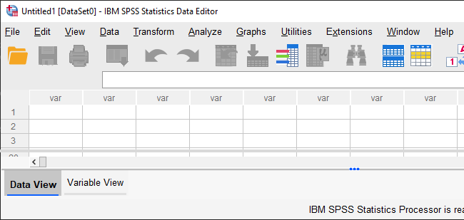
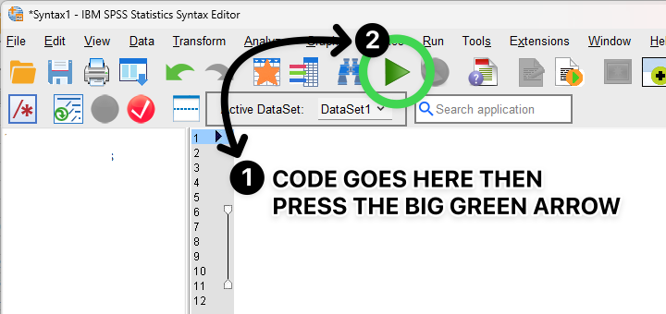
2 Keep Data and Syntax Editors open
Data Editor
Syntax Editor
Enter and inspect data
Save and rerun commands
Notes:
The Data Editor holds the dataset. The Syntax Editor keeps the commands: choose Paste in a dialog, then run and save the syntax.

Slide 4
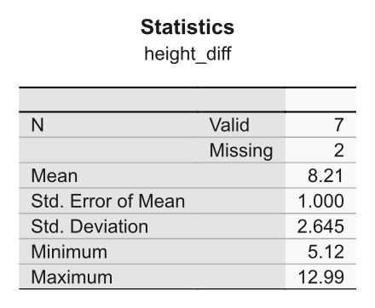
3 Find results in Output Viewer
Notes:
The Output Viewer collects tables, charts, and messages. Use this table to show where results appear; return to its values after the walkthrough.

Slide 5
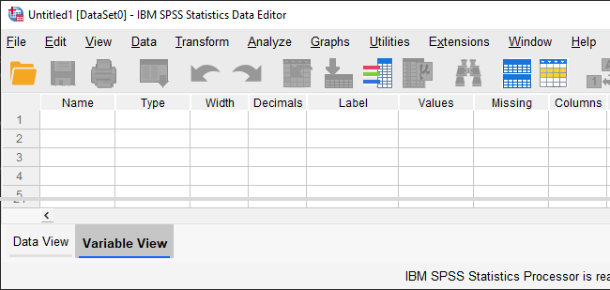
4 Switch views inside Data Editor
Data View
Rows: cases · Columns: variables
Variable View
Rows: variables · Columns: settings
Notes:
Define variable settings in Variable View, then enter one case per row in Data View. Point out the tabs at the lower left.

Slide 6
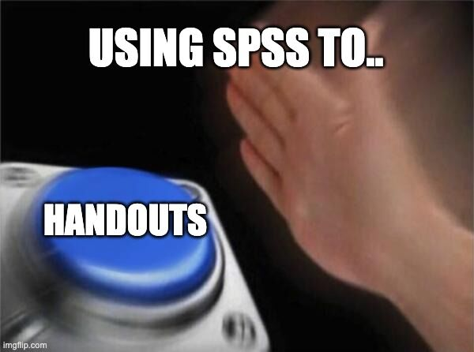
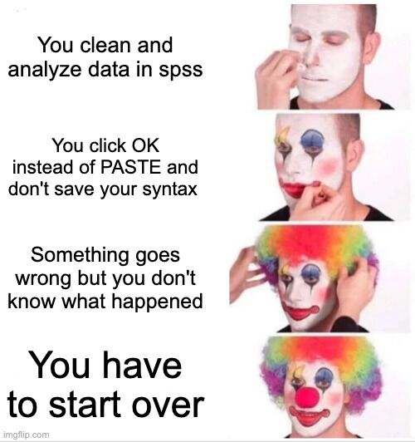
5 Keep the guide and syntax handy
Keep the guide open
Paste and save syntax
Notes:
Keep the relevant guide open. Pasting and saving syntax lets students rerun a step or find an error without reconstructing every click.

Slide 7
6 Check each change as you work
Define variables and missing values
Enter one row per case
Transform into new variables
Verify each change before continuing
Notes:
Have students check each operation before starting the next. Labels and frequency tables make errors easier to spot.

Slide 8
7 Match summaries to variable type
Quantitative
Report M and SD
Example: height in inches
Categorical
Report N and % for each category
Example: type of media
Notes:
These are the reporting choices for the worksheet tables. The checker separately asks whether a mean is interpretable and distinguishes quantitative, binary, multiple-category, and ID variables. Ask students to explain their choices.

Slide 9
8 Define the five variables
In Variable View, create:
num, year, and type
clark_height and lois_height
value labels for type
−99 as the missing-value code
Notes:
Use the worksheet’s variable names and type codes. Declare −99 missing before computing anything, so SPSS does not treat it as an actor’s height.

Slide 10
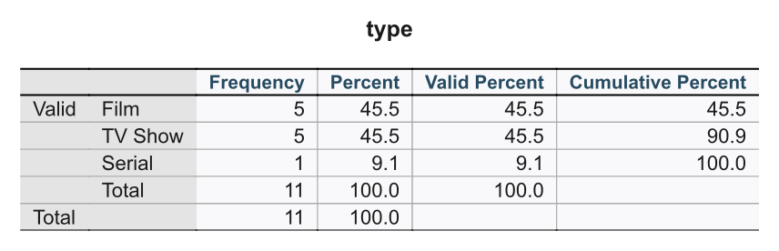
9 Check the 11 entered cases
One row per actor record
Codes match the worksheet
Declare −99 missing
Frequency total = 11
Notes:
Run frequencies for type and compare the counts with the worksheet. If they differ, check the entered rows and value labels before continuing.

Slide 11
10 Convert both heights to inches
COMPUTE clark_height_in =
clark_height * 39.37.
COMPUTE lois_height_in =
lois_height * 39.37.
EXECUTE.
Notes:
Keep the original meter variables. Missing heights should stay missing after conversion; changing units does not supply missing data.

Slide 12
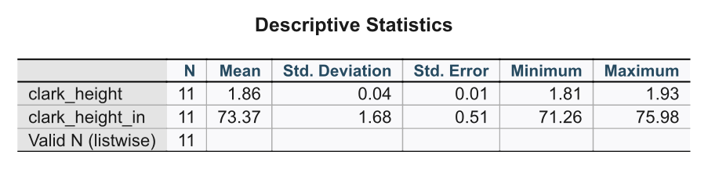
11 Check the converted heights
Check Lois’s height separately
Notes:
This table shows Clark’s height only. Check Lois’s height separately: both her original and converted variables should have nine valid cases and two missing.

Slide 13
12 Create the next three variables
[Walk-through steps 4–6]
clark_grp: group Clark’s height using the worksheet’s cutoff
height_diff: compute Clark’s height minus Lois’s, in inches
height_gap: group the height differences
Add labels and check frequencies after each step
Notes:
Follow worksheet steps 4–6 one at a time. For clark_grp, the second group includes exactly 72 inches. For height_gap, the middle group includes both 6 and 8 inches. Keep missing values missing and verify labels and frequencies after each step.

Slide 14
13 Select media after 1975
USE ALL.
COMPUTE filter_$ =
(year > 1975).
FILTER BY filter_$.
EXECUTE.
Notes:
Filter the cases rather than deleting them. The diagonal lines in Data View show which rows are excluded from the next analyses.

Slide 15
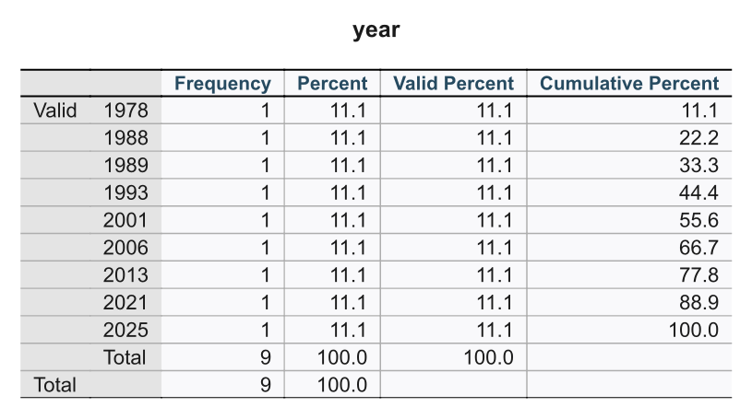
14 Confirm nine active cases
Notes:
Check that the active years are all after 1975. If the total differs, check the entered years and filter before computing summaries.

Slide 16
15 Request the walkthrough summaries
FREQUENCIES
VARIABLES=num year type
clark_height lois_height
clark_height_in
lois_height_in
height_diff clark_grp
height_gap
/STATISTICS=
MEAN STDDEV SEMEAN.
Notes:
The worksheet asks for the mean, SD, and SEM for every entered and created variable. Ask students to decide whether each mean is interpretable using the checker’s variable-type choices.

Slide 17
16 Read the height-difference summary
Notes:
Ask why there are fewer valid height differences than selected cases. Students should use their own output in the walkthrough checker, then save a screenshot with every answer correct.

Slide 18
17 Complete Table 1
[Walk-through steps 10–11]

Slide 19
17 Complete Table 1 (continued)
Variable | Report
height_diff | M and SD
clark_grp | N and % for each group
height_gap | N and % for each category

Slide 20
17 Complete Table 1 (continued 2)
Reset to All cases, then save data and syntax
Notes:
Use the worksheet’s Table 1 template and the filtered output. Include each level of clark_grp and height_gap. Before the take-home section, return Select Cases to All cases and save the data and syntax.

Slide 21
18 Add the take-home variables
[Take-home steps 1–8]
Add the ratings variables to your saved data
Create tomatometer, rt_avg, rt_diff, then popular
Select cases with rt_critics_count ≥ 5
Run the summaries and complete the take-home checker
Notes:
Add the ratings to the saved walkthrough dataset, keeping the same row order. Work through the transformations in the worksheet’s order and check each result. Declare −99 missing before calculating the ratings summaries.

Slide 22
19 Finish Table 2 and the checker
Report M (SD) for rt_avg and rt_diff
Report N (%) for tomatometer and popular
Include checker screenshots with all answers correct for both sections
Reset to All cases, then save data and syntax
Notes:
Check that both sections’ checker screenshots are in the worksheet. Reset Select Cases to All cases and save both files; students will need the dataset in the next lab.

