Slide 1
How to Make an APA Style Poster
Final Project Guide

Slide 2
Poster Assignment
Content
• Introduction
• Methods
• Results
• Discussion
• References*
The Poster
• Layout
• Visuals
• Color
• Whitespace
• Aesthetics
Getting started
• Use a template
• Know your audience
• Keep text brief
Notes:
Preview the three goals for this guide: choose concise content, organize it visually, and use the supplied templates rather than starting from a blank page.

Slide 3
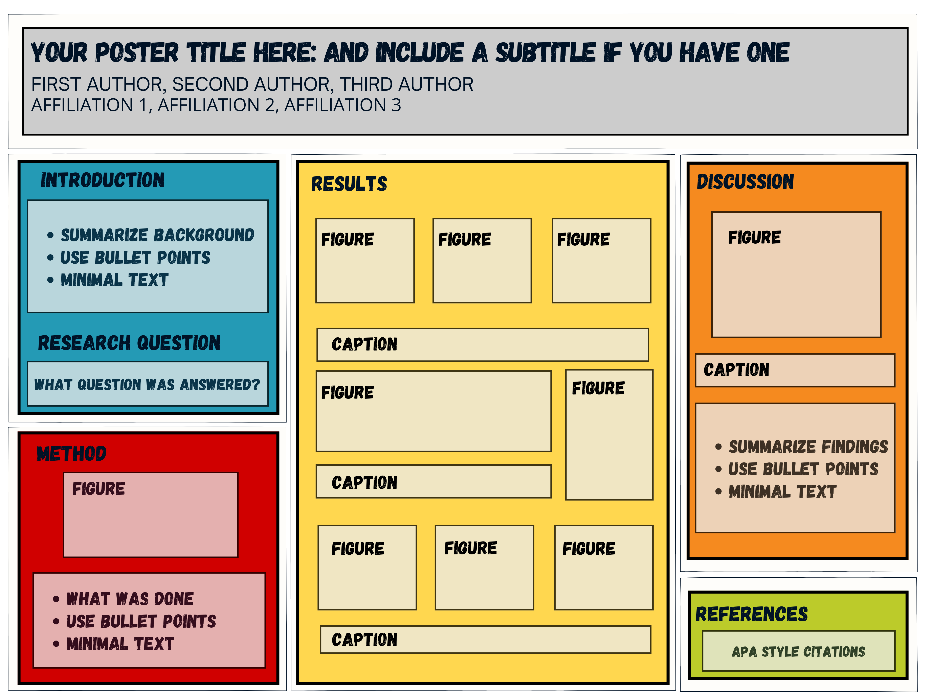
Elements of a Poster
Notes:
Use the diagram to show the audience’s reading path. The title establishes the question; the center of the poster carries the evidence; the discussion closes the story.

Slide 4
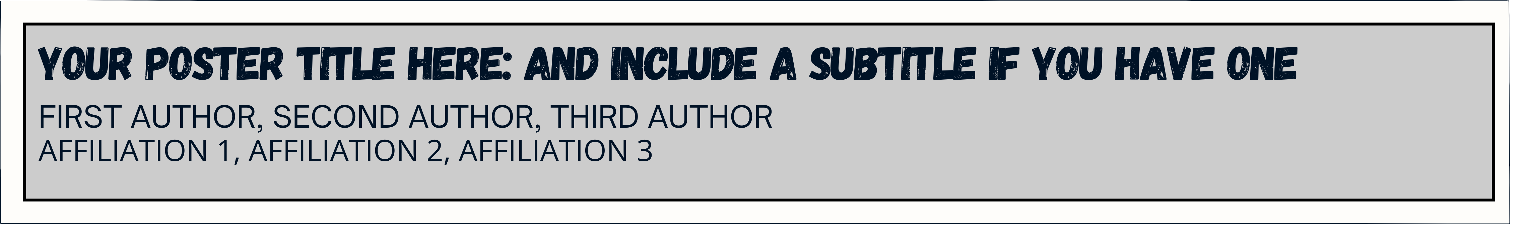
Title Section
Notes:
The title should state the study clearly and remain readable from several feet away. Include all authors and the institutional affiliation without crowding the banner.

Slide 5
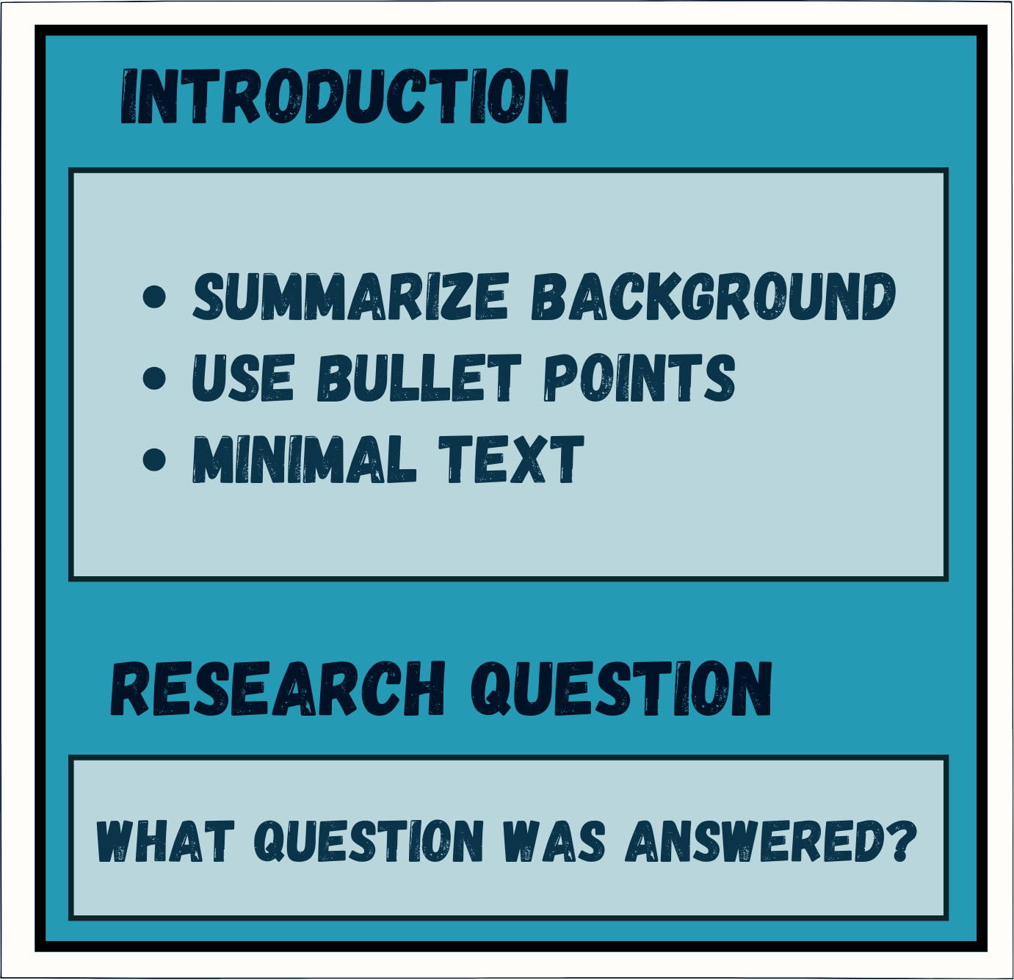
Introduction
Overview of why research was conducted
Describe core theory & background
  Provide factual basis for RHs
  Synthesize & summarize research area
State the research question(s)
Notes:
The introduction should move quickly from the research problem to the current hypotheses. Replace literature-review paragraphs with short, connected claims and citations.

Slide 6
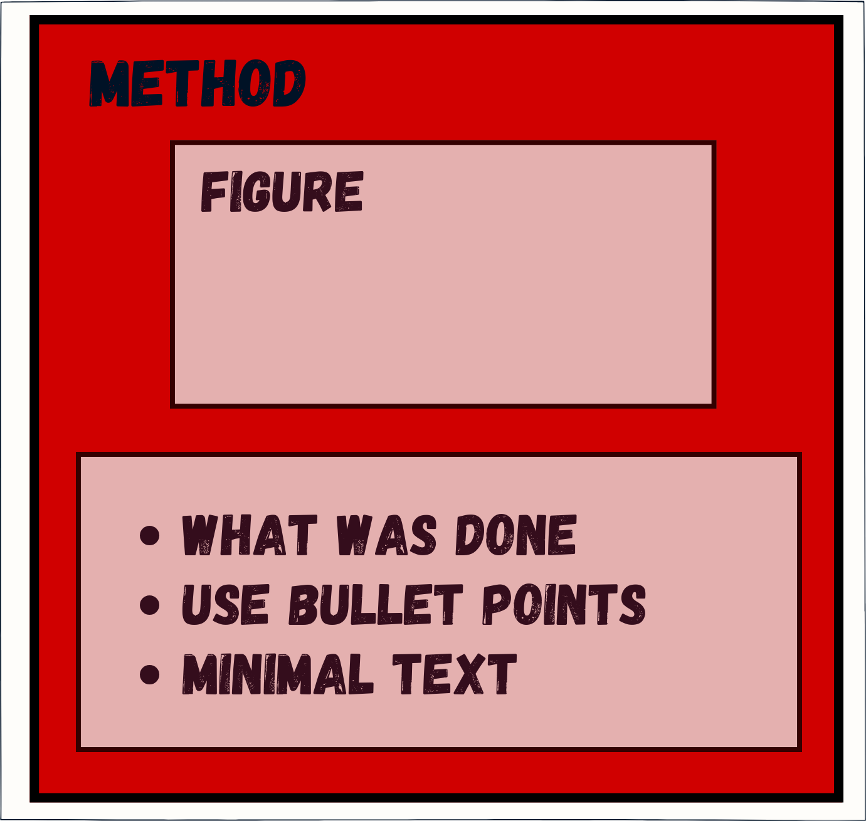
Methods
Describe how they studied topic
Describe steps or processes
Include who was studied and where
  Sample size (n)
  Demographics (M & SD or # & %)
Notes:
Keep only the method details needed to understand or reproduce the study. Diagrams, timelines, and labeled measures usually communicate the procedure better than prose blocks.

Slide 7
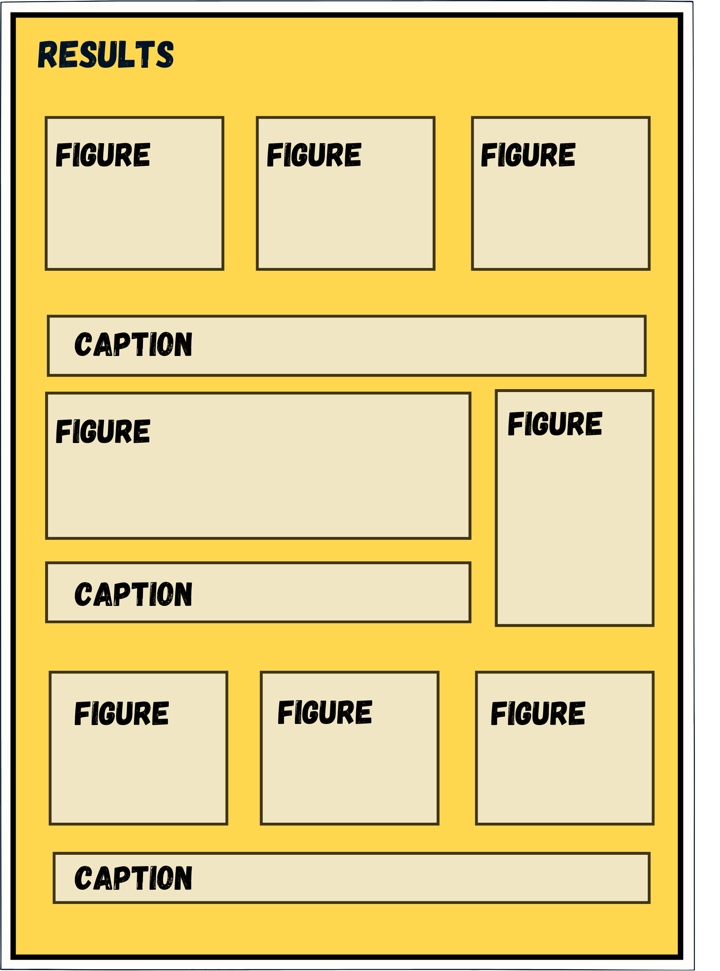
Results
Show what they found
Focus on the key findings
  Organize by RHs
Include tables & figures (graphs & pictures)
Keep text brief
Notes:
Organize findings by hypothesis. Use readable tables or figures and follow APA formatting.

Slide 8
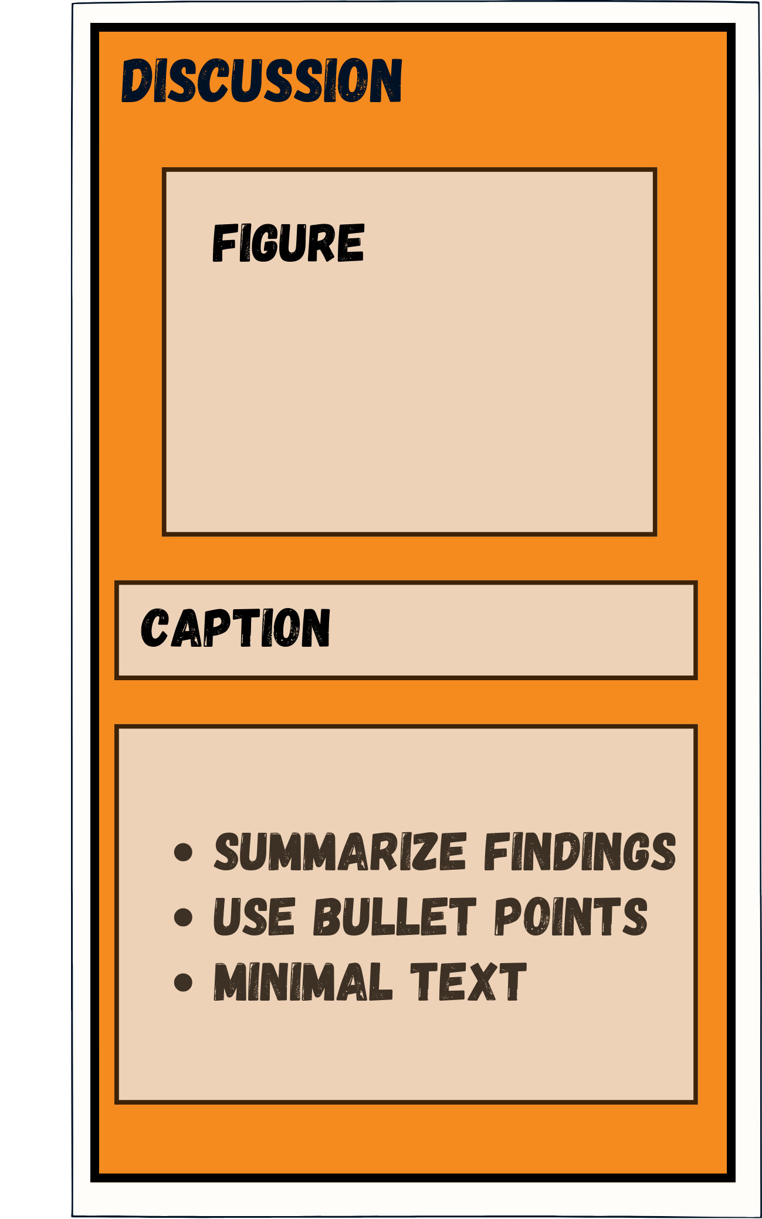
Discussion
Explain why results matter
Describe real-world implications
Bound conclusions to the sample, task, and setting
Identify limitations
Suggest future directions for research
Notes:
The discussion should answer the research questions, connect findings to prior work, qualify conclusions, and identify a specific next study. Keep the visual hierarchy consistent with the results section.

Slide 9
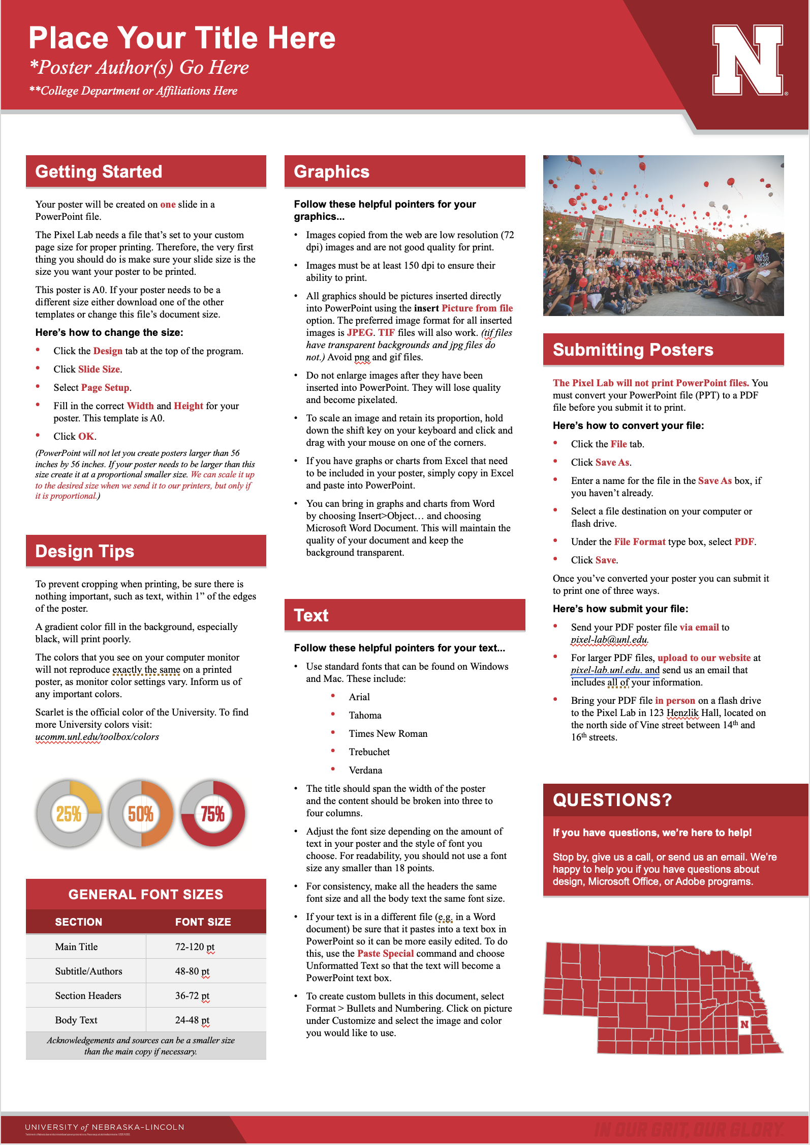
How to Make a Poster
No single design is correct. Make yours:
  visually appealing
  proofread
  logical and organized
Tell a visual story
Use minimal text
Keep figures and tables readable
Notes:
The UNL Pixel Lab provides student resources, including poster templates and printing.

Slide 10
What an APA poster generally includes
Title Section — title and author(s)
Introduction — background, purpose, and research question(s)
Method — participants, materials, and procedure
Results — key findings shown with visualizations, minimal text
Discussion — relation to prior literature, limitations, future directions
References/Funding — APA 7 citations & disclosures
Notes:
Use this as a final content inventory. Students may adapt the section labels, but every claim, method, result, and disclosure still needs a clear home on the poster.

Slide 11
Build and export your poster
Use PowerPoint, Keynote, or Google Slides
Start from a template
Export the final poster as a PDF
Poster templates & examples:
Horizontal 36 × 48 (PPTX)
Square 42 × 42 (PPTX)
Vertical 48 × 36 (PPTX)
Example poster (PPTX)
Notes:
You may find it useful to watch this video on creating scientific posters in PowerPoint.

Slide 12
Examples
Notes:
Introduce the next posters as design examples rather than text to read line by line. Ask students to notice hierarchy, whitespace, alignment, and the balance of prose with figures.

Slide 13

Example: Clean Three-Column Layout
Notes:
Point out the clear three-column grid, consistent section headers, and dominant results visuals. Ask where the eye goes first and why.

Slide 14
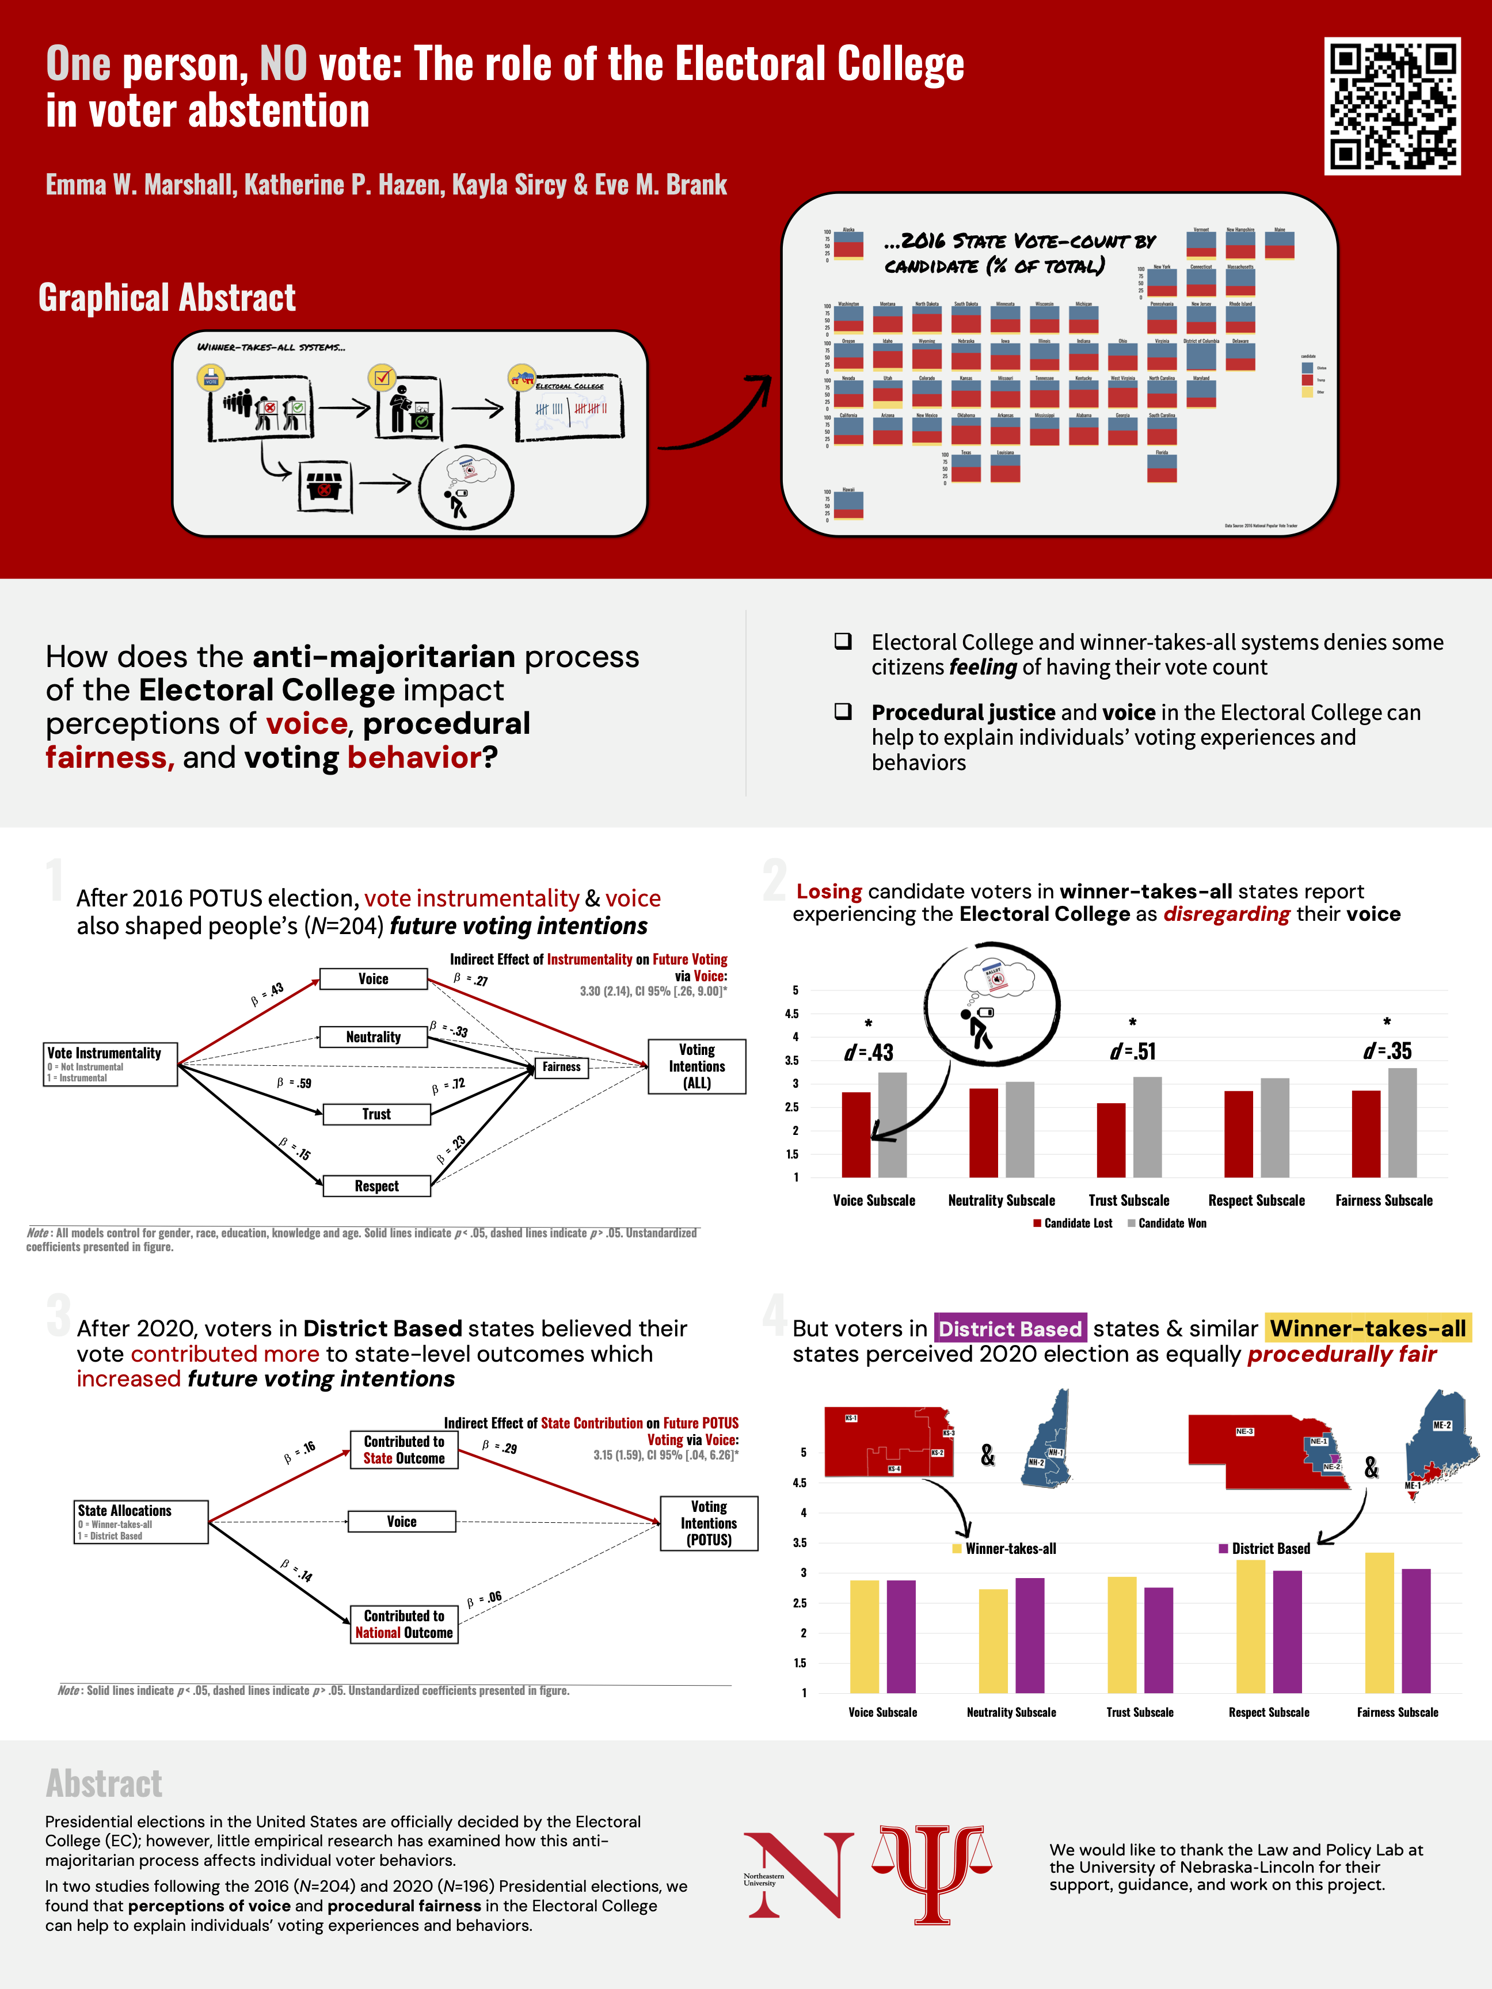
Example: Vertical Layout
Notes:
Use this poster to show that orientation can change while the same hierarchy principles remain. The design still needs a predictable reading path and readable figures.

Slide 15
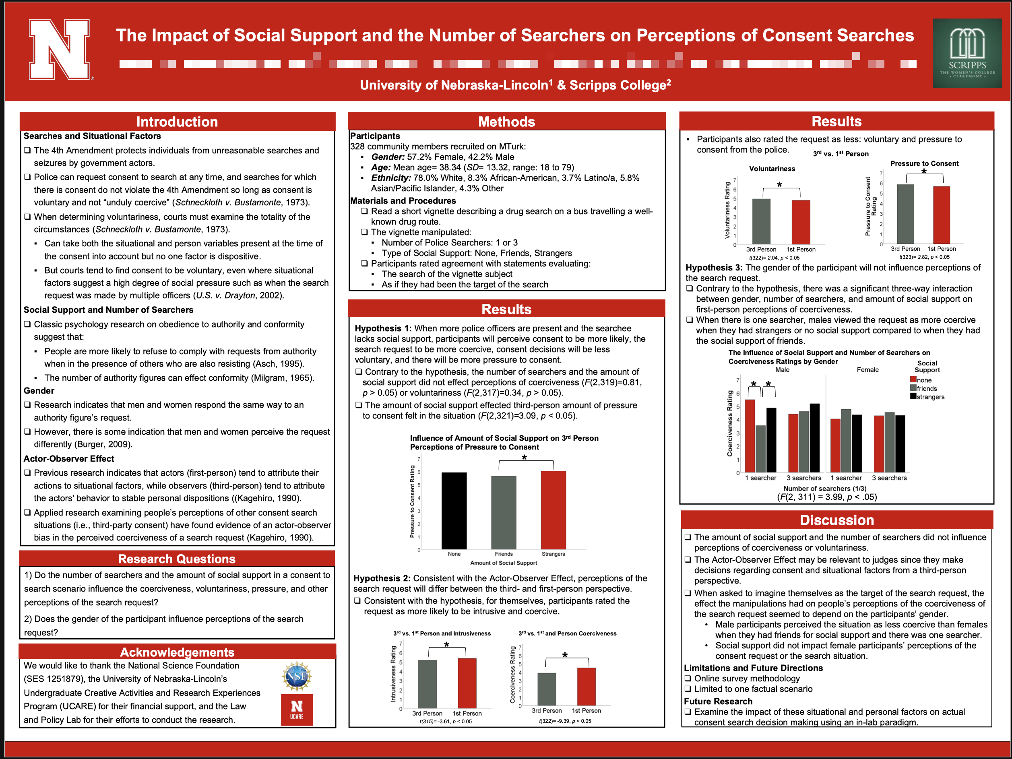
Example: Experiment Poster
Notes:
Notice how the experimental design and results receive more visual weight than background prose. Students should adapt this balance to their own project.

Slide 16
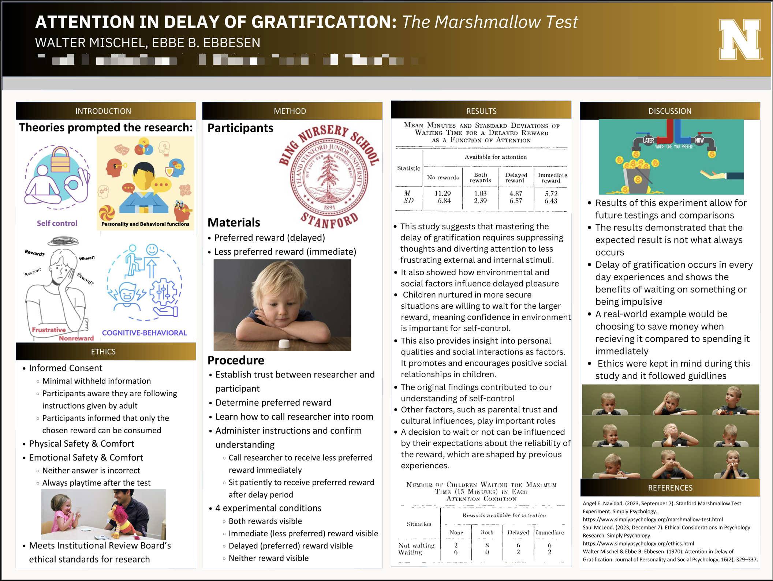
Example: Study Poster
Notes:
Ask students to identify the repeated alignment lines and section rhythm. A consistent grid makes the poster easier to scan.

Slide 17
A Few with Too Much Text
Notes:
Frame these as diagnostic examples. The goal is to locate the design failure and name a concrete revision, not to criticize the underlying research.

Slide 18
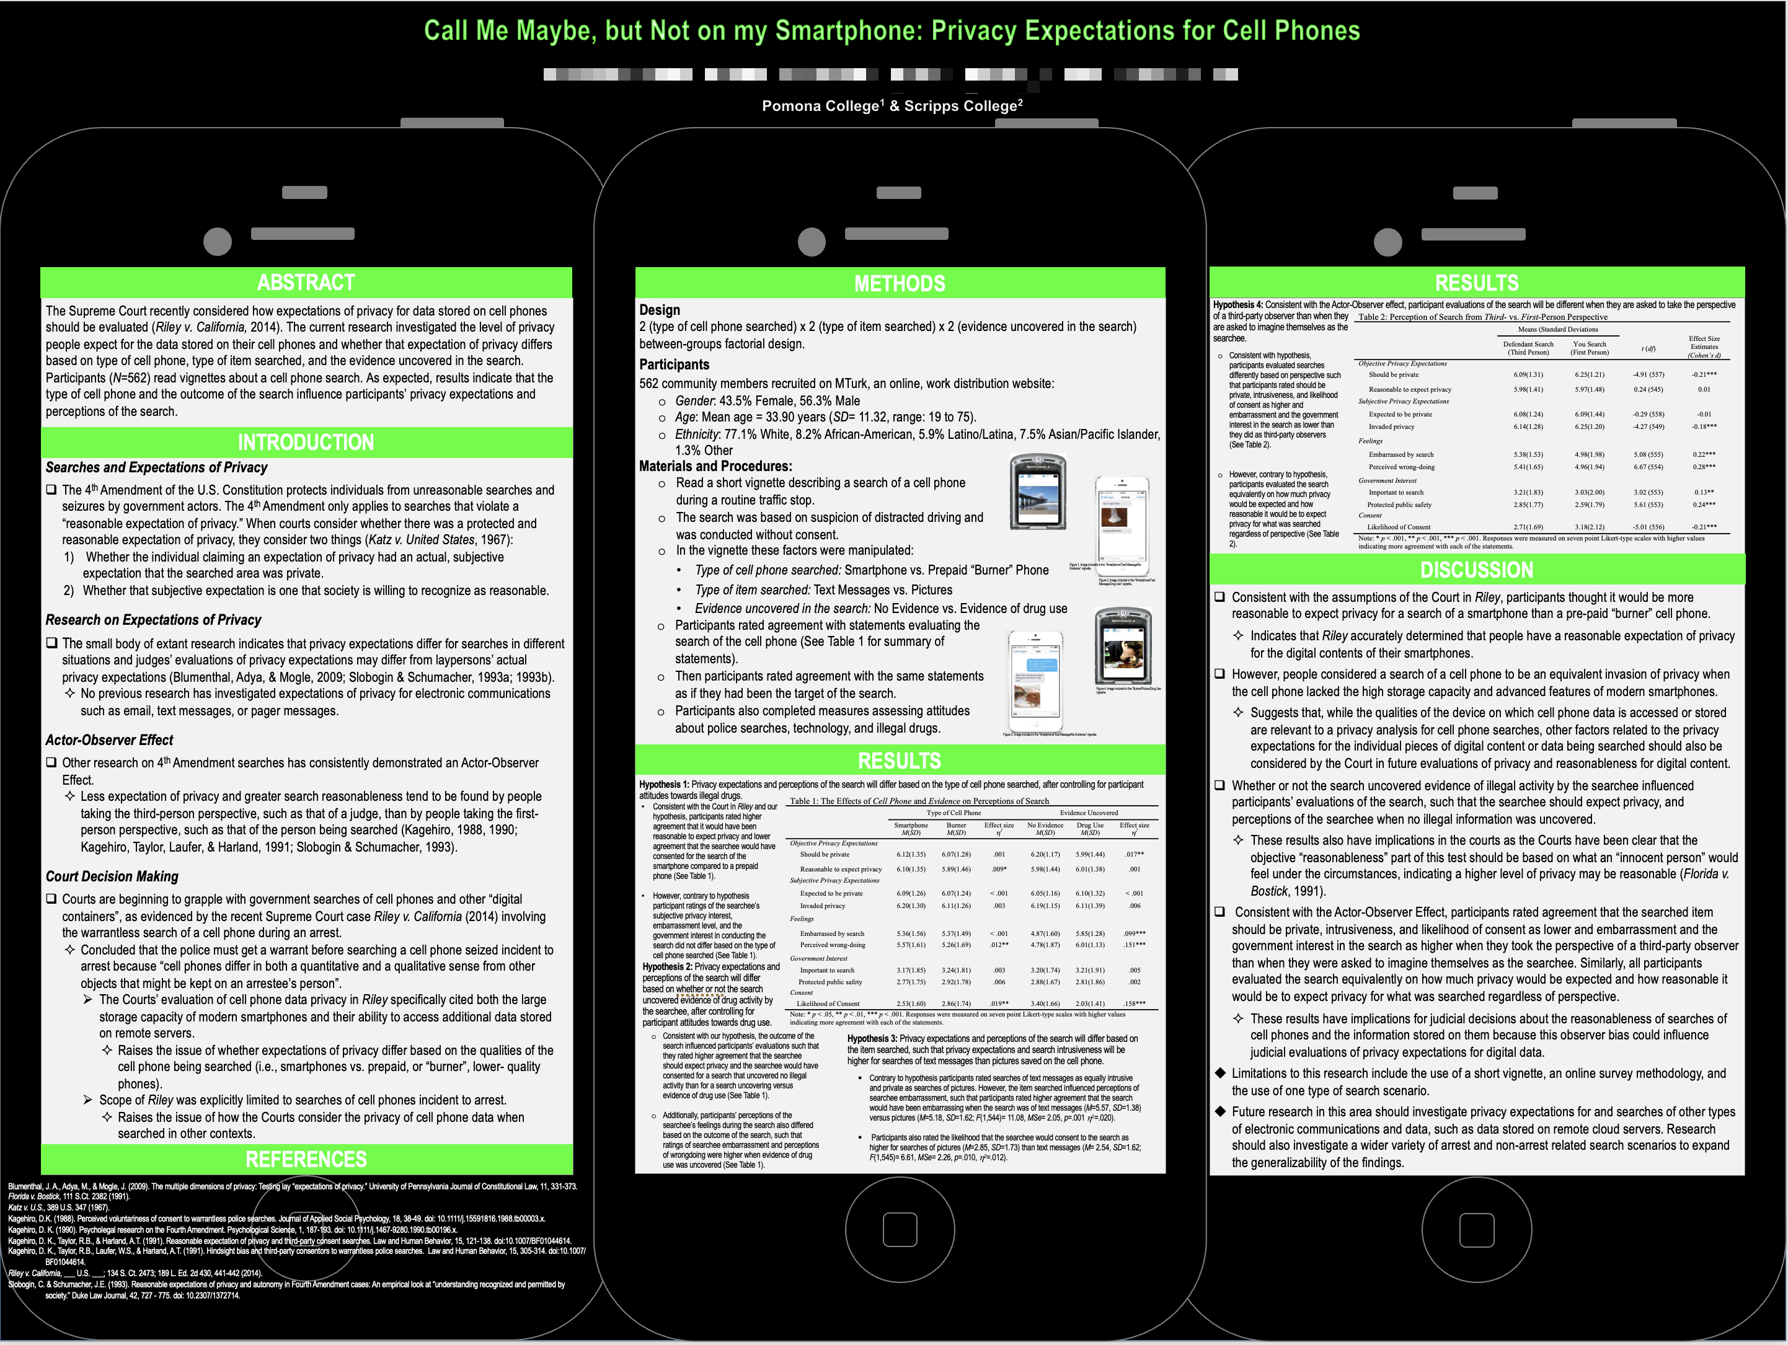
Avoid: Wall of Text
Notes:
The wall of text prevents a reader from finding the research question and result quickly. Replace paragraphs with a short claim, one visual, and supporting detail.

Slide 19
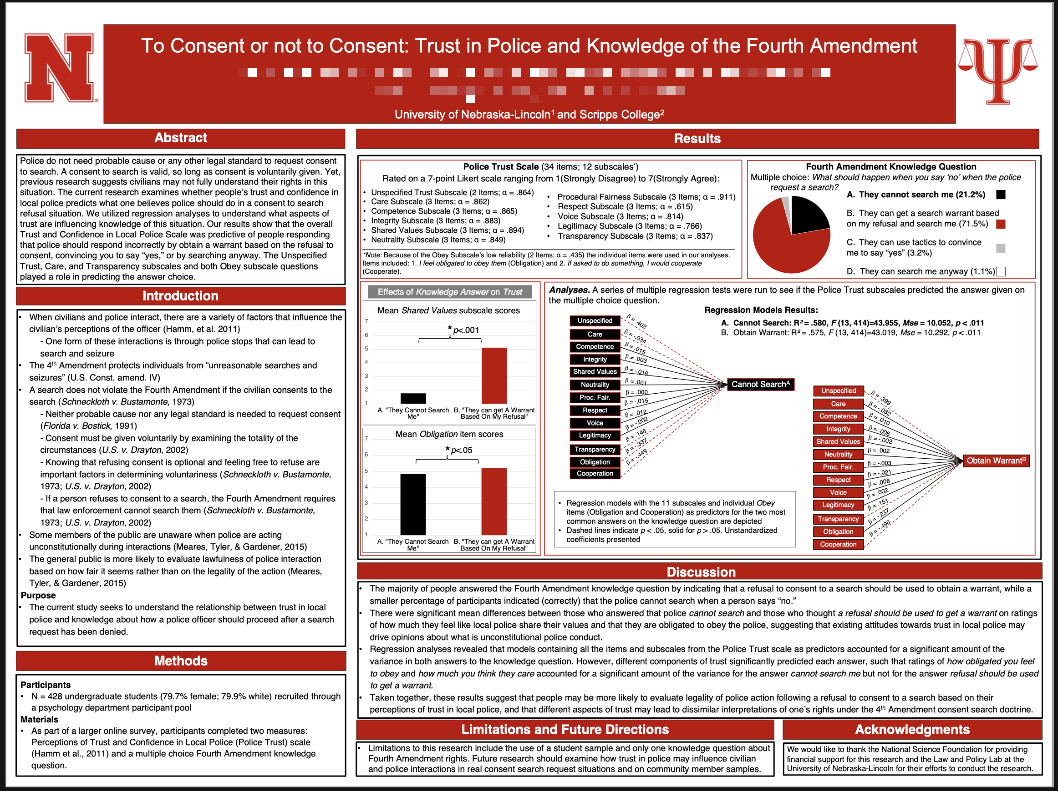
Avoid: Too Much Text
Notes:
Show how limited whitespace makes every section compete for attention. Remove low-priority prose before shrinking type.

Slide 20

Avoid: Dense Sections
Notes:
The figures cannot lead because long text blocks dominate the page. Turn each section into one key message supported by a readable visual.

Slide 21
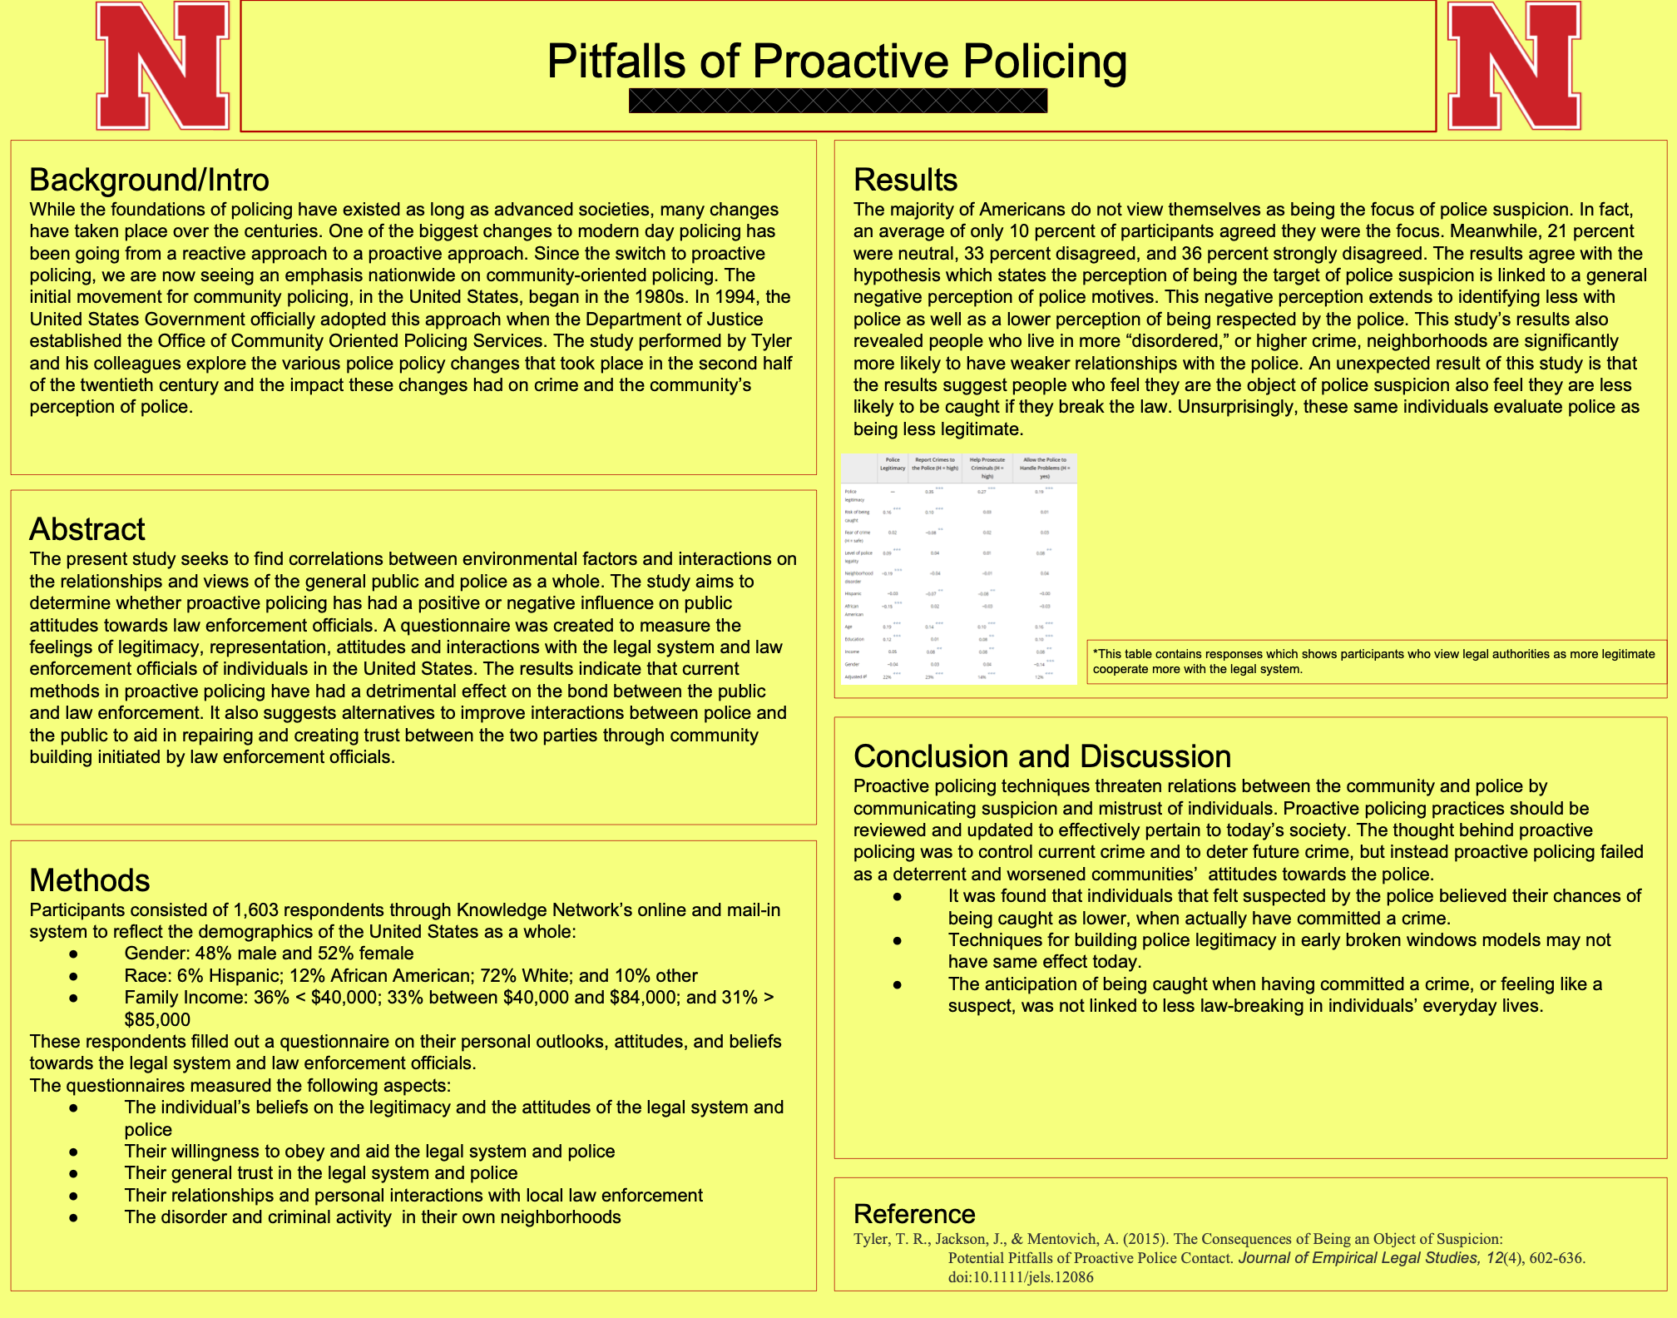
Avoid: Cluttered Design
Notes:
Identify the competing colors, alignments, and type sizes. A restrained palette and consistent grid would make the poster easier to navigate.

Slide 22
Check the finished poster
Follow the reading order
Check text and figure labels at the final size
Match citations to references
Open the exported poster PDF
Notes:
Check reading order, type size, figure labels, citations, and the exported poster PDF before submitting.

