Slide 2
What is Node.JS?
Server-side and networking applications
Javascript
Ryan Dahl, 2009
Joyent
Google’s V8 Javascript Engine
Non Blocking Evented I/O

Slide 3
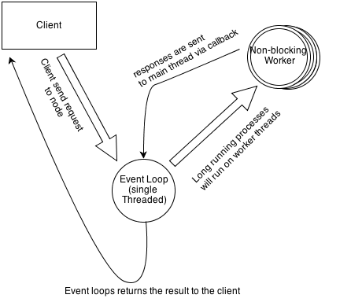
Evented IO

Slide 4
I/O Cost
L1 Cache : 3 cycles
L2 Cache : 14 cycles
RAM : 250 cycles
Disk : 41.000.000 cycles !!
Network : 240.000.000 cycles !!!!

Slide 5
Why Node?
You already know Javascript
It is fast
Rapid development
Strong community
NPM
Single programming language for frontend and backend

Slide 6
Where should we use Node.JS?
Network applications
Web applications
Services
Scalable applications
Middleware for several applications

Slide 7
Where should we not use Node?
CPU intensive applications

