Slide 1


Online Hotel Management System
Revolutionizing Hospitality Management…

Slide 2
INTRODUCTION
An online hotel management system is a comprehensive software solution designed to streamline and automate various aspects of hotel operations, ranging from reservations and guest services to billing and reporting. It provides a centralized platform that integrates different functions within a hotel, allowing for efficient management and seamless guest experiences..
The system is a critical tool for modern hotels seeking to improve guest experiences, optimize operations, and achieve sustainable growth in a rapidly evolving industry landscape.

Slide 3


KEY COMPONENTS
Reservation Management
Guest Services
Room Booking
Front Desk Operations
Reporting and Analytics
Integration Capabilities

Slide 4
IMPORTANCE
Enhanced guest experience
Improved operational efficiency
Cost Savings
Provide flexibility & better performance
Enhanced communication
Data-driven decision making

Slide 5
AIM
The aim of implementing an online hotel management system is to revolutionize hospitality operations by leveraging technology to enhance efficiency, guest experiences, and revenue generation. By automating tasks, streamlining processes, and providing personalized services, the system aims to optimize hotel operations, increase guest satisfaction, and maintain competitiveness in the dynamic hospitality industry.
Additionally, the system aims to provide valuable insights through data analytics, enabling informed decision-making and strategic planning to drive business growth and innovation. Ultimately, the aim is to create a seamless and memorable experience for guests while maximizing profitability and sustainability for the hotel.

Slide 6
OBJECTIVE
The objective of an online hotel management system revolves around enhancing guest experiences, optimizing operational efficiency, and maximizing revenue generation.
Firstly, it aims to streamline reservation processes, offering guests a seamless platform to book rooms effortlessly while ensuring real-time updates on room availability. This efficiency extends to front desk operations, automating check-ins, check-outs, and billing processes to reduce manual errors and enhance staff productivity. Moreover, the system focuses on delivering personalized guest services, facilitating communication between guests and staff for requests and inquiries.
Through comprehensive reporting and analytics, the system provides insights into key performance metrics, enabling informed decision-making to drive business growth.

Slide 7
Additionally, the system incorporates essential features like "Contact Us," "About Us," and "Book Rooms Now" to enrich the guest experience and promote direct bookings. The "Contact Us" feature provides easy access to hotel contact information, while the "About Us" section showcases the hotel's identity, values, and amenities.
Furthermore, the "Book Rooms Now" functionality enables guests to book rooms directly through the system, offering intuitive interfaces and secure payment options. By integrating these features seamlessly, the online hotel management system aims to foster guest satisfaction, loyalty, and engagement while driving revenue through direct bookings and enhanced operational efficiency.
These objectives and features collectively contribute to the success of an online hotel management system by improving guest satisfaction, increasing operational efficiency, and driving revenue growth.

Slide 8
SYSTEM COMPONENTS
User Interface (UI)
Application Logic
Database
Integration Interfaces
Security Mechanisms
Analytics and Reporting Tools
Mobile Application

Slide 9
DESIGN CONSTRAINTS
SOFTWARE CONSTRAINTS
Operating System: Windows 7 or more
Editor: Visual Studio Code
Front End: HTML, CSS, Bootstrap 4.6
Back End: Django, DB Browser
HARDWARE CONSTRAINTS
RAM: 2 GB or more
Hard Disk: 2 GB

Slide 10
ARCHITECTURE
The architecture of an online hotel management system typically consists of several layers, each serving a specific purpose in facilitating the system's functionalities.
Presentation Layer: Interfaces for guests to book rooms and for staff to manage operations, ensuring user-friendly interactions.
Application Layer: Centralizes core functionalities like reservation management, billing, and reporting, orchestrating system operations.
Integration Layer: Facilitates seamless communication with external systems such as payment gateways and property management systems, ensuring interoperability.
Data Layer: Stores and manages system data, including guest information, reservations, and operational records, ensuring data integrity and accessibility.

Slide 11
USER INTERFACE
Intuitive Design
Booking Interface
Dashboard for Staff
Guest Services Portal
Mobile Responsiveness
Visual Feedback and Confirmation
Personalization
Accessibility Features
Security Measures

Slide 12
METHODOLOGY
The methodology for developing an online hotel management system typically follows a structured approach to ensure efficient project management and successful implementation.
Requirement Analysis: Gather and document system requirements. Identify key features, user roles, and system constraints to establish a clear understanding of project scope and objectives.
System Design: Create system architecture and UI design. Define the user interface layout, navigation flow, and interaction design to optimize usability and user experience.
Development: Implement system functionalities. Follow best practices in software development, coding standards, and version control to ensure code quality, maintainability, and scalability.
Testing and QA: Execute testing to ensure functionality, performance, and security , and usability. Conduct various testing activities, including functional testing, regression testing, performance testing, and user acceptance testing

Slide 13
Deployment and Integration: Deploy the system and integrate with other software. Prepare the system for deployment by configuring servers, databases, and third-party integrations.
Training and User Adoption: Provide training and documentation to educate users (hotel staff, administrators, and guests) on how to use the system effectively
Maintenance and Support: Establish procedures for ongoing maintenance, monitoring, and support to address system updates, bug fixes, and user inquiries. Implement mechanisms for continuous improvement based on emerging technologies, and industry best practices
By following this methodology, the development team can ensure the successful delivery of the online hotel management system, meeting stakeholders' expectations and contributing to the efficiency and profitability of hotel operations.

Slide 14
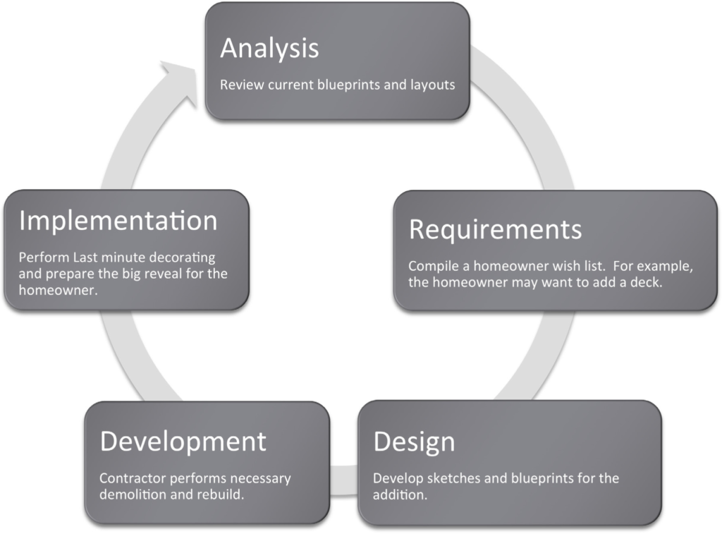
Software Development Lifecycle

Slide 15
RESULTS
Operational Efficiency: Streamlined processes, reduced errors, and increased staff productivity.
Enhanced Guest Experience: Convenient booking, personalized services, and improved guest-staff interactions.
Increased Revenue: Optimized pricing, upselling opportunities, and cost savings.
Data-Driven Decision Making: Informed decisions based on analytics and insights.
Competitive Advantage: Reputation enhancement and differentiation in the market.
Scalability and Adaptability: Flexibility to meet evolving industry needs and trends.
Implementing an online hotel management system can lead to a wide range of positive outcomes, ultimately contributing to the success and growth of the hotel business.

Slide 16
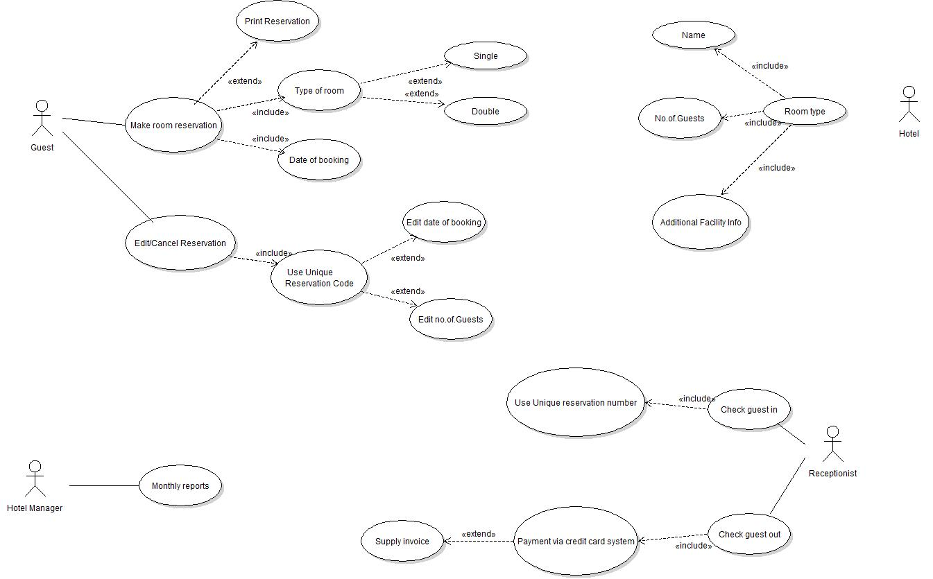
ER Diagram

Slide 17
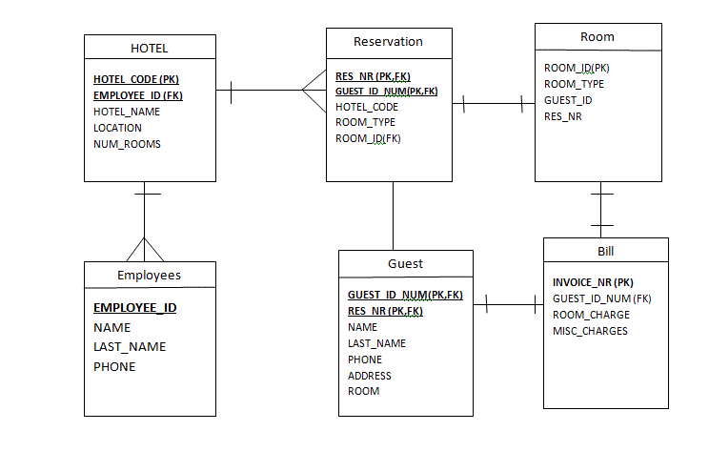
ER Diagram

Slide 18
FUTURE ENHANCEMENT
AI Integration: Integrate AI chatbots to provide instant guest assistance and personalize experiences. Predictive analytics driven by AI algorithms can anticipate guest needs and optimize service delivery.
IoT Integration: Automate room controls with IoT devices like smart locks and thermostats, enhancing guest comfort. Leverage IoT data for predictive maintenance, reducing downtime and optimizing operational efficiency.
Blockchain Implementation: Utilize blockchain for secure management of guest data, transactions, and loyalty programs. Implement smart contracts to automate agreements like room bookings and payment settlements, enhancing transparency and trust.

Slide 19
CONCLUSION
The implementation of an online hotel management system offers a myriad of benefits that significantly impact both operational efficiency and guest satisfaction. By streamlining processes, enhancing guest experiences, and maximizing revenue generation opportunities, hotels can achieve tangible improvements in their overall performance and competitiveness. Moreover, the system's data-driven approach empowers hotel managers to make informed decisions, adapt to changing market dynamics, and drive sustainable growth.
With scalability and adaptability at its core, the online hotel management system ensures continued relevance and effectiveness in meeting the evolving needs of the hospitality industry. Ultimately, investing in such a system not only yields immediate results but also positions hotels for long-term success and excellence in guest service delivery.

Slide 20
THANK YOU!

