Slide 1
Introduction to
CMOS VLSI
Design
Circuits & Layout

Slide 2
Outline
CMOS Gate Design
Pass Transistors
CMOS Latches & Flip-Flops
Standard Cell Layouts
Stick Diagrams
Circuits and Layout
Slide <number>

Slide 3
CMOS Gate Design
Activity:
  Sketch a 4-input CMOS NAND gate
Circuits and Layout
Slide <number>

Slide 4
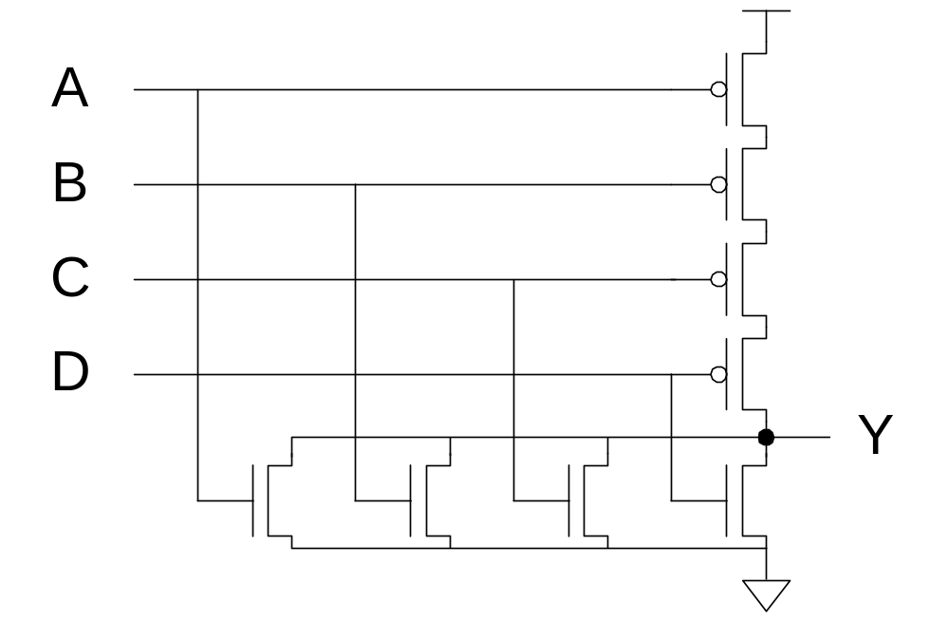
CMOS Gate Design
Activity:
  Sketch a 4-input CMOS NOR gate
Circuits and Layout
Slide <number>

Slide 5
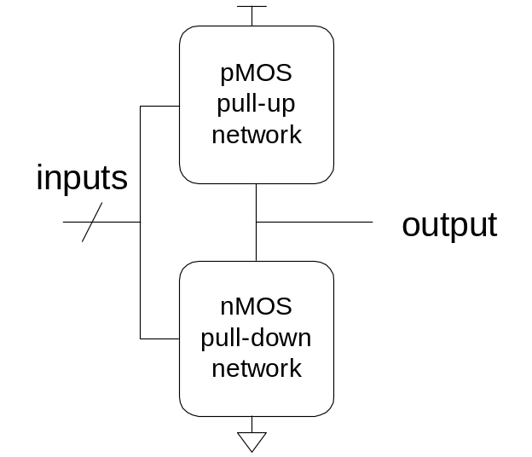
Complementary CMOS
Complementary CMOS logic gates
  nMOS pull-down network
  pMOS pull-up network
  a.k.a. static CMOS
 | Pull-up OFF | Pull-up ON
Pull-down OFF | Z (float) | 1
Pull-down ON | 0 | X (crowbar)
Circuits and Layout
Slide <number>

Slide 6
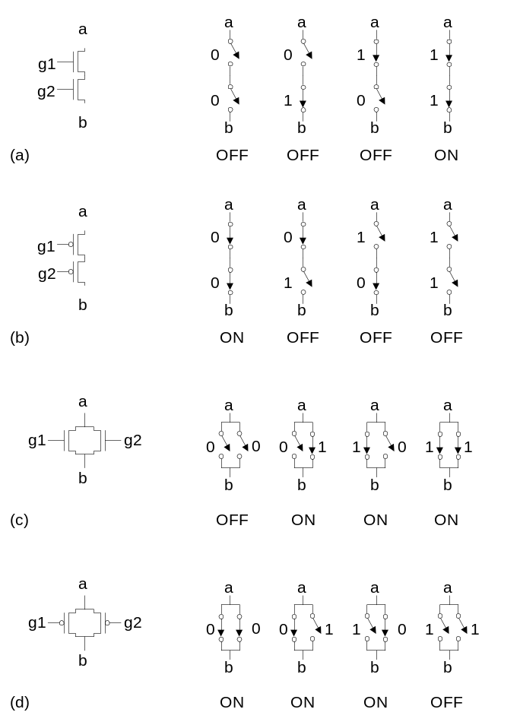
Series and Parallel
nMOS: 1 = ON
pMOS: 0 = ON
Series: both must be ON
Parallel: either can be ON
Circuits and Layout
Slide <number>

Slide 7
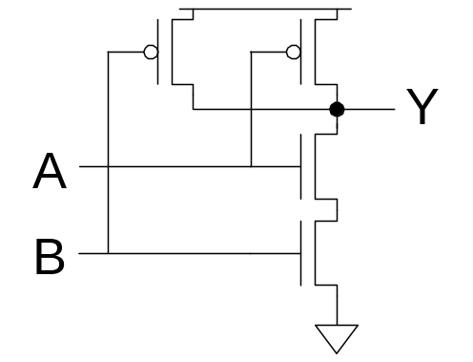
Conduction Complement
Complementary CMOS gates always produce 0 or 1
Ex: NAND gate
  Series nMOS: Y=0 when both inputs are 1
  Thus Y=1 when either input is 0
  Requires parallel pMOS
Rule of Conduction Complements
  Pull-up network is complement of pull-down
  Parallel -> series, series -> parallel
Circuits and Layout
Slide <number>

Slide 8
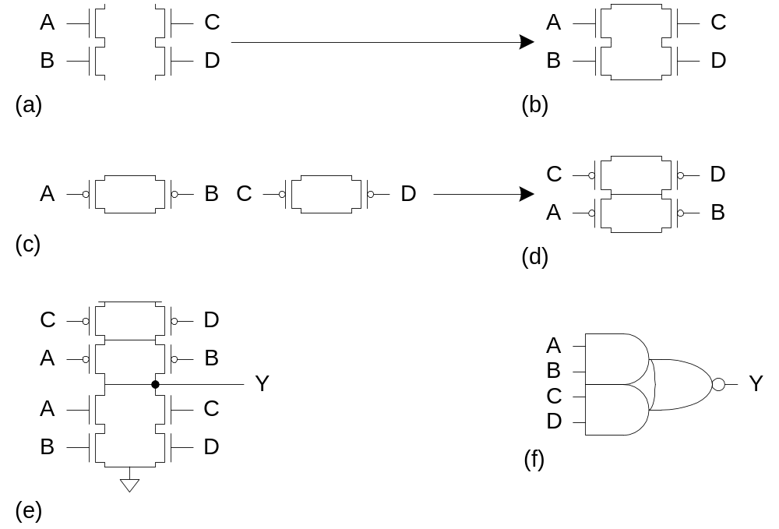
Compound Gates
Compound gates can do any inverting function
Ex:
Y = (A.B + C.D)’
Circuits and Layout
Slide <number>

Slide 9
Example: O3AI
Y = ((A+B+C).D)’
Circuits and Layout
Slide <number>

Slide 10
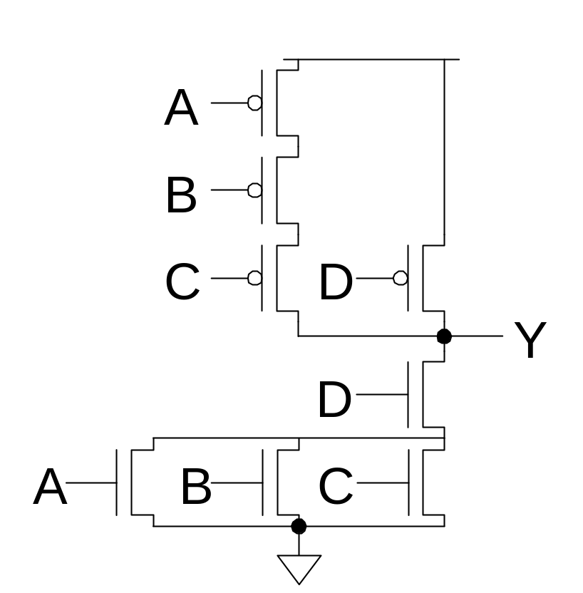
Example: O3AI
Y = ((A+B+C).D)’
Circuits and Layout
Slide <number>

Slide 11
Signal Strength
Strength of signal
  How close it approximates ideal voltage source
V_{DD} and GND rails are strongest 1 and 0
nMOS pass strong 0
  But degraded or weak 1
pMOS pass strong 1
  But degraded or weak 0
Thus nMOS are best for pull-down network
Circuits and Layout
Slide <number>

Slide 12
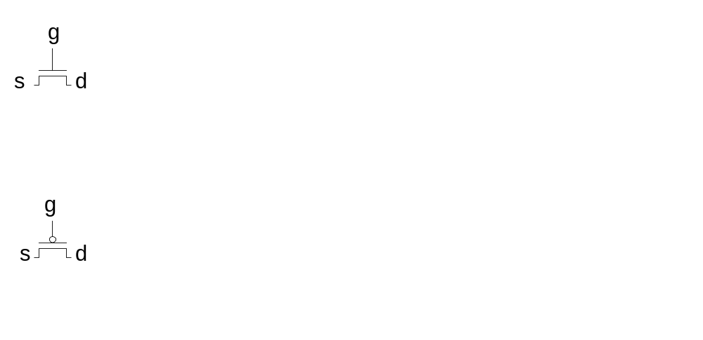
Pass Transistors
Transistors can be used as switches
Circuits and Layout
Slide <number>

Slide 13
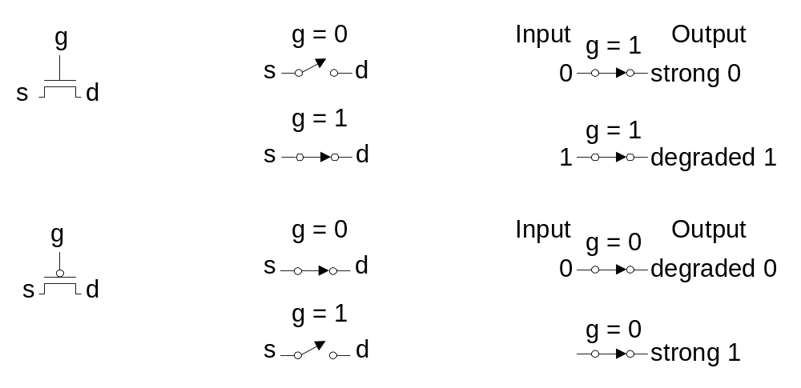
Pass Transistors
Transistors can be used as switches
Circuits and Layout
Slide <number>

Slide 14
Transmission Gates
Pass transistors produce degraded outputs
Transmission gates pass both 0 and 1 well
Circuits and Layout
Slide <number>

Slide 15
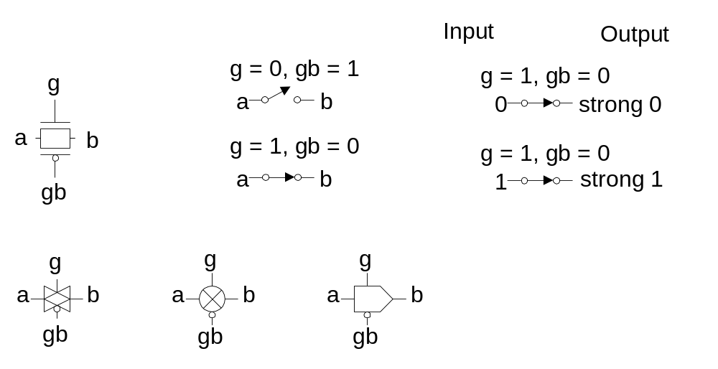
Transmission Gates
Pass transistors produce degraded outputs
Transmission gates pass both 0 and 1 well
Circuits and Layout
Slide <number>

Slide 16
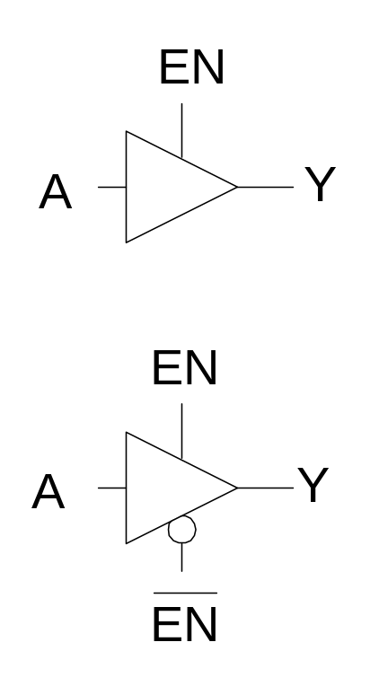
Tristates
Tristate buffer produces Z when not enabled
EN | A | Y
0 | 0
0 | 1
1 | 0
1 | 1
Circuits and Layout
Slide <number>

Slide 17
Tristates
Tristate buffer produces Z when not enabled
EN | A | Y
0 | 0 | Z
0 | 1 | Z
1 | 0 | 0
1 | 1 | 1
Circuits and Layout
Slide <number>

Slide 18
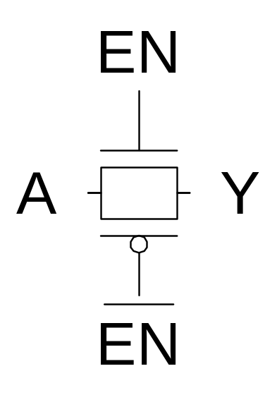
Nonrestoring Tristate
Transmission gate acts as tristate buffer
  Only two transistors
  But nonrestoring
    Noise on A is passed on to Y
Circuits and Layout
Slide <number>

Slide 19
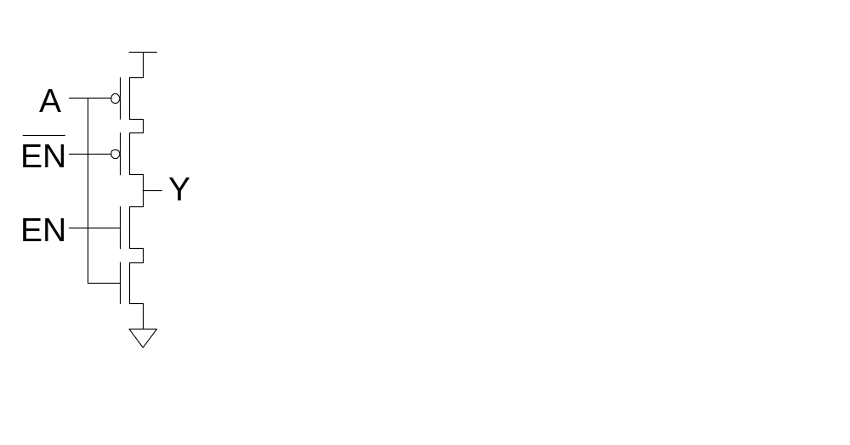
Tristate Inverter
Tristate inverter produces restored output
  Violates conduction complement rule
  Because we want a Z output
Circuits and Layout
Slide <number>

Slide 20
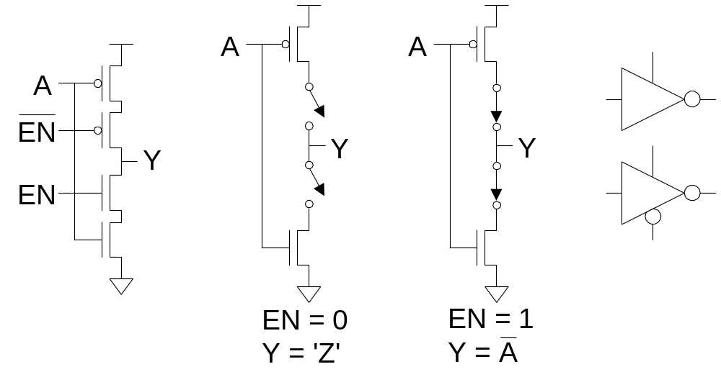
Tristate Inverter
Tristate inverter produces restored output
  Violates conduction complement rule
  Because we want a Z output
Circuits and Layout
Slide <number>

Slide 21
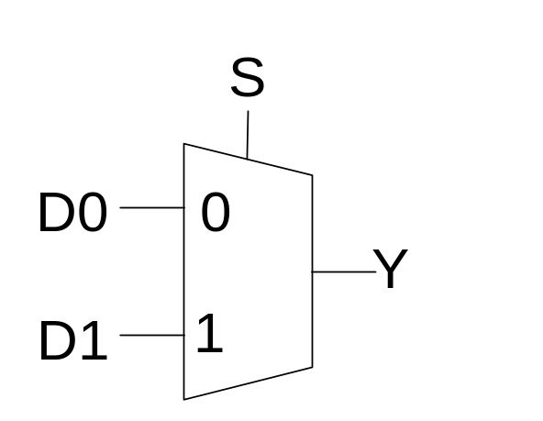
Multiplexers
2:1 multiplexer chooses between two inputs
S | D1 | D0 | Y
0 | X | 0
0 | X | 1
1 | 0 | X
1 | 1 | X
Circuits and Layout
Slide <number>

Slide 22
Multiplexers
2:1 multiplexer chooses between two inputs
S | D1 | D0 | Y
0 | X | 0 | 0
0 | X | 1 | 1
1 | 0 | X | 0
1 | 1 | X | 1
Circuits and Layout
Slide <number>

Slide 23
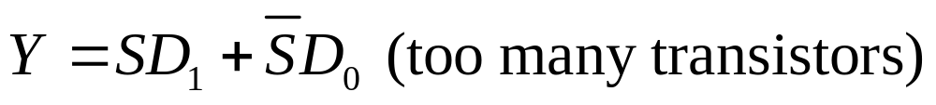
Gate-Level Mux Design
How many transistors are needed?
Circuits and Layout
Slide <number>

Slide 24
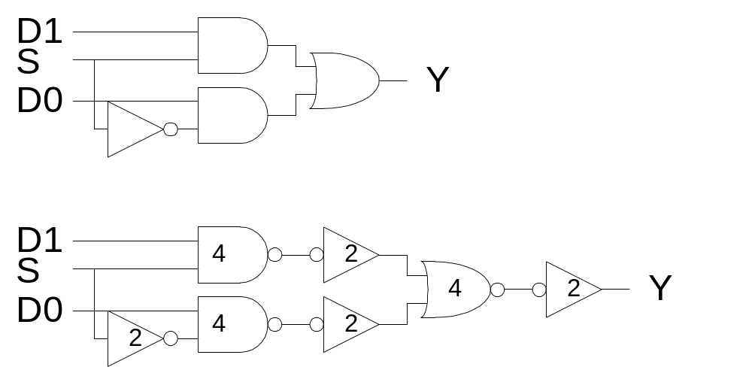
Gate-Level Mux Design
How many transistors are needed? 20
Circuits and Layout
Slide <number>

Slide 25
Transmission Gate Mux
Nonrestoring mux uses two transmission gates
Circuits and Layout
Slide <number>

Slide 26
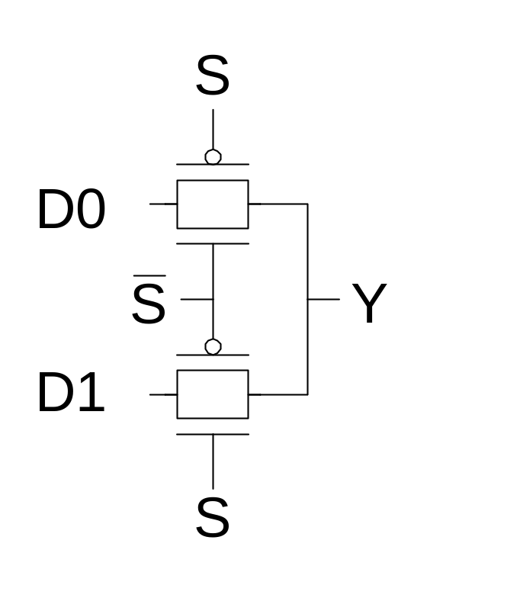
Transmission Gate Mux
Nonrestoring mux uses two transmission gates
  Only 4 transistors
Circuits and Layout
Slide <number>

Slide 27
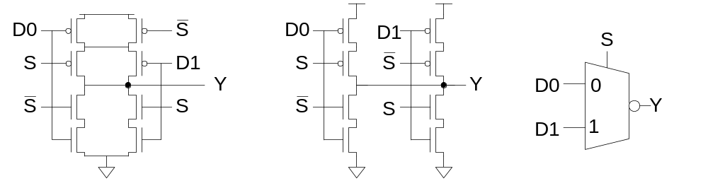
Inverting Mux
Inverting multiplexer
  Use compound AOI22
  Or pair of tristate inverters
  Essentially the same thing
Noninverting multiplexer adds an inverter
Circuits and Layout
Slide <number>

Slide 28
4:1 Multiplexer
4:1 mux chooses one of 4 inputs using two selects
Circuits and Layout
Slide <number>

Slide 29
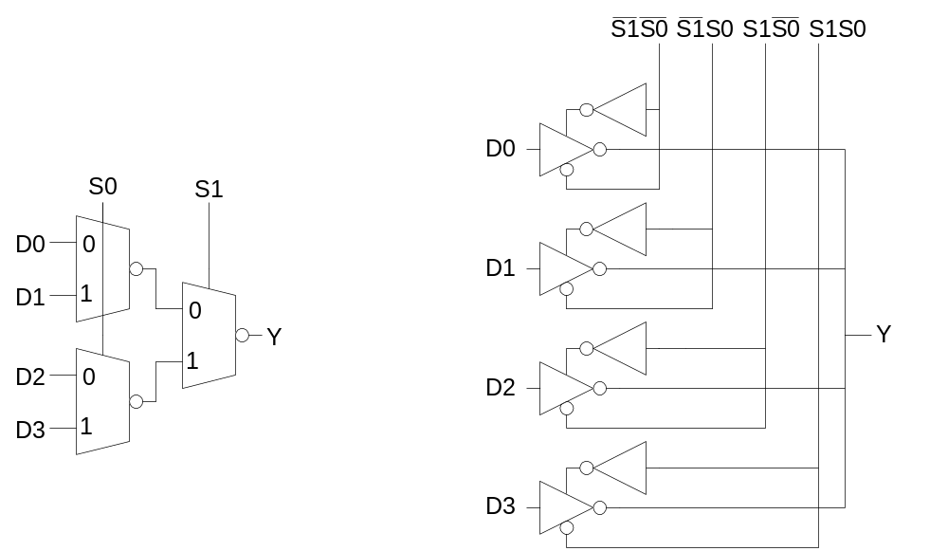
4:1 Multiplexer
4:1 mux chooses one of 4 inputs using two selects
  Two levels of 2:1 muxes
  Or four tristates
Circuits and Layout
Slide <number>

Slide 30
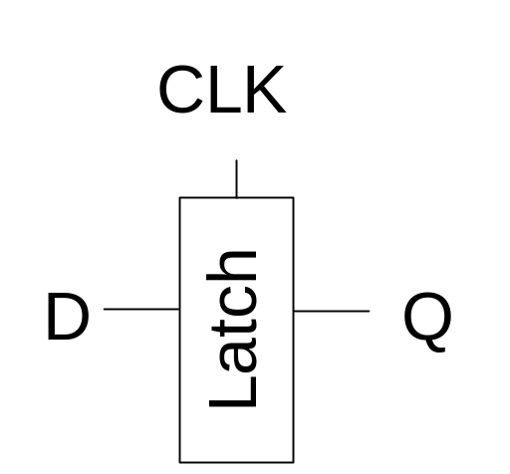
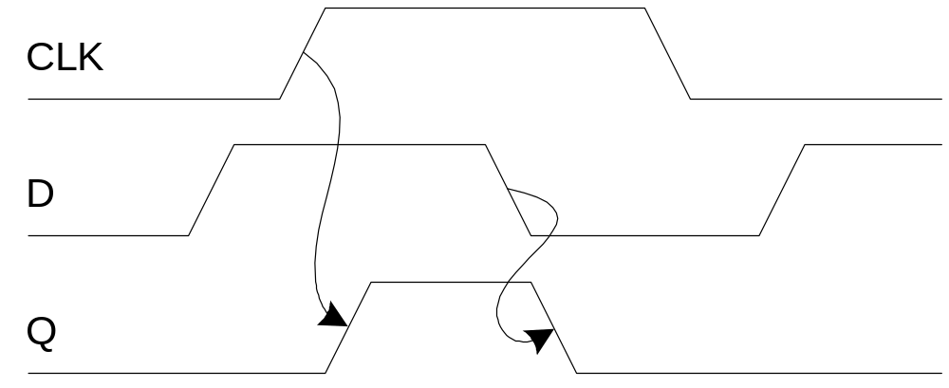
D Latch
When CLK = 1, latch is transparent
  D flows through to Q like a buffer
When CLK = 0, the latch is opaque
  Q holds its old value independent of D
a.k.a. transparent latch or level-sensitive latch
Circuits and Layout
Slide <number>

Slide 31
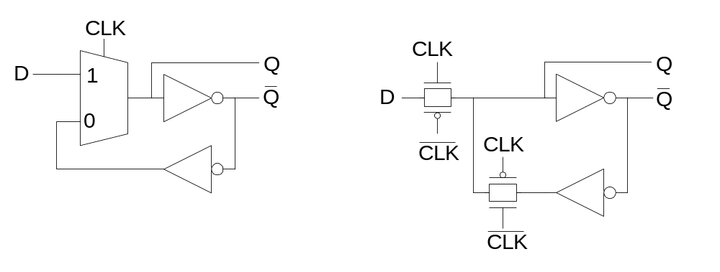
D Latch Design
Multiplexer chooses D or old Q
Circuits and Layout
Slide <number>

Slide 32
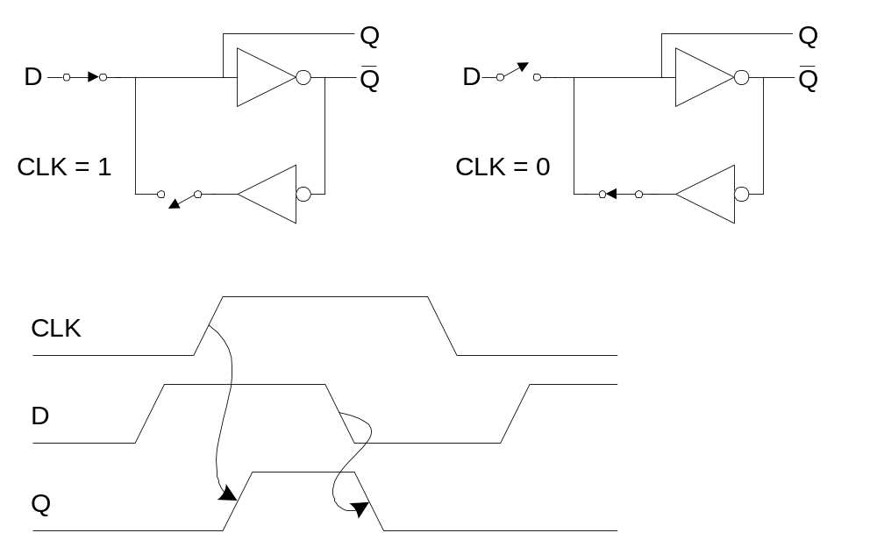
D Latch Operation
Circuits and Layout
Slide <number>

Slide 33
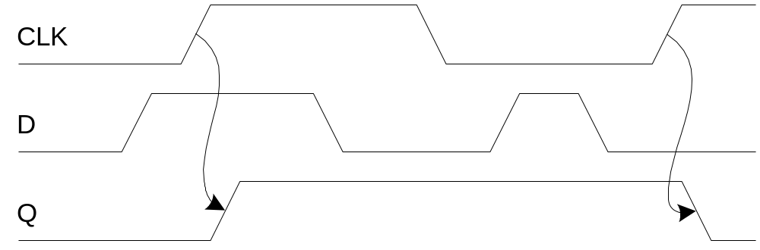
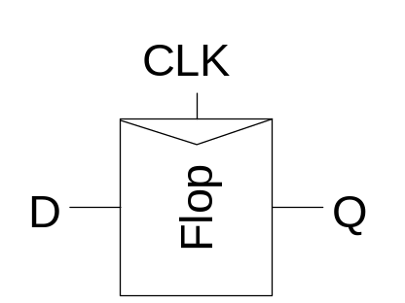
D Flip-flop
When CLK rises, D is copied to Q
At all other times, Q holds its value
a.k.a. positive edge-triggered flip-flop, master-slave flip-flop
Circuits and Layout
Slide <number>

Slide 34
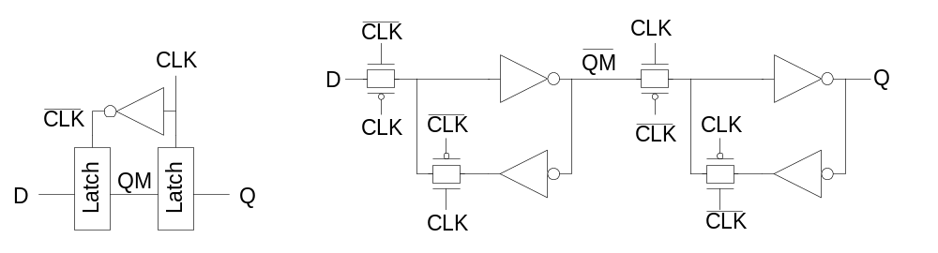
D Flip-flop Design
Built from master and slave D latches
Circuits and Layout
Slide <number>

Slide 35
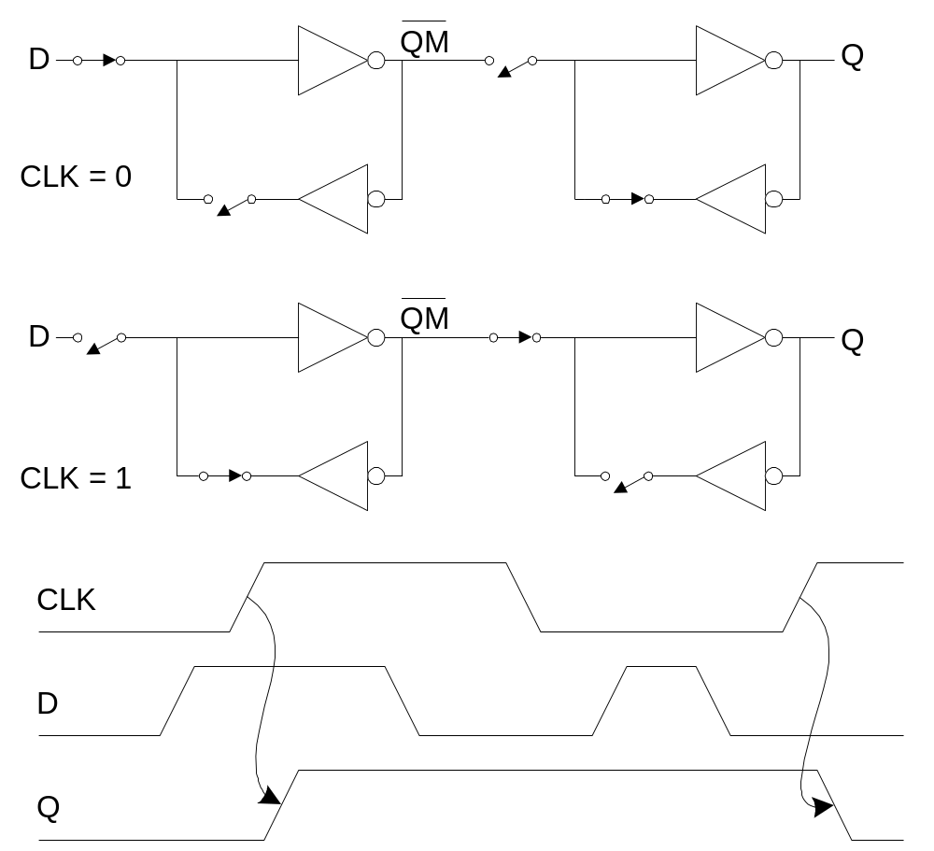
D Flip-flop Operation
Circuits and Layout
Slide <number>

Slide 36
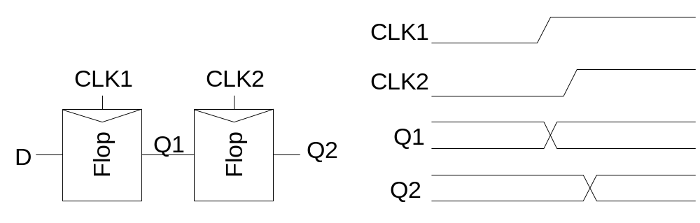
Race Condition
Back-to-back flops can malfunction from clock skew
  Second flip-flop fires late
  Sees first flip-flop change and captures its result
  Called hold-time failure or race condition
Circuits and Layout
Slide <number>

Slide 37
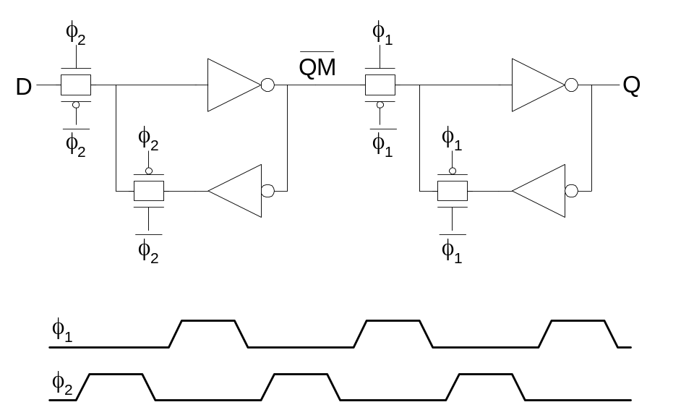
Nonoverlapping Clocks
Nonoverlapping clocks can prevent races
  As long as nonoverlap exceeds clock skew
We will use them in this class for safe design
  Industry manages skew more carefully instead
Circuits and Layout
Slide <number>

Slide 38
Gate Layout
Layout can be very time consuming
  Design gates to fit together nicely
  Build a library of standard cells
Standard cell design methodology
  V_{DD} and GND should abut (standard height)
  Adjacent gates should satisfy design rules
  nMOS at bottom and pMOS at top
  All gates include well and substrate contacts
Circuits and Layout
Slide <number>

Slide 39
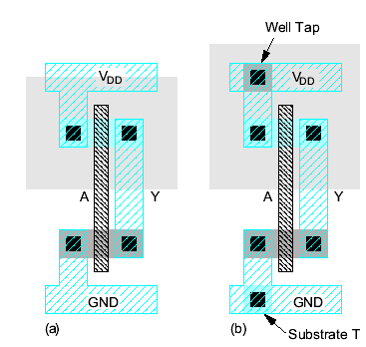
Example: Inverter
Circuits and Layout
Slide <number>

Slide 40
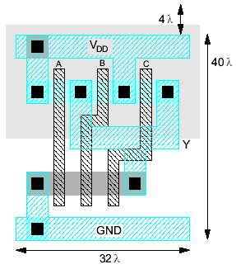
Example: NAND3
Horizontal N-diffusion and p-diffusion strips
Vertical polysilicon gates
Metal1 V_{DD} rail at top
Metal1 GND rail at bottom
32 λ by 40 λ
Circuits and Layout
Slide <number>

Slide 41
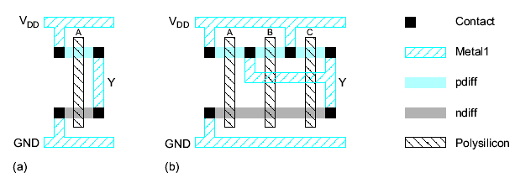
Stick Diagrams
Stick diagrams help plan layout quickly
  Need not be to scale
  Draw with color pencils or dry-erase markers
Circuits and Layout
Slide <number>

Slide 42
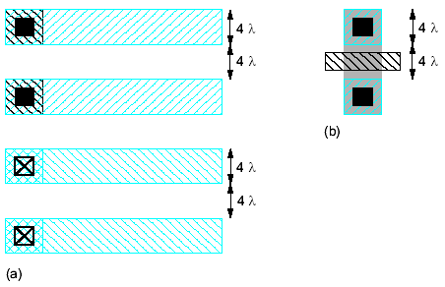
Wiring Tracks
A wiring track is the space required for a wire
  4 λ width, 4 λ spacing from neighbor = 8 λ pitch
Transistors also consume one wiring track
Circuits and Layout
Slide <number>

Slide 43
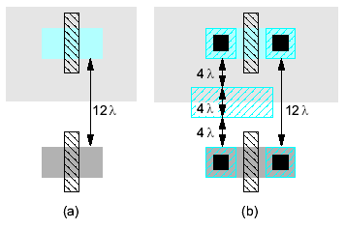
Well spacing
Wells must surround transistors by 6 λ
  Implies 12 λ between opposite transistor flavors
  Leaves room for one wire track
Circuits and Layout
Slide <number>

Slide 44
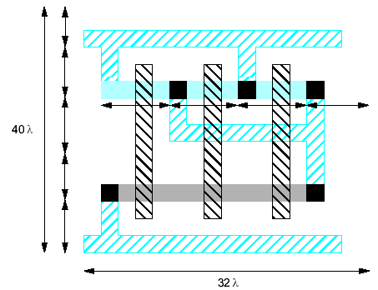
Area Estimation
Estimate area by counting wiring tracks
  Multiply by 8 to express in λ
Circuits and Layout
Slide <number>

Slide 45
Example: O3AI
Sketch a stick diagram for O3AI and estimate area
  Y = ((A+B+C).D)’
Circuits and Layout
Slide <number>

Slide 46
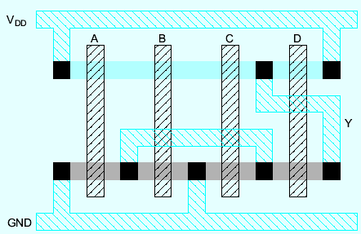
Example: O3AI
Sketch a stick diagram for O3AI and estimate area
  Y = ((A+B+C).D)’
Circuits and Layout
Slide <number>

Slide 47
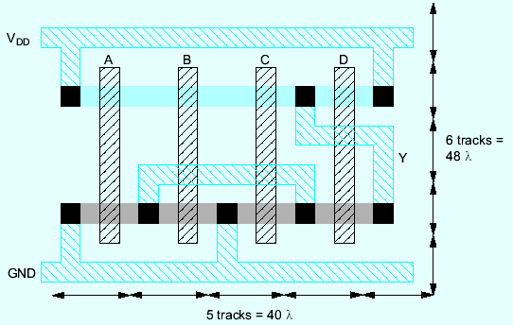
Example: O3AI
Sketch a stick diagram for O3AI and estimate area
  Y = ((A+B+C).D)’
Circuits and Layout
Slide <number>

