Slide 1
2-to-1 MULTIPLEXOR USING L-EDIT
SUBMITTED TO
DR.ROMAN STEMPROK
SUBMITTED BY
SRITEJA TARIGOPULA

Slide 2
Objective
Design and Simulate of a 2-Input Multiplexor
Using L-Edit

Slide 3
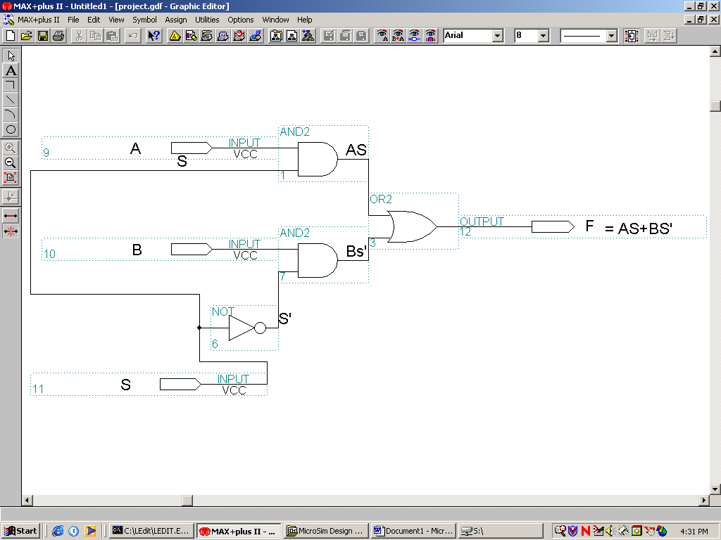
2-Input Multiplexor based on Logic Gates
Fig1. Logic Gate diagram of a 2-Input Multiplexer

Slide 4
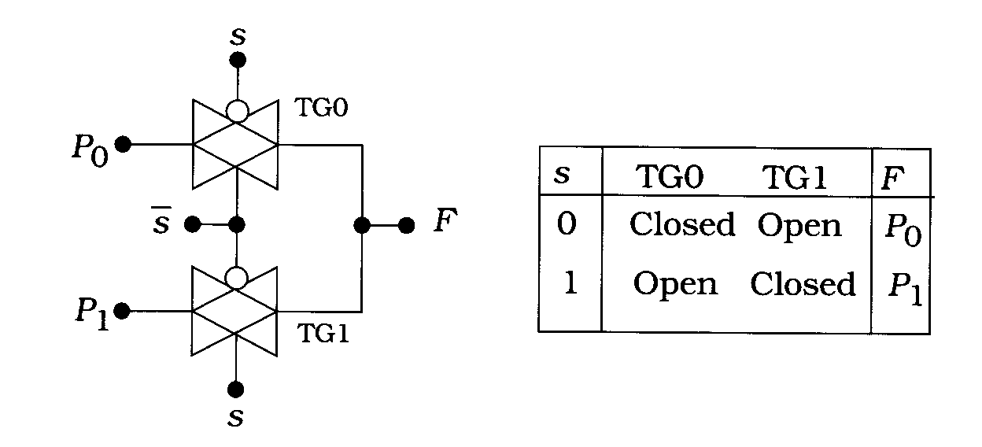
2-Input Multiplexor based on Transmission Gates
A TG-based 2-to-1 Multiplexor

Slide 5

Comparison of the two models
Multiplexor based on logic gates
Number of transistors required is = 20
Cannot be simulated in PSPICE
Multiplexor based on Transmission Gates
Number of transistors required is=4
Can be simulated in PSPICE
Therefore this model is choosen for the project

Slide 6
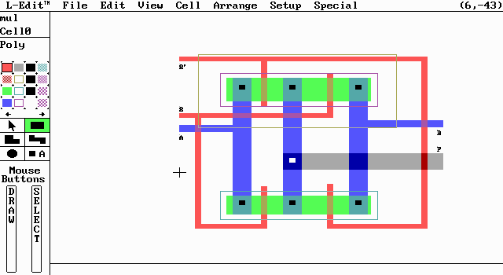
L-Edit Layout of 2-Input Multiplexor

Slide 7
DRC for 2-Input Multiplexor
DRC Errors in cell Cell0 of file a:\mul.
0 errors.
DRC Elapsed Time: 13 seconds.

Slide 8
.SPC file for 2-Input Multiplexor
* Circuit Extracted by Tanner Research's L-Edit V5.17 / Extract V2.06 ;
* TDB File a:\mul, Cell Cell0, Extract Definition File morbn20.ext ;
C1 15 0 15.804FF
C2 14 0 12.18FF
C3 13 0 11.571FF
* WARNING: Node 11 has zero capacitance.
* WARNING: Node 6 has zero capacitance.
* WARNING: Node 4 has zero capacitance.
* WARNING: Node 3 has zero capacitance.
.MODEL NMOS
.MODEL PMOS
.MODEL poly2NMOS
.MODEL poly2PMOS
.MODEL NPN
M8 13 3 15 4 PMOS L=2U W=10U
* M8 Drain Gate Source Bulk (26 30 28 40) A = 20, W = 10
M9 15 6 14 4 PMOS L=2U W=10U
* M9 Drain Gate Source Bulk (47 30 49 40) A = 20, W = 10
M10 15 3 14 11 NMOS L=2U W=8U
* M10 Drain Gate Source Bulk (47 -18 49 -10) A = 16, W = 8
M11 13 6 15 11 NMOS L=2U W=8U
* M11 Drain Gate Source Bulk (26 -18 28 -10) A = 16, W = 8
* Total Nodes: 7 ;
* Total Elements: 11 ;
* Extract Elapsed Time: 5 seconds ;
.END

Slide 9
.CIR file for 2-to-1 Multiplexor
* Circuit Extracted by Tanner Research's L-Edit V5.17 / Extract V2.06 ;
* TDB File a:\mul1, Cell Cell0, Extract Definition File morbn20.ext ;
C1 15 0 15.804FF
C2 14 0 12.18FF
C3 13 0 11.571FF
VS 6 0 PULSE (5 0 5ns 0.1ns 0.1ns 5ns 10ns)
VS1 3 0 PULSE (0 5 5ns 0.1ns 0.1ns 5ns 10ns)
VA 13 0 DC 10
VB 14 0 DC 5
M8 13 3 15 4 PMOS L=2U W=10U
M9 15 6 14 4 PMOS L=2U W=10U
M10 15 3 14 11 NMOS L=2U W=8U
M11 13 6 15 11 NMOS L=2U W=8U
.MODEL NMOS NMOS LEVEL=2 LD=0.250000U TOX=417.000008E-10
+ NSUB=6.108619E+14 VTO=0.825008 KP=4.919000E-05 GAMMA=0.172
+ PHI=0.6 UO=594 UEXP=6.682275E-02 UCRIT=5000
+ DELTA=5.08308 VMAX=65547.3 XJ=0.250000U LAMBDA=6.636197E-03
+ NFS=1.98E+11 NEFF=1 NSS=1.000000E+10 TPG=1.000000
+ RSH=32.740000 CGDO=3.105345E-10 CGSO=3.105345E-10 CGBO=3.848530E-10
+ CJ=9.494900E-05 MJ=0.847099 CJSW=4.410100E-10 MJSW=0.334060 PB=0.800000
.MODEL PMOS PMOS LEVEL=2 LD=0.227236U TOX=417.000008E-10
+ NSUB=1.056124E+16 VTO=-0.937048 KP=1.731000E-05 GAMMA=0.715
+ PHI=0.6 UO=209 UEXP=0.233831 UCRIT=47509.9
+ DELTA=1.07179 VMAX=100000 XJ=0.250000U LAMBDA=4.391428E-02
+ NFS=3.27E+11 NEFF=1.001 NSS=1.000000E+10 TPG=-1.000000
+ RSH=72.960000 CGDO=2.822585E-10 CGSO=2.822585E-10 CGBO=5.292375E-10
+ CJ=3.224200E-04 MJ=0.584956 CJSW=2.979100E-10 MJSW=0.310807 PB=0.800000
.TRAN .2ns 20ns
.PROBE
.END

Slide 10
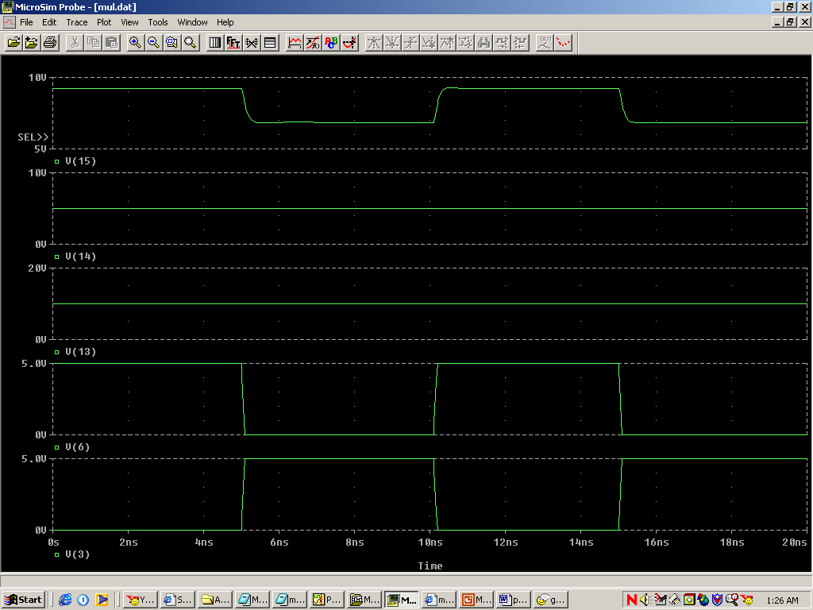
.dat file for 2-to-1 Multiplexor

Slide 11
Refrences
  Introduction to VLSI Circuits and Systems, by John P.Uyemura
  Physical Design of CMOS Integrated Circuits, by John P.Uyemura
  http://www.personal.dundee.ac.uk/~dmgoldie/teaching/eg4013/lectures/10
  http://uhaweb.hartford.edu/ilumokanw/#DVLSI

Slide 12
Thankyou…

