Slide 1
Getting ready for Banner XE
Creating a Stand-alone GRAILS Application
Presented by: Stirling Crow and Jason Foutz University of New Mexico
June 5th, 2014

Slide 2
Presentation Overview
Getting Started
Demo
Walk Through of our code
Deployment Challenges
Source on GitHub
University Policy
New Tools for a New Development

Slide 3
Getting Started
Technologies for development

Slide 4
Getting Started
Java
Spring Framework
Groovy
Hibernate
Grails

Slide 5
Demo
See Spriden Search in action!

Slide 6
Demo
Simple, useful application
SPRIDEN – BannerID vs Pidm
Tomcat Deployment on development machine
WebLogic Deployment

Slide 7
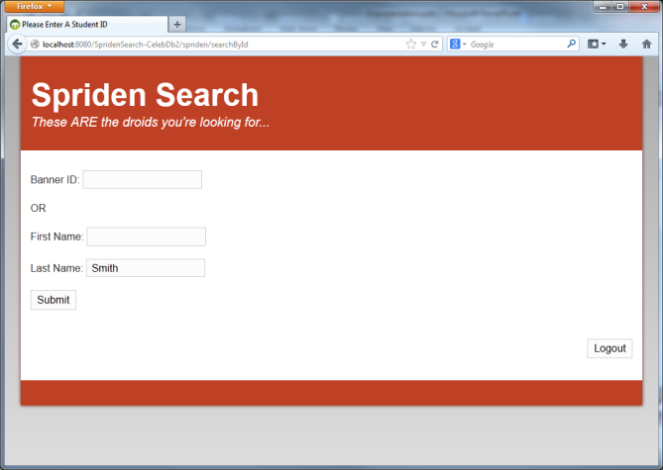
Demo

Slide 8
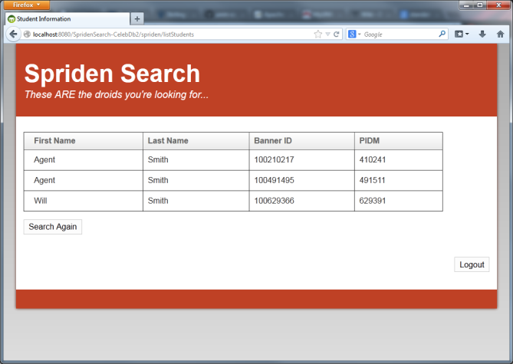
Demo

Slide 9
Source Code Tour
MVC Framework
DB Connection
Customization – Groovy Server Pages

Slide 10

Development Process Changes
Developing in PL/SQL
Oracle Database
Tables
PL/SQL Code

Slide 11
Development Process Changes
Developing in GRAILS
IDE:
GGTS
or
IntelliJ
Tomcat
WAR
file
Grails Web App
Oracle Database
Java
Tables

Slide 12
Development Process Changes
Developing in GRAILS
WAR
file
AIX / Red Hat Linux Production Server
Oracle Database
Tomcat or WebLogic
Tables
Grails Web App

Slide 13
DB Connection
JDBC
Datasource
Hibernate
GORM
Grails Web App
Grails Web App
GORM
(Hibernate)
Oracle JDBC
GORM
(Hibernate)
Oracle JDBC
MySQL JDBC
Oracle Database
MySQL Database
Tables
Tables

Slide 14
Customization
Groovy Server Pages
Templates
g:Tags

Slide 15
MVC Framework
Models/Domains = Table Column Specs
Views = Display HTML info to users
Controllers = Perform logic, info to views

Slide 16
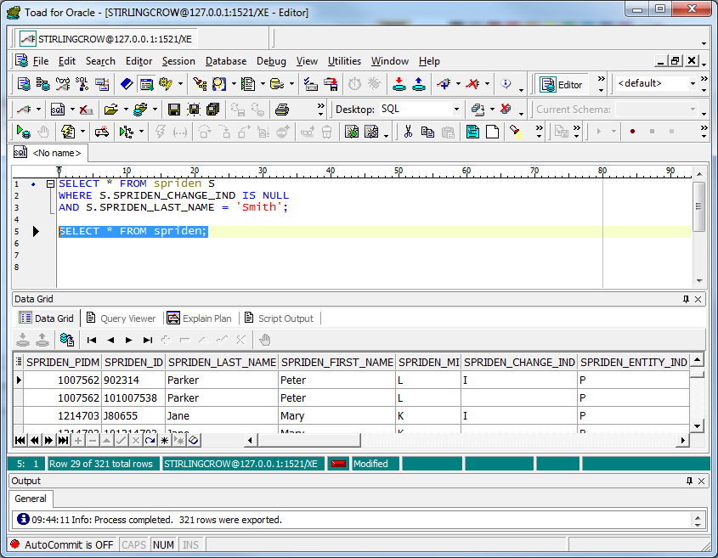
Model/Domain

Slide 17
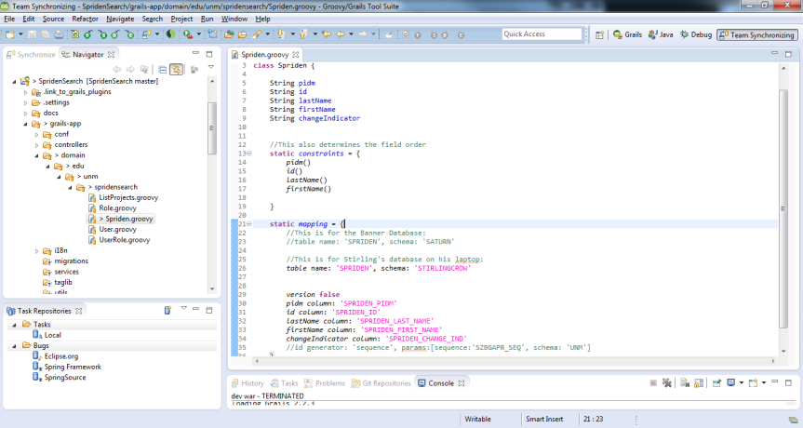
Model/Domain - Spriden

Slide 18
Spriden Controller Methods
index
searchById
listStudents

Slide 19
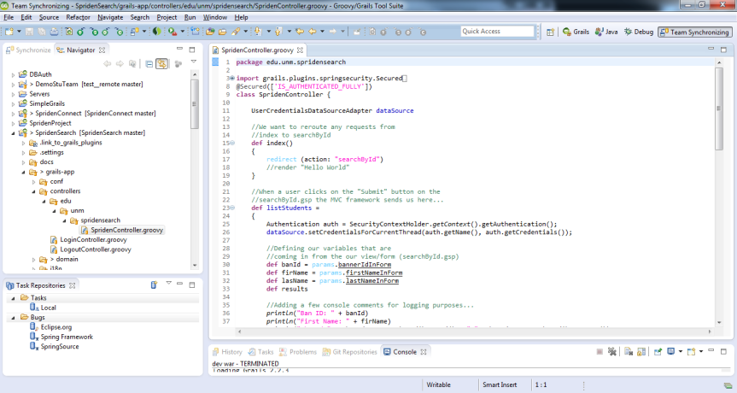
Controller:

Slide 20
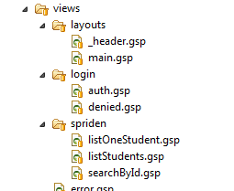
Important Views:
searchById.gsp
listStudents.gsp

Slide 21
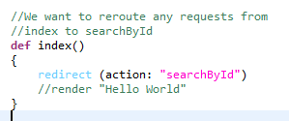
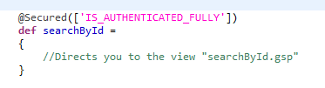
MVC Overview
Controllers perform business logic
Logic result is sent to a View
Controller’s actions and Views have the same name
SpridenController’s searchById uses the searchById view

Slide 22
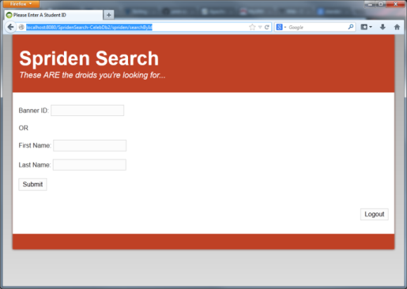
MVC Overview
searchById view

Slide 23
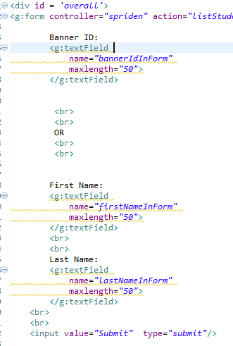
MVC Overview
searchById sends us to listStudents in SpridenController

Slide 24
MVC Overview
Variables come from the form
listStudents’ action executes a query, using those variables
The results get sent to the listStudents view
Controller methods map view names

Slide 25
Source Code Tour
Spring plugins
Authentication
Spring beans
Autowire in java is the default in Grails

Slide 26
Deployment Challenges
Deployment Servers
Weblogic Quirks

Slide 27
Deployment Challenges
Tomcat
Weblogic
Weblogic quirks

Slide 28

Weblogic Discoveries
MalformedParameterizedTypeException
See:
http://grails.org/Deployment

Slide 29
Weblogic Discoveries
/index.gsp not found
See:
http://jira.grails.org/browse/GRAILS-8767

Slide 30
WebLogic Discoveries - War files
Clean
Refresh-dependencies
Compile
War

Slide 31
Source Code
GitHub!

Slide 32
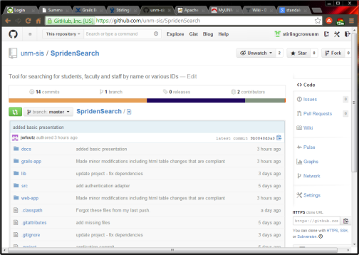
Source Code
https://github.com/unm-sis/SpridenSearch

Slide 33
Watch The Application Being Built
Go to:
https://www.youtube.com/playlist?list=PLmEKL_BOSNSlim-DnV7re8Yn4Yyunvbsx
Or.. Just go to www.youtube.com and search for:
stirling crow grails

Slide 34
University Policy
Security
FERPA

Slide 35
University Policy
Did we build it right?
FERPA
Security at all layers

Slide 36
New Tools
New environment

Slide 37
New Tools
Issue tracking - JIRA
Documentation - Confluence
Version Control - GitHub

Slide 38
Summary
Development tools
Technical Environment
Security
Policy compliance

Slide 39
Questions
Questions? Comments?
We’d love to know if any of you have created applications using GRAILS!

Slide 40
Thank You!
Stirling Crow, Jason Foutz
stirlingcrow@unm.edu jwfoutz@unm.edu

