Slide 1
Getting ready for Banner XE
Creating a Stand-alone GRAILS Application

Slide 2
Welcome
Unm Student Team
Stirling Crow (stirlingcrow@unm.edu)
Jason Foutz (jwfoutz@unm.edu)

Slide 3
Presentation Overview
Getting Started
Demo
Walk-Through Code
Deployment Environments
Source Code on GitHub
Unviersity Policy
New Tools for New Development

Slide 4
Getting Started
Java
Spring Framework
Groovy
Hibernate
Grails

Slide 5
Demo
We wanted to build a simple application that was also useful.
SPRIDEN - Banner ID vs Pidm
Demo of WebLogic Deployment
Demo of Tomcat Deployment on laptop

Slide 6
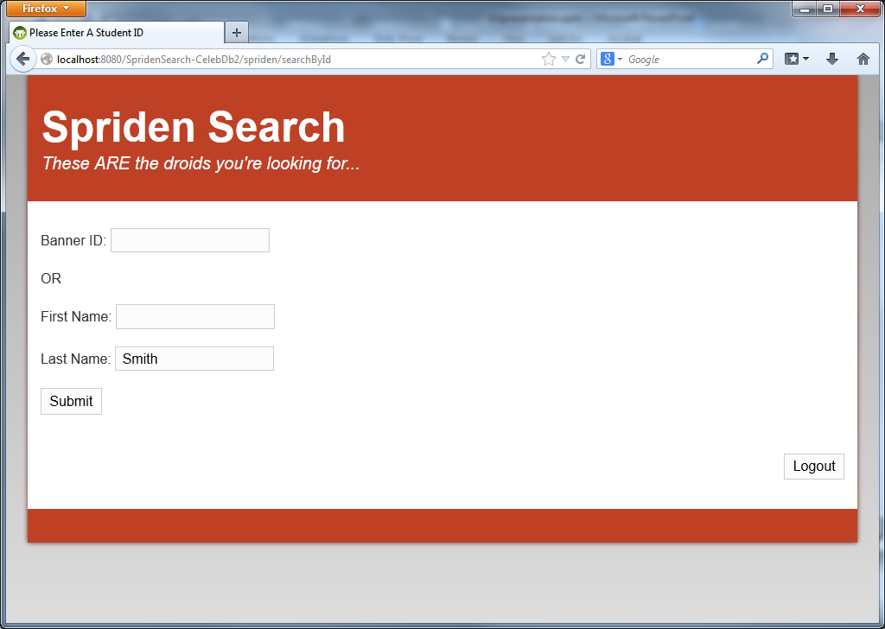

Slide 7
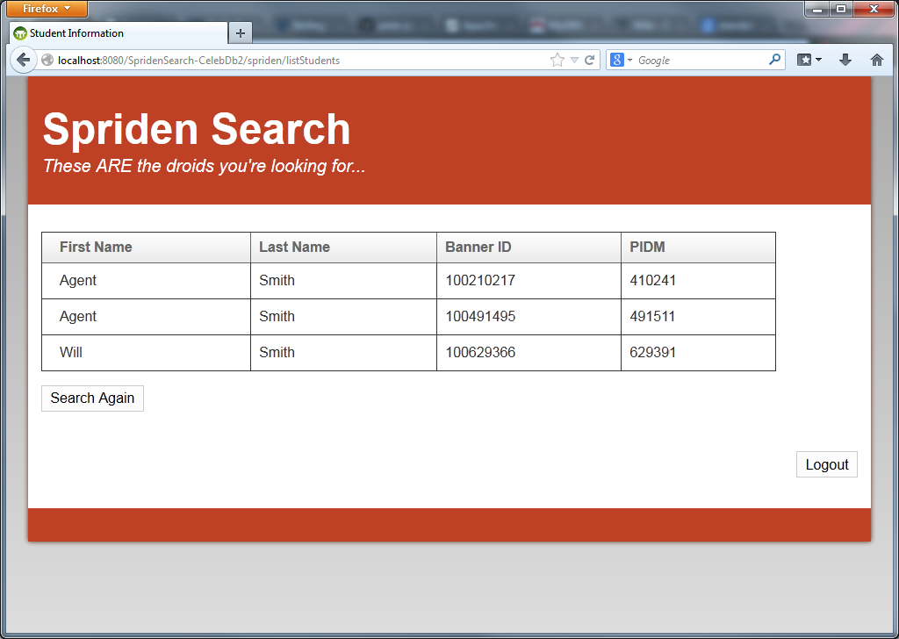

Slide 8
Source Code Tour
MVC Framework
Models/Domains = Table Column Specs
Views – Display HTML info to users
Controllers – perform logic, return info to views
DB Connection
JDBC
Datasource
Customization – Groovy Server Pages

Slide 9
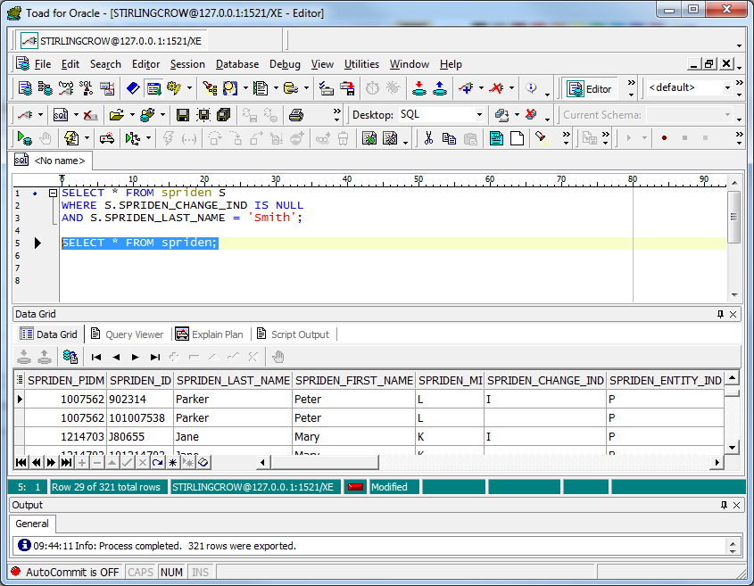
Model/Domain

Slide 10
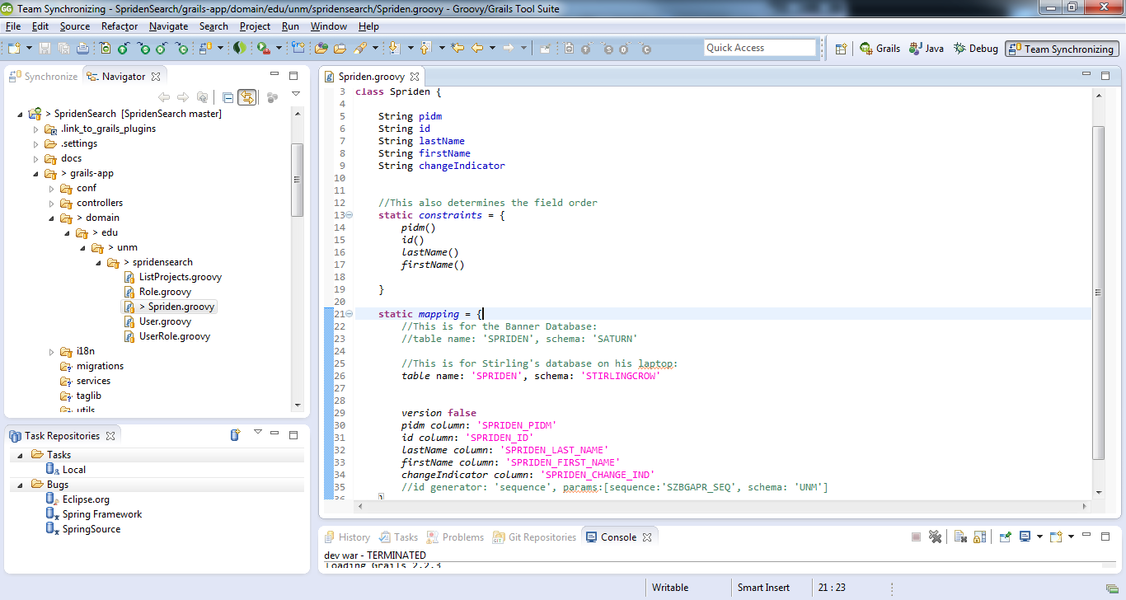
Model/Domain - Spriden

Slide 11
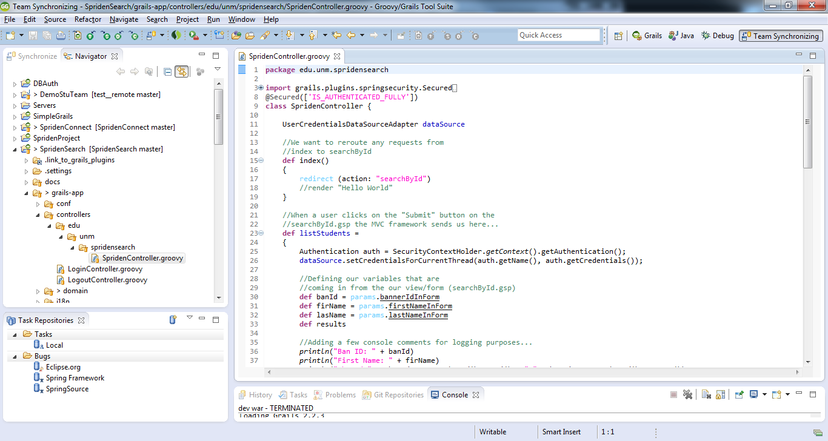
Controller
Spriden Controller
3 Methods: index, searchById, listStudents

Slide 12
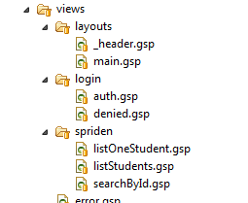
Views
2 Important Views:
searchById.gsp
listStudents.gsp

Slide 13
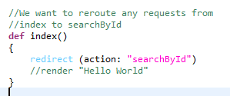
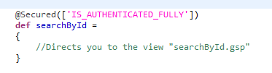
MVC Overview
Controllers perform business logic and then send results (or nothing) to the view with the same name.
For example, the “index” method in the Spriden Controller redirects us to the “searchById” method
The “searchById” method has nothing in it so we go straight to the searchById view.

Slide 14
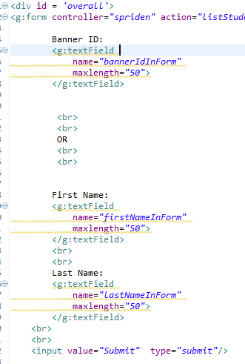
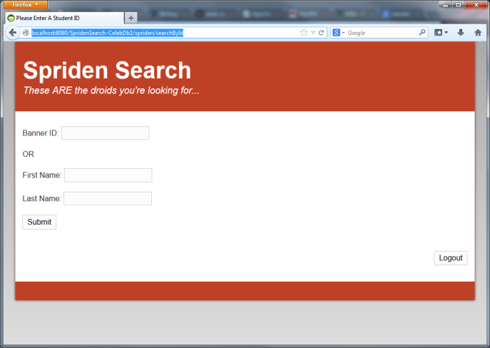
MVC Overview
The searchById view then generates the following:
Notice the code in the view will direct us to the listStudents method in the Spriden controller

Slide 15
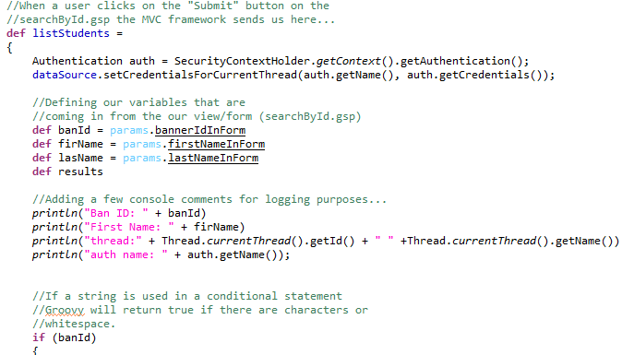
MVC Overview
We grab variables from the form and the SpridenController’s listStudents method executes a query the returns results from that query. Those results then get sent to the listStudents view.

Slide 16
Source Code Tour - Security
Spring Plugins
Spring Inversion of Control

Slide 17
Deployment Challenges
Deployment Servers
WebLogic
Tomcat
WebLogic Quirks and Discovery

Slide 18

WebLogic Discoveries
MalformedParameterizedTypeException
See: http://grails.org/Deployment
“/index.gsp” not found.
See: http://jira.grails.org/browse/GRAILS-8767
Do the following before building WAR:
clean
refresh-dependencies
compile
war

Slide 19
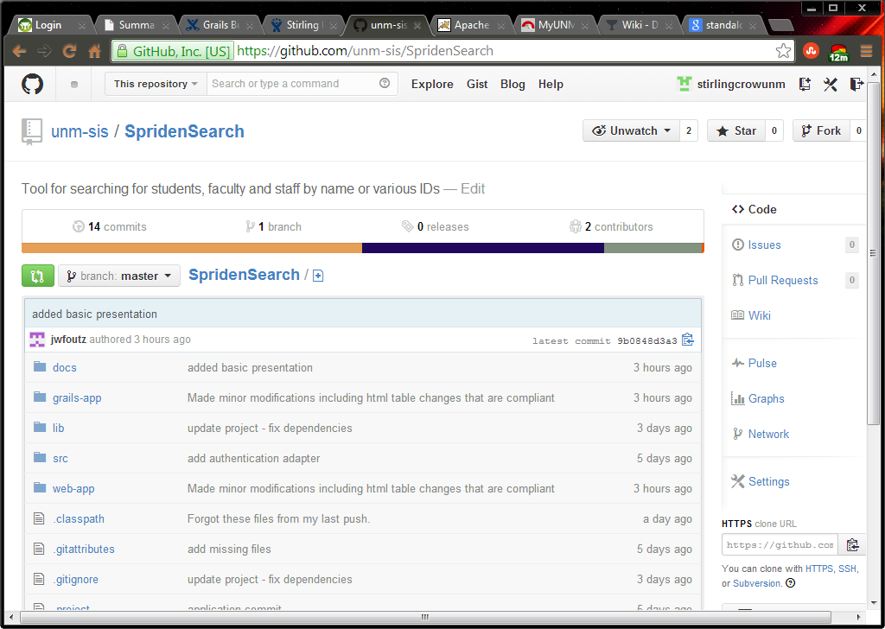
Source Code
Available on GitHub
https://github.com/unm-sis/SpridenSearch

Slide 20
University Policy
Did we build it right?
FERPA
Security at all layers

Slide 21
New Tools for New Development
Issue tracking - JIRA
Documentation - Confluence
Version Control - GitHub

Slide 22
Closing

