Slide 1

POLITICAL JUGGERNAUT: LOK SABHA ELECTION 2019
PRESENTED BY
A.SUJITHA (LEADER)
E.SANGEETHA
C.KEERTHANA
S.MAHALAKSHMI

Slide 2
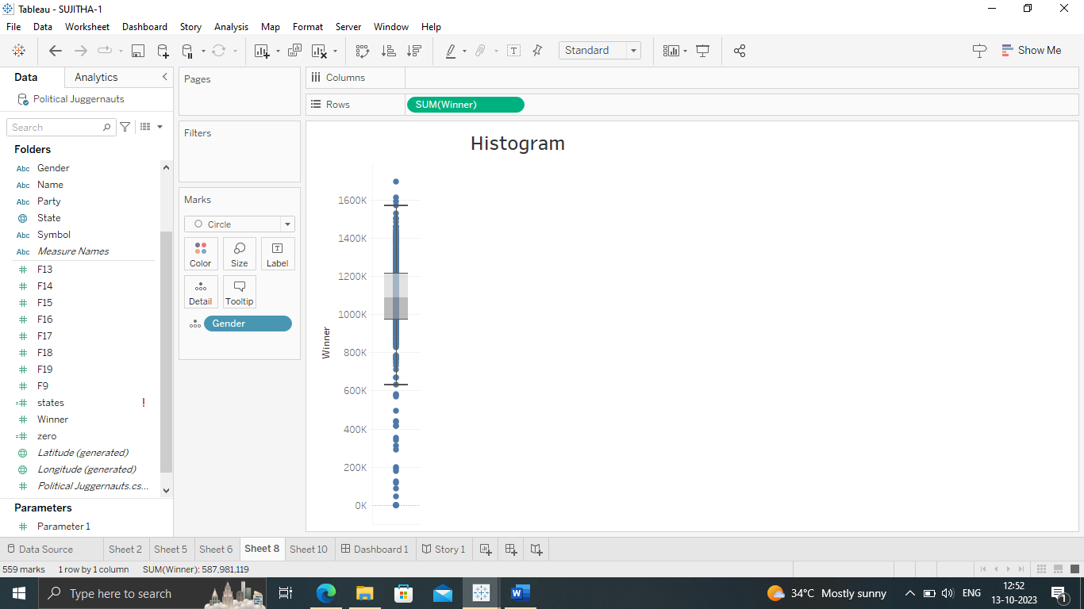
POLITICAL JUGGERNAUT: LOK SABHA ELECTION 2019

Slide 3
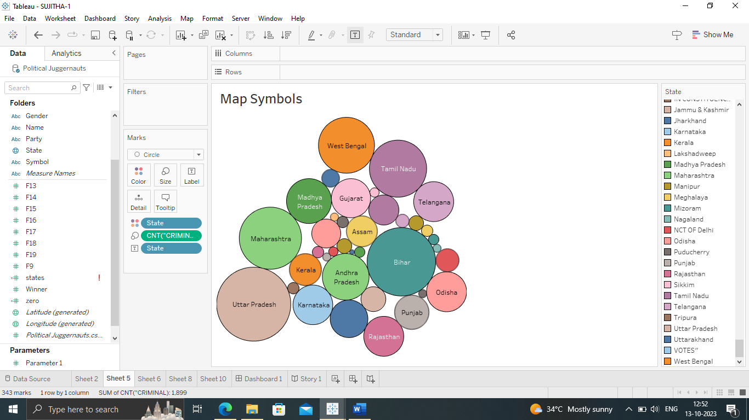
POLITICAL JUGGERNAUT: LOK SABHA ELECTION 2019

Slide 4
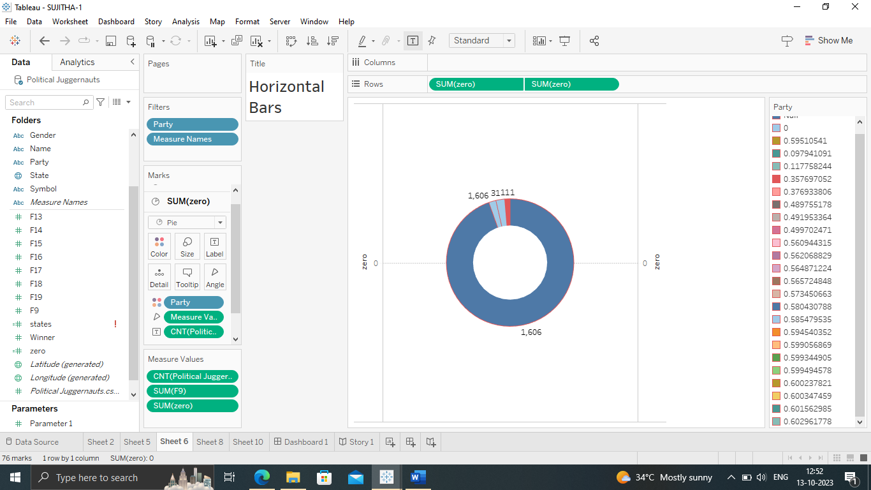
POLITICAL JUGGERNAUT: LOK SABHA ELECTION 2019

Slide 5
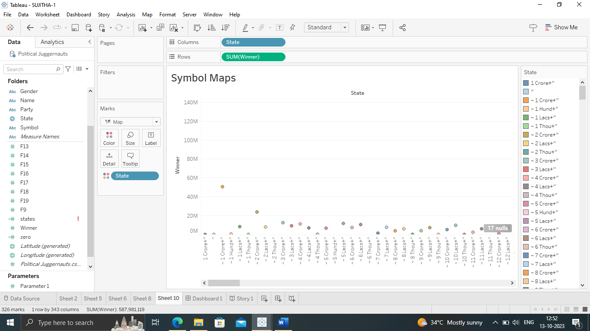
POLITICAL JUGGERNAUT: LOK SABHA ELECTION 2019

Slide 6
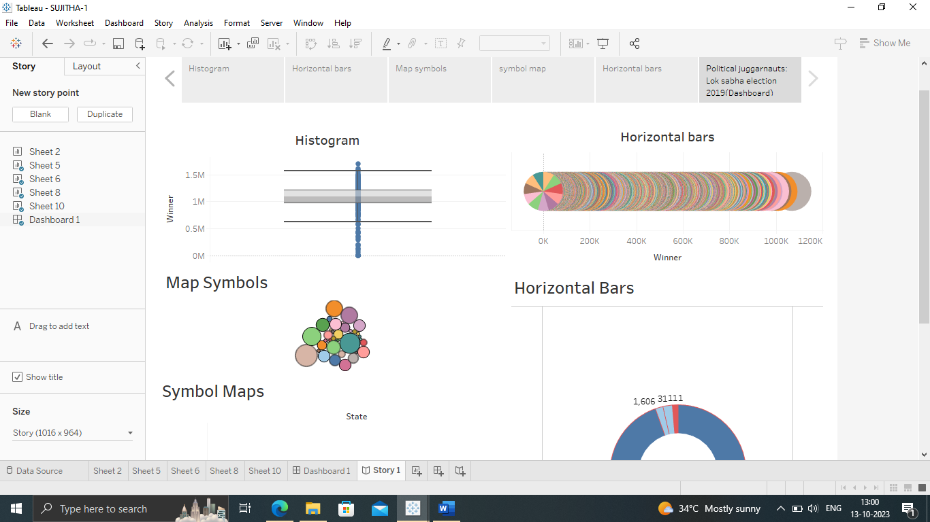
POLITICAL JUGGERNAUT: LOK SABHA ELECTION 2019

Slide 7
THE END

