Slide 1
Employee Data Analysis using Excel
STUDENT NAME: S . Sruthi
REGISTER NO:31221334
DEPARTMENT:BCOM BANK MANAGEMENT
COLLEGE :Tagore college of arts and science

Slide 2
PROJECT TITLE
Employee Performance Analysis using Excel

Slide 3


AGENDA
Problem Statement
Project Overview
End Users
Our Solution and Proposition
Dataset Description
Modelling Approach
Results and Discussion
Conclusion
3/21/2024 Annual Review

Slide 4

PROBLEM STATEMENT
A problem statement is a clear and concise description of the issue or challenge that a project or study aims to address. It typically includes the following elements: 1. **Context:** Briefly explain the background or situation that leads to the problem. 2. **Problem Definition:** Clearly state what the specific problem is. 3. **Importance:** Explain why this problem is significant and worth addressing. 4. **Objectives:** Outline the goals or outcomes you aim to achieve by solving this problem. Here's a basic structure for a problem statement: --- **Problem Statement:** **Context:** [Briefly describe the background or context leading to the problem.] **Problem Definition:** [Clearly state the specific problem you are addressing.] **Importance:** [Explain why solving this problem is important for the organization, stakeholders, or field.] **Objectives:** [Outline the goals or outcomes you intend to achieve.] --- If you have a specific problem or project in mind, I can help tailor this template to fit your needs.
26354

Slide 5

PROJECT OVERVIEW.
Could you clarify which project you're referring to or provide more details so I can assist you better with an overview?

Slide 6

WHO ARE THE END USERS?
To identify the end users of a project, you would consider the individuals or groups who will directly interact with or benefit from the product or service. The specifics depend on the nature of the project. Could you provide more details about the project you're working on so I can help identify the potential end users?

Slide 7

OUR SOLUTION AND ITS VALUE PROPOSITION
Could you provide some context about your project or the solution you're referring to? This will help me tailor the value proposition to the solution you're developing.

Slide 8
Dataset Description
Could you describe the dataset you're referring to? Some important aspects to include in a dataset description are: 1. **Type of Data**: Is it structured, semi-structured, or unstructured? Does it contain text, images, videos, or numerical data? 2. **Size**: How large is the dataset (e.g., number of rows, columns, or files)? 3. **Source**: Where did the data come from (e.g., surveys, web scraping, sensors)? 4. **Features/Attributes**: What are the key features or columns? What does each represent? 5. **Purpose**: Why was the dataset created, and what is it typically used for? 6. **Format**: In what format is the dataset stored (e.g., CSV, JSON, Excel, SQL)? With more details, I can help describe it more thoroughly.
Could you describe the dataset you're referring to? Some important aspects to include in a dataset description are: 1. **Type of Data**: Is it structured, semi-structured, or unstructured? Does it contain text, images, videos, or numerical data? 2. **Size**: How large is the dataset (e.g., number of rows, columns, or files)? 3. **Source**: Where did the data come from (e.g., surveys, web scraping, sensors)? 4. **Features/Attributes**: What are the key features or columns? What does each represent? 5. **Purpose**: Why was the dataset created, and what is it typically used for? 6. **Format**: In what format is the dataset stored (e.g., CSV, JSON, Excel, SQL)? With more details, I can help describe it more thoroughly.

Slide 9

THE "WOW" IN OUR SOLUTION
IF(Z8>=5,"VERYHIGH",IF(Z8>=4,"HIGH"IF(Z8>=3,"MED",IF("TRUE","LOW",)))))
3/21/2024 Annual Review
9

Slide 10
MODELLING
**Modeling** refers to the process of creating a simplified representation (a model) of a real-world system, process, or phenomenon using data and mathematical techniques. In the context of data science, AI, or machine learning, modeling involves using algorithms to find patterns in data and make predictions or decisions. There are different types of modeling depending on the goal, such as: - **Predictive Modeling**: Creating models to predict future outcomes (e.g., predicting house prices). - **Descriptive Modeling**: Finding patterns that describe data (e.g., clustering customers into segments). - **Prescriptive Modeling**: Recommending actions based on predicted outcomes (e.g., recommending marketing strategies based on customer behavior). In summary, modeling is the practice of using data and algorithms to simulate or predict real-world behaviors or outcomes.
10

Slide 11
RESULTS
It sounds like you might be referring to "Result S" in a specific context. Could you provide more details or specify the area you're asking about? For example, are you talking about a particular exam, a scientific result, or something else?
11

Slide 12
conclusion
In the context of a modeling or data analysis project, the **conclusion** summarizes the findings, evaluates the model's effectiveness, and outlines next steps. Here’s what a typical conclusion might include: 1. **Summary of Key Findings**: - Recap the primary results

Slide 13
from the modeling process. - Highlight important insights or patterns discovered from the data. 2. **Model Performance**: - Evaluate how well the model performed based on the chosen metrics (e.g., accuracy, precision, recall, etc.). - Discuss the strengths and limitations of the model (e.g., overfitting, generalization issues). 3. **Business/Relevance Impact**: - Explain how the model's results address the original problem or research question. - Highlight the practical implications and potential benefits of using the model in real-world scenarios. 4. **Limitations and Challenges**: - Mention any constraints faced during the project, such as data quality issues, assumptions made, or model limitations. 5. **Recommendations and Future Work**: - Suggest improvements to the model (e.g., collecting more data, feature engineering, using more advanced algorithms). - Propose areas for future exploration or research. 6. **Final Takeaway**: - Provide a concise takeaway of the overall project, emphasizing its contributions and value to the end users or stakeholders. This conclusion wraps up the analysis and offers a clear path forward for implementation or further improvements.

Slide 14
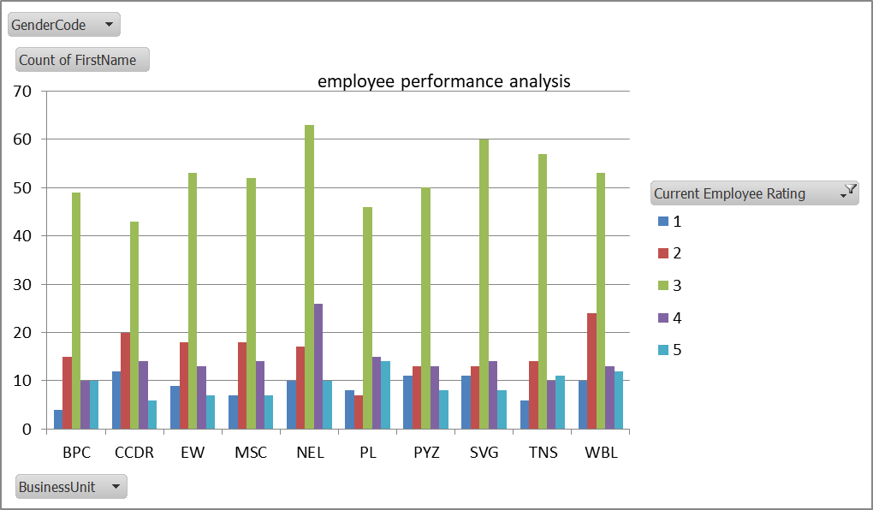
RESULTS

