Slide 1
Carcinogenic agents and their cellular interactions
Rugengamanzi Eulade,MD,MMed(Oncology)
The Butaro Cancer Center of Excellence (BCCOE)
Faculty at University of Global Health Equity(UGHE)
Director General of Butaro level II Teaching Hospital

Slide 2
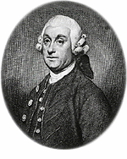
Sir Percival Pott:
More than 200 years ago the London surgeon Sir Percival Pott correctly attributed a link between the high incidence of scrotal cancer in chimney sweeps and their exposure to “soot.”
P. Pott (1775)

Slide 3
Etiology of Cancer (Carcinogenic Agents):
Three classes of carcinogenic agents have been identified:
Chemicals,
(2) Radiant energy, and
(3) Microbial agents.

Slide 4
Steps Involved in Chemical carcinogenesis:
The following concepts relating to the initiation-promotion sequence have emerged from the classical experiments:
Initiation results from exposure of cells to a sufficient dose of a carcinogenic agent (initiator); an initiated cell is altered, making it potentially capable of giving rise to a tumor (groups 2 and 3). Initiation alone, however, is not sufficient for tumor formation (group 1).
Initiation causes permanent DNA damage (mutations). It is therefore rapid and irreversible and has “memory.” This is illustrated by group 3, in which tumors were produced even if the application of the promoting agent was delayed for several months after a single application of the initiator.

Slide 5
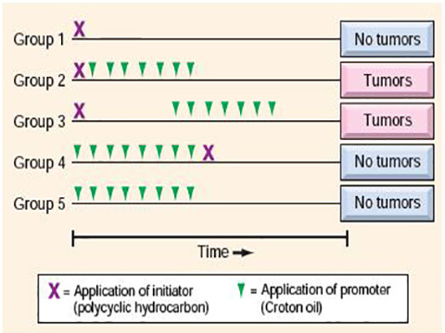
Promoters can induce tumors in initiated cells, but they are nontumorigenic by themselves (group 5). Furthermore, tumors do not result when the promoting agent is applied before, rather than after, the initiating agent (group 4).
Fig: Experiments demonstrating the initiation and promotion phases of carcinogenesis in mice.

Slide 6
Initiation of chemical carcinogenesis
All initiating chemical carcinogens are highly reactive electrophiles that can react with nucleophilic sites in the cell.
Their targets are DNA, RNA, and proteins, and in some cases these interactions cause cell death.
Initiation inflicts nonlethal damage to the DNA that cannot be repaired. The mutated cell then passes on the DNA lesions to its daughter cells.
Chemicals that can cause initiation of carcinogenesis are 2 types: direct acting and indirect acting.

Slide 7
Direct acting agents
Require no metabolic conversion to become carcinogenic.
Most are weak carcinogens but some are important because they are cancer chemotherapeutic drugs (e.g., alkylating agents).
The risk of induced cancer is low, but its existence dictates judicious use of such agents.

Slide 8
Indirect acting carcinogens
Chemicals that require metabolic conversion to become active Carcinogens (ultimate carcinogen).
Some of the most potent indirect chemical carcinogens—the polycyclic hydrocarbons (are present in fossil fuels); benzo[a]pyrene (the active component of soot, which Potts showed to be carcinogenic), are formed during the high-temperature combustion of tobacco in cigarettes
Most of the known carcinogens are metabolized by cytochrome P-450-dependent mono-oxygenases.
The genes that encode these enzymes are polymorphic, and the activity and inducibility of these enzymes vary significantly among individuals.

Slide 9
Because these enzymes are essential for the activation of procarcinogens, the susceptibility to carcinogenesis is related in part to the particular polymorphic variants that an individual inherits.
Thus, it may be possible to assess cancer risk in a given individual by genetic analysis of such enzyme polymorphisms

Slide 10
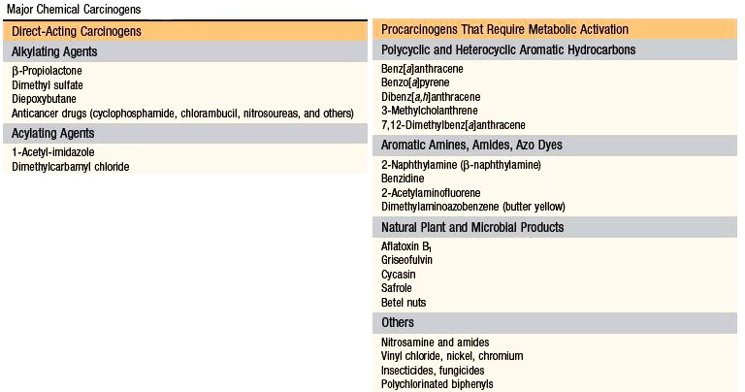

Slide 11
Molecular targets of chemical carcinogens
Because malignant transformation results from mutations, most chemical initiating agents target DNA and are mutagenic.
There is no single or unique alteration associated with cancer initiation. Nor is there any apparent predisposition for initiators to cause mutations in particular genes;
Presumably, mutations occur throughout the genome and cells that by chance suffer damage to the “usual suspects”, oncogenes and tumor suppressors such as RAS and TP53, gain a potential selective advantage and are at risk for subsequent transformation.

Slide 12
This is not to say that mutations induced by carcinogens occur in an entirely random fashion.
Because of their chemical structures, some carcinogens interact preferentially with particular DNA sequences or bases, and thus produce mutations that are clustered at “hotspots” or that are enriched for particular base substitutions.

Slide 13
Promotion of chemical carcionogenesis
Promoters are chemical agents that are not mutagenic, but which instead stimulate cellular proliferation.
In tissues that are normally quiescent, such as the liver, the mitogenic stimulus may be provided by the initiating agent. This occurs if the carcinogenic initiator is toxic and kills a large number of cells, thereby stimulating regeneration of the surviving cells.
In classic experimental systems, however, the carcinogenic potential of initiators is only revealed upon the subsequent administration of promoters (e.g., phorbol esters, hormones, phenols, and drugs).

Slide 14
Application of promoters leads to proliferation and clonal expansion of initiated (mutated) cells.
Driven to proliferate, subclones of the initiated cells suffer various additional mutations, and eventually a cancerous clone with all the necessary hallmark characteristics may emerge.

Slide 15
RADIATION CARCINOGENESIS
Radiant energy, in the form of the UV rays of sunlight or as ionizing electromagnetic and particulate radiation, is carcinogenic.
Ultraviolet rays:
Exposure to UV rays derived from the sun, particularly in fair-skinned individuals, is associated with an increased incidence of squamous cell carcinoma, basal cell carcinoma, and melanoma of the skin.
The degree of risk depends on the type of UV rays, the intensity of exposure, and the quantity of the light-absorbing “protective mantle” of melanin in the skin.

Slide 16
The UV portion of the solar spectrum can be divided into three wavelength ranges: UVA (320-400 nm), UVB (280-320 nm), and UVC (200-280 nm).
Of these, UVB is believed to be responsible for the induction of cutaneous cancers.
UVC, although a potent mutagen, is not considered significant because it is filtered out by the ozone layer surrounding the earth.
The carcinogenicity of UVB light is due to formation of pyrimidine dimers in DNA.

Slide 17
Ionising radiation:
Electromagnetic (x-rays, γ rays) and particulate (α particles, β particles, protons, neutrons) radiations are all carcinogenic.
Evidence:
Many individuals pioneering the use of x-rays developed skin cancers.
Miners of radioactive elements in central Europe and the Rocky Mountain region of the United States have a tenfold increased incidence of lung cancers compared to the rest of the population.
Most telling is the follow-up of survivors of the atomic bombs dropped on Hiroshima and Nagasaki. Initially there was a marked increase in the incidence of certain forms of leukemia after an average latent period of about 7 years. Subsequently the incidence of many solid tumors with longer latent periods (e.g., carcinomas of the breast, colon, thyroid, and lung) increased.

Slide 18
In humans there is a hierarchy of vulnerability of different tissues to radiation-induced cancers. Most frequent are myeloid leukemias.
Cancer of the thyroid follows closely but only in the young. In the intermediate category are cancers of the breast, lungs, and salivary glands.
In contrast, skin, bone, and the gastrointestinal tract are relatively resistant to radiation-induced neoplasia.
Practically any cell can be transformed into a cancer cell by sufficient exposure to radiant energy.

Slide 19
MICROBIAL CARCINOGENESIS
Only a few virus have been linked with human cancer
A. Oncogenic RNA virus
Only one human retrovirus, human T-cell leukemia virus type 1 (HTLV-1), is firmly implicated in the pathogenesis of cancer in humans
HTLV-1 causes adult T-cell leukemia/lymphoma (ATLL)
Similar to the human immunodeficiency virus, which causes AIDS, HTLV-1 has tropism for CD4+ T cells, and hence this subset of T cells is the major target for neoplastic transformation.
Human infection requires transmission of infected T cells via sexual intercourse, blood products, or breastfeeding.

Slide 20
HTLV-1 genome contains the gag, pol, env, and longterminal-repeat regions typical of all retroviruses, but, in contrast to other leukemia viruses, it contains another gene referred to as tax.
Several aspects of HTLV-1’s transforming activity are attributable to Tax, the protein product of this gene.
Tax contributes to the acquisition of several cancer hallmarks in the following ways:
Increased pro-growth signaling and cell survival.
Tax interacts with PI3K and thereby stimulates AKT (protein kinase B) these kinases participate in the cascade that promotes both cell survival and metabolic alterations that enhance cell growth.

Slide 21
Tax also directly upregulates the expression of cyclin D2 and represses the expression of multiple CDK inhibitors, changes thatpromote cell cycle progression.
Finally, Tax can activate the transcription factor NF-κB, which promotes the survival of many cell types, including lymphocytes.
Increased genomic instability.
By interfering with DNA-repair functions and inhibiting cell cycle checkpoints activated by DNA damage.

Slide 22
Oncogenic DNA virus
Of the various human DNA viruses, five—HPV, Epstein-Barr virus (EBV), hepatitis B virus (HBV), Merkel cell polyoma virus, and Kaposi sarcoma herpesvirus, also called human herpesvirus 8—have been implicated in the causation of human cancer.
HUMAN PAPILLOMAVIRUS.
At least 70 genetically distinct types of HPV have been identified. Some types (e.g., 1, 2, 4, and 7) cause benign squamous papillomas (warts) in humans.
In contrast, high-risk HPVs (e.g., types 16 and 18) have been implicated in the genesis of squamous cell carcinomas of the cervix, anogenital region, and head and neck (particularly tumors arising in the tonsillar mucosa).
These cancers are sexually transmitted diseases, caused by transmission of HPV.
In contrast to cervical cancers, genital warts have low malignant potential and are associated with low-risk HPVs, predominantly HPV-6 and HPV-11.

Slide 23
The oncogenic potential of HPV can largely be explained by the activities of the two viral genes encoding E6 and E7.
Oncogenic activities of E6.
The E6 protein binds to and mediates the degradation of p53, and also stimulates the expression of TERT, the catalytic subunit of telomerase, which you will recall contributes to the immortalization of cells.
E6 from high-risk HPV types has a higher affinity for p53 than E6 from low-risk HPV types.

Slide 24
Oncogenic activities of E7:
The E7 protein has effects that complement those of E6, all of which are centered on speeding cells through the G1-S cell cycle checkpoint.
It binds to the RB protein and displaces the E2F transcription factors that are normally sequestered by RB, promoting progression through the cell cycle.
As with E6 proteins and p53, E7 proteins from high-risk HPV types have a higher affinity for RB than do E7 proteins from low-risk HPV types.
E7 also inactivates the CDK inhibitors p21 and p27. Finally, E7 proteins from highrisk HPVs (types 16, 18, and 31) also bind and presumably activate cyclins E and A.

Slide 25
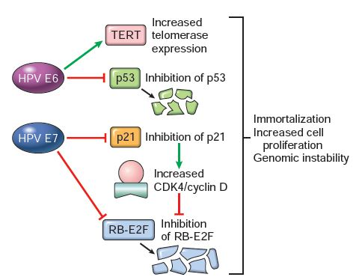
To summarize, high-risk HPV types express oncogenic proteins that inactivate tumor suppressors, activate cyclins, inhibit apoptosis, and combat cellular senescence.

Slide 26
EPSTEIN-BARR VIRUS
EBV, a member of the herpesvirus family, has been implicated in the pathogenesis of several human tumors:
The African form of Burkitt lymphoma;
B-cell lymphomas in immunosuppressed individuals (particularly in those with HIV infection or undergoing immunosuppressive therapy after organ or bone marrow transplantation);
A subset of Hodgkin lymphoma;
Nasopharyngeal and some gastric carcinomas etc.

Slide 27
EBV infects B lymphocytes and possibly epithelial cells of the oropharynx.
The virus uses the complement receptor CD21 to attach to and infect B cells.
The infection of B cells is latent.

Slide 28
One EBV gene, latent membrane protein-1 (LMP-1), acts as an oncogene.
LMP-1 behaves like a constitutively active CD40 receptor,a key recipient of helper T-cell signals that stimulate B-cell growth.
LMP-1 activates the NF-κB and JAK/STAT signaling pathways and promotes B-cell survival and proliferation, all of which occur autonomously (i.e.,without T cells or other outside signals) in EBV-infected B cells.
Concurrently, LMP-1 prevents apoptosis by activating BCL2.
In addition, the EBV genome contains a gene encoding a viral cytokine, vIL-10. This viral cytokine can prevent macrophages and monocytes from activating T cells and is required for EBV-dependent transformation of B cells.

Slide 29
In nonendemic areas 80% of tumors are unrelated to EBV, but virtually all endemic and sporadic tumors possess the t(8;14) or other translocations that dysregulate MYC.
Thus, although sporadic Burkitt lymphomas are triggered by mechanisms other than EBV, they appear to develop through similar oncogenic pathways.
In summary, in the case of Burkitt lymphoma, it seems that EBV is not directly oncogenic, but by acting as a polyclonal B-cell mitogen, it sets the stage for the acquisition of the (8;14) translocation and other mutations that ultimately produce a full-blown cancer.
The role played by EBV is more direct in EBV-positive B-cell lymphomas in immunosuppressed patients.

Slide 30
NASOPHARYNGEAL CARCINOMA
It is also associated with EBV infection. This tumor is endemic in southern China, in some parts of Africa, and in the Inuit population of the Arctic.
In contrast to Burkitt lymphoma, 100% of nasopharyngeal carcinomas obtained from all parts of the world contain EBV.
The structure of the viral genome is identical (clonal) in all of the tumor cells within individual tumors, excluding the possibility that EBV infection occurred after tumor development.

Slide 31
The uniform association of EBV with nasopharyngeal carcinoma suggests that EBV has a central role in the genesis of the tumor.
But (as with Burkitt lymphoma) the restricted geographic distribution indicates that genetic or environmental cofactors, or both, also contribute to tumor development.
Unlike Burkitt lymphoma, LMP-1 is expressed in nasopharyngeal carcinoma cells and, as in B cells, activates the NF-κB pathway. NF-κB in turn upregulates the expression of factors such as VEGF, FGF-2, MMP9, and COX2 that may contribute to oncogenesis.

Slide 32
HEPATITIS B AND C VIRUS
The oncogenic effects of HBV and HCV are multifactorial, the dominant effect seems to be immunologically mediated chronic inflammation and hepatocyte death leading to regeneration and, over time, genomic damage.
As with any cause of hepatocellular injury, chronic viral infection leads to the compensatory proliferation of hepatocytes.
This regenerative process is aided and abetted by a plethora of growth factors, cytokines, chemokines, and other bioactive substances.
These are produced by activated immune cells and promote cell survival, tissue remodeling, and angiogenesis.

Slide 33
The activated immune cells also produce other mediators, such as reactive oxygen species, that are genotoxic and mutagenic.
One key molecular step seems to be activation of the NF-κB pathway in hepatocytes in response to mediators derived from the activated immune cells.
Activation of the NF-κB pathway within hepatocytes blocks apoptosis, allowing the dividing hepatocytes to incur genotoxic stress and to accumulate mutations.
Although this seems to be the dominant mechanism in the pathogenesis of virus-induced hepatocellular carcinoma, the HBV genome also contains genes that may directly promote the development of cancer.

Slide 34
For example, an HBV gene known as HBx can activate a variety of transcription factors and several signal transduction pathways.
In addition, viral integration can cause structural changes in chromosomes that dysregulate oncogenes and tumor suppressor genes.
Although not a DNA virus, HCV is also strongly linked to the pathogenesis of liver cancer.
The molecular mechanisms used by HCV are less well defined than are those of HBV.

Slide 35
HELICOBACTER PYLORI
First bacterium classified as a carcinogen. Indeed, H. pylori infection is implicated in the genesis of both gastric adenocarcinomas and gastric lymphomas.
The scenario for the development of gastric adenocarcinoma is similar to that of HBV- and HCV-induced liver cancer, as it involves increased epithelial cell proliferation in a background of chronic inflammation.
As in viral hepatitis, the inflammatory milieu contains numerous genotoxic agents, such as reactive oxygen species.

Slide 36
There is an initial development of chronic gastritis, followed by gastric atrophy, intestinal metaplasia of the lining cells, dysplasia, and cancer.
This sequence takes decades to complete and occurs in only 3% of infected patients.
Like HBV and HCV, the H. pylori genome also contains genes directly implicated in oncogenesis. Strains associated with gastric adenocarcinoma have been shown to contain a “pathogenicity island” that contains cytotoxin-associated A (CagA) gene.

Slide 37
Although H. pylori is noninvasive, CagA penetrates into gastric epithelial cells, where it has a variety of effects, including the initiation of a signaling cascade that mimics unregulated growth factor stimulation.
The gastric lymphomas are of B-cell origin.
It is thought that H. pylori infection leads to the appearance of H. pylori-reactive T cells, which in turn stimulate a polyclonal B-cell proliferation.
In chronic infections, currently unknown mutations may be acquired that give individual cells a growth advantage.

Slide 38
These cells grow out into a monoclonal “MALToma” that nevertheless remains dependent on T-cell stimulation of B-cell pathways that activate the transcription factor NF-κB.
At this stage, eradication of H. pylori by antibiotic therapy “cures” the lymphoma by removing the antigenic stimulus for T cells.
At later stages, however, additional mutations may be acquired that cause constitutive NF-κB activation. At this point, the MALToma no longer requires the antigenic stimulus of the bacterium for growth and survival and develops the capacity to spread beyond the stomach to other tissues.

Slide 39
References:
Robbins and Cotran: Pathologic basis of disease.

