Slide 1
MODULE: 102
ACID –BASE BALANCE- RESPIRATORY AND RENAL MECHANISMS
PROFESSOR OLUTAYO IFEDAYO AJAYI
Lecture series
UNIVERSITY OF GLOBAL HEALTH EQUITY.

Slide 2
Objectives
Explain the role of the respiratory system in acid base balance
Explain the role of the renal system in acid base balance

Slide 3
Introduction
Acid-base regulation
Regulation of hydrogen ion
Buffer system
Respiratory regulation
Renal regulation

Slide 4

Introduction
The maintenance of the blood pH is important for the proper functioning of our body and can be critical if not maintained.
The main buffers in blood are bicarbonate, haemoglobin, plasma proteins and phosphates.
Mainly, the buffer involves carbonic acid (H₂CO₃), a weak acid, and bicarbonate ion (HCO³⁻), the conjugate base.

Slide 5
INTRO…
Buffers
resist changes in pH from the addition of acid or base
in the body absorb H₃O⁺ or OH⁻ from foods and cellular processes to maintain pH
are important in the proper functioning of cells and blood
in blood maintain a pH close to 7.4; a change in the pH of the blood affects the uptake of oxygen and cellular processes

Slide 6
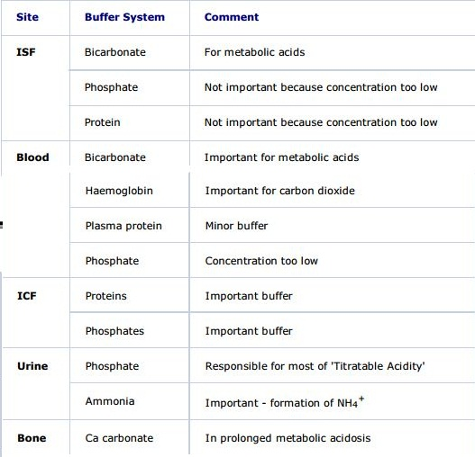
The Major Body Buffer Systems

Slide 7
Functions of acid base-balance
To maintain homeostasis
Metabolism is the basis of life.
Metabolism is possible only because of enzymes.
Enzyme activity is influenced by pH of the surrounding medium.
So, maintenance of acid base balance is crucial for life’s processes.

Slide 8
Acids And Bases
Acids
Release protons (H) ;Eg-H2CO3 , HCL
Bases
Accept protons (H) ; Eg-HCO3

Slide 9
Types of acids and bases
Strong acids
Release large amount of Hydrogen ions
Weak acids
Release small amount of Hydrogen ions
Strong bases
Accept large amount of Hydrogen ions
Weak bases
Accept small amount of Hydrogen ions

Slide 10
ACIDS
VOLATILE ACIDS:
Produced by oxidative metabolism of CHO, Fat, Protein
Excreted through LUNGS as CO₂ gas
FIXED ACIDS Acids that do not leave solution ,once produced they remain in body fluids Until eliminated by KIDNEYS
Eg: Sulfuric acid ,phosphoric acid , Organic acids
Are most important fixed acids in the body
Are generated during catabolism of:
amino acids(oxidation of sulfhydryl gps of cystine,methionine)
Phospholipids(hydrolysis)
nucleic acids

Slide 11
Acidic Substances of body:
Carbonic acid(H2CO3)
Phosphoric acid( H3PO4)
Sulphuric acid (H2SO4)
Organic Acids:
Lactate, Acetoactate, Pyruvate
Alkaline Substances of body:
Citrate
Bicarbonates.

Slide 12
Response to ACID BASE challenge
Buffering
Compensation

Slide 13
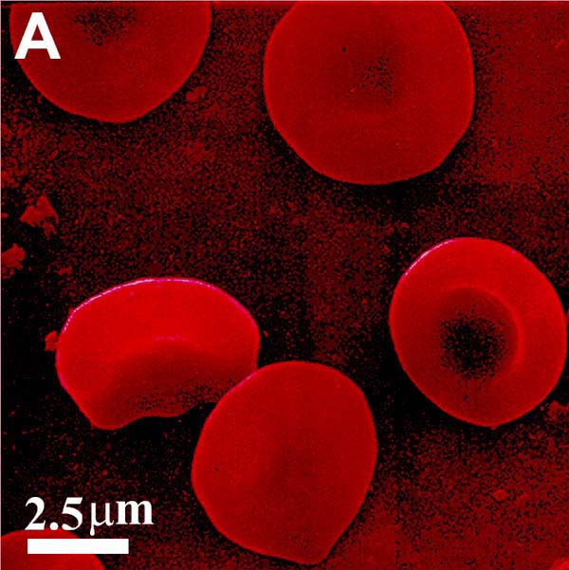
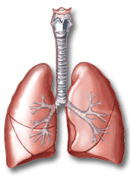
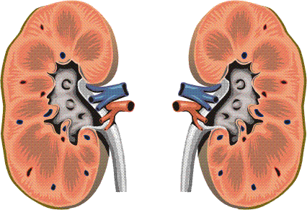
Factors Regulating Acid Base Balance

Slide 14
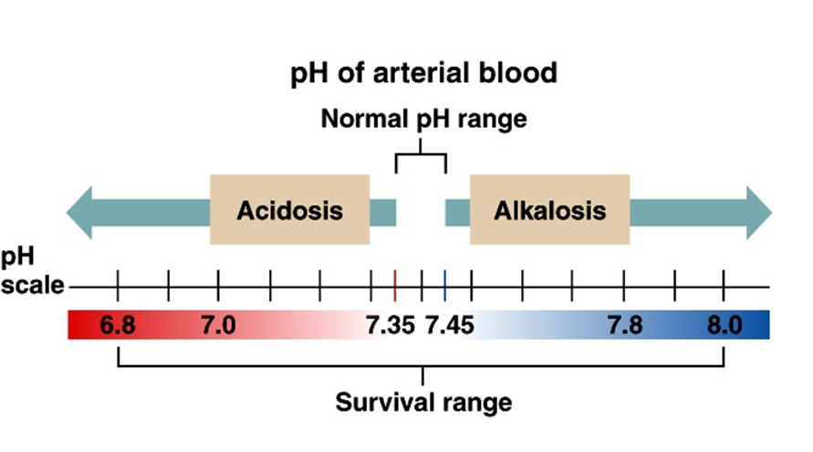

Slide 15
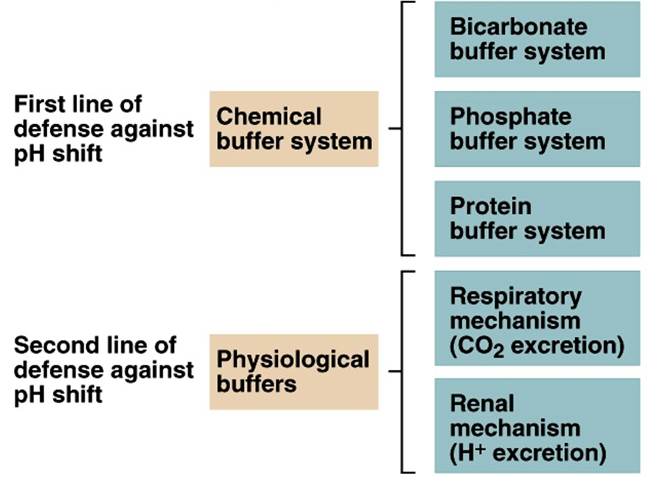

Slide 16
Acid Base Balance is Regulated By:
First Line of Defense
Blood Buffer System
Second Line of Defense
Respiratory Mechanism
Third Line of Defense
Renal Mechanism

Slide 17
Chemical Buffers
React very rapidly (less than a second)
2) Respiratory Regulation
Reacts rapidly (seconds to minutes)
3) Renal Regulation
Reacts slowly (minutes to hours)

Slide 18
Buffers
First line of defense (> 50 – 100 mEq/day)
Two most common chemical buffer groups
Bicarbonate
Non bicarbonate (Hb,protein,phosphate)
Blood buffer systems act instantaneously
Regulate pH by binding or releasing H⁺
Notes:
Buffers are always present and can act fast to reduce amount of free H+ ions.
Bicarbonate active in both ICP and ECF
Phosphate active in ICF
Protein buffers are largest source and are present in both intracellular and extracellular fluid
Major protein buffers: hemoglobin, albumin, globulin

Slide 19
Carbonic Acid–Bicarbonate Buffer System
Carbon Dioxide
Most body cells constantly generate carbon dioxide
Most carbon dioxide is converted to carbonic acid, which dissociates into H⁺ and a bicarbonate ion
Prevents changes in pH caused by organic acids and fixed acids in ECF
Cannot protect ECF from changes in pH that result from elevated or depressed levels of CO₂
Functions only when respiratory system and respiratory control centers are working normally
Ability to buffer acids is limited by availability of bicarbonate ions

Slide 20
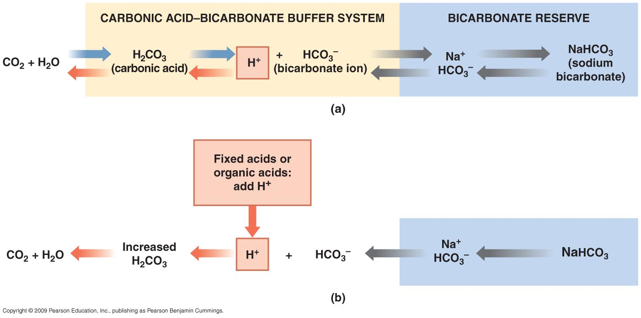
Acid–Base Balance
The Carbonic Acid–Bicarbonate Buffer System

Slide 21
The Hemoglobin Buffer System
CO₂ diffuses across RBC membrane
No transport mechanism required
As carbonic acid dissociates
Bicarbonate ions diffuse into plasma
In exchange for chloride ions (chloride shift)
Hydrogen ions are buffered by hemoglobin molecules
Is the only intracellular buffer system with an immediate effect on ECF pH
Helps prevent major changes in pH when plasma P_{CO2} is rising or fallinG

Slide 22
Phosphate Buffer System
Consists of anion H₂PO₄⁻ (a weak acid)(pKa-6.8)
Works like the carbonic acid–bicarbonate buffer system
Is important in buffering pH of ICF
Limitations of Buffer Systems
Provide only temporary solution to acid–base imbalance
Do not eliminate H⁺ ions
Supply of buffer molecules is limited

Slide 23
Extracellular Buffers
Bicarbonate Buffer
NaHCO3/H2CO3 (20:1 at 7.4 pH)
Phosphate Buffer
Na2HPO4/NaH2PO4 (4:1 at 7.4 pH)
Protein Buffer
Na-Protein/H-Protein

Slide 24
Intracellular Buffers
Bicarbonate Buffer
KHCO3/H2CO3
Phosphate Buffer
K2HPO4/KH2PO4
Protein Buffer
K-Hb/H-Protein

Slide 25
Mechanism of Action of Buffer Systems
Buffers mixture of weak acids and its salts
Resist change in pH of blood when small amount of acids or alkalis added to the medium.
Acids (H⁺) added are neutralized by the salt part of buffer.
Buffers act quickly but transiently.

Slide 26
Respiratory Acid-Base Control Mechanisms
When chemical buffers alone cannot prevent changes in blood pH, the respiratory system is the second line of defense against changes.
Eliminate or Retain CO₂
Change in pH are RAPID
Occuring within minutes
Notes:
Sentence and phrases

Slide 27
Mechanism..
In the lungs, oxygenation of hemoglobin releases H+ which combines with bicarbonate to form carbonic acid by carbonic anhydrase.
Carbonic acid dissociates into water and CO₂.
CO₂ is expired out by lungs.
Chloride comes out in exchange for HCO₃- to maintain electrical neutrality.
Carbonic acid is a volatile acid, so it is eliminated by lungs.
Increased H₂CO₃ to a critical value (40mmHg) stimulates the respiratory centre in Medulla Oblongata.
This in turn stimulates hyperventilation which promptly removes H₂CO₃ from blood by expiration.

Slide 28
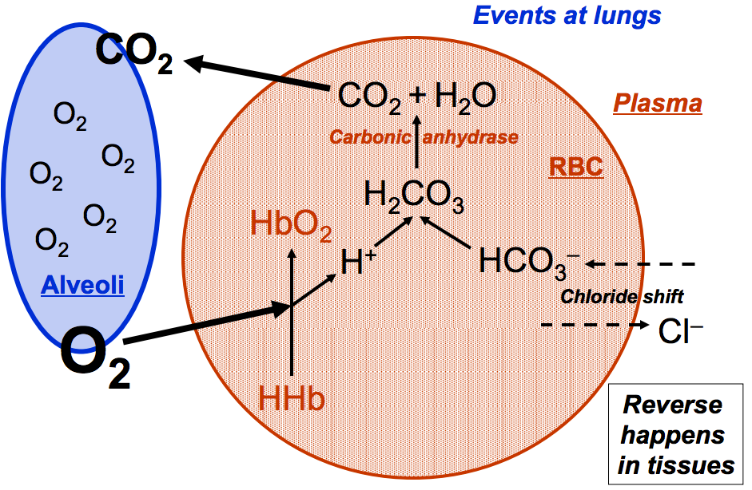
Lungs

Slide 29
Mechanism…
Respiratory mechanism is powerful and fast,but only works with volatile acids.
Doesn’t affect fixed acids like lactic acid.
Low H₂CO3 concentration in blood depresses respiratory centre,causes hypoventilation i.e slow and shallow respiration.
This retains H₂CO3 in blood
If Nervous centre or Respiratory system fails, the Acid Base Balance fails.

Slide 30
Renal Acid-Base Control Mechanisms
The kidneys are the third line of defence against wide changes in body fluid pH.
movement of bicarbonate
Retention/Excretion of acids
Generating additional buffers
Long term regulator of ACID – BASE balance
May take hours to days for correction
Notes:
S&P

Slide 31
Renal regulation of acid base balance
Role of kidneys is preservation of body’s bicarbonate stores.
Accomplished by:
Reabsorption of 99.9% of filtered bicarbonate
Regeneration of titrated bicarbonate by excretion of:
Titratable acidity (mainly phosphate)
Ammonium salts
The renal tubular cells and erythrocytes generate bicarbonate, the buffer base in the bicarbonate system from CO₂ under physiological conditions.
The kidneys play the major role in maintaining the circulating bicarbonate conc. and in the elimination H+ from the body.

Slide 32
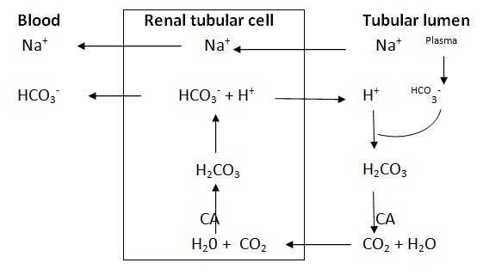
Reabsorption of bicarbonate

Slide 33
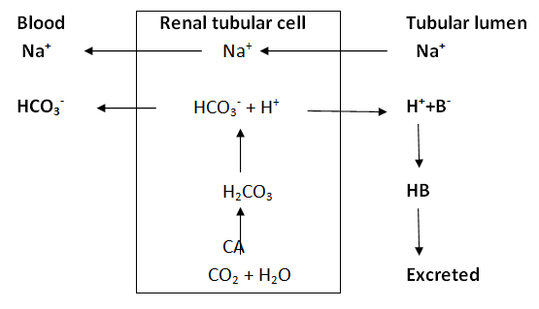
Excretion of H⁺ ions

Slide 34
Mechanism
HCO₃⁻ generation is accelerated if the conc.of
CO₂ rises
HCO₃⁻ falls.
H₊ falls because it is either buffered by erythrocytes or excreted from the body by renal tubular cells.
Therefore an increase of intracellular PCO₂ or decrease in intracellular [HCO₃⁻] in the erythrocytes and renal tubular cells maintain the extracellular bicarbonate conc. by accelerating the production of HCO₃⁻.
This minimizes changes in the ratio of [HCO₃⁻] to PCO₂ and therefore change in PH.
The kidney therefore utilizes two mechanism of bicarbonate reclamation and or generation to maintain its homeostasis.

Slide 35
Urinary buffers
Two important urinary buffers are
1. Phosphate buffer
2. Ammonia
The maximum limit of acidification of urine is 4.5.
Normally 70 meq acid is excreted daily. In metabolic acidosis, this can raise to 400 meq/day.

Slide 36
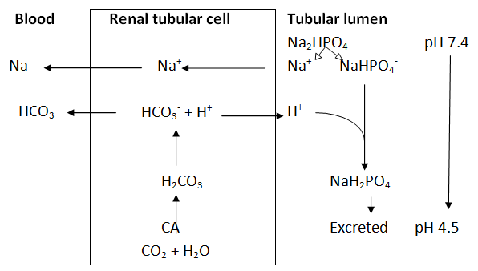
Phosphate buffer

Slide 37
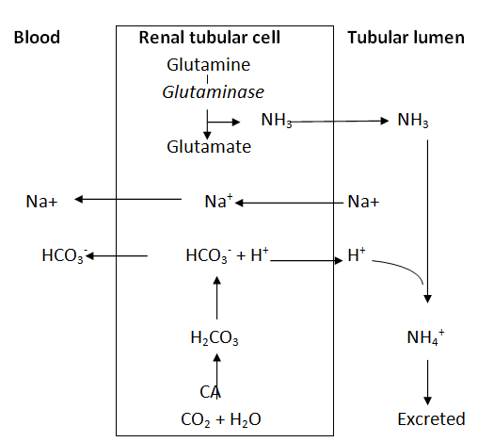
Ammonia buffer

Slide 38
NET ACID EXCRETION
Hydrogen Ions
Are secreted into tubular fluid along
Proximal convoluted tubule (PCT)
Distal convoluted tubule (DCT)
Collecting system

Slide 39
The Body and pH
Homeostasis of blood pH is tightly controlled by mechanisms of Acid Base Balance.
Extracellular fluid = 7.4
Blood pH regulated to = 7.35 – 7.45

Slide 40
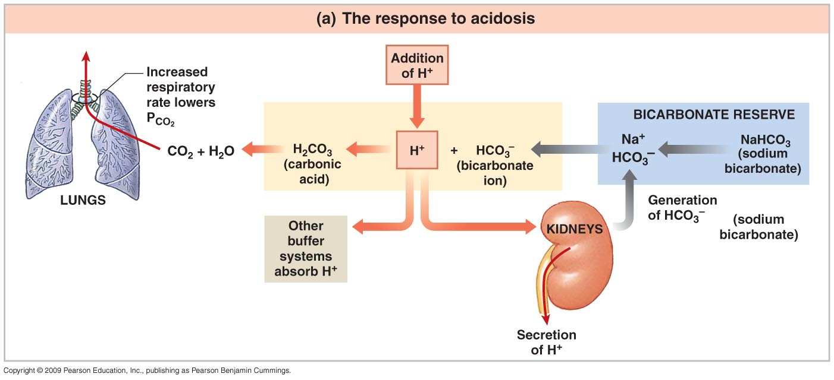
Acid–Base Balance Disturbances
Interactions among the Carbonic Acid–Bicarbonate Buffer System and Compensatory Mechanisms in the Regulation of Plasma pH.

Slide 41
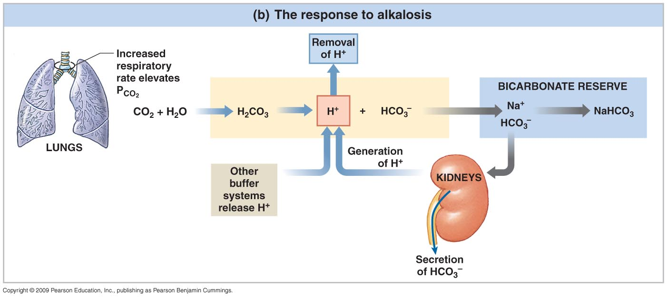
Acid–Base Balance Disturbances
Interactions among the Carbonic Acid–Bicarbonate Buffer System and Compensatory Mechanisms in the Regulation of Plasma pH.
decreased

Slide 42
Four Basic Types of Imbalance
Metabolic Acidosis
Metabolic Alkalosis
Respiratory Acidosis
Respiratory Alkalosis

Slide 43
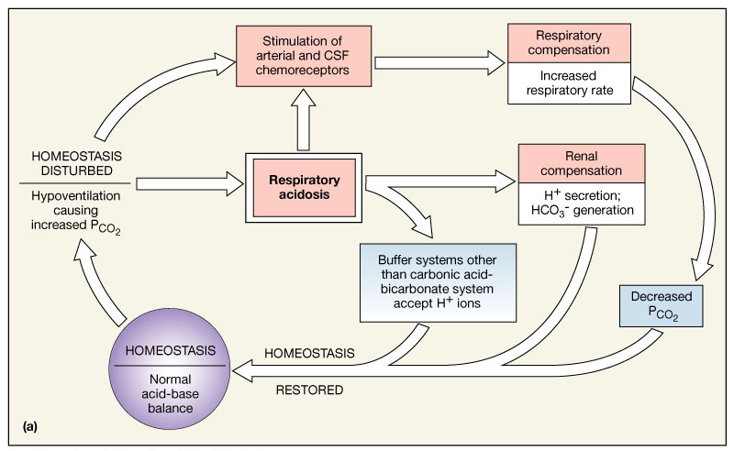
Respiratory acidosis
Figure 27.12a

Slide 44
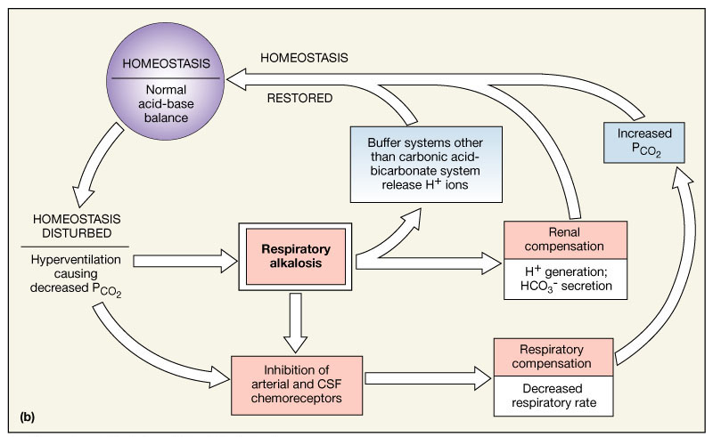
Respiratory alkalosis
Figure 27.12b

Slide 45
Acid Base Disorders
Disorder | pH | [H⁺] | Primary disturbance | Secondary response
Metabolic acidosis | ↓ | ↑ | ↓ [HCO₃⁻] | ↓ pCO₂
Metabolic alkalosis | ↑ | ↓ | ↑ [HCO₃⁻] | ↑ pCO₂
Respiratory acidosis | ↓ | ↑ | ↑ pCO₂ | ↑ [HCO₃⁻]
Respiratory alkalosis | ↑ | ↓ | ↓ pCO₂ | ↓ [HCO₃⁻]

Slide 46
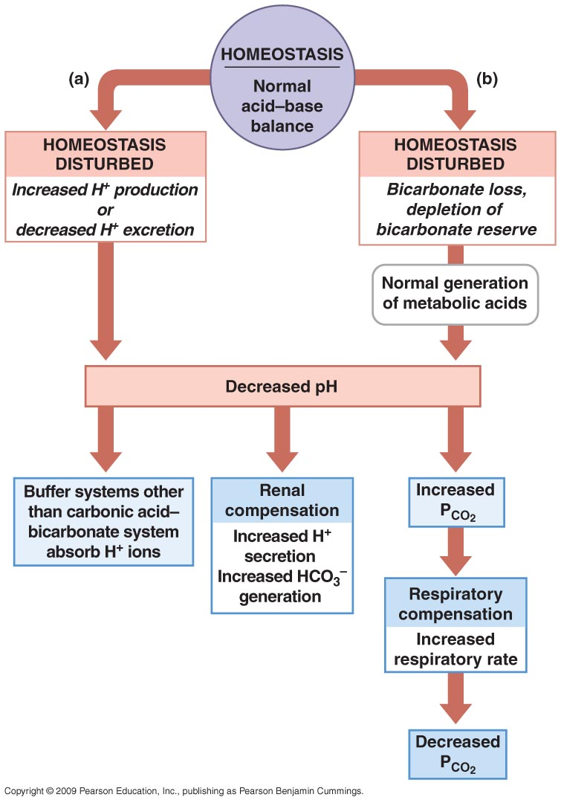
Acid–Base Balance Disturbances
.
Responses to Metabolic Acidosis

Slide 47
Metabolic acidosis
Symptoms are specific and a result of the underlying pathology
Respiratory effects:
Hyperventilation
CVS:
↓ myocardial contractility
Sympathetic over activity
Resistant to catecholamines
CNS:
Lethargy,disorientation,stupor,muscle twitching,COMA,
CN palsies
Others : hyperkalemia

Slide 48
Metabolic Alkalosis
↑ pH due to ↑HCO₃⁻ or ↓acid
Initiation process :
↑in serum HCO₃⁻
Excessive secretion of net daily production of fixed acids
Maintenance:
↓HCO₃⁻ excretion or ↑ HCO₃⁻ reclamation
Chloride depletion
Pottasium depletion
ECF volume depletion
Magnesium depletion

Slide 49
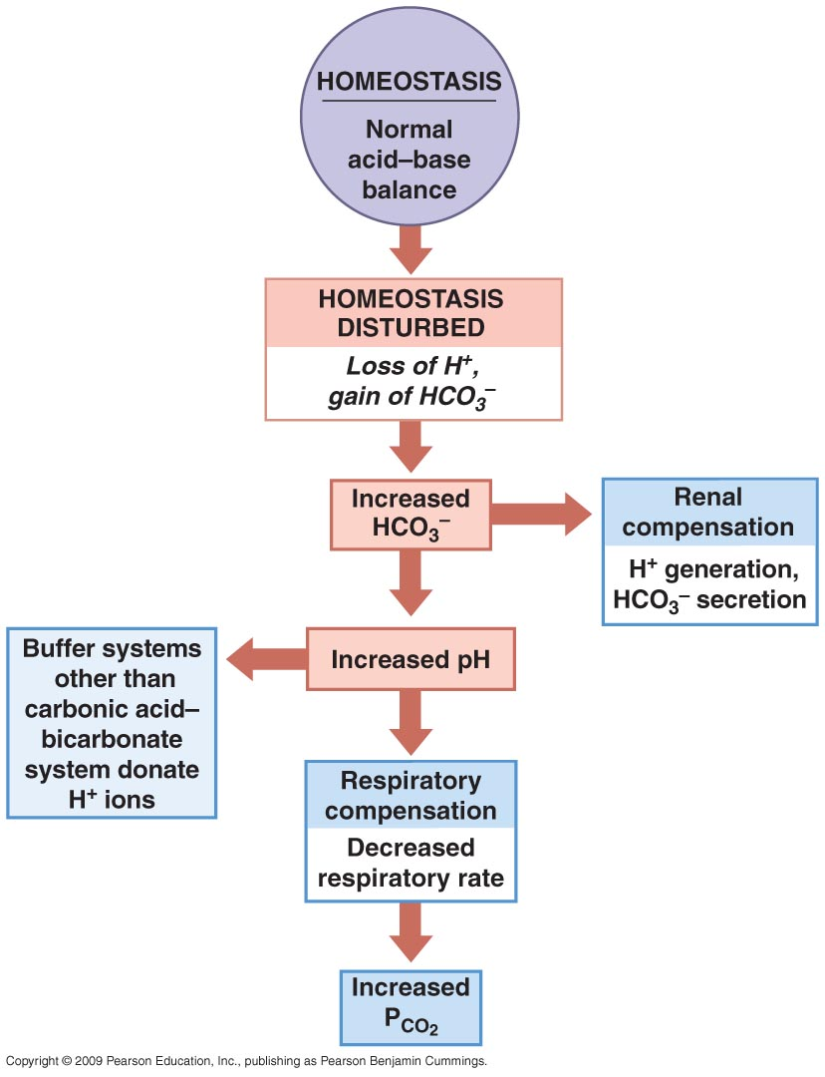
Acid–Base Balance Disturbances
.
Metabolic Alkalosis

Slide 50
Metabolic Alkalosis
Decreased myocardial contractility
Arrythmias
↓ cerebral blood flow
Confusion
Mental obtundation
Neuromuscular excitability
Hypoventilation
pulmonary micro atelectasis
V/Q mismatch(alkalosis inhibits HPV)

