Slide 1
ACID-BASE DISORDERS
DEO RUHANGAZA, MD, MMed/Path
Consultant/BCCOE/UGHE

Slide 2
Overview
Acid-base disorder: example of diabetic ketoacidosis
Brief reminder on acid-base homeostasis
Laboratory tests (pH, PaCO_{2,} HCO⁻₃) interpretation for acid-base disorders, role of anion gap calculation
Metabolic acidosis/alkalosis common causes
Respiratory acidosis/alkalosis common causes

Slide 3
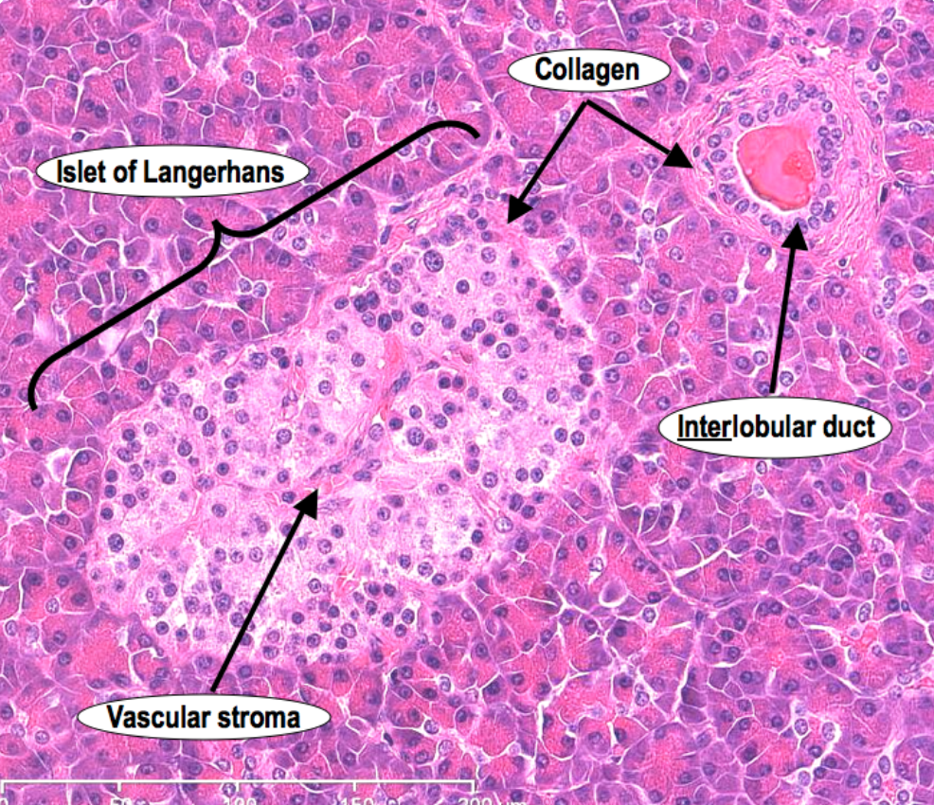
Endocrine pancreas
β cells: Produce insulin
-Lowers serum glucose
-Storage of glucose in liver, skeletal muscle & adipose tissue
α cells: Produce glucagon
-Increases blood glucose levels by stimulation of glycogenolysis
-Stimulate gluconeogenesis in the liver
δ cells: Produce somatostatin
-Inhibits secretion of insulin and glucagon
-Producing cells are also found in duodenum, stomach antrum (suppression of GI hormones production) and hypothalamus (inhibition of GH, TSH)
PP cells (pancreatic polypeptide cells):
-Stimulate production of GI enzymes, inhibit intestinal motility
D1 cells: produce VIP (glycogenolysis, hyperglycemia, ↑GI fluid secretion)
Enterochromaffin cells: produce serotonin (regulation of intestinal movements, etc…)

Slide 4
Diabetes mellitus
Hyperglycemia related to:
Defects in insulin secretion
Defects insulin action
Combination of both
-Normal range of glucose: 70-120 mg/dl
Acute complications
Chronic complications
Diagnosis (Rwanda NCDs guidelines-RBC/MoH)
Fasting blood glucose: > 126mg/dL on two different visits
Random blood glucose: > 200mg/dL on a single visit
HbA1c > 6.5% on two different visits
NB: Transient hyperglycemia (infections, burn, trauma)

Slide 5
Glucose regulation
Liver production
Uptake and utilization by peripheral tissue
Effects of insulin and glucagon on glucose uptake & metabolism
Insulin action: ↑glucose transport to the cells like skeletal muscle (↑glucose uptake, ↑protein synthesis, ↑glycogen synthesis), hepatocytes (↑glycogen synthesis, ↑lipogenesis, ↓gluconeogenesis), adipose tissue (↑glucose uptake, ↑lipogenesis, ↓lipolysis)

Slide 6
Type 1 diabetes mellitus
Pathogenesis
Our T-cells lose their self-tolerance for pancreatic islet antigens:
T_{H}1 cells produce IFN-γ and TNF→ injury to β cells
CD8+ CTLs →direct injury to β cells
Antigens targeted on β cells: insulin, β cell enzyme glutamic acid decarboxylase (GAD), islet cell autoantigen 512
The autoimmune damage progress slowly until more than 90% of the β cells have been destroyed→ appearance of clinical signs

Slide 7
Diabetes mellitus-Clinical presentation
Primarily in < 18 years old (type1), often > 40 years & obese (type2)
May be asymptomatic (especially type 2)
Excess glucose cannot be reabsorbed in kidneys →glycosuria → osmotic diuresis → polyuria →loss of water & electrolytes
Hyperosmolarity→ depletion of intracellular water → stimulation of osmoreceptors in hypothalamus → feeling thirsty → polydypsia
Catabolism of proteins & fats →low energy →↑appetite →polyphagia
Predominace of protein & fat catabolism despite intense appetite →loss of waight.

Slide 8
Diabetes mellitus-Acute complications
Diabetic ketoacidosis
Common with type 1 diabetes
Precipitating factors: Lack of insulin medication, infections, trauma→ release of stress-induced hormones (adrenaline, cortisol) → blockage & worsening of insulin action + stimulation of production of glucagon → worsening of hyperglycemia → worsening of osmotic diuresis with severe dehydration
Insulin deficiency → stimulation of hormone sensitive lipase activity → breakdown of fat stores into free fatty acids → esterification in liver into fatty acyl-CoA →oxydation into acetoacetic acid, β-hydroxybutyric acid (ketone bodies)→ketonemia/ketonuria → low pH, ketoacidosis
Effects of ketoacidosis: nausea, vomiting, abdominal pain, fruity odor, fatigue, deeper & faster breathing (Kussmaul breathing), progressive alteration of consciousness, coma
Loss of electrolytes: Na⁺ (with hypotension, tachycardia), K⁺ (irregular heart contraction, cardiac arrest)

Slide 9
Overview
Acid-base disorder: example of diabetic ketoacidosis
Brief reminder on acid-base homeostasis
Laboratory tests (pH, PaCO_{2,} HCO⁻₃) interpretation for acid-base disorders, role of anion gap calculation
Metabolic acidosis/alkalosis common causes
Respiratory acidosis/alkalosis common causes

Slide 10
Acid-base homeostasis
Acidemia/acidosis
Alkalemia/alkalosis
Effects of changes in PaCO₂ and HCO₃-
Role of the kidney and lungs in maintaining a normal acid-base balance
Remember: acid-base disorders are a result of underlying disease, not a diagnosis on their own. The initial cause should be identified and treated.

Slide 11
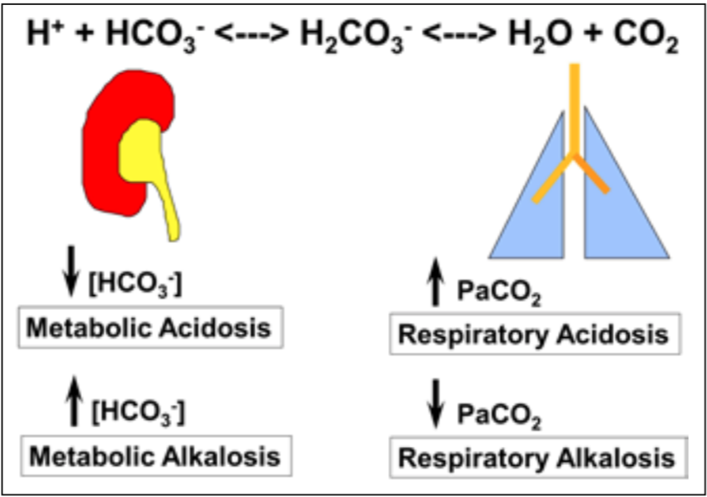
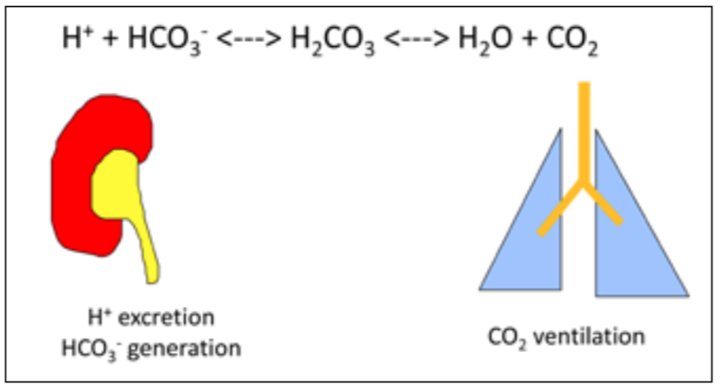
Paul K. Hamilton, Neal A. Morgan, Grainne M. Connolly, Alexander P. Maxwell. Understanding Acid-Base disorders. Ulster Med J 2017;86(3):161-166

Slide 12
Overview
Acid-base disorder: example of diabetic ketoacidosis
Brief reminder on acid-base homeostasis
Laboratory tests (pH, PaCO_{2,} HCO⁻₃) interpretation for acid-base disorders, role of anion gap calculation
Metabolic acidosis/alkalosis common causes
Respiratory acidosis/alkalosis common causes

Slide 13
Labs interpretation-acid/base disorders
pH: acidosis vs alkalosis→ (7.37-7.42)
HCO⁻₃: →normal: 22-29mmol/L
-↓HCO⁻₃: indicates metabolic origin of acidosis: excessively being used to neutralize H⁺ during buffering process (e.g: ketoacidosis), GI loss (severe diarrhea), kidneys failing to synthesize it or to reabsorb it from kidney tubules
-↑ HCO⁻₃: indicates metabolic origin of alkalosis: excessive loss of acidic fluid (↓stomach acidic content through vomiting, nasogastric aspiration of stomach content, kidneys producing and reabsorbing more HCO⁻₃ in response to a chronic ↑PaCO₂

Slide 14
Labs interpretation-acid/base disorders
PaCO₂:
-↓PaCO₂: loss through hyperventilation as a response to an initial metabolic acidosis state (= secondary respiratory alkalosis)
-↑PaCO₂: low ventilation rate (retension of CO₂ in lungs due to COPD, diaphragm or intercostal muscle paralysis) = respiratory acidosis
Anion gap : determine the gap btn cations (Na⁺, K⁺) and anions (Cl⁻, HCO⁻₃)
Anion gap = Na⁺- (Cl⁻+ HCO⁻₃): Normal range: 3-11 mEq/L

Slide 15
Short clinical examples
67 years old male patient admited with 39.8⁰C, HR: 129 b/min, RR: 24/min and PB: 82/54mmHg, suspected with a Dx of septic shock.
-ABGs: pH: 7.15 (7.37-7.42), PaCO₂: 2.7kPa (4.5-6); HCO⁻₃ :7 mmol/L (22-29)
-Electrolytes: Na⁺: 138 mEq/L (136-145); K⁺: 3.9 mEq/L (3.5-5.3); Cl⁻: 95 mEq/L (95-108)
What is going on?

Slide 16
Short clinical examples…
62 years old male patient, known smoker since the age of 20 years, with clinical signs of COPD, chronic cough and recently exacerbation with difficult in breathing.
-ABGs: pH: 7.12 (7.37-7.42), PaCO₂: 11.2 kPa (4.5-6); HCO⁻₃ :35 mmol/L (22-29)
Electrolytes: Na⁺: 140 mmol/L (136-145); K⁺: 4.7 mmol/L (3.5-5.3); Cl⁻: 94 mmol/L (95-108)
What is going on?

Slide 17
Overview
Acid-base disorder: example of diabetic ketoacidosis
Brief reminder on acid-base homeostasis
Laboratory tests (pH, PaCO_{2,} HCO⁻₃) interpretation for acid-base disorders, role of anion gap calculation
Metabolic acidosis/alkalosis common causes
Respiratory acidosis/alkalosis common causes

Slide 18
Metabolic acidosis
-High anion gap metabolic acidosis (>12): lactic acidosis, ketoacidosis, kidney failure, intoxication with methanol (⇒formic acid metabolite), ethylene glycol (⇒oxalic acid metabolite), 5-oxoproline, salicylates (aspirin)
-Normal anion gap metabolic acidosis (8-12) : ↑Cl⁻ compensates for the loss of bicarbonate in the equation: persisting diarrhea, impaired renal excretion of H⁺ or impaired reabsorption of HCO⁻₃ in renal tubule), carbonic anhydrase inhibitors (lowers HCO⁻₃ ), low production of aldosterone by adrenal glands (key role in elinimation of H⁺)
Causes that are related to increased anaerobic metabolism(↑Lactic acidosis): isoniazid (anti-TB drug) intoxication, iron overdose, propylene glycol intoxication

Slide 19
Respiratory acidosis
All causes of hypoventilation of the lungs
-↑PaCO₂⇒ more production of H⁺, compensatory reabsorption of HCO⁻₃ by the kidney
Airways obstruction, foreign body, chest wall muscles or diaphragm muscle paralysis, diffuse alveolar damage, pulmonary edema, COPD, depressed respiratory centers in brainstem (stroke, intoxication with opioids and sedatives)

Slide 20
Metabolic alkalosis
Excessive loss of H⁺: vomiting of gastric content (low excretion of HCO⁻₃ from pancreas to intestines ⇒its accumulation in blood), high levels of aldosterone (excessive H⁺ excreted in urine)
Increased HCO⁻₃: excessive reabsorption by the kidneys, use of loop diuretics (favoring more reabsorption of HCO⁻₃), intoxication with antiacids (NaHCO⁻₃)

Slide 21
Respiratory alkalosis
Excessive loss of CO₂ by hyperventilation process in the lungs⇒ low PaCO₂, ⇒ high pH
Compensatory mechanism: the kidneys dicrease their absorption and synthesis of HCO⁻₃
Response to hypoxia (low O₂ levels in tissues like in PE), hypoxemia (low O₂ levels in blood) of high altitudes, situations of anxiety and panick attacks

Slide 22
THANK YOU! QUESTIONS/COMMENTS

