Slide 1
Cell Communication
Jaineel Dharod,
Dept. of Pharmacology

Slide 2
Do cells communicate?

Slide 3
Cells can also communicate directly with one another — and change their own internal workings in response — by way of a variety of chemical and mechanical signals.
In multicellular organisms, cell signaling allows for specialization of groups of cells.

Slide 4
Why…?
In multicellular organisms, cells send and receive chemical messages constantly to coordinate the actions of distant organs, tissues, and cells.
The ability to send messages quickly and efficiently enables cells to coordinate and fine-tune their functions.

Slide 5
How…?
Cells communicate through their own language of chemical signals.
Different compounds, such as hormones and neurotransmitters, act like words and phrases, telling a cell about the environment around it or communicating messages.

Slide 6
Cell communication is the ability of cells to communicate with adjacent cells within an organism.
The term is mostly applicable for multicellular organisms.
The phenomenon belongs to the scope of cell signaling.
Cell communication is important for metabolic homeostasis as well as development.
One important function of cell communication is to guide the path for cell migration.

Slide 7
Cell Signalling or Bio signalling

Slide 8
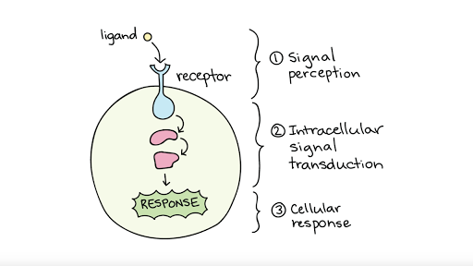

Slide 9
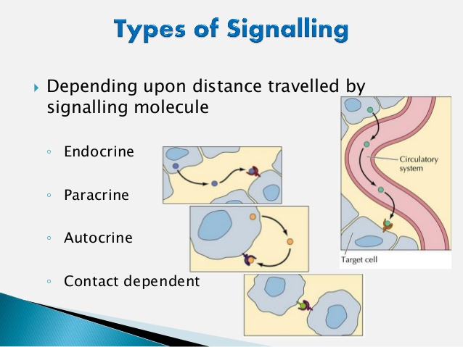

Slide 10
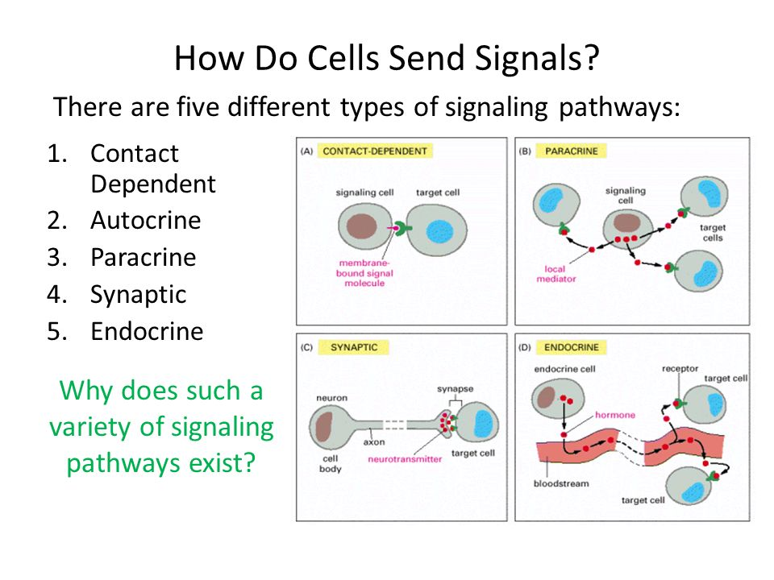

Slide 11
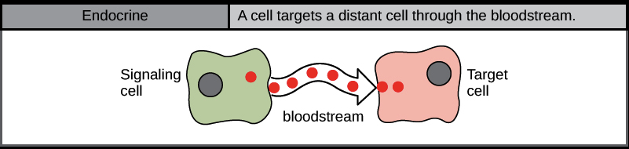
Endocrine signaling occurs between distant cells and is mediated by hormones released from specific endocrine cells that travel to target cells, producing a slower, long-lasting response.
An example of endocrine signaling includes the hypothalamic-pituitary-adrenal (HPA) axis

Slide 12
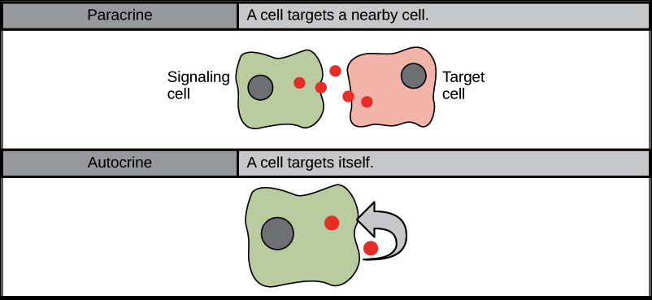
Paracrine signaling is a form of cell signaling or cell-to-cell communication in which a cell produces a signal to induce changes in nearby cells, altering the behaviour of those cells.
An example of paracrine signals is the chemical transmitted from nerve to muscle that causes the muscle to contract. In this instance, the muscle cells…

Slide 13
Autocrine signaling is a form of cell signaling in which a cell secretes a hormone or chemical messenger (called the autocrine agent) that binds to autocrine receptors on that same cell, leading to changes in the cell.
An example of an autocrine agent is the cytokine interleukin-1 in monocytes. When interleukin-1 is produced in response to external stimuli, it can bind to cell-surface receptors on the same cell that produced it.

Slide 14
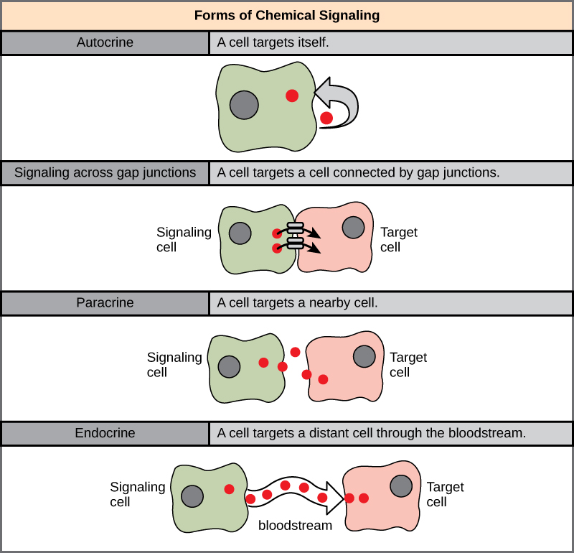
Gap junctions in animals and plasmodesmata in plants are connections between the plasma membranes of neighbouring cells. These water-filled channels allow small signaling molecules, called intracellular mediators, to diffuse between the two cells.

Slide 16
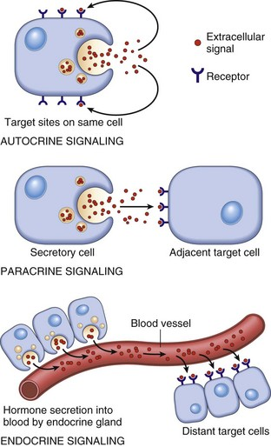

Slide 17
Desmosome cell junctions physically hold the cells together, but do not allow the cells to pass materials between each other like in gap junction.
Desmosome junctions connect the cell with a thread like substance that also connect to the cytoskeleton aiding in the structural support of the cell.
These types of junctions are found in areas of the body that undergo a lot of stress, require a lot of flexibility, and movement such as the epidermis and intestines.
Desmosomes contain the molecule Cadherin which are also signal receptors.
Cadherin of one cell works as the receptor for cadherin in neighbouring cell.
Cadherin plays role in contact inhibition

Slide 18
Contact Inhibition
Contact inhibition is a process of arresting cell growth when cells come in contact with each other.
As a result, normal cells stop proliferating.
Contact inhibition is a powerful anticancer mechanism that is lost in cancer cells
In cell biology, contact inhibition refers to two different but closely related phenomena: Contact inhibition of locomotion and contact inhibition of proliferation.

