Slide 1
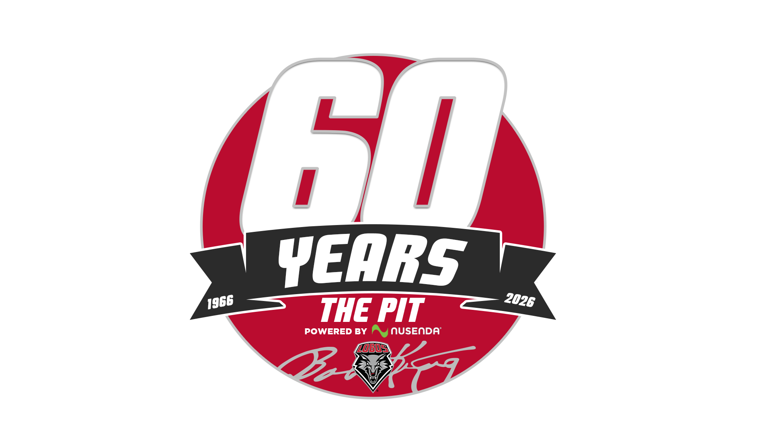
UNM ATHLETICS · THE PIT · POWERED BY NUSENDA
32 OZ SOUVENIR CUP
60th Anniversary · Concept Review
Vertical print handout for executive review.
Seven prototype faces. One required lockup. Not a production file.
SEPTEMBER 2026
PACKAGING STUDY · INTERNAL USE ONLY
CONFIDENTIAL · PROTOTYPE — NOT LICENSED FOR PRODUCTION · UNM ATHLETICS
1 / 13

Slide 2
01 — THE ASSIGNMENT
What leadership is being asked to review
Design a 32 oz arena souvenir cup for the 60th anniversary season of University Arena — The Pit (1966–2026). Administration supplied one required mark and no other art direction. This packet translates the live prototype into a printed review.
VESSEL
REQUIRED MARK
THIS PACKET
32 fl oz plastic stadium cup
~7 in. tall, tapered
Full-wrap print, 10.5 × 5.75 in.
0.25 in. bleed · 0.4 in. safe zone
Official 60 Years lockup, unaltered.
1966 / 2026 · The Pit
Powered by Nusenda
Lobo shield · Bob King signature
One page per concept: cup, wrap,
lockup placement, rights, and a
studio recommendation.
Prototypes. Not licensed for production.
HOW TO READ THE SET
Cherry Voltage is the studio’s modern recommendation.
Remember the Feeling and The Opening are the history pair. Both need photo rights.
The Ramp is the architecture story — unique to this building.
Subterranean Red is the operational fallback: lockup on cherry.
Four Eras and 60 Howls keep their briefs. Their current faces are not ready to approve.
Interactive source of these faces:
https://stand-revel-66898789.figma.site
CONFIDENTIAL · PROTOTYPE — NOT LICENSED FOR PRODUCTION · UNM ATHLETICS
2 / 13

Slide 3
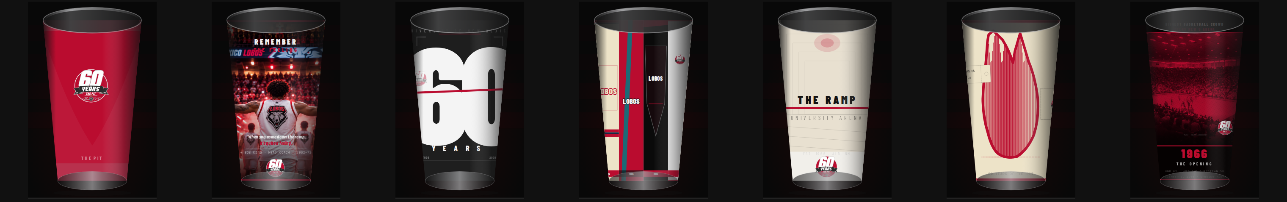
02 — THE LINEUP
Seven faces. One cup.
Printed from the live prototype. Hold Four Eras and 60 Howls at concept — do not treat those two drawings as finished art.
#
CONCEPT
JOB
STATUS
01
Subterranean Red
Simple SKU
READY
02
Remember the Feeling
Legacy
READY
03
Cherry Voltage
Modern
RECOMMEND
04
Four Eras
Years in review
HOLD
05
The Ramp
Architecture
READY
06
60 Howls
Collectible
HOLD
07
The Opening
Opening night
READY
Ask in the room: which one face should carry the season, and whether a second history SKU is worth the photo-rights work.
CONFIDENTIAL · PROTOTYPE — NOT LICENSED FOR PRODUCTION · UNM ATHLETICS
3 / 13

Slide 4
03 — THE REQUIRED MARK
This lockup does not get redesigned.
Cherry circle. Giant 60. YEARS ribbon. 1966 / 2026. THE PIT. POWERED BY NUSENDA. Lobo shield. Bob King signature. Place the official PNG. Never redraw, recolor, stretch, or drop a line.
Minimum width on cup: 1.75 in. · Keep 0.4 in. off seam, rim, and base.
Nusenda lives inside the mark. Do not add a second sponsor lockup.
If a decorative line (the Cherry Voltage strike) approaches the badge, stop the line.
Any generated version of this mark is a reject. Swap in the official file.
CONFIDENTIAL · PROTOTYPE — NOT LICENSED FOR PRODUCTION · UNM ATHLETICS
4 / 13

Slide 5
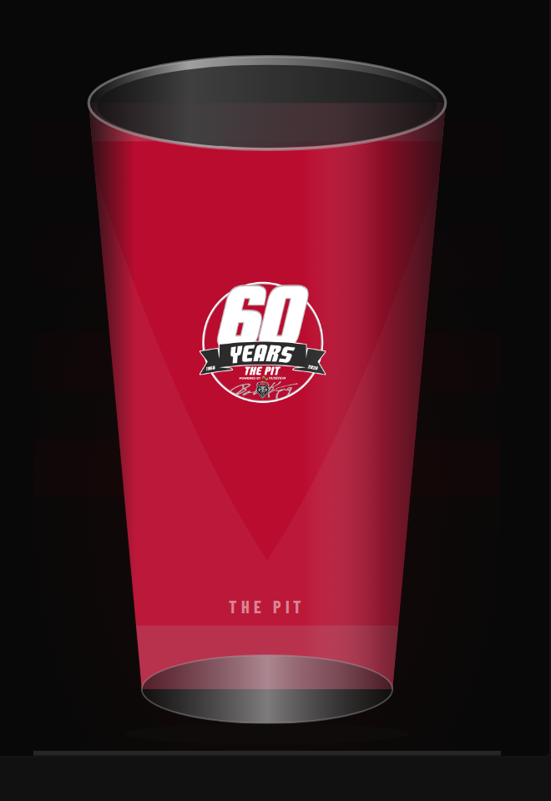
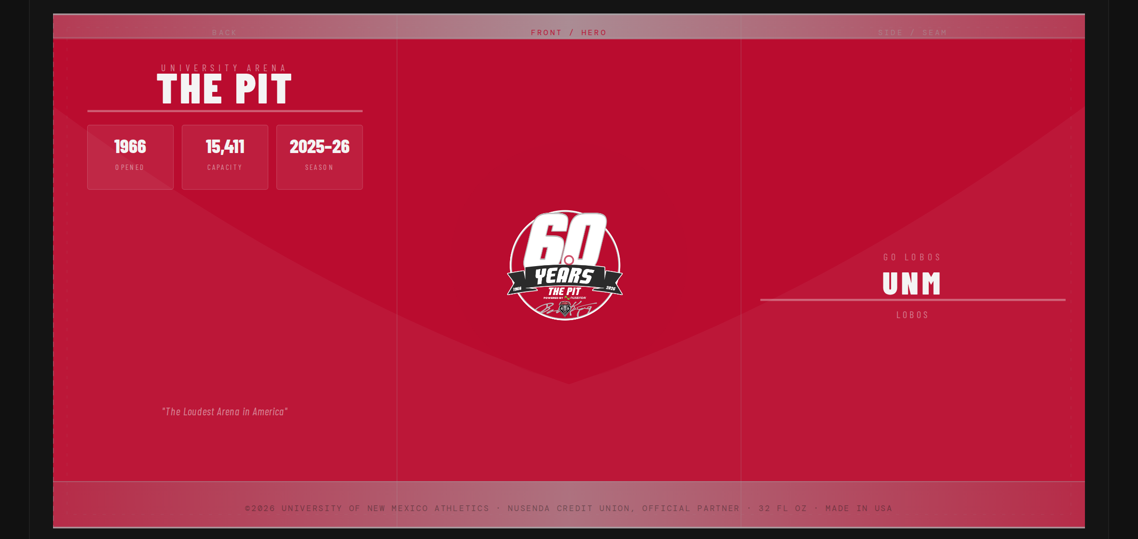
CONCEPT 01 / 07 · SIMPLE SKU
READY FOR REVIEW
SUBTERRANEAN RED
A full cherry field with the required 60 Years lockup front and center. The safest, most operational option — it reads on a concourse in one second.
REQUIRED MARK
Front panel, centered
PRINT / COLOR
Cherry PMS 186 · White · Silver 877
PHOTO RIGHTS
None. Graphic only.
STUDIO NOTES
· Best as the default concession cup if only one SKU is produced.
· Correct the season line to 2026–27 before any print proof.
· Does not tell a unique Pit story beyond the required mark.
FULL WRAP · 10.5 × 5.75 IN. · BACK / FRONT / SIDE
CONFIDENTIAL · PROTOTYPE — NOT LICENSED FOR PRODUCTION · UNM ATHLETICS
5 / 13

Slide 6
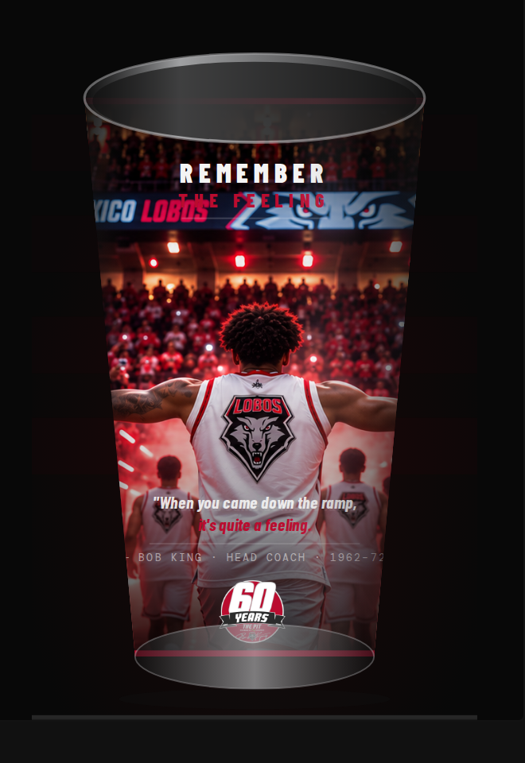
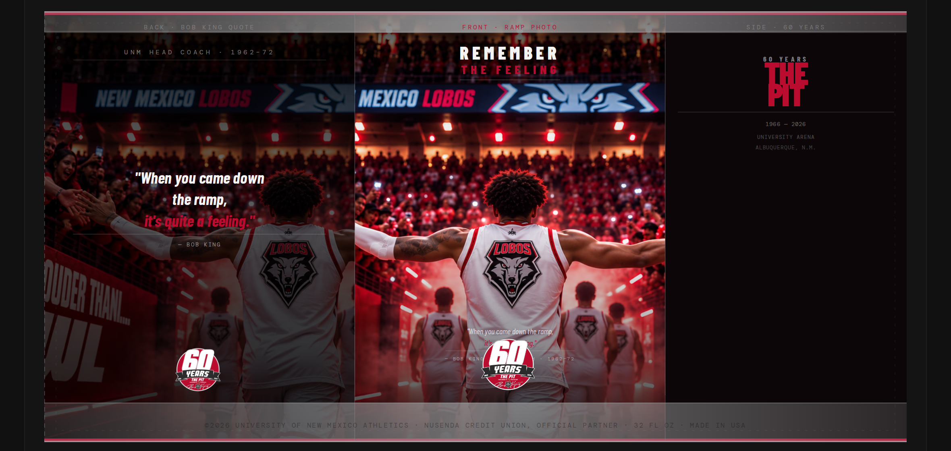
CONCEPT 02 / 07 · LEGACY / HISTORY
READY FOR REVIEW
REMEMBER THE FEELING
Bob King’s line — “When you came down the ramp, it’s quite a feeling” — set as a commemorative coin on a cherry-duotone ramp / newsprint wrap.
REQUIRED MARK
Front coin, ~2 in. diameter
PRINT / COLOR
Newsprint cream · Cherry · Black · Silver
PHOTO RIGHTS
Yes. Historic photos must come from UNM Athletics archives.
STUDIO NOTES
· Strongest emotional board for alumni and season-ticket holders.
· Current photography is labeled placeholder until rights are cleared.
· Pairs well with The Opening as a two-SKU legacy set.
FULL WRAP · 10.5 × 5.75 IN. · BACK / FRONT / SIDE
CONFIDENTIAL · PROTOTYPE — NOT LICENSED FOR PRODUCTION · UNM ATHLETICS
6 / 13

Slide 7
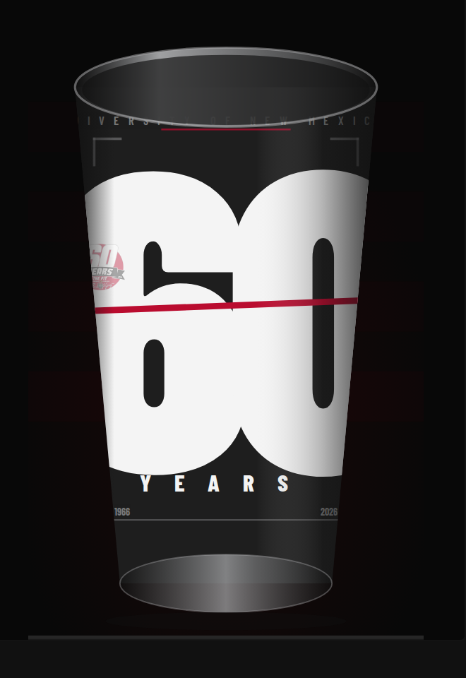
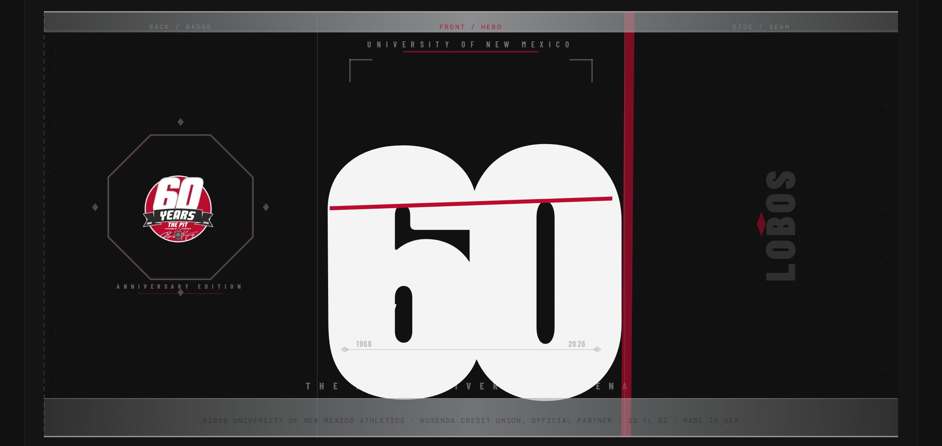
CONCEPT 03 / 07 · MODERN MERCH
STUDIO RECOMMENDATION
CHERRY VOLTAGE
Matte black. One oversized 60. A single cherry strike. The required lockup sits on the back as an untouched badge so the front can stay loud.
REQUIRED MARK
Back badge, 2 in., PNG as-is
PRINT / COLOR
Matte black · White · Cherry strike only · Silver rules
PHOTO RIGHTS
None. Graphic only.
STUDIO NOTES
· Highest shelf impact of the set. Reads at 20 feet.
· Four-color / spot-friendly. No photography to clear.
· Do not let the cherry strike cut the official lockup.
FULL WRAP · 10.5 × 5.75 IN. · BACK / FRONT / SIDE
CONFIDENTIAL · PROTOTYPE — NOT LICENSED FOR PRODUCTION · UNM ATHLETICS
7 / 13

Slide 8
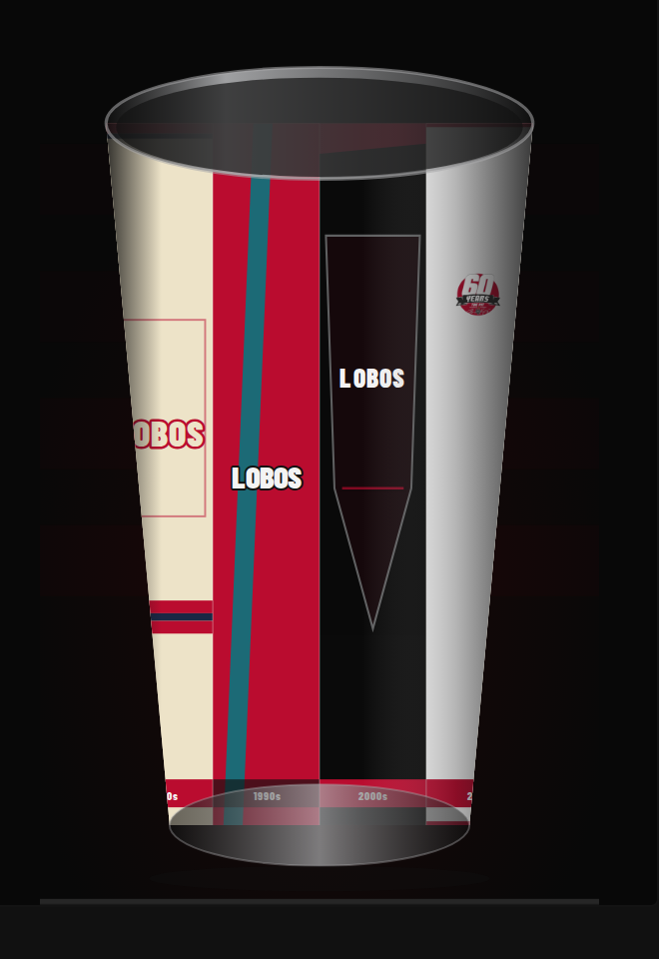
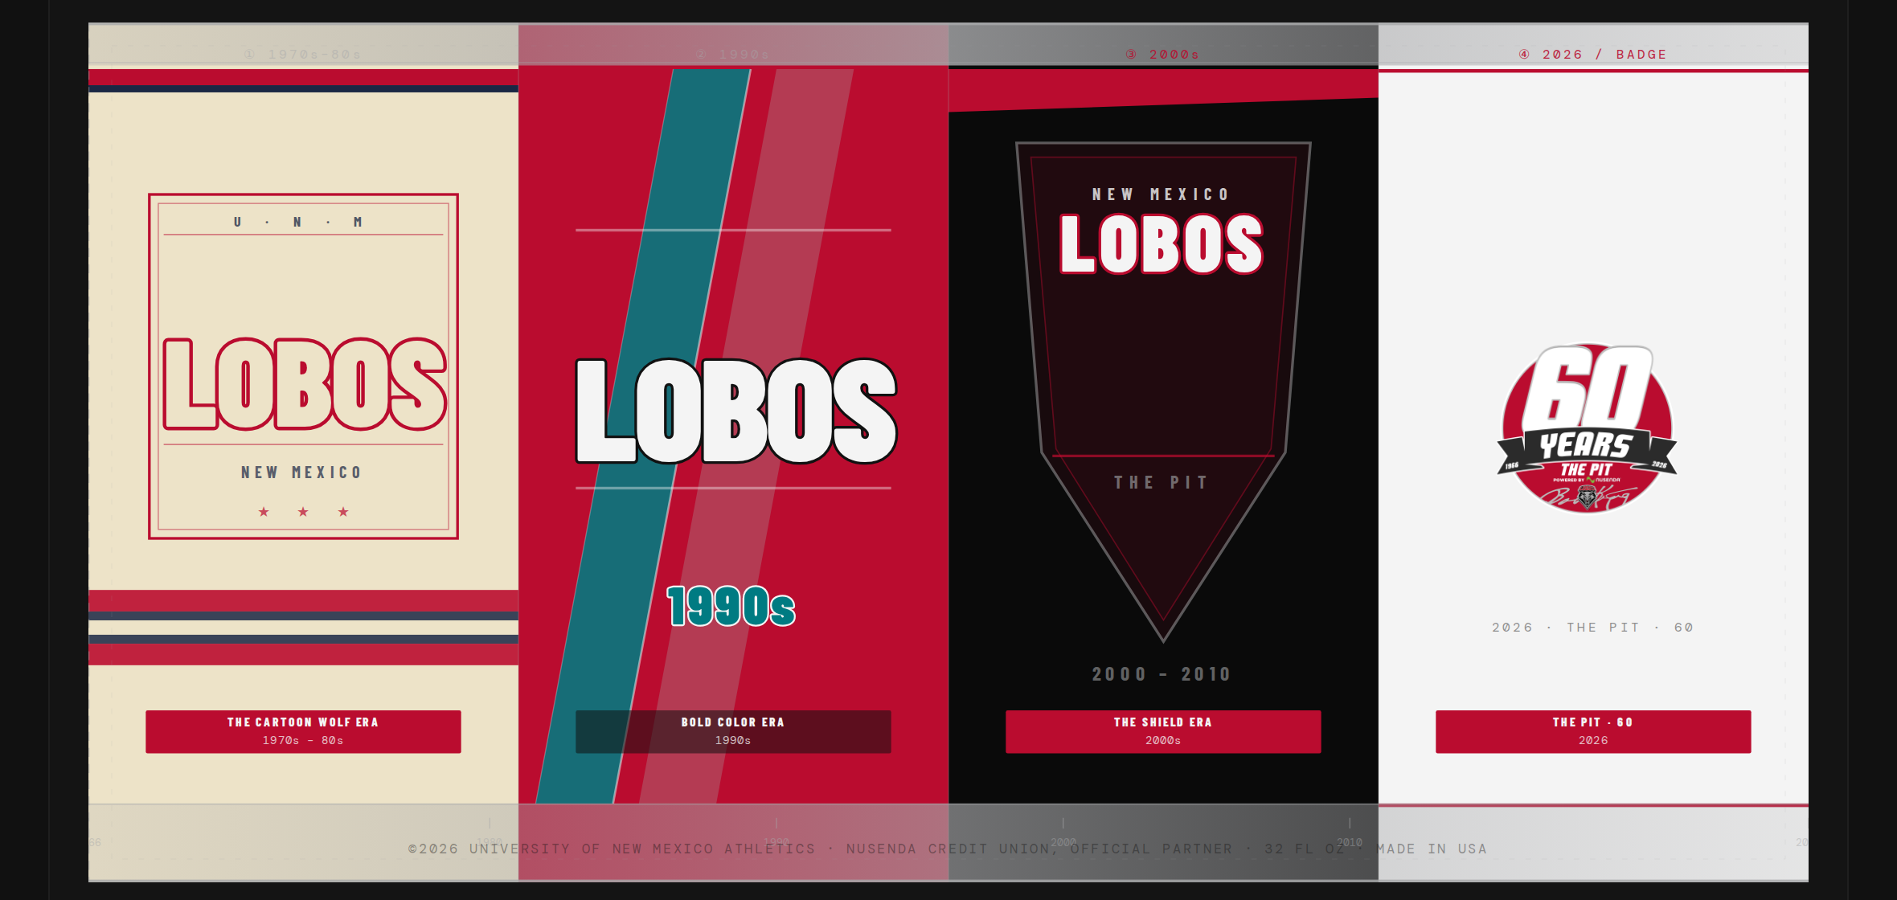
CONCEPT 04 / 07 · YEARS IN REVIEW
CONCEPT HOLD — ART IN REVISION
FOUR ERAS
Turn the cup, move through 60 years: 1970s–80s cartoon wolf, 1990s bold color, early-2000s shield, 2026 lockup. The idea is sound. The drawings are not finished.
REQUIRED MARK
Panel 4 of 4 only (2026)
PRINT / COLOR
Cream · Navy · Cherry · Teal (1990s only) · Black · White
PHOTO RIGHTS
Mascot art needs UNM Athletics approval. No licensed cartoon characters.
STUDIO NOTES
· Keep the four-panel structure. Do not approve current mascot drawings.
· 1990s teal / LOBOS panel is the strongest piece of the wrap today.
· Present as a direction, not a print-ready face.
FULL WRAP · 10.5 × 5.75 IN. · BACK / FRONT / SIDE
CONFIDENTIAL · PROTOTYPE — NOT LICENSED FOR PRODUCTION · UNM ATHLETICS
8 / 13

Slide 9
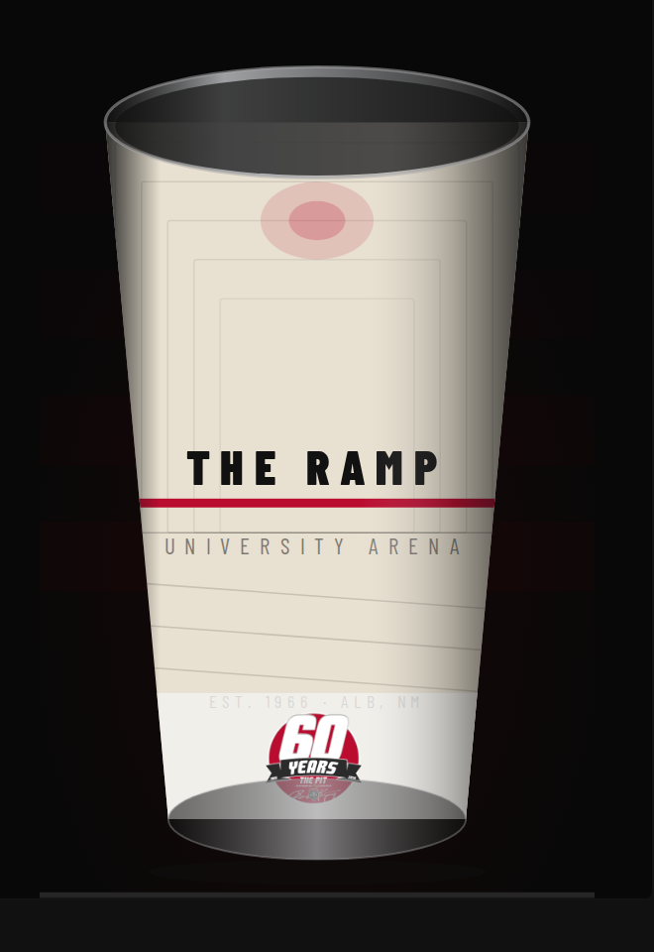
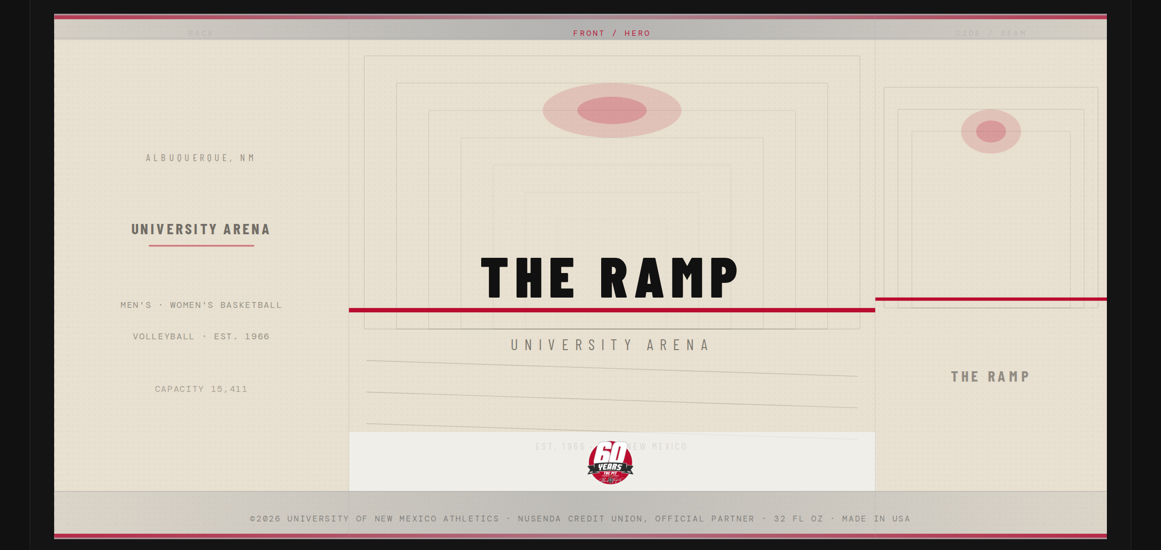
CONCEPT 05 / 07 · ARCHITECTURE
READY FOR REVIEW
THE RAMP
Type-led cream cup about the walk into the building. The Pit is underground. No other arena souvenir can own that sentence.
REQUIRED MARK
Base zone, below the type band
PRINT / COLOR
Cream stock · Black type · Cherry rule · Official lockup
PHOTO RIGHTS
None. Graphic only.
STUDIO NOTES
· Quiet on purpose. Works as the “collector” or hospitality cup.
· Best story line for a buyer presentation: only we have the ramp.
· Keep it type-only. Do not add a photo dump later.
FULL WRAP · 10.5 × 5.75 IN. · BACK / FRONT / SIDE
CONFIDENTIAL · PROTOTYPE — NOT LICENSED FOR PRODUCTION · UNM ATHLETICS
9 / 13

Slide 10
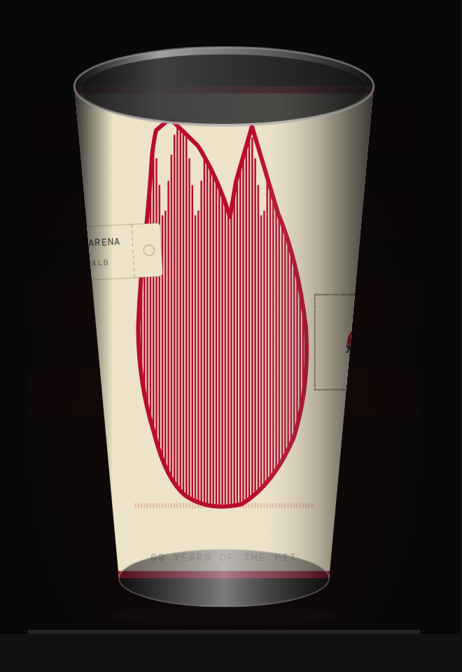
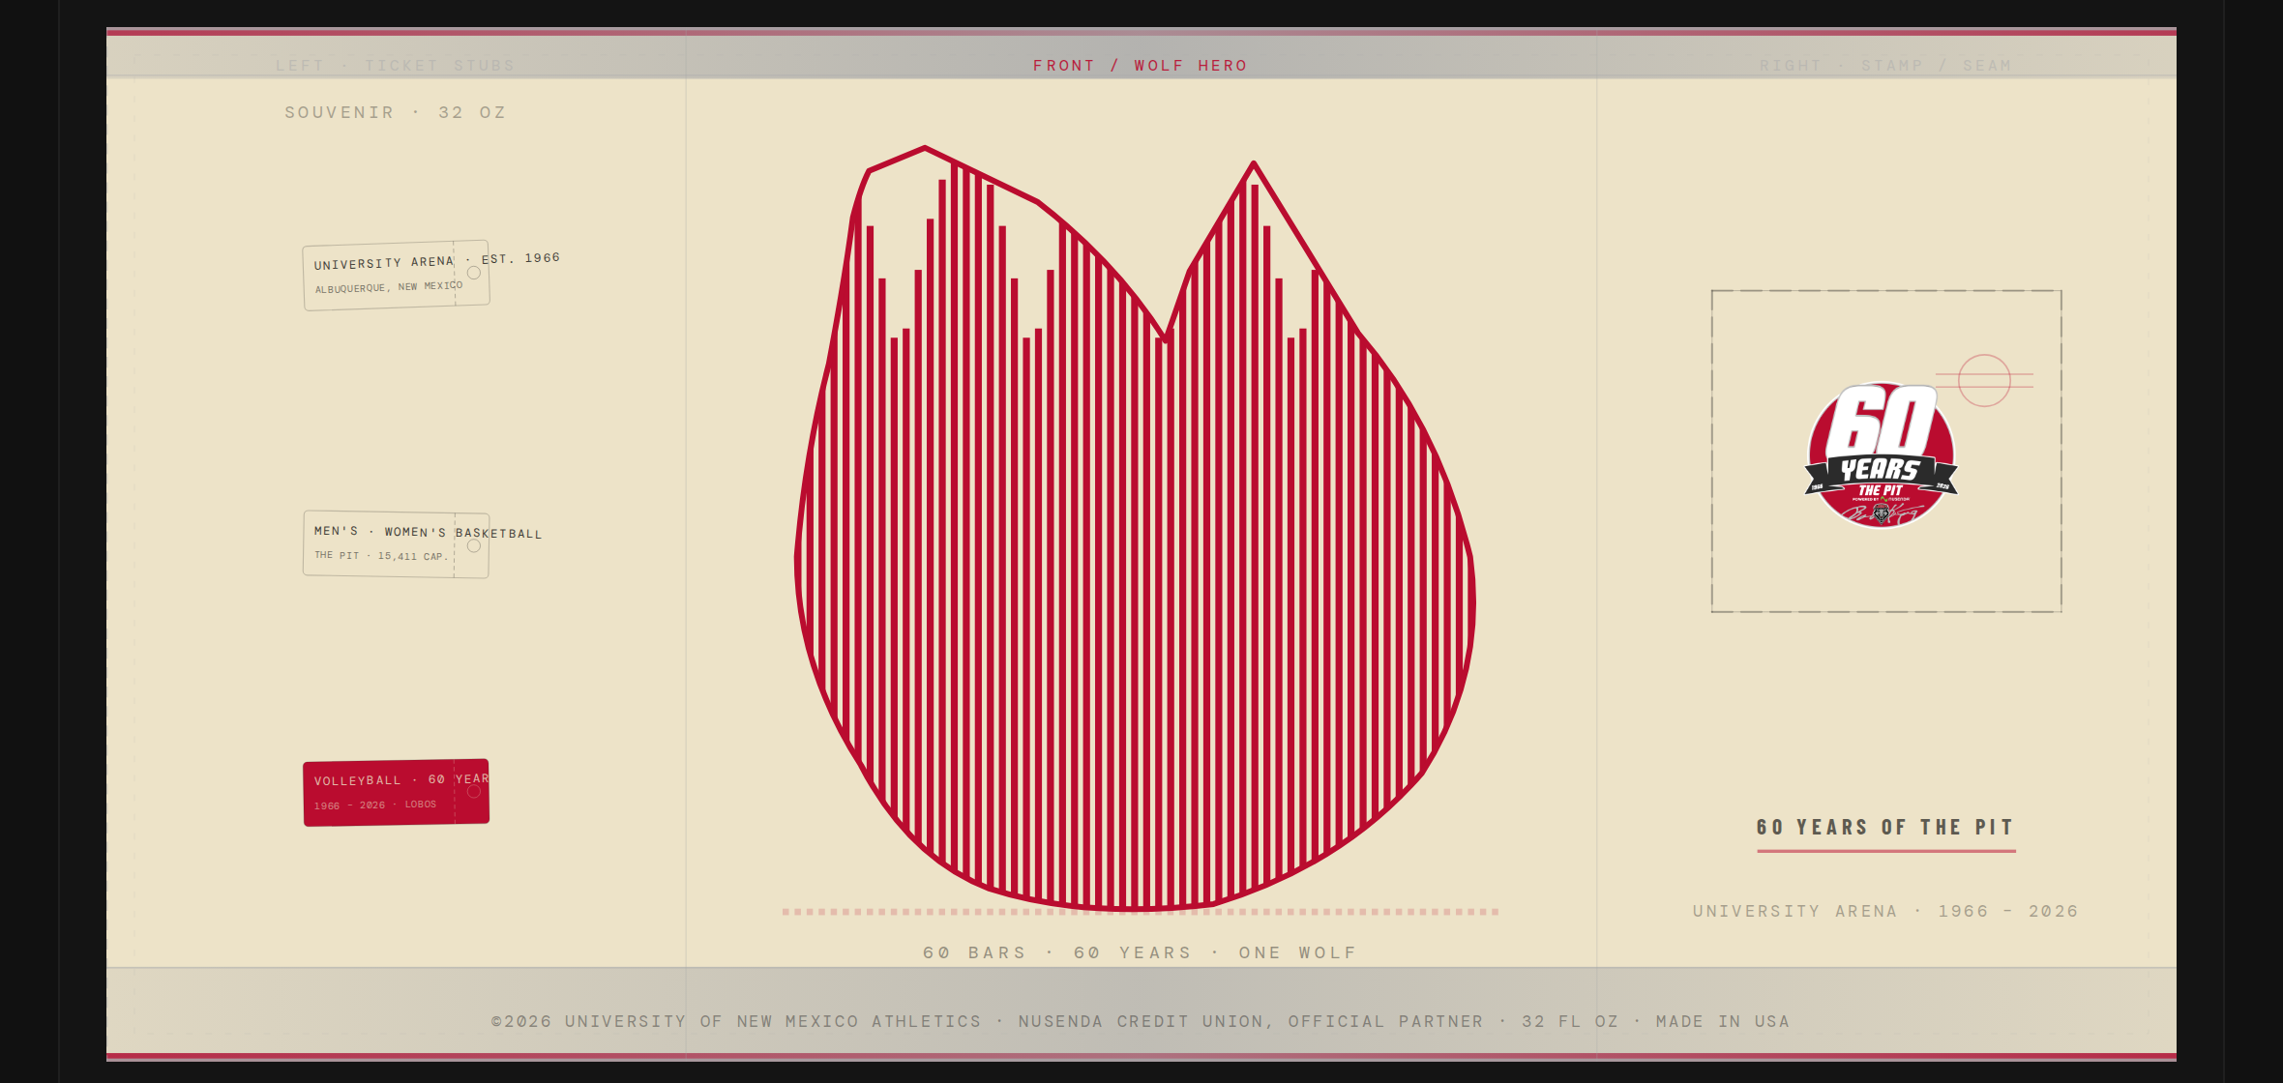
CONCEPT 06 / 07 · COLLECTIBLE GRAPHIC
CONCEPT HOLD — ART IN REVISION
60 HOWLS
Sixty vertical bars — one per year — should form a howling wolf you see at 15 feet, then count at 2 feet. Current art reads as a red barcode cloud, not a wolf.
REQUIRED MARK
Side stamp (intended)
PRINT / COLOR
Cream · Cherry · Black (3-color screenprint)
PHOTO RIGHTS
None if the wolf is original geometry.
STUDIO NOTES
· Retain the idea. Do not show this face as a finished option.
· Next pass needs a clear wolf-head silhouette filled with 60 bars.
· If the wolf never reads, retire the name and keep Cherry Voltage.
FULL WRAP · 10.5 × 5.75 IN. · BACK / FRONT / SIDE
CONFIDENTIAL · PROTOTYPE — NOT LICENSED FOR PRODUCTION · UNM ATHLETICS
10 / 13

Slide 11
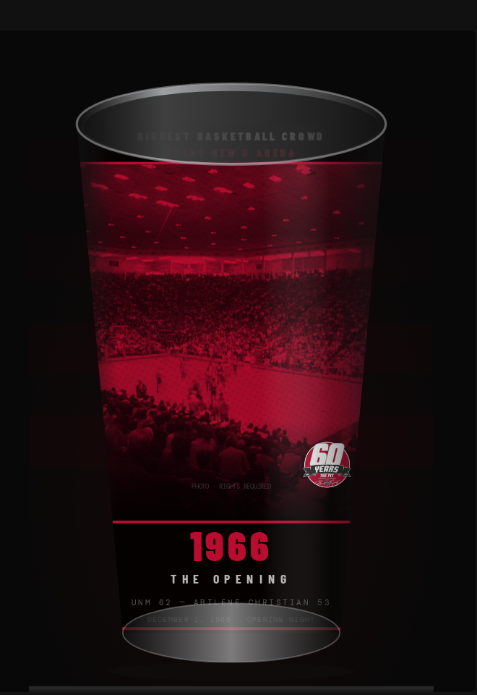
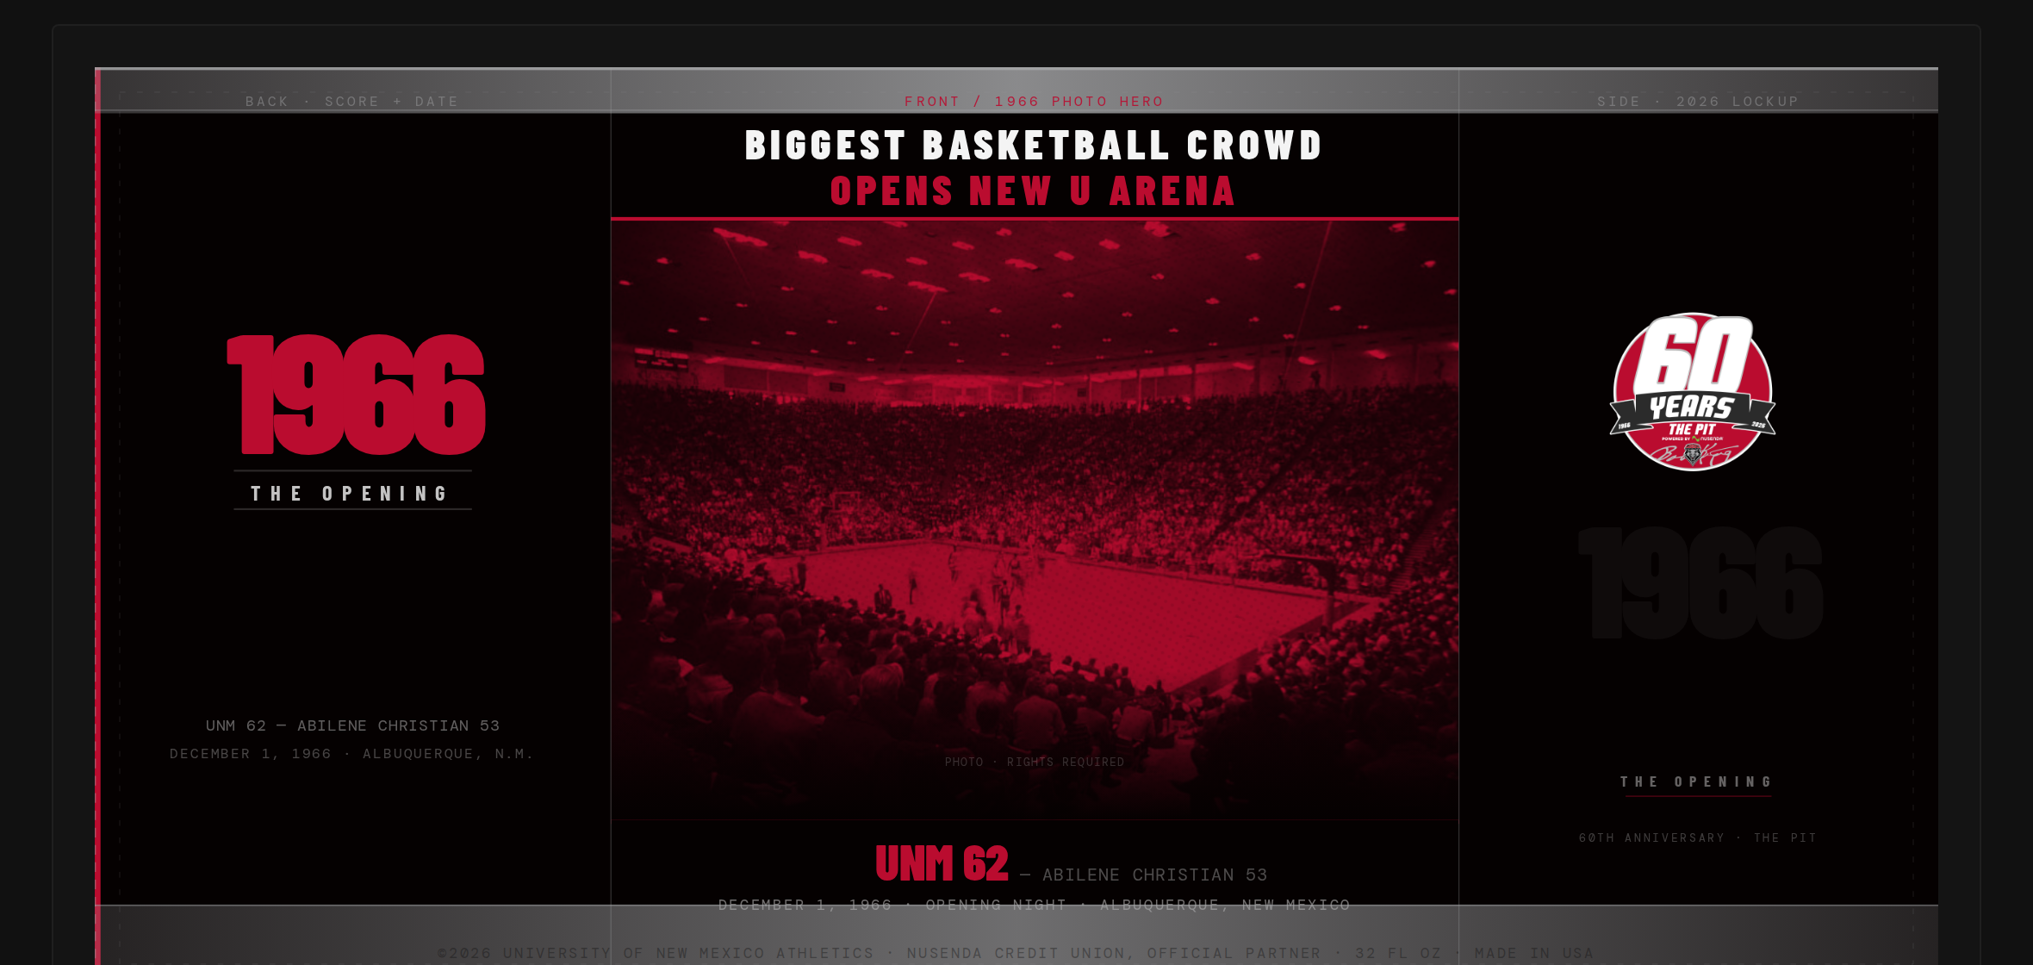
CONCEPT 07 / 07 · OPENING NIGHT / ARCHIVE
READY FOR REVIEW
THE OPENING
December 1, 1966. Lobos 62, Abilene Christian 53. A black-and-cherry duotone of the packed bowl, built like a Tribune front page.
REQUIRED MARK
Side commemorative stamp
PRINT / COLOR
Black · Cherry duotone · White type
PHOTO RIGHTS
Yes. Period photography and any newspaper masthead need clearance.
STUDIO NOTES
· Newest concept on the board, and one of the strongest.
· Label every archive photo PHOTO · RIGHTS REQUIRED until legal clears it.
· Natural pair with Remember the Feeling for a history-led season.
FULL WRAP · 10.5 × 5.75 IN. · BACK / FRONT / SIDE
CONFIDENTIAL · PROTOTYPE — NOT LICENSED FOR PRODUCTION · UNM ATHLETICS
11 / 13

Slide 12
11 — STUDIO RECOMMENDATION
If one cup ships, ship Cherry Voltage.
It is the only face that already looks like a finished souvenir: high contrast, no photo rights, required mark legally parked on the back, cherry used as a strike instead of a wallpaper.
IF TWO SKUS
IF YOU NEED SAFE
DO NOT APPROVE YET
Cherry Voltage for the concourse.
Remember the Feeling or The Opening
for the history / alumni cup — after
photo rights are cleared.
Subterranean Red. Logo on cherry.
It will not win a design award.
It will not get anyone in trouble.
Four Eras and 60 Howls.
Keep the briefs. Redo the drawings.
Showing those faces as finals will
weaken the rest of the room.
CHERRY
VOLTAGE
03 / 07
CONFIDENTIAL · PROTOTYPE — NOT LICENSED FOR PRODUCTION · UNM ATHLETICS
12 / 13

Slide 13
12 — NEXT STEPS · FINE PRINT
What to decide in this meeting
1
Pick a primary face for the 2026–27 souvenir cup.
2
Decide whether a second history SKU is in budget (photo rights + a second plate).
3
Confirm the official 60 Years PNG is the only lockup that may print.
4
Park Four Eras and 60 Howls as R&D unless new art is requested.
5
Move the approved wrap to a real 32 oz stadium-cup dieline — current mockups are still a pint silhouette.
FINE PRINT
These are prototype wraps for internal review. They are not licensed for production, sale, or public release. University marks, The Pit naming, Nusenda partnership language, and Bob King’s signature are used here only as specified by the official 60th lockup. Historic photography and any newspaper treatment remain placeholders until UNM Athletics and Legal clear them.
Vessel note: renderings use a pint-style silhouette. Production stock should be a 32 oz stadium cup.
Interactive reference: https://stand-revel-66898789.figma.site
Prepared as a printed executive handout, September 2026.
CONFIDENTIAL · PROTOTYPE — NOT LICENSED FOR PRODUCTION · UNM ATHLETICS
13 / 13

