Slide 1

A Seminar Review II Presentation on
Submitted to Savitribai Phule Pune University
for the partial fulfillment of Under Graduate Degree in
Department of Computer Engineering
Presented By
Unmesh R Patil| PRN : 72331665B
Guided By
Prof. S. C. Waje
Department of Computer Engineering
PVG’s College of Engineering & S. S. Dhamankar Institute of Management, Nashik
Academic Year 2025 - 26
Understanding the Security Risks of Websites Using Cloud Storage for Direct User File
Uploads
Notes:
1

Slide 2
Outline
Introduction
Motivation
Challenges
Literature Survey (Minimum 8 Papers)
✔ Technology/Algorithm/Methods Used
✔ Research gap
Objectives
Problem Statement

Slide 3
Outline
Existing /Proposed System Architecture/Proposed Methodology / Prototype / Idea / Algorithm
DFD (Level 0/1/2) Or ER Diagrams (Existing Paper/Proposed System)
Results (Existing Paper/Proposed System)
Applications
Conclusion
Future scope
Reference

Slide 4
1. Introduction
As websites grow in popularity, they start handling more users and way more data. Big platforms deal with hundreds of millions of users, which makes storing all that information a serious challenge. To keep things smooth and scalable, many sites now rely on cloud storage.
This Cloud Storage help us to store large amount of data which is provided by our user. It also helps our website to access and use that data later whenever needed.
Straight to cloud Method . There's a new way for users to upload files: instead of sending files to the website first, users upload them straight to the cloud. This process has three steps:-
Getting Permission – The user asks the website for permission to upload. If approved the website gives a special upload pass.
Uploading the File – The user uses that pass to send the file directly to the cloud.
Sending a Notification – After the upload the cloud , The cloud or the User tells website that’s its done
4
Department of Computer Engineering | PVG’s COE&SSDIOM Nashik
Notes:
4

Slide 5
2.Motivation
  New Upload Method:
Instead of sending files through the website’s server, users now upload files directly to the cloud. While
this saves resources, it changes how security needs to be handled.
  Hidden Risks:
Many websites using this method unknowingly expose themselves to new vulnerabilities, such as identity
spoofing or unauthorized access to files.
  Research Value:
By studying these risks, we can help improve the safety of millions of users and guide future web development.
  Need for Awareness:
Developers and security teams may not fully understand these risks. This title aims to raise awareness and
encourage better security practices.
5
Department of Computer Engineering | PVG’s COE&SSDIOM Nashik
Notes:
5

Slide 6
Broken Access Controls
3.Challenges
Malware Uploads
Users may upload malicious files (e.g., viruses, trojans) that can infect systems or other users.
Insufficient File Validation
Weak or missing checks on file type, size, or content can allow dangerous uploads (e.g., disguised executables).
Public Access Misconfiguration
Improper cloud storage settings may expose sensitive files to the public unintentionally.
Broken Access Controls
Users might access or overwrite files they shouldn’t if permissions aren’t strictly enforced.
4. Insecure Upload Channels
Upload on HTTP (instead of HTTPS) can be intercepted or can be seen . As Our HTTP is not as secure as our
HTTPS sites.
6
Department of Computer Engineering | PVG’s COE&SSDIOM Nashik
Notes:
6

Slide 7
3. Challenges
Lack of Virus Scanning
Without automatic scanning, infected files may remain undetected in storage
Storage Bucket Enumeration
Attackers may guess or brute-force URLs to access files if naming is predictable
Overconsumption of Resources
Unrestricted uploads can lead to denial-of-service (DoS) by filling up storage or exhausting bandwidth.
7
Department of Computer Engineering | PVG’s COE&SSDIOM Nashik
Notes:
7

Slide 8
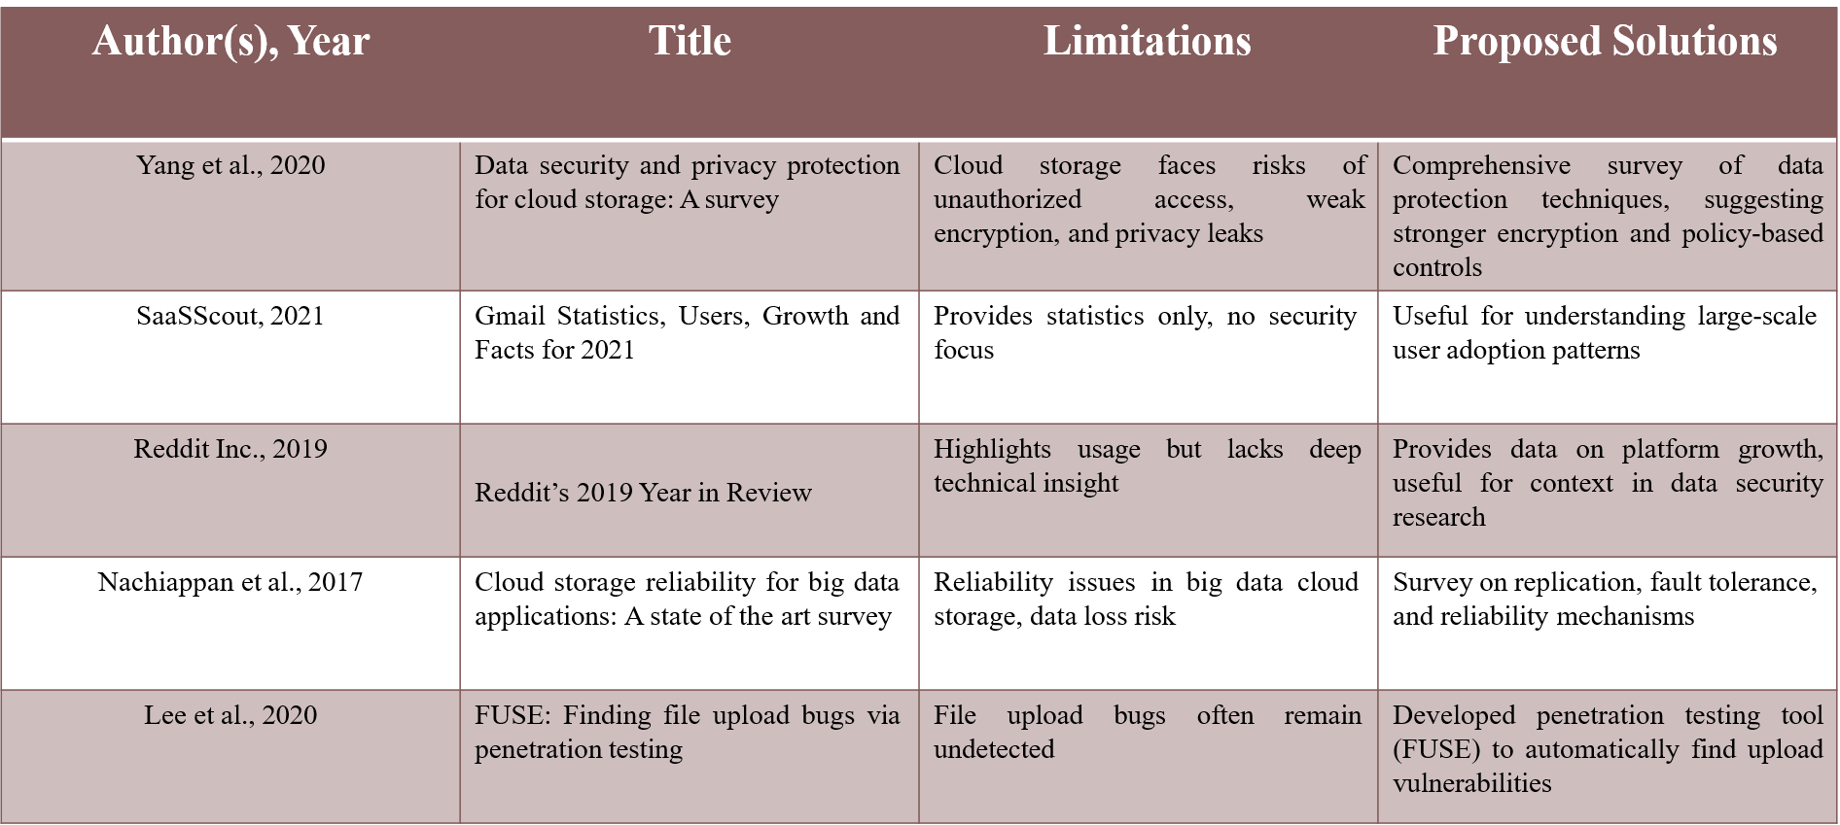
4.Related Work / Literature Survey
8
Department of Computer Engineering | PVG’s COE&SSDIOM Nashik
Notes:
8

Slide 9
Automated tools struggle to factor in business context, user roles, and data sensitivity when evaluating risks.
5.Research Gap
Limited Scope of Cloud Service Coverage
Most studies focus on major providers (e.g AWS , Azure) leaving smaller or hybrid cloud platforms
underexplored
Static vs. Dynamic Capability Inference
Current tools often rely on static analysis; dynamic, real-time inference of exposed capabilities is still
immature.
Lack of Context-Aware Risk Assessment
Automated tools struggle to factor in business context , user roles , and data sensitivity when evaluating
risks
9
Department of Computer Engineering | PVG’s COE&SSDIOM Nashik
Notes:
9

Slide 10
6.Algorithm
Algorithm (Step-wise)
Request Upload Credential:
User sends a request to the web server asking for permission to upload a file.
Generate or Request Temporary Credential:
  Generates a token using the user's existing credentials, or
  Requests a temporary credential from the cloud storage provider.
Receive Temporary Credential:
Cloud storage service returns a temporary credential to the web server
Upload File to Cloud Storage:
User uploads the file directly to the cloud storage using the received credential
Cloud Callback to Web Server:
Cloud storage service sends a callback to the web server indicating that the upload is complete.
10
Department of Computer Engineering | PVG’s COE&SSDIOM Nashik
Notes:
10

Slide 11
6.Algorithm
Algorithm (Step-wise)
6. Acknowledge Upload Completion:
Web server processes the callback and confirms that the upload was successful.
  Notify User:
  Web server sends a response to the user confirming that the upload is finished.
Enable File Management:
User can now manage (view, delete, share) the uploaded files on the cloud storage platform..
11
Department of Computer Engineering | PVG’s COE&SSDIOM Nashik
Notes:
11

Slide 12
7.Objectives
  Analyze the security risks involved when websites use cloud storage services for direct user file uploads.
  Identify and categorize vulnerabilities that arise from this new upload method, especially those affecting authentication, authorization, and data integrity
Evaluate real-world websites to understand how widespread these risks are and how they impact user data protection.
  Raise awareness among developers and website administrators about the hidden dangers of direct-to- cloud uploads.
  Propose effective security measures to reduce the risk of attacks and improve the safety of cloud-based file handling.
12
Department of Computer Engineering | PVG’s COE&SSDIOM Nashik
Notes:
12

Slide 13
8.Problem Statement
Modern web applications increasingly rely on cloud storage services to handle direct user file uploads due to their scalability and convenience. However, this architecture introduces a complex security landscape involving temporary credentials, user-controlled upload flows, and asynchronous callbacks. Improper configuration, weak validation, and exposed cloud capabilities can lead to serious vulnerabilities such as unauthorized access, malware injection, privilege escalation, and data leakage. Despite existing security mechanisms, there remains a lack of automated, context-aware systems to infer and mitigate risks associated with exposed cloud services during file upload processes. This research aims to identify and address these gaps by analyzing the end-to-end upload flow, evaluating current protection strategies, and proposing robust, scalable solutions for secure credential management and file handling
13
Department of Computer Engineering | PVG’s COE&SSDIOM Nashik
Notes:
13

Slide 14
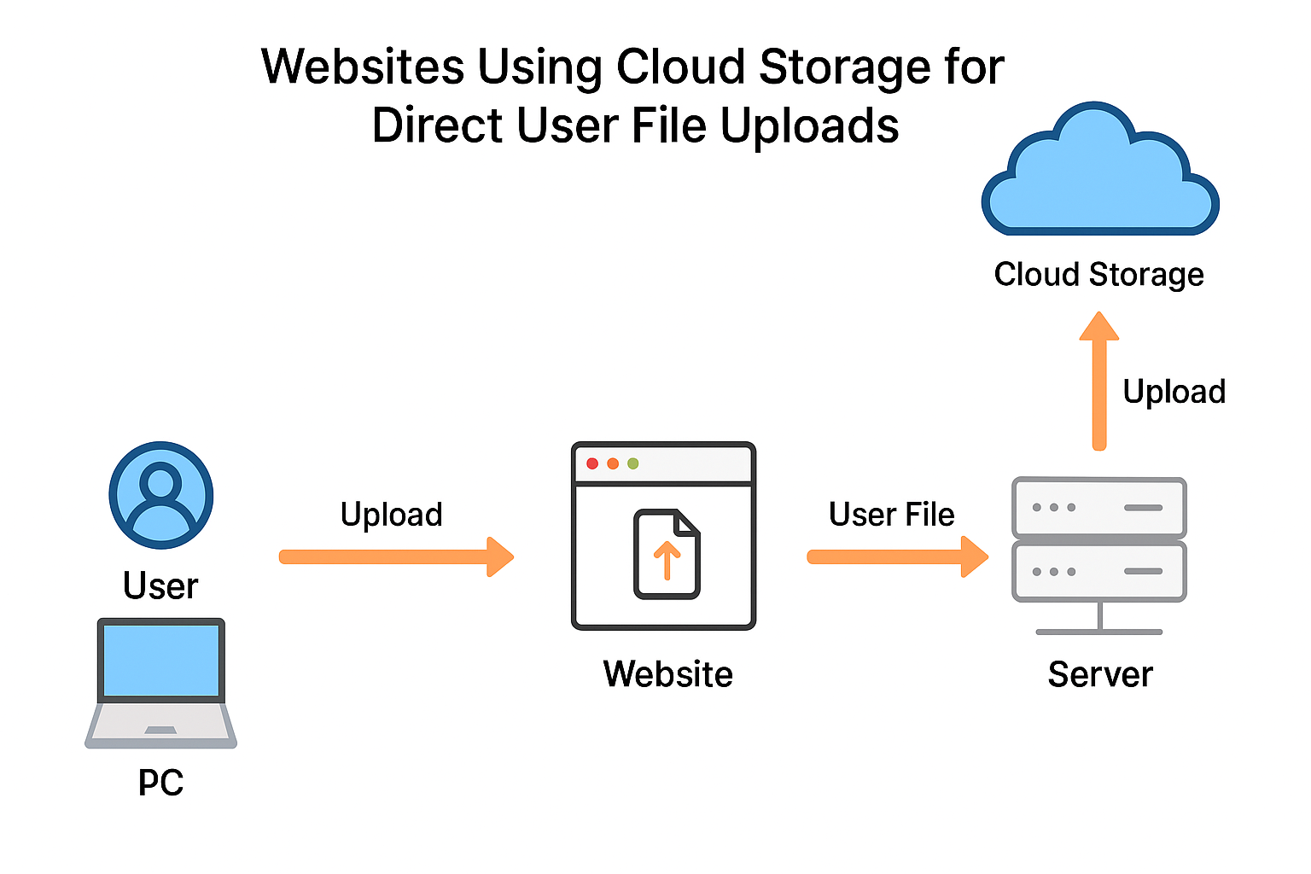
9. System Architecture
How the direct cloud upload is performed on the website is shown in diagram below
Figure 2.1 Direct file Upload Method
14
Department of Computer Engineering | PVG’s COE&SSDIOM Nashik
Notes:
14

Slide 15
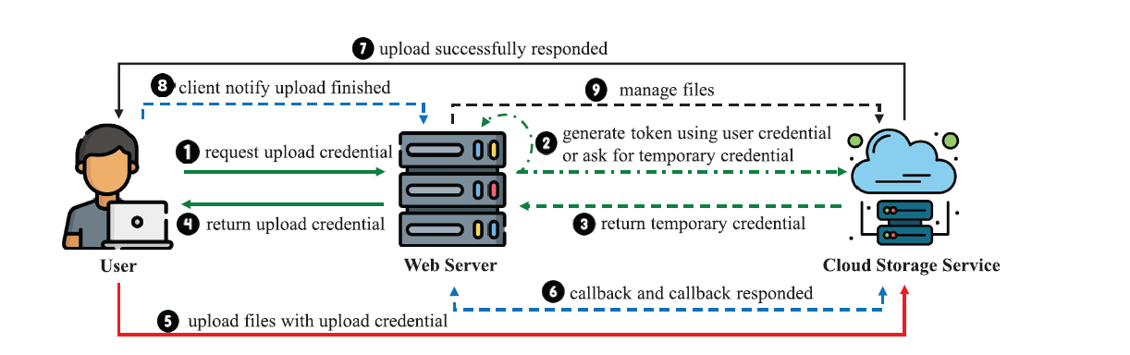
10.Algorithm
15
Department of Computer Engineering | PVG’s COE&SSDIOM Nashik
Notes:
15

Slide 16
11. Results
Improved Developer Awareness
Helps developers understand the risks and best practices for secure file Uploads and Encourages thoughtful
architecture rather than quick implementation
Stronger Security Protocols
Promotes adoption of pre-signed URLs , MIME type validation and Malware scanning
Cost Optimization
Uploading file handling to cloud reduces infrastructure costs
Standardization of Upload Workflows
Encourage consistent patterns across platforms (e.g., Mobile , web).
Its easier to audit and maintain systems
16
Department of Computer Engineering | PVG’s COE&SSDIOM Nashik
Notes:
16

Slide 17
Users upload images, videos, and audio directly to cloud storage (e.g., Instagram, TikTok).
12.Applications
Social Media Platforms:
Users Upload images, videos and audio directly to cloud storage (e.g., Instagram , Linkedin).
Helps to Secure all the data which is uploaded by the user on platform.
Education:
Students and instructors upload assignments, lecture on the platform or in classroom so cloud storage helps to maintain that record which is uploaded.
Our security methods helps us to secure all the student information and all the data which is uploaded by students and instructor.
Healthcare Systems:
Patients Records and all the medicine stock management and patients details can be stored and secured in the cloud system.
Government and Legal Services:
All the Records are stored in the government clouds and also this records can be verified whenever they are required.
17
Department of Computer Engineering | PVG’s COE&SSDIOM Nashik
Notes:
17

Slide 18
13.Conclusion
Websites using cloud storage for direct file uploads offer speed and scalability, but they must be secured properly to prevent misuse, data leaks, and malware threats. Strong validation, access control, and monitoring are essential for safe implementation.
Websites that let users upload files directly to cloud storage are fast and scalable — but they also come with serious security risks. If not handled properly, attackers can upload harmful files, steal data, or misuse cloud resources. To stay safe, developers must add strong checks like file type validation, access control, malware scanning, and secure upload links. With the right precautions, this system can be both powerful and secure.
What major risk can be avoided:
Attackers can upload malicious files like scripts, executables, or disguised payloads.
The corrupted or virus-oriented files can be upload to our which can lead to corruption of our complete cloud storage or partial damage.
18
Department of Computer Engineering | PVG’s COE&SSDIOM Nashik
Notes:
18

Slide 19
Hashing and timestamping uploads to ensure tamper-proof records.
14.Future Scope
AI-Powered File Validation:
Use of machine learning to detect malicious or suspicious uploads in real time.
Zero-Trust Upload Architectures:
Every upload treated as untrusted until verified
Blockchain for File Integrity:
Hashing and timestamping uploads to ensure tamper-proof records.
Smart Quotas and Billing Alerts:
Predictive analytics to manage storage costs and prevent abuse.
19
Department of Computer Engineering | PVG’s COE&SSDIOM Nashik
Notes:
19

Slide 20
15.References
[1] P. Yang, N. Xiong, and J. Ren, “Data security and privacy protection for cloud storage: A survey,” IEEE Access, vol. 8, pp. 131723–131740, 2020.
[2] (2021). Gmail Statistics, Users, Growth and Facts for 2021.[Online].Available: https://saasscout.com/statistics/gmail-statistics/
[3] (2019). Reddit’s 2019 Year in Review. [Online]. Available: https://www.redditinc.com/blog/reddits-2019-year-in-review/
[4] R. Nachiappan, B. Javadi, R. N. Calheiros, and K. M. Matawie, “Cloud storage reliability for big data applications: A state of the art survey,” J. Netw. Comput. Appl., vol. 97, pp. 35–47,Nov. 2017.
[5] T. Lee, S. Wi, S. Lee, and S. Son, “FUSE: Finding file upload bugs via penetration testing,” in Proc. Netw. Distrib. Syst. Secur. Symp., 2020, pp. 1–11.
[6] Y. Chen, Y. Li, Z. Pan, Y. Lu, J. Chen, and S. Ji, “URadar: Discovering unrestricted file upload vulnerabilities via adaptive dynamic testing,” IEEE Trans. Inf. Forensics Security, vol. 19, pp. 1251–1266, 2024.
20
Department of Computer Engineering | PVG’s COE&SSDIOM Nashik
Notes:
20

Slide 21
15.References
[7] C. Zuo, Z. Lin, and Y. Zhang, “Why does your data leak? Uncovering the data leakage in cloud from mobile apps,” in Proc. IEEE Symp. Secur. Privacy (SP), May 2019, pp. 1296–1310.
[8] Y. Zhou, L. Wu, Z. Wang, and X. Jiang, “Harvesting developer credentials in Android apps,” in Proc. 8th ACM Conf. Secur. Privacy Wireless Mobile Netw., Jun. 2015, pp. 1–12.
[9] M. Meli, M. R. McNiece, and B. Reaves, “How bad can it git? Characterizing secret leakage in public GitHub repositories,” in Proc.Netw. Distrib. Syst. Secur. Symp., 2019, pp. 1–18.
[10] H. Wen, J. Li, Y. Zhang, and D. Gu, “An empirical study of SDK credential misuse in iOS apps,” in Proc. 25th Asia–Pacific Softw. Eng. Conf. (APSEC), Dec. 2018, pp. 258–267.
21
Department of Computer Engineering | PVG’s COE&SSDIOM Nashik
Notes:
21

