Slide 1


Crowdfunding Kickstarter
Analysis
Presenter: Maaz Ahmed Risaldar
Date: 6 June 2026

Slide 2
Project Team
Our contributors bring collaboration, insight, and analysis together.
Anil Kumar Biswal
Anunidhi Sharma
Kondaparthi Kussulu
Unmesha Milind Ghogle
Maaz Ahmed Risaldar
Arun

Slide 3
Business Objectives
Analyze crowdfunding project outcomes
Identify successful project categories
Evaluate the impact of funding goals on success
Understand the geographical distribution of projects
Measure backer engagement and funding performance

Slide 4
Tools & Technologies
Data Analysis
Data Cleaning
Visualization
Microsoft Excel
Data Cleaning
Data Transformation
Pivot Tables
Slicers
Excel Dashboard
Pie Charts
Bar Charts
KPI Cards
Interactive Filters
Techniques Applied: Exploratory Data Analysis (EDA), Descriptive Analytics, Data Aggregation, KPI Tracking

Slide 5
Data Cleaning Process
01
02
Removed duplicate records, handled missing/null values, and standardized category names.
Corrected inconsistent country codes, formatted date fields properly, and removed unnecessary columns.
03
04
Grouped funding goals into ranges and categorized outcomes as Successful, Failed, Canceled, Live, Suspended, and Purged.
Validated project outcome values and created Year, Month and Quarter fields.

Slide 6
Key Performance Indicators
$133,864,213
3,996,583
Total Amount Raised
Total Backers
80.43 Days
39%
Average Days for Successful Projects
Success Rate
51%
9%
Failure Rate
Cancellation Rate

Slide 7
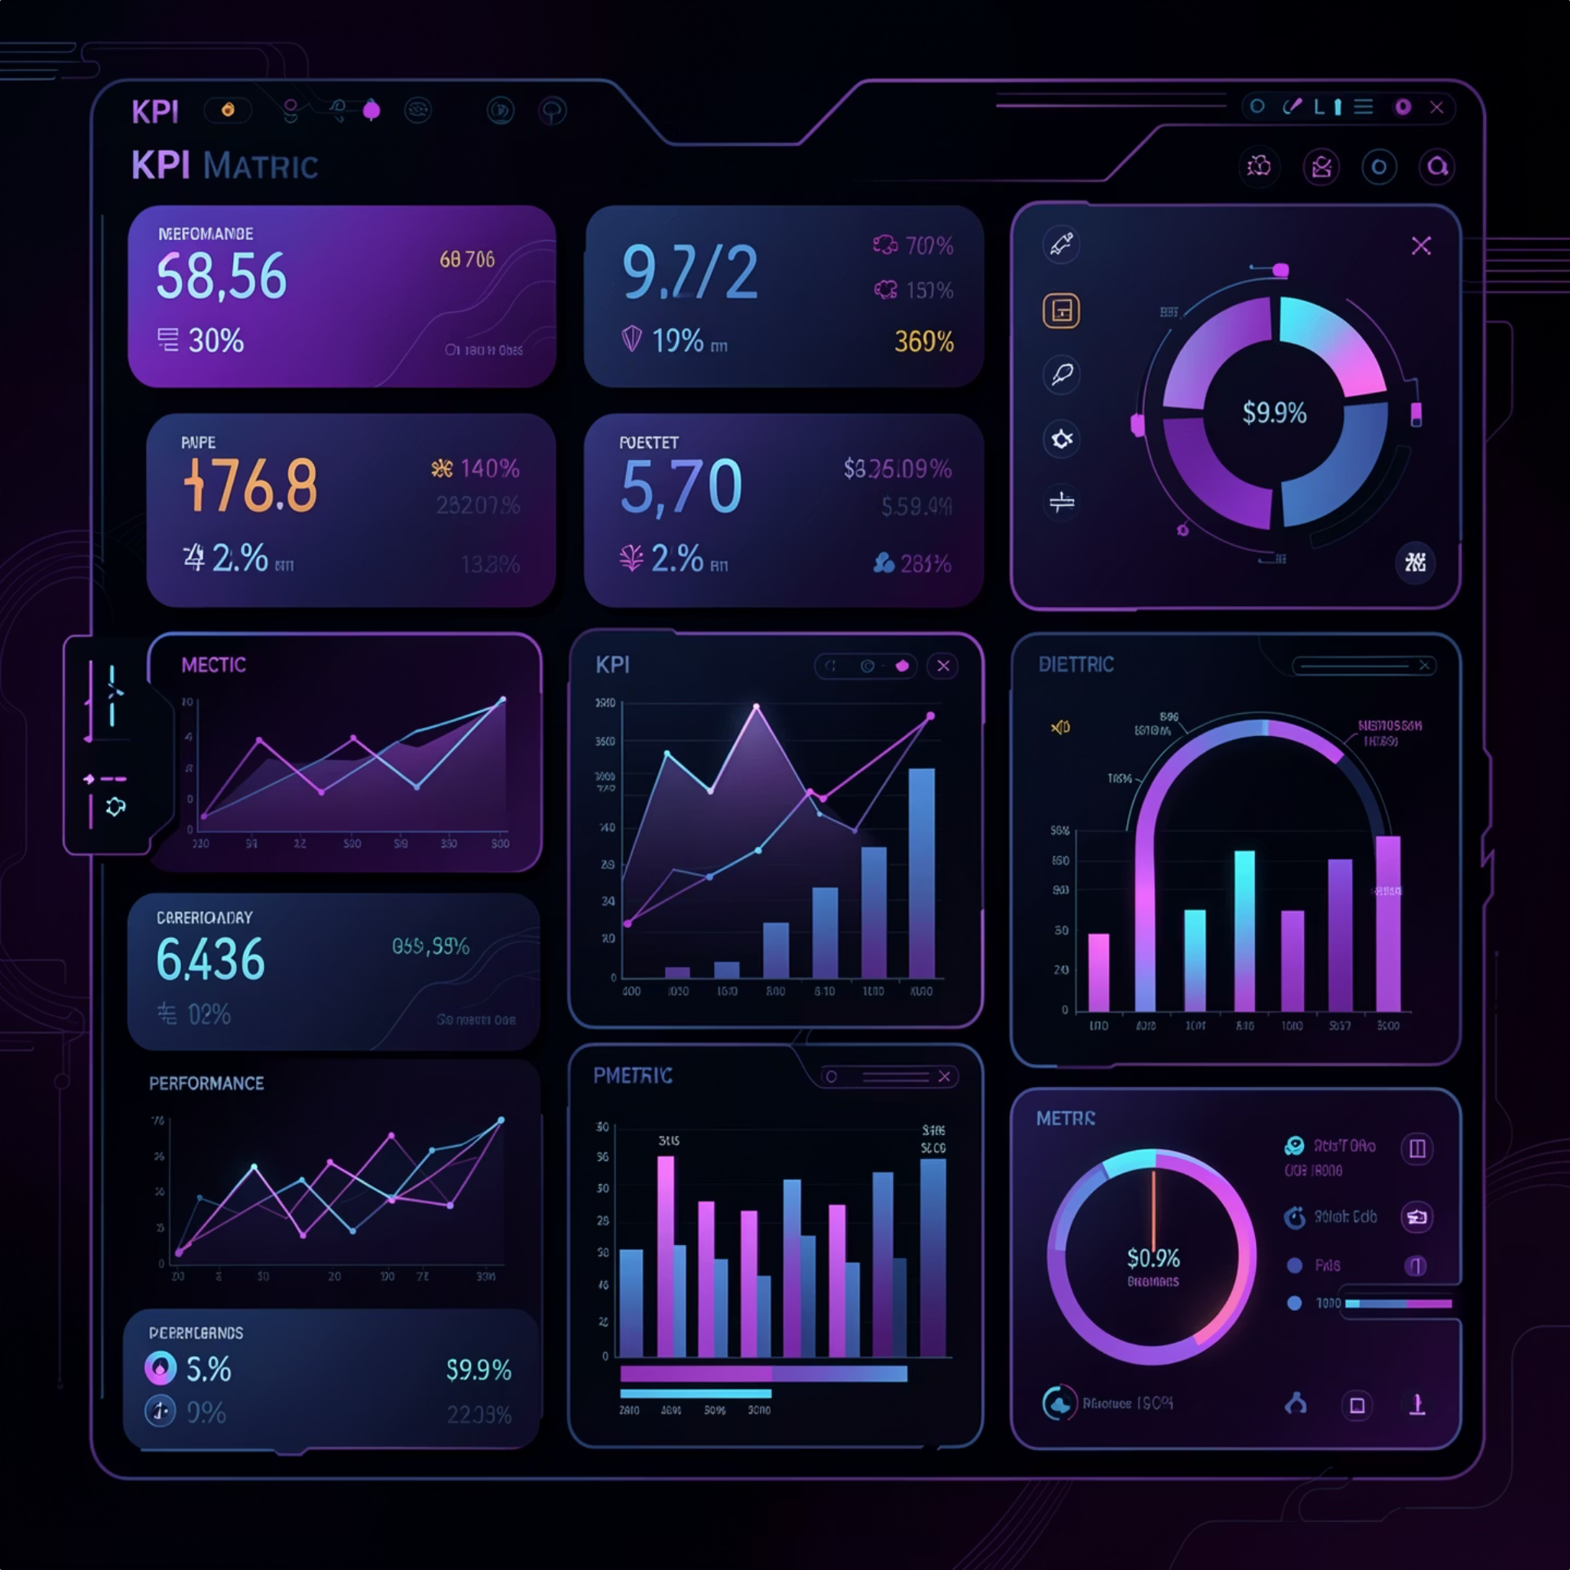
Key Insights
Project Outcomes
Country Analysis
More than half of all projects failed (51%). Only 39% achieved successful funding, while canceled projects account for approximately 9%.
The United States dominates Kickstarter activity. The United Kingdom is the second-largest contributor, followed by Canada, Australia, and Germany.
Category Analysis
Funding Goal Analysis
Top categories by number of projects are Product Design, Tabletop Games, Music, Documentary, and Video Games.
Lower funding goals show higher success rates. The $501–$20,000 range contributes significantly to successful campaigns, while extremely high goals perform less well.

Slide 8
Dashboard Features
Interactive Filters
Visualizations
Year Filter
Month Filter
Quarter Filter
Outcome Filter
Project Outcome Distribution
Projects by Country
Projects by Category
Goal Range Success Analysis
Top Projects by Backers
Top Projects by Amount Raised
KPI Summary Cards

Slide 9
Key Insight and Analysis

Slide 16
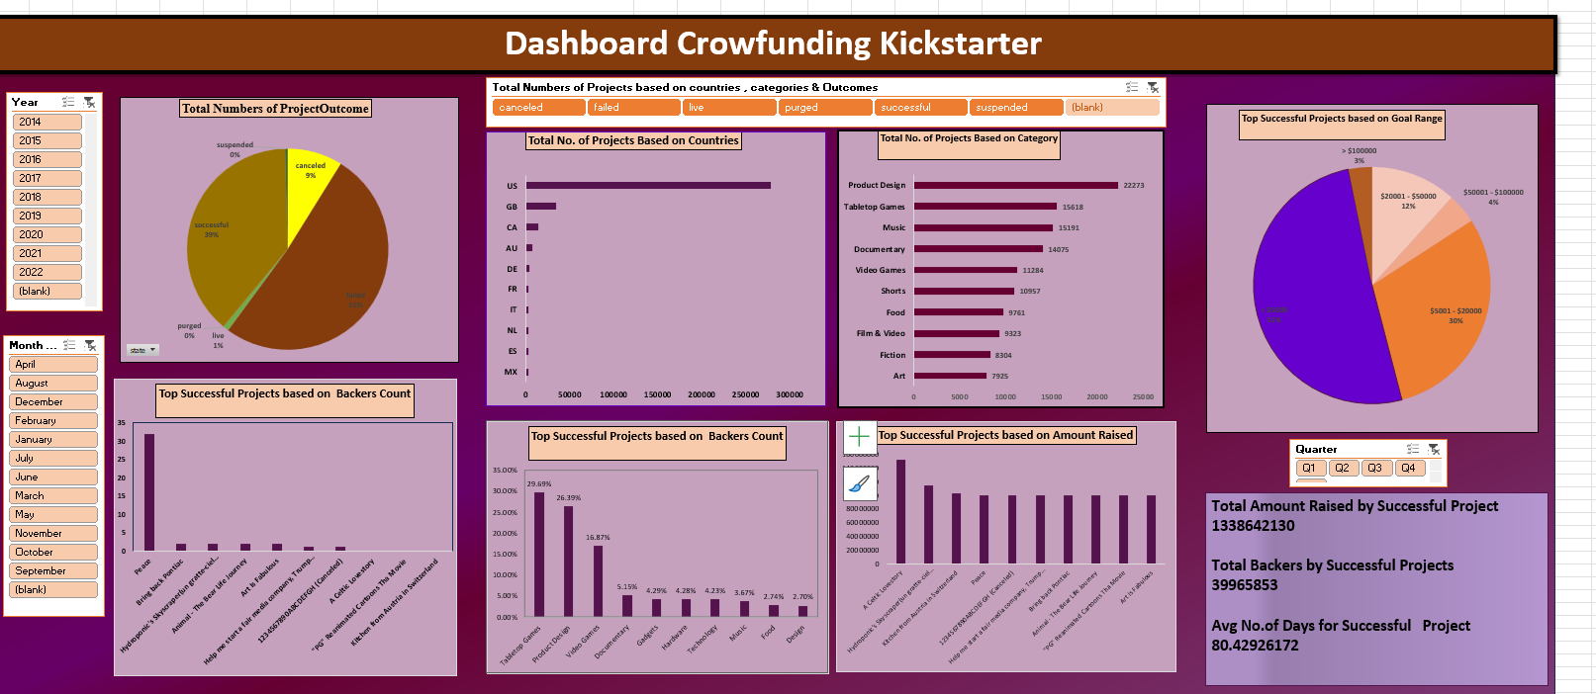
Dashboards - Excel

Slide 17
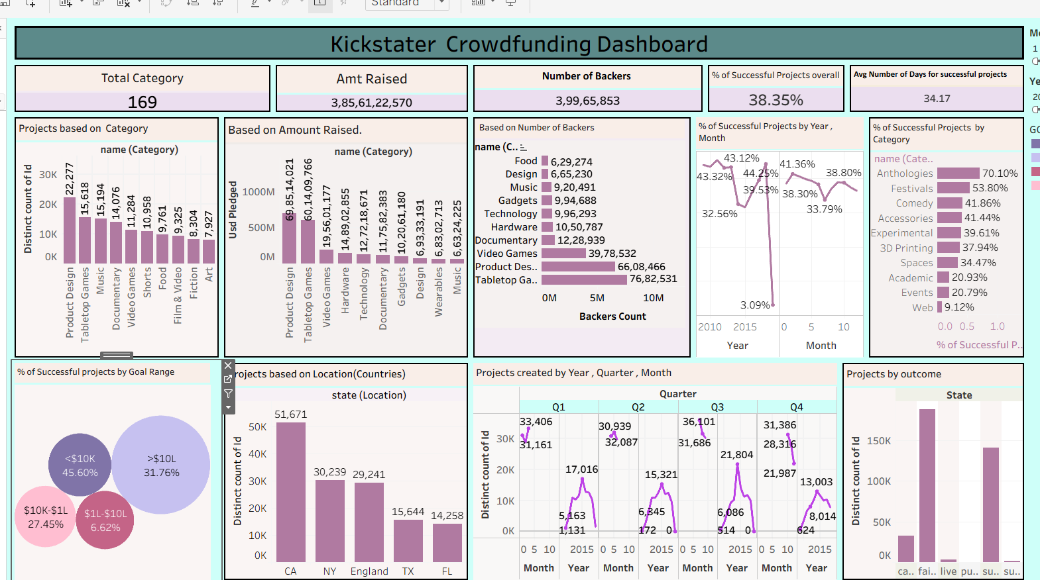
Tableau

Slide 18
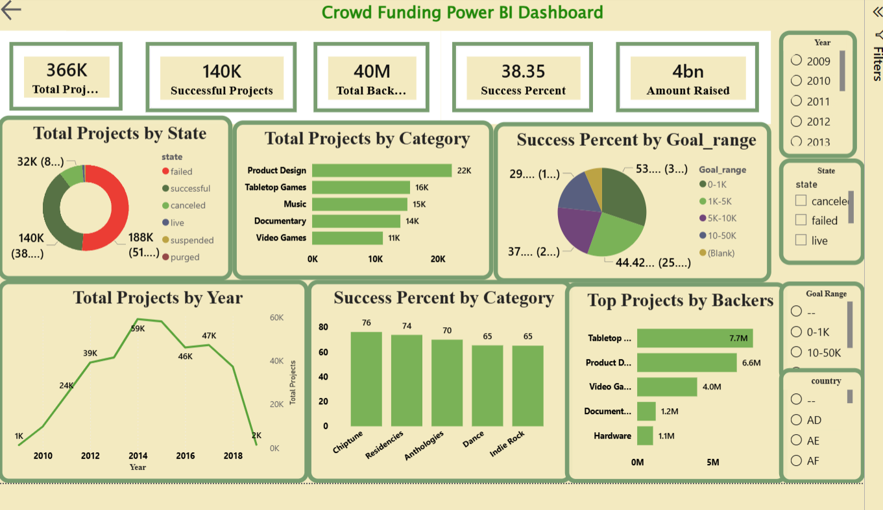
Power BI

Slide 19
Challenges & Solutions
Challenge | Solution
Missing values in dataset | Cleaned and standardized records
Large number of categories | Grouped and summarized categories
Inconsistent date formats | Converted into standard date structure
Complex project outcomes | Created meaningful outcome groups
Large dataset visualization | Used Pivot Tables and interactive slicers
User navigation issues | Added dashboard filters and clear KPI cards

Slide 20
Business Recommendations
For Project Creators
For Investors
Set realistic funding goals
Focus on categories with proven success rates
Increase community engagement before launch
Build strong marketing campaigns
Prioritize categories with historically higher success rates
Evaluate backer engagement alongside funding goals
Monitor trends by country and category

Slide 21
Conclusion & Future Scope
The analysis shows that project category, funding goal, and backer engagement significantly influence campaign success. Interactive visualizations help users identify patterns and make data-driven decisions.
Future Enhancements
Build dashboard in Power BI/Tableau
Add predictive analytics for success probability
Implement machine learning models
Perform sentiment analysis on project descriptions
Create real-time crowdfunding monitoring
* Develop automated reporting and alerts
Advanced Analytics
Success prediction model
Backer behavior analysis
Funding trend forecasting
Country-wise market opportunity analysis

Slide 22
THANK YOU

