Slide 1

Encrypt your USB drive using a Raspberry Pi
Presented By : The Assembly Team

Slide 2
Why make it?
When you are on the go, and if you need to encrypt a USB Flash Drive, then you will need a portable solution. Using a raspberry pi, and some python script, you can now make your own portable Flash Media encryption device.
Applications :
Using Raspberry Pi
Raspbian OS
Encrypting/decrypting your drive
Notes:
*explain gesture control

Slide 3
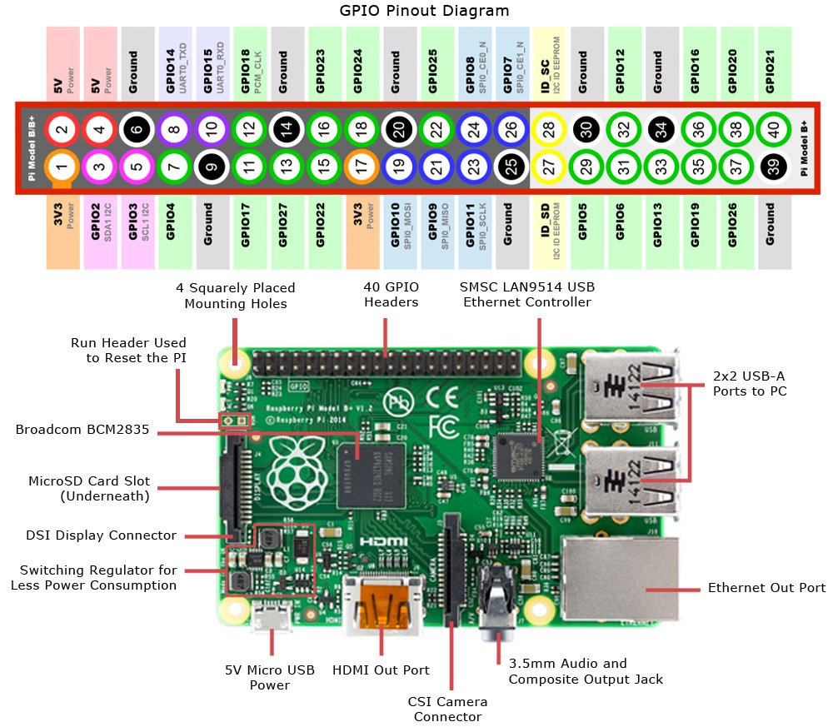

What is a Raspberry Pi?
Notes:
The Arduino Nano is a small, complete, and breadboard-friendly board based microcontroller
Nano has two extra analog pins
Good replacement for uno as it is breadboard friendly

Slide 4
Operating systems
NOOBS
OS installer manager
Pick and choose which OSes to install
Selection of OSes include, not limited to Raspbian, OSMC, OpenELEC, Windows IOT and RISC OC.
Raspbian –
“Official OS”
Packed software
Inbuilt functionalities and programs
Notes:
*The HC-06 acts as a serial port through which you can send and receive data.
*So using a serial terminal or a Bluetooth customized application on your computer or phone, you can control and monitor your project.
*HC06 functions only as slave to a microcontroller

Slide 5
Layout and pin configuration
Notes:
*L298N Dual H-Bridge Motor Controller module
*H-Bridge's are typically used in controlling motors speed and direction, but can be used for other projects such as driving the brightness of certain lighting projects such as high powered LED arrays.
*An H-Bridge is a circuit that can drive a current in either polarity and be controlled by *Pulse Width Modulation (PWM)
*Pulse Width Modulation is a means in controlling the duration of an electronic pulse
*Motors are rated at certain voltages and can be damaged if the voltage is applied to heavily or if it is dropped quickly to slow the motor down.
* The longer the pulses the faster the wheel will turn, the shorter the pulses, the slower the water wheel will turn.
*why a motor driver

Slide 6
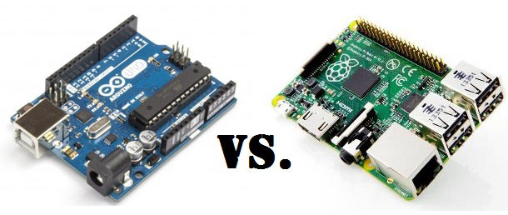
Arduino VS Raspberry Pi

Slide 7
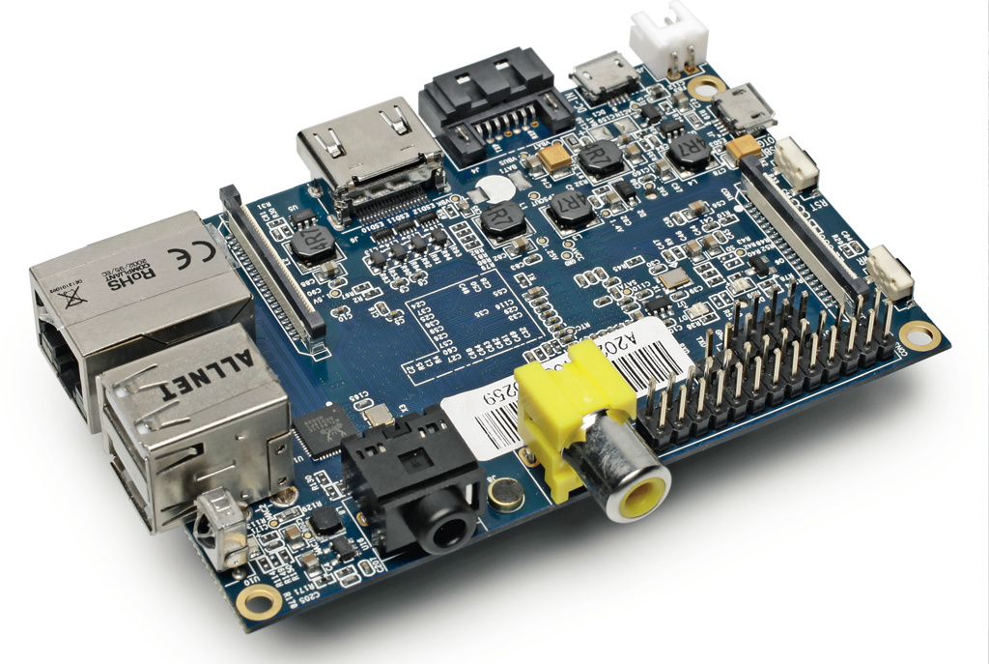
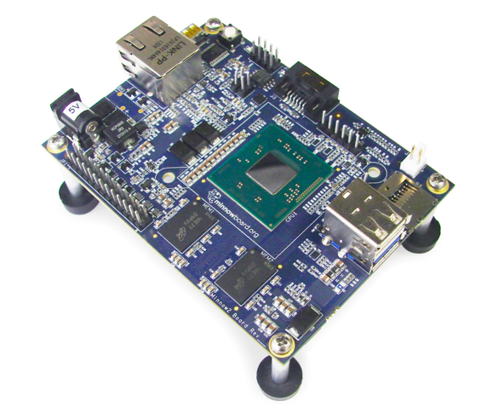
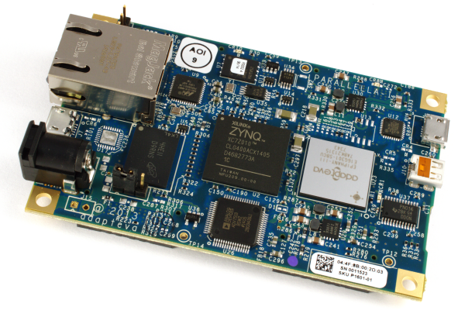
Raspberry Pi alternatives
Banana pi
MinnowBoard MAX
Parallella

Slide 8
Software
What is encryption?
Process of encoding your data using an algorithm and a unique parameter (key)to change it into a format which is not understood by unauthorized people.
What is decryption?
Process of decoding your data using the same algorithm and key used in the encryption stage to change it back to the original format so that the relevant user can access the data.
Why do we need encryption?
Encryption is used to keep your files safe and secure, and it ensures that unauthorized people have no access to this information.

Slide 9
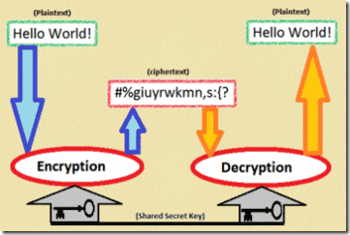

Slide 10
What we are going to do today
Encryption stage:
The system will detect when a USB device is plugged in.
The program generates a pair of keys (32 bytes each). These are the public keys and the private keys.
Public key encrypts the contents of the USB using AES256 (Advanced Encryption System) encryption algorithm.
The private key will encrypt the public key with RSA(named after Rivest, Shamir and Adleman, the makers of this algorithm) encryption algorithm and store it with the rest of the encrypted data.
Decryption stage:
Using the same RSA algorithm, the private key is used to decrypt the public key.
Using the same AES256 algorithm, the public key will be used to decrypt the rest of the files in the USB.
Now the relevant user has access to all of their files without it being used by unwanted people.

Slide 11

THANK YOU
THANK YOU

