Slide 1
Introduction to Consensus
Consensus is fundamental to distributed systems
Key challenges in achieving agreement
Understanding the need for two-phase protocols

Slide 2
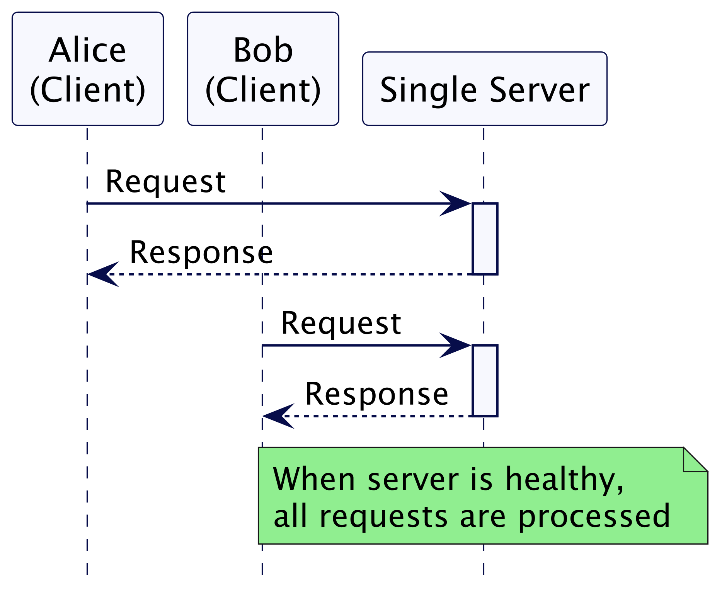
Single Server Lacks Fault Tolerance

Slide 3
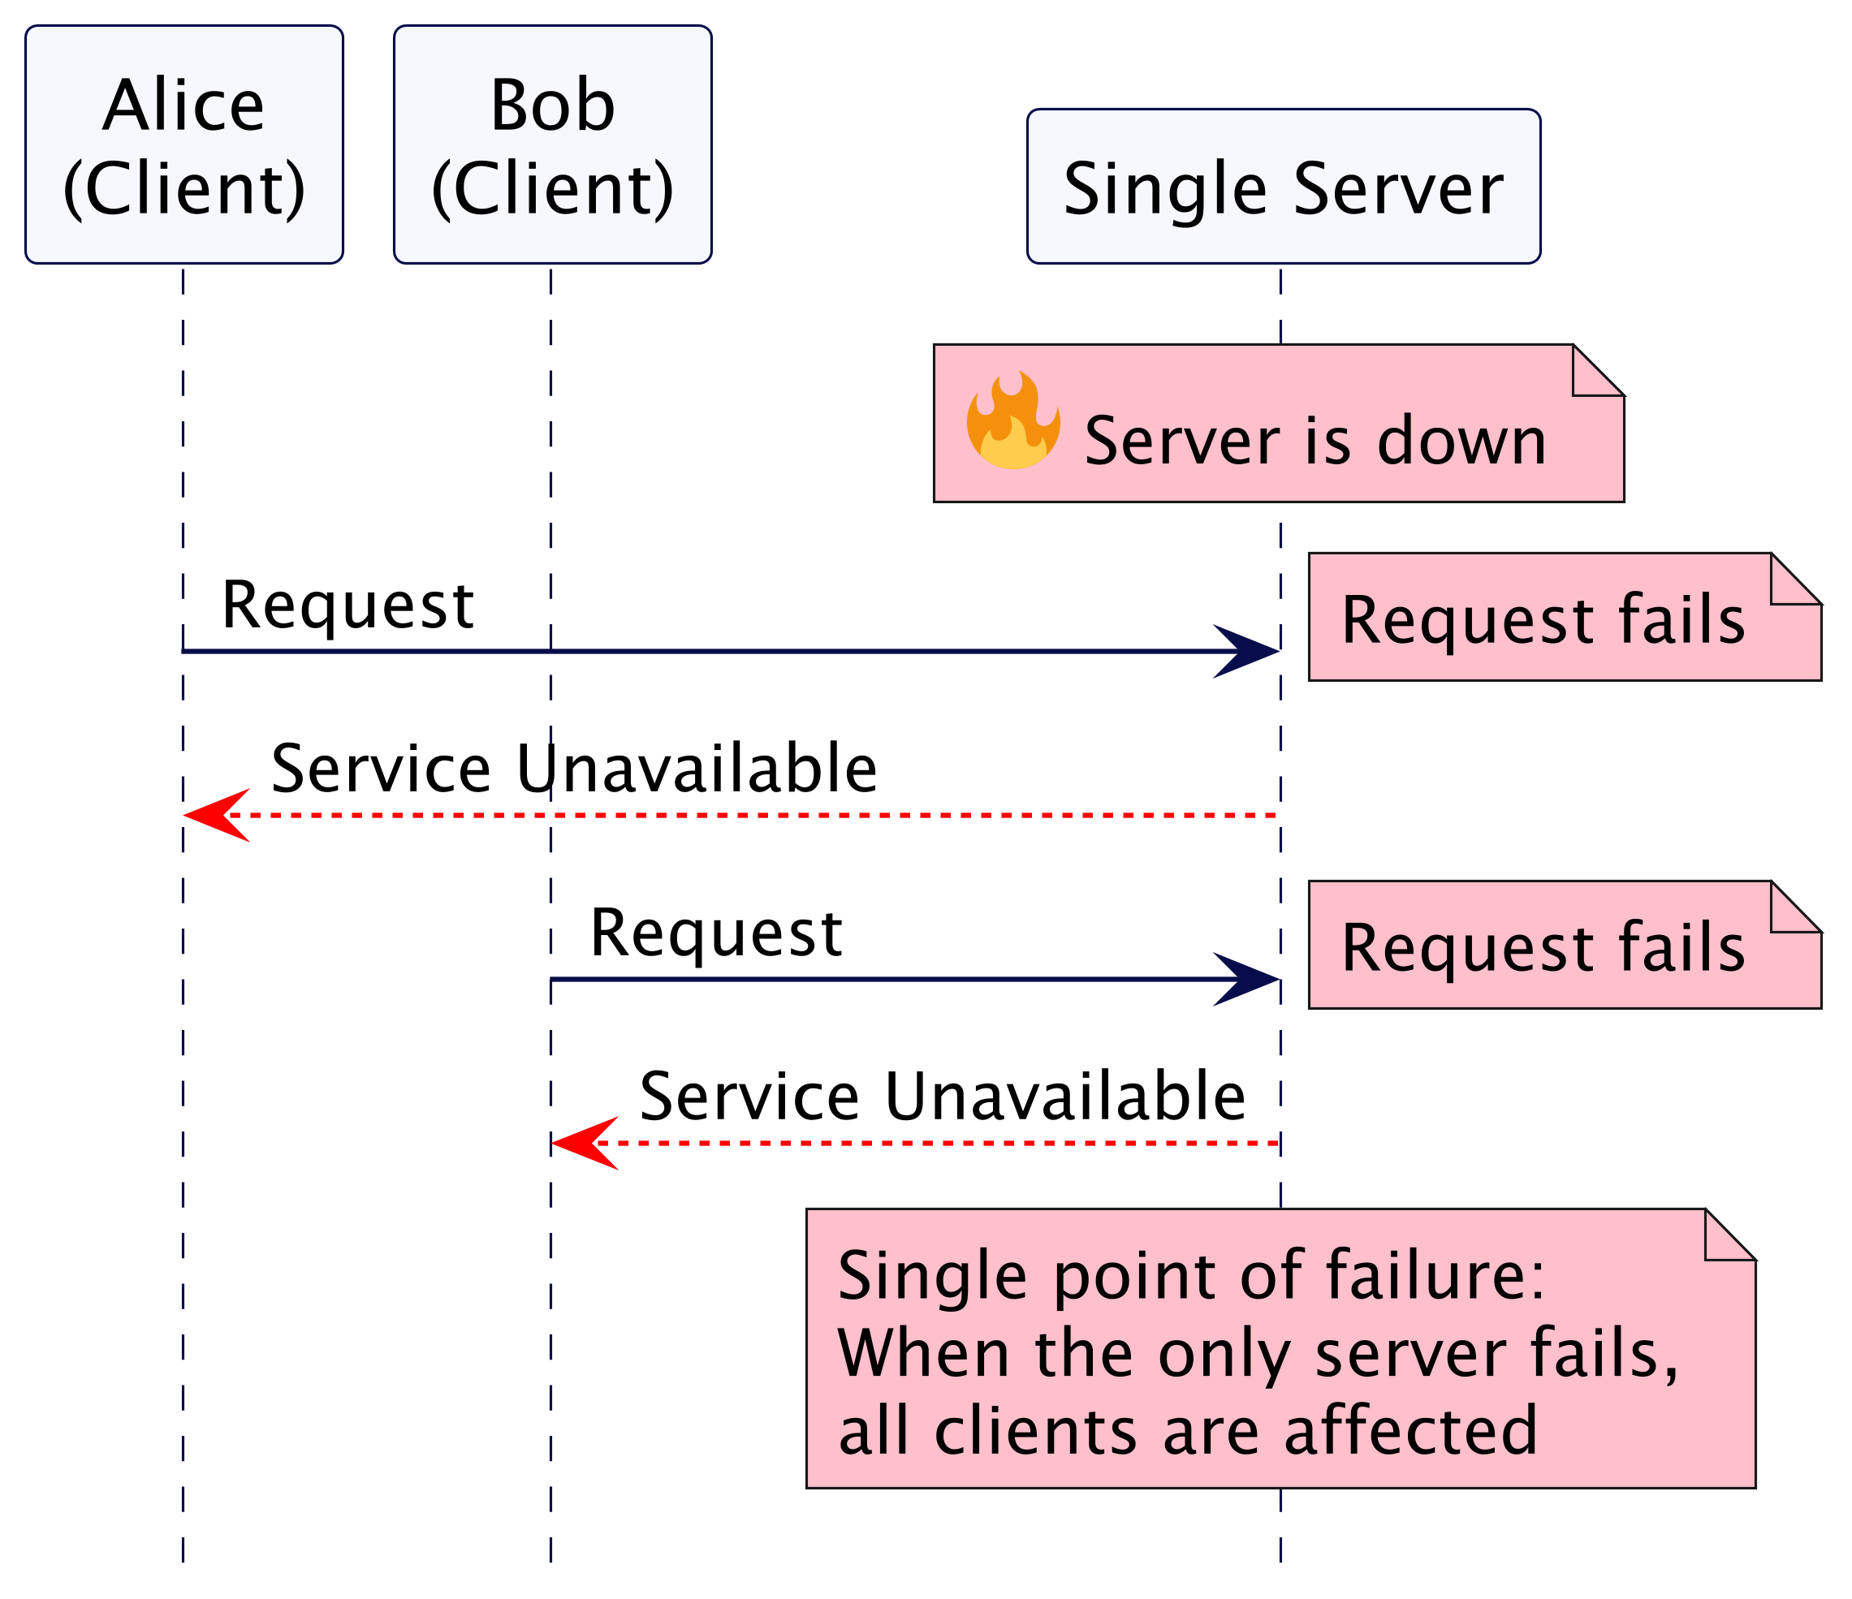
Single Server Lacks Fault Tolerance

Slide 4
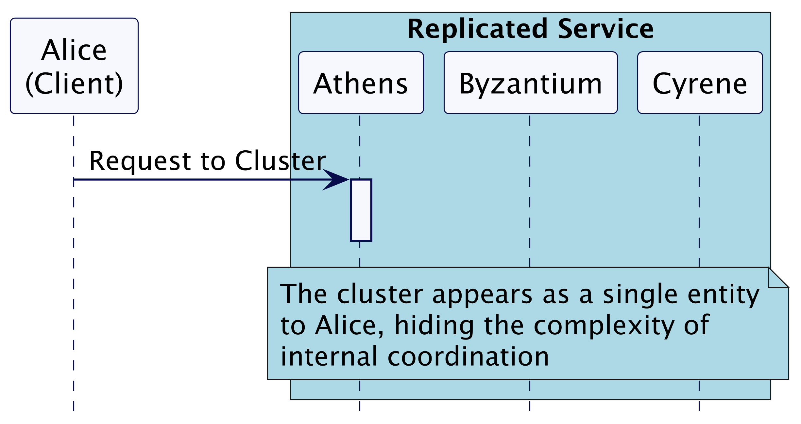
Consensus: Ensuring Consistency in Clustered Environments

Slide 5
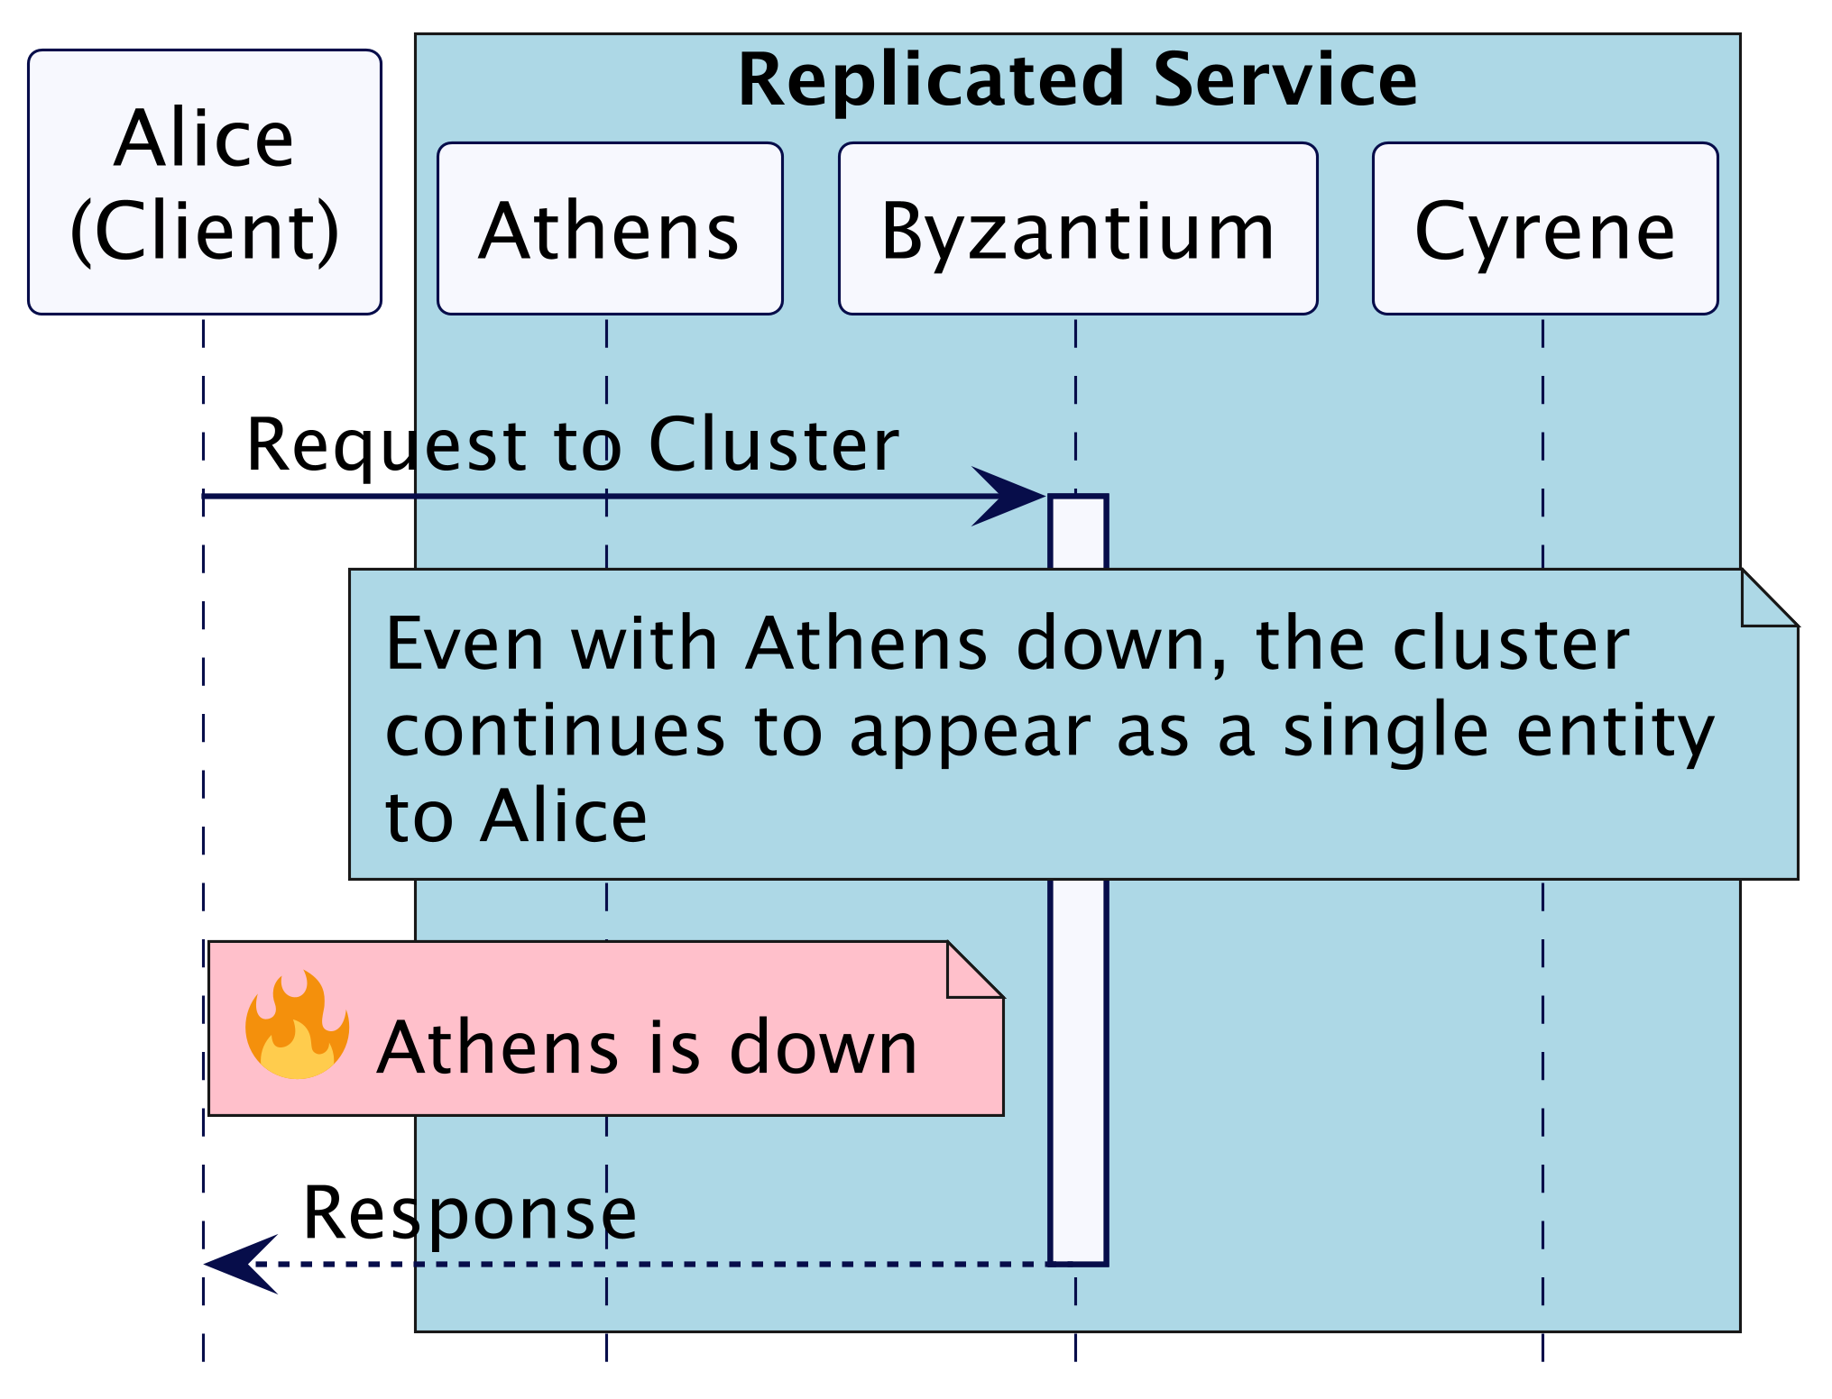
Consensus: Ensuring Consistency in Clustered Environments

Slide 6
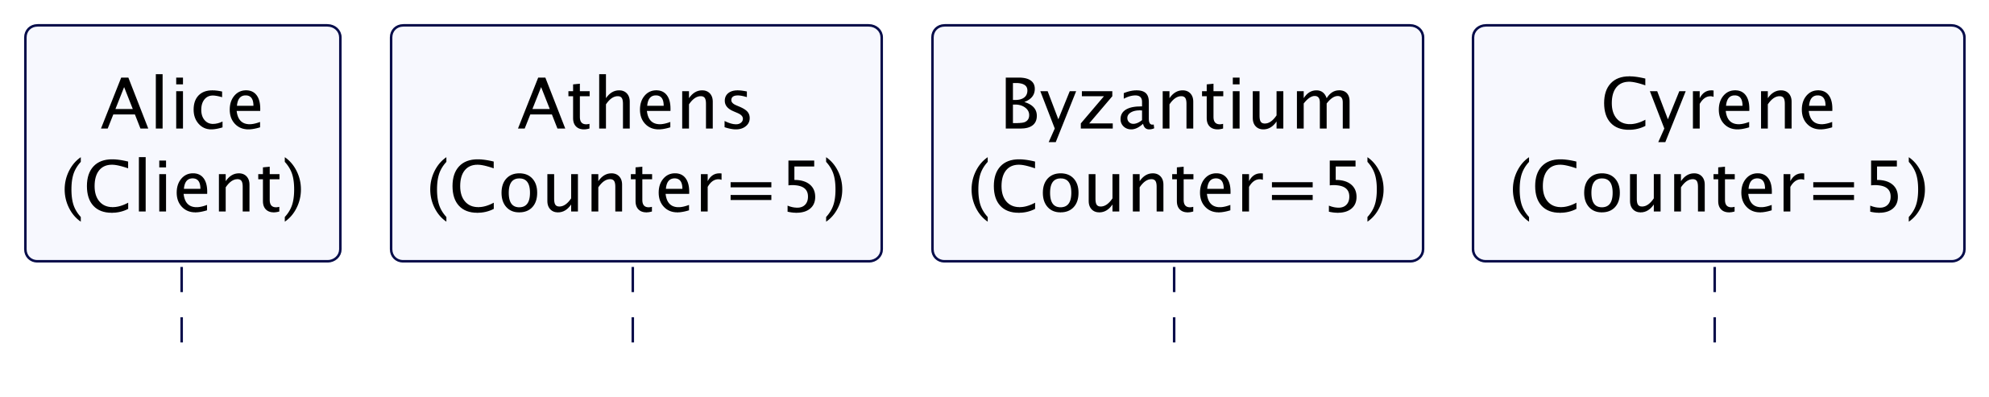
Why Immediate Request Execution is Not Always Possible

Slide 7
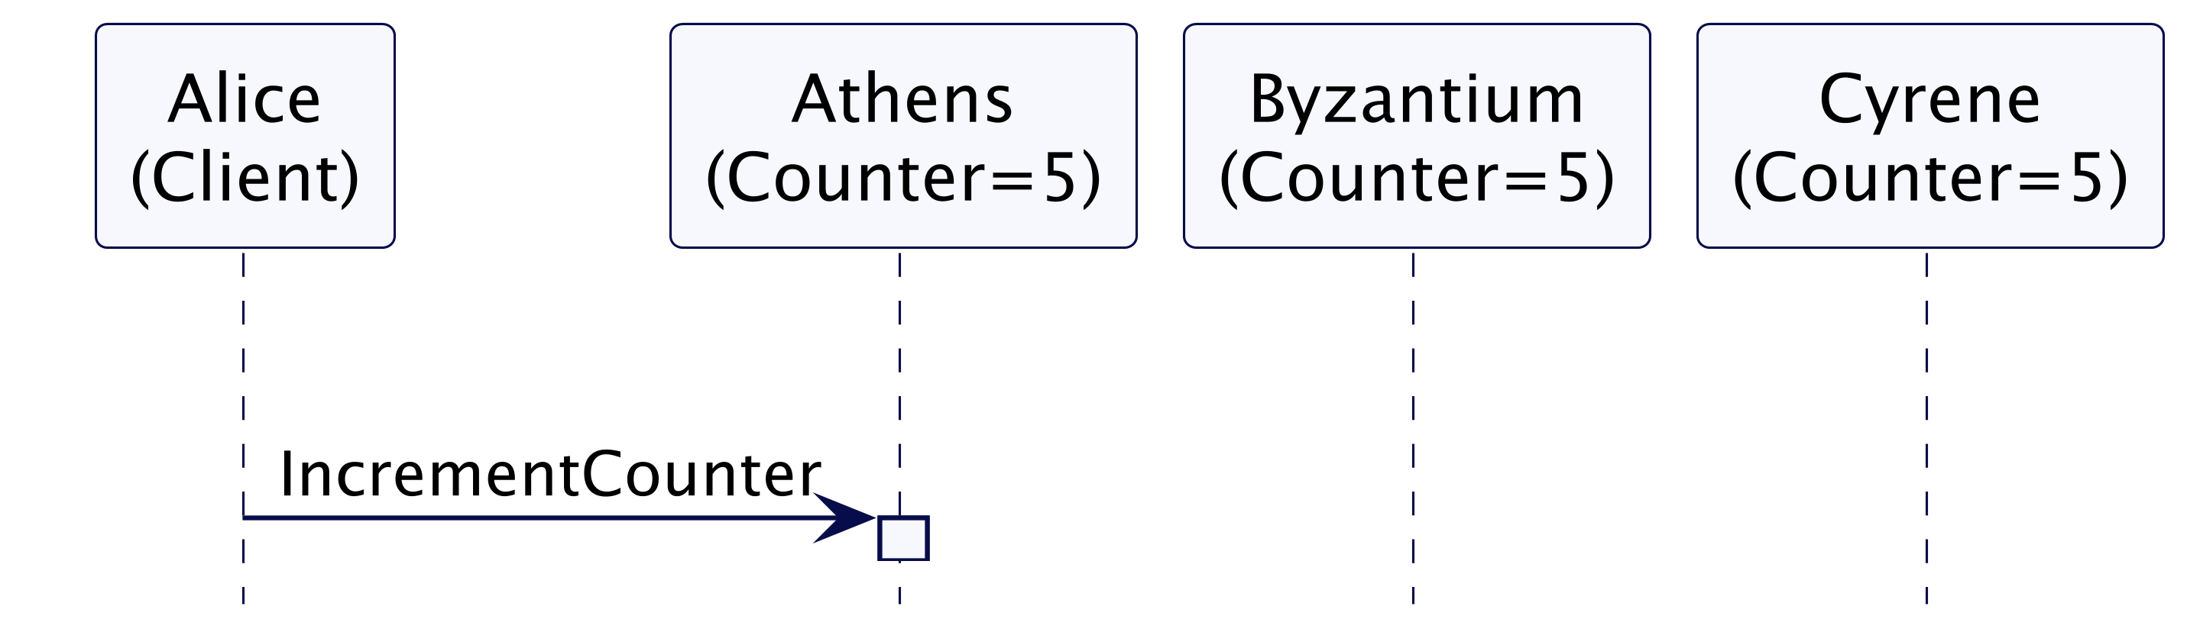
Why Immediate Request Execution is Not Always Possible

Slide 8
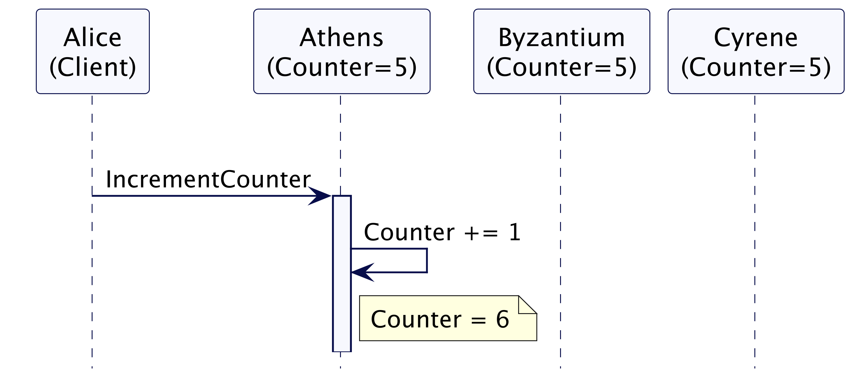
Why Immediate Request Execution is Not Always Possible

Slide 9
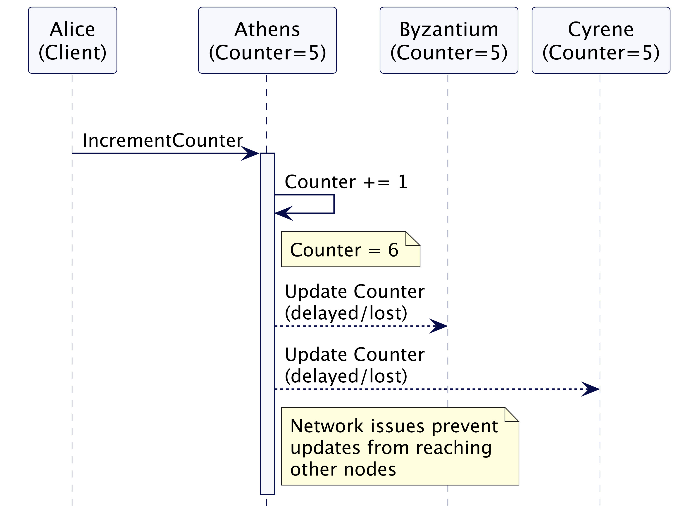
Why Immediate Request Execution is Not Always Possible

Slide 10
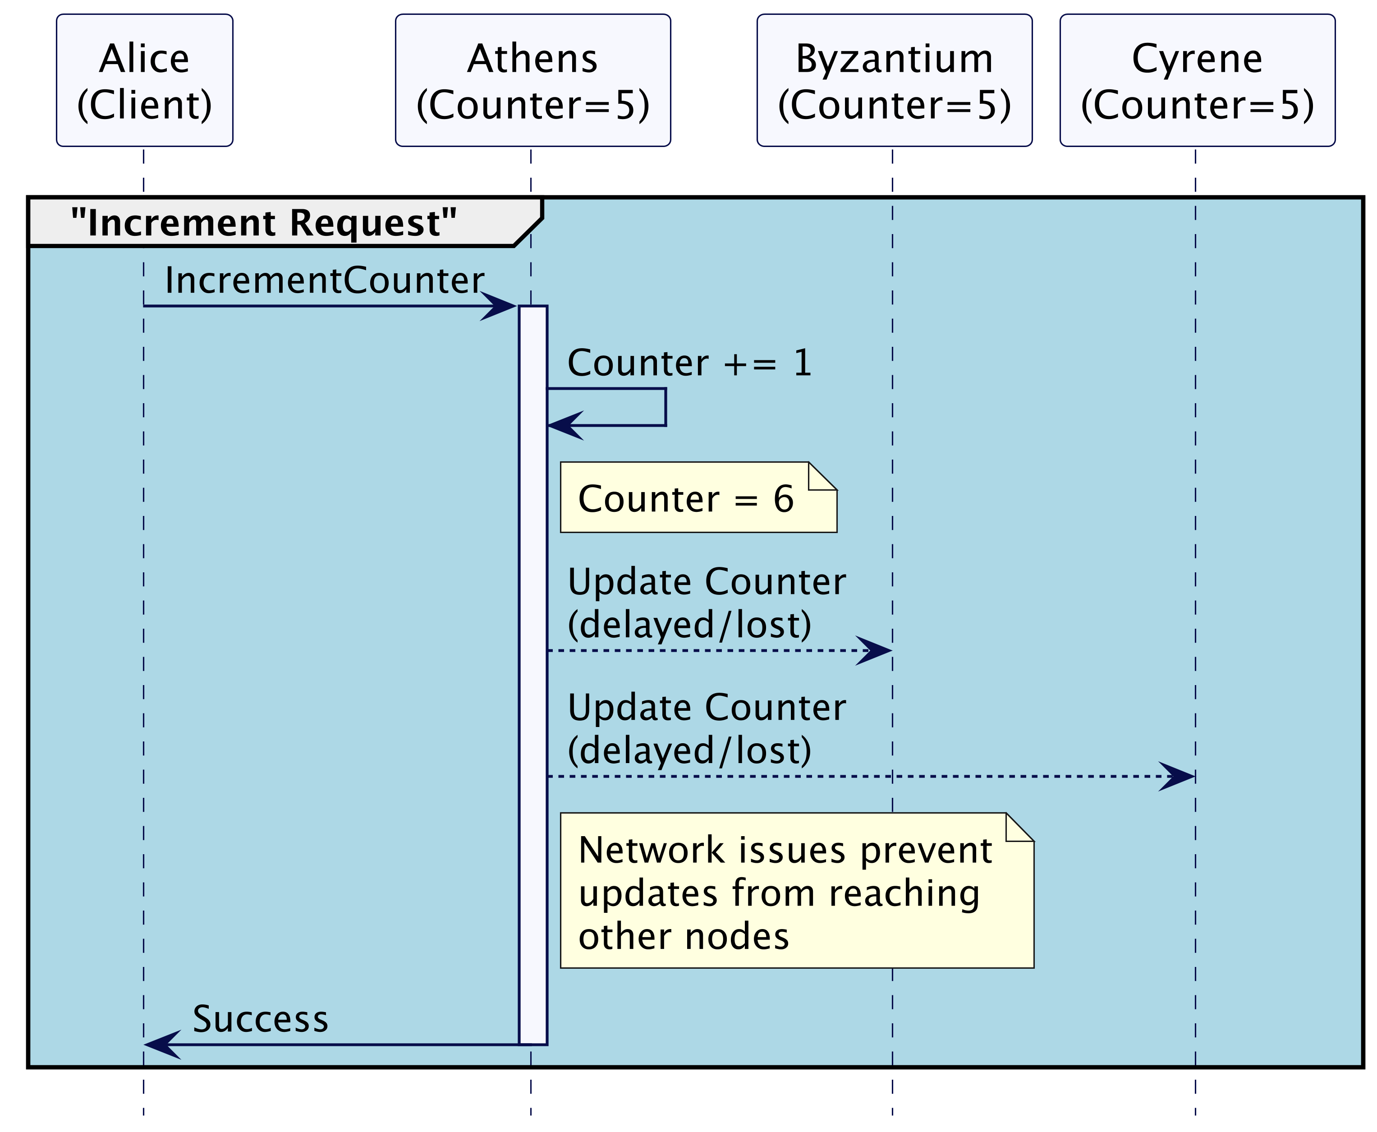
Why Immediate Request Execution is Not Always Possible

Slide 11
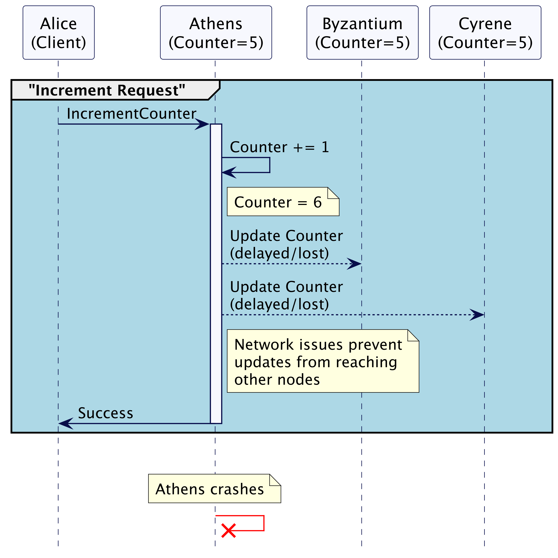
Why Immediate Request Execution is Not Always Possible

Slide 12
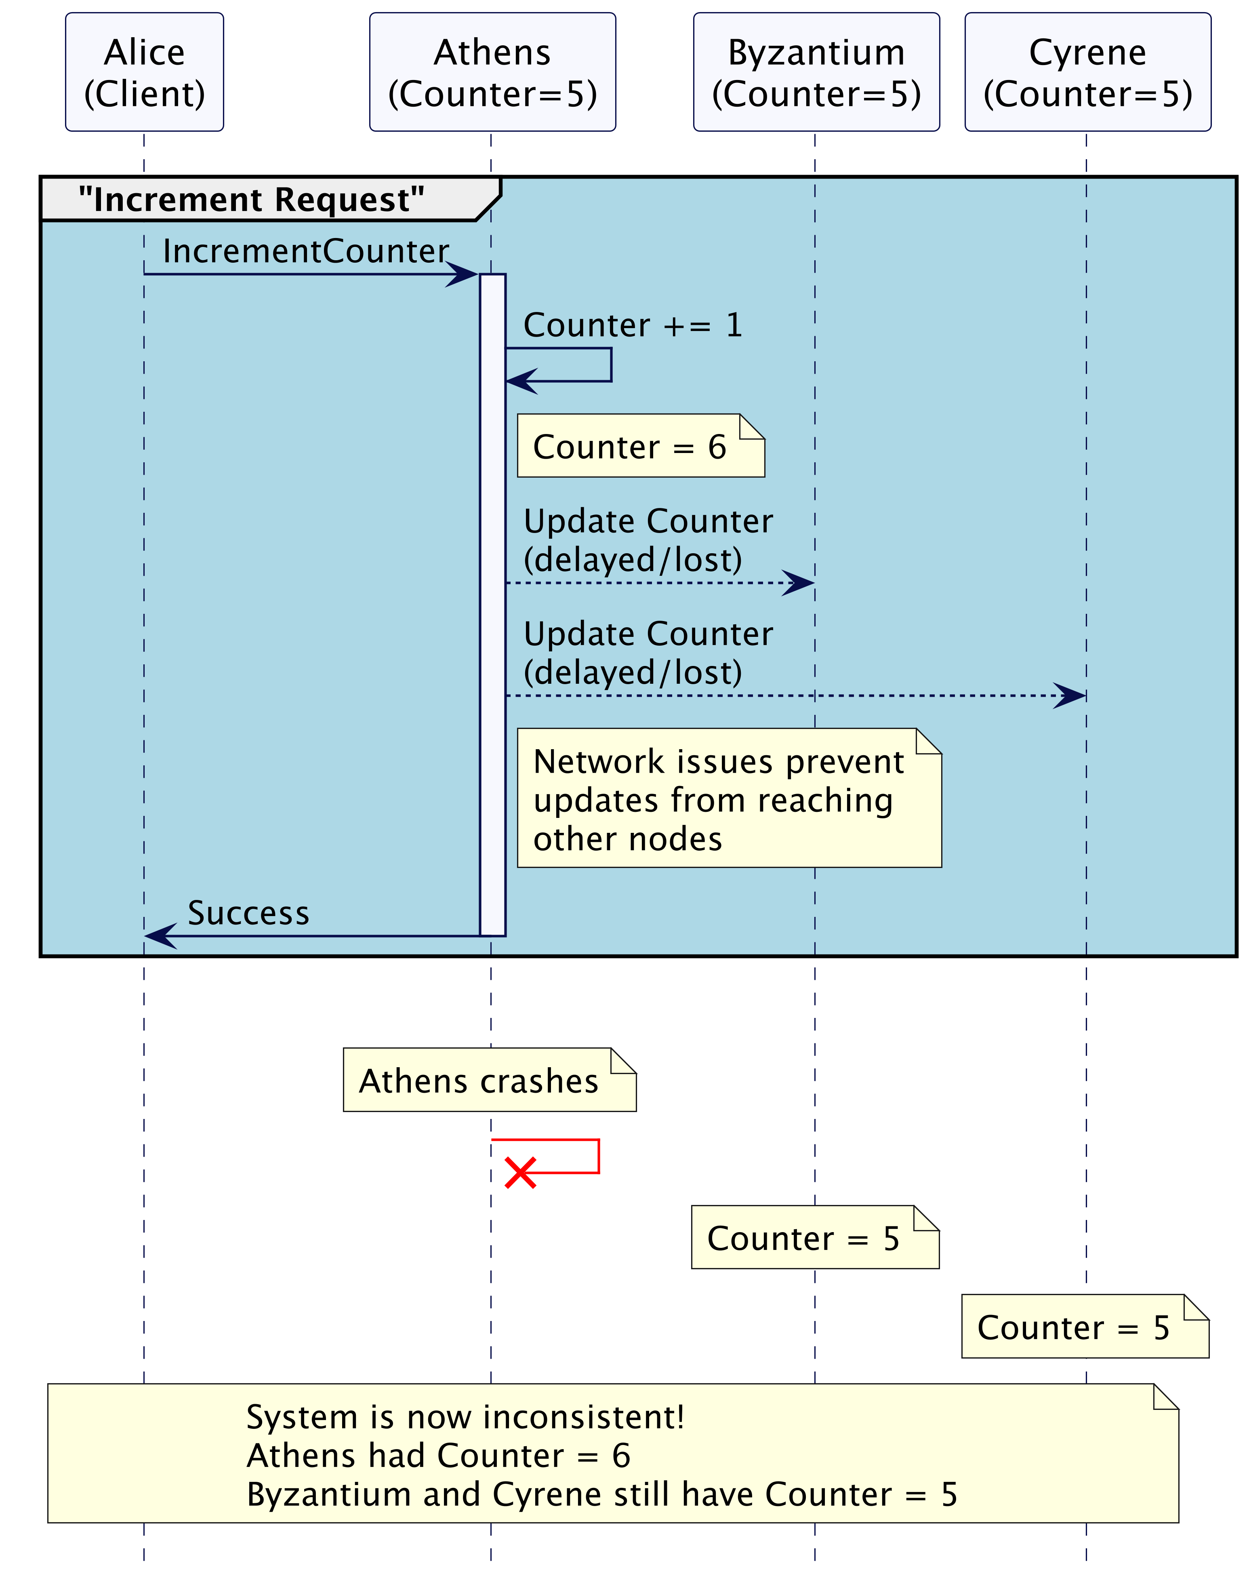
Why Immediate Request Execution is Not Always Possible

Slide 13
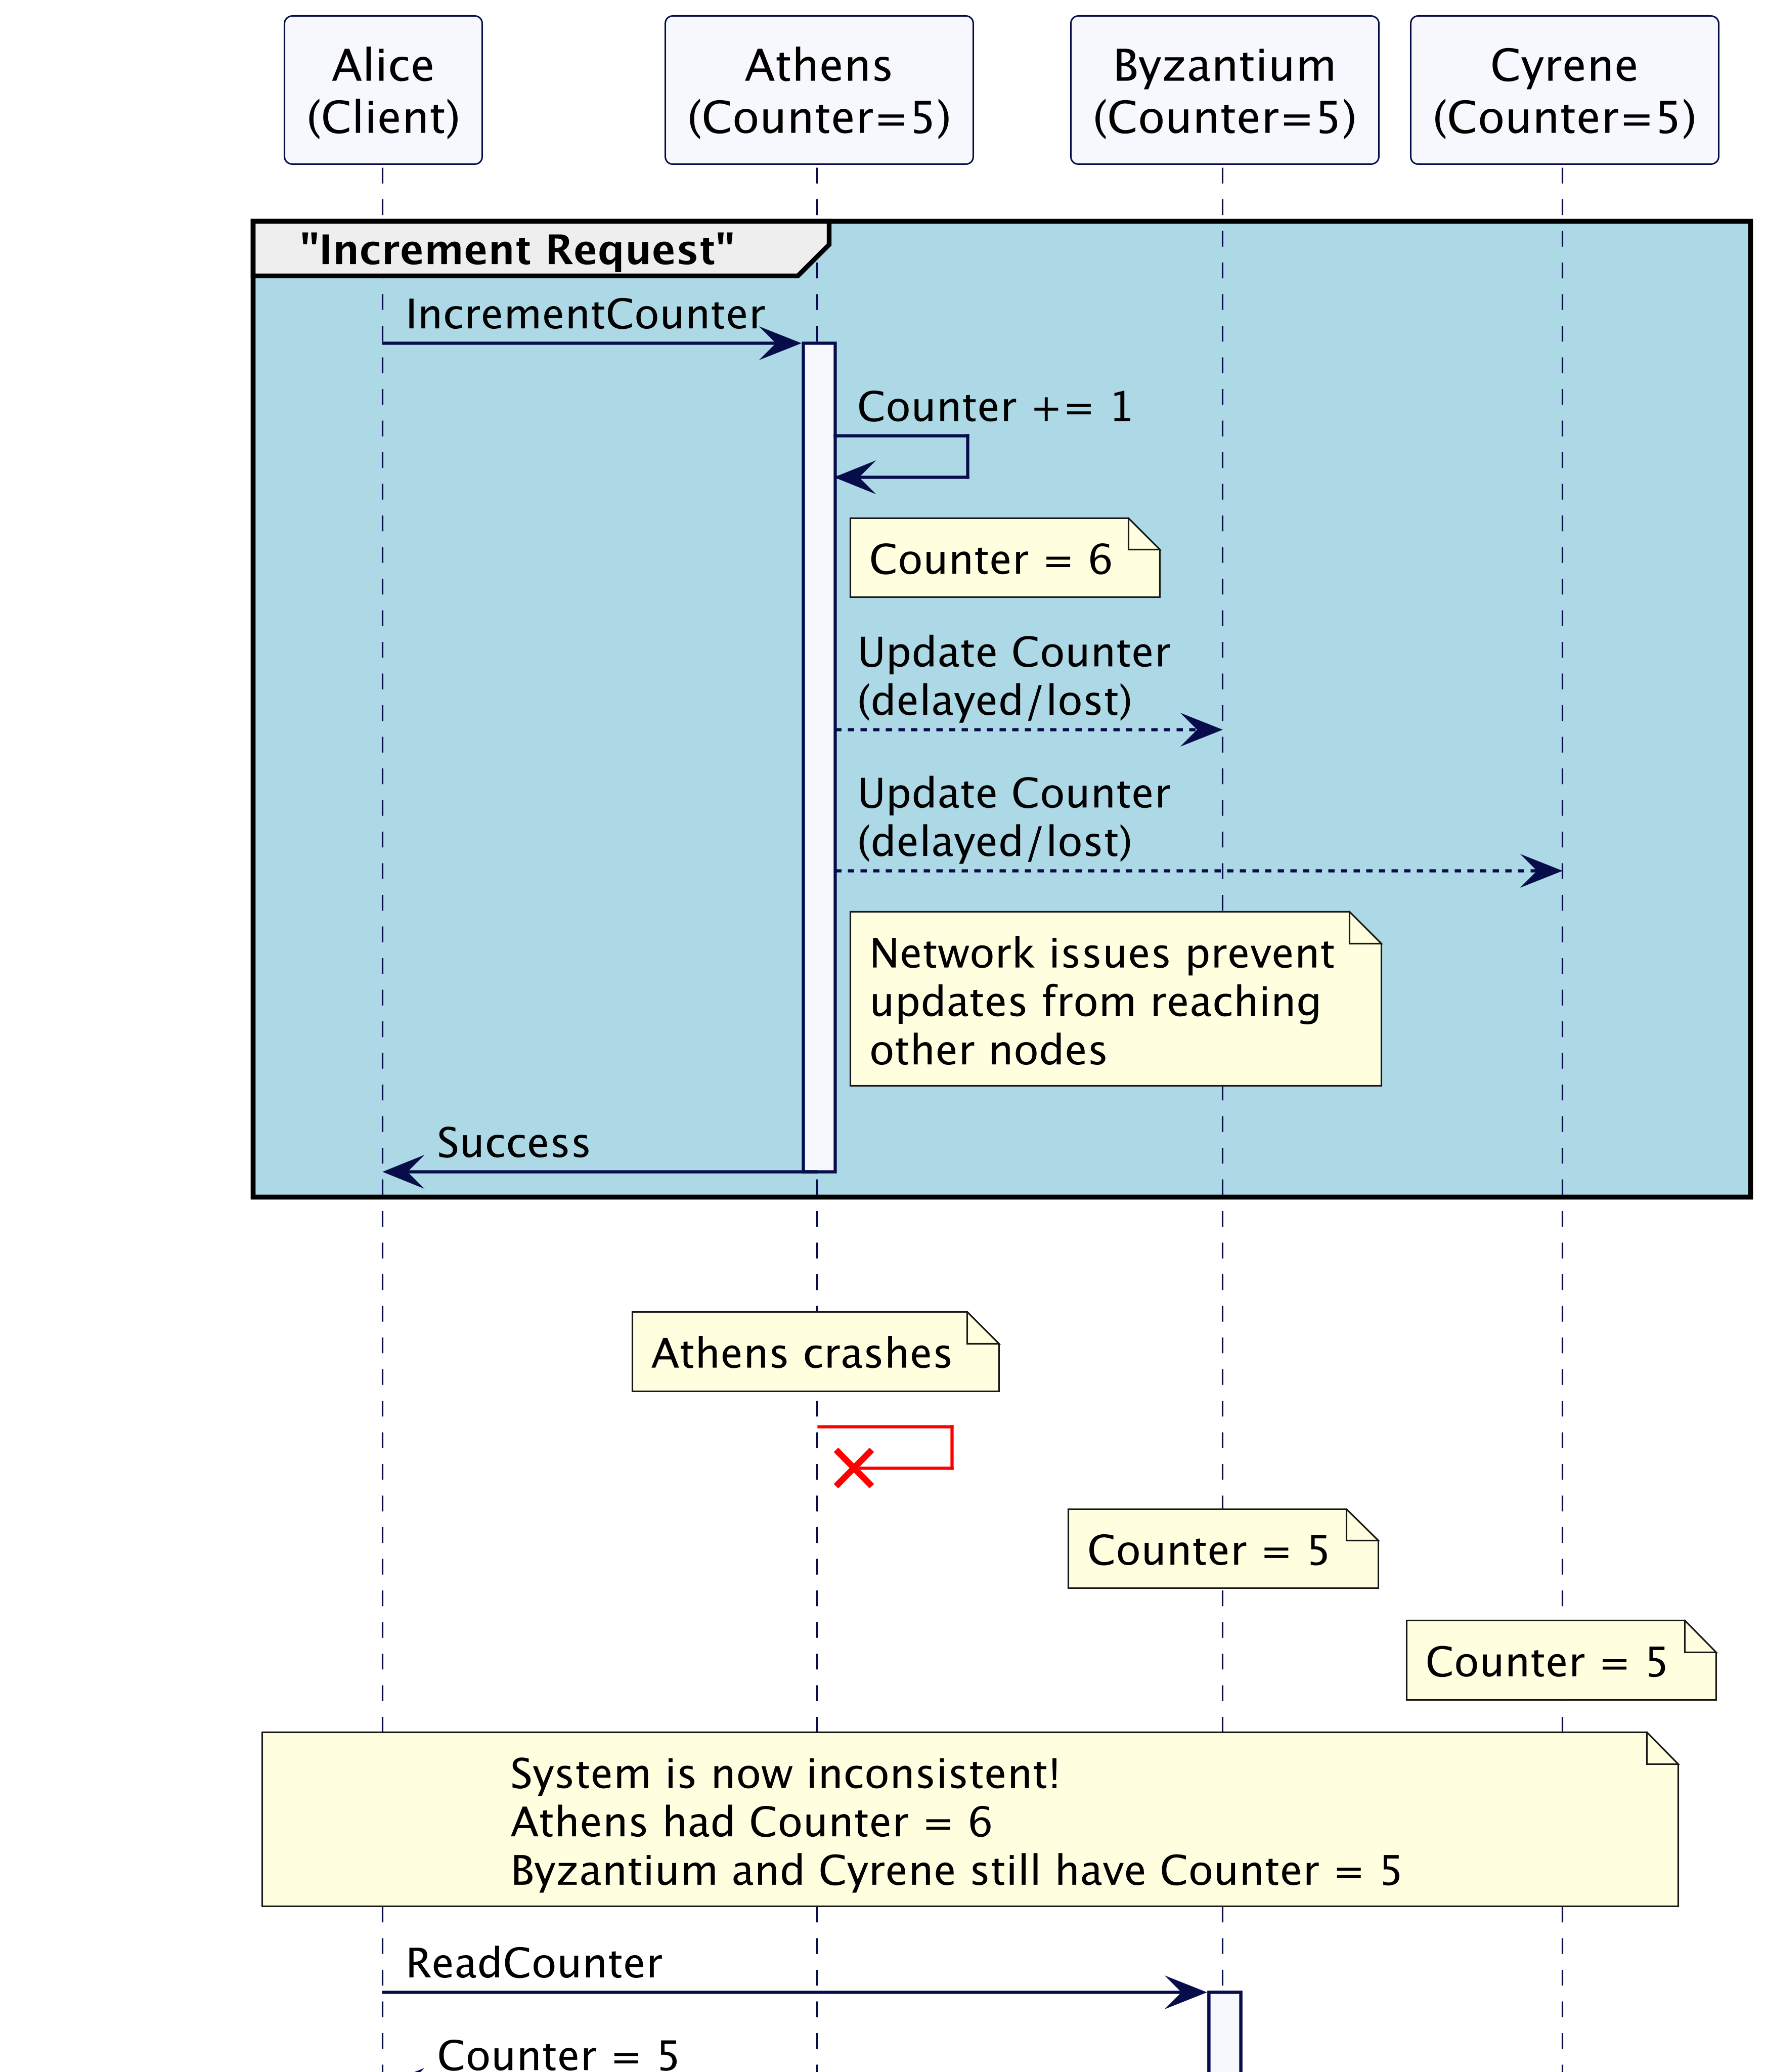
Why Immediate Request Execution is Not Always Possible

Slide 14
The Need for Two-Phase Execution

Slide 15
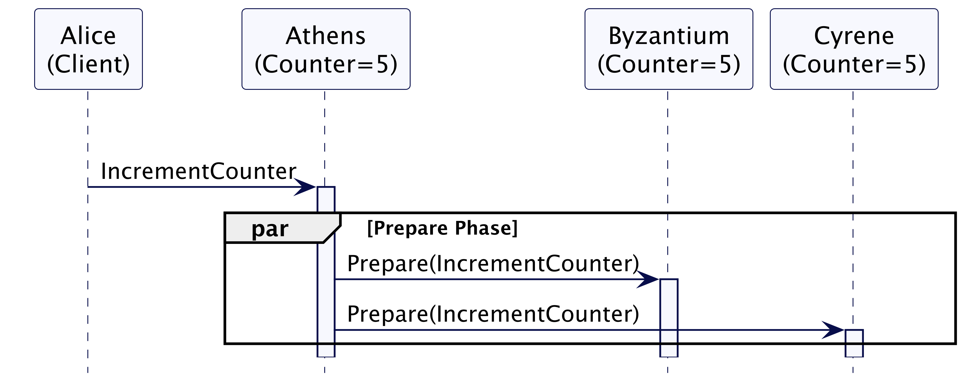
The Need for Two-Phase Execution

Slide 16
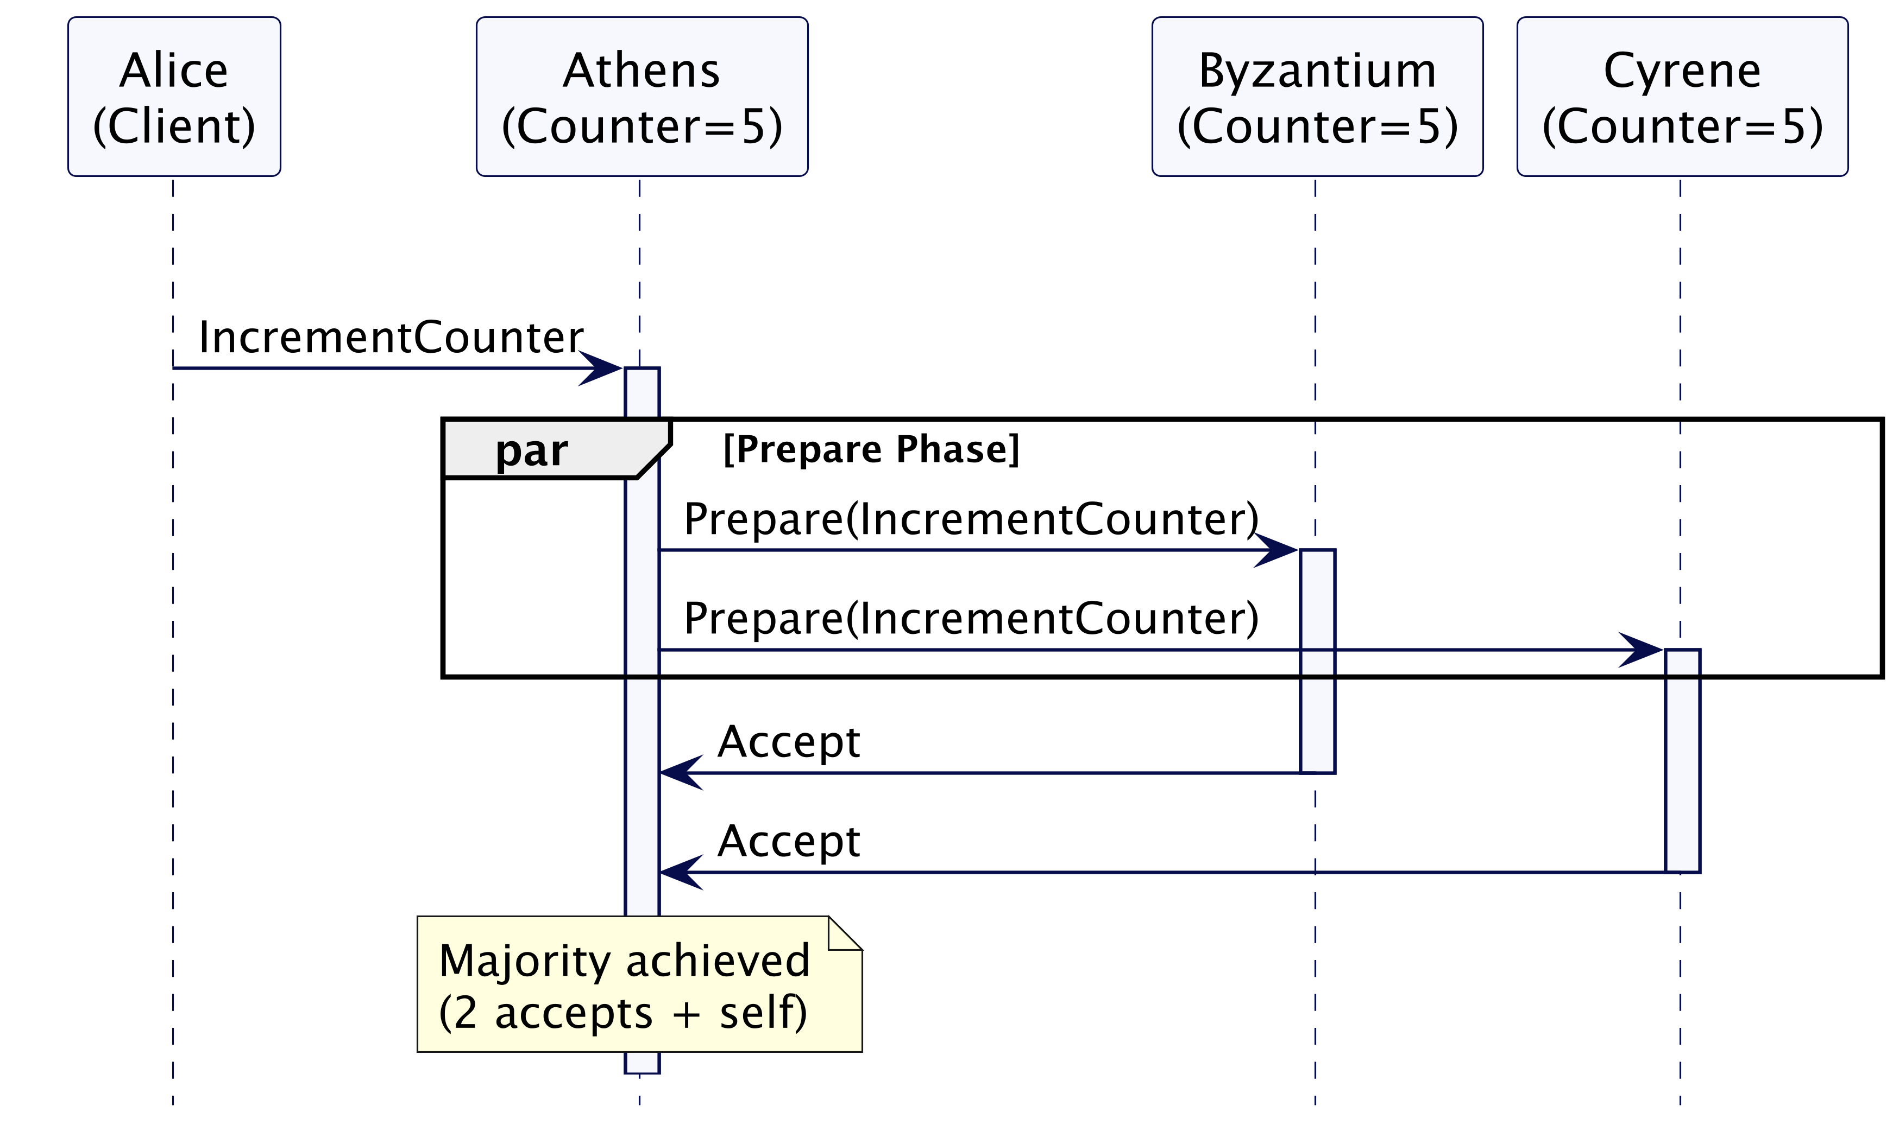
The Need for Two-Phase Execution

Slide 17
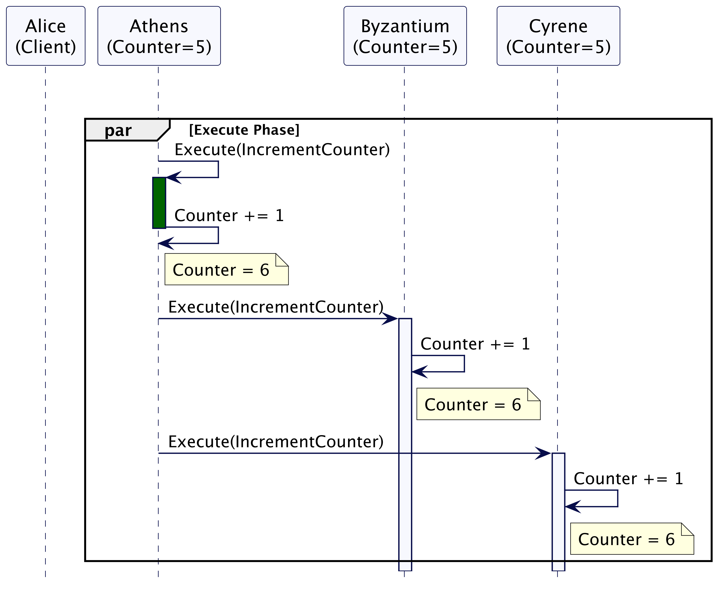
The Need for Two-Phase Execution

Slide 18
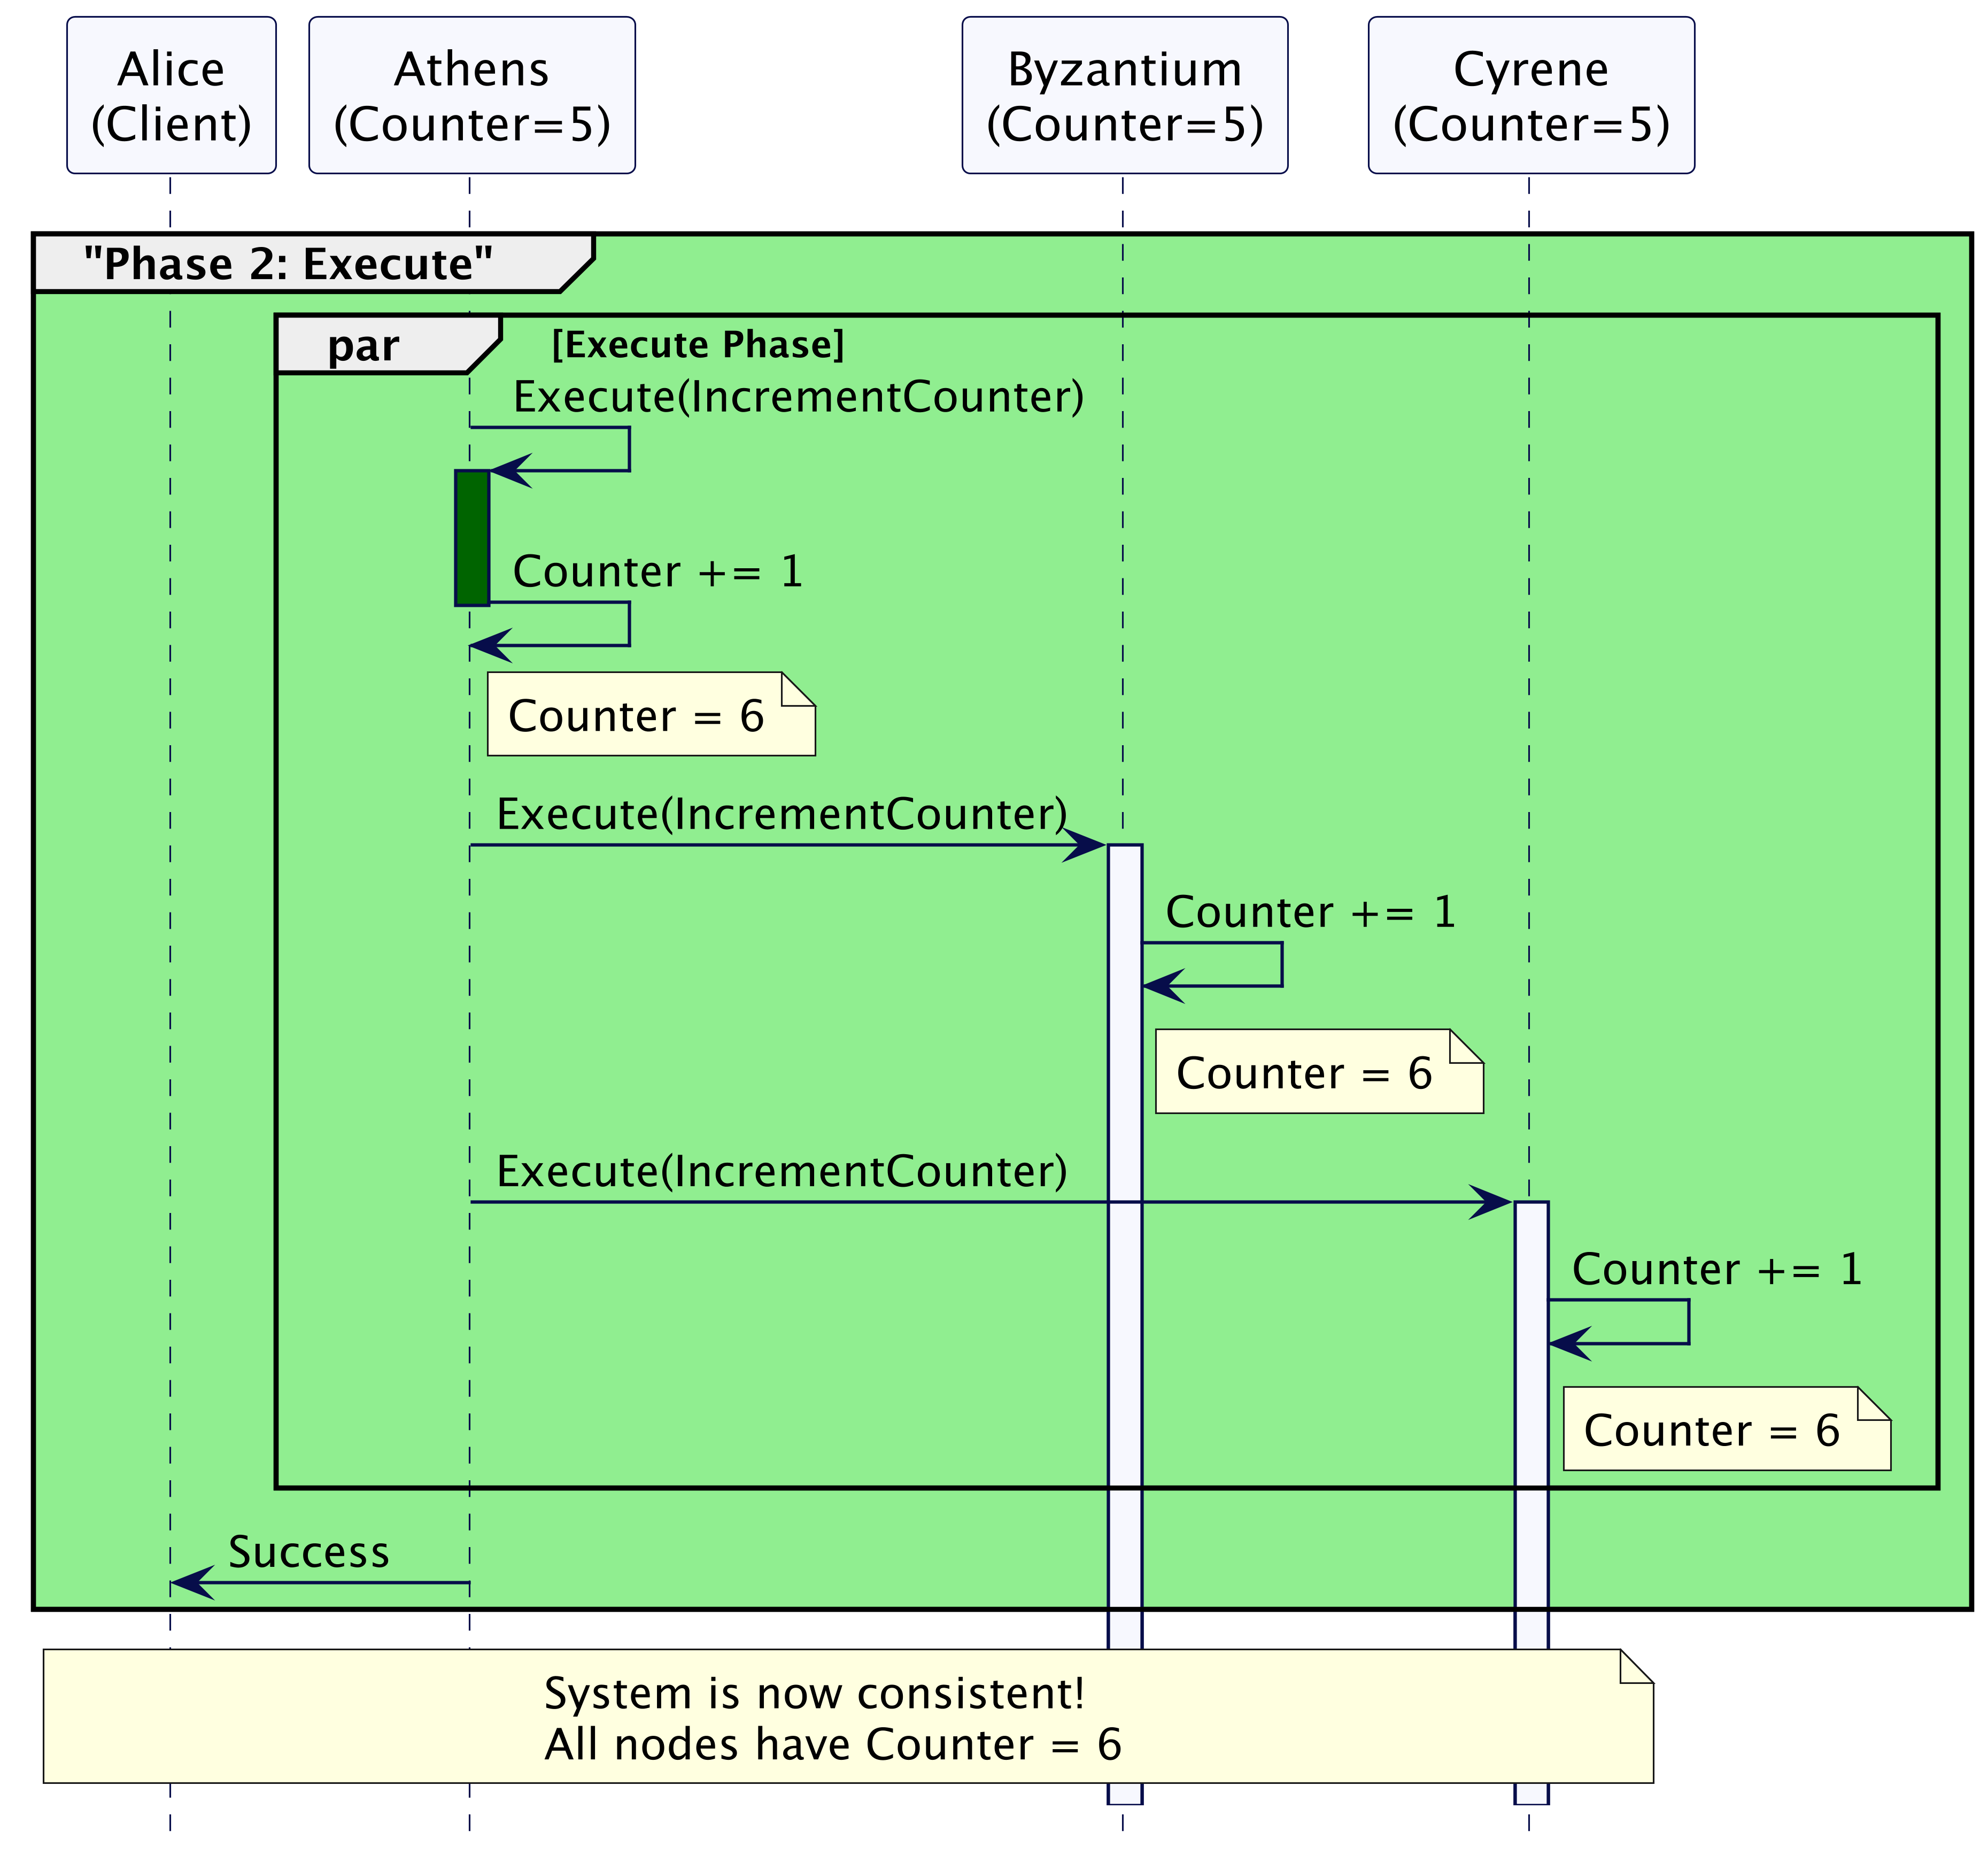
The Need for Two-Phase Execution

Slide 19
The Commit requests can get lost

Slide 20
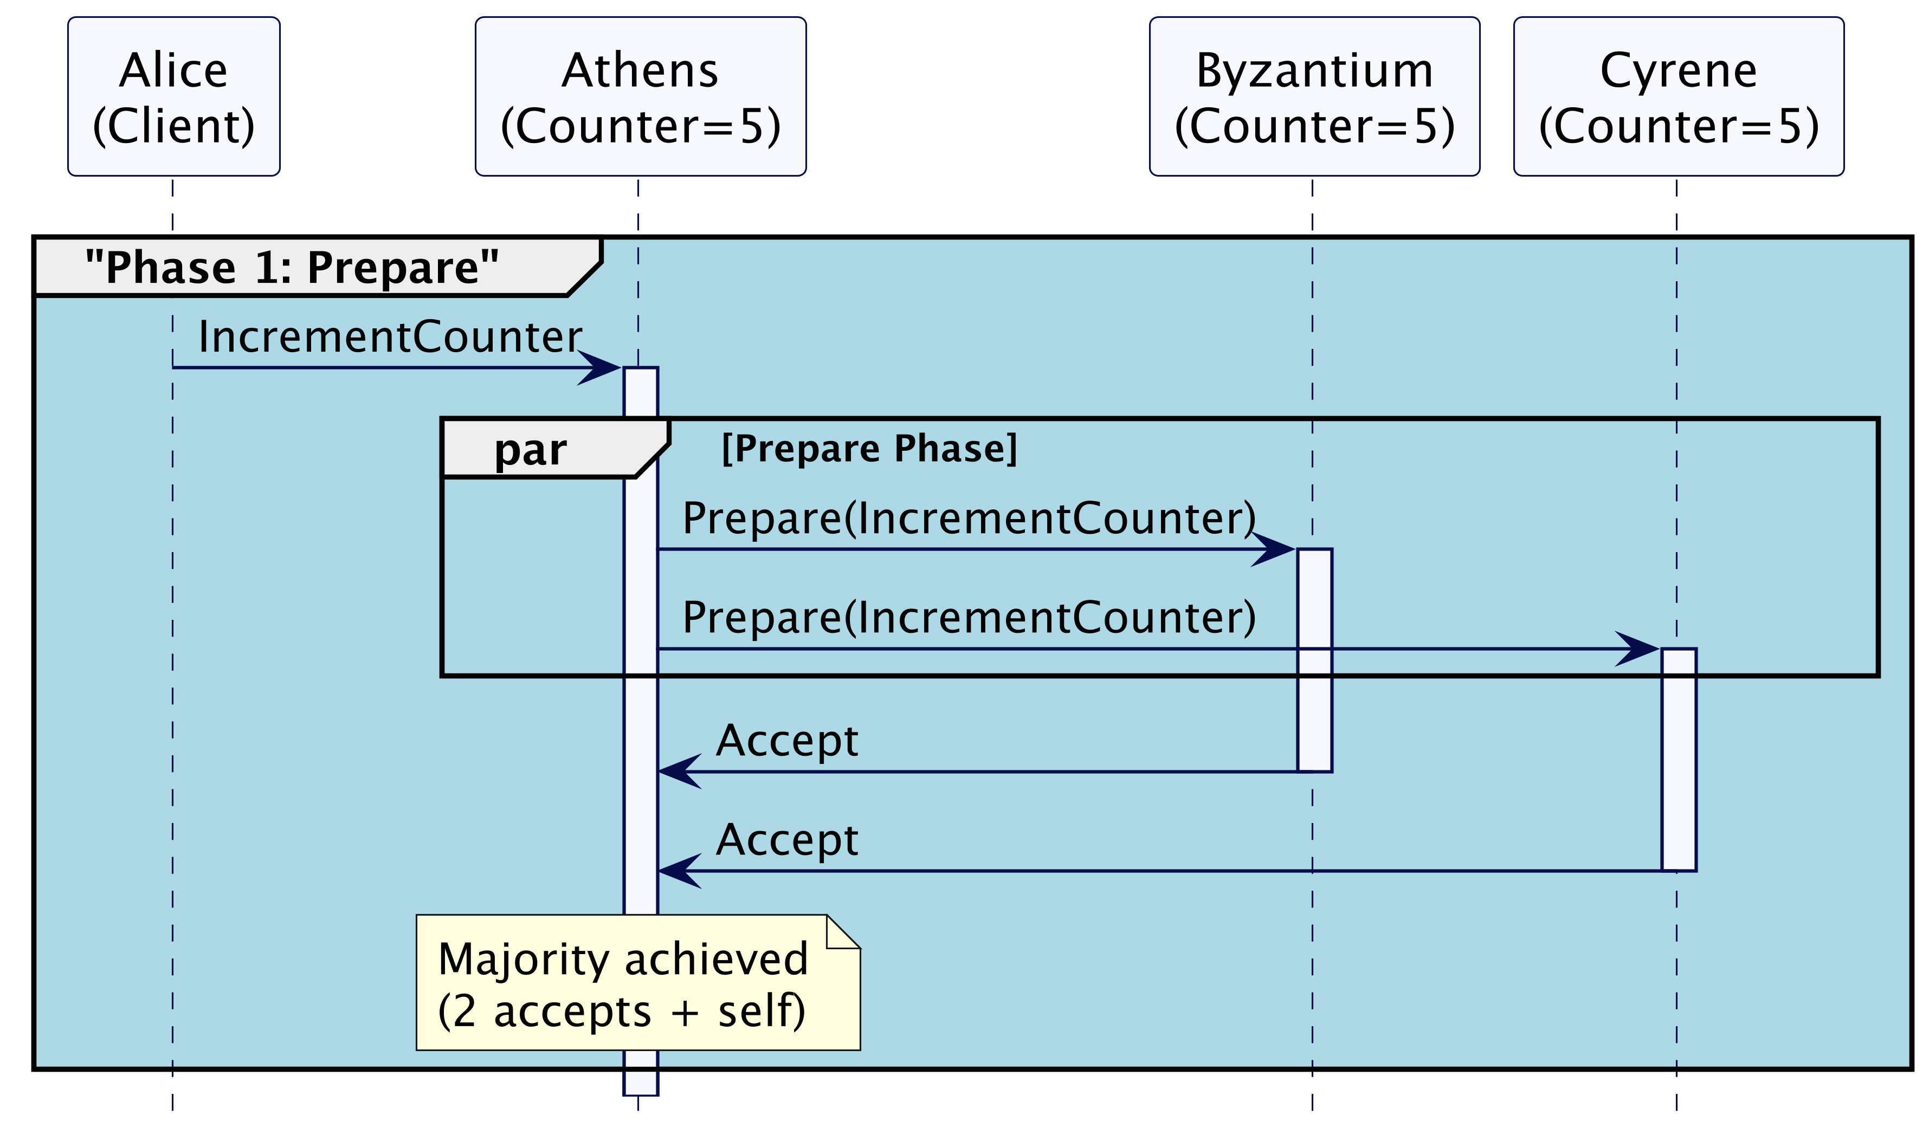
The Commit requests can get lost

Slide 21
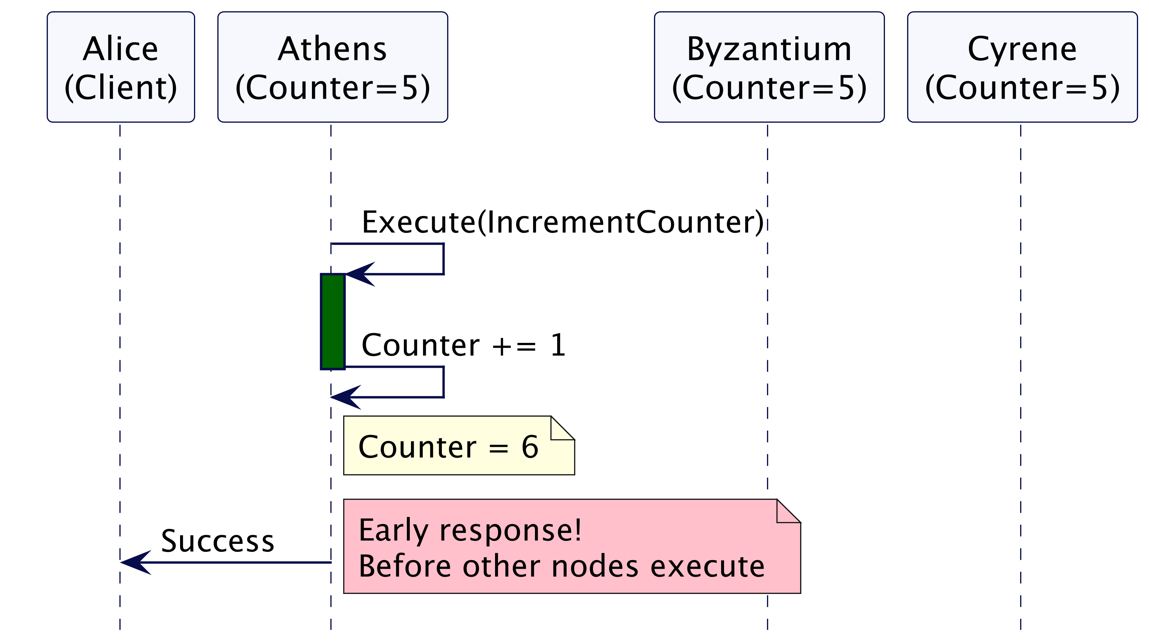
The Commit requests can get lost

Slide 22
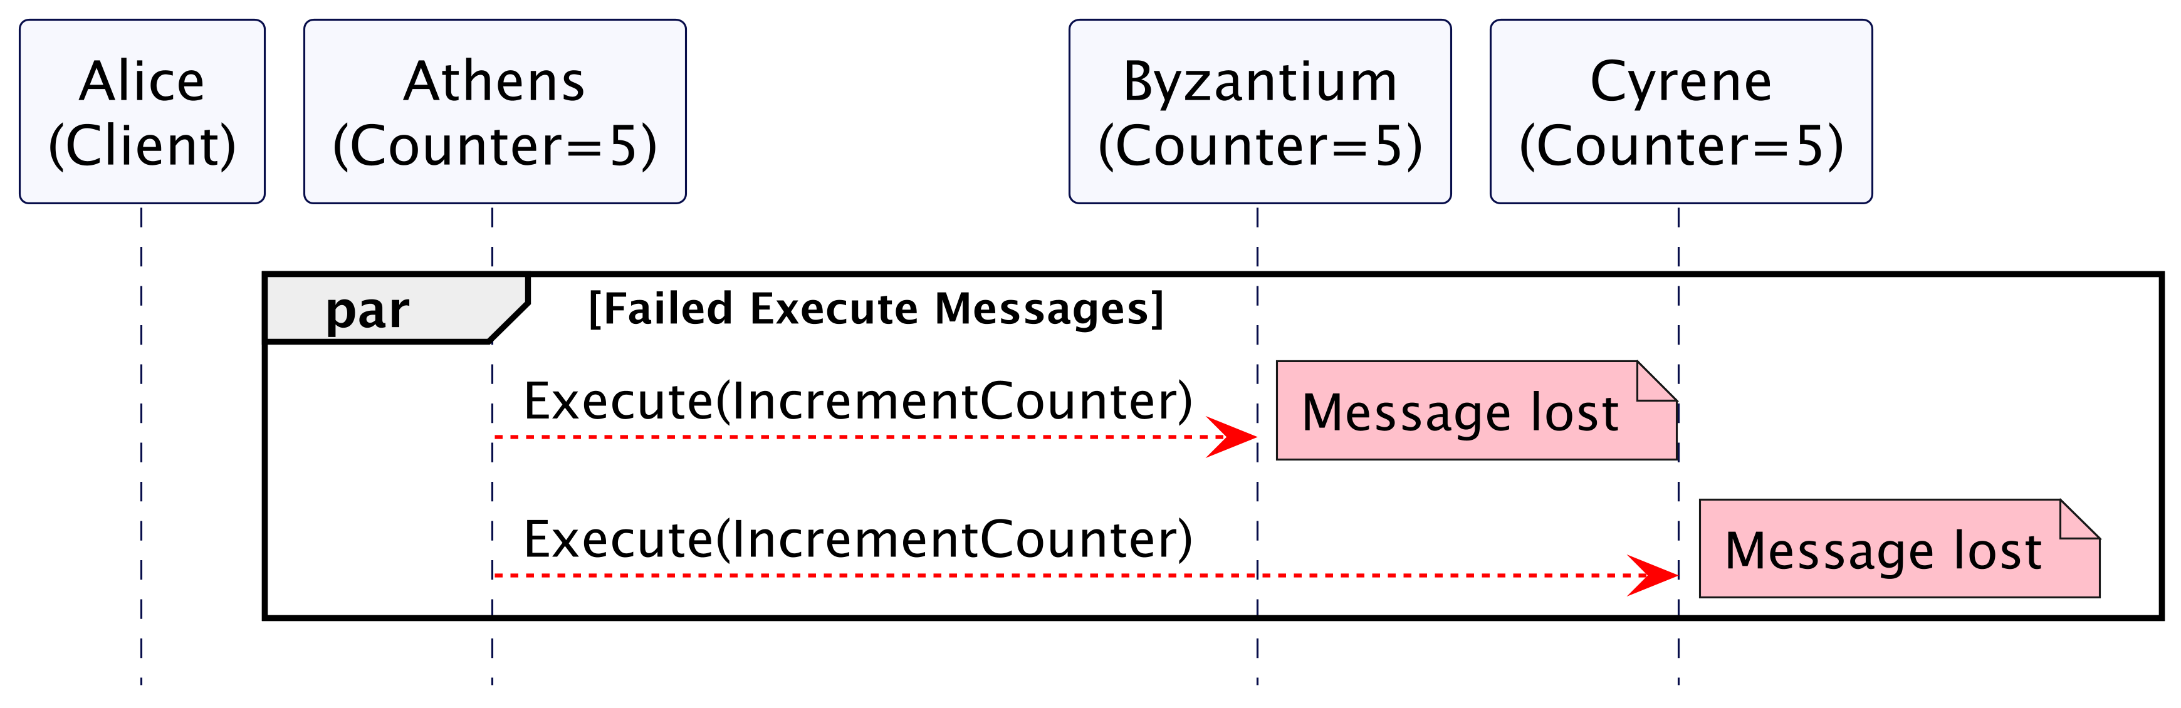
The Commit requests can get lost

Slide 23
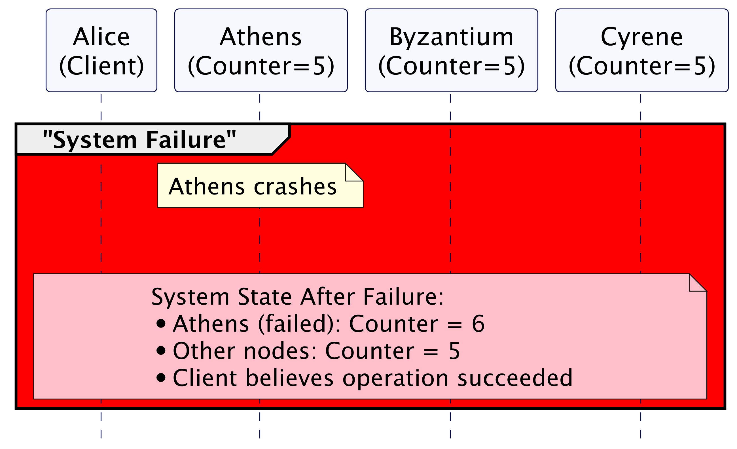
The Commit requests can get lost

Slide 24
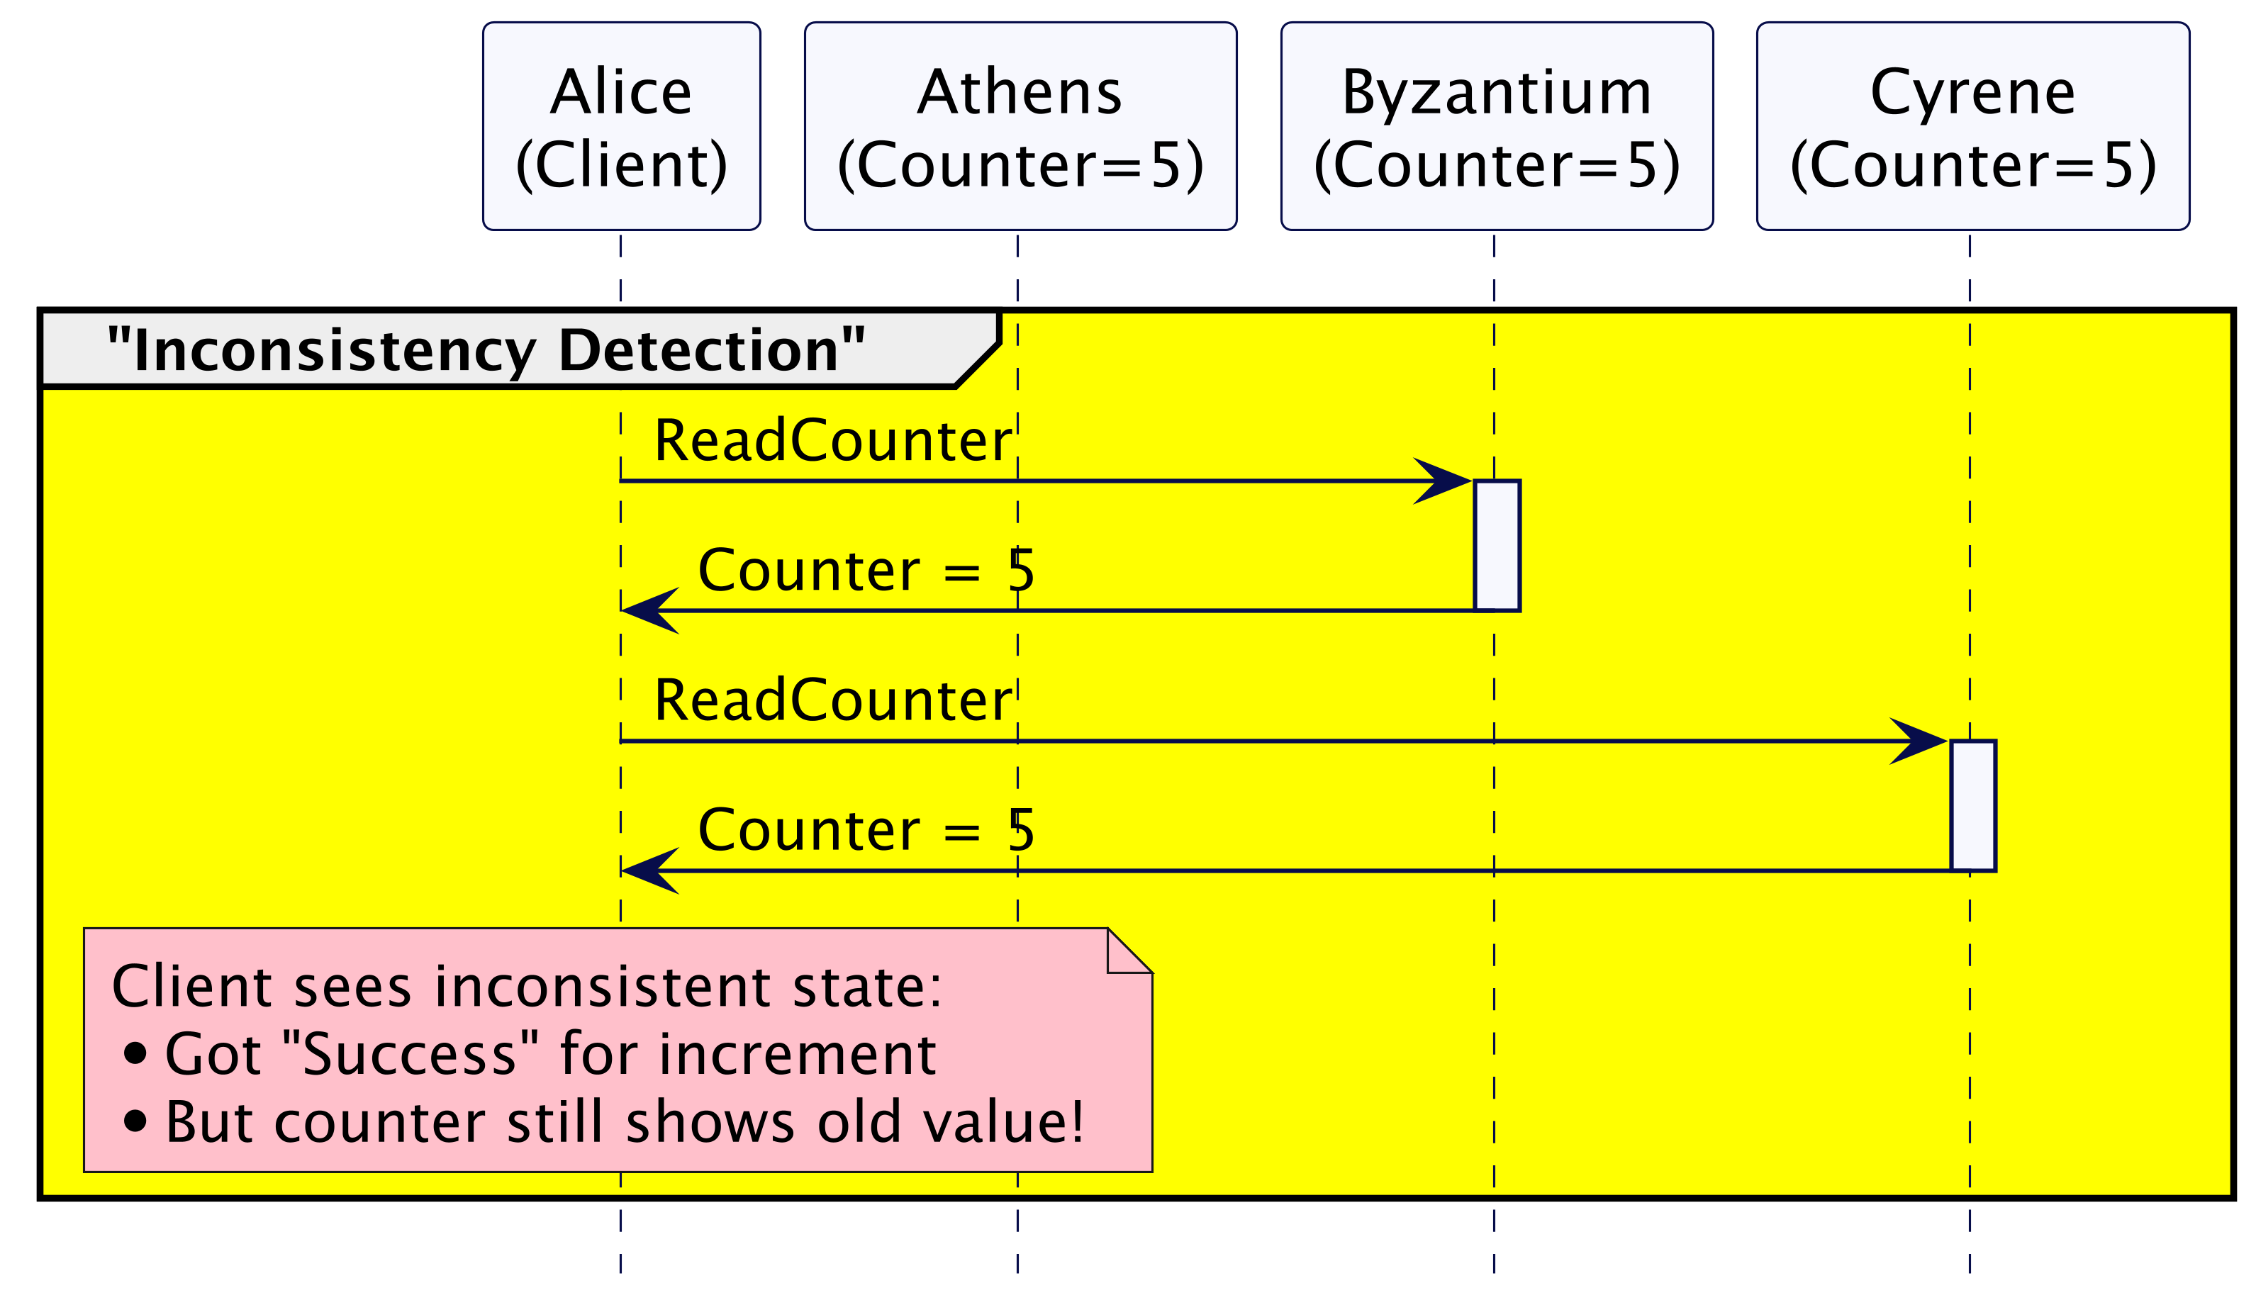
The Commit requests can get lost

Slide 25
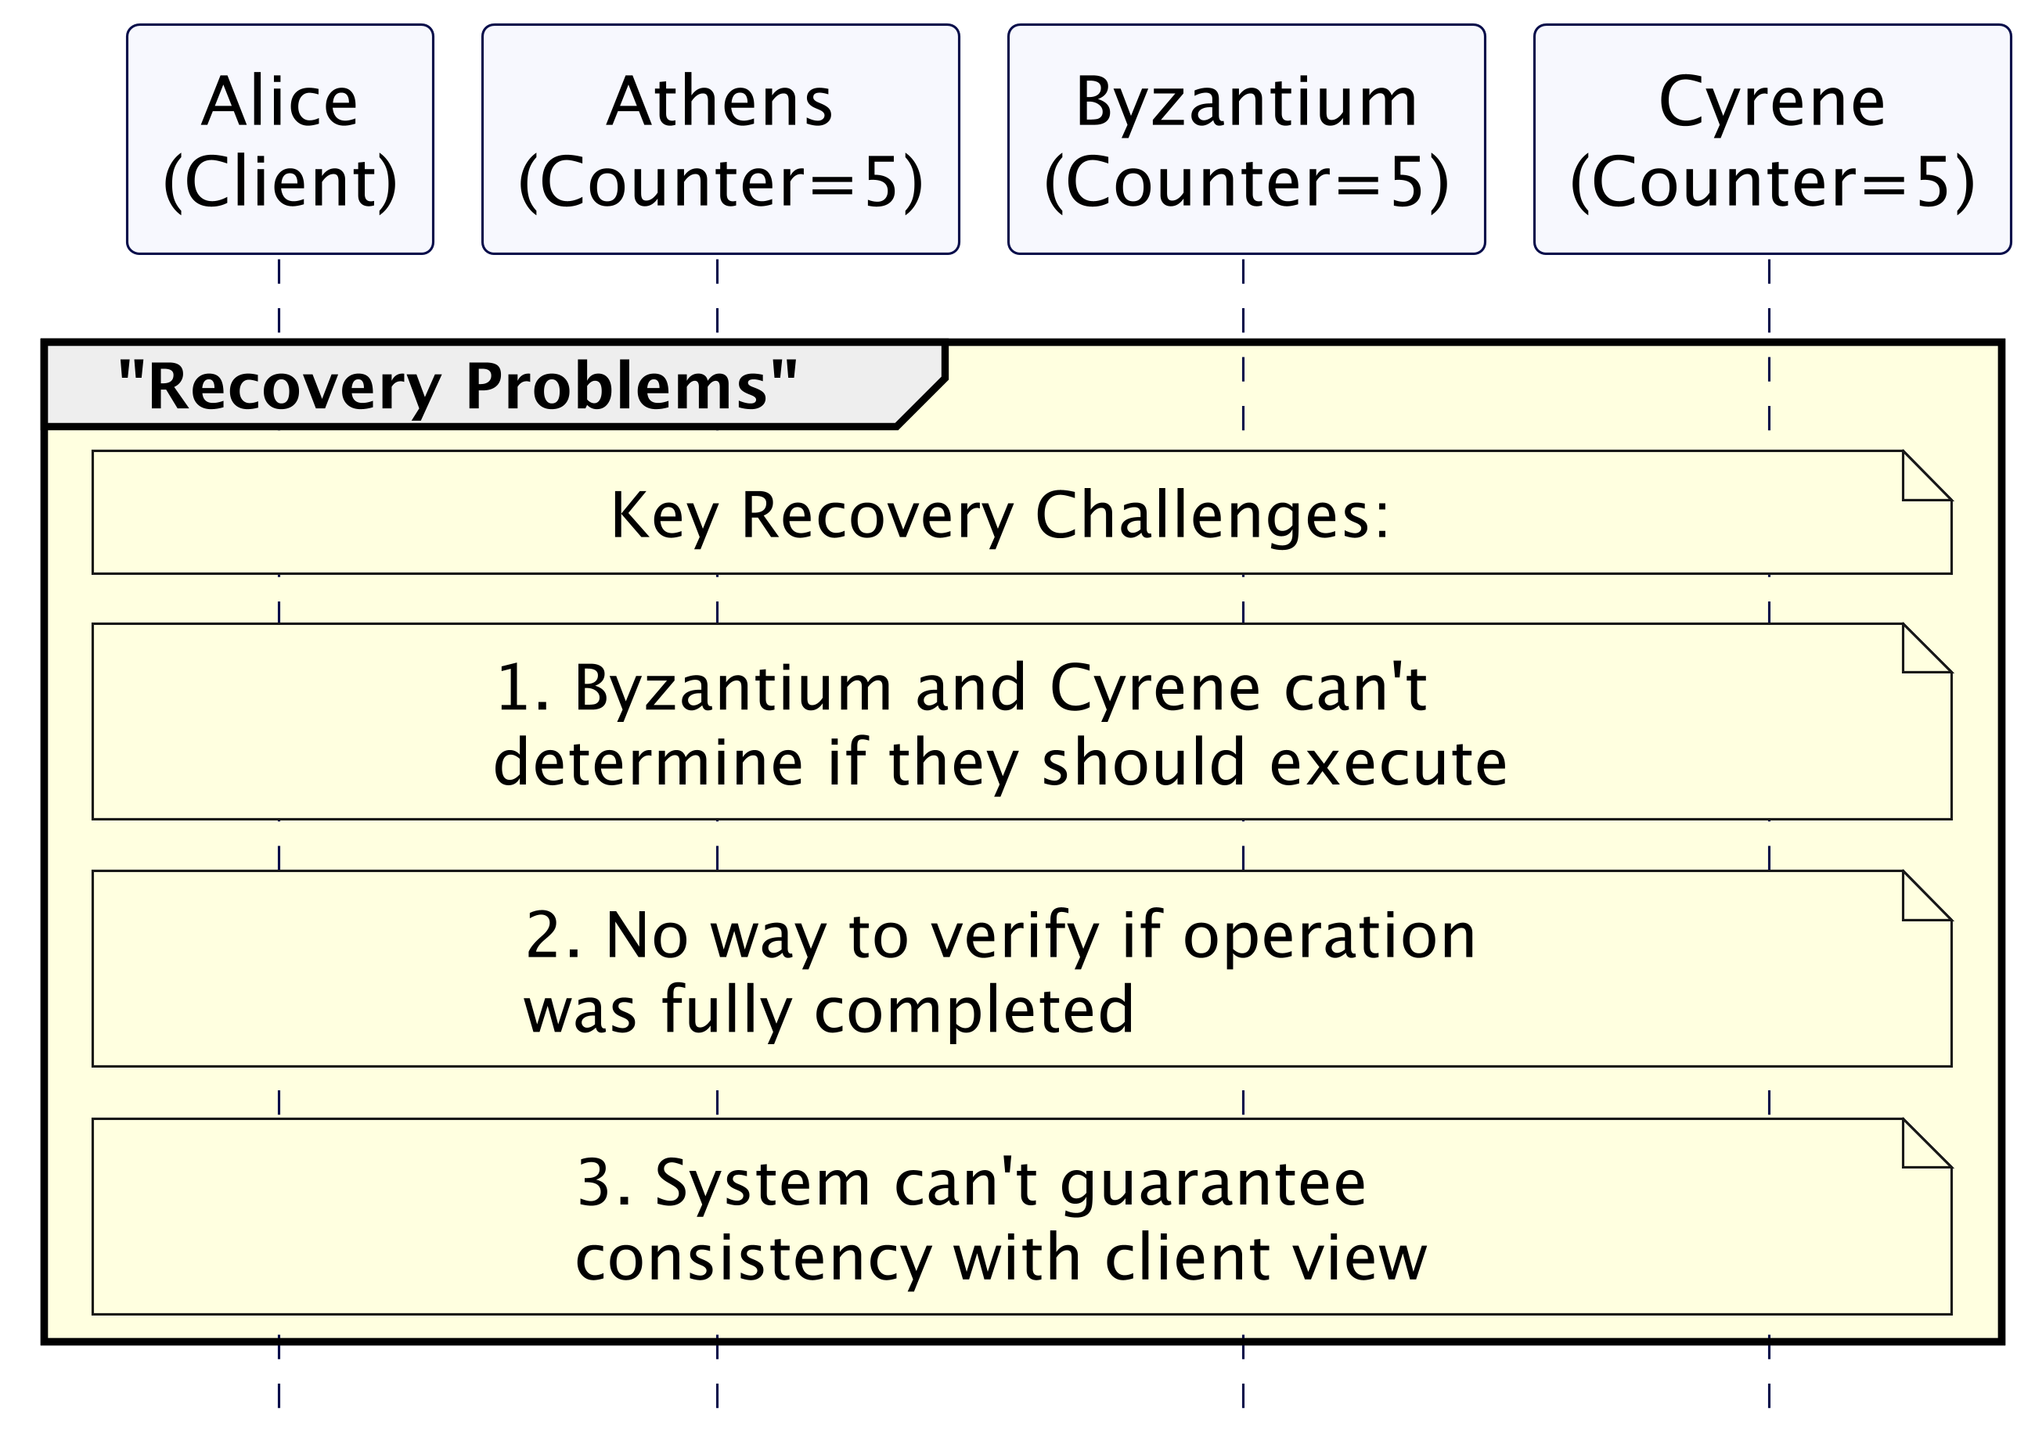
The Commit requests can get lost

Slide 26
Key Concepts
Generation numbers for leadership
Two-phase commit protocol
Handling network partitions
Recovery and fault tolerance

